Slide 1

Let’s Get Digital!
A Very Human Approach to Illinois State’s Digital Interfaces
presented by Mary K. Ditchen
Notes:
Good morning! I'm excited to share stories about how putting human relationships at the center of digital design creates measurable institutional value.

Slide 2

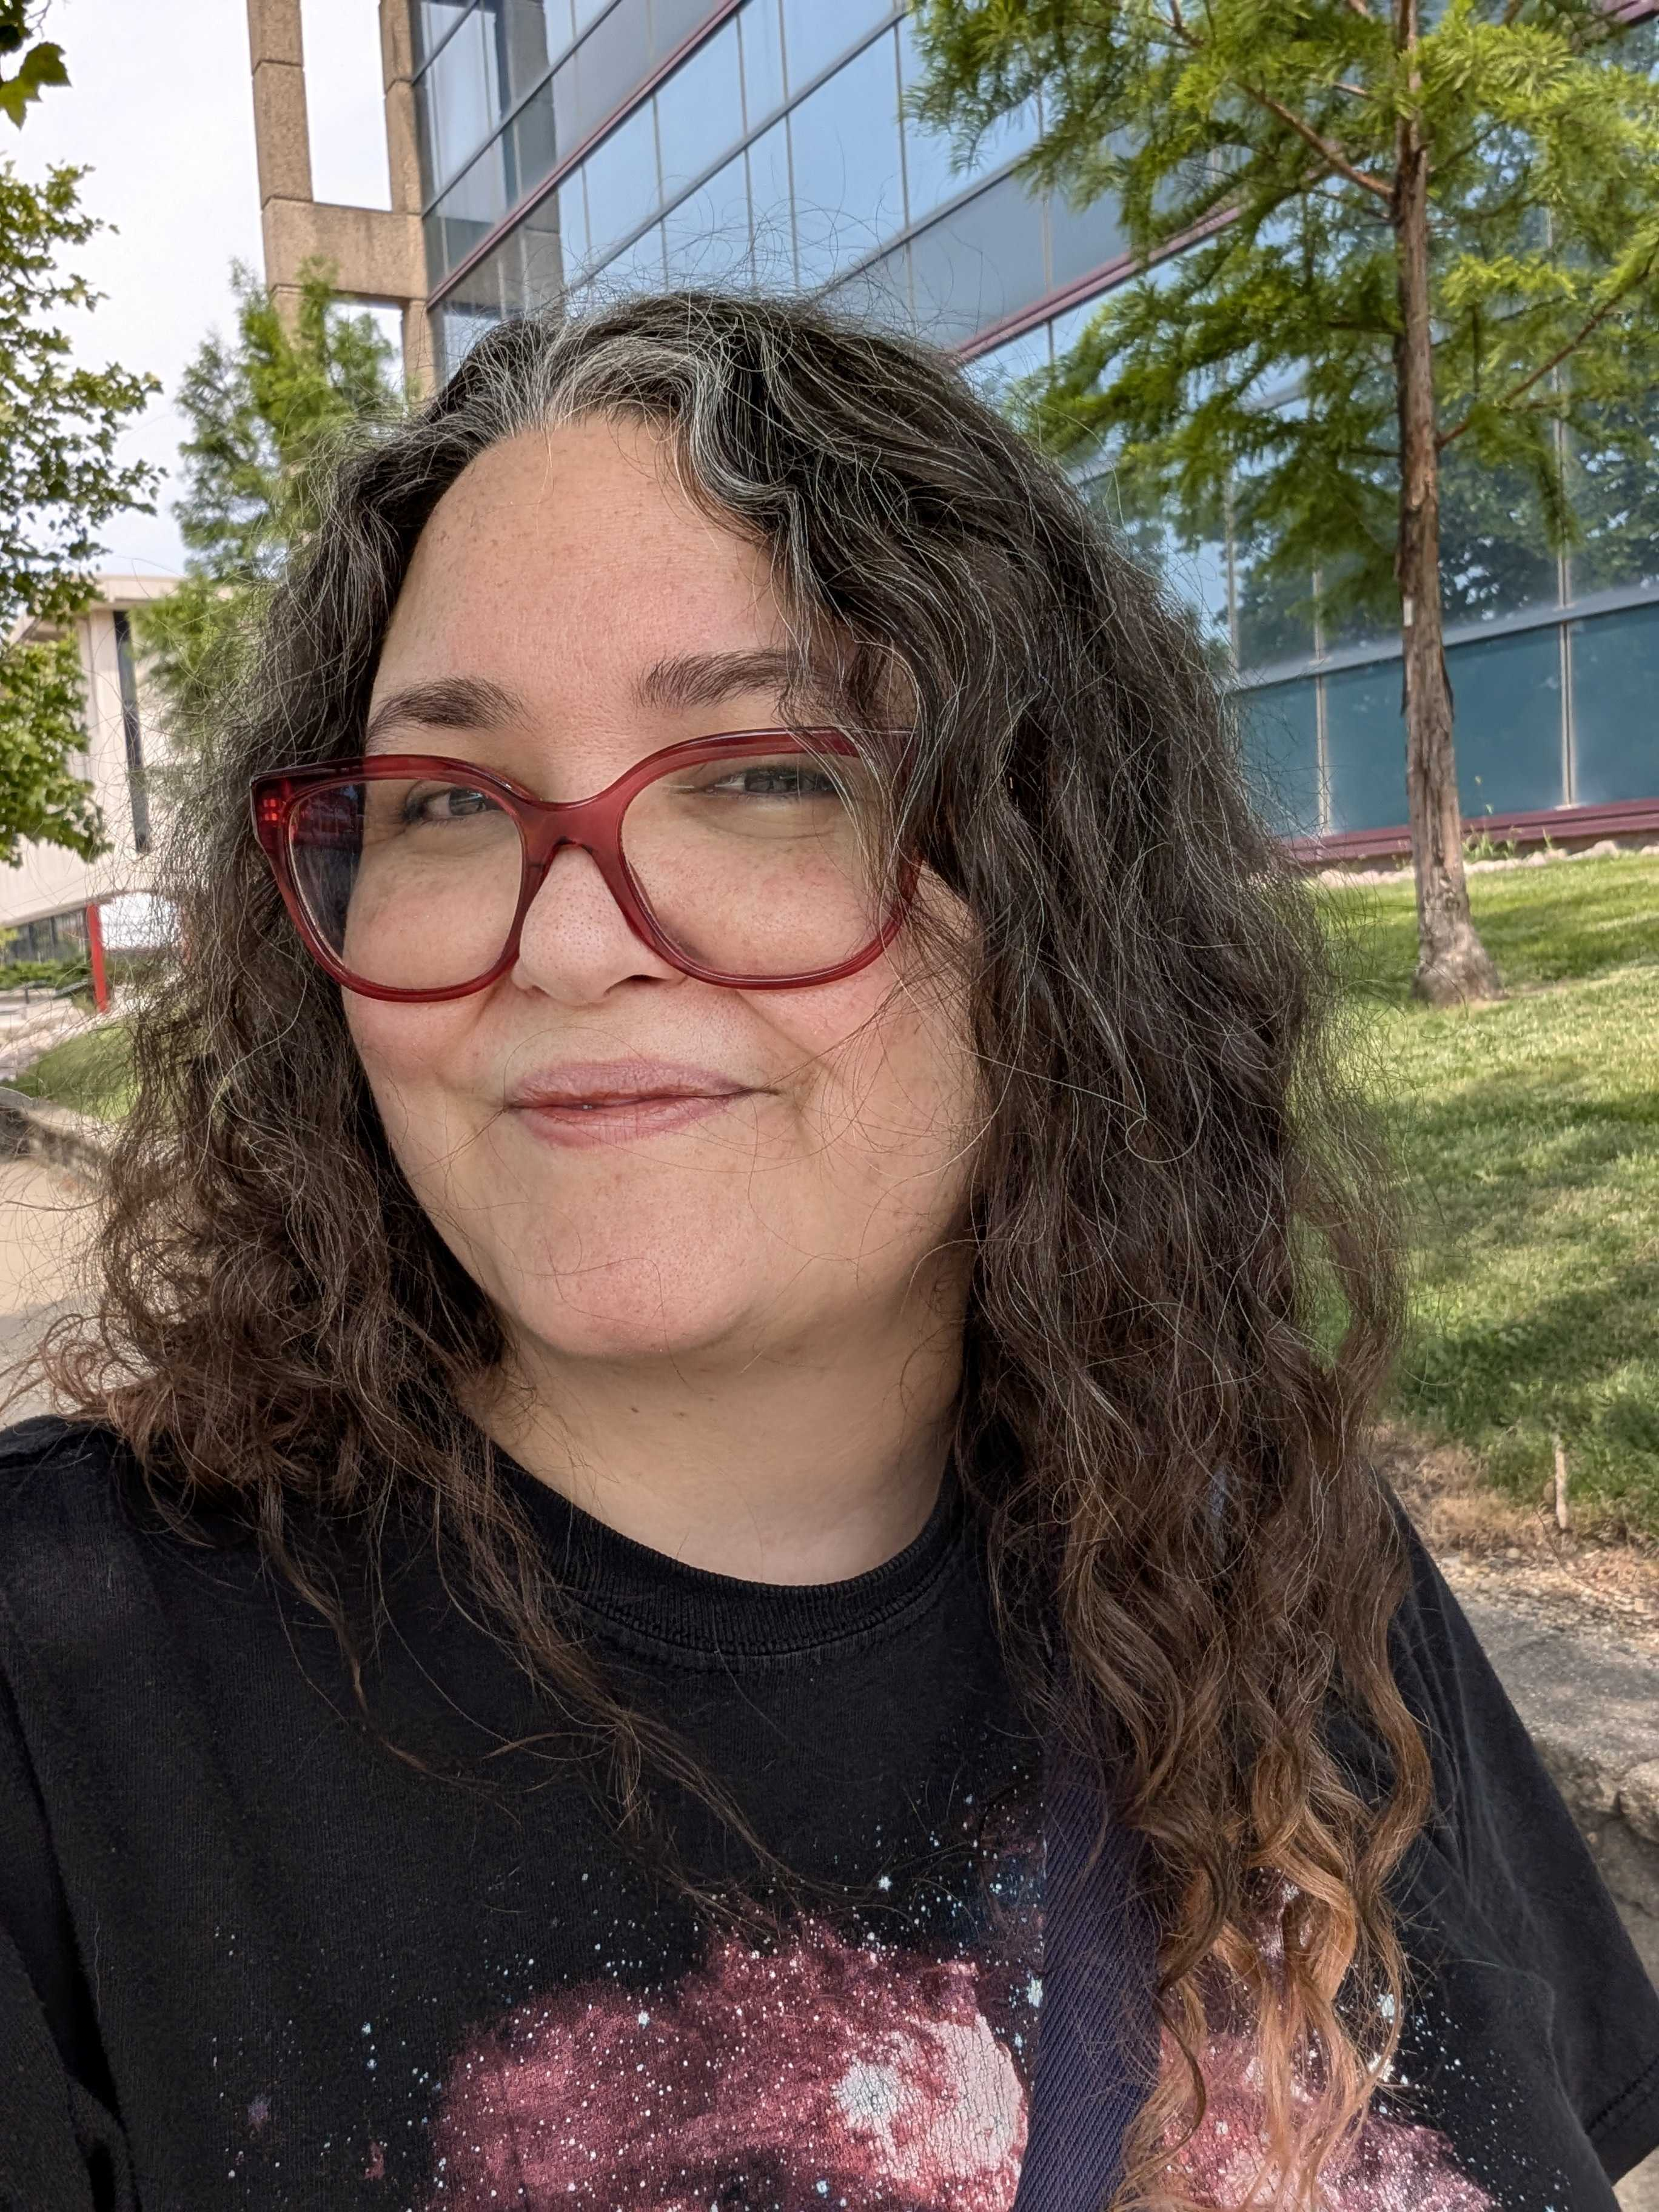

Hi, I’m Mary!
👩🏻‍💻
I make the web more human by building the relationships that make IT work.
UX Strategist and Lead Frontend Developer
Web and Interactive Communications
Illinois State University
Proud alum
Notes:
I'm Mary Ditchen from Web and Interactive Communications at Illinois State. My mission is simple: I make the web more human by building the relationships that make IT work.

Slide 3

“We don’t stop being human when we go online.”
Beth Dean, Emotional Intelligence in Design (2015)
Let's Get Digital! with Mary K. Ditchen
#ISUCIT
Notes:
Beth Dean wrote something in 2015 that stuck with me and shaped my early thinking as a UX professional: 'We don't stop being human when we go online.’ And if there’s anything I’ve learned in the decade-since, it’s that you can’t “make the web more human” – or even “make it work” – without collaborating with other humans.

Slide 4
Every Interface Has a UX
Intentional UX
Reduced friction
Unintentional UX
Frustrated users
User confidence
Streamlined workflows
High volume of similar calls/contacts
Staff time waste
Behind every intentional UX are intentional human relationships
Notes:
Every interface has a user experience - either intentional or unintentional. When we design intentionally, we reduce friction and build confidence. When we don't, users get frustrated and staff waste time. But here's the key insight: behind every intentional UX are intentional human relationships.

Slide 5
The Reality of Digital Design
Users expect Google/Amazon-level experiences everywhere
We can't paper over messy business processes with pretty interfaces
Complex institutional processes require collaborative understanding
Notes:
Users expect Google-level experiences everywhere they go online. But we can't just paper over messy business processes with pretty interfaces. Real digital transformation requires understanding complex institutional processes - and that means people have to work together. Building an intentional user experience starts with understanding the interconnected web (lol) of people, policies, and processes involved.

Slide 6
Human Relationships are the Heart of Effective Digital Interfaces
Human Relationships
Crucial Conversations
Communities of Practice
navigate difficult moments and create breakthrough
Cross-Departmental Partnerships
solve real problems
drive continuous improvement
Notes:
This is my central premise: that effective human relationships are at the heart of every effective digital interface. This morning, I want to share two case studies with you – stories that show the ongoing value created when we form cross-departmental partnerships to solve real problems and the space we create for innovation and breakthrough when we lean into crucial conversations and difficult moments.

Slide 7
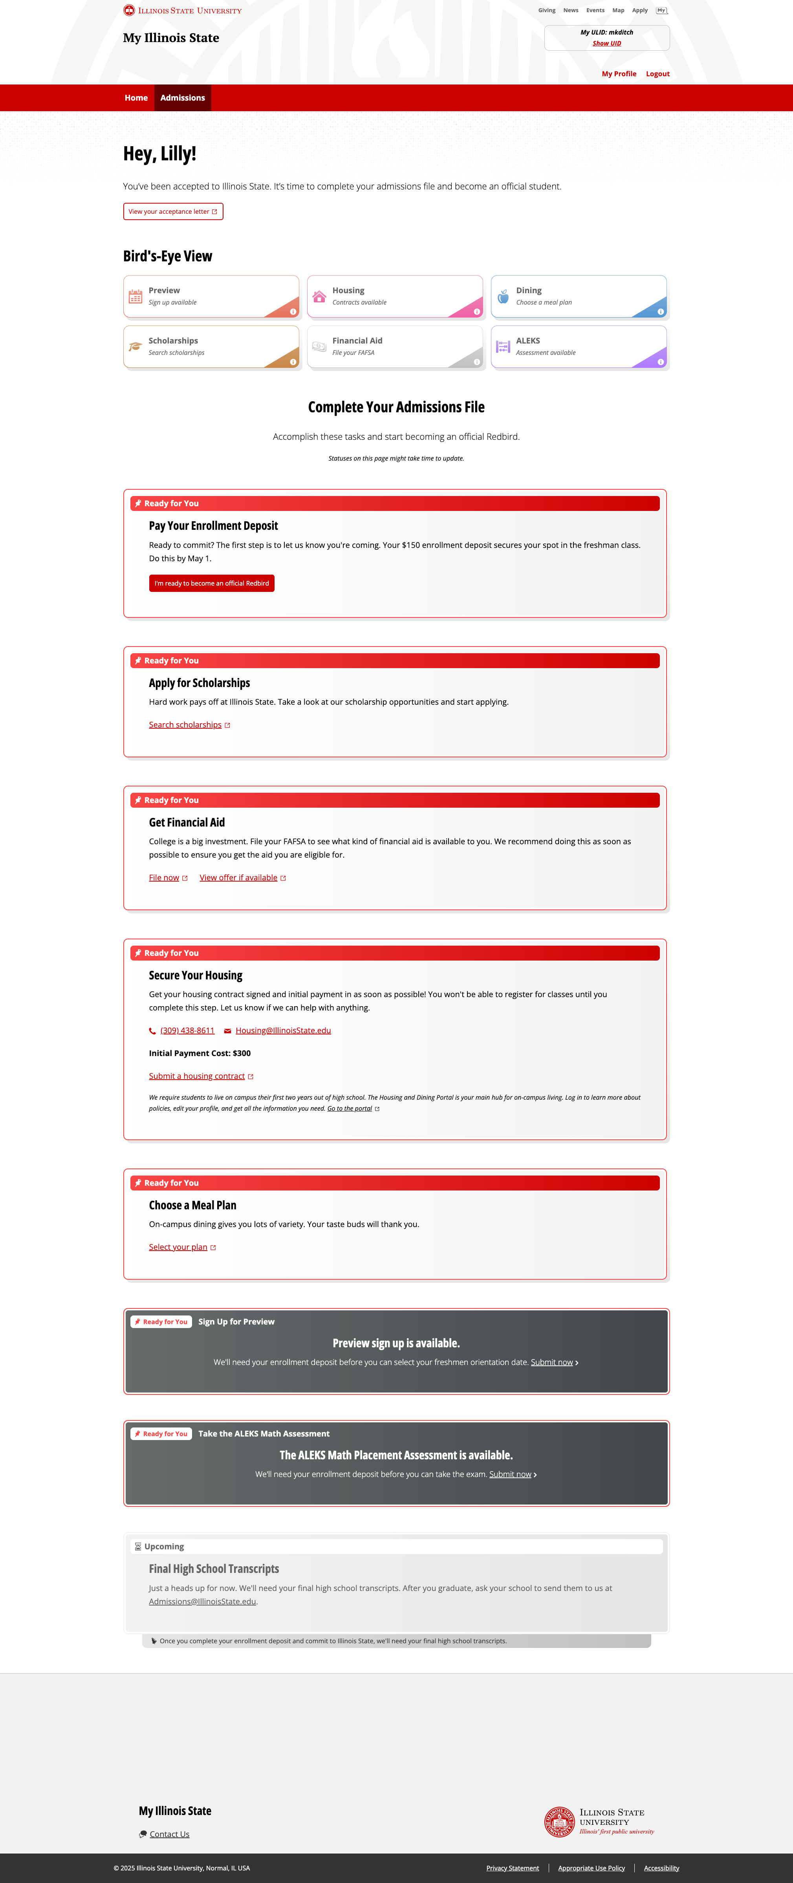
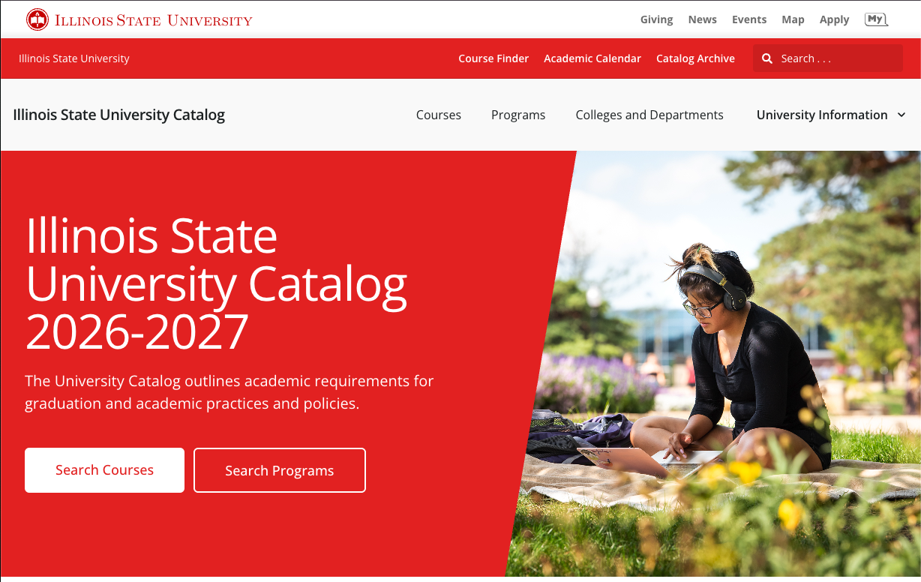
Two Stories, Same Foundation
Human relationships enabling digital success
Case Study #1 – Building Relationships
  FTIC Admissions Dashboard in My
Case Study #2 – Crucial Conversations
  Coursedog Catalog
Notes:
I'm going to tell you two main stories. The first shows what happens when you build relationships across departments from the ground up. The second shows what happens when established collaboration faces a real crisis and how crucial conversations can create breakthrough innovation. Both prove that when humans work together effectively, the digital experiences we create serve humans better. Let's start with what happens when you build relationships from scratch...

Slide 8
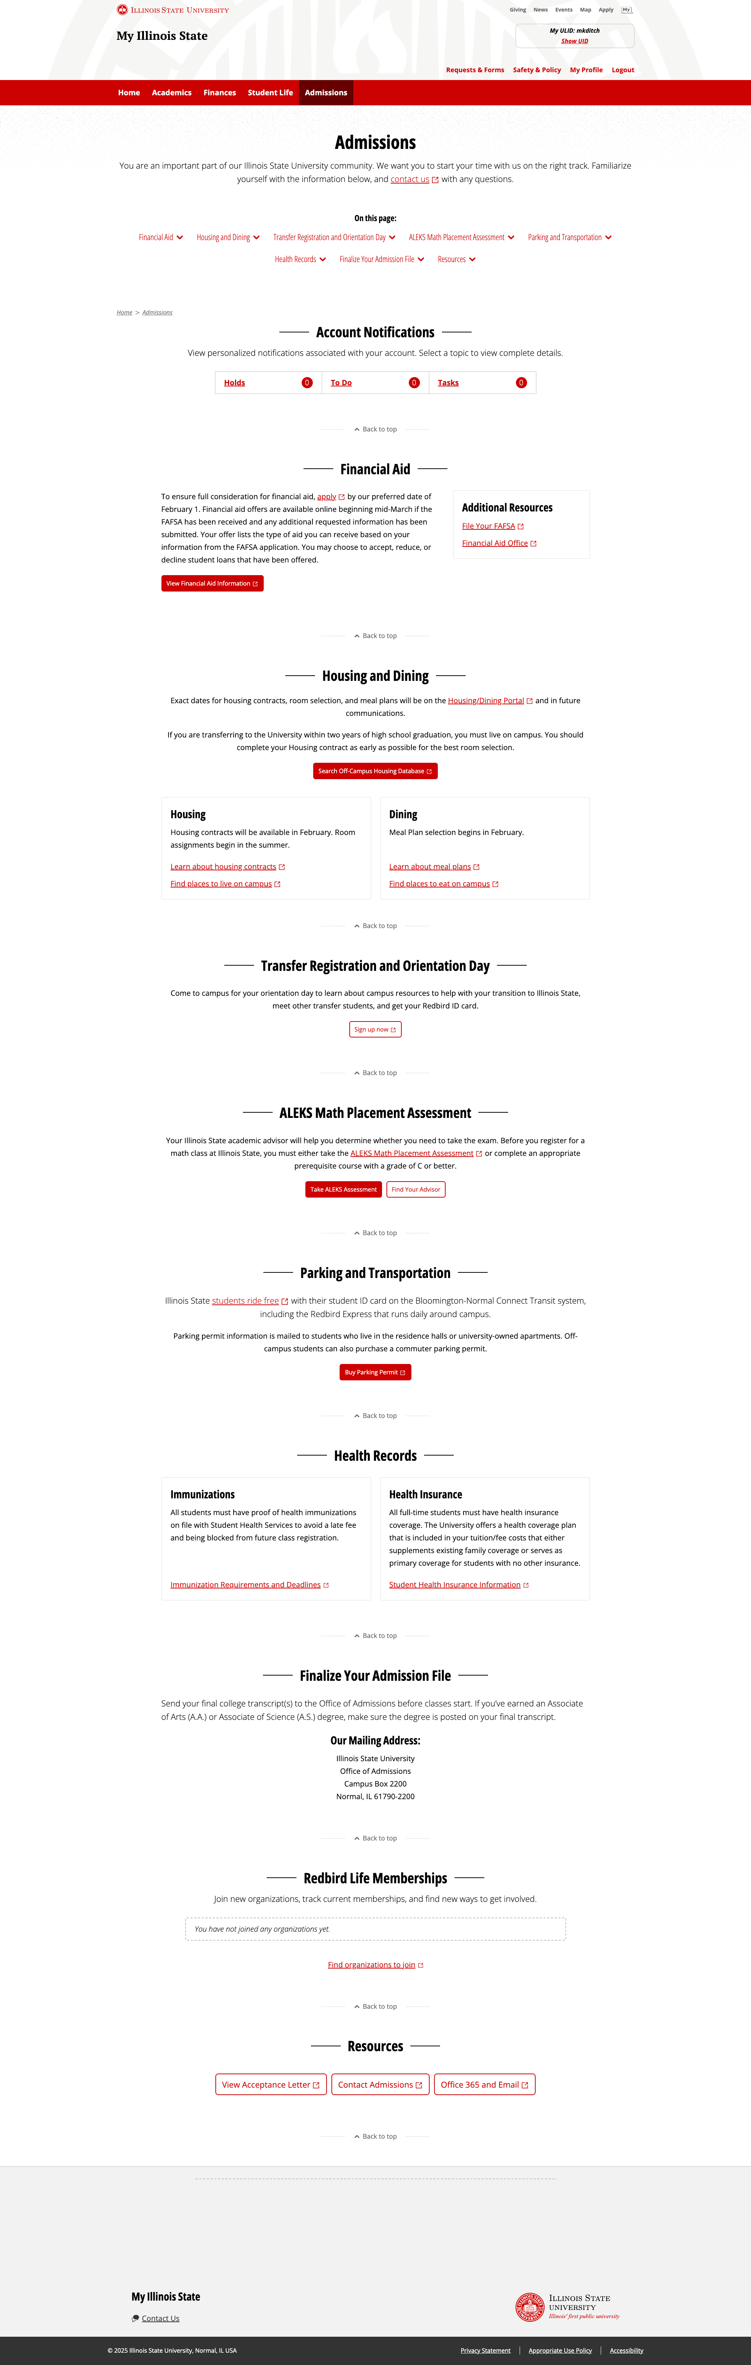
Case Study #1: FTIC Admissions Dashboard
Students navigating multiple disconnected systems
Staff fielding repetitive questions about status and requirements
Complex business processes creating "weird mess" situations
Information scattered across different departments
The Challenge
Notes:
Before we designed a single interface element, we had to understand the human cost of disconnected systems. Students were lost between multiple systems. Staff were answering the same questions over and over. Complex business processes were creating what we called 'weird mess' situations. But understanding problems isn't enough - you need people who can dive deep enough to solve them...

Slide 9
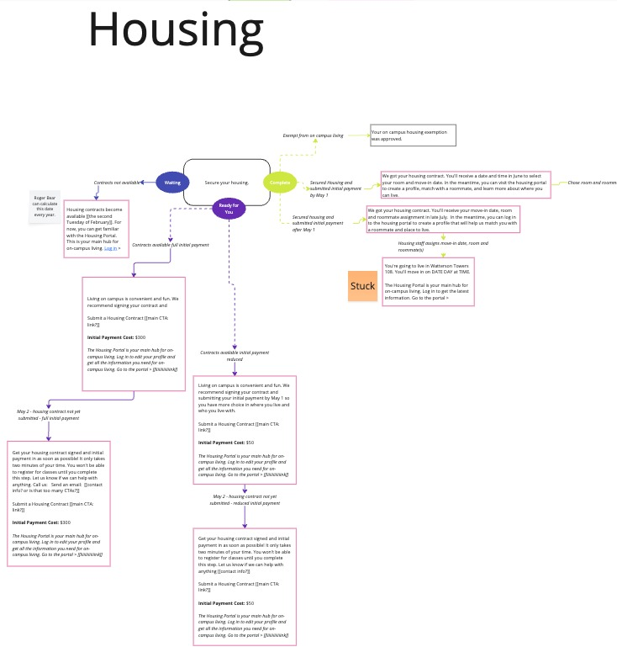
FTIC Admissions Dashboard
Understanding the Systems Humans Have to Navigate
The Mission
Roger’s Deep-dives
Becky's Process Maps
The Outcome
Map every business process affecting FTIC students from admission → enrollment → registration → arrival → 10th day census
Asking "what about..." questions until every scenario is covered.
Converting complex workflows into visual understanding through collaborative Miro sessions
Campus-wide confidence in task-based interface because everyone understood every edge case
Notes:
This is the real story behind human-centered UX. Before anyone designed a single interface element, Roger and Becky worked together - along with Dillon, myself, Trey, Arturo, and our campus partners - to map every business process that touches an FTIC student's journey. Roger would dive into the super deep 'what about...' questions, ensuring we missed nothing. Becky would turn those complex workflows into visual understanding through collaborative Miro sessions. This thorough foundation work gave everyone confidence that we could create a task-based interface knowing we understood every edge case, every business rule, every scenario that could affect a student's experience. You can only create truly human-centered experiences when you thoroughly understand the systems humans have to navigate. And the results prove that relationships drive outcomes...

Slide 10
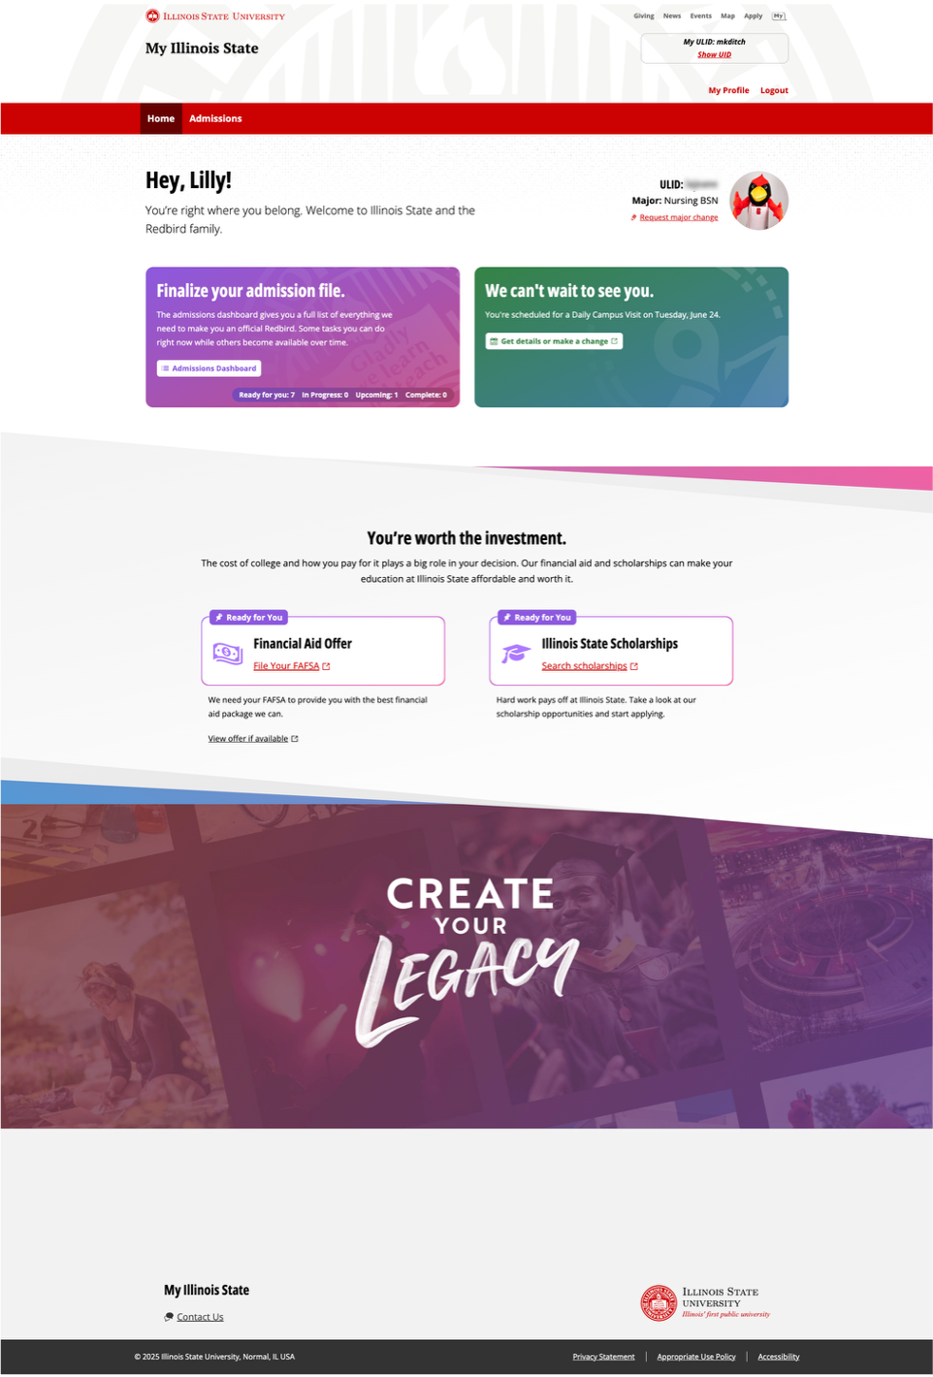
Deliberate and Inclusive Collaboration
FTIC Admissions Dashboard
Deep process understanding
collaborative design
confident implementation
  Campus partners brought their process expertise and pain point insights to our technical capabilities and design thinking.
"They were deliberate and inclusive... You could tell they really wanted to get things right"
- Jana Albrecht, AVP (EMAS)
Notes:
We built relationships with our campus partners in Dining, Housing, Admissions, Financial Aid, Student Accounts, others... This wasn't just consultation - it was true collaboration. Our campus partners shared their process expertise and pain points. We brought technical capabilities and design thinking. Jana Albrecht from Academic Affairs said our team was 'deliberate and inclusive - you could tell they really wanted to get things right.' That collaborative foundation made everything else possible. When you build relationships first, the results speak for themselves...

Slide 11
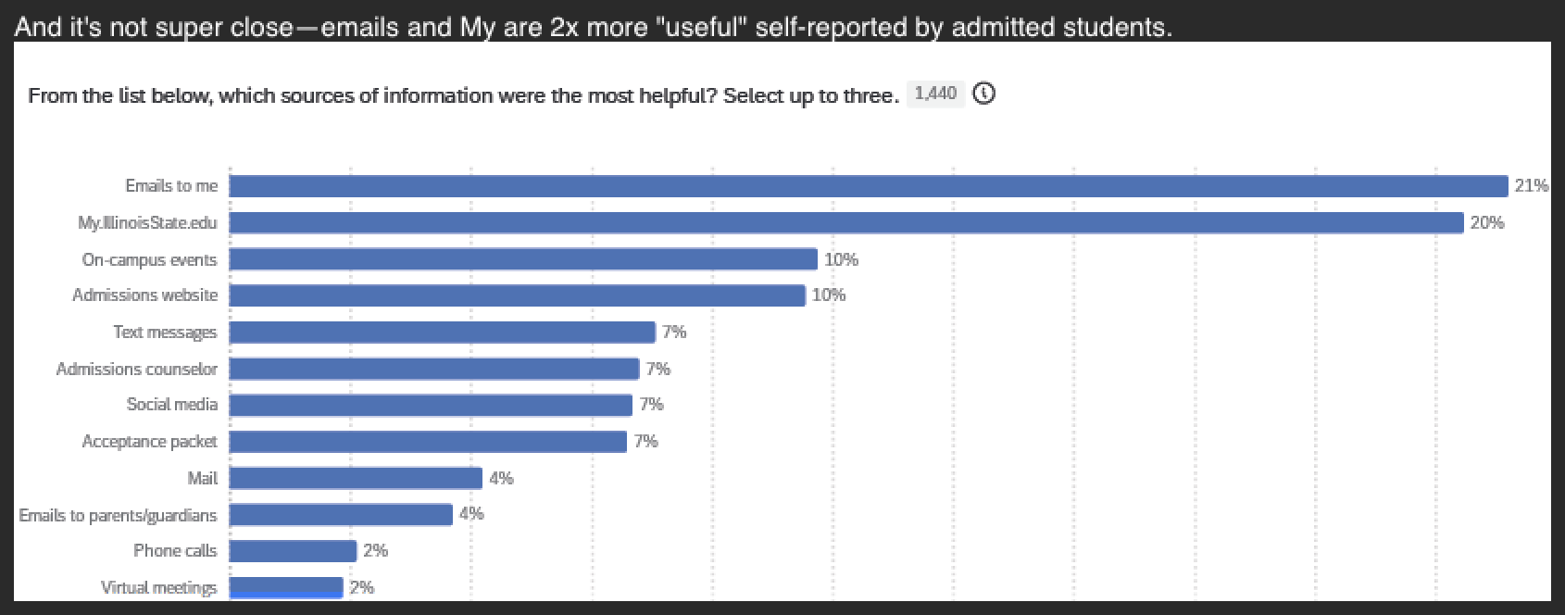
Results that speak for themselves
FTIC Admissions Dashboard
50% reduction in manual FTIC meal plan assignments (from ~500 to ~250 students)
Student Success
Process Efficiency
FTIC meal plan completion rate significantly outpaced the average for all residential students (86.65% vs. 70%)
Engagement Success
Housing and Dining portal engagement from My/Admissions increased from 20% (2023) to 41-44% (2024-2025)
Staff Experience
"This was one of the smoothest [selection processes] they've had" - Campus partner in Housing
Student Choice
ASQ data shows My.IllinoisState.edu jumped from #5 to #2 as students' primary information source
Each year, Admissions sends an Admitted Student Questionnaire to all students who were admitted for the previous year (even those who did not end up attending ISU).
In 2022, before the improved dashboard experience launched, My was ranked #5 – today My is #2, second only to direct email communications. 🎉
Notes:
When you build relationships first, the results speak for themselves. We didn't just improve the interface—we improved the entire process for everyone involved. Our campus partners in Dining saw a 50% reduction in manual work. FTIC students completed meal plans at 86.65% - far above the 70% average. Traffic to Housing and Dining portals more than doubled. But here's the most telling evidence - students voted with their clicks. In our ASQ survey data, My.IllinoisState.edu jumped from #5 all the way to #2 as students' primary information source. Students are actively choosing our dashboard over other ways to get information. That's what happens when you design with humans at the center. But let me show you what students are saying in their own words...

Slide 12
ASQ 2025 Responses to "What Did ISU Do Better Than Other Schools?"
FTIC Admissions Dashboard
"The ISU portal was much more in depth"
"They had a student portal with a to do list which clearly laid out my tasks I needed to complete"
"The information is easily accessible and the admissions portal is easy to maneuver"
"The student portal was really organized. Everything in the checklist was smooth and easy so there was no hassle or any problems whatsoever"
Notes:
These aren't our words - these are students' words. When we asked what Illinois State did better than other schools, they specifically called out the organization, clarity, and task-based approach. 'Everything in the checklist was smooth and easy.' 'They had a student portal with a to do list which clearly laid out my tasks.' This is what human-centered design sounds like from the people who actually use it. These students are describing exactly what we set out to create through collaborative relationships with our campus partners.

Slide 13
The My Admissions Dashboard
FTIC Admissions Dashboard
Personalized Landing with clear status and next steps
Bird's-Eye View with visual progress indicators showing completed, in-progress, and upcoming tasks
Contextual Information communicates the right information at the right time
Clear Action Items for specific tasks with deadlines and clear calls-to-action
Integrated Experience for housing, dining, financials, and academics in one place
Notes:
This visual transformation represents hundreds of hours of collaborative conversation with our campus partners about what students actually need to succeed. Students went from navigating multiple disconnected systems to having a personalized, integrated experience that guides them through every step. And when you do that level of human-centered work, people notice...

Slide 14
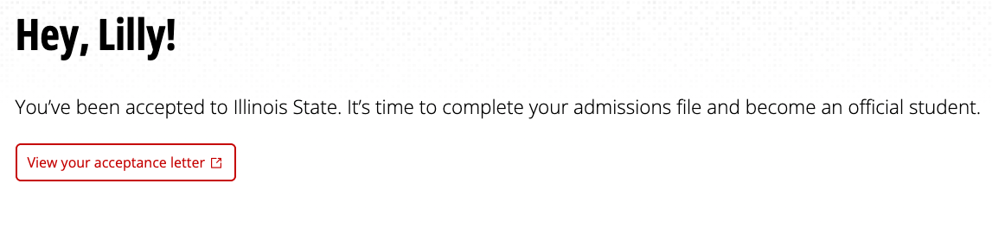
The My Admissions Dashboard: Personalized Landing
FTIC Admissions Dashboard
The My Admissions Dashboard
Personalized Landing with clear status and next steps
Bird's-Eye View with visual progress indicators showing completed, in-progress, and upcoming tasks
Contextual Information communicates the right information at the right time
Clear Action Items for specific tasks with deadlines and clear calls-to-action
Integrated Experience for housing, dining, financials, and academics in one place
Notes:
This visual transformation represents hundreds of hours of collaborative conversation with our campus partners about what students actually need to succeed. Students went from navigating multiple disconnected systems to having a personalized, integrated experience that guides them through every step. And when you do that level of human-centered work, people notice...

Slide 15
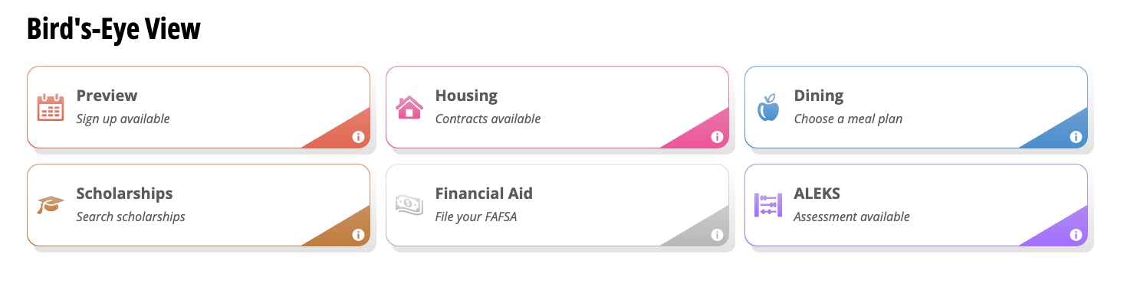
The My Admissions Dashboard: Bird’s-Eye View
FTIC Admissions Dashboard
The My Admissions Dashboard
Personalized Landing with clear status and next steps
Bird's-Eye View with visual progress indicators showing completed, in-progress, and upcoming tasks
Contextual Information communicates the right information at the right time
Clear Action Items for specific tasks with deadlines and clear calls-to-action
Integrated Experience for housing, dining, financials, and academics in one place
Notes:
This visual transformation represents hundreds of hours of collaborative conversation with our campus partners about what students actually need to succeed. Students went from navigating multiple disconnected systems to having a personalized, integrated experience that guides them through every step. And when you do that level of human-centered work, people notice...

Slide 16
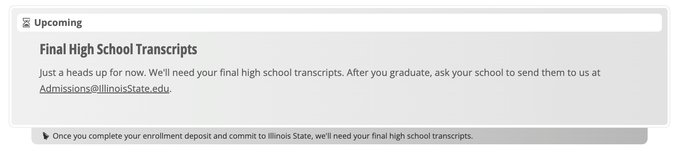
The My Admissions Dashboard: Contextual Information – Upcoming Tasks
FTIC Admissions Dashboard
The My Admissions Dashboard
Personalized Landing with clear status and next steps
Bird's-Eye View with visual progress indicators showing completed, in-progress, and upcoming tasks
Contextual Information communicates the right information at the right time
Clear Action Items for specific tasks with deadlines and clear calls-to-action
Integrated Experience for housing, dining, financials, and academics in one place
Notes:
This visual transformation represents hundreds of hours of collaborative conversation with our campus partners about what students actually need to succeed. Students went from navigating multiple disconnected systems to having a personalized, integrated experience that guides them through every step. And when you do that level of human-centered work, people notice...

Slide 17

The My Admissions Dashboard: Contextual Information – Right Information at the Right Time
FTIC Admissions Dashboard
The My Admissions Dashboard
Personalized Landing with clear status and next steps
Bird's-Eye View with visual progress indicators showing completed, in-progress, and upcoming tasks
Contextual Information communicates the right information at the right time
Clear Action Items for specific tasks with deadlines and clear calls-to-action
Integrated Experience for housing, dining, financials, and academics in one place
Notes:
This visual transformation represents hundreds of hours of collaborative conversation with our campus partners about what students actually need to succeed. Students went from navigating multiple disconnected systems to having a personalized, integrated experience that guides them through every step. And when you do that level of human-centered work, people notice...

Slide 18
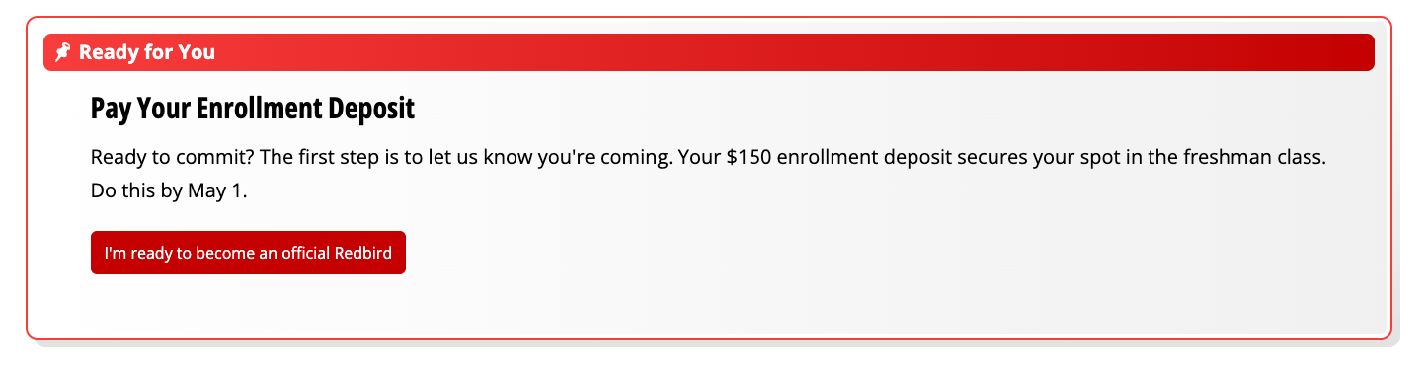
The My Admissions Dashboard: Clear Action Items
FTIC Admissions Dashboard
The My Admissions Dashboard
Personalized Landing with clear status and next steps
Bird's-Eye View with visual progress indicators showing completed, in-progress, and upcoming tasks
Contextual Information communicates the right information at the right time
Clear Action Items for specific tasks with deadlines and clear calls-to-action
Integrated Experience for housing, dining, financials, and academics in one place
Notes:
This visual transformation represents hundreds of hours of collaborative conversation with our campus partners about what students actually need to succeed. Students went from navigating multiple disconnected systems to having a personalized, integrated experience that guides them through every step. And when you do that level of human-centered work, people notice...

Slide 19
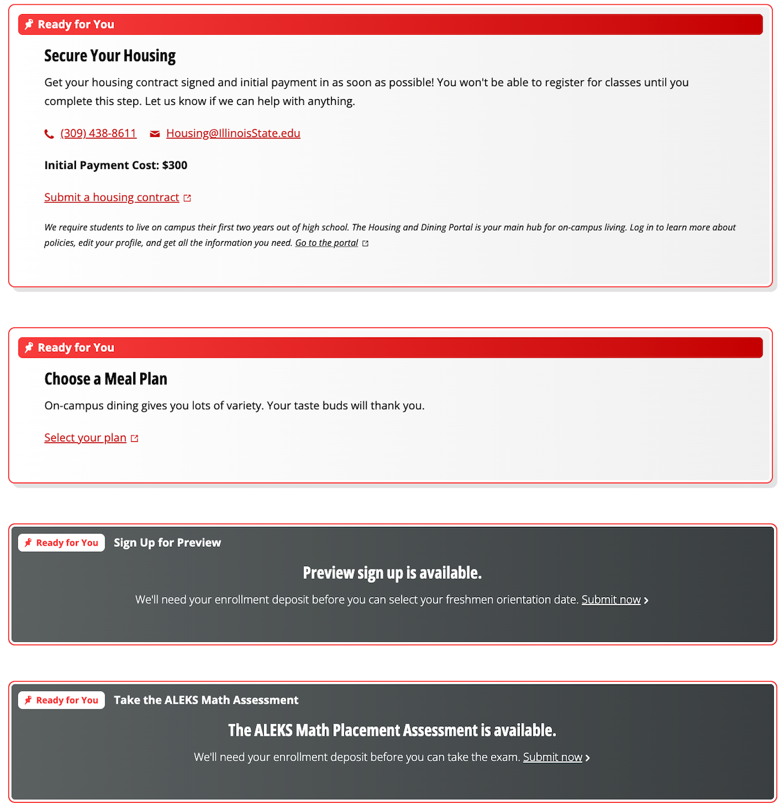
The My Admissions Dashboard: Integrated Experience
FTIC Admissions Dashboard
The My Admissions Dashboard
Personalized Landing with clear status and next steps
Bird's-Eye View with visual progress indicators showing completed, in-progress, and upcoming tasks
Contextual Information communicates the right information at the right time
Clear Action Items for specific tasks with deadlines and clear calls-to-action
Integrated Experience for housing, dining, financials, and academics in one place
Notes:
This visual transformation represents hundreds of hours of collaborative conversation with our campus partners about what students actually need to succeed. Students went from navigating multiple disconnected systems to having a personalized, integrated experience that guides them through every step. And when you do that level of human-centered work, people notice...

Slide 20
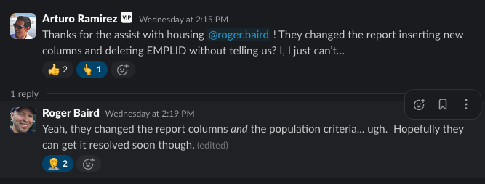
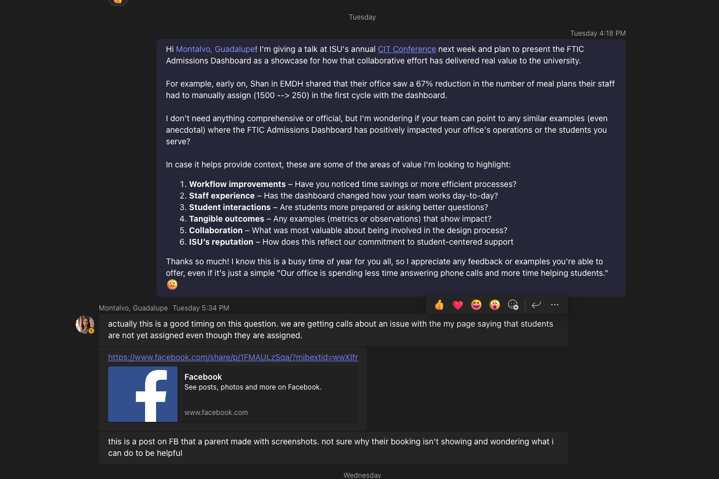
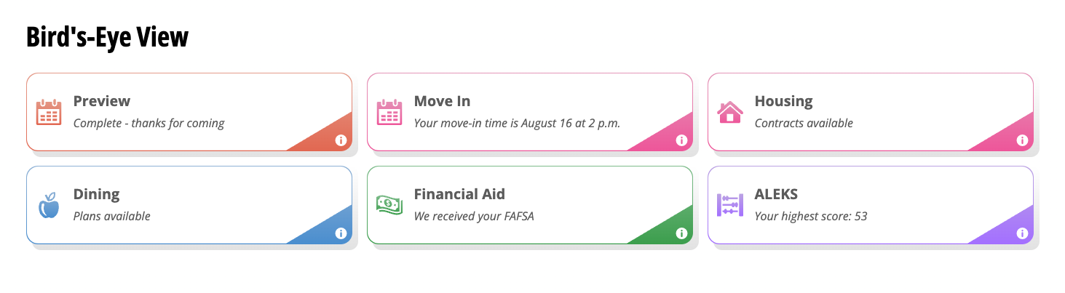
The Ultimate Success Indicator
FTIC Admissions Dashboard
When Systems Don't Match, Users Notice
😳
Notes:
Here's what happened when I reached out to our campus partners for this presentation. Students were calling because their housing tiles weren't updating after they'd completed actions in the Housing Portal. But here's the sophisticated part - they're following the integrated journey we designed: see what's 'Ready for You' in My, complete the action, then return to My expecting confirmation. This is what successful system integration looks like - users develop clear mental models of how systems should work together. Isn’t that funny? While preparing to talk about our human-centered approach, we're actively living it.

Slide 21
When Systems Don't Match, Users Notice
FTIC Admissions Dashboard
What Really Happened: Students completed housing actions → returned to My dashboard expecting confirmation
The Sophistication: Users have clear mental models of how integrated systems should work
Ongoing Collaboration: Campus partners providing real-time feedback, Roger diagnosing technical issues

Slide 22
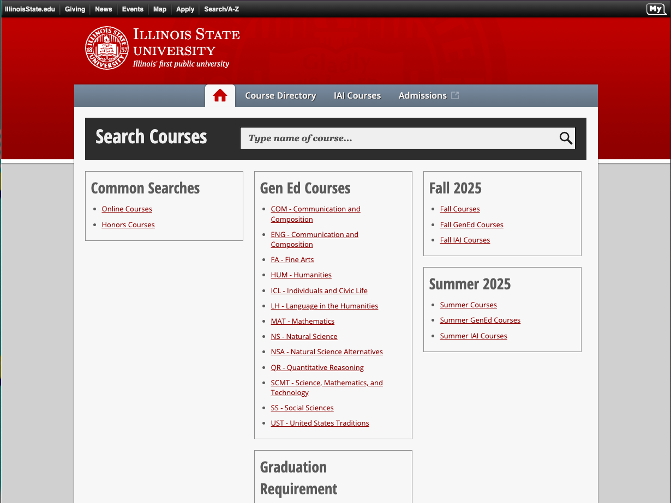
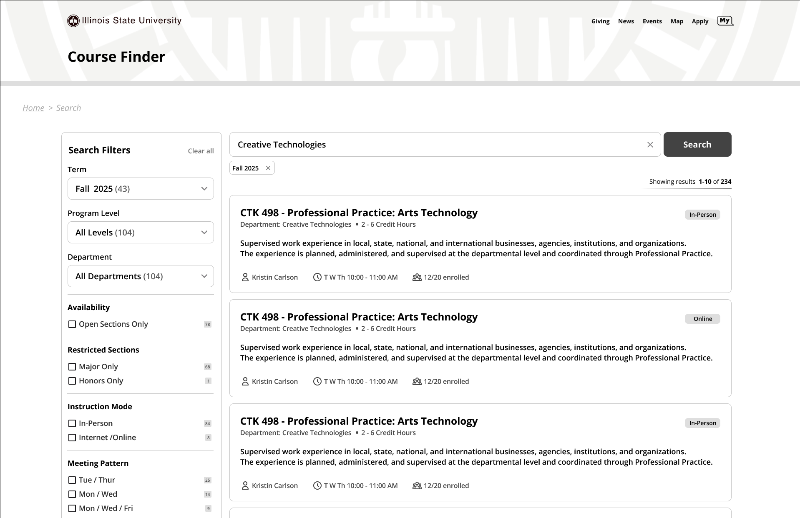
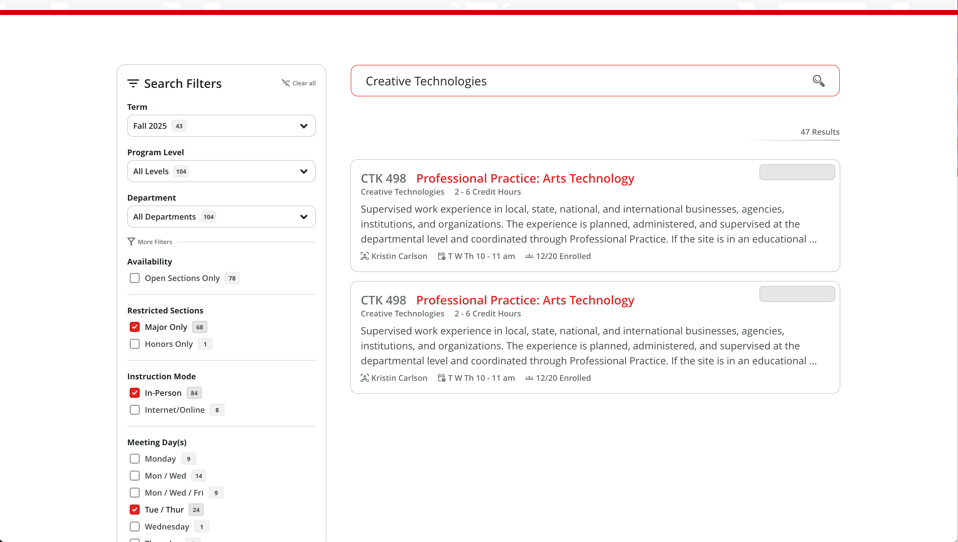
Success Enables New Collaborations
When collaboration works, it scales
Course Finder Enhancement
Same collaborative relationships, new technical challenge
Built into Coursedog’s collaborative space
Transfer Student Experience
Built off FTIC success
Same methodology, different student population
Notes:
When human-centered collaboration actually works - it scales. The relationships built during Coursedog work created the collaborative space for Course Finder enhancement - using the same trusted partnerships to tackle Algolia and Vue.js development. The success we achieved with FTIC students created institutional confidence to extend that same methodology to transfer students. Multiple collaborative projects are running simultaneously because the relationships exist. Success breeds success...

Slide 23
Success Creates Institutional Momentum
Not starting from zero: Each new project leverages existing trust
Institutional confidence: "We know this team can deliver collaborative results"
Sustainability: Methodology that works across different challenges and contexts
Evidence: Multiple collaborative projects running simultaneously
But what happens when established collaboration faces crisis?
Notes:
We're not starting from zero on new projects. Each collaboration leverages existing trust. Our campus partners already know this team can deliver collaborative results. The methodology works across different challenges and contexts. This isn't one-off success, it's sustainable institutional approach. But what happens when established collaboration faces a crisis?

Slide 24
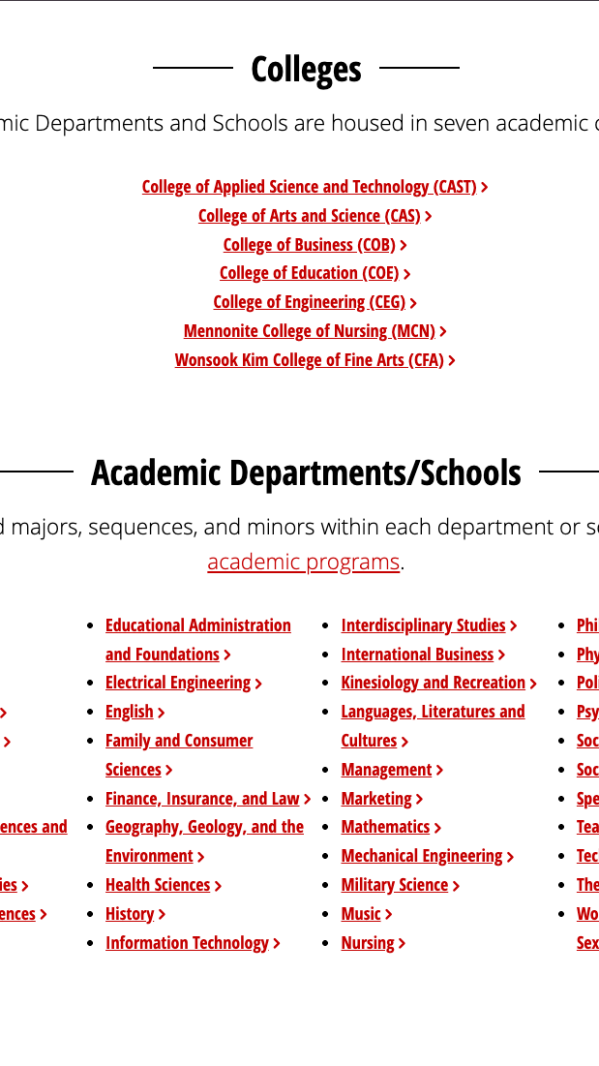
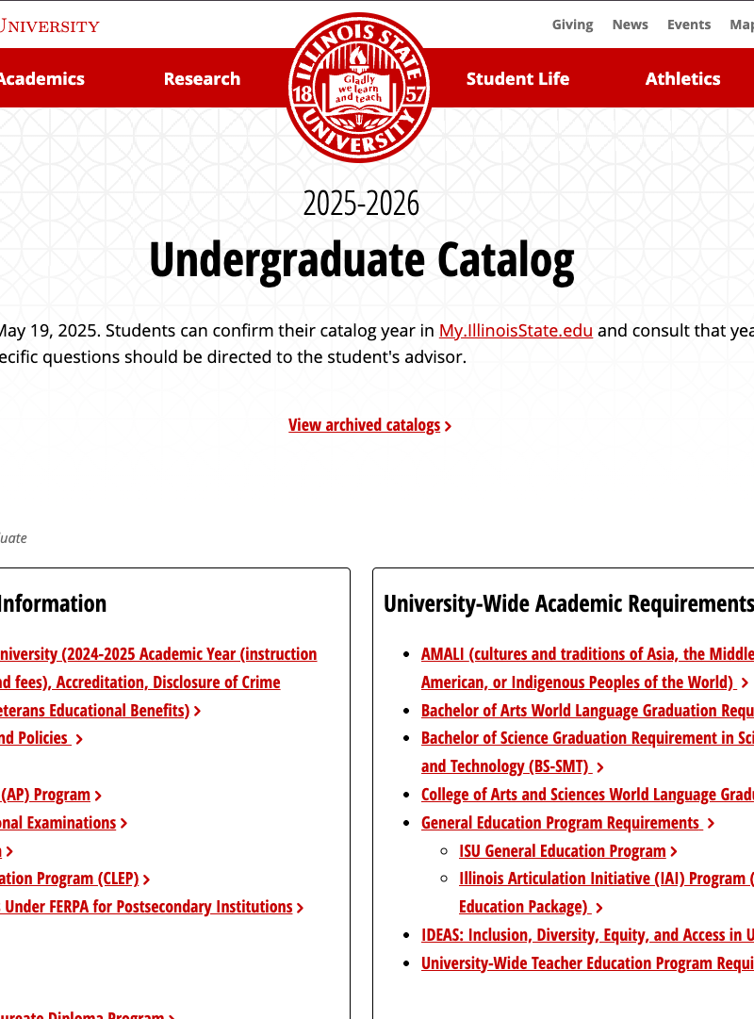
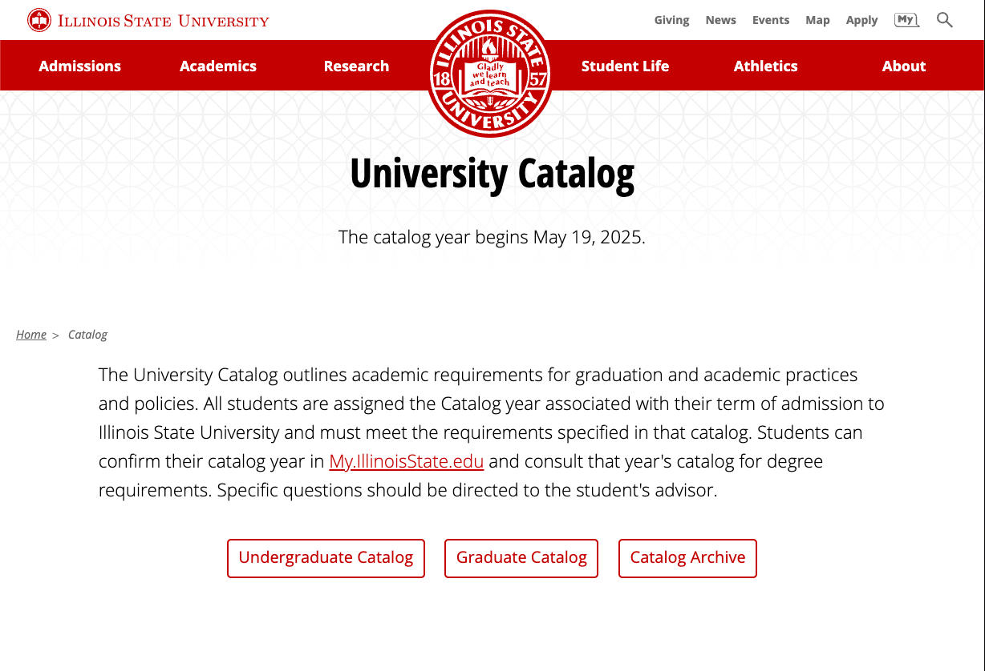
Case Study #2: Coursedog Catalog
When Collaboration Is At Risk
The Crisis: What happens when an established collaboration hits a breaking point?
Real Stakes: Could break collaborative relationships built through previous success
The Players: Mary (WEB), Dani (Registrar's Office), Mark (PM)
Notes:
Our first story showed collaboration building success from the ground up. But what happens when an established collaboration hits a crisis point? Let me tell you about a February day when our collaborative approach was put to the ultimate test. This is the story of how a crucial conversation didn't just save a project - it made the collaboration stronger than before.

Slide 25
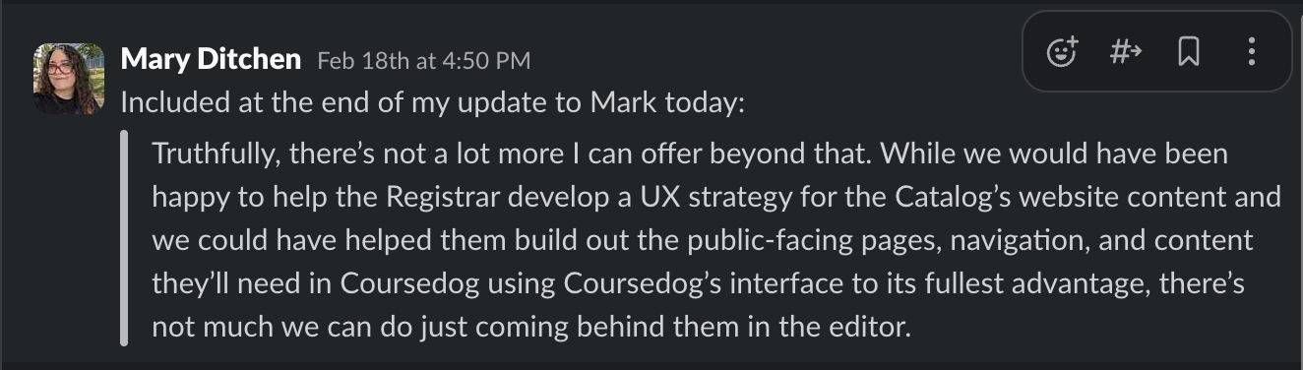
February 18 – Setting a Professional Boundary
Coursedog Catalog
The Problem: WEB team positioned as "cleanup crew" rather than collaborative partners
The Boundary: "While we would have been happy to help develop a UX strategy for the Catalog... there's not much we can do just coming behind them in the editor."
The Reality: Professional boundaries needed to preserve collaborative relationship potential
The Stakes: This could end collaboration or create breakthrough
Notes:
By February 2025, our team was feeling like we were being asked to fix problems rather than prevent them. I had to communicate clear professional boundaries to Mark about what WEB could and couldn't accomplish when brought in after key decisions had already been made. Professional boundaries are essential, but they require skillful communication. This is where Mark's leadership made the difference...

Slide 26
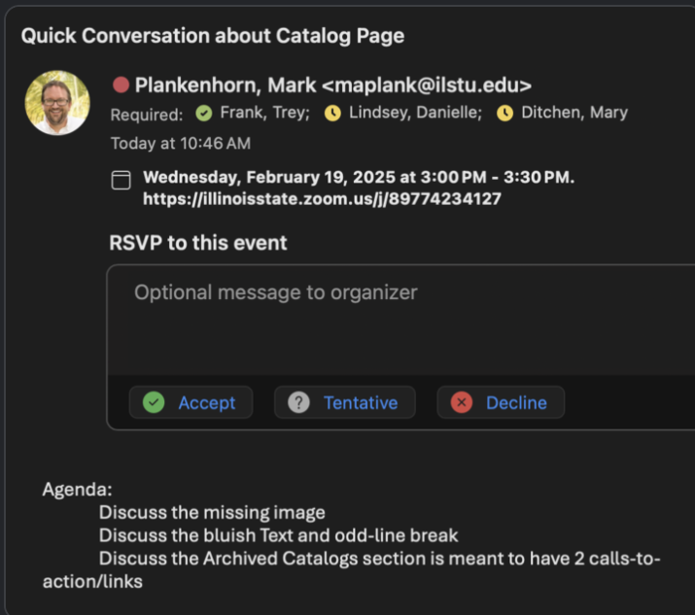
February 19 – Setting Up a Crucial Conversation
Coursedog Catalog
Mark's Leadership: Recognizes need for direct conversation between all parties
The Approach: Direct dialogue rather than managing tensions separately
The Conversation: Understanding each other's pressures, constraints, and capabilities
Notes:
Mark demonstrated real leadership here. Instead of letting tensions simmer or trying to manage them separately, he brought everyone together for direct dialogue. Sometimes the most important meetings are the ones that address relationships, not just deliverables. Now, Mark probably didn't know exactly what he was in for when he set that meeting up! What I remember is that after Dani left the call, Mark and I stayed on to process what had just happened. I've never had a crucial conversation that hasn't touched on real, raw human emotion—because getting to the core of any problem requires real honesty, transparency, even vulnerability. That post-conversation debrief became a relationship-building moment for WEB and PMO too. We built trust, mutual respect, and better understanding of each other's team dynamics. For Mark and I, this was our first project working together, and that conversation set the foundation for everything that followed. And look what happened the very next day...

Slide 27
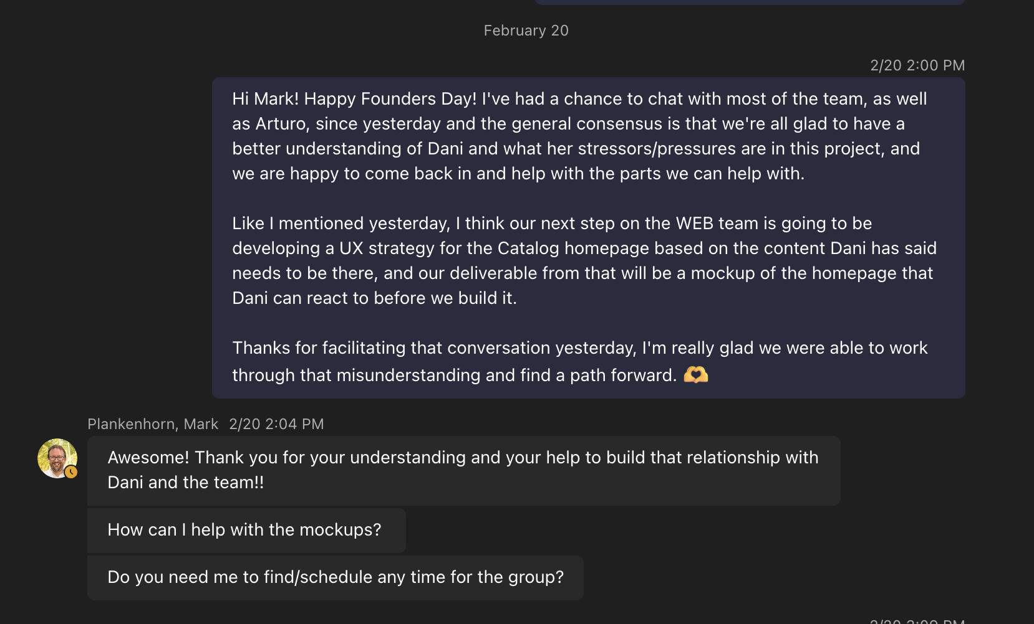
February 20 – A Shift in Tone
Coursedog Catalog
Mary's Follow-up: "I've had a chance to chat with the team... we're all glad to have a better understanding of Dani and what her stressors/pressures are in this project, and we are happy to come back in and help with the parts we can help with."
Mark's Response: "Awesome! Thank you for your understanding and your help to build that relationship with Dani and the team!!"
The Shift: From defensive positioning to collaborative problem-solving in 24 hours
Notes:
Look at this exchange from February 20th - just one day after the crucial conversation. The tone has completely shifted from boundaries and limitations to understanding and collaboration. Mark specifically recognizes the relationship-building aspect, not just the task completion. Crucial conversations create mutual understanding, not just conflict resolution. And that understanding enables something powerful...

Slide 28
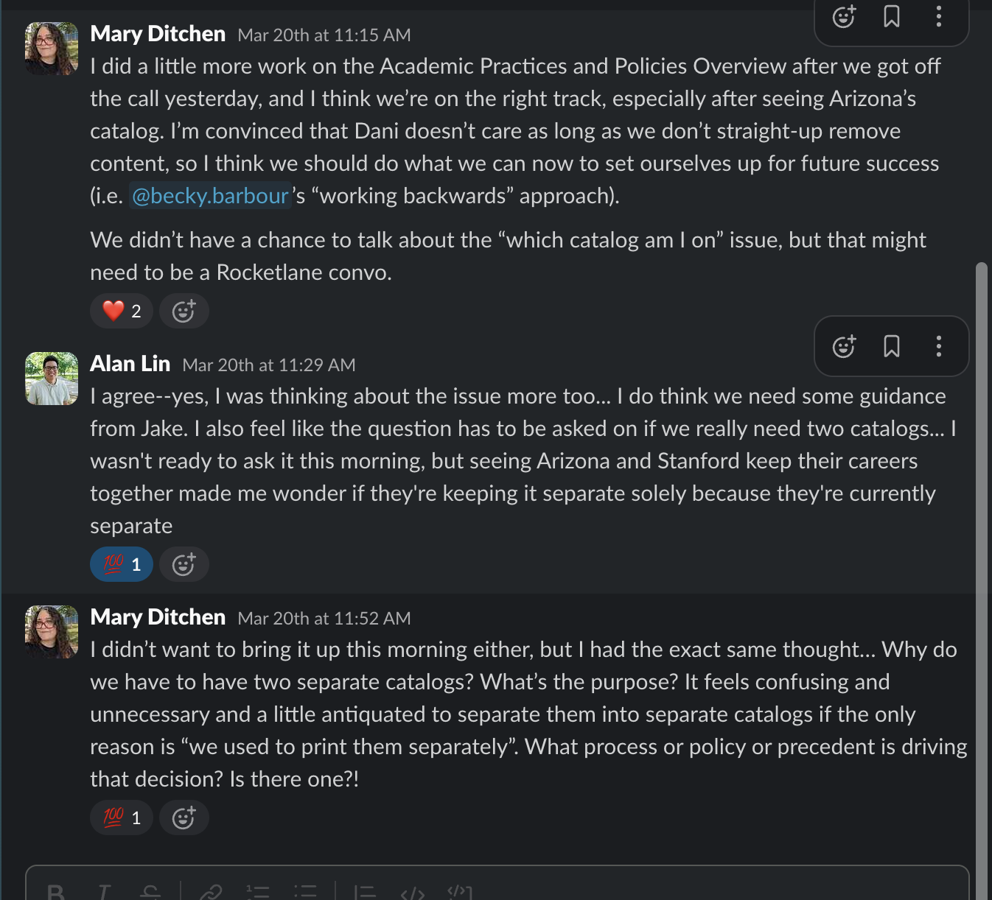
March 20 – Trust Enables Innovation
Coursedog Catalog
Strategic Questioning: "Why do we have to have two separate catalogs? What's the purpose? It feels confusing and unnecessary..."
Team Dialogue: WEB team questioning fundamental UX assumptions
The Foundation: Strategic conversation only possible because trust had been rebuilt
Notes:
This March 20th conversation shows the real power of crucial conversations. A month after the February meeting, our team felt confident enough to raise fundamental UX questions about the entire catalog structure. These strategic insights could only emerge from a foundation of restored trust and collaboration. Strategic questioning could only happen because trust had been rebuilt. And that confidence led to institutional breakthrough...

Slide 29
Crucial conversations don't just resolve problems - they create space for innovation
Coursedog Catalog
March 20 – Trust Enables Innovation
Strategic Questioning: "Why do we have to have two separate catalogs? What's the purpose? It feels confusing and unnecessary..."
Team Dialogue: WEB team questioning fundamental UX assumptions
The Foundation: Strategic conversation only possible because trust had been rebuilt

Slide 30
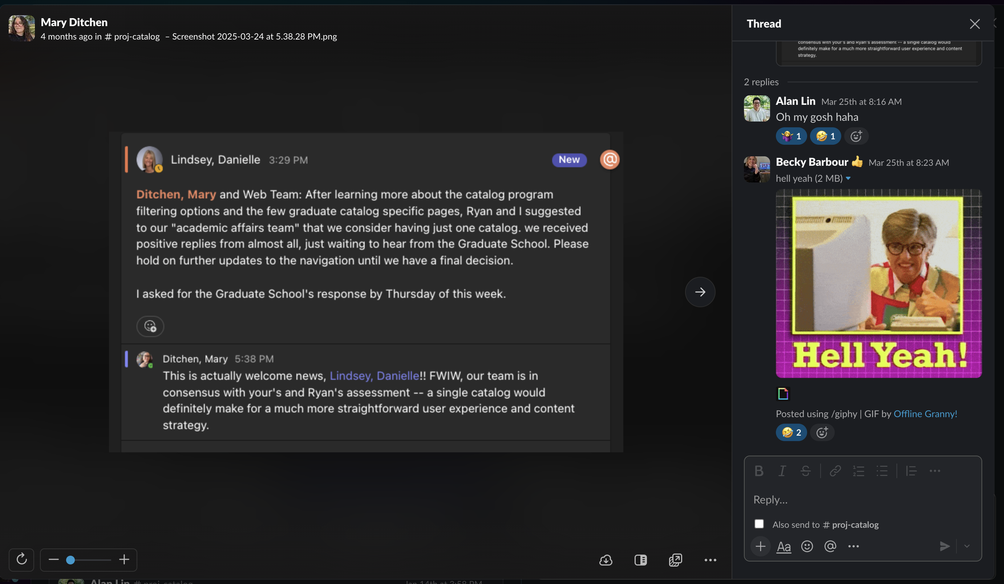
March 24 – Institutional Breakthrough
Coursedog Catalog
Institutional Innovation: "After learning more about the catalog program filtering options... Ryan and I suggested to our 'academic affairs team' that we consider having just one catalog."
Mary's Response: "This is actually welcome news! FWIW, our team is in consensus -- a single catalog would definitely make for a much more straightforward user experience and content strategy."
The Timeline: 5 weeks from crisis to institutional innovation
Notes:
Four days after our strategic questioning, the Registrar's Office independently arrived at the same conclusion. This isn't coincidence - it's what happens when crucial conversations create mutual understanding and trust. Dani felt confident proposing a major structural change because she knew WEB would be a collaborative partner, not just a cleanup crew. Five weeks from crisis to institutional innovation - that's the power of crucial conversations.

Slide 31

Two Stories, One Foundation
Human relationships drive digital success
FTIC Dashboard: Building relationships from scratch → measurable collaborative success
Coursedog Catalog: Crucial conversations under pressure → trust that enables breakthrough innovation
Course Finder and Transfer projects possible because this foundation exists
Notes:
Two different challenges, same foundation. Whether we're building cross-departmental partnerships from scratch or navigating crucial conversations under pressure - the principle remains constant: human relationships drive digital success. Both stories show how collaborative relationships create the foundation for measurable outcomes, institutional recognition, and scaling success.
If I've learned anything from these projects, it's this: behind every effective digital interface are effective human relationships, and effective relationships depend on crucial conversations. Every project I've shown you had moments requiring honesty, transparency, vulnerability, and respect - always focused on the best outcome for students, staff, and the institution.

Slide 32
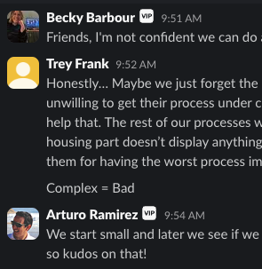



Crucial Conversations Are Key
Making collaboration work when it gets hard
Honest Assessment
Transparent About Limits
Collaborative Solution
Notes:
Here's a perfect example from our housing integration work - honest frustration led to transparent discussion which led to collaborative solution. In fact, this is exchange could have been pulled from any number of moments our team has experienced while working this way. It’s Willy Wonka’s boat ride – “There's no earthly way of knowing / Which direction we are going!” In every collaborative journey, the deeper we venture, the more we uncover – what seems (perhaps not simple, but straightforward) on the surface might be a tangled mess of cords underneath. And just like with a tangled mess of cords, all you can do is ”start small” and start untangling the mess one cord at a time.

Slide 33
Every successful project has hinged on honest, transparent, respectful dialogue
Crucial Conversations Are Key
Every successful project has hinged on honest, transparent, respectful dialogue
Notes:
If I've learned anything from these projects, it's this: behind every effective digital interface are effective human relationships, and effective relationships depend on crucial conversations. Every project I've shown you had moments requiring honesty, transparency, vulnerability, and respect - always focused on the best outcome for students, staff, and the institution. Here's a perfect example from our housing integration work - honest frustration led to transparent discussion which led to collaborative solution. In fact, this is exchange could have been pulled from any number of moments our team has experienced while working this way. It’s Willy Wonka’s boat ride – “There's no earthly way of knowing / Which direction we are going!” In every collaborative journey, the deeper we venture, the more we uncover – what seems (perhaps not simple, but straightforward) on the surface might be a tangled mess of cords underneath. And just like with a tangled mess of cords, all you can do is ”start small” and start untangling the mess one cord at a time.

Slide 34
When humans collaborate effectively, the digital experiences we create serve humans better.
Let's Get Digital! with Mary K. Ditchen
#ISUCIT
Notes:
So what does this mean for all of us working in digital spaces? When humans collaborate effectively - through cross-departmental partnerships and crucial conversations that navigate difficult moments - the digital experiences we create serve humans better. Effective digital interfaces are the result of effective, intentional human relationships – and those relationships depend on our ability to have crucial conversations when collaboration gets hard. The framework is simple: honesty, transparency, vulnerability, and respect. The application is…a little easier said than done, admittedly, lol. But, as I hope you’ve seen today, it’s absolutely possible – and as I’m sure the rest of my team would agree – incredibly worthwhile.

Slide 35
Thank you! Questions?
Let’s Get Digital! Together
Collab with WEB
WEB Office Hours Zoom
Every morning 9-10 a.m.
(except Thursdays)
Let's Get Digital! with Mary K. Ditchen
#ISUCIT
Notes:
The ability to have crucial conversations isn't just about creating better digital experiences - it's about building the relationships that make continuous improvement possible. I'd love to hear your thoughts and questions about how this applies to your own collaborative work. And if you want to continue these conversations, we have WEB Office Hours every morning from 9-10 except Thursdays on Zoom. Come collaborate with us!

