Slide 1

Under the Surface:
The Hidden Work of the Technology Support Center

Slide 2

Who are we
TSC consists of:
9 Full Time Staff, including 2 shared with K&T
13 to 15 Part-Time Student Workers
Primarily focused on daily tickets
K&T consists of:
4 Full Time Staff, including 2 shared with TSC
Focuses on keeping knowledge up to date and creation of new knowledge
SMO Consists of:
4 Full Time Staff (formerly known as the Incident Coordinators)
Focused on ITSM processes, ServiceNow frontend development, CMDB, and the Major Incident/Problem Management and Change Management processes for Tech Solutions
Notes:
Service Management Office
Formerly the Incident Coordinator team - find us in SN as Service Management Office (SMO)
New focuses on ServiceNow frontend development
primarily catalog items, will be a completely different experience in SN from Cherwell - already more request forms than we had previously and they work better, many more to come
supporting emphasis on customers using these forms, Major Incident coordination continues
ITSM metrics and reporting will continue to be a focus
Managing major incident response continues, coordinating with all teams involved
Documenting root cause and resolution, organizing post mortem for continuous improvement (Problem Management activities)
Outage communications

Slide 3
Who do we help and how do we do it?
Guests
Students
Chat
8HELP
VIP
TSC
Email
From Other Teams
Faculty
Web
In Person
Retirees
Staff

Slide 4
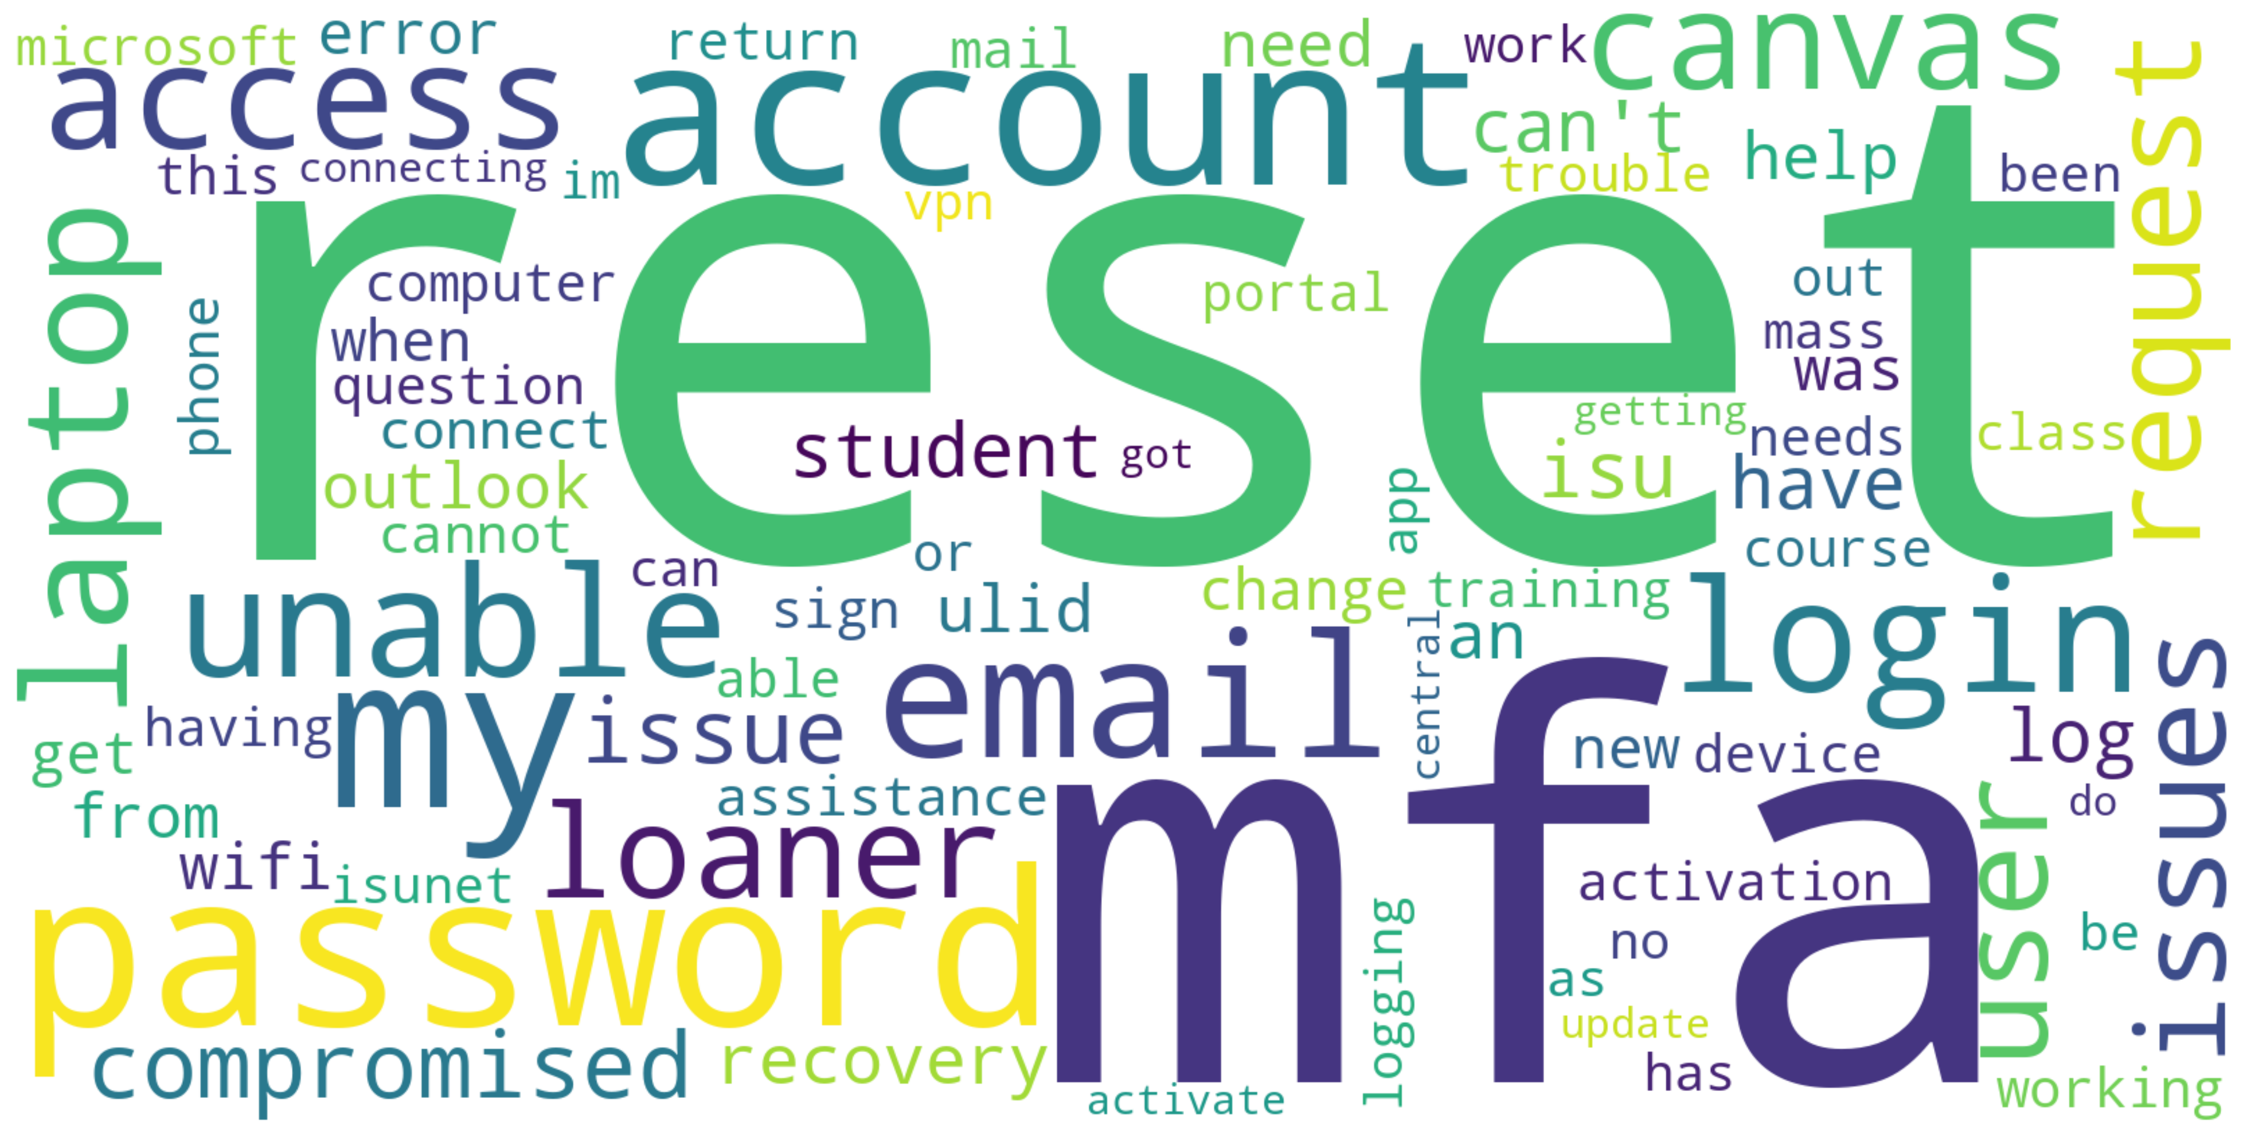
What do we support?

Slide 5


On the Surface
Help Desk
  After Hours and Weekend Support
  Ticket Triage and Routing
    23,256 total tickets, 71% resolved within 24 hours
    Tech Solutions teams resolve 54% of faculty/staff tickets, 12% the TSC resolves directly
    The TSC resolves 25% of all tickets
How To
  Software downloads and use
  General information
  Where to go
Account Support
  Send Block Removal
  Compromised Account Process
  Guest Accounts
  MFA/Password Reset

Slide 6

Just Below the Surface
Equipment Reservations
  Mi-Fis
  Short-Term Loaner Laptops
Student Loaner Laptops
  Approximately 250 New 4 Year Loans
  Approximately 100 Used 1 Year Loans
In Person Support
  International Student Arrival
  Various High School Events
  Preview Class Registration
Canvas Support
  TSC is now the frontline support for Canvas
  All the Canvas documentation now lives in Help
Ansible/Grouper
Lab Rats

Slide 7

Intermediate Depths
Knowledge and Training Team
Help (Help.IllinoisState.edu)
  Total Help articles: 934
    New articles past 12 months: 122
    Updated in the past 12 months: 718
  Daily view range past year:
    712 – 21,857
  Total anonymous views past year:
    4,041,796
Confluence:
  Total Confluence spaces: 68
  Knowledge Champions
Notes:
Knowledge and Training Team
We publish and curate Public and internal facing content using Confluence, with public content available on Help.IllinoisState.edu. We share a portion of our staff with the TSC, and help to maintain internal TSC documentation as well.
As you can see, with new knowledge being added and old knowledge being retired, we have been maintaining roughly ~900 public facing articles over the past several years. In the past year, 77% of this content has been updated in some way as we work to keep it fresh and accurate.
This content is available to anyone with an internet connection, with some of our most popular articles showing up prominently in Google searches.
Confluence
The Knowledge and Training team works closely with the Application Administrators to ensure timely updates to head off technical issues whenever possible.
We have currently 68 individual spaces for areas all across campus as Confluence becomes a great place to store, view, and share documentation with your team and others.
Knowledge Champions
SAIT
CIPD
ISUAnswers (student-to-student)
Training
We have a training specialist who creates, maintains, and administers a menu of different training courses as well as online and in-person training sessions upon request.

Slide 8
Intermediate Depths continued…
Training
  Online
  In-person
    Examples include: Tech QuickStart/Formstack/Qualtrics
Software Documentation:
  Software Catalog: 126 items (many more to come!)
  Canvas LTIs
  M365 App Consent
  AI-enabled options
  Mainstay
Project Support
  Internal documentation
  Public documentation
Notes:
Training
We have a training specialist who creates, maintains, and administers a menu of different training courses as well as online and in-person training sessions upon request.
Software Catalog
We have been working to revamp and populate the Software Catalog, also available on the Help site. While we do not currently include all of available software in use on campus by any stretch, we are diligently working toward that goal as we more software moves through the campus-wide software review process.
We also maintain documentation related to Learning Tool Integrations currently enabled for use in our academic Canvas environment.
We help manage a process regarding 3rd party integration with our M365 environment. This involves collecting instances where users are attempting to connect an app to their ISU M365 account and coordinate with the ISO, WEB Accessibility and various commitees
Chatbot
K&T maintains our current Mainstay-based RedbirdBot, available on the Registrar, and Financial Aid websites. This current bot is not AI driven, though we have recently enabled a scraping tool within the software to enhance the responses the bot is able to provide for students and prospective students.
Project Support
K&T maintains a presence in many IT projects to create related documentation, as well as to champion the customer/end-user experience.

Slide 9

Deeper Depths
The Face of Technology Solutions
User Champion
Leadership of IT Service Management process and tool for campus
Major Incident/Problem Management
Change/Release Management
CMDB
Notes:
Moving deeper to less obvious TSC services...
When the ISU Community thinks of TS, they are most likely thinking of the TSC. Most of campus may never interact with another team within TS. It's a responsibility that has pluses and minuses.
TSC has an important role as the user champion with TS – as the team that works directly with users seeking TS services, hears their concerns and feedback, the TSC is best situated to speak on behalf of the user. As mentioned previously, the TSC/Knowledge Team is intentionally included in TS projects in that role and TSC staff actively participate in our weekly release meeting, challenging the other TS teams as necessary on user experience.
The TSC is the enterprise service desk and also leads ITSM process and tool practices and improvement for campus. Tyler Piper is the Director of ITSM and also leads the TSC, he works in close coordination with the ITSM Advisory Group. Tyler also serves as the service owner for ServiceNow, for which you may have heard we have an active project - Tyler is working with the ServiceNow steering team and project team to continue to bring improvements to our new tool.
The Service Management Office team, formerly known as the Incident Coordinators, are first responders to Tech Solutions service outages and degradations. They quickly assess the known information, gather the right teams together and coordinate communication so that the staff who need to fix the problem can fix the problem. During an outage, they keep everyone organized and focused. After an outage, they work with the teams to document what happened and facilitate a post mortem review to ensure continuous improvement. Dedicating staff to this service has greatly increased the response time to TS service outages and reduced down time, which benefits everyone.
Change/Release Management & CMDB are also managed by the Service Management Office team. They manage the process by which all Tech Solutions teams submit changes for review at our weekly Release meeting, ensuring changes get appropriate review prior to release. The CMDB is also managed by this team, working with app admins, and IT teams teams across campus to establish good practice around configuration management and ensure that our CIs are properly tracked and related to each other in ServiceNow.

Slide 10

Support Center of the future
The Need
  Anytime, Anywhere Support – Consumer Expectations
  Support of increases in online/distance education
  Efficiencies in service delivery (and not just IT)
Meeting the Need
  Tier 1 Support
  Ticket Tracking
  Knowledge
  Chatbot/Digital Assistant
Tier 1 Support & Escalation
Trained Staff Available Extended Hours
Ticket Tracking & Request Workflows in ServiceNow
Internal & Public
Knowledge
Chatbot
Notes:
Climate change is real! We're seeing rising seas in service management – users expect the type of service they get from Amazon, the University plans to increase online/distance education offerings, and we are all be asked to find ways to do our jobs more efficiently.
The TSC has been working toward a concept we refer to as the Support Center of the Future, it's a package of services that can provide foundational tier 1 support on any subject, in coordination with departmental experts. The pieces of that package are:
Tier 1 support & escalation – TSC staff are available extended hours and we have established training practices for adding new subjects. Escalation to the next level experts is also an established process and can extended to new subjects and teams. We know how this is done currently for IT – say, a Canvas question that is beyond what the TSC can answer gets sent to CIPD or the app admins. It could work the same way for questions about financial aid, or housing, or any other department's services.
Ticket Tracking & Request Workflows in SN – any department that gets questions and requests from faculty/staff/students has a need to track them to make sure they are being resolved. ServiceNow can do that, and many of the non-IT subjects are pre-built add-on modules. Workflows in SN are also a powerful tool – we can quickly create and edit request forms (like what you see now for IT in the SN portal), and they can be enhanced with workflows to automate common tasks. Many of the things currently done in Formstack can find a home in SN in the future.
Internal & Public Knowledge – a foundation of subject matter knowledge is a critical piece of this service. The TSC covers a very wide and long list of topics currently, and they couldn't do it without the knowledge documented in Confluence – take a look at the Client Services space there and you can see the large base of knowledge the staff use every day (and that is separate from the hundreds of public articles the Knowledge Team maintains). Building a culture of knowledge in areas where they don't exist currently would likely be the most difficult part of adding new services to the Support Center of the Future.
Chatbot – we use a text-based chatbot with a subset of students now, and we have live chat through the TSC, but clearly any Support Center of the Future needs a chatbot and/or digital assistant that can serve as a first level of support for basic questions and transactions. Documented subject matter knowledge is also very important here. We're very aware of this need and are exploring solutions – the SN Virtual Agent is one possibility.

Slide 11
The FUTURE IS NOW
Support efficiencies within Tech Solutions
Tier 1 support for COB Faculty/Staff
Shift Left
SEE Program
Knowledge Champions
ServiceNow
Notes:
Turns out the future isn't very far away... here's what we're doing right now.
We have multiple tier 1 support units with Tech Solutions - the TSC, Endpoint Support, and the TZ Service Center. We're working to collaborate and consolidate services between those teams so we don't duplicate our own services. TZ Service Center will soon be able to offer password & MFA resets, and we plan to move loaner laptop and checkout operations to the TZ Service Center. In Spring 2026, we expect to have the Tier 1 calls for Endpoint Support customers go to the TSC. We also have a formal arrangement for Tier 1 calls already in place with the College of Business, to help augment their local staff.
Shift Left – enabling service desk staff to resolve issues that previously were escalated. We're using Ansible and other methods to do this without having to increase the level of permissions given to TSC staff – examples include software requests like Grammarly and NVivo handled completely within the TSC, and guest accounts. There is huge potential with this to move repeatable tasks to the TSC and free up admin time.
We couldn't provide any of our support services without our talented students. Tech Solutions invested in those students recently by hiring a full-time Student Employment Experience (SEE) Coordinator – expanding on the existing SEE program and providing coordination and support for all Tech Solutions students. This will help us greatly in efficiently providing training to our students so that they can work flexibly between teams and cover surges in demand.
Chris talked about Knowledge Champions, that effort is critical to establishing that culture of knowledge that allows efficient support. We have 16 non-IT spaces in Confluences currently.
ServiceNow is barely a month old, but we're seeing more and more potential for any user and any subject. It's a powerful tool for us to put in service of efficient and consistent support, we just need the resources to get through the long list of ideas for how people can use the tool to make their jobs easier. Things currently done in Formstack at the departmental level are good examples of things that could shift to ServiceNow as part of a support offering.

Slide 12

What can the TSC do for you?
Notes:
What can the TSC do for you?
Interested in Tier 1 support, help with knowledge, do you have repeatable requests we could shift to the TSC to fulfill?
Take out any consideration of ISU knowledge/structure/etc.... what have you seen work elsewhere that works well as Tier 1 support that we haven't consolidated here?
What are pain points in your area?

