Slide 1


Slide 2


Resilient By Design
Disaster Recovery, Continuity, & Campus-wide Sustainability
Elizabeth Findley, Emergency Management & Joey Brown, Information Security Office
Notes:
+ Welcome
+ Remind folks Q&A at end and virtual attendees can submit questions in the chat

Slide 3
What is Resiliency in Higher Ed?
The ability to prevent (where possible), prepare for, respond to and recover from all threats and hazards.
Examples
  Human-caused: Targeted violence, sabotage, Cyber attack, CBRNE attack
  Natural: Inclement Weather, Earthquake, Space Weather, Epidemic/Pandemic
  Technological: Haz-Mat Incident, Utility Outage, Train Derailment, Transportation Accident
  Other: Reputational, Financial
How Resilient is the University against these threats and hazards?
Notes:
Joey
Resilience is comprehensive – It’s not just about response or recovery. True resilience means being able to prevent, prepare for, respond to, and recover from a wide range of threats and hazards.
Threats aren’t just physical – While we often think of weather or active threats, cyberattacks, reputational damage, and financial disruptions can be just as impactful to university operations.
Threats come from many sources – We categorize them as human-caused, natural, technological, or other—each requiring different preparation strategies.
Some risks can be prevented, others must be absorbed – For example, we can harden systems against cyberattacks, but we must adapt and recover when facing unavoidable events like severe weather.
All departments have a role – Whether you're in IT, facilities, health services, or academics, your continuity planning contributes to overall resilience.
Ask the critical question – “How resilient are we really?” This drives the conversation from reactive thinking to proactive planning. It’s not just about surviving an event—it’s about sustaining the university's mission through it.

Slide 4
University Continuity Program
Defined: The identification and continuation of essential University services in the wake of a disruption.
Not every University services must be running post-disruption
But those that do generally sit atop one or more of the 3 pillars of Continuity
  Utilities
  Facilities
  IT
Which of the below do we need to continue:
  Playing a sports event
  Teaching classes
  Conducting animal research at the Farm
  Feeding residents in the Dining Centers
Notes:
Liz
What is continuity?
Continuity is the ability to maintain essential services during and after a disruption.
It is the “band-aid”
• What is an “essential service”?
“Essential services” are operations that must continue, even in a degraded fashion, despite there being a disruption.
Not all departmental functions need to resume immediately following a disruption; some may be temporarily deferred until normal operations are restored.
In order to do maintain these essential functions we need some combination of the three pillars: utilities, facilities or IT
The University Continuity Program was established last fall and with it a Continuity Steering Team lead by leaders across an array of disciplines on campus.
We have a department representative for all 114 departments on campus to actively engage in their continuity plans.
Traditionally, continuity comes before IT Disaster Recovery, because continuity identifies the priorities which drives DR, but we as an institution took to long to get things moving, and IT didn’t wait (as they shouldn’t).
Throughout the continuity process we are asking departments to identify their essential services which in the end we will compare with IT and adjust from there.
But not everything is essential, right? Not everything we think is important, is.
Part of what comes out of this process is what will drive investments and what we need.
The steering team exists to be a clear set of eyes on what comes out of these plans before they go to Cabinet for review. And that means tough conversations are going to have to happen.
The goal is to shift the culture from “it will never happen here” to “it could happen here”, fostering a proactive approach to both continuity and preparedness

Slide 5



ISU Disaster Recovery (DR) Overview
IT system restoration: time- and priority-based timelines
TS and decentralized IT depts are involved
DR strategy based on risk tiers
DR = restoring systems, not ISU operations
Notes:
Joey
Speaker Notes:
(JOEY) System restoration follows predefined timelines based on both urgency (time) and criticality (priority).
Technology Solutions and decentralized IT units must coordinate during recovery—no single group can restore everything alone.
Disaster recovery (DR) uses a tiered strategy, prioritizing systems based on business impact and risk.
Not all systems are restored at once—critical services come first, less essential ones later.
DR is focused on restoring IT systems, not the full operational continuity of the University.
Operational continuity is addressed separately through the University Continuity Program, which complements DR.
Engagement Question:
Which of your systems would you say are “mission critical”? Are they covered under DR plans?

Slide 6

Business Continuity
Payroll
Vendor Payments
Procurement
Human Resources
Institutional Finances
Notes:
Liz
We’ll be approaching continuity through
Business
Academic (which instructional and research feed into)
Research
Continuity of Operations
Business Continuity focuses on maintaining critical administrative and support functions such as payroll, finance, procurement, and HR services. These ensure the university can continue operating smoothly and meet legal, financial, and operational obligations.
“Business” is what we would consider revenue generating areas of the institution.

Slide 7

Academic Continuity
Academic Instruction (in-person / virtual)
Testing
Materials
Access to Canvas
Access to Cognos
Notes:
Liz
Academic Continuity ensures that teaching and learning can proceed during disruptions. This includes shifting to online learning platforms, maintaining access to academic materials, and supporting faculty and students in alternative instructional methods.
Academic Continuity is the umbrella which instruction and research fall under.

Slide 8

Research Continuity
Lab Backups
Data Preservation
Grant Reporting
Equipment Power, HVAC and Protection
Notes:
Liz
Research Continuity safeguards ongoing research activities, protecting data, facilities, equipment, and funding timelines. It includes maintaining compliance with grant requirements and ensuring continuity of laboratory operations or fieldwork where possible.

Slide 9

Continuity of Operations
Facilities & Building Operations
Public Safety & Health Services
Housing & Dining Operations
Internal & External Communications
Notes:
Liz
Continuity of Operations (COOP) is a broader organizational strategy that ensures the university can maintain its essential functions—across all departments and missions—through any hazard. It involves communication planning, facilities and buildings operations, public safety and health services, and housing and dining operations to preserve institutional resilience.
Non-revenue generating operations

Slide 10

Interdependencies
Tech, HR, finance, facilities interdependencies
Continuity is becoming increasingly reliant on effective IT DR
Identify and plan for single points of failure
Notes:
Joey
As we strengthen our continuity efforts, it's important to recognize how deeply interconnected our tech, HR, finance, and facilities functions have become.
Continuity today depends more than ever on effective IT disaster recovery, and that means we must proactively identify and address single points of failure before they disrupt operations.

Slide 11

Documentation
Notes:
Joey

Slide 12
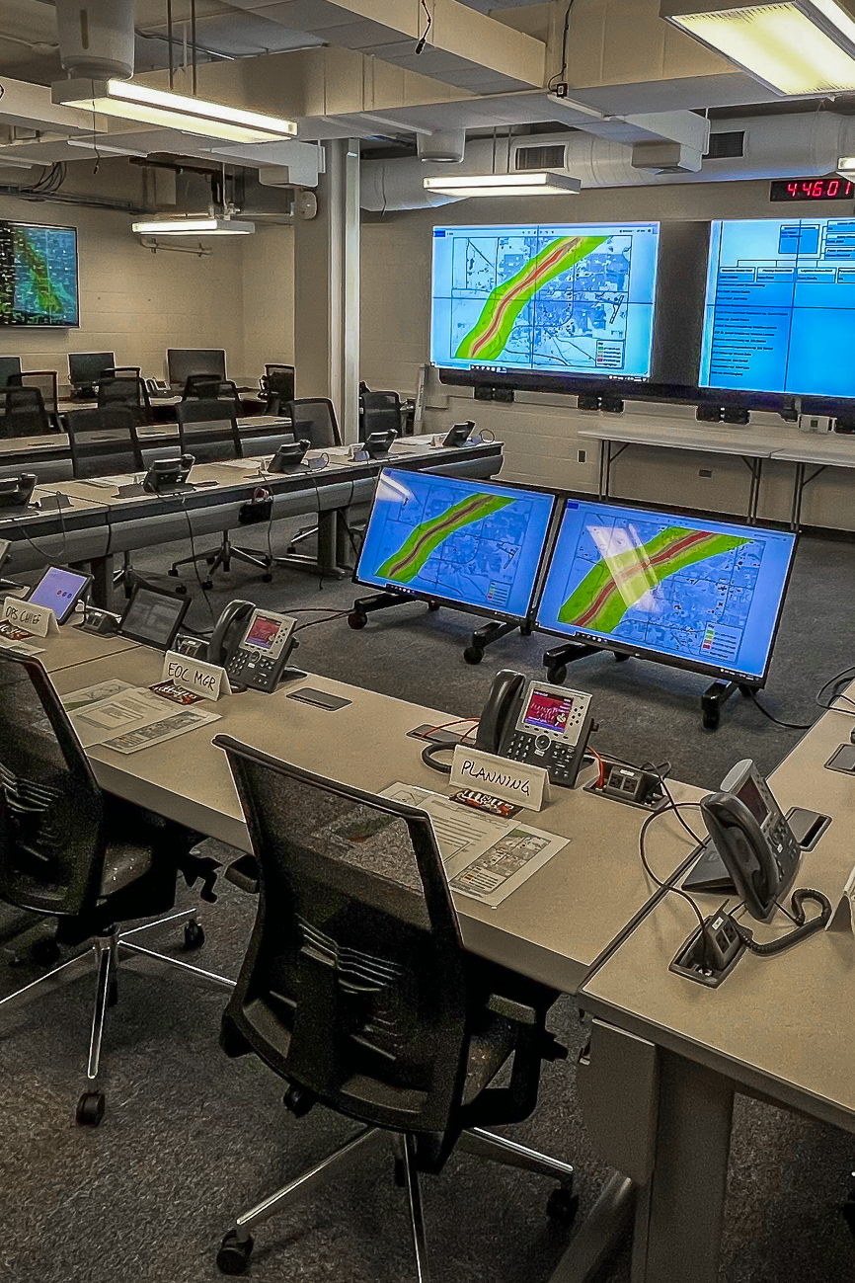
Exercises & Testing
EM Responsible for Exercises Across Campus
  Drills
  Workshops
  Tabletops Exercises
  Functional Exercises
  Full-Scale Exercises
Tabletop Exercise (TTX) Series – Began June 2025
  2 / 5 Completed
  Final TTX to Take Place Following Completion of Plans
Notes:
Liz
The Emergency Management Department is responsible for exercises across campus (drills, workshops, TTX’s).
As part of the University Continuity Program rollout, we are conducting a series of continuity tabletop exercises with the intent that all 114 departments attend at least one.
To date, we’ve conducted 2/5 and the remaining 3 will be held in September.
Following the completion of continuity plans, we will conduct a final TTX before presenting to Cabinet.

Slide 13

Today’s Snapshot & Next Steps
Conducted 2/5 TTX’s with Departments
On-Site Training Workshops in October
Development of Continuity Plans to Begin Fall ’25
DR Tiering Updated & Refined
Goal: 100% Coverage & Annual Review Cycle
Annual DR Testing During Maintenance Windows
Notes:
Joey & Liz
Liz:
As mentioned, to date we’ve conducted 2/5 TTX’s and will conduct the remaining 3 in September.
We will be hosting an on-site training workshop with our departments in October to kick off the continuity planning. Training sessions will be designed to show departments how to navigate the solution and how to fill out fields, and the second half will be helping departments start their plans.
Departments will then be assigned the first few steps to complete within the solution as “homework”, then we will host a second training workshop at the end of January and parse out more work for departments to do until we have our third training workshop end of March.
Goal is to have plans completed my end of the Spring (’26)
Joey:
Stay flexible. As the Continuity Plan is built, it might call for a change to the DR plan. Look for a Tech Solutions DR TTX coming in Feb.

Slide 14

Questions

Slide 15
Thank you!
Information Security Office
Joey Brown, Deputy Chief Information Security Officer
Phone: (309) 438-3142
Email: Jdbrow9@ilstu.edu
University Continuity Program
Elizabeth Findley, Continuity Program Manager
Phone: (309) 438-1663
Email: Ekfindl@ilstu.edu

