Slide 1


Slide 2

Research DMZ
NSF Campus Cyberinfrastructure Award #2346712
PI: Yongning Tang, School of IT
Co-PI: Olcay Akman, George Barnes, Charley Edamala, Craig Jackson

Slide 3
Obstacles of the campus network
Building switches were connected at 2 x 1Gbps
  Since upgraded to 2 x 25G
  Shared with campus network traffic
10Gb to Internet 2 (I2)
SDN for research

Slide 4


Research Network vs Campus Network
Research Network
Campus Network
High Bandwidth
No firewalls, yet secure
Strict access control
Isolated
Internet 2 connectivity
Multiple Firewalls
Layers of security
  ACLs, layer 2 protocols
Fairly open access
Multiple Internet Service Providers

Slide 5
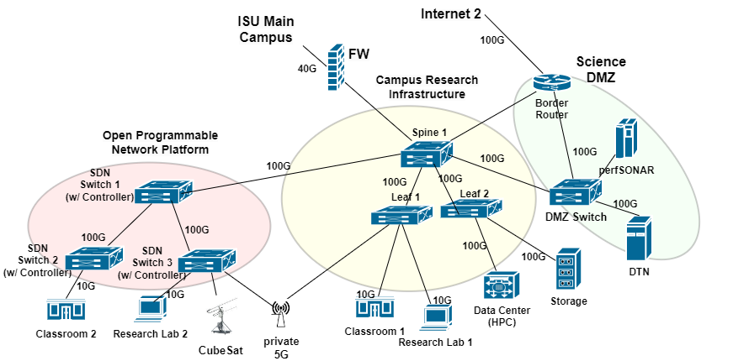
Logical Diagram

Slide 6
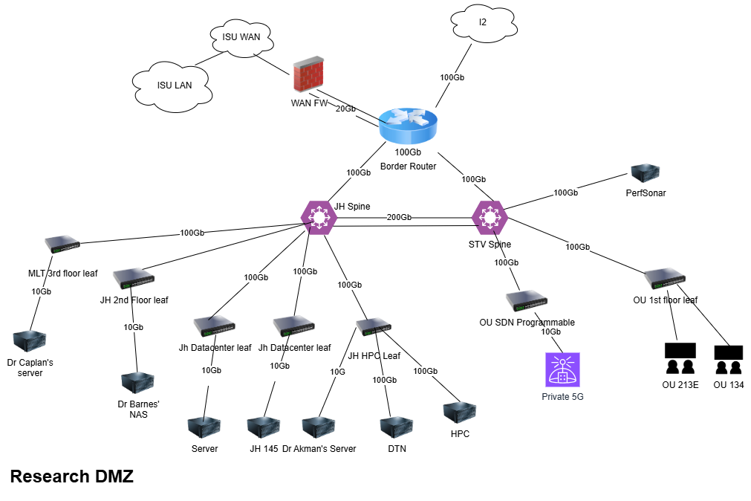
Architecture
Key Components
Border Router
Data Transfer Node (DTN)
PerfSONAR
No firewalls
Coming Soon
Intrusion Detection System
SD WAN

Slide 7
Hardware
Border Router + Spines
  Cisco Catalyst 9500X
Leafs
  Cisco Catalyst 9300X
HPC Switch
  Nexus 9300
Data Transfer Node
  PowerEdge R760

Slide 8
Research Use Cases
Computational Biochemistry
  Connecting to HPC resources
    NAC (Network Access Control)
Intercollegiate Biomathematics Alliance
  Modeling of disease propagation
  CDC Datasets
Cybersecurity lab
  Months of IoT data to run algorithms
  Teaching and research
Telemetry data from the USAF
  Run analysis
GIS Datasets
  Run analysis and create maps for end products
Physics
  Transfer datasets between ISU and Indiana University

Slide 9
Challenges
Submitting the Grant
  Timeline
  Understanding a research dmz
Once the grant was awarded
  Getting started (in the middle of a large project)
  Taking the logical diagram and planning a real network
  Hardware
    Switched vendors
  Staffing for research
  Many details to understand and decide upon.

