Slide 1
Managing Stress . . . & More by Practicing Mindfulness
Jim Almeda, M.S., CHES , NBC-HWC
Health Promotion and Wellness
Certified MIEA Mindfulness Teacher
Certified Health and Wellness Coach

Slide 2
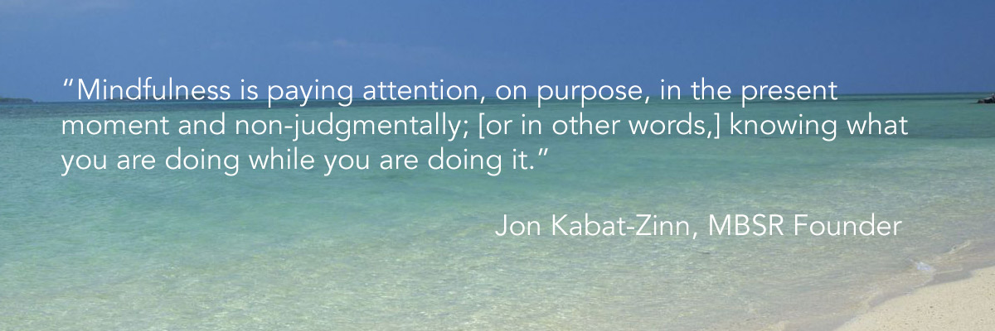
What is Mindfulness?

Slide 3

So, what is meditation then?

Slide 4
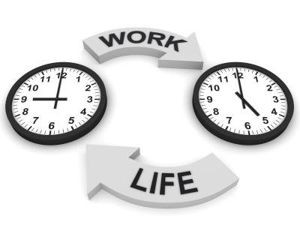
Why do we need mindfulness?
Increasing levels of:
Stress
Anxiety
Sleep problems
Feel overwhelmed
Loneliness
Challenges with:
Work/Academics
Relationships
Finances
Technology/Social Media

Slide 5
The Components and Benefits of *MIEA Mindfulness
Meet once a week (four weeks) & learn how to:
Meditate at least five minutes a day
Practice being mindful with something that you do every day (e.g. taking a shower, brushing your teeth, etc.)
Write down one or two things that you are grateful for each day
Improves sleep, eating behaviors, focus and work performance, reduces stress and anxiety, and contributes to a greater sense of well-being and happiness.
*Mindfulness Institute for Emerging Adults

Slide 6
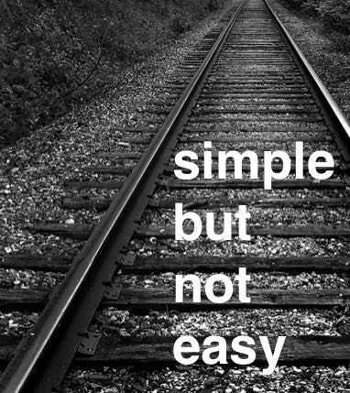
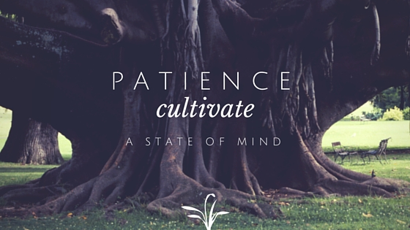
Mindfulness

Slide 7
Barriers to Practicing Mindfulness
Time – we’re already busy and don’t have time
As little as 5 minutes a day can make a difference.
Patience – it can be challenging at first
Like any skill, you will get better with practice
Procrastination – I keep putting things off
Schedule a time to practice each day
Doubt – will this really work?
There is a LOT of research about the effectiveness of mindfulness

Slide 8
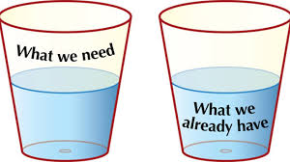
Neuroscience (Brain Research) Happiness and Acceptance
Genetic temperament – 50%
Circumstances of our lives – 10%
Intentional behaviors – 40%
  How we relate to our circumstances
Gratitude

Slide 9
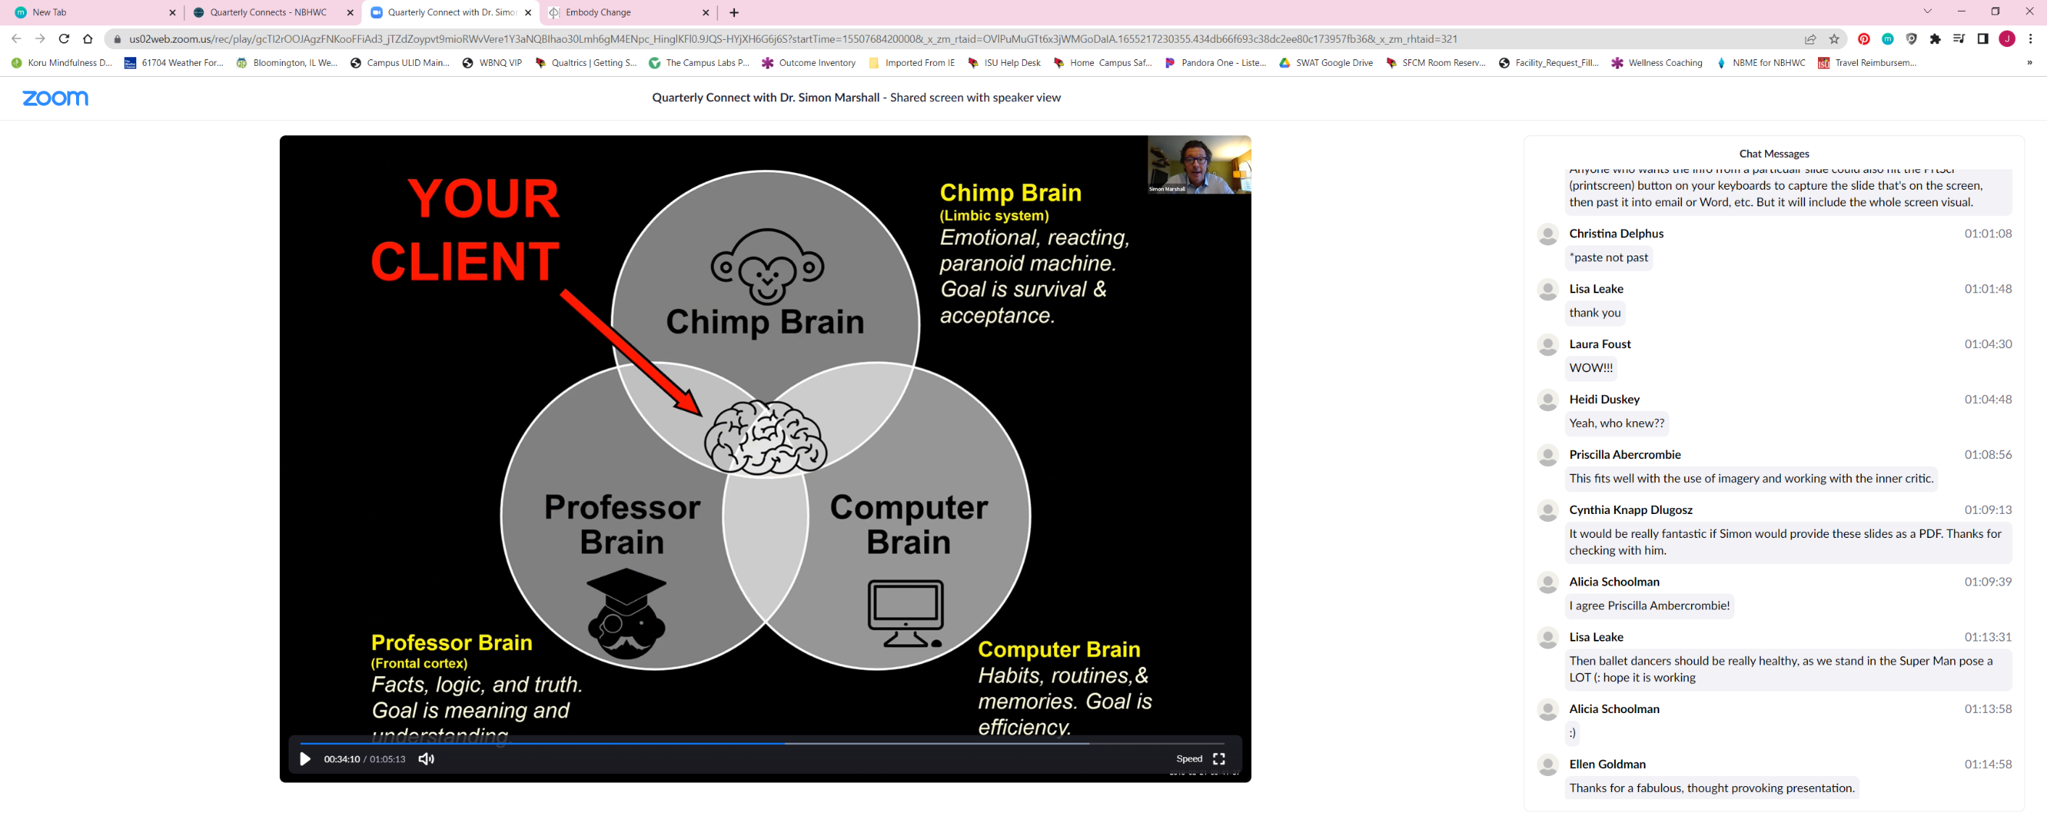

Slide 10

The Impact of Mindfulness
Mindfulness meditation doesn’t change life.
Life remains as fragile and unpredictable as ever.
Meditation changes the heart’s capacity to accept life as it is.
Sylvia Boorstein
The Mindful Twenty-Something

Slide 11

Questions to Ask Yourself in Stressful Situations
Is it a big deal?
  If no, let it go (acceptance)
  If yes, proceed
Can I change the situation?
  If not, let it go (acceptance) & manage emotions and feelings
  If yes, choose the best course or action (mindfully)

Slide 12
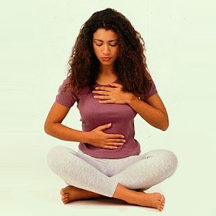
Let’s Practice . . . Belly Breathing
https://www.youtube.com/watch?v=6Gy1aktlDq0

Slide 13
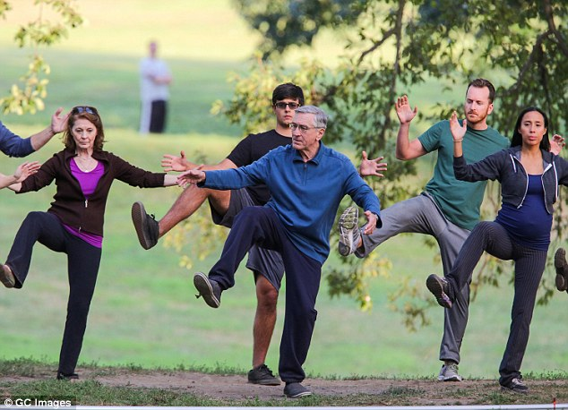
Dynamic Breathing

Slide 14


Gatha
I know I am breathing in
I know I am breathing out
Breathing in, I calm myself
Breathing out, I smile
I dwell in the present moment
I know this is a precious moment
IN
OUT
CALMING
SMILING
PRESENT MOMENT
PRECIOUS MOMENT

Slide 15
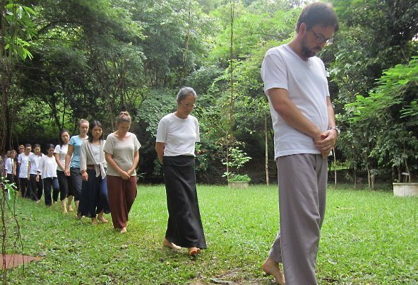
Other MIEA Meditation Practices
Walking meditation
Body Scan
Guided Imagery
Eating Meditation
Labeling Thoughts
Labeling Feelings
Loving-kindness (Part II)
Chair Yoga (Part II)

Slide 16

Online Resources
Free Guided Meditations • Mindfulness Institute for Emerging Adults
Mindfulness Classes at Illinois State University
Mindfulness | Health Promotion and Wellness | Illinois State

Slide 17
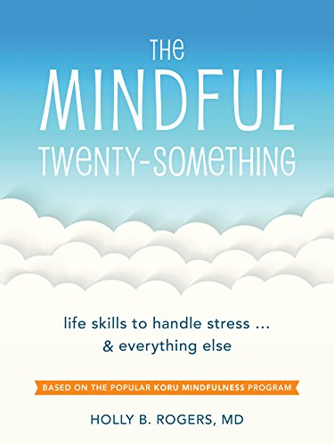
Books on Mindfulness
E-book available thru Milner Library (FREE)

Slide 18

Jon Kabat-Zinn
“You can’t stop the waves,
  But you can learn to surf.”
  Wherever You Go, There You Are:
  Mindfulness Meditation in Everyday Life

Slide 19
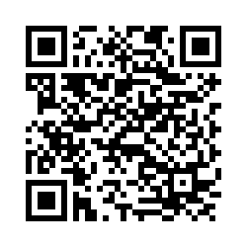
Evaluation
tinyurl.com/mindfulisu
Jim Almeda
(309) 438-2053
jralmed@ilstu.edu

