Slide 1
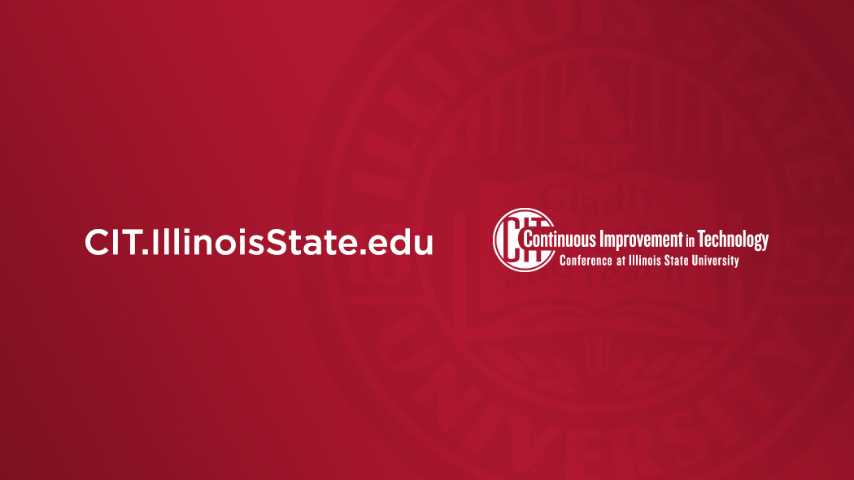
Evaluation of Next Generation Storage and Virtualization Platforms
Majeed Abu-Qulbain
Kevin Selinger

Slide 2

Overview
Introduce CCA team – Same Acronym, New Name
Quick Overview of Services Managed by the Team
Overview of Presentation
  Quick Recap of our private cloud journey over the past 3 years
    Reference CIT 2022 discussing the switching from UCS/Compellent to Lenovo/vSAN
    The Software Defined Strategy
    Why the need to change again?
  Evaluating Alternatives
    Why OpenShift? Why Ceph?
    Continuing the software defined approach, but separating storage from hypervisor
    PoC Results – Comparisons with VMware
    Demo of OpenShift Virt Console
  Questions & Discussion
    Next Steps
    Migration Scenarios

Slide 3
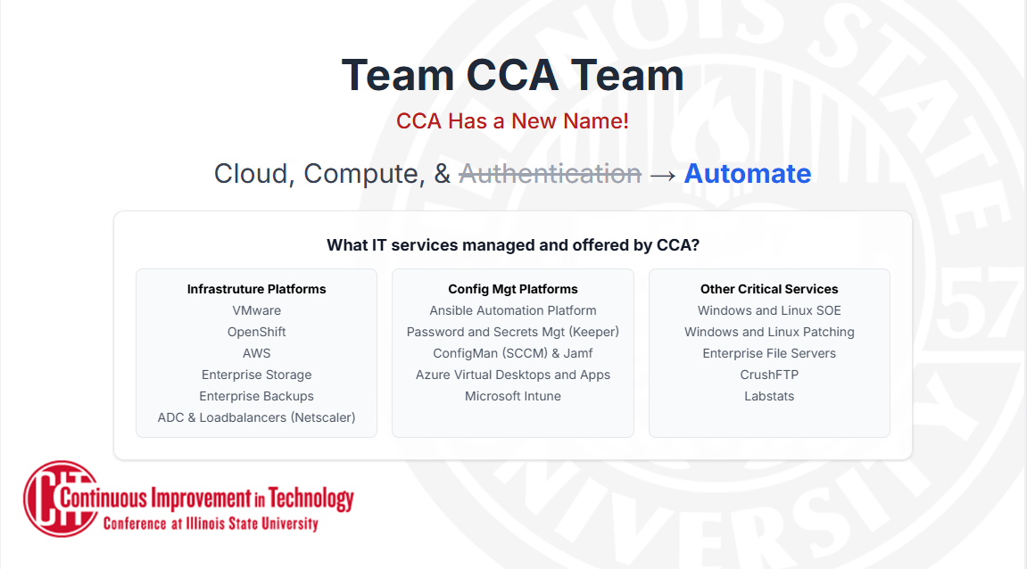

Slide 4
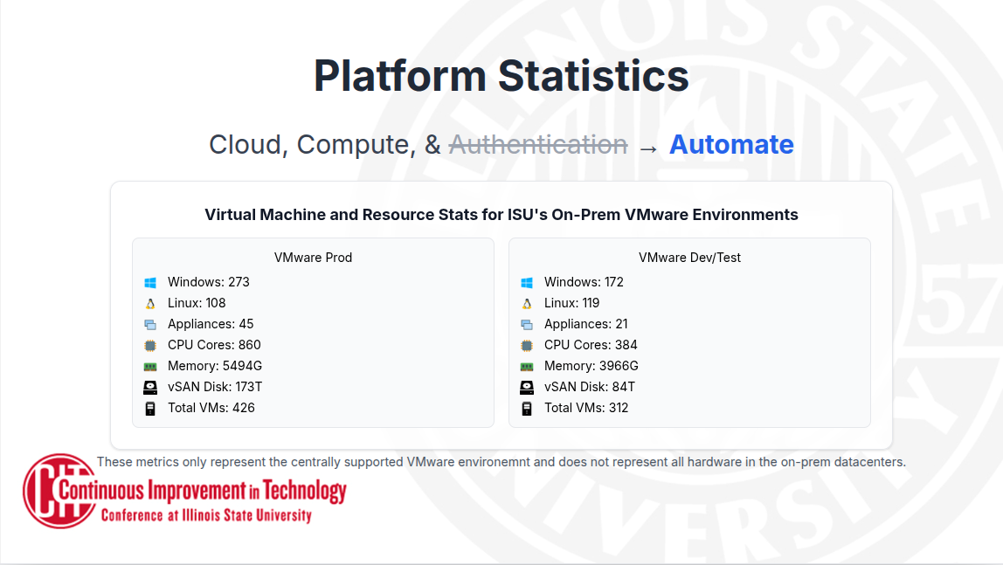
Notes:
Updated Facts Slide about our Private Cloud
# of Prod VM's and Test/Dev VM's
Prod: 426 Test: 312
# of Windows
Prod: 273 Test: 172
# of Linux
Prod: 108 Test: 119
# of Appliances VM
Prod: 45 Test: 21
# CPU cores across virt
Prod: 860 Test: 384
# Memory across virt
Prod: 5494G Test: 3966G
# VM disk Consumption
Prod: 173T Test: 84T

Slide 5
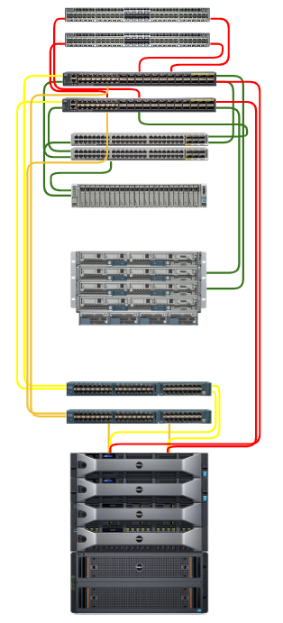
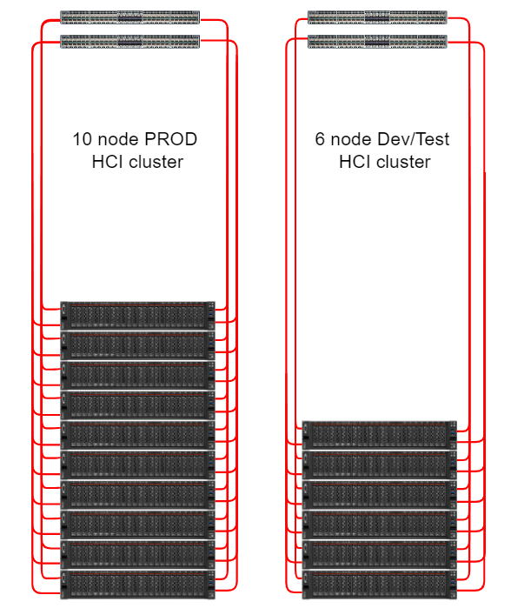
Recap of our private cloud journey (2022 – 2025)
3 Tier Blade/SAN -> Rack Servers
Keep the hardware simple and let software define it
Initial Software Defined Storage
VMware VSAN
Consolidation to 10/25g Ethernet
Aging Fiber Channel Network

Slide 6
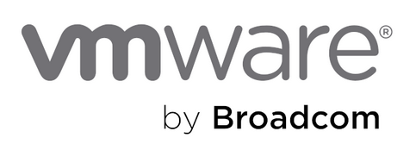


Why the need to change again?
Opportunity to consolidate vm's and containers in a single platform
Cost
Opportunity to separate your storage & virtualization vendors
Vendor trust
Opportunity to modernize
Notes:
Started with HyperV
Consolidated to VMware
Why reduce footprint?
Broadcom bought VMware
Price increases
Current Arch – Decouple Compute from Storage
What's next?

Slide 7
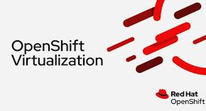

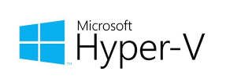


Evaluate VMware Alternatives
Notes:
We looked at other hypervisors and decided to POC Openshift Virt

Slide 8




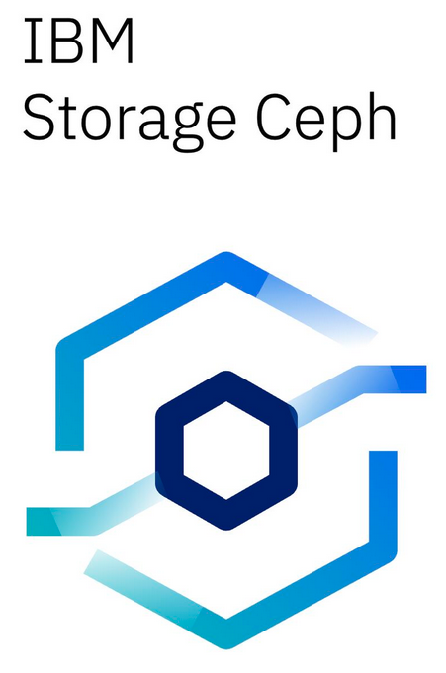

Evaluate VMware (Storage) Reduction
Notes:
We looked at other hypervisors and decided to POC Openshift Virt

Slide 9
What's Important?
High Availability
Cost
Workload & Storage balancing
Seamless maintenance
Backups
Testing everything
Security
Performant Virtual Machines
Performant & Flexible Storage
Virtual Machine Mgt
Ease of Migrations
Scalability
Security
Notes:
Consolidate this slide so that it is "Whats important for Virtualization and for Storage". Would be nice to have some shapes or containers showing overlap (merge with whats important storage slide)

Slide 10
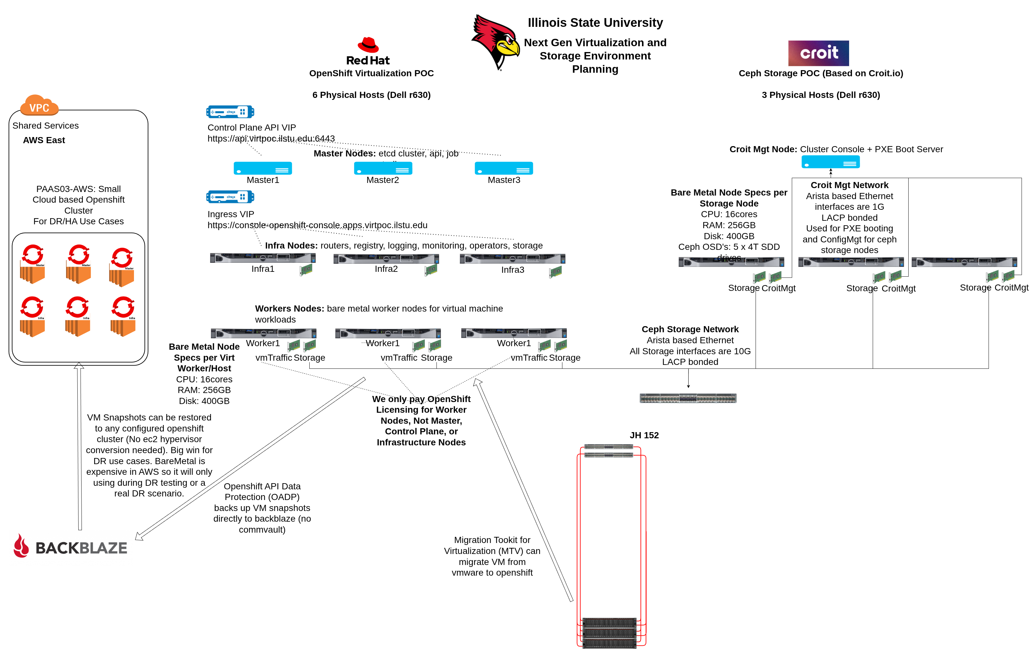
Notes:
This is the PoC environment we built using re-purposed hardware with a few temporary VM's as the management and master nodes.

Slide 11

PoC Results and Findings – Overall
Feature | VMware | OpenShift
High Availability | ✔ Mature HA Polished DRS Rules | ✔ Supported Descheduler, NHC, FAR
Live Migration | ✔ Full support Live within and across clusters | ✔ Supported (PoC successful) Live within the same cluster Small blip Across clusters
Container Integration | ✔Evolving | ✔ Native
Management Tools | ✔ vCenter | ✔ OpenShift Console
Cost | High (rising) & Not Flexible | Lower & More Flexible
Notes:
Commvault
OpenShift APIs for Data Protection (OADP)
VM vs File Recovery
Not as polished as Commvault

Slide 12
PoC Results and Findings Cont'd
Feature | OpenShift | VMware
Networking & VLANs | Dedicated bonded NICs; VLAN trunking enabled | Standard with full VLAN support
HA / Node Failover | NHC + FAR auto reboots and recovers VMs | vSphere HA with DRS
Workload Balancing | Descheduler (hourly); tuning in preview | DRS handles balancing dynamically
VM Backups | OADP to S3 (Ceph); limited GUI | Commvault and other enterprise backup tools
File-Level Recovery | Manual mount workaround (commvault on the way) | Supported by enterprise tools (commvault)
Notes:
Commvault
OpenShift APIs for Data Protection (OADP)
VM vs File Recovery
Not as polished as Commvault

Slide 13
PoC Results and Findings Cont'd
Feature | OpenShift | VMware
Snapshots | Self-service via UI or Ansible | Fully supported in vCenter
RBAC | Namespace-based, flexible | Role-based through vCenter
Live Migration | Supported (CPU model restrictions) | Fully supported between hosts
Migration from VMware | Warm migration with CBT | Native platform
Affinity Rules | Taints & Tolerations | DRS Rules
iSCSI Support | Under evaluation | Widely supported
Notes:
Commvault
OpenShift APIs for Data Protection (OADP)
VM vs File Recovery
Not as polished as Commvault

Slide 14
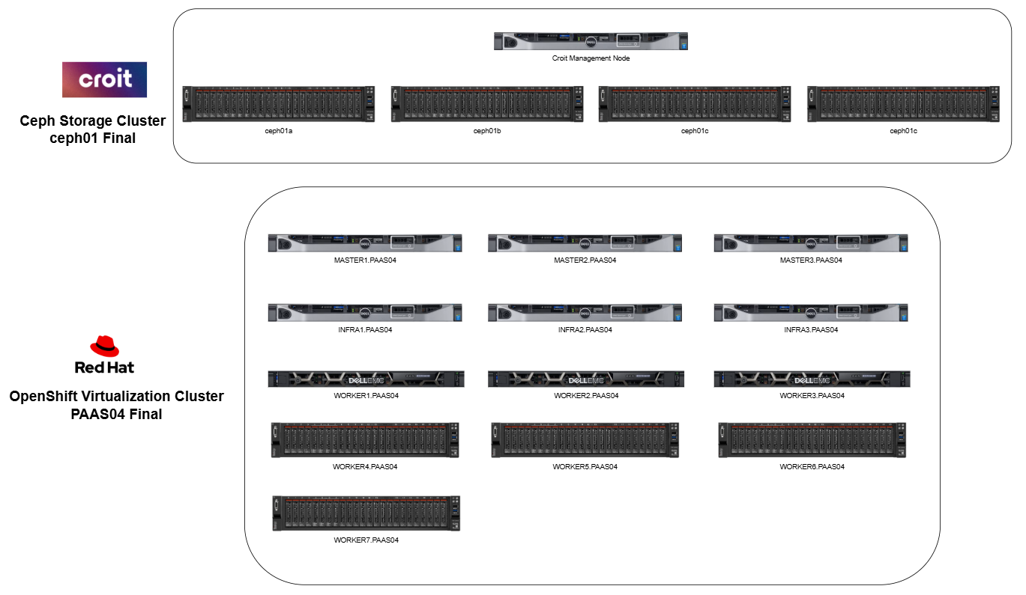
Notes:
This slide will be the architecture that we envision at the end of the migration process. Include both the reduced vmware prod hci as well as the croit ceph cluster

Slide 15
Demo Time
OpenShift Virt Console

Slide 16
Questions & Discussion
Next Steps
Migration Scenarios
Notes:
If no questions:
- Discuss how migration works, and what folks can expect around application impact

