Slide 1

Notes:
https://www.redhat.com/en/interactive-labs/write-your-first-playbook
Make sure we are logged into the following beforehand:
AAP
GitLab
ServiceNow isudev AND pdi
Splunk
Grouper
Keeper
Remote Desktop
Orion

Slide 2
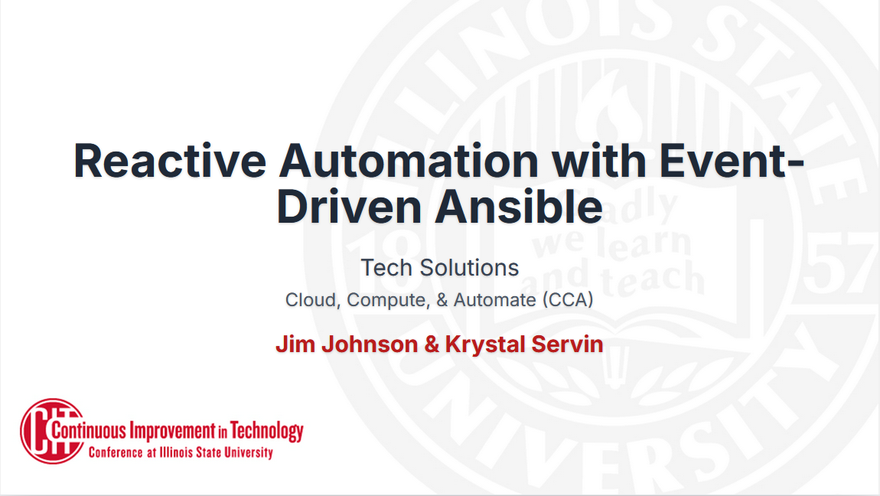

Slide 3
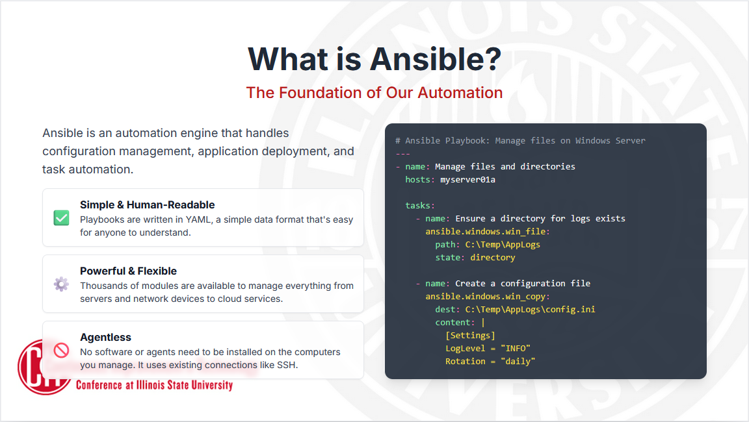

Slide 4
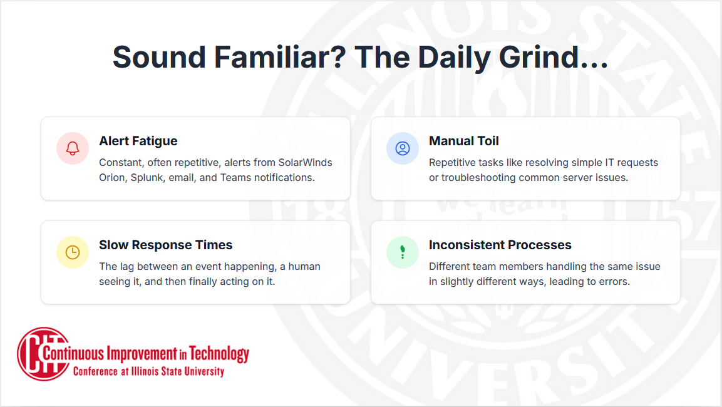

Slide 5
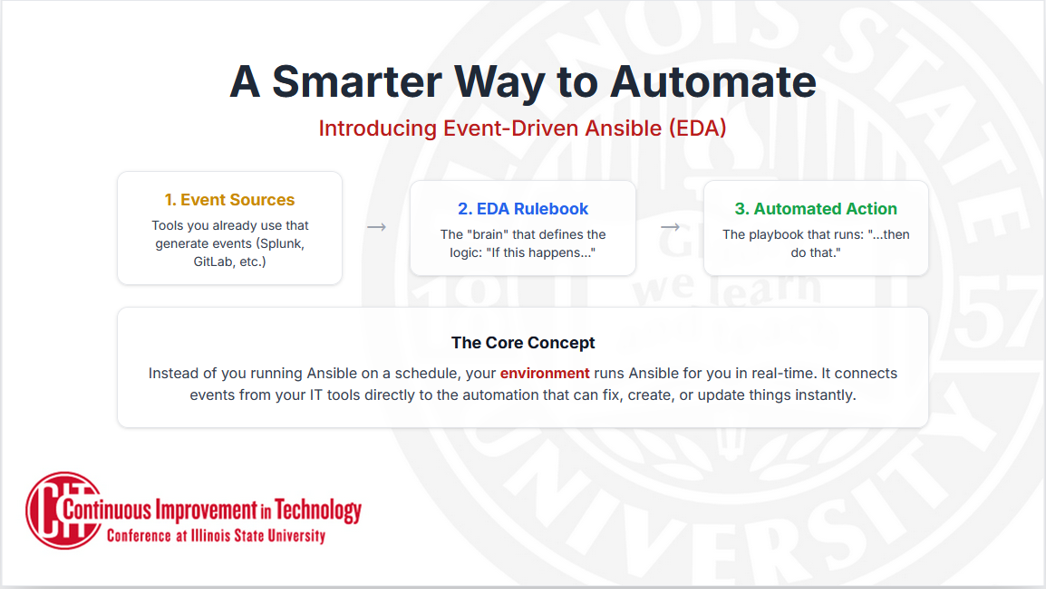
Notes:
Event Source triggers the process: Ex. Splunk alert, ServiceNow ticket, SolarWinds alert, webhook
EDA Rulebook checks if conditions are met: Ex. "If priority is critical" or "If server is down"
Automated Action runs: Ex. Send a Teams message, reboot a server, run a remediation playbook

Slide 6
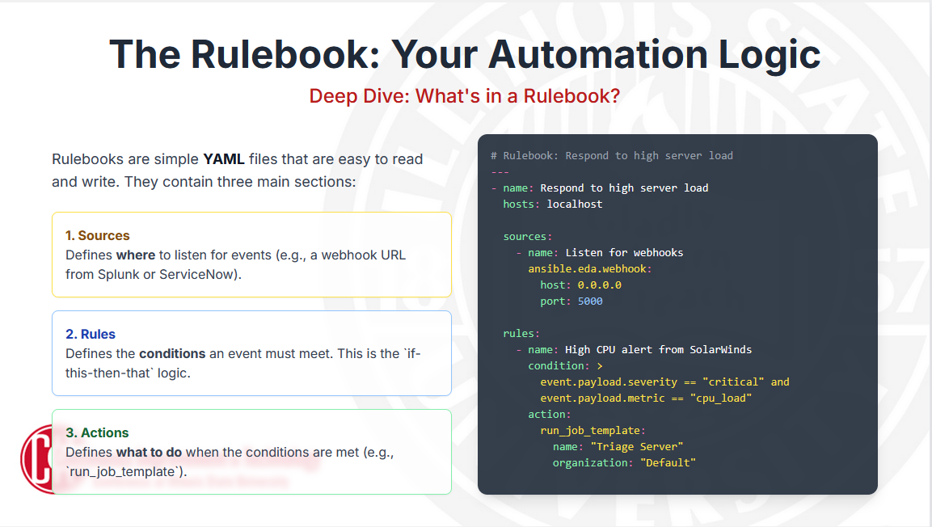

Slide 7
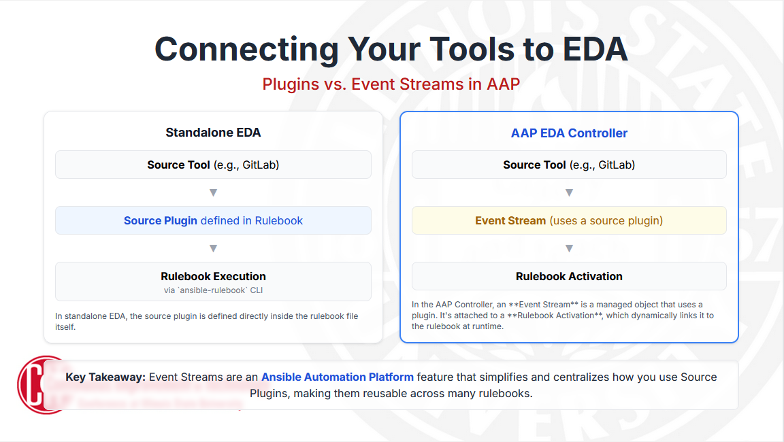
Notes:
Job Template comparable to a Rulebook Activation, where ansible-playbook cli > JT in AAP & ansible-rulebook cli > Rulebook activation.
We will maintain a lot of these Event Streams for you and for everyone:
The Event Stream for GitLab under the AAP Group
Splunk
Orion
ServiceNow

Slide 8
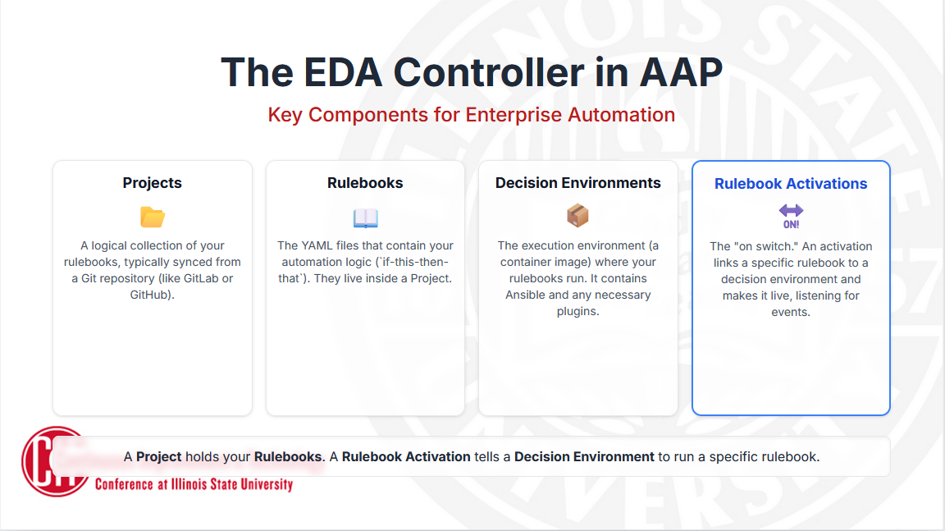
Notes:
The EDA Controller, has its own section inside the Ansible Automation Platform.
Projects are simply a logical collection of your rulebooks, and importantly, they are synchronized directly from a Git repository, in GitLab.
Rulebooks themselves live inside that project. the YAML files that contain all of your automation logic—your 'if-this-then-that' instructions.
A Decision Environment is essentially a container image that has everything your rulebook needs to run, including Ansible and any special plugins. This ensures that your automation runs the same way every single time. There are similar to Execution Environments.
DEs will be maintained by us. So just select it from the list.
Rulebook Activations is the 'on switch.' An activation is what links a specific rulebook from your project to a decision environment and makes it live and ready to listen for events.
A Project holds your Rulebooks. A Rulebook Activation tells a Decision Environment to run a specific rulebook.

Slide 9
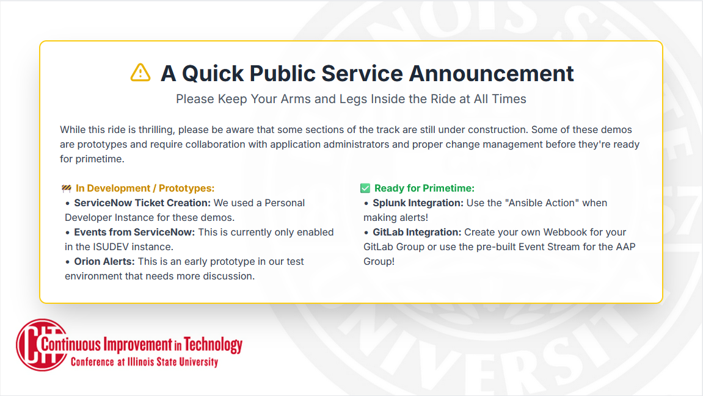

Slide 10
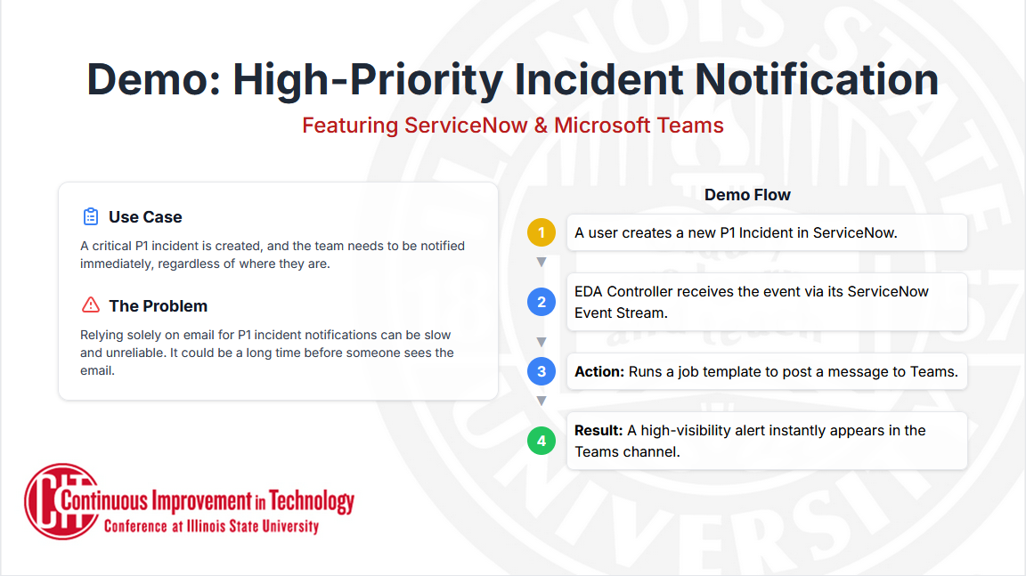

Slide 11
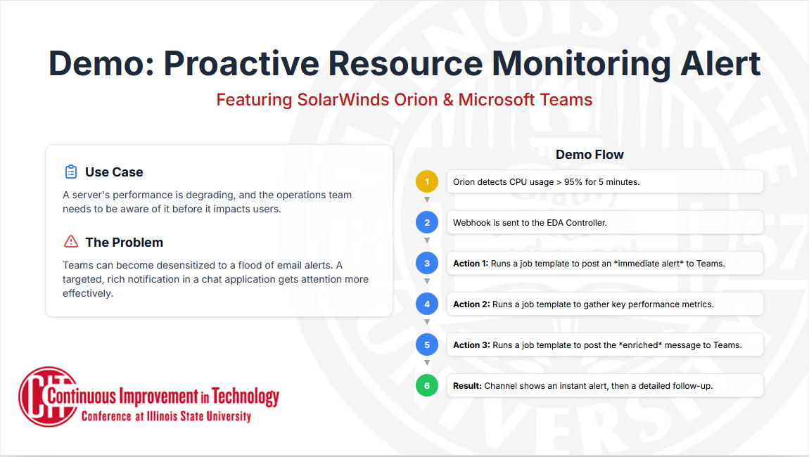

Slide 12
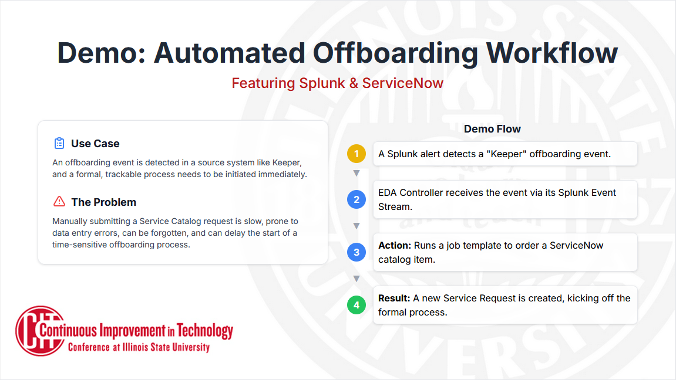

Slide 13
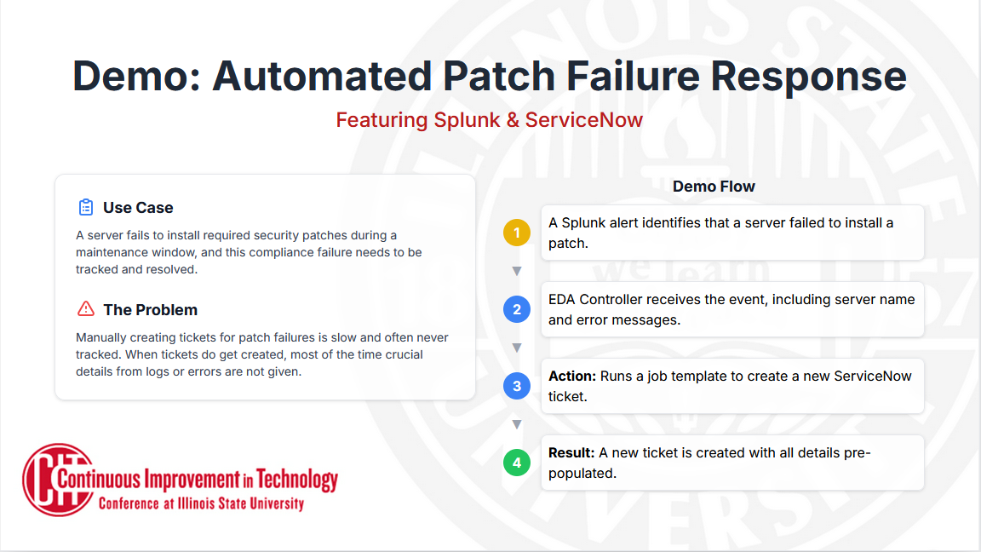

Slide 14
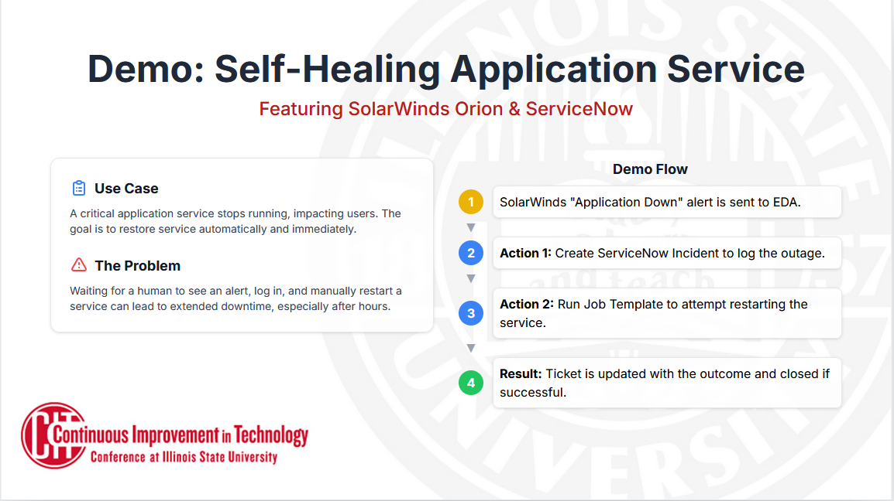

Slide 15
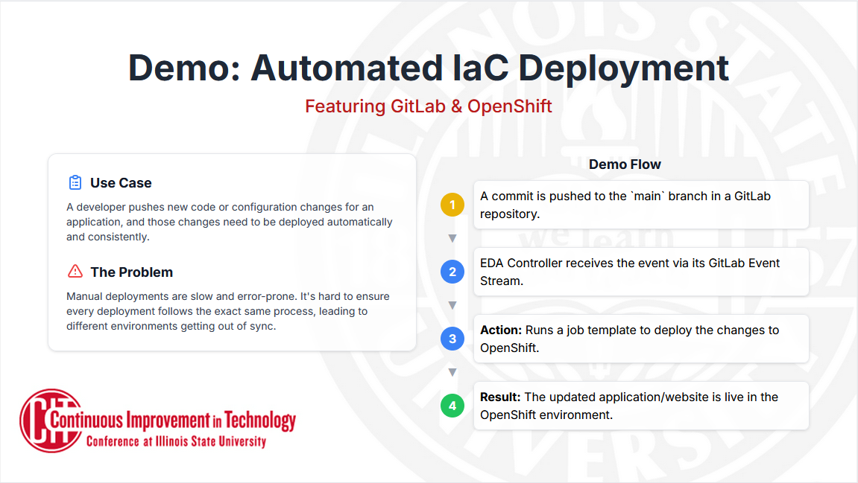

Slide 16
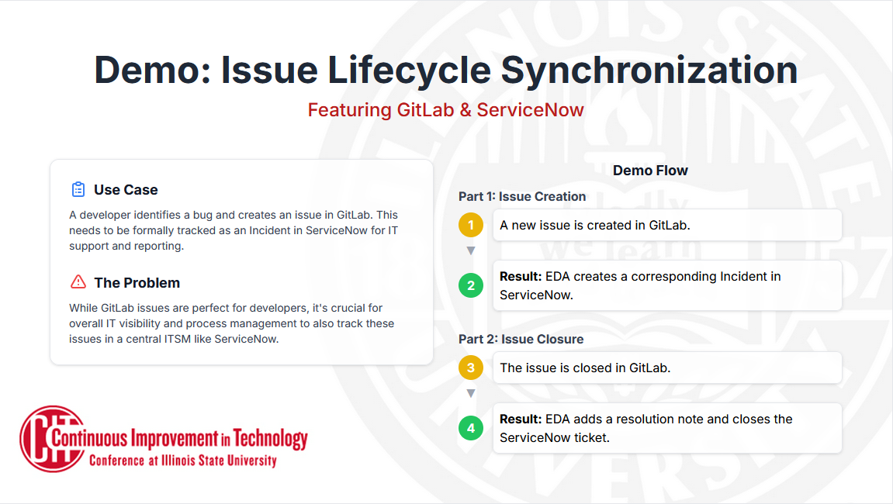

Slide 17
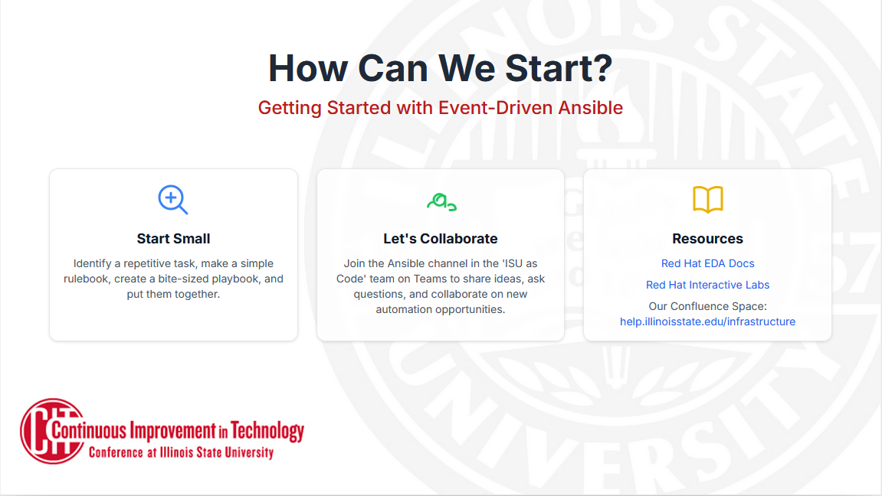
Notes:
Resources:
Introduction — Ansible Rulebook Documentation
Red Hat Ansible Automation Platform - Event-Driven Ansible
Interactive labs for hands-on practitioners | Red Hat
Event-Driven Ansible rulebook for automation | Red Hat Developer
Introduction to Event-Driven Ansible | DO274
Event-Driven Ansible Event Streams
Ansible Galaxy - servicenow.itsm
https://help.illinoisstate.edu/x/c4DcEw
Event-Driven Ansible controller user guide | Red Hat Ansible Automation Platform | 2.4 | Red Hat Documentation
Demo: Getting started with Event-Driven Ansible and Ansible Rulebooks - YouTube

