Slide 1


Slide 2

Staff Augmentation and Necromancy
Utilizing the undead to realize efficiencies
and maximize organizational value

Slide 3
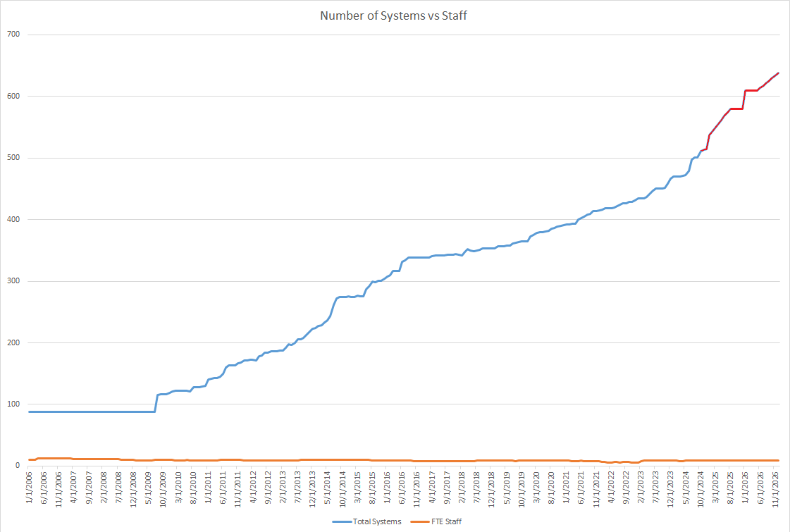
Context

Slide 4


Slide 5


Animated corpses and outside the laws of man and nature
  No Salary or Benefits
  Overhead reduced to near-zero
  No existing laws or regulations
    L.O.O.P.H.O.L.E.!
Deep labor pool
  ~117 billion

Slide 6
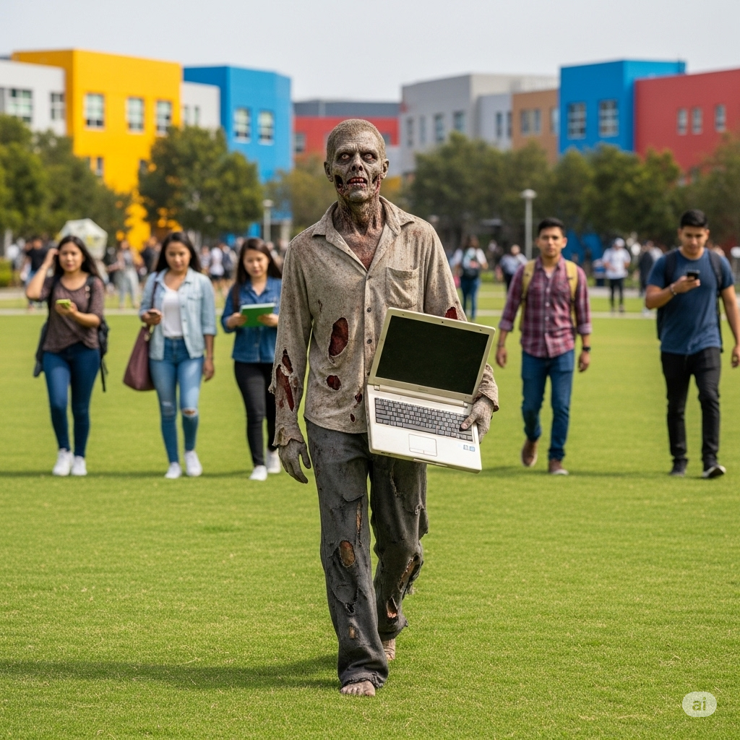
Previously employed
  Time-to-train new living dead greatly reduced

Slide 7

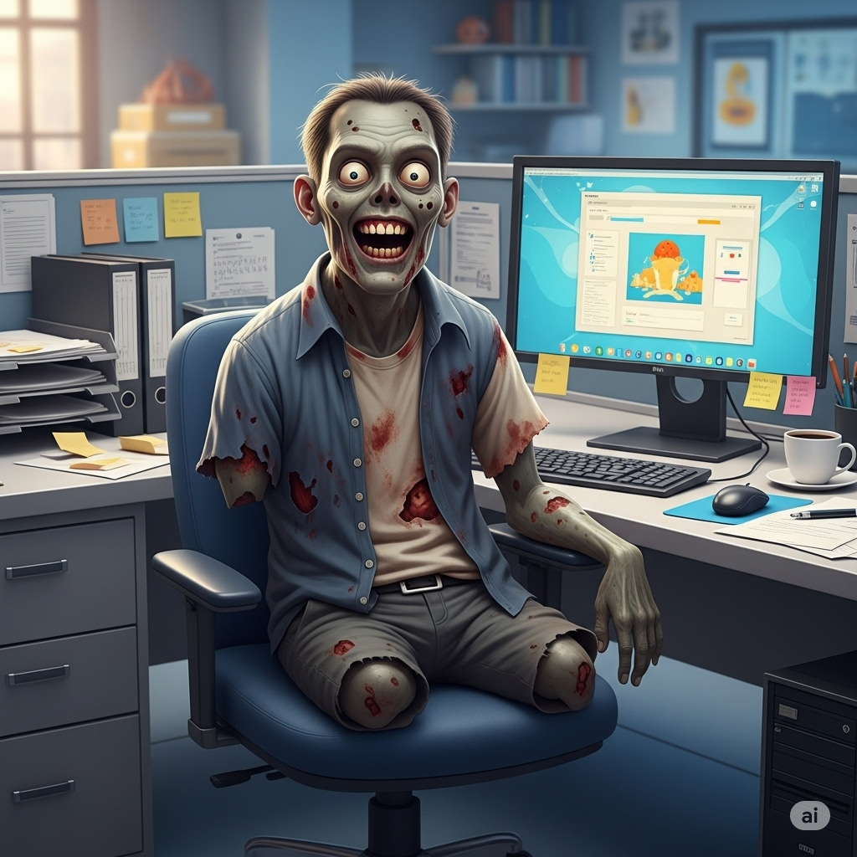
Limbs rot off
  Task-match remaining functionality
  Down-cycle
  Merge synergistic opportunities

Slide 8
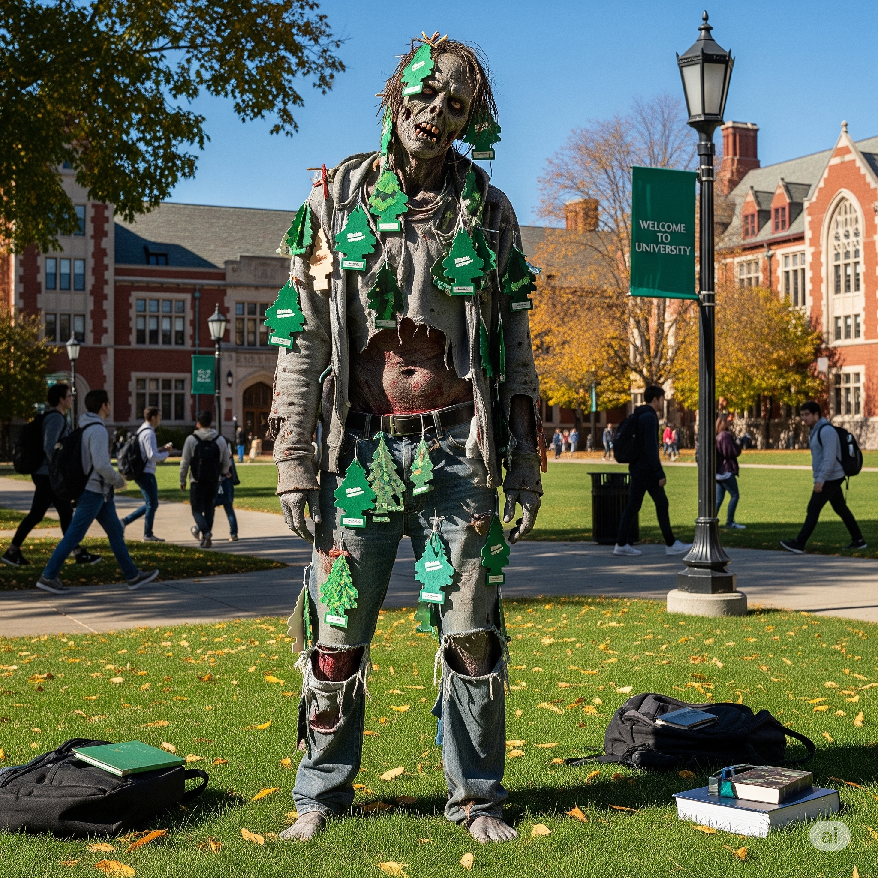
Challenges

Slide 9
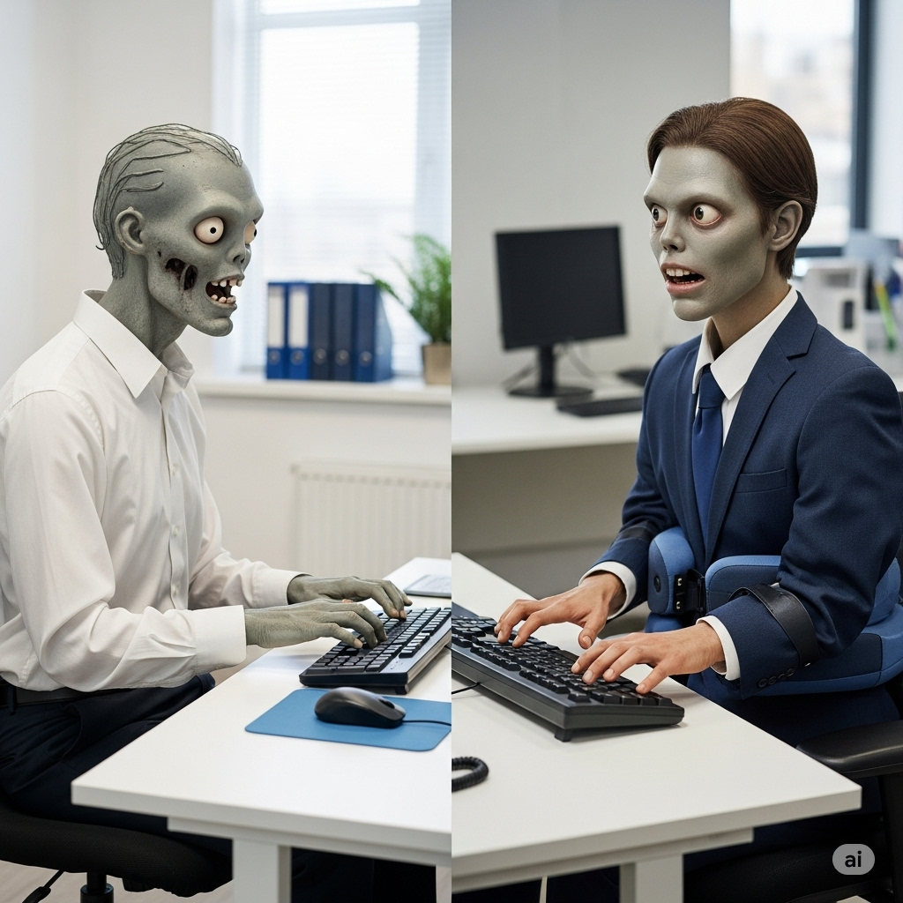
Challenges

Slide 10

Challenges

Slide 11
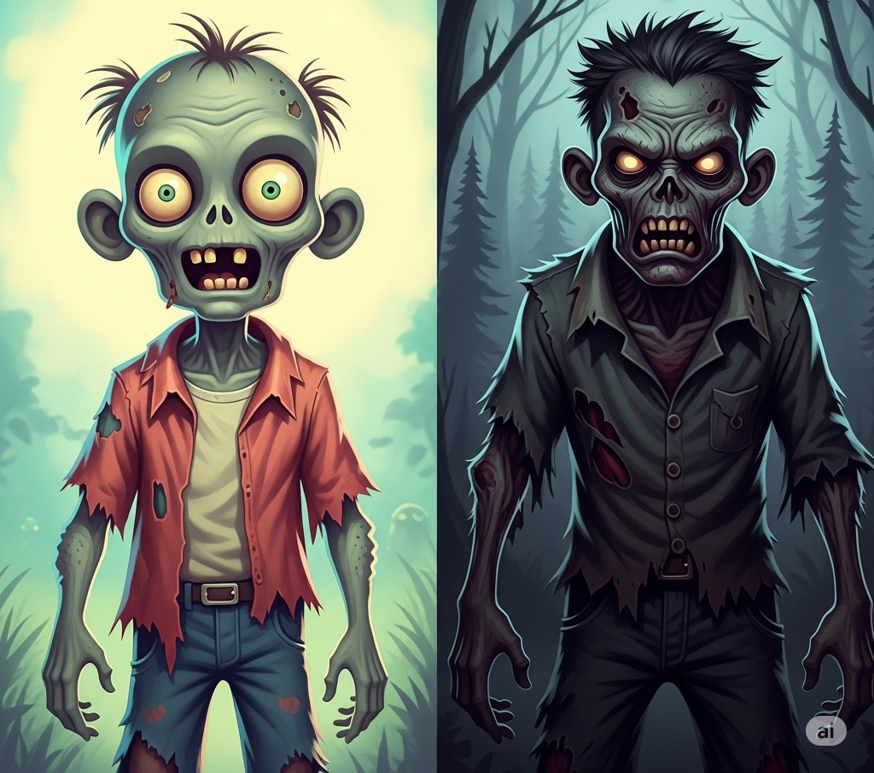
Challenges
Go To The Source
Was once probably a decent human being
Sociable*
Less likely to rend Preview attendees
On-Prem
Anti-social
Counter-productive
Tends to focus on pulling students into the darkest abyss instead of KPI contributions

Slide 12
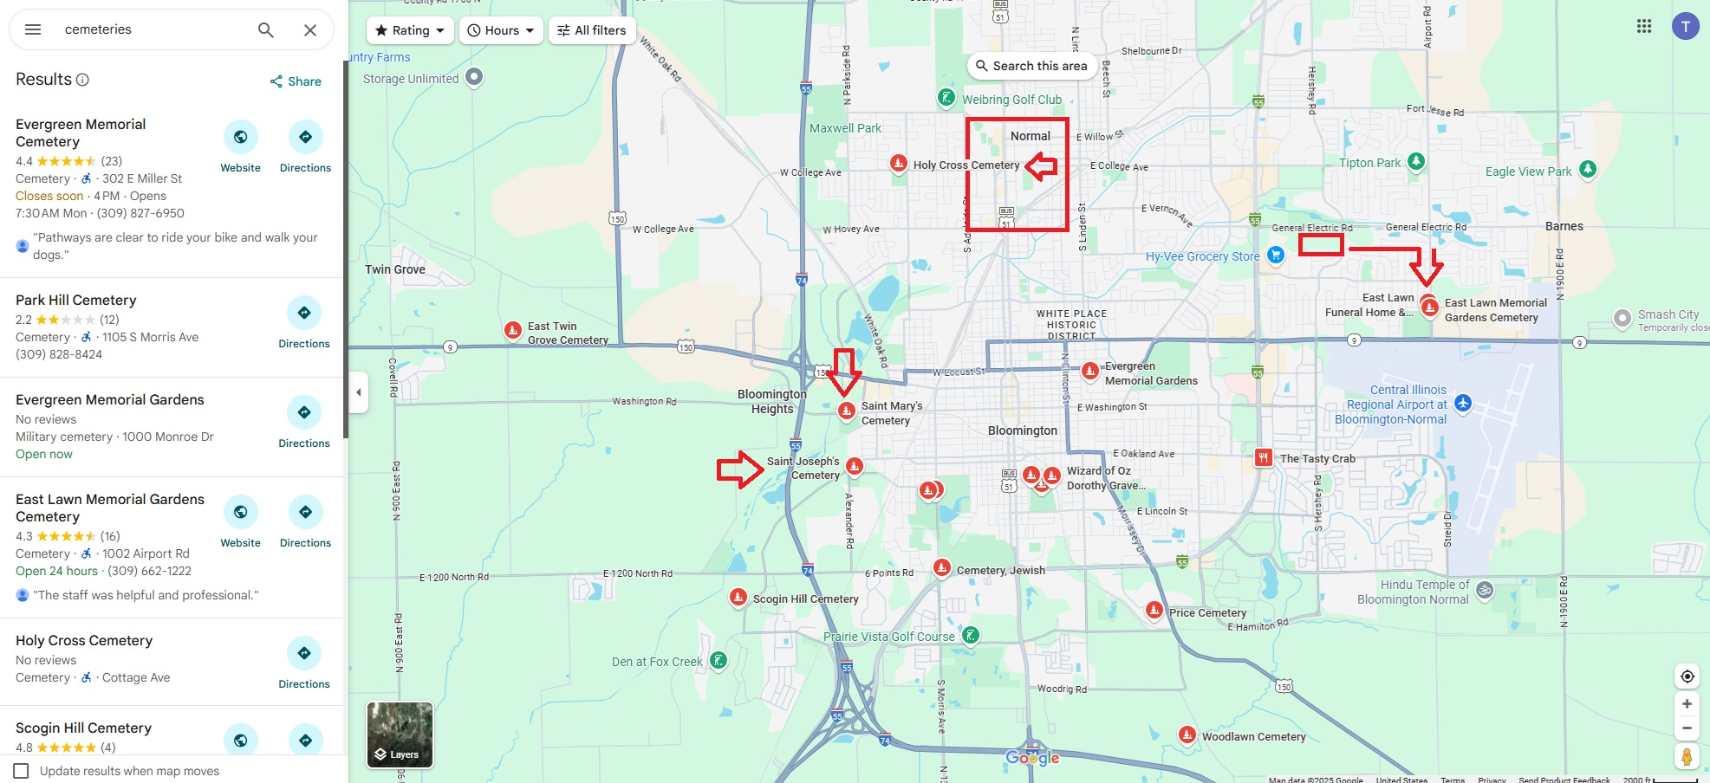
Challenges

Slide 13

Re-Alived
Again!
Undead
Zombie

Slide 14
Life-Affirming
Job
You’re alive!
Now go back
to work
Dead-End
Job

Slide 15

Staff Augmentation
Utilizing
The Re-Alived
Again

Slide 16
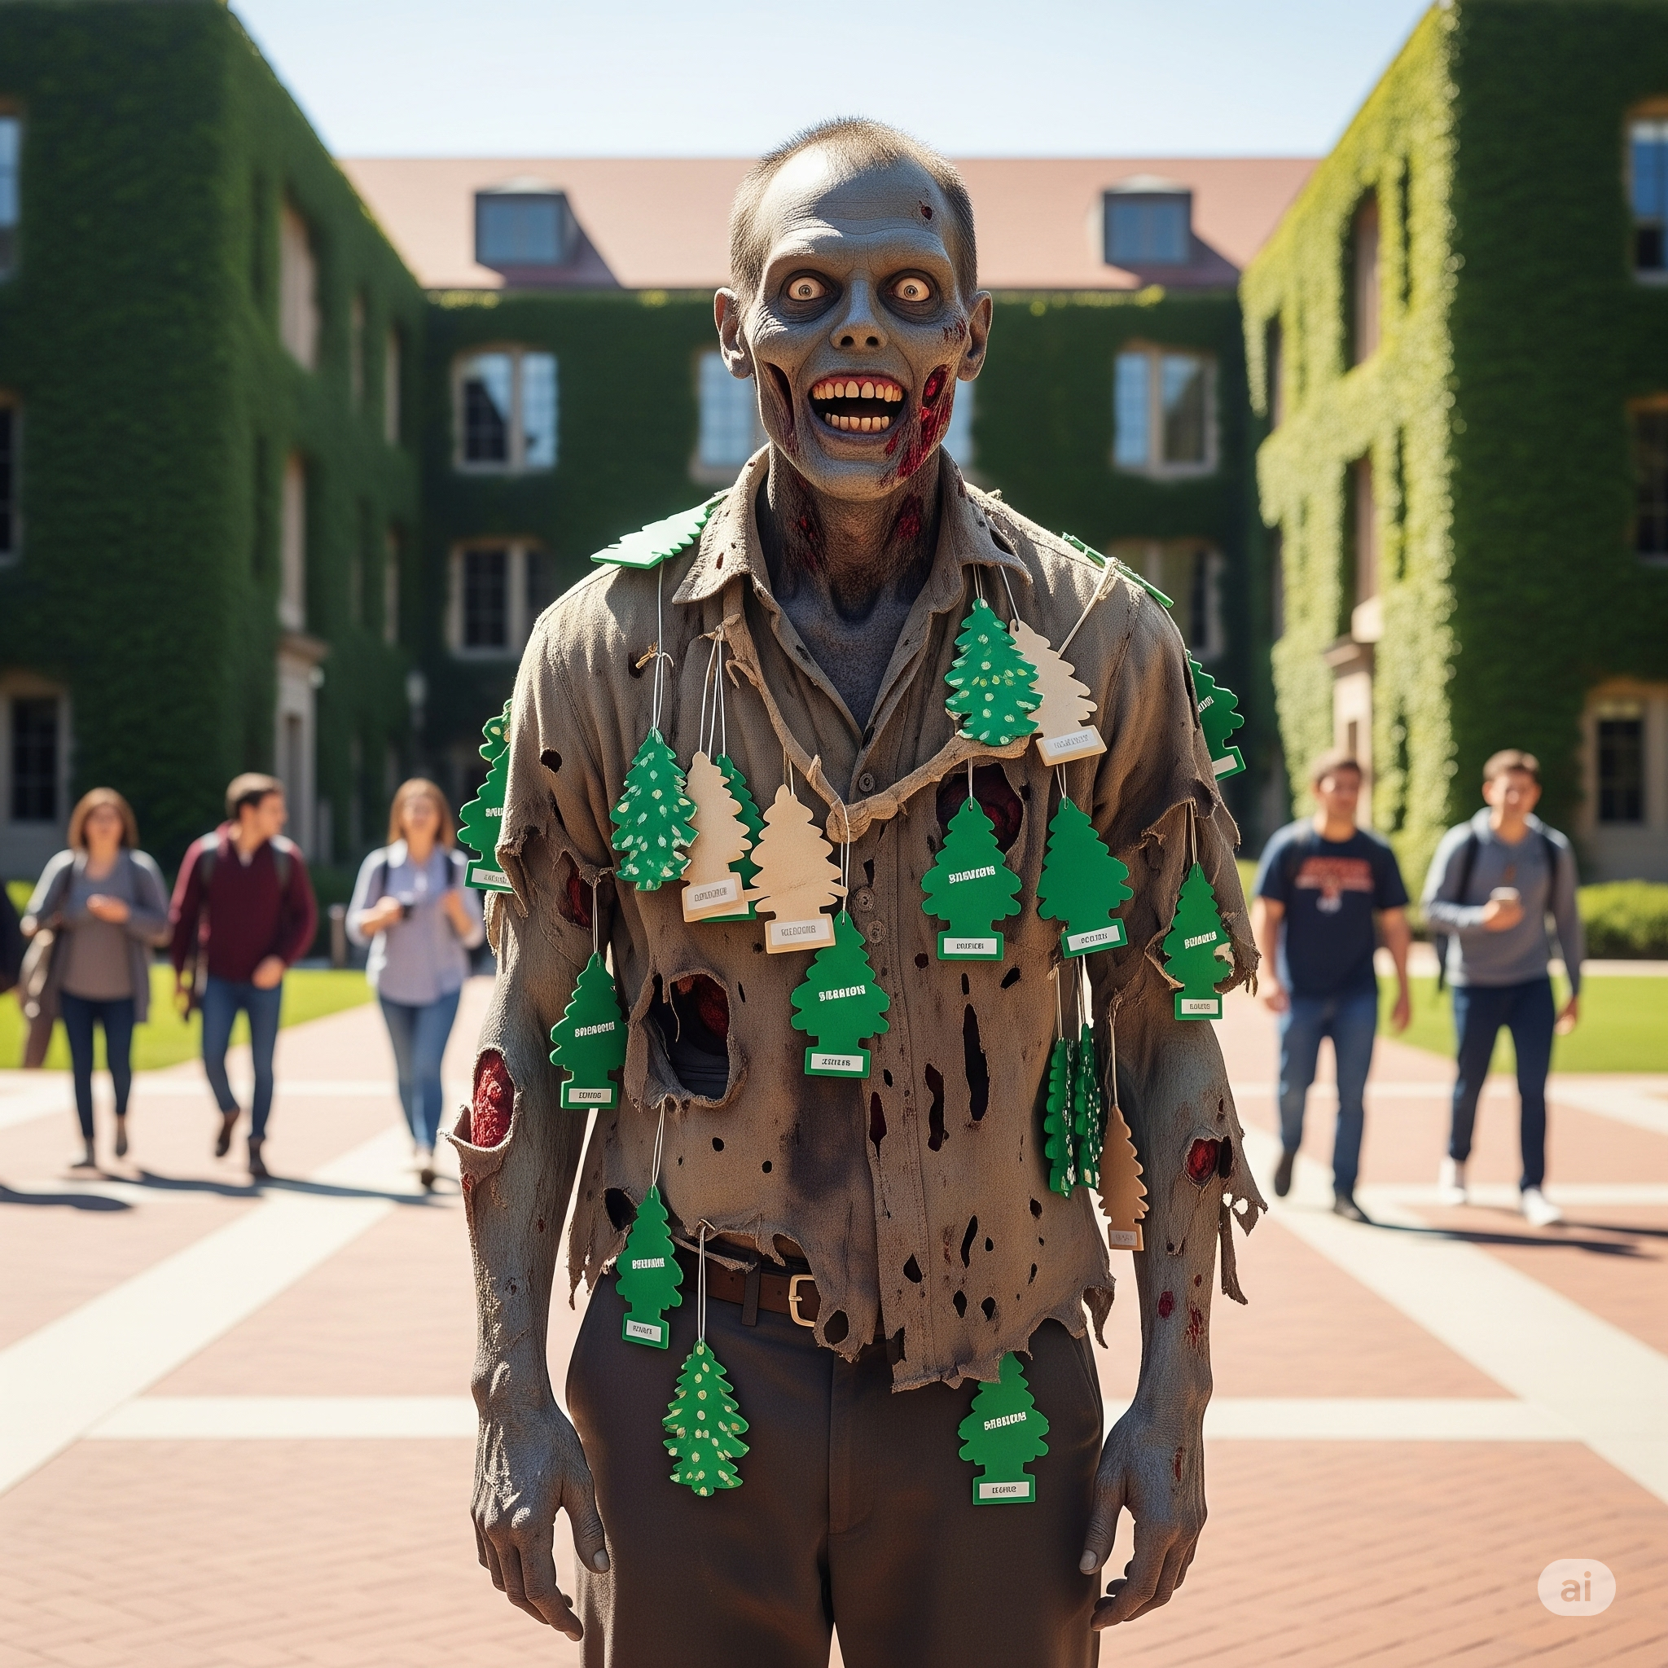

Slide 17
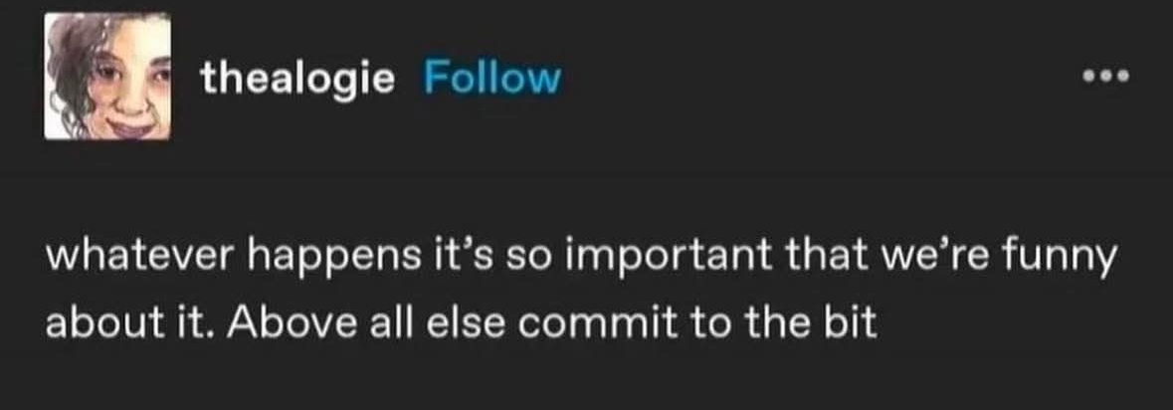
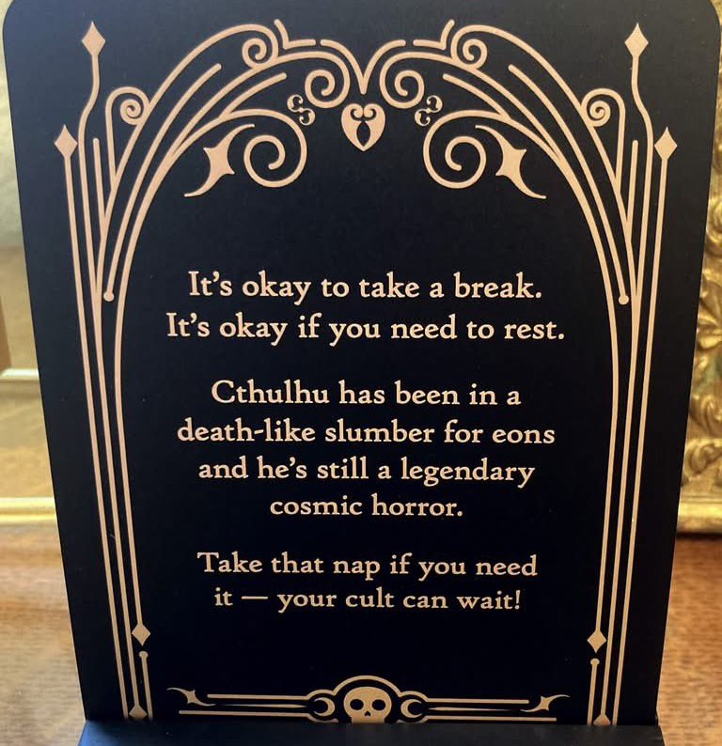

Slide 18
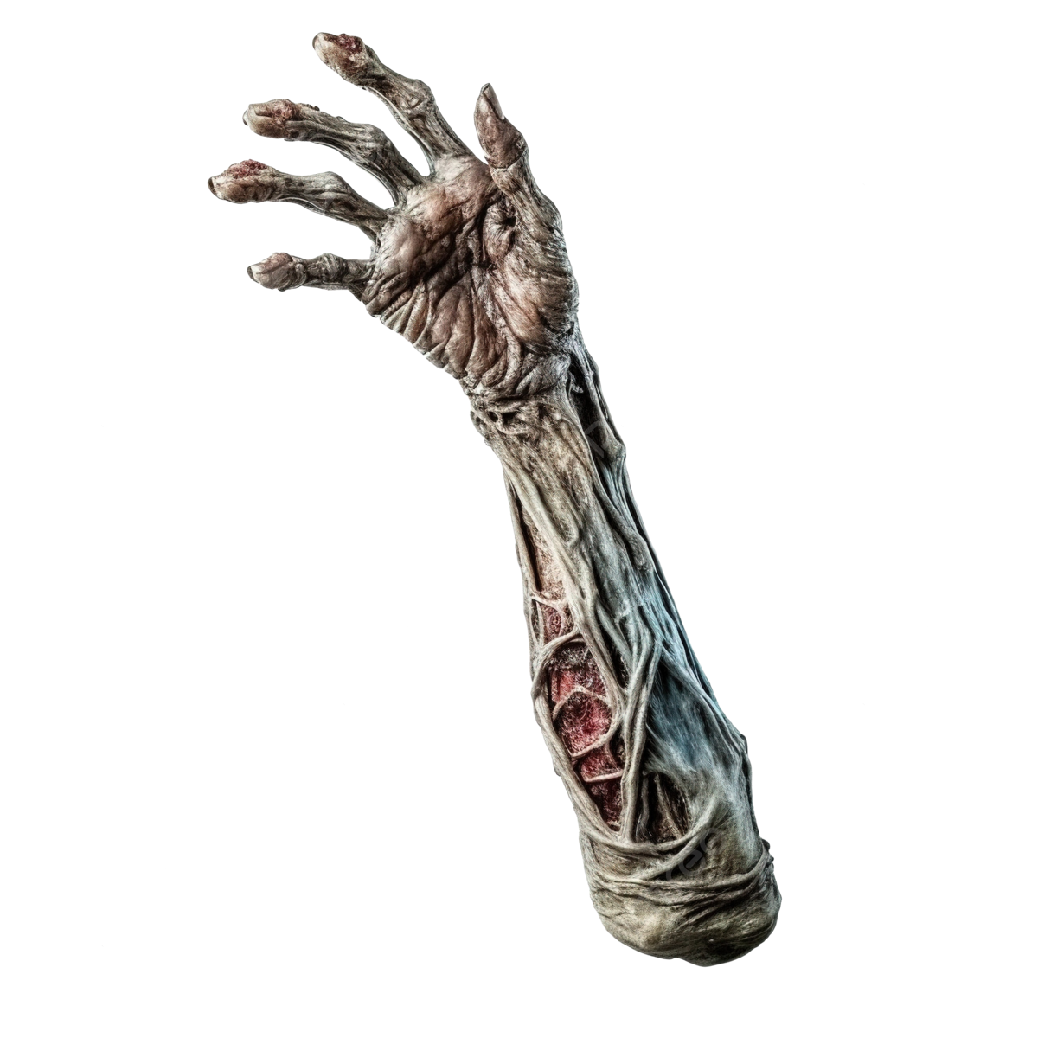
Ideas?
Questions?

