Slide 1


Slide 2

MISO Insights:
Translating 5 Years of User Feedback into Actionable
IT Improvements

Slide 3

The MISO Survey
MISO = Measuring Information Service Outcomes
misosurvey.org
Notes:
MISO is a standardized IT and library customer satisfaction measure for higher ed, administered by Bryn Mawr College
2025 was our 5th year with the MISO survey.

Slide 4
What’s a MISO?
Standard list of questions – each institution chooses which questions to display to which group (students, grad students,faculty, staff)
Can add local questions
Mix of qualitative and quantitative responses
Allows comparison to other participating schools
Notes:
The main measures of the MISO survey are a list of our major services that respondents are asked to rate based on usage, importance and satisfaction
There are also questions aimed at learning how aware customers are of our services, how they use academic tools, how interested they are in learning about IT services; demographic questions on things like how often you backup your data, what OS do you use, where do you store your files. In the interests of keeping the survey shorter, we’re not asking every question every year.
Ratings of tech staff for friendliness, knowledge, responsiveness, and reliability are part of the standard question set
Qualitative questions are framed as the “one thing” respondents would change about a specific service, aimed at getting to the most important things
The survey is administered at the same time every year, 2-3 weeks into the Spring semester.

Slide 5
Why Measure?
Continuous improvement
Actionable feedback
Help us put limited resources where they make the most impact
IT’s contribution to student and employee success
Notes:
Why measure customer satisfaction with IT services? We know how important IT services are to success as a student or employee, and how they can hinder if not done well. If we’re serious about providing good service, we first have to know what our customers think about the service we are providing
Our main goal with the survey is to get actionable and candid feedback from our users that we can use to measure the job we’re doing as an IT community and improve on it
A lot of effort goes into utilizing the results of this survey, but we really do use it year-round and take it quite seriously. It helps us prioritize our work and where to focus improvement efforts.

Slide 6
Step 1: Prepare & Administer Survey
Choose questions
Any new services?
Feedback from IT teams, customers
Administer survey in Jan/Feb
Notes:
There is a ton of data from this survey, so we will be doing a whirlwind tour of select results from 2025 and over the 5-year period, illustrating the lifecycle of measuring customer satisfaction with the MISO survey.
Choosing the questions for each year is important – we want always to mindful of the length of the survey, and the temptation is always to add more. New questions are added to the standardized set each year and we add new services that we want to measure. Choices have to be made as to which things need to be measured each year, and which can be done less frequently.
Feedback from IT teams and customers also help shape the next year’s survey – if there are unanswered questions raised by the data a question might be added, or if the responses from customers indicate they aren’t understanding the question it might be skipped or reworded (where we can).
The survey is run through Bryn Mawr’s Qualtrics, and it’s a busy time answering questions from respondents and ensuring we get good response rates.
We’ve enjoyed great response rates to this survey since the beginning – responses are also representative of all colleges, divisions, and types of positions for faculty/staff. These rates are from representative samples for all audiences but faculty. That number for faculty is literally 40% of all faculty. This is a long survey, it takes 10-15 minutes to complete depending upon role, and it’s a strong indicator of the value of IT services for so many to take the time to take it year over year.

Slide 7
Step 2: Initial Analysis
Usage - All Audiences 2025 | Mean Score
Canvas | 4.69
Email | 4.66
My.IllinoisState.edu | 4.47
Microsoft 365 | 4.00
Microsoft OneDrive | 3.95
Wired Network | 3.47
Technology in meeting spaces/classrooms | 3.36
Zoom | 3.32
Departmental Printers | 3.18
Mobile Phone Service on Campus | 2.73
Importance - All Audiences 2025 | Mean Score
Email | 3.83
Canvas | 3.82
Ease of Logging into Campus Systems | 3.77
My.IllinoisState.edu | 3.75
Performance of Wireless Network | 3.70
How ISU's security keeps my device secure | 3.69
Availability of Wireless Network | 3.69
How ISU's security keeps my account secure | 3.69
How ISU's security impact using university systems | 3.63
How ISU's security impacts time to do what I need to do | 3.59
Satisfaction - All Audiences 2025 | Mean Score
Email | 3.82
Wired Network | 3.81
My.IllinoisState.edu | 3.81
How ISU's security keeps my account secure | 3.78
How ISU's security keeps my device secure | 3.77
Campus Phone Services | 3.77
Zoom | 3.76
Canvas | 3.75
How ISU's security impact using university systems | 3.72
Availability of Wireless Network | 3.71
Notes:
Initial analysis focuses on the main measures of the survey – the list of services that are measured for usage, importance, and satisfaction. We look at the top 10 services for each audience and for all audiences combined. This a useful measure for year over year comparison.
Here’s the top 10 services for all audiences combined in 2025 – for usage, the scale is 1-5 from never to more than 3 times a week. For importance, the scale is 1-4, from not important to very important. And for satisfaction, 1-4 from dissatisfied to satisfied.
The services in green appear in the top 10 for all audiences on all measures – Canvas, Email, My. Some services are not measured for usage, but appear in the top 10s for both importance and satisfaction – How ISU’s security keeps my account secure, How ISU’s security keeps my device secure, How ISU’s security impacts using systems, and Availability of the Wireless Network.

Slide 8
Step 2: Initial Analysis
 | 2021 | 2022 | 2023 | 2024 | 2025
 | ReggieNet | ReggieNet | ReggieNet | Canvas | Canvas
 | Zoom | My.IllinoisState.edu | Email | Email | Email
 | My.IllinoisState.edu | Email | My.IllinoisState.edu | My.IllinoisState.edu | My.IllinoisState.edu
 | Email | Microsoft 365 | Microsoft 365 | Microsoft 365 | Microsoft 365
 | Microsoft 365 | Zoom | Microsoft OneDrive* | Microsoft OneDrive | Microsoft OneDrive
 | Technology in Classrooms | Technology in Classrooms | Wired Network | Wired Network | Wired Network
 | VPN | Departmental Printers* | Zoom | Zoom | Technology in Classrooms
 | Wired network | VPN | Technology in Classrooms | Departmental Printers | Zoom
 | Recorded lectures | Wired Network | Departmental Printers | Technology in Classrooms | Departmental Printers
 | Campus Solutions | Recorded Courses and Lectures | Mobile Phone Service on Campus | Mobile Phone Service on Campus | Mobile Phone Service on Campus
Usage
All Audiences
2021-2025
Notes:
How do the top 10s look year over year? Remarkably consistent.
Usage in particular is almost entirely the same top 10 for 5 years in a row. Items in green appear in the top 10 every year once presented. If there is an asterisk present it means it was new that year.
So from this list only VPN and Recorded Courses & Lectures don’t appear in the top 10 after 2022. Any guesses as to why those two services might have been used more in 2021 and 2022 as opposed to later? Campus Solutions was #10 in 2021 and appears pretty consistently around #11 in the subsequent years for usage.

Slide 9
Step 2: Initial Analysis
2021 | 2022 | 2023 | 2024 | 2025
ReggieNet | Email | Email | Email | Email
Zoom | ReggieNet | ReggieNet | Canvas | Canvas
Email | My.IllinoisState.edu | My.IllinoisState.edu | Ease of Logging Into Campus Systems | Ease of Logging into Campus Systems
Time to Resolve - Classroom Support | Ease of Logging Into Campus Systems* | Ease of Logging Into Campus Systems | My.IllinoisState.edu | My.IllinoisState.edu
My.IlinoisState.edu | Availability of Wireless Network | Performance of Wireless Network | Performance of Wireless Network | Performance of Wireless Network
Computer replacements | Zoom | Availability of Wireless Network | Availability of Wireless Network | How ISU's security keeps my device secure*
Performance of Wireless Network | Performance of Wireless Network | Coverage of Mobile Phone Service on Campus | Access to free/low cost textbooks * | Availability of Wireless Network
VPN | Microsoft 365 | Microsoft 365 | Coverage of Mobile Phone Service on Campus | How ISU's security keeps my account secure*
Technology in classrooms | Coverage of Mobile Phone Service on Campus* | Email Spam Filtering* | Email spam filtering | How ISU's security impact using university systems*
Availability of Wireless Network | Time to Resolve - Classroom Support | Time to Resolve - Classroom Support | Time to Resolve - Classroom Support | How ISU's security impacts time to do what I need to do*
Importance
All Audiences
2021-2025
Notes:
Importance is usually the most variable measure – things can be well used and/or very satisfactory but not terribly important. There is still a lot of consistency here, the top 5 is consistently Zoom, Email, LMS (whether ReggieNet or Canvas) My, Ease of Logging In, and Wireless. Some of the others would have been in the top 10 all 5 years but we added the security measures about account security, device security, etc. to importance in 2025 and they jumped right into the top 10.
Again, a pandemic-related change with Zoom in the top 10 for importance in 2021 and 2022 but not in subsequent years.

Slide 10
Step 2: Initial Analysis
2021 | 2022 | 2023 | 2024 | 2025
Email | Email | Email | My.IllinoisState.edu | Email
Campus phones | Wired Network | My.IllinoisState.edu | Email | Wired Network
Wired Network | Campus phones | Wired Network | Zoom | My.IllinoisState.edu
VPN | My.IllinoisState.edu | Campus phones | Wired Network | How ISU's security keeps my account secure
My.IllinoisState.edu | Zoom | Zoom | Campus phones | How ISU's security keeps my device secure
Zoom | Microsoft 365 | Microsoft 365 | How ISU's security keeps my device secure | Campus phones
Departmental printers | Overall Computing Service | How ISU's security keeps my account secure* | Canvas | Zoom
Microsoft 365 | Availability of Wireless Network | How ISU's security keeps my device secure* | Microsoft OneDrive | Canvas
3D Printing | VPN | Microsoft OneDrive* | How ISU's security keeps my account secure | How ISU's security impact using university systems
Availability of Wireless Network | College/Dept. Support | Availability of Wireless Network | Microsoft 365 | Availability of Wireless Network
Satisfaction
All Audiences
2021-2025
Notes:
Top 5 services for satisfaction are very consistent – Email, phones, wired network, My, and Zoom.
Notably, Canvas appeared in 2024 (and 2025) whereas ReggieNet did not appear in the top 10 for satisfaction prior to that time.

Slide 11
Step 2: Initial Analysis
Notes:
One of the “services” we measure for importance and satisfaction each year is the Overall Computing Service, this functions as our final grade. Here again we see consistency year over year. Importance varies a bit between roles, with the student audiences considering the overall computing services somewhat less important than faculty/staff. Satisfaction is closer across all audiences.
So while this is a bit boring, it’s what we want to see since the numbers are high overall – importance between 3.0 and 3.42 for the student audiences, and between 3.5 and 3.7 out of 4 for faculty/staff. Satisfaction ranges from 3.56 to 3.82 out of 4 for all roles.

Slide 12
Step 2: Initial Analysis
Notes:
IT staff are rated by survey respondents on four qualities – whether they are friendly, knowledgeable, reliable, and responsive. TSC staff, College/Departmental staff, and CIPD staff are rated each year on these measures.
The ratings are also very consistent year over year, and very high – between 3.67 and 3.88 out of 4 across all measures. IT staff are highly valued by their customers.

Slide 13
Step 3: Deeper Analysis
Qualitative Analysis of comments
Comparison with other MISO schools
Team level results
Service Reports & Reviews
Notes:
The answers survey respondents give to questions about the one thing they would do to enhance IT services, and what they would do to enhance specific services like My and Canvas, provide valuable context to the quantitative data. Those answers are analyzed and weighted as part of the overall picture of customer feedback.
MISO provides comparison data among all schools that participate each year – that can be a useful benchmark where good comparison schools exist.
Team level data is provided to all teams that provide direct user support on the support-related measures like College/Departmental Support and Time to Resolve – College/Departmental Support. This allows teams to look at how their team measures in comparison to others and determine where improvement might be needed.
Comprehensive service reports on the major services – Canvas, My, Web Sites, Infrastructure Services (network, phones, Zoom), Microsoft 365, Campus Solutions, etc. are prepared for the teams that support those services. The reports included the specific measures by role for their service as well as all comments specific to the service, comparison to other MISO schools, and analysis. We then meet and review the report in detail and determine what improvement items would address the feedback.

Slide 14
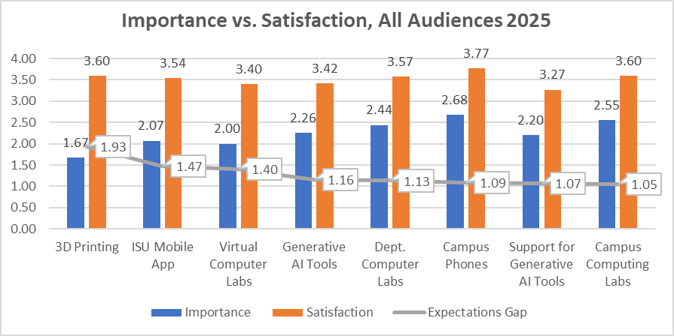
Step 3: Deeper Analysis
Notes:
Another aspect of the deeper analysis step is taking a closer look at the importance and satisfaction ratings for our services.
We always want satisfaction to be higher than importance, indicating that we are meeting customer expectations for that service. The difference between importance and satisfaction scores forms the “expectation gap”, and it varies widely among services for various reasons.
Let’s take a quick walk through all of the services and their expectation gaps for all audiences combined. There are some things to highlight for specific services and specific roles that warrant further investigation, those are highlighted in the service reports.
We’re starting here with the services with the highest expectation gaps, gaps over 1. So are we just killing it with these services? Yes and no. There are two new services in here – ISU Mobile App and Support for Generative AI Tools – so we only have one year’s data for those. Some of the services have low usage – 3D Printing and all 3 types of computer labs. While these gaps are undeniably positive, they are mostly driven by the lower importance ratings for these services.

Slide 15
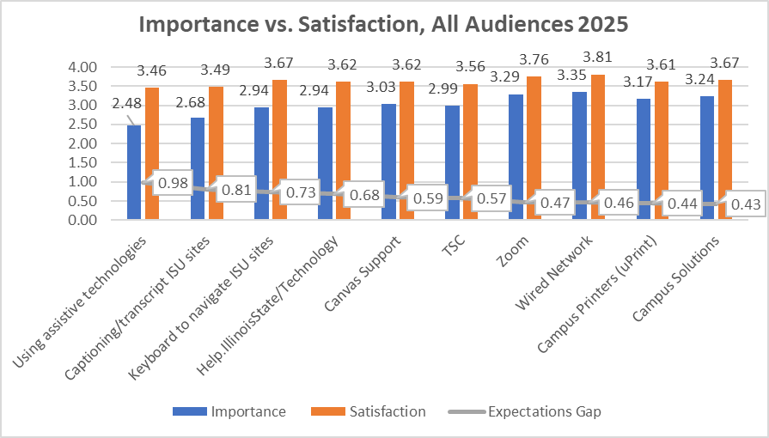
Step 3: Deeper Analysis
Notes:
The next set of services have expectation gaps from .43 to .98, and we’re starting to see importance scores above 3 out of 4.

Slide 16
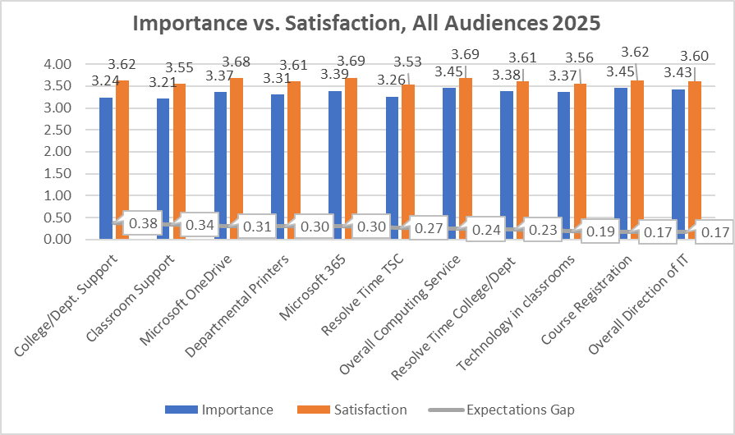
Step 3: Deeper Analysis
Notes:
The expectation gaps are now narrowing further, from .38 down to .17. All of these services have importance scores over 3 out of 4.

Slide 17
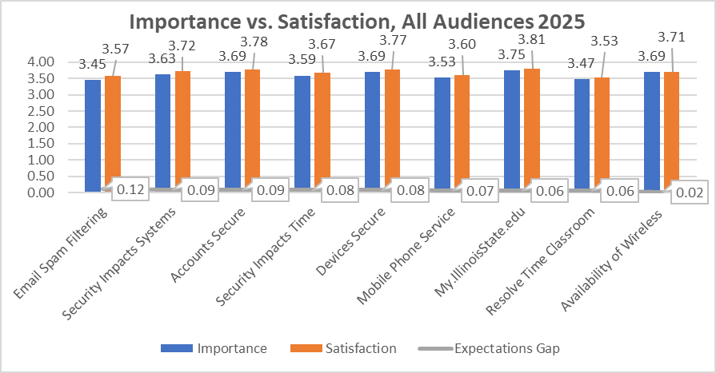
Step 3: Deeper Analysis
Notes:
The gap is now quite small, from .12 down to just .02.

Slide 18
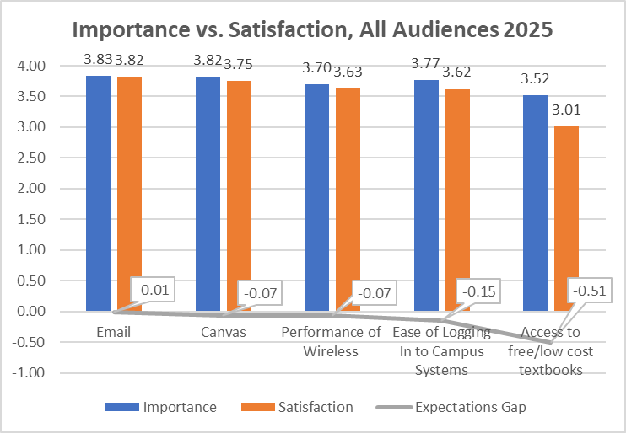
Step 3: Deeper Analysis
Notes:
And finally, we’ve arrived at the negative expectation gaps. So do we have a problem with these services? Again, yes and no.
Access to free/low cost textbooks is an outlier, and not really an IT service – it was part of the standard question set and it was a good opportunity to get data on an important issue. The expectation gap here does seem to indicated that ISU has significant work to do in this area.
The other four services with negative expectation gaps – email, Canvas, performance of wireless, and ease of logging in, should look familiar. They appeared in the top 10 charts in green for usage, importance and satisfaction. This also true of several of the services on the previous slide with small positive expectation gaps. So while there are always improvements that can be made and we need to mind these gaps, the context that the scores themselves are among the highest is important.

Slide 19
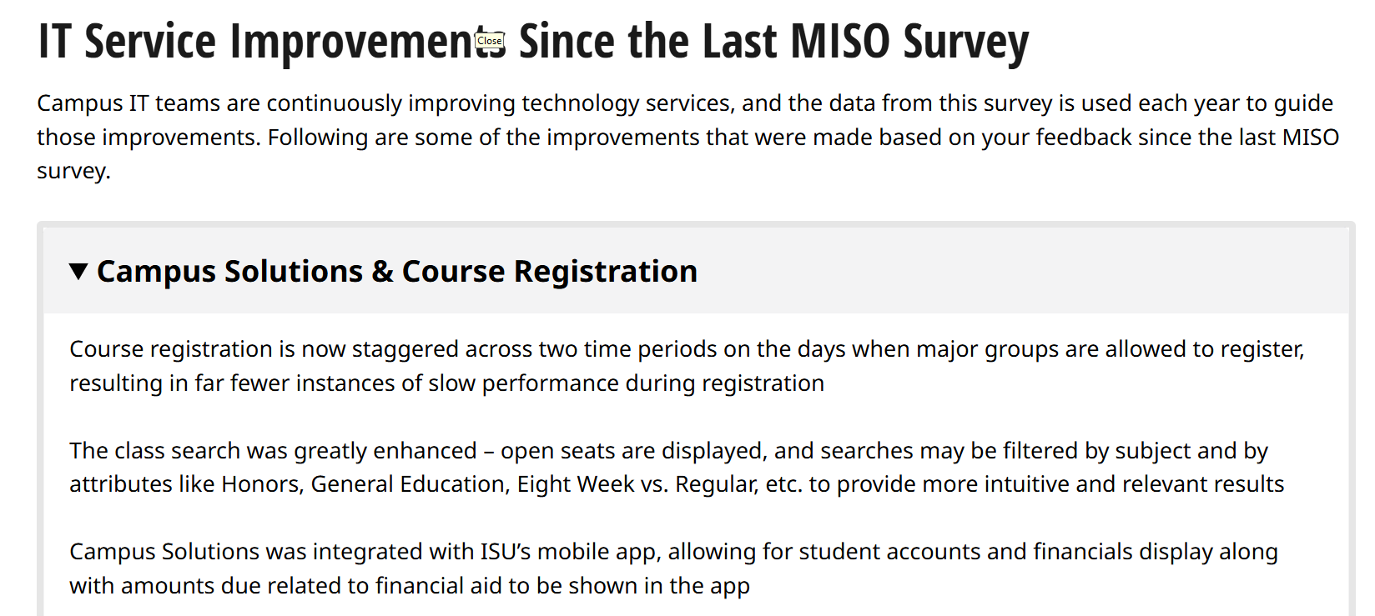
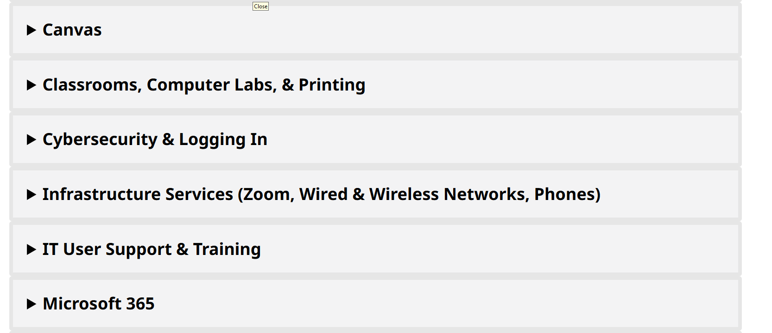
Step 4: Use the Data
Improvement items
Executive Summary
Published at https://about.illinoisstate.edu/customersatsurvey/
Notes:
The end of each year’s analysis cycle is to publish the results to our About site, about/customersatsurvey. We include there a list of improvements implemented since the last survey for our major services, things that correspond to feedback in the survey. It’s generally an impressive list. There is also an executive summary version of survey results posted there.

Slide 20
Step 4: Use the Data
Success stories
  Course registration
  LMS consistency
How else should we be using this data? What would help you?
Notes:
After that, we use the data at every opportunity, when making decisions, determining priority, refuting urban myths, etc. People I work regularly would probably tell you they get pretty tired of hearing me say “MISO”. Then, it’s rinse and repeat as we prepare for the next year’s survey – it’s a year-round activity.
There are a couple of stories I would highlight, where we learned about something major in the MISO data and were able to correct for it.
Course registration – we noted a lot of comments from students about congestion and “crashes” when trying to register. This was surprising because we weren’t hearing about system issues in the usual ways, getting tickets from students or advisors. When we dug into it we learned that it was a known issue (to others) that wasn’t showing up well in our system logs and everyone just figured that was how it worked and couldn’t be improved, so they didn’t report. We worked with our hosting vendor for Campus Solutions to make some improvements, and then also worked with EMAS to change the schedule of registration. Things are now greatly improved for students during registration.
LMS consistency – When students are asked about what they would do to improve the LMS – whether it is ReggieNet or Canvas – many of them focus more on how it is used by faculty than on the tool itself. They really want a consistent experience from course to course, with common course elements in the same place, and for faculty to use things like the calendar. With the rollout of Canvas, we worked with CIPD to really emphasize this with faculty and with the use of the Canvas template. We would never have learned about this mostly non-technical issue without asking.
There are many more stories like that, big and small, and many we have yet to uncover. What else should we be doing with this data and how can it help you?

Slide 22
Step 2: Initial Analysis
Notes:
There are many other quantatative measures in the survey – this is a sampling of the IT demographic data collected. File storage choices across all audiences is interesting in what it reveals about changing habits. Network file share usage has gone steadily down over the 5 years while OneDrive has gone up.
The device ownership chart shows that faculty/staff are more likely to own both desktop computers and tablets, and that we have very near 100% ownership of smart phones across all roles.

