Slide 1


Slide 2

Welcome to the
2025 CIT Annual Conference

Slide 3
IT News

Slide 4
IT News Rules of the Road
This session is being recorded and will be posted to the CIT web site
Please keep your mic on mute if joining the Zoom
Questions are welcome if time permits at the end
  In person attendees, raise your hand we’ll bring the mic to you
  Online attendees, put your question in chat and we will repeat it in the room
Mike Regilio

Slide 5
ServiceNow – We’re Live!
Thank you!
Early Life Support
  Incident, Request, Problem, Change, Customer Portal all working in the (mostly) OOTB configuration
  Historical Data from Cherwell available
  Under construction – CMDB wiring dashboards, CMDB asset data, Equipment Reservation
Carla Birckelbaw
Notes:
Thank you to all of you for participating in testing, and training, and town halls, and for adding items to the UAT list as we all continue to get used to ServiceNow. Thank you also for being good sports – we had to make this change that is a major disruption to your daily work life more quickly than we would have chosen to.
We were aware, of course, of the end of life of Cherwell in 2026 and evaluating our options – by the time the choice of SN was made, implementation partner chosen, purchasing requirements met, and Board of Trustees approval gained, we had about 5 months to implement before the end of the Cherwell contract on 6/30. The alternative was to pay $160K plus for another year of Cherwell.
And we did it! We all did it. The project has logged 3800 hours up to now and 6000 hours are estimated, which makes the project comparable in size to when we implemented Slate (that was also done in a hurry!). That doesn’t even include the hours spent by all of our partners – including all of you, and departments that like Facilities and HR that provide data used by the system.
Here’s where we stand today: Cherwell was retired on 6/30 as planned, and we are in Early Life Support in SN for the core functions we used in Cherwell – Incident, Request, Problem, Change, Customer Portal al working in a mostly OOTB configuration. The historical data from Cherwell is available for reference. The vast majority of things we need to do we are doing in ServiceNow and learning the differences between the systems.
There are a few exceptions, things under construction – the CMDB wiring team dashboards for managing our network infrastructure, and CMDB asset data. Assets will continue to come into the system from SCCM, and soon from Jamf. Once that is available in the system, location data for those assets will be imported from Cherwell data.
And equipment reservation is in flux – the plan we had developed with our implementation partner has not panned out and we have moved to a short term solution for the teams that use Equipment Reservation heavily. The longer term fix is TBD.

Slide 6
ServiceNow – Next Steps
Tweaks to OOTB – coming soon
  Email Notifications
  My Work dashboard
  More catalog items – submit requests through the Service Catalog
  Portal enhancements
Regular Releases & Easier Admin
Quality of Life Enhancements
  First phase of project is complete minus the exceptions
  Target finish date is 1/30/26
Carla Birckelbaw
Notes:
We’re making a few tweaks now (in the next few weeks) to the OOTB setup – some changes to email notifications, primarily for customer-facing notifications. A wider review will follow this Fall. Many of us are finding Lists to be a good, personalizable tool for tracking our work, but we are also releasing a dashboard for use that will be similar to the Cherwell My Work dashboard. And you’ll see more and more catalog items created – there is a catalog item for requesting catalog items, please submit things where you need to gather specific details. We’re also releasing some enhancements to the customer portal, such as helper text on the catalog item cards to help customers pick the right card. One change you can see now is an expansion of the things visible in the Activity Stream – it is now closer to what you were used to in Cherwell.
ServiceNow has a regular cadence for changes released, every other week a bundle of (ISU level) changes will hit the platform. They are approved through the Tech Solutions review process (after approvals to develop earlier in the process) on Monday and then released on Wednesday. Configuring things – particularly things like catalog items is way easier in SN than it was in Cherwell, and we will be able to respond quickly to change requests.
We will be moving soon into the next phase of the project, addressing Quality of Life enhancements. Many of these things are things we would have done earlier if we had had the year originally planned for implementation. We’ll be working from the UAT list that you all have been adding items to (keep going!) and making changes based on our continued experience with the tool. Examples include continuing to perfect catalog items and extending them by adding automated task sequences that will save your teams time. These are things that you may have done via one-step in Cherwell. We’ll also be working with integrations to other sources of data, like rooms and departments.
ServiceNow works differently from Cherwell, and we are all still learning. Now that we’ve gotten past going live with the basic config that allowed us to move off Cherwell, we need to take the time to think through some processes and how they work best in the new tool. ServiceNow is the market leader in ITSM tools, and we should be able to trust that when they’ve configured their tool a certain way it’s for good reason and perhaps it is us that needs to change.

Slide 7
ServiceNow – Next Steps
SO many things we can do with ServiceNow – we start tackling that long list in February ’26
Upgrade!
  ServiceNow releases upgrades twice a year
  Can pick the date (to a degree)
  Moving to Yokohama Sept/Oct
Carla Birckelbaw
Notes:
Many of us are pretty excited about the possibilities with ServiceNow – it’s a huge and complex tool, and we have just begun to scratch the surface of what we can do with it. It can certainly expand beyond IT, and it has tons of add-ons and integrations we can consider. (Keep in mind that many of those things require extra licensing.) We’ll start tackling things like that after the implementation project concludes in January.
Branding – as I’m sure you’ve noticed, we made a conscious choice not to call ServiceNow anything but ServiceNow. This is consistent with other recent implementations, such as Canvas. ServiceNow has name recognition beyond IT staff, and it simplifies things not to have to accommodate an ISU-level name. So the URL is ServiceNow, it is labelled ServiceNow in all communications, and the customer portal is ServiceNow. How great is that portal, BTW? Easy to use and we can now share direct URLs to request forms!
One of the first things we will need to tackle after the semester begins is preparing for an upgrade of ServiceNow. SN releases upgrades every 6 months, and we cannot be more than 2 versions behind. So Yokohama is the next version, and Zurich (the newest version) is also available to us right now. We could choose to move straight to Zurich if we like, and that would allow us to not have to upgrade for a year, but for our first upgrade we’ve elected to move up just one version to Yokohama.
We can request delays on this up to a point – we will be moving to Yokohama in the September/October timeframe. The timing isn’t awesome, but the good news is that we have SN resources available to assist. They’ve already scanned our environment and reported that we are 97% OOTB and they predict that our upgrade will be pretty easy to do. They will be providing us pointers to things that could be problematic and assisting all along as the upgrade is applied to the non-prod environments for testing prior to prod release. The release notes for Yokohama are very detailed and there are some things in the upgrade that address issues raised on our UAT list.

Slide 8
OneDrive Analysis Project
Migrating Files to OneDrive (project 10318) is wrapping up as an analysis project
Confirmed: significant savings & other benefits
Next up: implementation project
Carla Birckelbaw
Notes:
We’ve been working on the data gathering and analysis phase of Project 10318 for a bit, and it is wrapping up this month.
We started with the hypothesis that a move to primarily Microsoft/OneDrive file storage would result in cost savings, a more consistent user experience, and better security​. Those hypotheses have been found to be correct.
- Significant cost savings in utilizing Microsoft file storage
- User experience is improved by streamlining number and type of locations for file storage, in addition to readily available knowledge and training resources
Having most storage in the Microsoft environment allows us to utilize tools that don’t have wide benefit currently
We will be meeting with the project team later this month to finalize recommendations and the next step would be to move to an implementation project.

Slide 9



Geeking Out With WEB
Hope you caught us in the first two sessions!
Let’s Get Digital! A Very Human Approach to Illinois State’s Digital Interfaces
The Unofficial SecUnit Guide to Campus AI or How to Train Your Murderbot*
Digital Accessibility ADA Title II Updates
* honorary mention
Mary Ditchen
Where’s Arturo?
Notes:
Good morning, I’m Mary Ditchen, and I’m the lead frontend developer in WEB. Our director, Arturo Ramirez, couldn’t be here today, so he asked me to share an update with you all. Hopefully you caught one of these sessions this morning from our team. I’m including Nathan even though he recently deserted us for an exciting venture in AI with Roy Magnusen. [In case you’re wondering… Where’s Arturo?]

Slide 10
Actual footage of our fearless leader from a beach in Mexico
Mary Ditchen

Slide 11

Let’s Get Digital!
In the age of AI and instant digital expectations, why do human-centered interfaces matter more than ever?
”We don’t stop being human when we go online.”
Putting people first in digital design creates measurable institutional value.
Mary Ditchen
Notes:
If you missed my presentation this morning, allow me to summarize it for you because it ties in to a lot of the work our office has been busy doing. I don’t know if you all have heard, but… there’s thing called AI that’s coming for all of our jobs. Lol, jk jk.
Like I’m sure many of you, even as I’ve embraced the age of AI, I’ve had to grapple with my place in it, and consider how it will impact not just the way we work but also the work we do.
This morning I showed how our collaborative, very human approach to digital interfaces at Illinois State translates to workflow improvements, process efficiencies, and measurable value to the university.

Slide 12
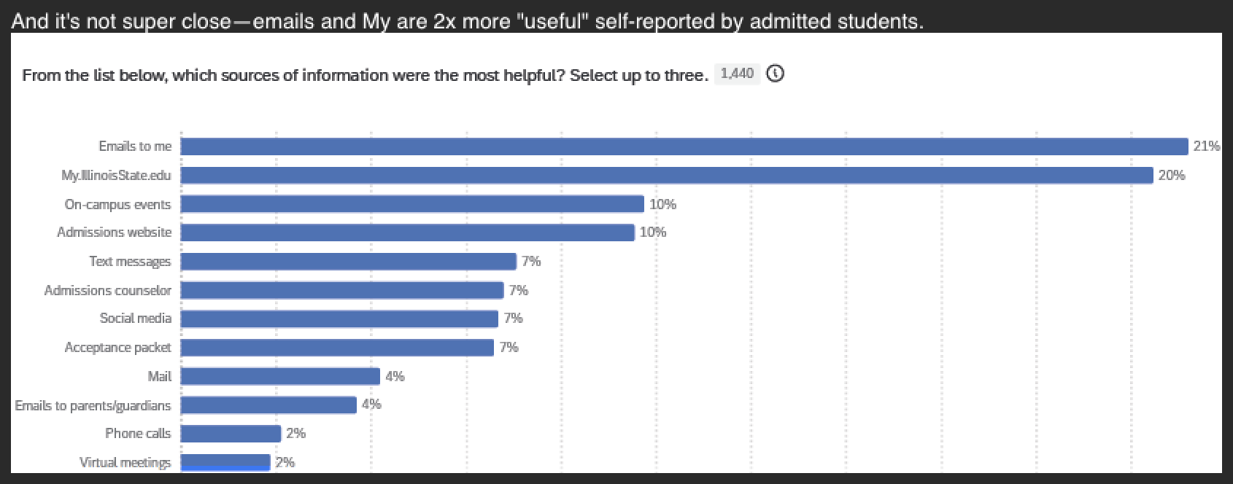
FTIC Admissions Dashboard in My
50% reduction in manual FTIC meal plan assignments (from ~500 to ~250 students)
Student Success
Process Efficiency
FTIC meal plan completion rate significantly outpaced the average for all residential students (86.65% vs. 70%)
Engagement Success
Housing and Dining portal engagement from My/Admissions increased from 20% (2023) to 41-44% (2024-2025)
Staff Experience
"This was one of the smoothest [selection processes] they've had" - Campus partner in Housing
Student Choice
ASQ data shows My.IllinoisState.edu jumped from #5 to #2 as students' primary information source
Results that speak for themselves
Each year, Admissions sends an Admitted Student Questionnaire to all students who were admitted for the previous year (even those who did not end up attending ISU).
In 2022, before the improved dashboard experience launched, My was ranked #5 – today My is #2, second only to direct email communications. 🎉
Mary Ditchen
Notes:
When you build relationships first, the results speak for themselves. We didn't just improve the interface—we improved the entire process for everyone involved. Our campus partners in Dining saw a 50% reduction in manual work. FTIC students completed meal plans at 86.65% - far above the 70% average. Traffic to Housing and Dining portals more than doubled. But here's the most telling evidence - students voted with their clicks. In our ASQ survey data, My.IllinoisState.edu jumped from #5 all the way to #2 as students' primary information source. Students are actively choosing our dashboard over other ways to get information. That's what happens when you design with humans at the center. But let me show you what students are saying in their own words...

Slide 13
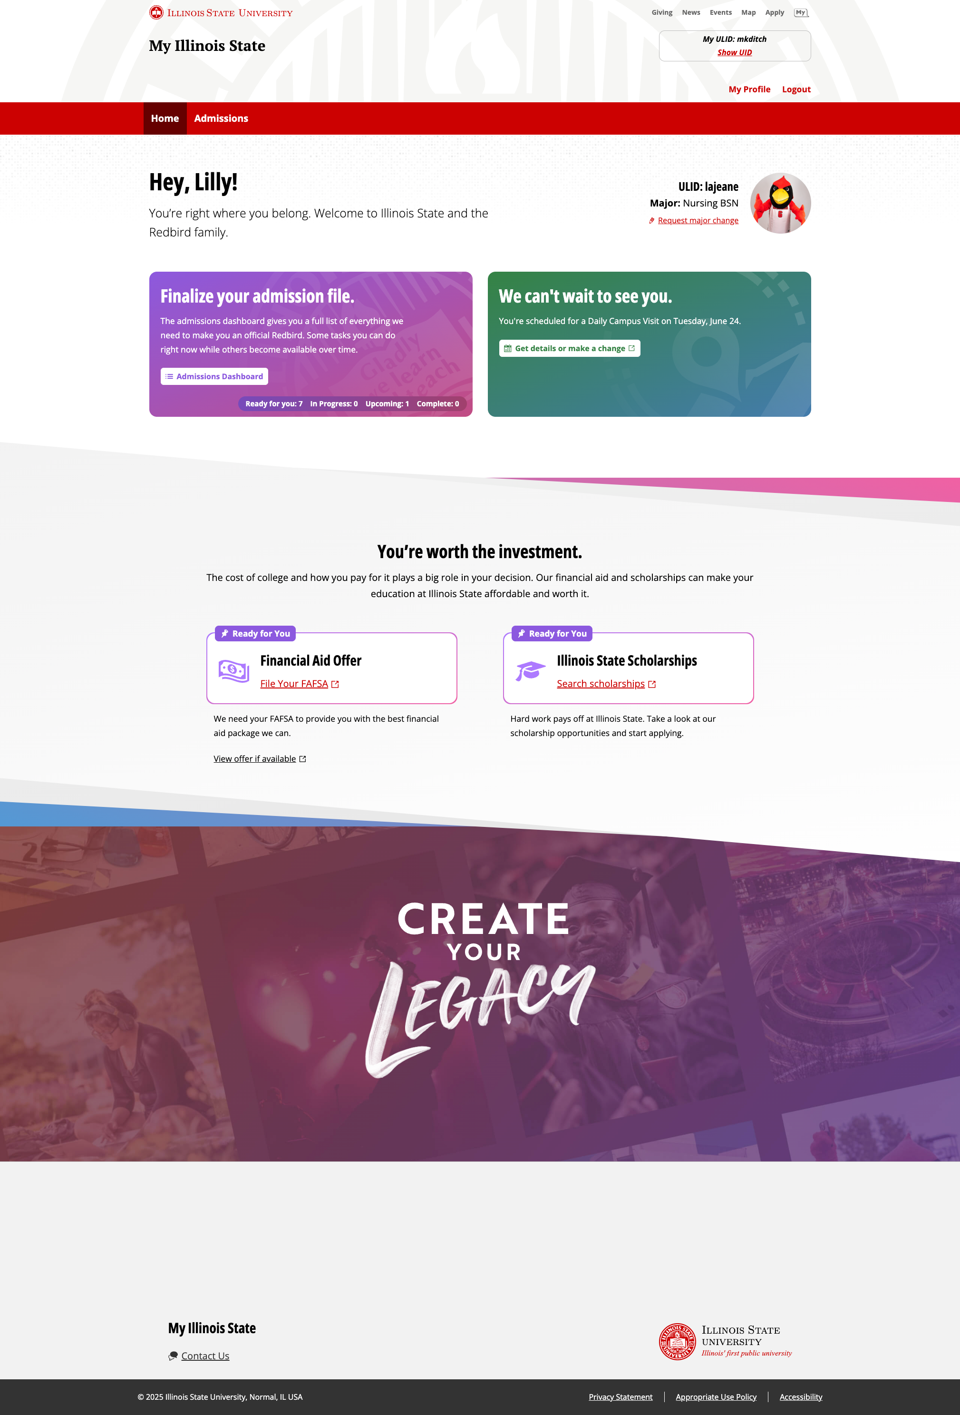
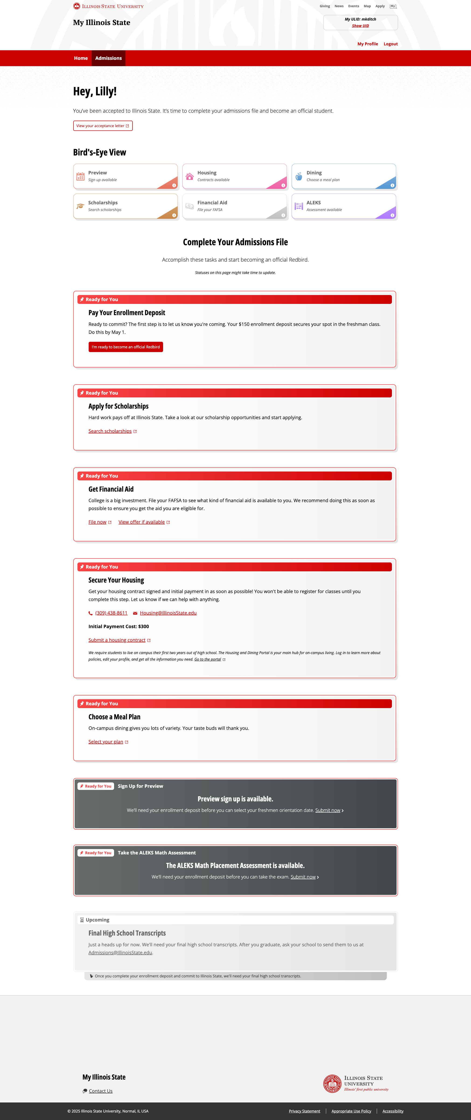
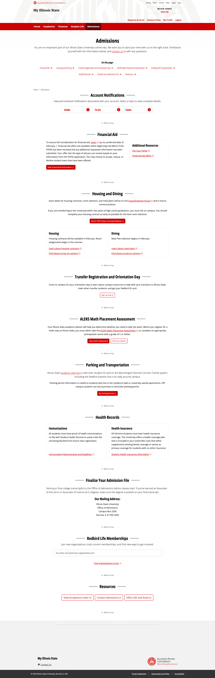
Transfer Experience in My
10854-Improve Transfer Student Experience
Highly anticipated sequel to 10594 - Improve Prospective Student Experience in My
Mary Ditchen
Notes:
So, how does that tie in to what we’re doing in WEB? Well, one of the projects we’re currently working on is “10854-Improve Transfer Student Experience”, which is the highly anticipated sequel to project “10594 - Improve Prospective Student Experience in My” (i.e. the FTIC Admissions Dashboard). As I showcased in my presentation this morning, the integrated dashboard experience we created for our newly admitted FTIC students in partnership with our colleagues and process owners across campus (Housing, Dining, Financial Aid, Student Accounts, Admissions, etc.) has proven very effective and has delivered real value to the university. How? [trigger overlay] Collaboration.

Slide 14
Mary Ditchen

Slide 15
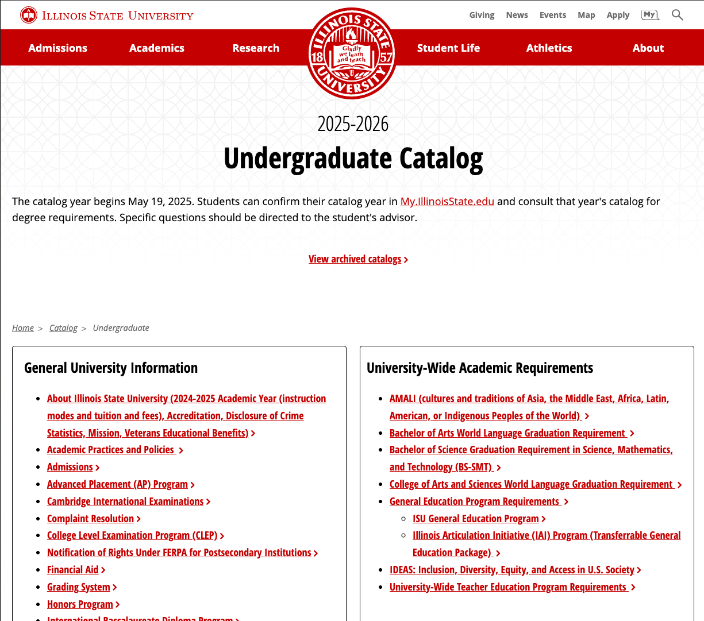
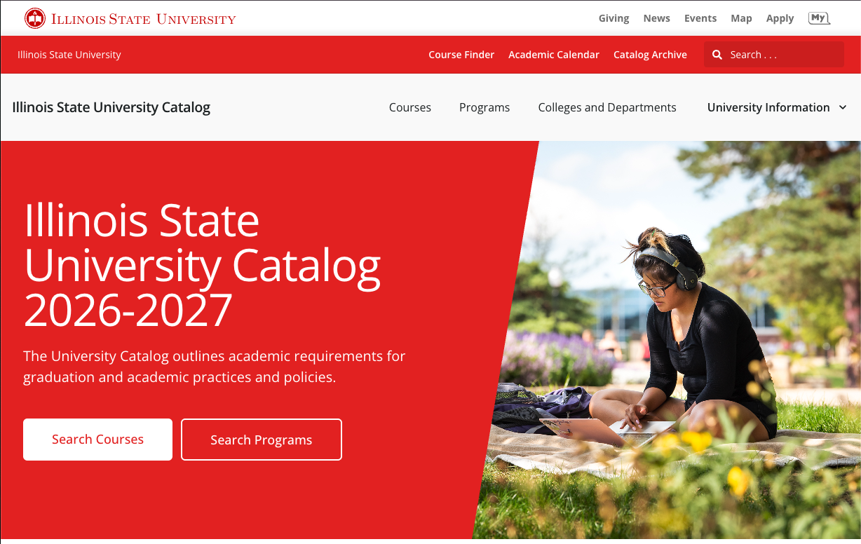
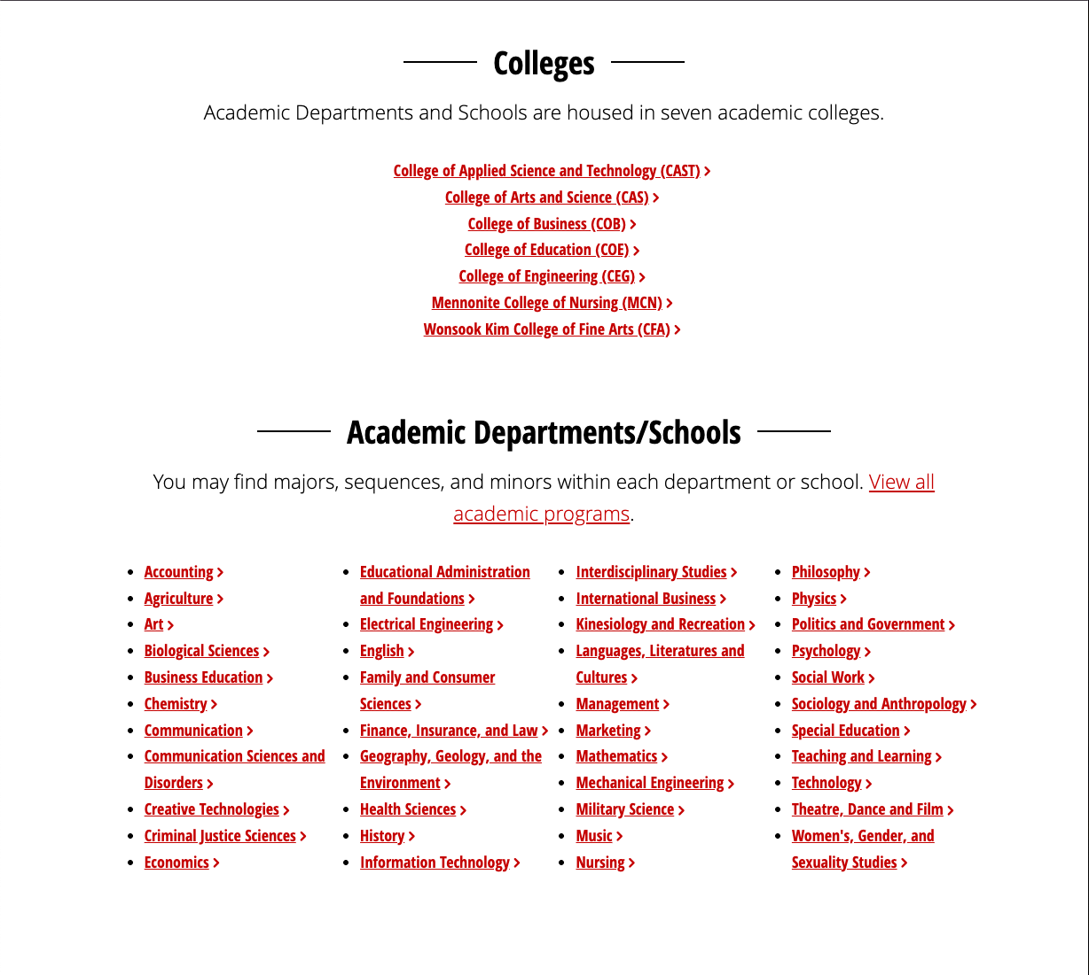
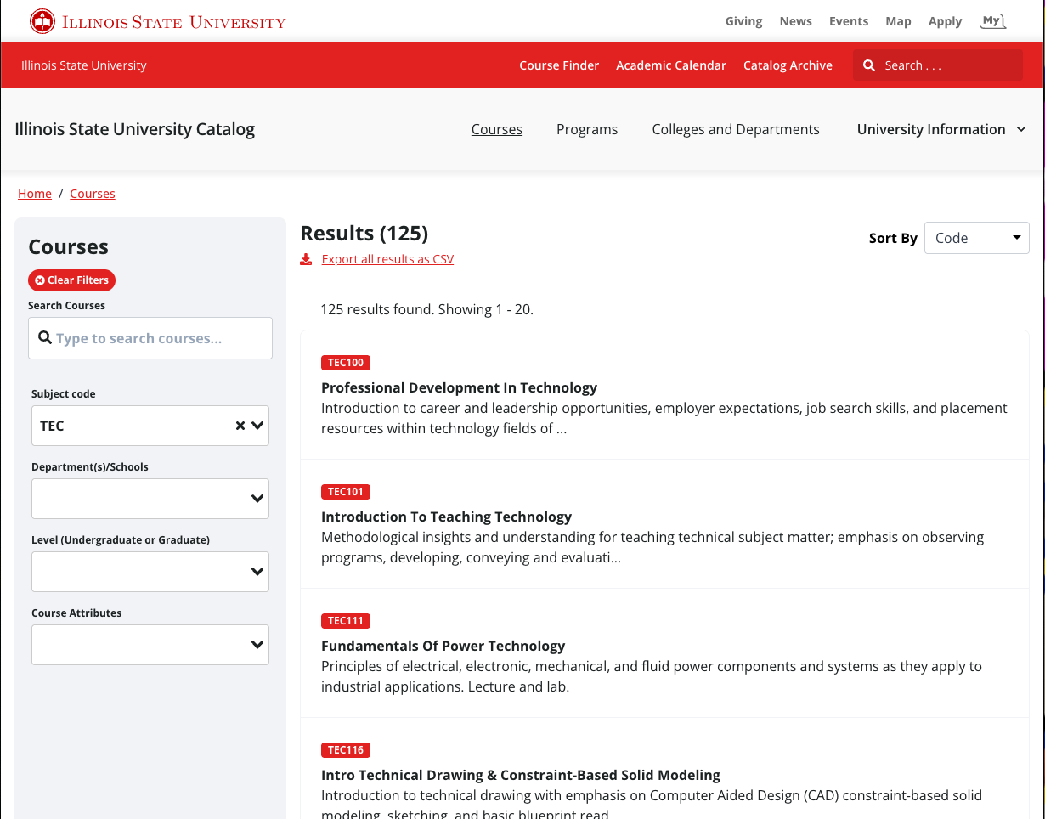
Coursedog Implementation – Catalog
10749 - Implement Curriculum Software
Mary Ditchen
Notes:
Searchable modern catalog
Streamlined curriculum management

Slide 16
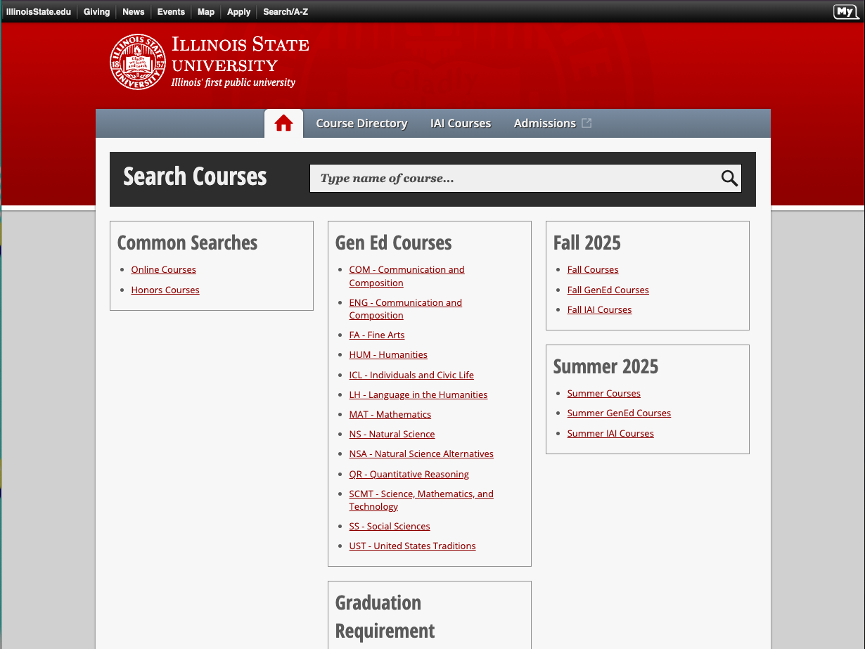
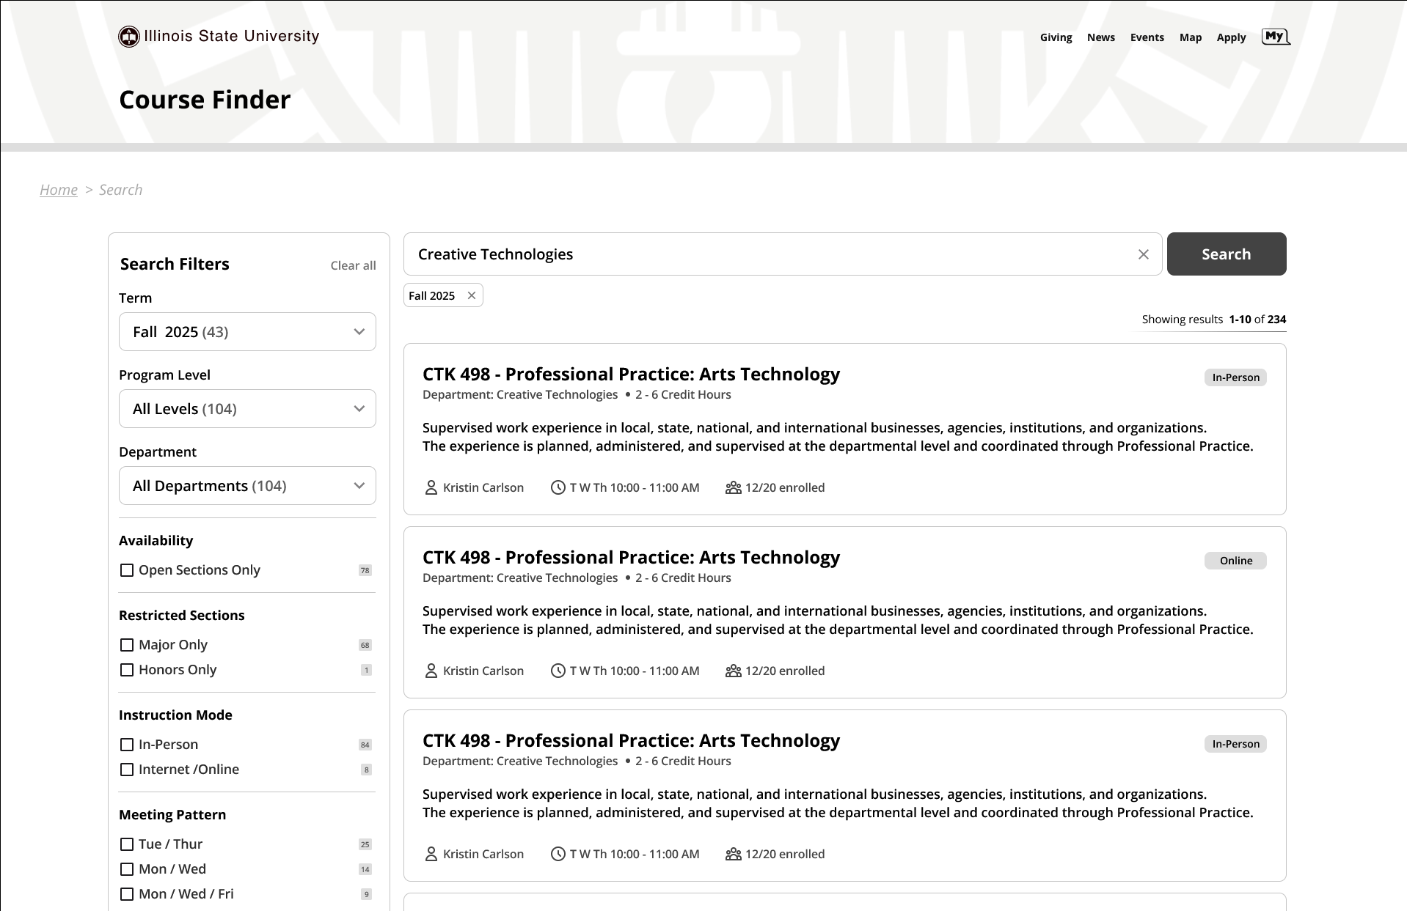
Coursedog Implementation – Course Finder
10749 - Implement Curriculum Software
Mary Ditchen

Slide 17
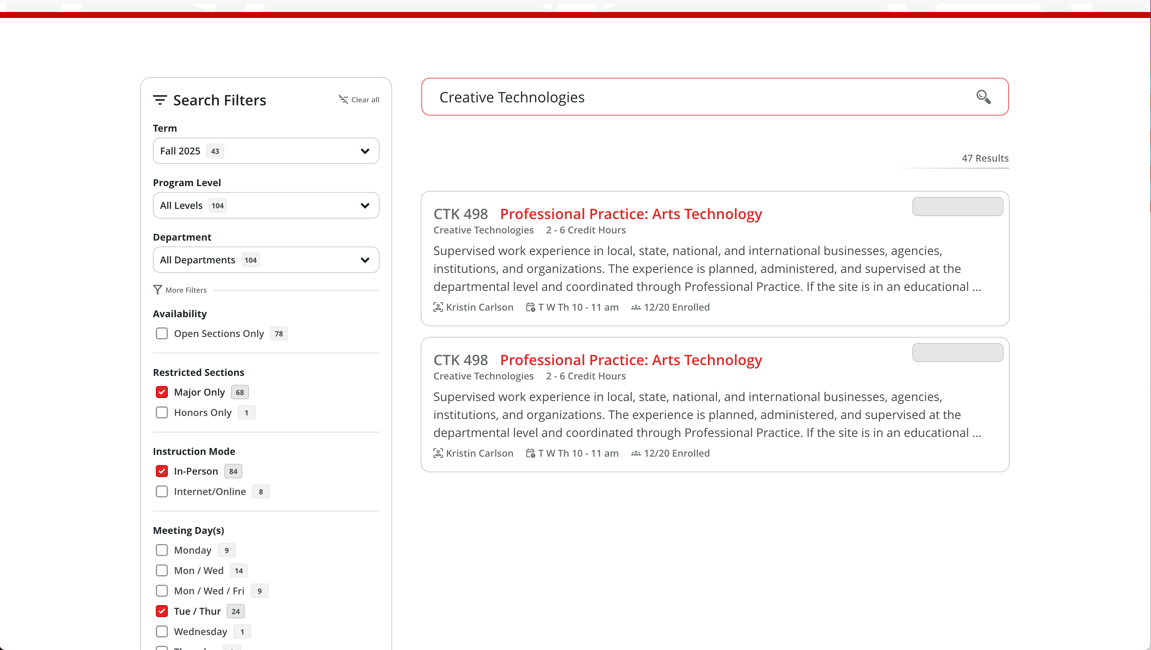
Coursedog Implementation – Course Finder
10749 - Implement Curriculum Software
Mary Ditchen

Slide 18
Geek Out with Us!
WEB Office Hours
9 a.m. – 10 a.m.
(except Thursdays)
Shout out to Dev Club!
Third Thursday of Month
10 a.m. – 11 a.m.
Mary Ditchen

Slide 19
Maintenance/Upgrades
VMware upgrade to 8u3
Openshift upgrade to 4.16
Netscaler ADC Upgrade
Ansible Automation Platform Major Upgrade to 2.5
RightFax Upgrade
Listserv Security Upgrade
Commvault (Enterprise Backup) Hyperscale Upgrade
Craig Jackson

Slide 20
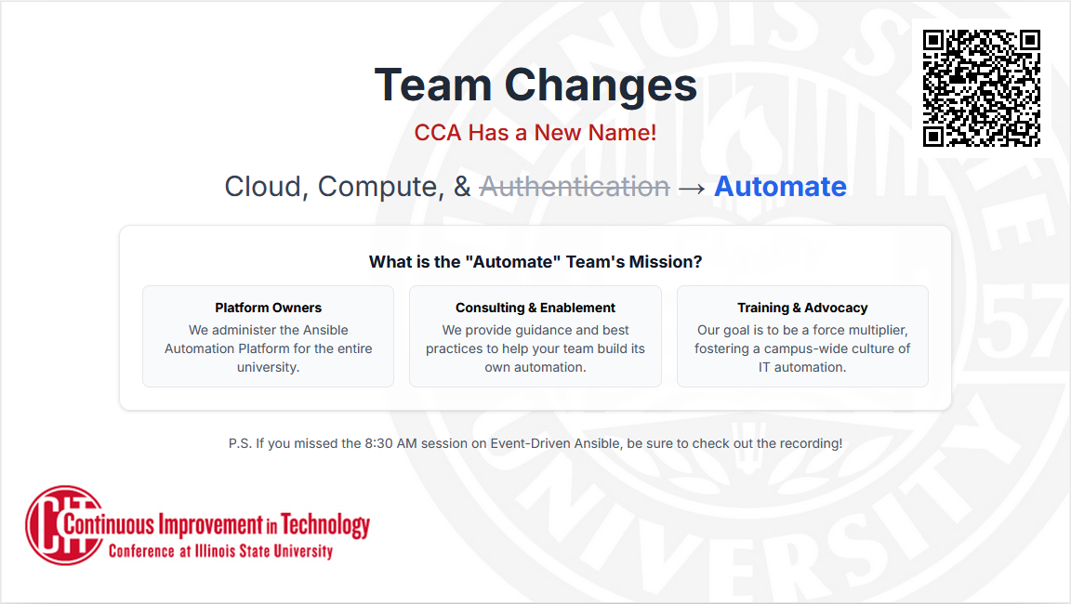
Craig Jackson

Slide 21
Campus Network Upgrade
Wired and wireless networking
  75 academic and administrative buildings
  1,721 wireless access points
  Increased bandwidth
  Greater PoE capabilities
  Wi-Fi6e for greater throughput/lower latency
Craig Jackson
Notes:
Increased bandwidth by 2400% to accommodate the growing needs of the campus community.
Greater Power over Ethernet (PoE) capabilities to accommodate the new wireless access points and growing power needs for cameras and other endpoint devices. – anything to add re: LSAVT/classrooms?
The addition of Wi-Fi 6e brings the new 6Ghz spectrum, higher throughput, lower latency, less interference, and better performance in high-density locations.
New hardware and software equate to higher reliability, advanced security features, and better device management.
Multi-Gigabit Ethernet (MGig) allows capable wired devices to connect at speeds from 1Gig, 2.5G, 5Gig, or 10Gig.

Slide 22
Microsoft A5
Target Date: Fall 2025
Benefits
  Advanced Security and Threat Protection
  Teams Voice and Teams Live Events
  PowerBI Pro Licenses
  Compliance & Data Governance (DLP)
Craig Jackson
Notes:
Microsoft Defender for Endpoint: Offers cross-platform endpoint detection and response (EDR) to detect and respond to advanced threats on student and faculty devices.
Microsoft Defender for Office 365 Plan 2: Provides advanced phishing and malware protection with automated investigation and response capabilities.
Unified Security: It correlates security data across email, identities, and endpoints for a holistic view of threats.

Slide 23
Research DMZ
$611,586 NSF Grant
PI’s – Dr Tang, Charley Edamala, Rachal Roach, George Barnes, Craig Jackson
Session highlights will be posted online
Craig Jackson

Slide 24
AI Tools & Services
Microsoft - Copilot & Teams Premium
AWS – Bedrock (multiple LLM’s)
Google – Gemini & Google AI Pro
Session highlights will be posted online
Craig Jackson

Slide 25
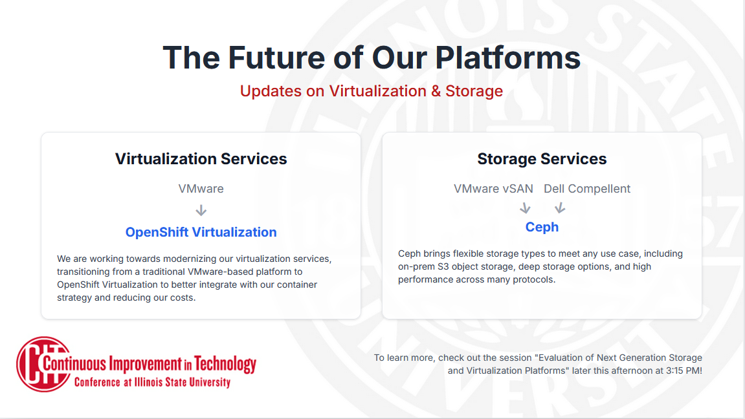
Craig Jackson

Slide 26
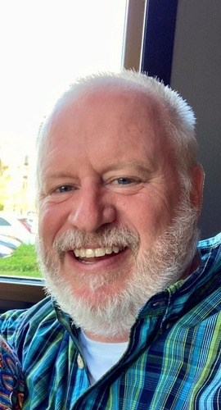
In Remembrance
Dan Thames
1964 – 2025
30 years at ISU

Slide 27
CIT MVP Award
The MVP Award recognizes one full-time technical staff member each year in the Illinois State University community for outstanding contribution(s) to the support of faculty, staff, students, and/or operations, as well as collaboration with others.
Mike Regilio
Notes:
Ask the 3 nominees to stand, and deliver mug to them, then announce winner.

Slide 28
CIT MVP Award Nominee
Tony Brook
Technology Solutions App Admin team
Mike Regilio
Notes:
Tony is OOO, the rest of the nominees should be present in the audience

Slide 29
CIT MVP Award Nominee
Ted Coussens
Technology Solutions LSAVT team
Mike Regilio

Slide 30
CIT MVP Award Nominee
Allison Hauser
Center for Integrated Professional Development
Mike Regilio

Slide 31
CIT MVP Award Nominee
Matt Lindstrom
Information Security Office
Mike Regilio

Slide 32
CIT MVP Award
And the 2025 winner is…
Ted Coussens
Technology Solutions LSAVT team
Mike Regilio
Notes:
Introduce Kristie Toohill, who will say a few words and then Ted will also say a few words
Winner mug & plaque will be at instructor station, also deliver mugs to nominees

Slide 33
Congratulations on your retirement!
Mike Dargatz
Tech Solutions Peoplesoft Development team
5/31/25
Mike Regilio

Slide 34
Congratulations on your retirement!
Kevin McCrone
SAIT
7/31/25 after 33 years of service
Mike Regilio

Slide 35
Congratulations on your retirement!
Keith Reynolds
Tech Solutions Peoplesoft Development team
7/31/25
Mike Regilio

Slide 36

Thank you!
Many thanks to the
Presenters
and Tech Facilitators
who make a
hybrid CIT event possible
Mike Regilio
Notes:
Have presenters stand, and then tech facilitators
Note that they have CIT coffee mugs as a thank you on the table at the front of the auditorium
Have planning committee stand and thank them as well

Slide 37
Door Prize Drawing
Get your tickets ready!
Mike Regilio

Slide 38
Secure by Design
A Strategic Commitment to Defensible Security
Dan Taube
Chief Information Security Officer
Dan Taube

Slide 39
A New Foundation for Security
CISO
Direct Report to VP
ISO as a Department
Board Designation
Audit Priority
Program Planning
Governance and Reporting
Dan Taube

Slide 40
Establishing Baseline Controls
To address repeat audit findings, ISU must develop and establish written policies, procedures, and standards for key functions.
Policies
Procedures
Standards
Access Management
System & Change Management
Risk & Vulnerability Management
Data Governance & Protection
Dan Taube

Slide 41
Moving from Practice to Policy
Formalizing our processes is essential for consistency, clarity, and a legally defensible program. Work is already underway.
9.2 Appropriate Use Policy
Procedures
Standards
Policies
9.8.1 Data Classification Procedure Update
Patch Management
9.8 Information Security Program
IT Change Management
9.8.6 Security Incident Response Procedure Update
Endpoint Local Admin
Privileged Access Management
Log Management
Vulnerability Management
Vendor Management
Remote Access
Policies and procedures are published at policy.illinoisstate.edu
ISO standards are published at help.illinoisstate.edu/informationsecurity/standards
Dan Taube

Slide 42
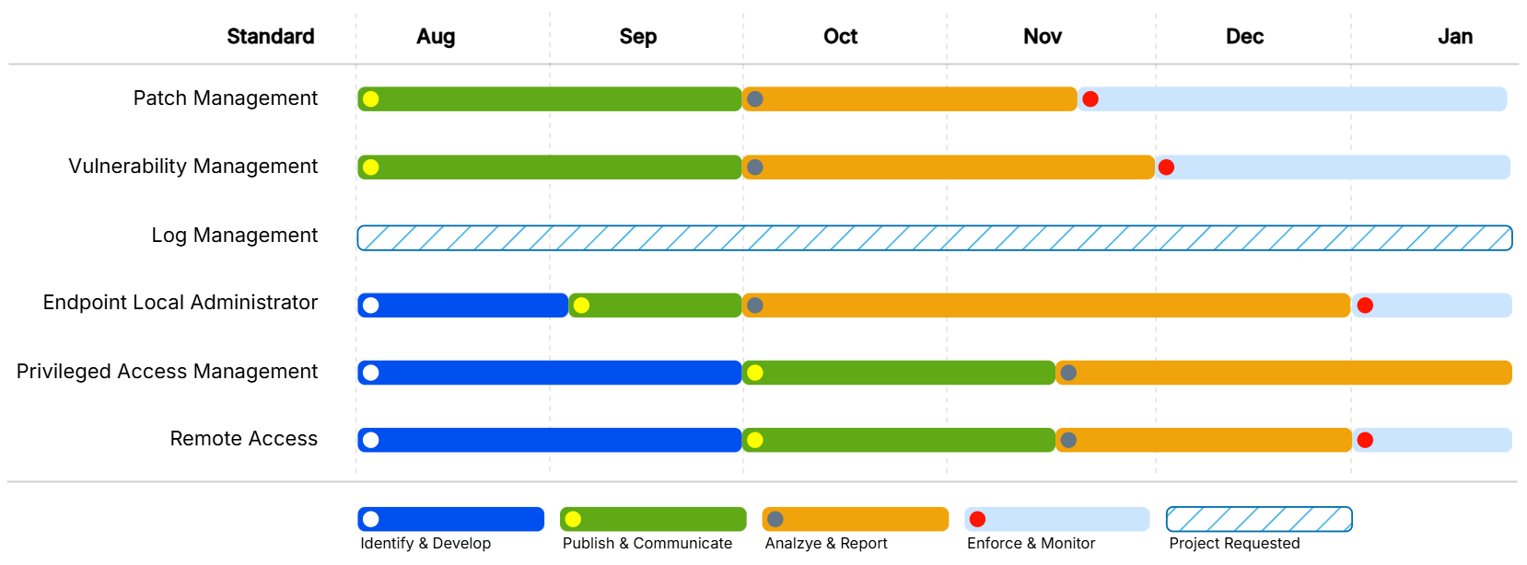
Standards Milestones Timeline
Dan Taube

Slide 43
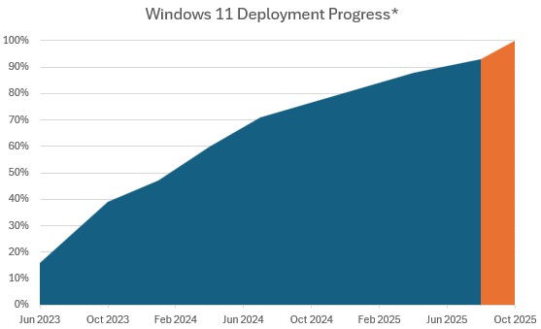
A Case Study: Windows 10 EOL
In spring 2023, Microsoft announced Windows 10 would reach end of life on October 14, 2025. In summer 2023, ISU IT responded by evaluating, planning, and initiating a focused Windows 11 implementation strategy.
Relevant Patch Management Standard snippet:
Systems must have an operating system or firmware installed that is supported by the vendor.
Timeline Review:
Aug 5 – Patch Management Standard Published
Oct 1 – Patch Management Standard Reporting Begins
Oct 14 – Windows 11 EOL and added to reporting scope
Nov 17 – Patch Management Standard Enforcement Begins
* Does not represent Windows 10 LTS.
Dan Taube

Slide 44
Q & A
Mike Regilio
Notes:
Questions for any presenter as time permits – remind everyone of the question protocol

Slide 45
That’s a Wrap!
Lunch is up next – same on both sides, water downstairs
More great sessions after lunch – reminder that the Keynote Address and Analog Leadership in a Digital World will not be recorded
Join us at the Pub II after CIT!
CITx in late February 2026
Nominate one of our great student employees for the CIT Student MVP Award – cit.illinoisstate.edu/awards
Mike Regilio
Notes:
Remind presenters and facilitators to pick up their coffee mugs as they leave IT News
Gluten-free meals will be on the registration table

Slide 46
Keynote Address
1 pm, SHFB 139
Dr. Ani Yazedjian
Vice President for Academic Affairs & Provost
Mike Regilio

