Slide 2
Secrets and Password Management – Where We are and Where We’re Going
Tech Solutions CCA
Sky Wallace

Slide 3
About the Presenter
Department: Infrastructure Operations and Networking
Team: Cloud Compute and Authentication (CCA) – Compute
Title: Infrastructure System Administrator
Specialties: Backups/Data Protection, Password and Secrets management
Degrees / Certificates:
B.A. – Information Systems – Systems Development and Analysis – Illinois State University
Commvault Certified Professional – Commvault
Notes:
2020
- Moved from Xen to VMware ESXi
- Ran xen for awhile > issues arose > migrated to vmware since we had it > things got better
- Another hypervisor to support
Pandemic
Physical Labs as a Virtual Lab Offerings
Remote Desktop Broker for your ISU Workstation (1:1’s)
Return to Campus
Scaled back licensing
Overall Usage Drops

Slide 4
Passwords and Secrets Management “Dictionary”
“Vault” – A place where credentials are stored
“Password” – A string of characters that allows access to a secure space
“Secret” – Any form of sensitive data that should remain confidential
Passwords
Keys
API tokens
Certificates
“Privileged Access Management (PAM)” – A service or practice utilized to secure privileged accounts and access.
Notes:
2020
- Moved from Xen to VMware ESXi
- Ran xen for awhile > issues arose > migrated to vmware since we had it > things got better
- Another hypervisor to support
Pandemic
Physical Labs as a Virtual Lab Offerings
Remote Desktop Broker for your ISU Workstation (1:1’s)
Return to Campus
Scaled back licensing
Overall Usage Drops

Slide 5
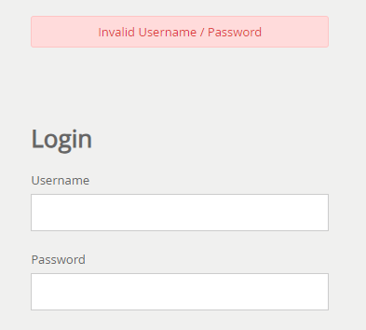
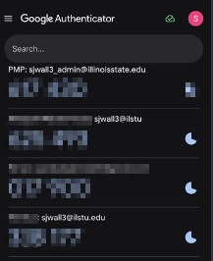
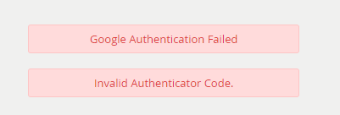
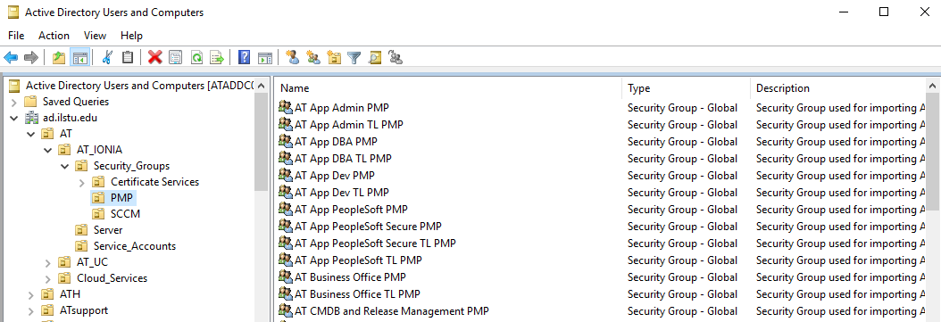
Where We Were!
Password Manager Pro
Google authenticator
Single node AD Reliant Sync
Manual RBAC
User Populations
800+ Total Active Users
~100 Administrators
Functionality
Intermittent outages, Perm Sync Issues, etc…
Minimal automation
Notes:
2020
- Moved from Xen to VMware ESXi
- Ran xen for awhile > issues arose > migrated to vmware since we had it > things got better
- Another hypervisor to support
Pandemic
Physical Labs as a Virtual Lab Offerings
Remote Desktop Broker for your ISU Workstation (1:1’s)
Return to Campus
Scaled back licensing
Overall Usage Drops

Slide 6
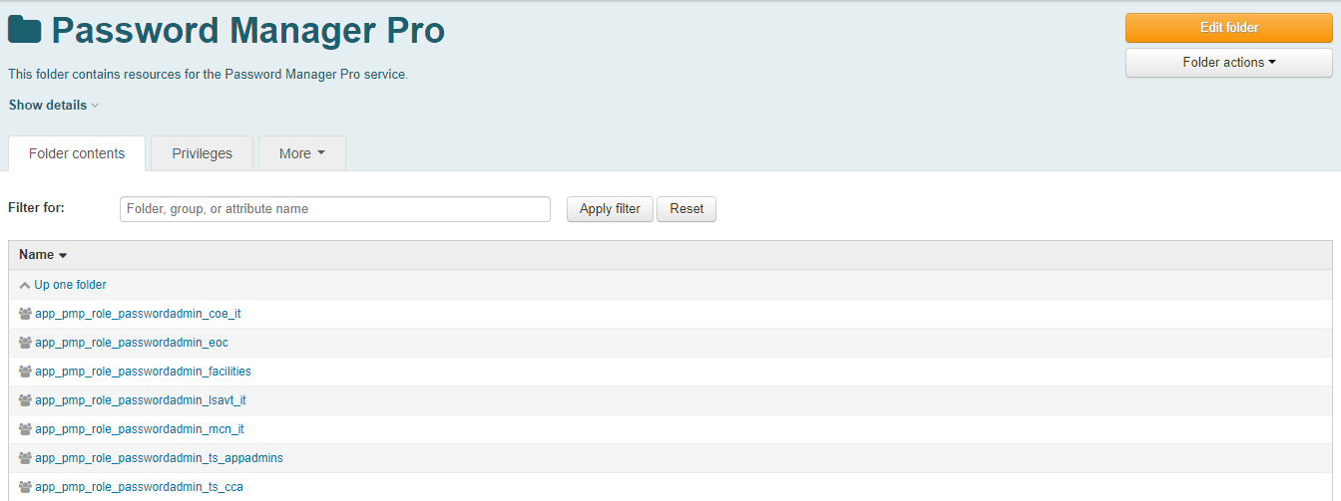
Our Due Diligence (Where We are Now)
Password Manager Pro
Google authenticator
Multi-node failover sync
Automated RBAC w/Grouper
User Populations
600 Total Active Users
90 Administrators
Functionality
Less re-sync issues, outages for update
API usage
Notes:
2020
- Moved from Xen to VMware ESXi
- Ran xen for awhile > issues arose > migrated to vmware since we had it > things got better
- Another hypervisor to support
Pandemic
Physical Labs as a Virtual Lab Offerings
Remote Desktop Broker for your ISU Workstation (1:1’s)
Return to Campus
Scaled back licensing
Overall Usage Drops

Slide 7
So What do We Do Now?
Get a new Password Management service!
But how should we get things started?
Dive right in! (kind of)
Expand and learn about Password, Secrets, and PAM
Learn about vendor specialties
Determine ISU’s needs
Thoroughly understand current use-cases
Get necessary stakeholders involved
Notes:
2020
- Moved from Xen to VMware ESXi
- Ran xen for awhile > issues arose > migrated to vmware since we had it > things got better
- Another hypervisor to support
Pandemic
Physical Labs as a Virtual Lab Offerings
Remote Desktop Broker for your ISU Workstation (1:1’s)
Return to Campus
Scaled back licensing
Overall Usage Drops

Slide 8
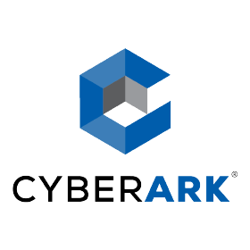
The Actual Process
CIT 2023 – Secrets Management in a Digital World
Sept. 2023 - Gartner Interaction – Secrets management Services
Oct. 2023 - Committee Assembly
Nov. 2023 - Scope and Needs/Wants Assessment
Nov./Dec. 2023 - Vendor Conversations and Demonstrations
(HashiCorp, Keeper Security, CyberArk, Delinea)
Dec. 2023 - Further Gartner Interactions
Jan 2024 - Re-assessment of Needs and Timeline
Feb 2024 - Further Vendor Conversations
Mar. 2024 - Start POC Processe(s)
Admin Configs, Onboardings, Testing, Feedback
Apr./May 2024 - Feedback Review
Jun. 2024 – Decision
Current – Waiting for Purchasing
Notes:
2020
- Moved from Xen to VMware ESXi
- Ran xen for awhile > issues arose > migrated to vmware since we had it > things got better
- Another hypervisor to support
Pandemic
Physical Labs as a Virtual Lab Offerings
Remote Desktop Broker for your ISU Workstation (1:1’s)
Return to Campus
Scaled back licensing
Overall Usage Drops

Slide 9
Important Findings!
Passwords vs Secrets vs PAM
We had a passwords Management solution
We had “secrets management” practices without a solution
PAM was spread few and far between
Many systems for many things or one system for many things?
Gartner Recommendations
What we want vs what we need
Passwords and secrets were the need
PAM was a want (a hefty want at that)
Who should be involved in the selection process?
Notes:
2020
- Moved from Xen to VMware ESXi
- Ran xen for awhile > issues arose > migrated to vmware since we had it > things got better
- Another hypervisor to support
Pandemic
Physical Labs as a Virtual Lab Offerings
Remote Desktop Broker for your ISU Workstation (1:1’s)
Return to Campus
Scaled back licensing
Overall Usage Drops

Slide 10
The Committee!
Infrastructure
*Sky Wallace and *Ben Hendrix
Later additions of *Jim Johnson and *Craig Watts
Management
*Majeed Abu-Qulbain, Devin Carlson, and Craig Jackson
Security
Matthew Tunberg and *Ryan Haas
IAM Team
Anderson Klay, Ben Rappleyea, and *Jeremiah Haywood
DevOps/Apps Team
*Tony Brook, *Nathan Stien, and *Adam Julian
SAIT
*Kevin McCrone, Suni Brown, and Jason Mays
Milner Library
*Paul Unsbee
TS Business Office
Lew Steinbach
* Denotes members of the “Proof of Concept” team.
Notes:
2020
- Moved from Xen to VMware ESXi
- Ran xen for awhile > issues arose > migrated to vmware since we had it > things got better
- Another hypervisor to support
Pandemic
Physical Labs as a Virtual Lab Offerings
Remote Desktop Broker for your ISU Workstation (1:1’s)
Return to Campus
Scaled back licensing
Overall Usage Drops

Slide 11
Our Scope and Needs
Password Vaults
Enterprise vaults for sharing passwords between users
Work related, individual user password storage
Secrets managers
Workload secrets and certificate management
File configs and files-based secrets
Access key rotation
General Requirements
Periodic security auditing
A robust API for automation and runtime workloads
PKI and Certificate Management System
Certificate management tools to perform CA-agnostic discovery
Report and provide certificate life cycle management capabilities using standards, such as ACME or nonstandard life cycle management for services, when needed
Code signing
Notes:
2020
- Moved from Xen to VMware ESXi
- Ran xen for awhile > issues arose > migrated to vmware since we had it > things got better
- Another hypervisor to support
Pandemic
Physical Labs as a Virtual Lab Offerings
Remote Desktop Broker for your ISU Workstation (1:1’s)
Return to Campus
Scaled back licensing
Overall Usage Drops

Slide 12
“Nice to Have” and Future State Ideas
Privileged Access Management system
Broker High-Level Privileged Access
Expanded support for end-users
Potential staff outside of IT staff
Potential for student support
Browser extension and mobile application
Support for in-place resource notes
A notes field or way to store files with the secret resource
Extended user licensing for administration of resources
Custom object creation
For “non standard” business items such as key codes
Automated exportation of access
Anything a user has access to / secrets
Modernized UI
Usable by IT and Non-IT end-users
Notes:
2020
- Moved from Xen to VMware ESXi
- Ran xen for awhile > issues arose > migrated to vmware since we had it > things got better
- Another hypervisor to support
Pandemic
Physical Labs as a Virtual Lab Offerings
Remote Desktop Broker for your ISU Workstation (1:1’s)
Return to Campus
Scaled back licensing
Overall Usage Drops

Slide 13
Brief Overview of Demos
Hashicorp Vault
Geared HEAVILY towards secrets management
Highly limited for password management
Minimal PAM capabilities
Most “hands on” vendor for implementation
Keeper Security
Strongly established as an end-user password manager
Integrated secrets manager with the password solution
PAM solution “Connection Manager” with remote solutions
Most simplified Deployment
CyberArk
Highly modular system
Enterprise vault for password management
Robust secrets management platform
Most well known PAM vendor on the market
Delinea
HIGHLY modular system
Strong competition for CyberArk’s PAM solution
Mid-level deployment and administration of the system
Self proclaimed most “integrate-able” system with external vendors and systems
Notes:
2020
- Moved from Xen to VMware ESXi
- Ran xen for awhile > issues arose > migrated to vmware since we had it > things got better
- Another hypervisor to support
Pandemic
Physical Labs as a Virtual Lab Offerings
Remote Desktop Broker for your ISU Workstation (1:1’s)
Return to Campus
Scaled back licensing
Overall Usage Drops

Slide 14
The Committee’s Choice
Notes:
2020
- Moved from Xen to VMware ESXi
- Ran xen for awhile > issues arose > migrated to vmware since we had it > things got better
- Another hypervisor to support
Pandemic
Physical Labs as a Virtual Lab Offerings
Remote Desktop Broker for your ISU Workstation (1:1’s)
Return to Campus
Scaled back licensing
Overall Usage Drops

Slide 15
Keeper Security!
Password Vaults
Enterprise vaults for sharing passwords between users
Work related, individual user password storage
Secrets managers
Workload secrets and certificate management
File configs and files-based secrets
Access key rotation
General Requirements
Periodic security auditing
A robust API for automation and runtime workloads
PKI and Certificate Management System
Certificate management tools to perform CA-agnostic discovery
Report and provide certificate life cycle management capabilities using standards, such as ACME or nonstandard life cycle management for services, when needed
Code signing
Privileged Access Management system capabilities
Broker High-Level Privileged Access
Expanded support for end-users
Potential staff outside of IT staff
Potential for student support
Browser extension and mobile application
Support for in-place resource notes
A notes field or way to store files with the secret resource
Extended user licensing for administration of resources
Custom object creation
For “non standard” business items such as key codes
Automated exportation of access
Anything a user has access to / secrets
Modernized UI
Usable by IT and Non-IT end-users
Notes:
2020
- Moved from Xen to VMware ESXi
- Ran xen for awhile > issues arose > migrated to vmware since we had it > things got better
- Another hypervisor to support
Pandemic
Physical Labs as a Virtual Lab Offerings
Remote Desktop Broker for your ISU Workstation (1:1’s)
Return to Campus
Scaled back licensing
Overall Usage Drops

Slide 16
So What’s the Plan Now? (Where We are Going!)
“Short Term” (Year 1)
Finish the procurement process (purchasing)
Create documentation around system functions specific to ISU
Determine an implementation plan and timeline
Pre July 1 2025
Further / Extended (Years 2+)
Explorer the extent of secrets management usage
Review usability for expanded use cases (end-users, students, etc…)
PAM
Notes:
2020
- Moved from Xen to VMware ESXi
- Ran xen for awhile > issues arose > migrated to vmware since we had it > things got better
- Another hypervisor to support
Pandemic
Physical Labs as a Virtual Lab Offerings
Remote Desktop Broker for your ISU Workstation (1:1’s)
Return to Campus
Scaled back licensing
Overall Usage Drops

Slide 17
Y’all Wanna See the New System? (Demo and Sneak Peak)
Also a Pause for Questions
Notes:
2020
- Moved from Xen to VMware ESXi
- Ran xen for awhile > issues arose > migrated to vmware since we had it > things got better
- Another hypervisor to support
Pandemic
Physical Labs as a Virtual Lab Offerings
Remote Desktop Broker for your ISU Workstation (1:1’s)
Return to Campus
Scaled back licensing
Overall Usage Drops

