Slide 1
Institution-Wide Initiatives and Projects: Lessons Learned from an LMS Migration
Anthony Piña, Todd Smoak & Christopher Brandt

Slide 2
Background
During 2022-23, ISU implemented a successful LMS transition from Sakai (ReggieNet) to Canvas.
What were the contributors to the project’s success and what were the challenges and pain points?

Slide 3
Objectives
Determine what large-scale technology initiatives and projects need to be successful
Discuss the challenges of large-scale technology initiatives
Discuss the lesson learned and implications of large-scale technology initiatives and projects

Slide 4
Large-Scale Technology Initiatives
Involves personnel and resources throughout the organization
Scope and beneficiaries not limited to a single organizational unit (e.g., program or college)
Requires a comprehensive organizational and operational structure

Slide 5
Setting Up Organization for Success
Steering committee
Leadership
Project management
Task forces and working groups

Slide 6
Steering Committee
High-level decision makers
Authority to allocate funds and personnel
Ties initiative to mission & strategic plan
Determines metrics for success
Provides accountability to chief executives
“Over-arching” decision-making
Not too involved in minutiae or micro-management

Slide 7
Leadership
The “face” of the project
Reports to the Steering Committee
Promote project across and/or outside the organization
“Daily” (operations) decision-making
Coordinates/leads daily operations
Configurations, policy, procedures, training, support
Gathers and reports data

Slide 8
Project Management
Too often neglected
Provides accountability
Works closely with leadership to make sure that all tasks are completed
Identifies gaps and redundancies
Keeps project on track

Slide 9
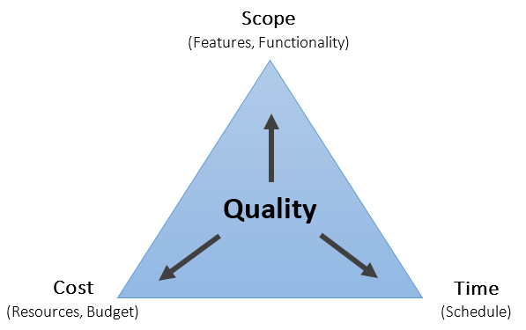
Project Management Triple Constraint

Slide 10
Task Forces and Working Groups
“Boots on the ground”
Steering, Leaders & Project Managers can’t do everything
Opportunities for inclusiveness
Included stakeholders, end users & support staff
Performed pilot testing & formative evaluation
Made recommendations to leadership

Slide 11
Challenges
Personnel changes (leadership, project manager)
Issues with 3rd party vendors (LTIs, migration timelines)
A few product technical issues (e.g. quizzes)
Vendor guidance better for teaching than for admin
Not all users were 100% satisfied
Small minority preferred the old system

Slide 12
Successes of LMS Initiative
Project implemented in an expedited timeline
Broad coalition (students, faculty, staff, administration)
High-level of end-user satisfaction
Improved working relationships
e.g., addressing redundancies between TSC and CIPD

Slide 13
Successes of LMS Initiative
Implemented policies and procedures to improve existing operations
Configurability of the product worked very well
Overall, Instructure has been a good vendor partner
We were effective in decision making & adaptation
We had to adjust our integrations with 3 revisions

Slide 14
Lessons Learned and Implications
Change will happen! Put people & processes in place
Need to be able to make timely decisions
Get the right people in the right positions
Do not skimp on these organizational functions
Clear and shared vision across the institution
Communication is vital

Slide 15
Institution-Wide Initiatives and Projects: Lessons Learned from an LMS Migration
Anthony Piña, Todd Smoak & Christopher Brandt

