Slide 1
Strategic Benefits of Managed Security Baseline Configurations
Dan Taube, Chief Information Security Officer

Slide 2
Security State of the Environment
8500 assets are actively running Defender for Endpoint
61% are rated as high exposure
37% are rated as medium exposure
2% are rated as low exposure
Exposure is the likelihood of an asset being compromised due to the current configuration, vulnerabilities, and use discovered about the device.

Slide 3
Security Baselines
Security baselines are a set of defined security standards and controls that represent the minimum level of security necessary to safeguard an asset or environment.

Slide 4
Security Baseline Configurations
Security baseline configurations are the technical implementation of the baselines, tailored to the specific capabilities and context of a given asset or solution.

Slide 5
Automatic Device Lock
Baseline
Automatically lock workstations after 15 minutes of inactivity.
Baseline Configuration
Computer Configuration\Policies\Windows Settings\Security Settings\Local Policies\Security Options\Interactive logon: Machine inactivity limit [900]

Slide 6
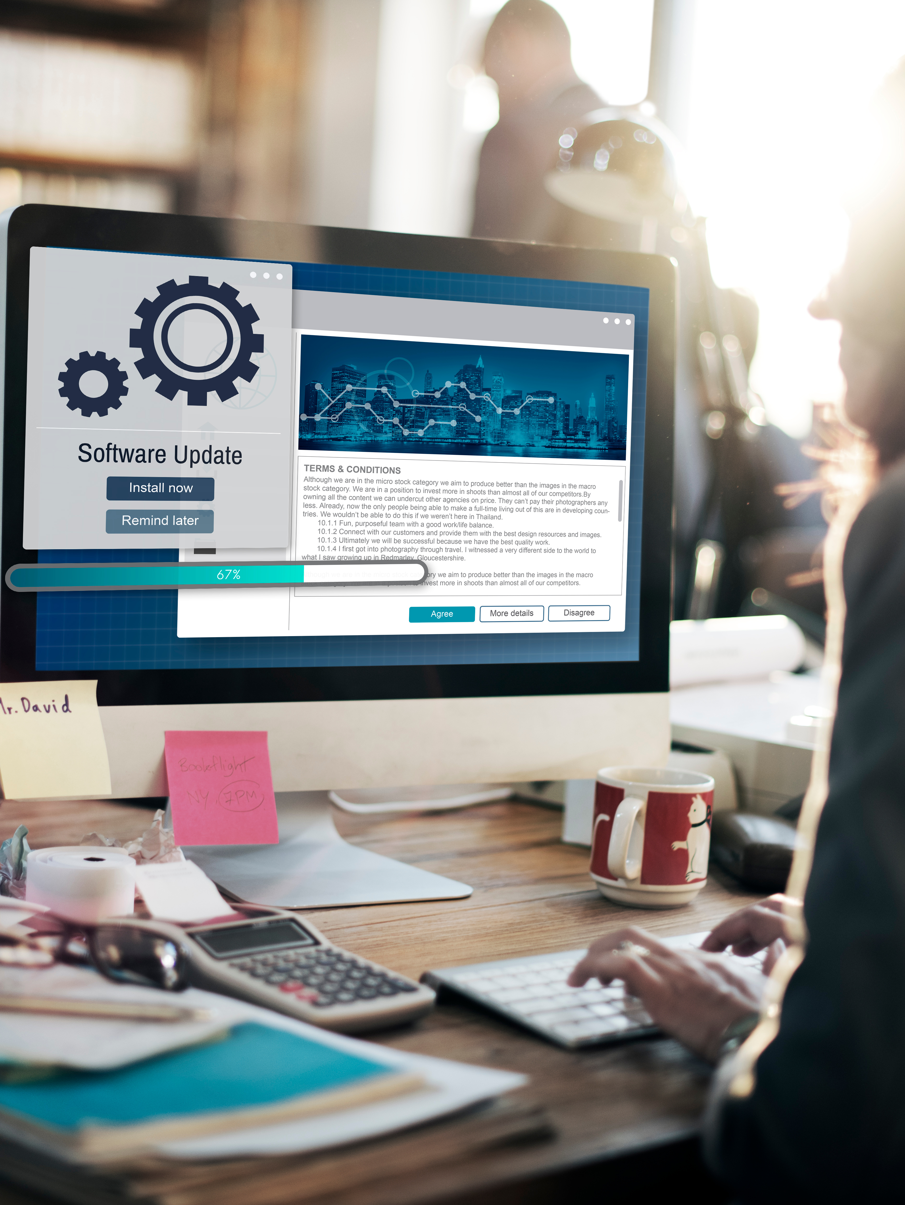
Operating System Updates
Baseline
Automatically receive and install operating system updates.
Baseline Configuration
Computer Configuration\Policies\Administrative Templates\Windows Components\Windows Update\Manage end user experience\Configure Automatic Updates [Enabled]

Slide 7
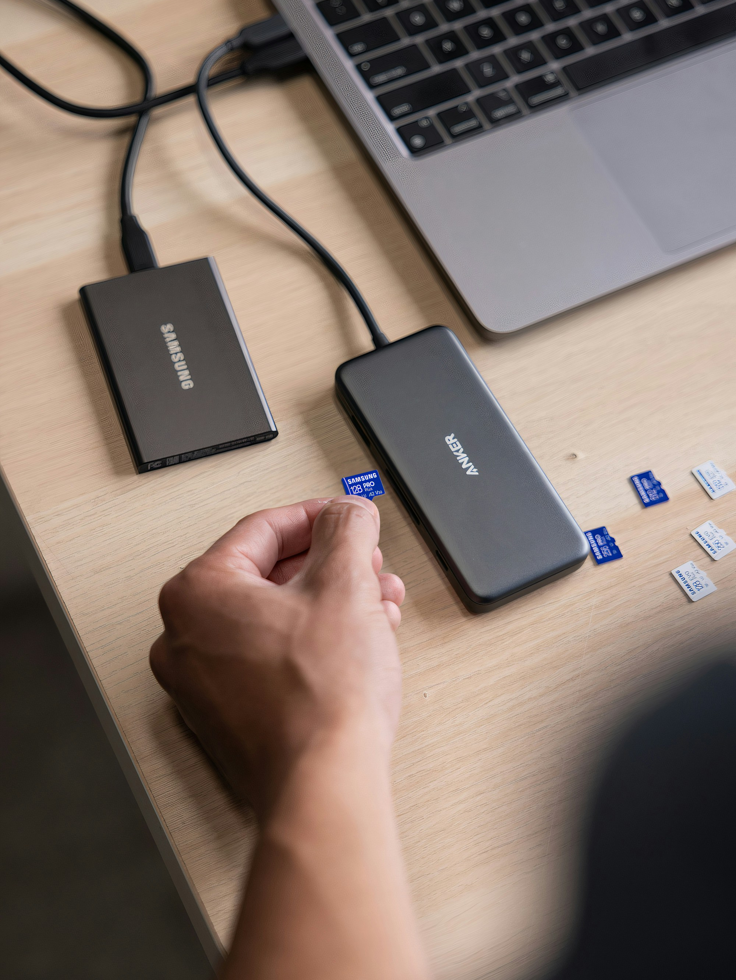
Device Drive Encryption
Baseline
Encrypt all device drives on user workstations.
Baseline Configuration
Computer Configuration\Policies\Administrative Templates\Windows Components\BitLocker Drive Encryption\Operating System Drives\Require additional authentication at startup [Enabled]

Slide 8
Where do Security Baselines come from?
Regulation (FERPA | HIPAA | GLBA)
Contracts (PCI DSS | Cyber Insurer | Federal Programs)
Standards Organizations (NIST | ISO | CIS)
Org Policies (Data Governance | Remote Work)

Slide 9
What about Security Baselines Configurations?
Vendor Configuration Guides (Microsoft | Amazon | Cisco)
Government Agencies (DoD | CISA | FBI)
Industry Communities (OWASP | CIS)

Slide 10
CISO Contemplation
What will provide us with reasonable security?
What aligns with the organization's culture?
What is ultimately effective for the threats we face?
What is most likely to achieve the necessary outcomes?

Slide 11
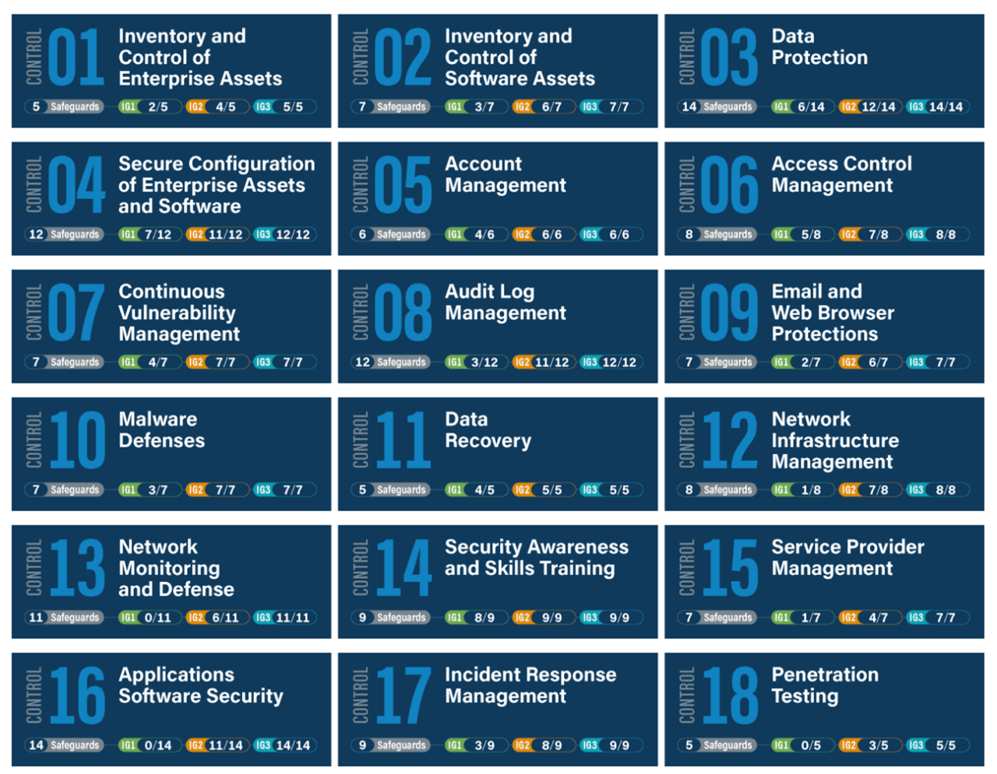
Center for Internet Security (CIS) Controls
A set of 18 best practice recommendations that help enterprises focus their resources on the most critical actions to defend against the most prevalent real-life attacks.

Slide 12
CIS Controls in Practice
CIS Community Defense Model v2.0, 2021

Slide 13
CIS Controls in Practice
CIS Community Defense Model v2.0, 2021

Slide 14
Automatic Device Lock
CIS Control and Safeguard
4: Secure Configuration of Enterprise Assets and Software
4.3: Configure Automatic Session Locking on Enterprise Assets
Baseline
Automatically lock workstations after 15 minutes of inactivity.
Baseline Configuration
Computer Configuration\Policies\Windows Settings\Security Settings\Local Policies\Security Options\Interactive logon: Machine inactivity limit [900]

Slide 15
Operating System Updates
CIS Control and Safeguard
7: Continuous Vulnerability Management
7.3: Perform Automated Operating System Patch Management
Baseline
Automatically receive and install operating system updates.
Baseline Configuration
Computer Configuration\Policies\Administrative Templates\Windows Components\Windows Update\Manage end user experience\Configure Automatic Updates [Enabled]

Slide 16
Device Drive Encryption
CIS Control and Safeguard
3: Data Protection
3.6: Encrypt Data on End-User Devices
Baseline
Encrypt all device drives on user workstations.
Baseline Configuration
Computer Configuration\Policies\Administrative Templates\Windows Components\BitLocker Drive Encryption\Operating System Drives\Require additional authentication at startup [Enabled]

Slide 17
CISO Contemplation
What will provide us with reasonable security?
What aligns with the organization's culture?
What is ultimately effective for the threats we face?
What enables us to achieve the desired outcomes?

Slide 18
The Cake is Not a Lie
I ask you to make a cake.
I provide you the ingredients.
How well will you do without a recipe?

Slide 19
CIS Benchmarks
Center for Internet Security

Slide 20
CIS Benchmarks
Desktop and Servers OS (Windows, Linux, macOS)
Mobile OS (iOS and Android)
Appliances (Palo Alto, Sophos, Cisco)
Services (M365, AWS, Google Workspace)

Slide 21
CIS Benchmarks Lifecycle
Center for Internet Security

Slide 22
CIS Benchmarks Resources
Online portal (CIS SecureSuite)
Web, PDF, and Excel versions of benchmark information
Profile groups (general use versus privileged system admin)
Community discussion and issue/feedback tracking
Build Kits and Secure Images for Cloud
Validation tools

Slide 23
Security State of the Environment
8500 assets are actively running Defender for Endpoint
61% are rated as high exposure
37% are rated as medium exposure
2% are rated as low exposure
Exposure is the likelihood of an asset being compromised due to the current configuration, vulnerabilities, and use discovered about the device.

Slide 24
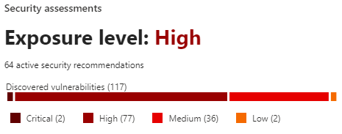
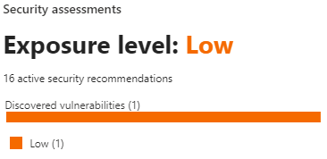
CIS Benchmarks Experiment
Latest available updates installed
Used for day-to-day email, documents, and web browsing
Microsoft Windows 11 Enterprise
Standard Build
Microsoft Windows 11 Enterprise
Standalone Benchmark
Information Security Office

Slide 25
What's the catch?
Microsoft Windows 11 Enterprise Standalone Benchmark
The PDF is 1300 pages.
The Excel is 619 rows in the most consolidated view.
No one person or team can reasonably digest all details.

Slide 26
CIS Build Kits
Build Kits automate the processes within the “Remediation” section of the CIS Benchmark PDF to spare the end user from manually applying each security recommendation.
Windows build kits are primarily in the form of GPOs.
Unix and Linux build kits are primarily in the form of shell scripts.
They are customizable to add to or subtract from.
Center for Internet Security

Slide 27
CIS Build Kits
Windows Standalone Build Kit Process
Download and prepare the CIS Build Kit
Opportunity to review and change provided configuration
Download and install LGPO from Microsoft
Compliance toolkit with templates
Run LGPO to deploy the desired benchmark profile
Level 1 (L1) - Corporate/Enterprise Environment (general use)
Level 2 (L2) - High Security/Sensitive Data Environment (limited functionality)
BitLocker (BL) - Extends profile to include BitLocker-related recommendations.
Center for Internet Security

Slide 28
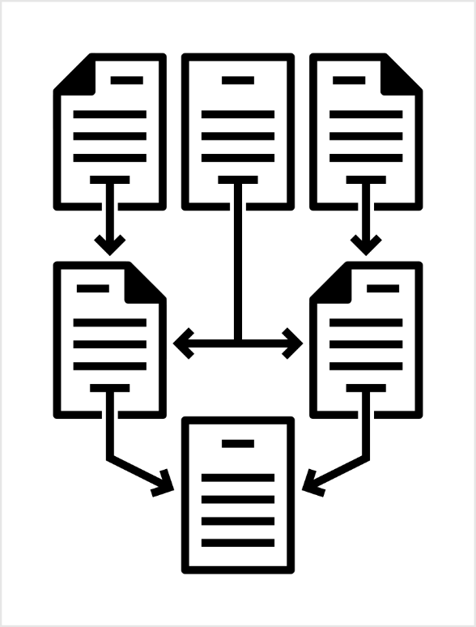
CISO Vision
CIS Controls are a measure of effective security.
CIS Benchmarks are a guide to securing assets.
CIS Build Kits are a catalyst to achieving the goal.
Through successful adoption of the controls, benchmarks, and build kits, IT staff will be able to uniformly deliver and maintain a secure user environment with less strain on capacity.

Slide 29
Strategic Benefits of Managed Security Baseline Configurations
Dan Taube, Chief Information Security Officer

