Slide 2
Beginner’s Guide to Microsoft Intune
Tech Solutions CCA
Jim Johnson

Slide 3
Topics
What is Intune?
Enrolling Devices
Device Configuration
Application Deployment
Microsoft Entra ID
Co-Management

Slide 5
Operating Systems
Supported On:
Windows 10/11
Android 8.0 and later
iOS/iPadOS 15.x and later
macOS 12.0 and later
Ubuntu LTS, version 22.04 or 20.04
Red Hat Enterprise Linux 8
Red Hat Enterprise Linux 9

Slide 6
Benefits
Manage Anywhere.
Deploy software, configure settings, enforce policies, and monitor from anywhere
Take Remote actions [MS Docs]
More Operating Systems.
Android
iOS/macOS
Red Hat Enterprise Linux (RHEL)
Enhance Your Current Environment.
Co-Management
Remote ConfigMgr (SCCM) actions
Conditional Access.
Device Compliance
Device Provisioning Anywhere.
Provisioning, Not Imaging
New Features but paid add-ons. ☹
Remote Help
Endpoint Privilege Management
BYOD.
Ability to secure ISU data on personal devices
Notes:
Remote actions:
Autopilot reset/Fresh Start
BitLocker key rotation Collect diagnostics Delete/Retire/Wipe Locate device Quick Scan Remote lock Rotate LAPS Password Sync Restart

Slide 7
Enrolling Android
Personally owned devices with a work profile (BYOD)
Corporate owned dedicated devices
Single App kiosk
Point of Sale device
Corporate owned fully managed
Corporate owned work profile

Slide 8
Enrolling Linux
Install Microsoft Edge
Install Intune App
Supported Features:
Compliance
Scripts

Slide 9
Enrolling Windows
Windows automatic enrollment
GPO
Windows Autopilot
During Provisioning
Co-management with Configuration Manager
Add Device to Collection
User enrollment (BYOD)
Conditional Access App Sign-in
Company Portal Sign-in

Slide 10
Let’s Check It Out

Slide 11
Entra ID – Administrative Units
Each IT Team has two AUs
Devices
(device.extensionAttribute6 -eq "isusakl")
(device.enrollmentProfileName -startsWith "TS ")
(device.devicePhysicalIds -any (_ -startsWith "[OrderID]:TS-"))
Groups
RBAC
Device Manager via PIM
Group Manager
User Read
https://entra.microsoft.com/

Slide 12
Terms and Definitions
Microsoft Entra hybrid joined (Previously, Hybrid Azure AD joined) - Device that is Domain Joined with On-Prem Active Directory and then synced to Entra ID
Microsoft Entra joined (Previously, Azure AD joined) - Device that Domain Joined with Entra ID
Microsoft Entra registered - Device that signed into a M365 service, primarily personal devices that access resources
Microsoft Entra ID (Previously, Azure AD) - cloud-based identity and access management service.
Co-management - Co-management enables you to concurrently manage Windows 10 or later devices by using both Configuration Manager and Microsoft Intune. [MS Docs]
Conditional Access polices – if a user wants to access a resource, then they must complete an action. For example: If a user wants to access an application or service like Microsoft 365, then they must perform multifactor authentication to gain access. [MS Docs]
Administrative Unit - An administrative unit is a Microsoft Entra resource that can be a container for other Microsoft Entra resources. An administrative unit can contain only users, groups, or devices. [MS Docs]

Slide 13
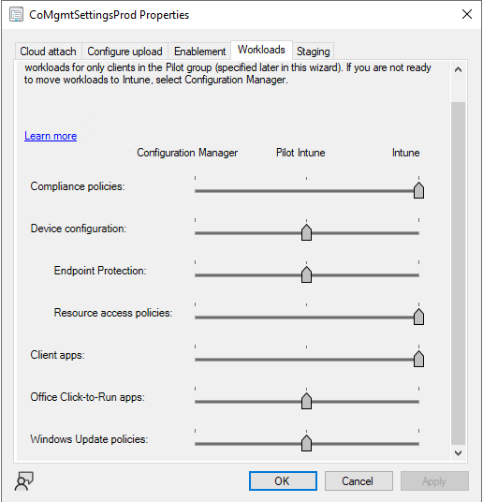
Co-Management Workloads
Compliance policies
Device configuration
Endpoint Protection
Client apps
Office Click-to-Run apps
Windows Update policies

Slide 14
Get Started with Intune
Portals
Intune Portal: https://intune.microsoft.com/
Entra ID Portal: https://entra.microsoft.com/
Docs
Intune MS Docs: https://learn.microsoft.com/en-us/mem/intune/fundamentals/what-is-intune
Windows Enrollment: https://learn.microsoft.com/en-us/mem/intune/fundamentals/deployment-guide-enrollment-windows
Android Enrollment: https://learn.microsoft.com/en-us/mem/intune/fundamentals/deployment-guide-enrollment-android
Co-management Workloads: https://learn.microsoft.com/en-us/mem/configmgr/comanage/workloads
Creating Entra ID groups: https://help.illinoisstate.edu/infrastructure/creating-a-security-group-from-an-administrative-unit-in-microsoft-entra-id-217251998.html

Slide 15
Questions?

