Slide 1
Notes:
https://www.redhat.com/en/interactive-labs/write-your-first-playbook

Slide 2
Utilizing Infrastructure and Configuration as Code in IT Applications & Services
Tech Solutions CCA
Jim Johnson
Notes:
What these concepts are.
What are the benefits of doing things this way.
How we are currently using it.
How can you use it.

Slide 3
What is Infrastructure as Code?
Infrastructure as Code (IaC)
The practice of managing and provisioning infrastructure through code deployment instead of manual processes.
Notes:
At a high level you are basically are making configuration files that makes up your infrastructure objects and use tools to deploy that code and create your resources
instead of using a GUI.
Instead of us logging into to AWS, and creating a EC2 VM, or a making networking resources like subnets and VPCs and manually doing it multiple times, we can lay it all out as code and use a deployment tool to provision all that stuff
We are using this practice deploying to VMware, any cloud environments, or our container platform, OpenShift.

Slide 4
What is Configuration as Code?
Configuration as Code (CaC)
The practice of IT management that involves defining the configuration of systems and applications through code deployment instead of manual processes.
Notes:
So for this one, let's say you have new application that you want to setup and install, and you just got a new server VM.
What do you normally do –
Install any prereq software, maybe a server role or feature
Maybe you need to add a service account to the local administrators group or give it access to something
Then you install it and then afterwards you configure this application and fine tune the settings
For Config as Code, you do the all of it or as much as you can, as code and deploy that configuration to the server.

Slide 5
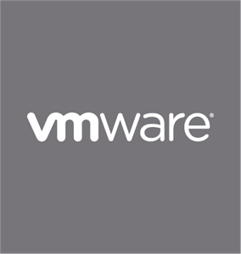
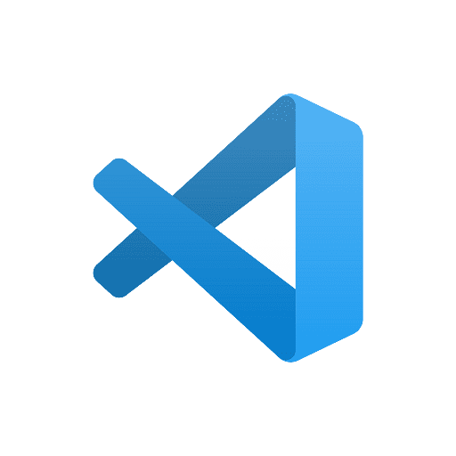
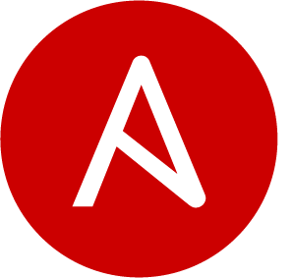
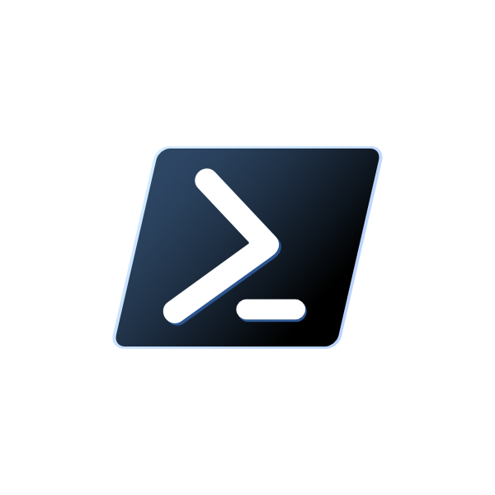
What’s Involved?
Notes:
VSCode & Ansible with PowerShell and Terraform
GitLab
Ansible Automation Platform and AWS CloudFormation
Vmware / Openshift / Azure / AWS
For Infra as code, we are creating a lot of resources in onprem and cloud.
VMware
Create VMs
Setup Tagging
VLANs
VM Folders
DRS Rulesets
Azure
AVD Hostpools / Power Schedules / Application Config
Azure Networking
Entra ID AUs
Openshift
Making Deployments / ConfigMaps
AWS
Makes Accounts / VPCs / Subnets / RBAC
For config as code, just remove all platforms on the right side and just envision your application there instead

Slide 6
What is Ansible?
Open-source automation tool that can automate:
Configuration Management
Infrastructure as Code / Config as Code
Task Automation
And more!
Agentless
Declarative language
Idempotent
Can manage various systems:
Servers
Networking Devices
On-prem & Cloud Infrastructure
Notes:
Agentless - Ansible operates over SSH and WinRM, making it agentless and eliminating the need to install any software on remote systems Declarative Language - Ansible uses a simple and human-readable YAML syntax to describe the desired state of your systems.
Idempotent – A task in Ansible could be ran multiple times only making changes if it needs to. You can run it once or 1000 times and it only makes change 1 time
IT professionals with specific domain expertise—like in network, security, or cloud—can create playbooks without having to learn a complicated coding language.

Slide 7
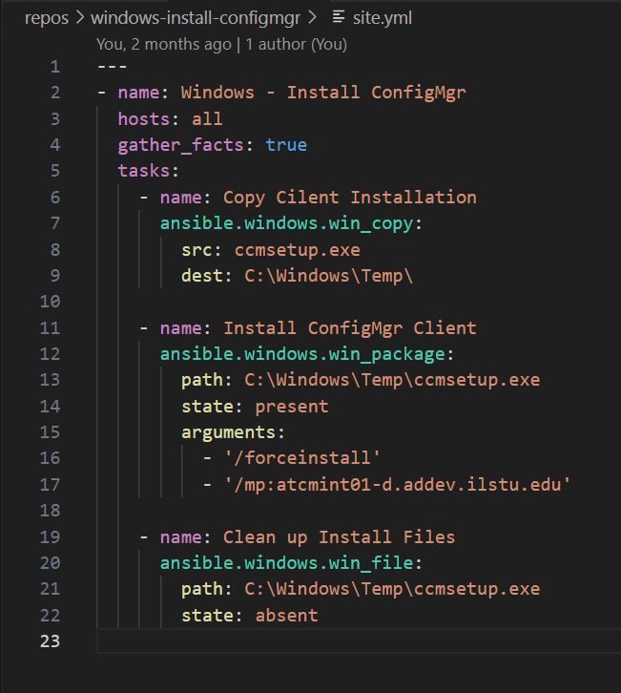
Ansible Playbook
YAML File
Name your tasks
Pick an Ansible module
Define parameters for the module
Module Index
https://docs.ansible.com/ansible/latest/collections/index_module.html
Notes:
Components: Control Node, Managed Nodes, and Inventory.
Communication with managed nodes using SSH or WinRM.
Ansible Playbooks: YAML-based syntax.

Slide 8
Ansible Automation Platform (AAP)
Automation Controller
Control Plane
Has an UI, API, and CLI
Role Based Access Control
Execution Environments
Control Nodes
Job Runners
Scheduling Jobs
Notes:
Think of it sort of like Rundeck, but for Ansible content.

Slide 9
What are the Benefits Overall?
Control.
Implement Coding Practices
Branches / Merge Requests / Review & Approvals
CI/CD Pipelines
Consistency.
Eliminate Configuration Drift
Scheduled Job Runs
Matching Config in all Environments
Dev > Test > Prod
Documentation.
Self documenting
Helps avoid undocumented & ad-hoc changes
Speed.
Create code once > Deploy many times
Spin-up a Test or a Prod environment quickly
No Clicking through GUIs
Notes:
Documentation
Helps avoid undocumented & ad-hoc changes – Tech Debt of someone that used to work here
Speed
Create code once > Deploy many times – AD Example
Spin up a Test or a Prod environment quickly – Just change a where it is targeted and any environment specific variables

Slide 10
Let’s Dive In.
Notes:
Install IIS
Web-Server
Install .NET Framework 4.8 Runtime
dotnetfx
Install ASP.NET Core Runtime Hosting Bundle
dotnet-6.0-windowshosting
Check if LabStats is Installed
programfiles_folders
Delete the Default Website
Default Web Site
when: "'LabStats' in programfiles_folders.files | map(attribute='path') | list"
Ensure Labstats is running on port 80
WebManager

Slide 11
Get Started
Installing Ansible: Ansible Docs
On Windows:
Install Windows Subsystem for Linux (WSL)
Use Latest Version, v2
On macOS/Linux:
Natively supported
Write Playbooks using Visual Studio Code
Ansible & WSL Extensions
VS Code & Git Integration
Getting Started with AAP
Request Access Today!
Read our Getting Started guide: https://help.illinoisstate.edu/technology/server/guides/get-started-with-the-ansible-automation-platform

Slide 12
Questions?

