Slide 1
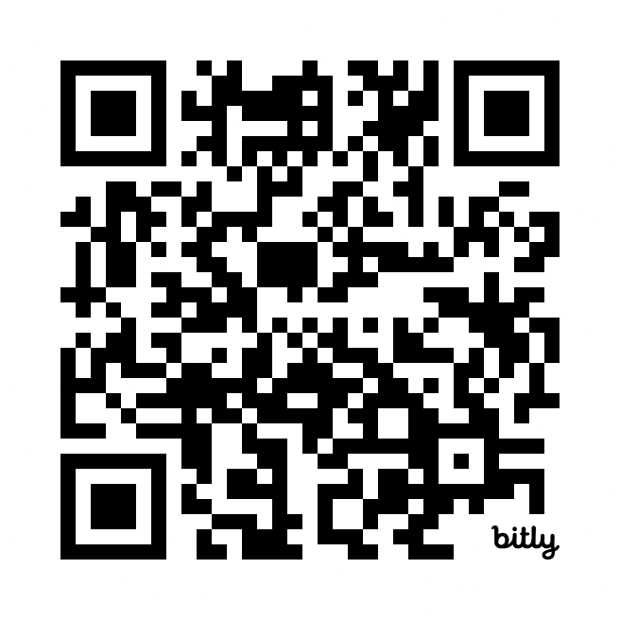
While We Wait:
Historical Data Survey: https://bit.ly/3LzveeA

Slide 2
A First Look At Our Future ITSM
Presenter: Tyler Piper, Interim Director of IT Service Management
Tech Facilitator: Ben Rappleyea

Slide 3
Replacing Cherwell
Tentative Project Timeline: September 2024 to June 2025
Go Live – January? March? May? 2025
When the platform is ready, AND training is complete.
Goal #1 – Replace Existing Cherwell Functionality
Change, CMDB, Incident, Service Request, Portal….
Out of the Box Configuration
Learn ---> Review ---> Revise

Slide 4
Session Housekeeping
Everything you see is subject to change.
This is not training. Focus on what, not how.
Ask Questions!
What does that button do?
How could we use that feature?
Give Feedback!

Slide 5
Demonstration Topics:
Roles
General Navigation
Personalization Settings
Workspaces & Dashboards
Record Types:
Interactions
Incidents
Service Requests
Cases (Future)
Visual Task Board
Side Bar
Virtual Agent
Customer Portal
Employee Center
Change Management
Other As Time Permits…

Slide 6
Features of the Future
API (Day 1?)
Virtual Agent
Teams Integration
Ansible Integration
Tech Alerts Replacement
What would you like to see?

Slide 7
Questions?
https://bit.ly/3LzveeA

