Slide 1


Slide 2

Welcome to the
2024 CIT Annual Conference

Slide 3
Keynote Address
Illinois State’s 21st President,
Dr. Aondover Tarhule

Slide 4
IT News

Slide 5
IT News Rules of the Road
This session is being recorded and will be posted to the CIT web site
Please keep your mic on mute if joining the Zoom
Questions are welcome if time permits at the end
  In person attendees, raise your hand we’ll bring the mic to you
  Online attendees, put your question in chat and we will repeat it in the room

Slide 6
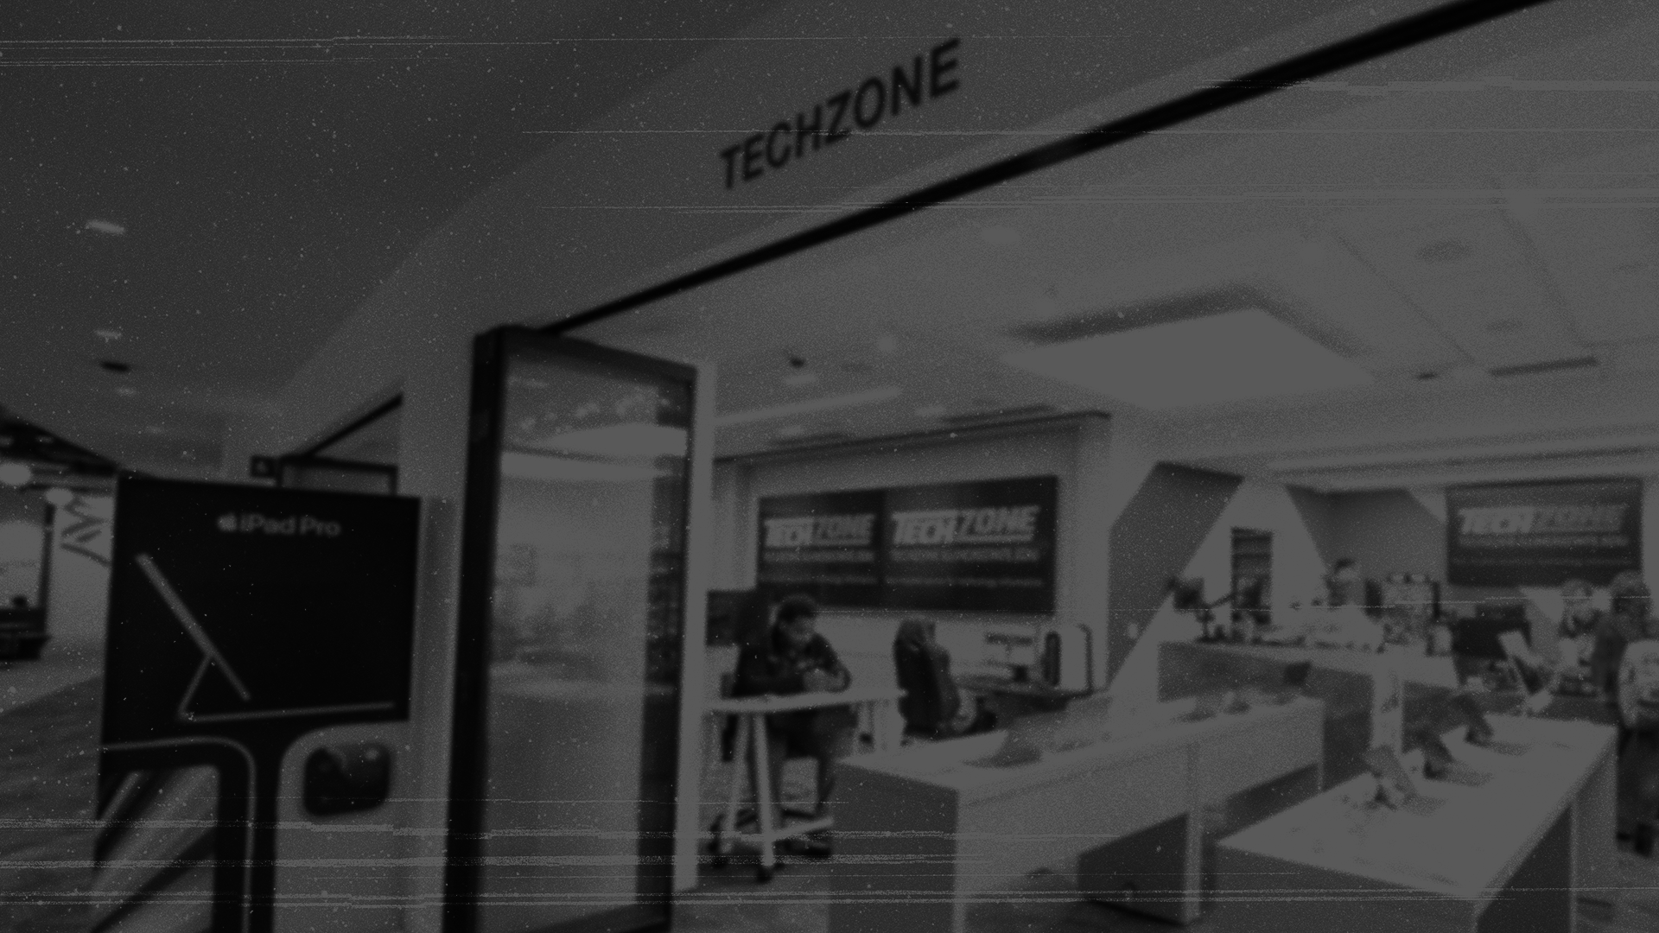

Slide 7


Units purchased by departments
Dell
Latitudes | 173
Optiplex MFF | 359
Optiplex SFF | 245
Chromebooks | 120
Precision | 203
Total | 1100
Lenovo
Desktops | 13
Laptops | 953
Total | 966
Apple
Desktops | 40
Laptops | 50
iPads | 134
Total | 224
Dave Greenfield

Slide 8
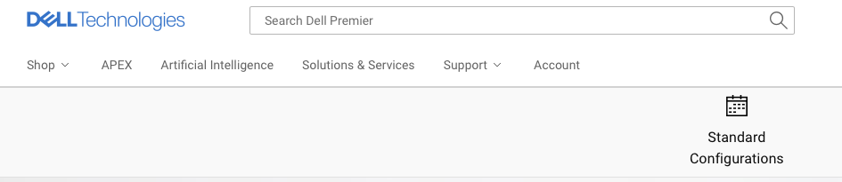
Dell ordering procedure
Start with Standard Configurations as they usually have the best price
Start here
Dave Greenfield

Slide 9
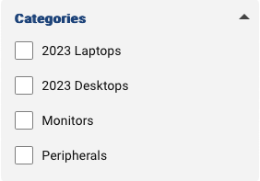
Dell ordering procedure
If what you need is not there, search Premier and create a quote as normal
Before submitting the Formstack please email your quote to TechZoneSales@IllinoisState.edu for pricing review
Once Dell issues a new quote, it will be sent back to you for approval, at which point your order will be placed
Detailed instructions can be found at TechZone.IllinoisState.edu under Departmental Orders
Dave Greenfield

Slide 10
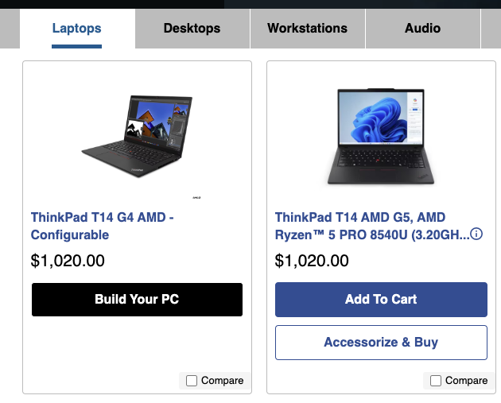
Lenovo ordering procedure
Build Your PC should have full customization options turned on
Accessorize and Buy will not allow any component changes; generally ignore these
Dave Greenfield

Slide 11
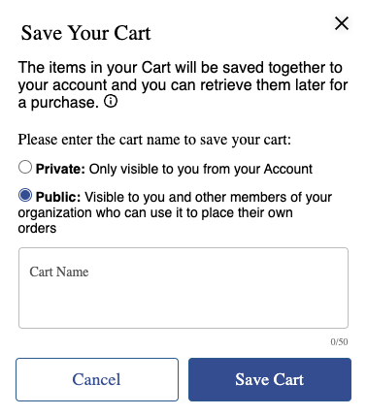
Lenovo ordering procedure
When saving your cart, always make sure Public is selected as no one has visibility for Private carts other than you
Detailed instructions can be found at TechZone.IllinoisState.edu under Departmental Orders
Dave Greenfield

Slide 12



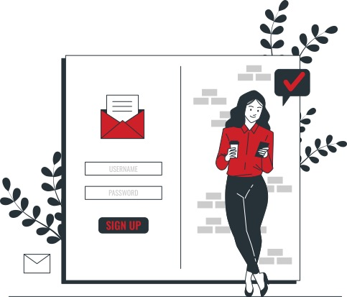
Top Tech Tips for new students
Get your devices connected
Campus technology orientation
Download software
Sign up for alerts
Microsoft
& Adobe
Dave Greenfield

Slide 13
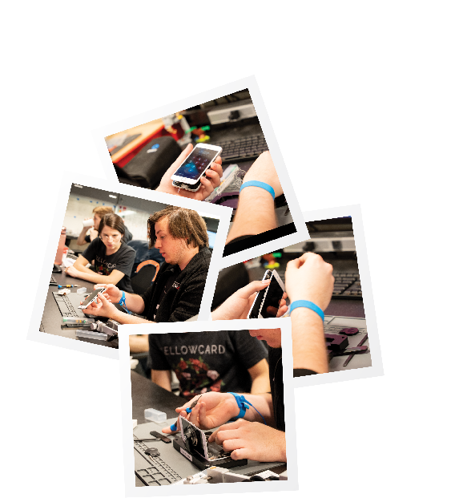
TechZone Repairs iPhones
In- and out-of-warranty iPhone repairs available
iPhone 8 / SE 2nd Gen or newer
Most replaceable parts in stock (screen, battery, cam, etc.)
Whole-unit replacements available for catastrophic damage
Apple School Manager / MDM management available for ISU-owned iPhones
All iPads & accessories (Beats, Pencil, etc.) remain mail-in repair only
Dave Greenfield

Slide 14
Redbird Exclusive Bundle
Save an additional $75 on any 13-inch MacBook Air or save $100 on any 15-inch MacBook Air or MacBook Pro when you include AppleCare+ in your purchase
Ultimate Redbird Bundle
The Redbird Exclusive bundle plus a 4th year added onto your AppleCare+ warranty and no service fees
Dave Greenfield

Slide 15

*Offer ends on September 30, 2024.

Slide 16






University-Funded STAT Programs for 24-25
SPSS Premium 27, 28, 29
(Includes Tables & Forecasting, NOT Amos)
SAS 9.4
Mathematica 14.0.0
MiniTab 22
STATA 18
MATLAB
Users can access at VirtualApps.IllinoisState.edu
IT staff can get package from SCCM
Dave Greenfield

Slide 17


University-Funded Software for 24-25
ArcGIS
Grammarly
Jamf
Users can access at VirtualApps.IllinoisState.edu
IT staff can get package from SCCM
Dave Greenfield

Slide 18

Adobe License Review
Full or “Download” License
All apps with 100GB Cloud Storage
Two Mac/Win download instances
  Fac/Staff/GAs automatically assigned
  Students upon request: About.IllinoisState.edu/Adobe
Base License
2 GB Cloud Storage
Student initial assignment
Labs/Classrooms/Open Areas
Shared Device License which uses logon
Others create a free Adobe ID
Dave Greenfield

Slide 19

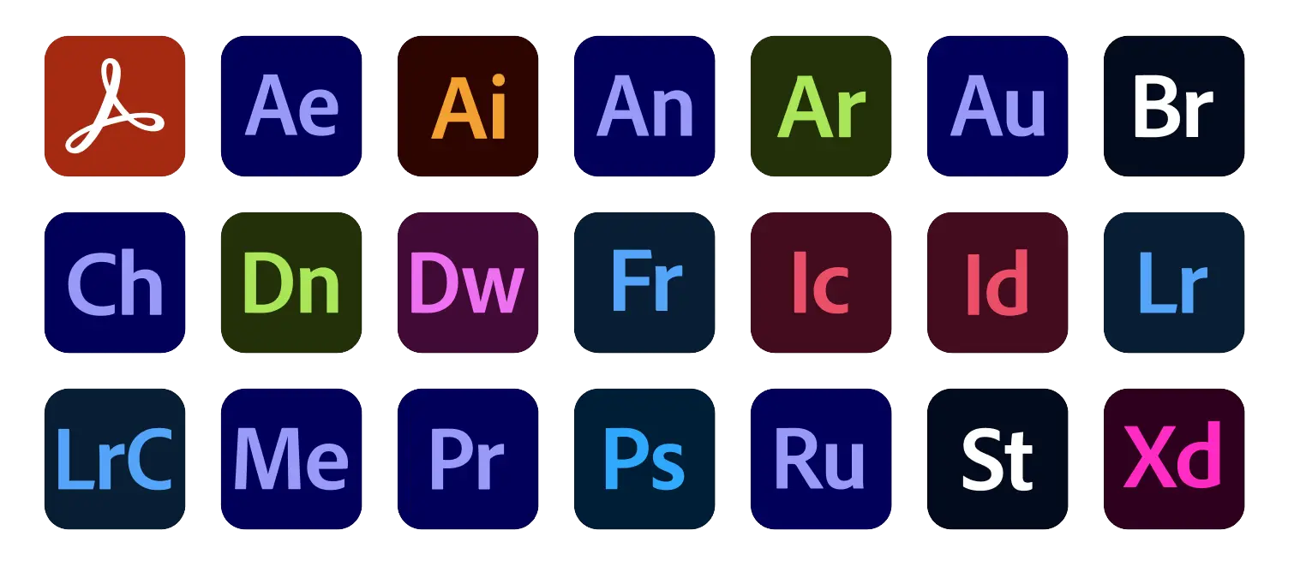

Adobe Product Updates
Express continues to gain more features: social media, video, photo, and document creation. Requires full license.
Firefly beta technologies (with generative graphic AI capabilities) have been incorporated into existing apps such as Photoshop and Express
Adobe Stock now included
Dave Greenfield

Slide 20

Microsoft License Review: A3 to A5
Timing
September – Renew A3
Sept to Nov – Pilot work
December – Implement A5
Benefits
Teams Converged Communications (Voice and Cisco VOIP)
PowerBI Pro
Security and Compliance Enhancements
AI Readiness
Dave Greenfield

Slide 21
Academic Software Request Process
Why have a process?
In scope
  New academic software
  Any (new or renewal) academic software that needs to integrate with Canvas or Microsoft 365
Out of scope - trial software, coding languages, electronic resource subscriptions
Carla Birckelbaw
Notes:
All about managing risk and ensuring an equitable user experience – all software, regardless of cost, includes implications for privacy, accessibility, licensing, information security, compliance, and user support
We were asked to try and streamline this process and provide more transparency
Literally thousands of pieces of software in use – needed a reasonable goal

Slide 22
Academic Software Request Process
Requestor fills out request form
College IT team and Dept Chair review
Tech Solutions handles compliance review
  Data Usage Form
  Accessibility
  Export Control
  Terms & Conditions
Software purchased/acquired
Carla Birckelbaw
Notes:
Process can be halted at any step of this sequential process
Key portion is #3, where the Tech Solutions Business Administration and Communications Team takes on the heavy lift of coordinating all of those compliance reviews for the user
Updates to requestor, college IT and Department Chair throughout the process
Still a time-consuming process overall

Slide 23
Academic Software Request Process
Some key resources related to this process:
Software Catalog
Requesting Academic Software knowledge article
Academic Software Use Cases knowledge article
Questions? Contact softwarerequests@ilstu.edu
Carla Birckelbaw
Notes:
The Software Catalog includes software that has been reviewed – a small list for now that does not reflect all of the software in use or even all that has been reviewed. It will grow over time.

Slide 24
CIT MVP Award
The MVP Award recognizes one full-time technical staff member each year in the Illinois State University community for outstanding contribution(s) to the support of faculty, staff, students, and/or operations, as well as collaboration with others.
Notes:
Ask the 3 nominees to stand, and deliver mug to them, then announce winner.

Slide 25
CIT MVP Award Nominee
Jeff Grabb
Technology Solutions LSAVT team

Slide 26
CIT MVP Award Nominee
Jason Ross
Technology Solutions Endpoint Support team

Slide 27
CIT MVP Award
And the 2024 winner is…
Jason Ross
Technology Solutions Endpoint Support team
Notes:
Introduce Montana McGowen, who will say a few words and then Jason will also say a few words
Winner mug & plaque will be at instructor station, also deliver mugs to nominees

Slide 28
Congratulations on your retirement!
Laurie Dale, Tech Solutions App Admin team (May)
Debbie Folks-Huber, Tech Solutions DBA team (July)
Dave Greenfield, Tech Solutions TechZone team (Oct)
Notes:
Debbie is here today, in her career she worked for the Army, at the U of I, and then finished up back here at her alma mater as the DBA Team Manager in Tech Solutions
Dave…

Slide 29

Thank you!
Many thanks to the
Presenters
and Tech Facilitators
who make a
hybrid CIT event possible
Notes:
Have presenters stand, and then tech facilitators
Note that they have CIT coffee mugs as a thank you on the table at the front of the auditorium
Have planning committee stand and thank them as well

Slide 30
Achieved since CITx
Implement A5 Security Services
Create Auxiliary Facilities Reporting
Implement Improvements to the Policy Approval Process
Improve MCN Preceptor Agreement Process
Implement State Federal State Employment Taxes Program
Implement Canvas LMS
Send All GPAs from Slate to Campus Solutions
Implement Key Management Boxes Software
Analyze Solution to Replace University sponsored Travel Notification
Upgrade SQL Server 2014 databases to SQL Server 2017 or SQL Server 2019
Identify Available Data from Canvas
Implement Learning Tool Integrations
HCI Prod Up and UCS Decommission
Transition LSAVT Asset Management to Cherwell
Bring OEM Data into the EDW and Update PowerBI reports
Automate Pickup of GRE and TOEFL Test Files
DECOM RHEL Servers
HPC added new GPU node, Software Upgrade
System Inventory Efforts
Citrix ADC Refresh Load Balancers
MS 365 Stream on SharePoint
UC Replacement HW from UCS
Standardize and Best Practices for Batch Scripting
Printer communication campaign
Update ER Studio and Tortoise with missing tables
Event Driven Ansible Dev Testing
Upgrade RHEL 7 Servers
Share Data with Follett Bookstore
Wired Network Upgrade Phase 2
Wireless Upgrade Phase 1
HCI migration from UCS
Restructure Receipt Downloads from JP Morgan
Create New Leave Reporting Codes
Acquire data and build DW for Canvas Outcome data
Create Outcome Reports from Canvas
Create FTC Enrollment Status Summary and Detail reports
Cleanup Unused Java
Implement Simplicity GME
Analyze1st Quantitative Course performance for FTIC
Analyze 1st Major Related Course
Create MAPS Program Profile reports
Share Data with Cornerstone
Add New Address Fields to PRPA Files
Updates to Student Success Dashboards
Create Student Affairs Restricted Demo Agg tables
Building a feature store database table and app
Interim Grade Submission Status Report and Dataset Performance Enhancements
Add Deletion Logic to the Academic Application and Applicant Dim tables
Analyze Impact of Ensemble Participation
IBHE Waiver Detail and Summary Reports
Create Bone Scholarship Nominee Report in Cognos
Encourage Students to Submit SSN
1st Language Course Enrollment Cognos Report
Class Room Utilization Reporting
Year Over Year Withdrawal Comparison Report
Identify Any Needed Accudemia Data
Update SSD with Predicted Values from the Persist Model
Update PRPA Admissions Table to Account for Additional Plans
Update to New GMAT Test Version in ETL and BI
Add Alerts for Data Acquisition jobs
Community College Transfer Reporting
New Cayuse Events Report in Cognos
Search IllinoisState upgrade
65+ Projects
+ $2.13m IT Research Revenue
Craig Jackson

Slide 31
Infrastructure by the Numbers
Servers (784)
  462 Windows/258 Linux/64 Appliances
Databases
  30 Clusters, 40 Stand Alone DB Servers
Network
  Wireless - Avg 23k active connections, peaked at 39k
  Wired- Avg 7GB bandwidth in use, 15GB peak
Data Backups:
  On-prem - 1.04PB Cloud Copies 2.5PB 8+ Restores per Month
EDW Stats: 2800 GB growing at 1.2 GB/day
  588 unique users, 375 Dashboards/Reports used 127x/day, 40 Data Sources (+5 in FY25)
Craig Jackson

Slide 32
Support by the Numbers
FY24 Tickets: 93,489 Resolutions (All Teams)
  60% Resolved within 24 Hours
  57% Faculty/Staff Tickets. 54% Resolved within 24 Hours
  Tech Solutions 2024 Trend: 77% of total, highest % since 2018. +9% to 64% of all F/S tickets resolved
User Accounts
  59,114 Active User & Service Accounts
Security
  2,028 unique phishing tickets since Jan 1 (YTD), countless emails purged
  1+ accounts locked daily due to compromise, 19 hrs to restore access
  YTD 9,652 total security alert tickets processed
  Defender is currently monitoring 8,300 Mac and Windows devices
Tyler Piper
Notes:
*

Slide 33

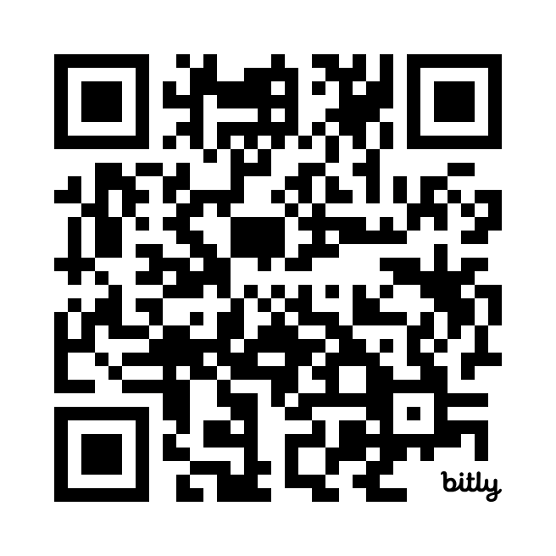
Where is the new ITSM?
Cherwell -> S Sept ‘24 – June ‘25
Historical Data Survey:
https://bit.ly/3LzveeA
Tyler Piper

Slide 34
Operations Updates - Knowledge
Knowledge Champions Group – Fall 2024
  A Knowledge Champion is a designated person from a team, department, or business unit who has completed training and is responsible for managing unauthenticated (public) content for their respective areas.
Tyler Piper

Slide 35
Operations Updates - Peoplesoft
PeopleSoft PeopleTools upgraded,
what’s different?
  This is the backend upgrade, we actually apply Application Feature updates 3x per year
  The searching experience has changed.
  New accessibility enhancements
Todd Smoak
Notes:
this tools brings about something called Configurable Search that should allow us to tailer application search pages to the needs of ISU vs Oracle default all while being maintained as a configuration and not a customization. adding saved/favorite searches, changing # of results displayed
Using a new accessibility button, screen reader mode can be enabled, keyboard shortcuts, and additional help

Slide 36
Operations Updates – In Progress
Continuous Improvement Efforts:
Orion
CommVault
Ticket Best Practices
Confluence
Todd Smoak
Notes:
Yesterday we just completed an Orion session, CommVault is coming. This Fall will continue to home in our ticket management processes.

Slide 37
Next Challenges Opportunities
Consolidate Print Server Management – Pharos/Uprint, PaperCut, MS
Perceptive Content (aka ImageNow)
Password Management Pro -> Keeper
Teams to replace traditional Phone System
AI – Policies and Tools (FireFly, CoPilot, Zoom AI, ChatGPT, Elvex)
Todd Smoak

Slide 38
The start of the semester is upon us!
We are Prepared!
We are Resilient!
We are not using CrowdStrike! (so we are thankful to not be impacted like the rest of the world for once. Knock on Wood, Fingers Crossed, $$$, etc…)
Todd Smoak
Notes:
what do you need to know that is coming in the next month.

Slide 39
That’s a Wrap!
More great sessions after lunch
Join us at the Pub II after CIT!
CITx in late February 2025
Nominate one of our great student employees for the CIT Student MVP Award – cit.illinoisstate.edu/awards. Due 12/31/24.
Notes:
Remind presenters and facilitators to pick up their coffee mugs as they leave IT News
Remind attendees to form two lines leaving the auditorium for lunch – lunch is the same on both sides, water and seating in the downstairs Atrium

