Slide 2
IT News

Slide 3
IT News Rules of the Road
This session is being recorded and will be posted to the CIT web site
Please keep your mic on mute
Questions are welcome if time permits at the end
In person attendees, raise your hand we’ll bring the mic to you
Online attendees, put your question in chat and we will repeat it in the room

Slide 4
Welcome to the New CVA Rotunda!!!
4 Rooms for (2x80, 2x200+) over 560 seats!
Integrated Mic system and Camera equipped
Over $116K in classroom technology alone…
Special thanks to Academic Enhancement Funds…and a cast of stars…
Jeff Grabb

Slide 5
Thanks Techbirds!!!
Dan Thames and the Networking Wiring Team, Rachel Roach and the Networking Team, Billy and TechZone, Becky Franz and Facilities Planning, Kyle Fisher and Facilities Construction, Crystal Nourie and the Registrar’s Office, Kristie Toohill and Facilities Management, Jason Ross and Endpoint, Rachel Purviance and Logan Vaughn…and as always… Ted, Julia, Ryan, Jeff, Eddie, Irvin, Wade, and Chris!
Jeff Grabb

Slide 6
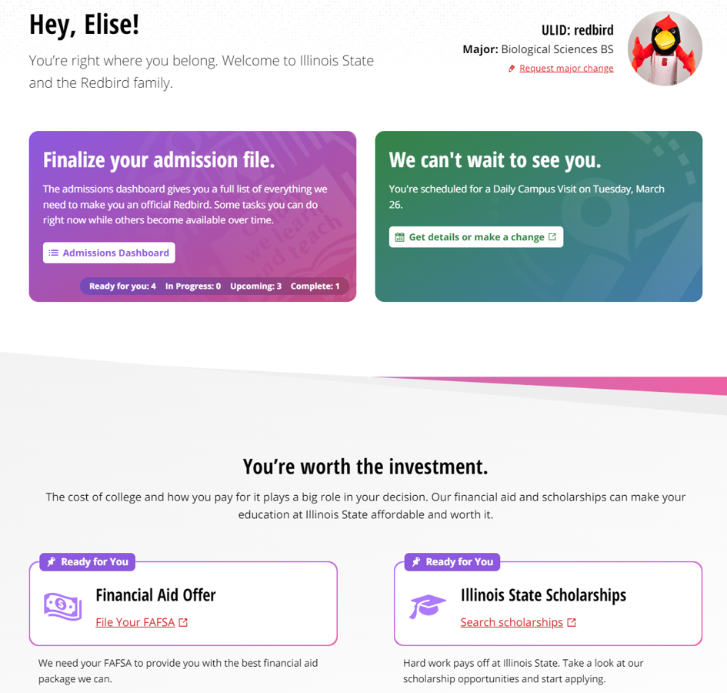
Student Experience in My.IllinoisState.edu
Admitted student journey – vastly improved
Team Excellence Award – Honorable mention
Arturo Ramirez

Slide 7
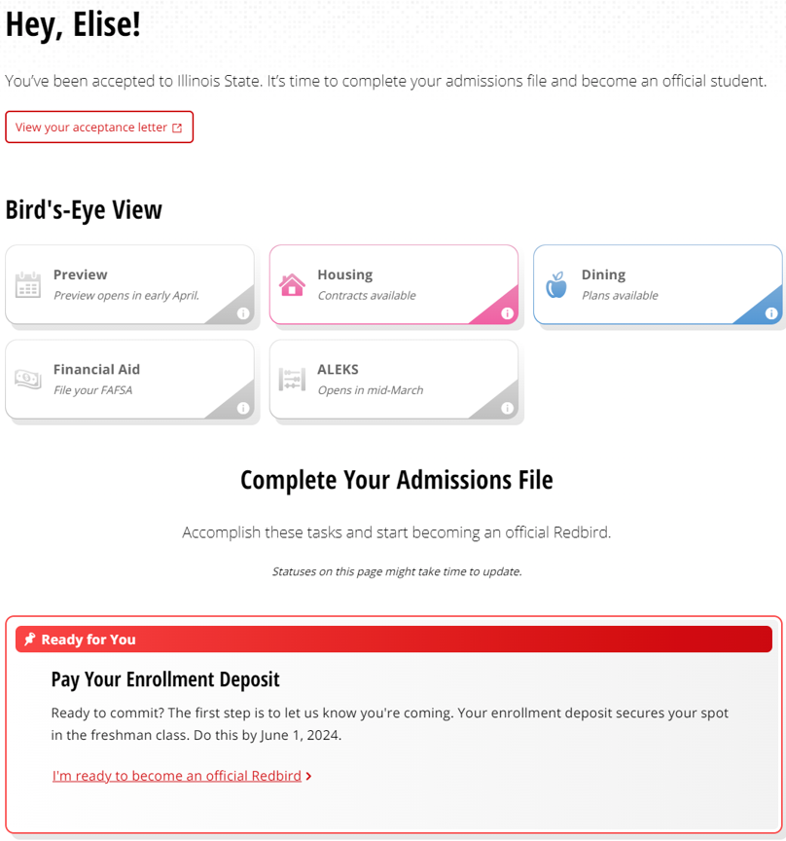
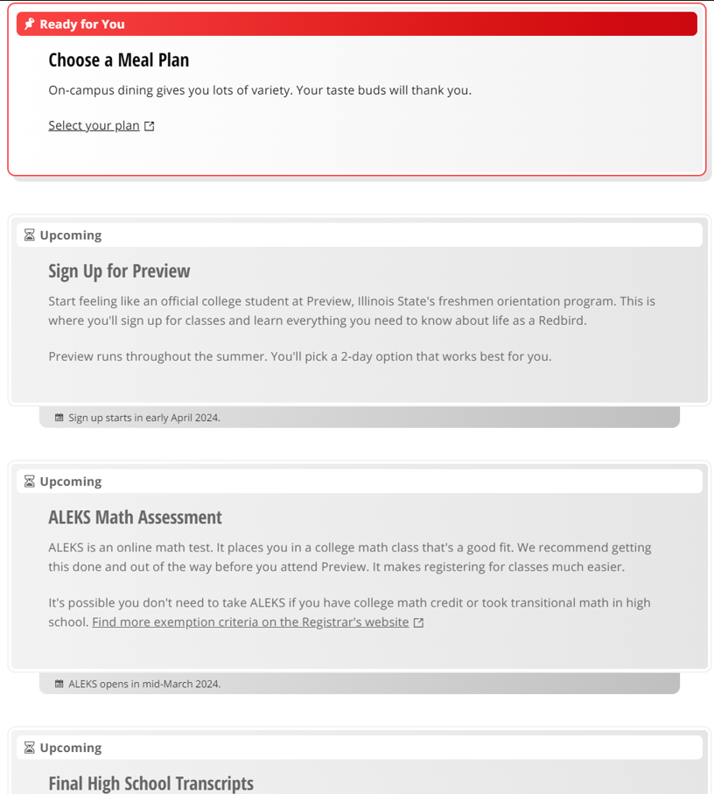

Slide 8
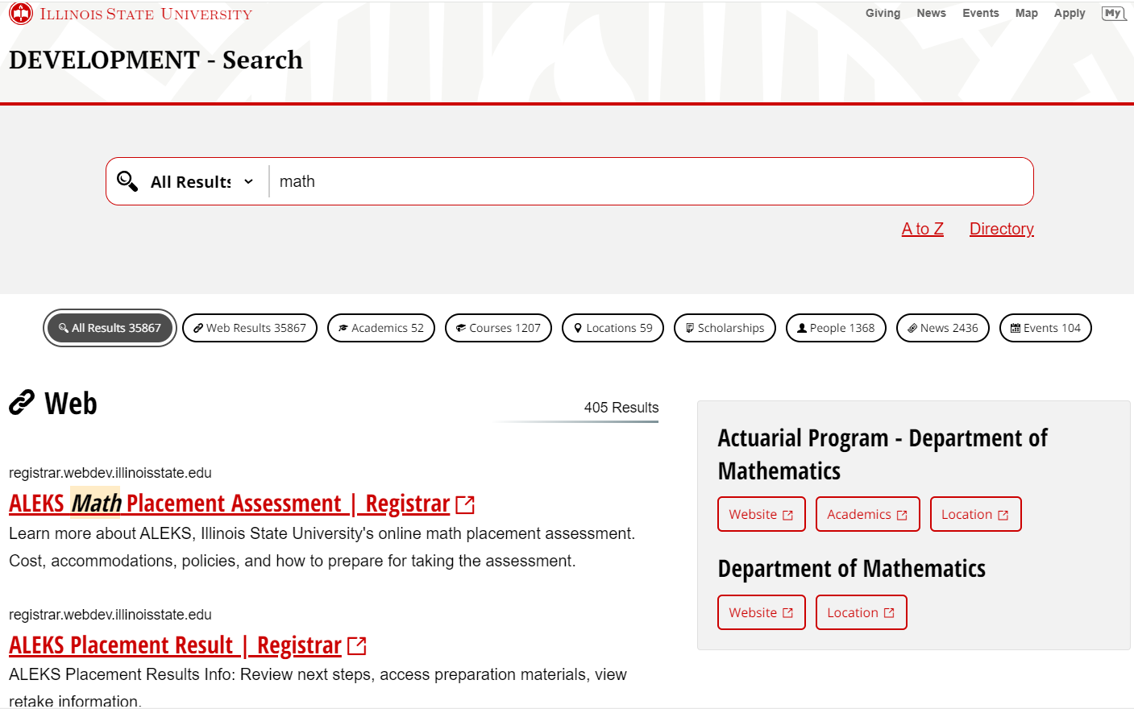
Arturo Ramirez

Slide 9
Student Affairs Updates
Rob Bailey

Slide 10
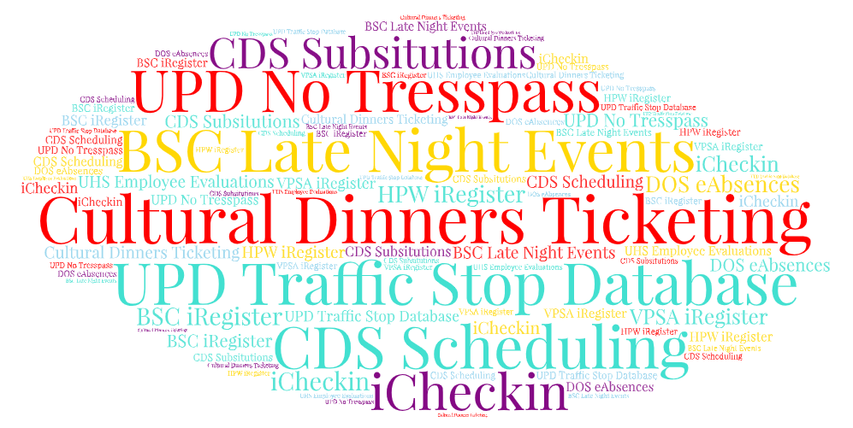
Saying Goodbye to Legacy Systems…
Rob Bailey

Slide 11
Saying Goodbye to Legacy Systems…
15 Months
Twelve Custom PHP Apps
Four Vendor Solutions
Rob Bailey

Slide 12
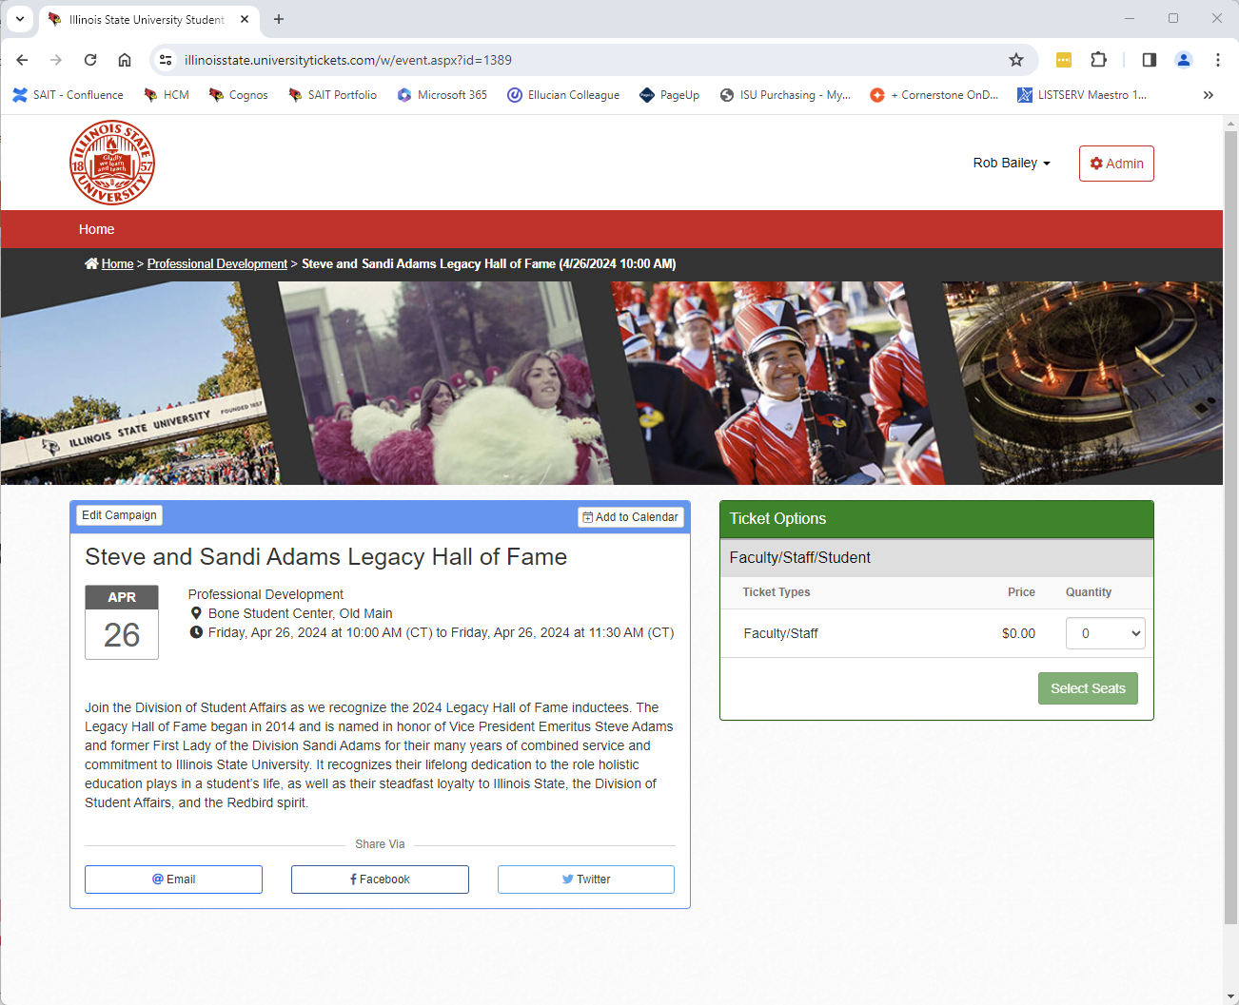
Event Ticketing and Registration System
Free and paid ticketed event registrations for the ISU community and general public
Available for use outside of Student Affairs, contact SAIT for details
Rob Bailey

Slide 13
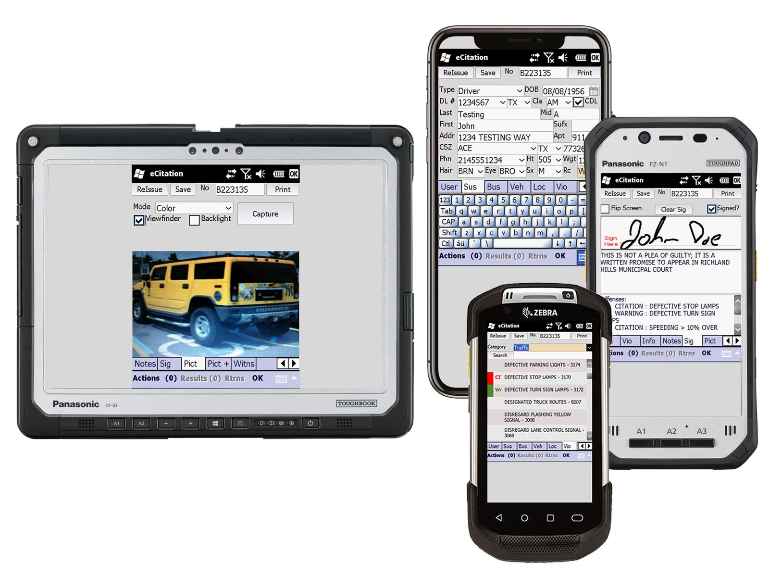
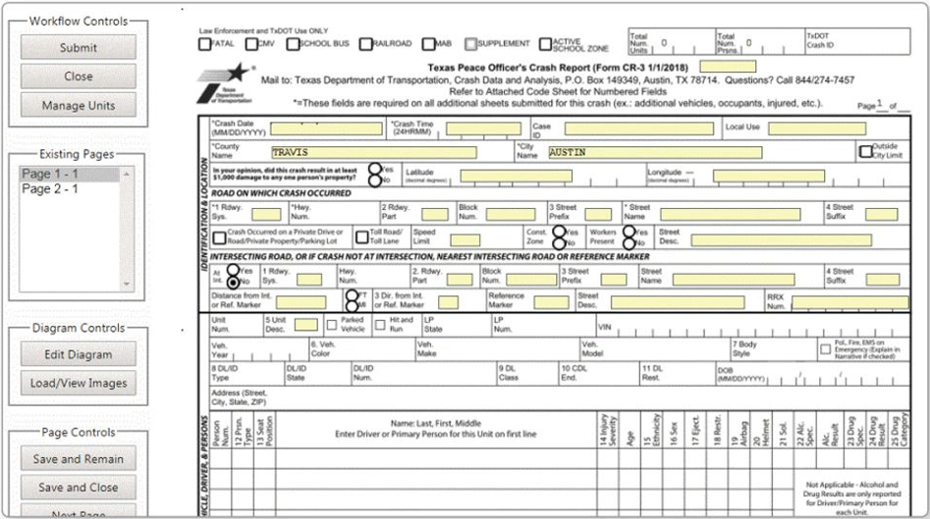
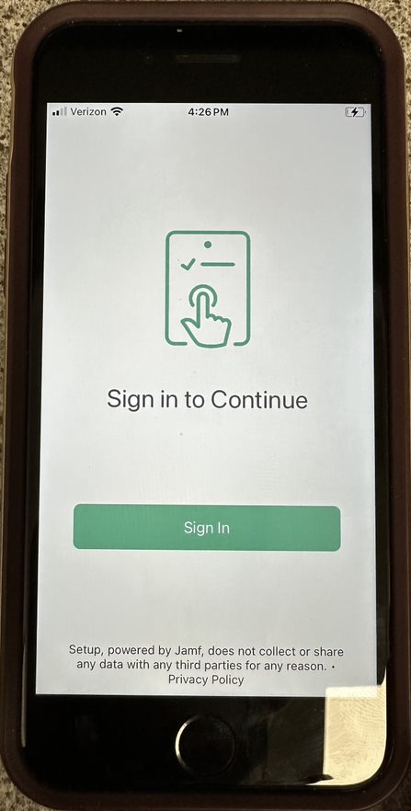
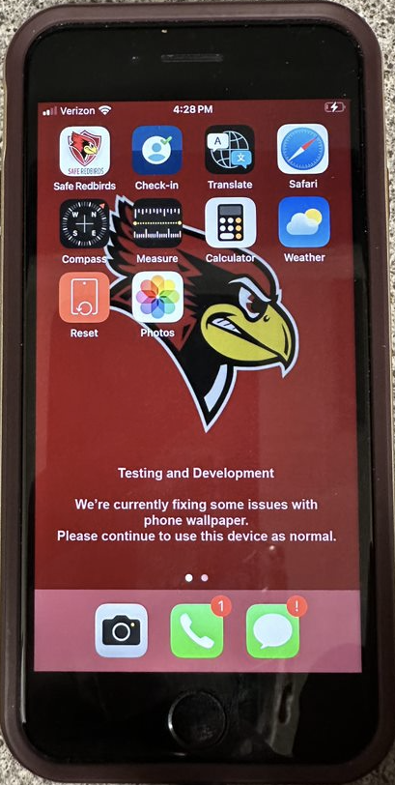
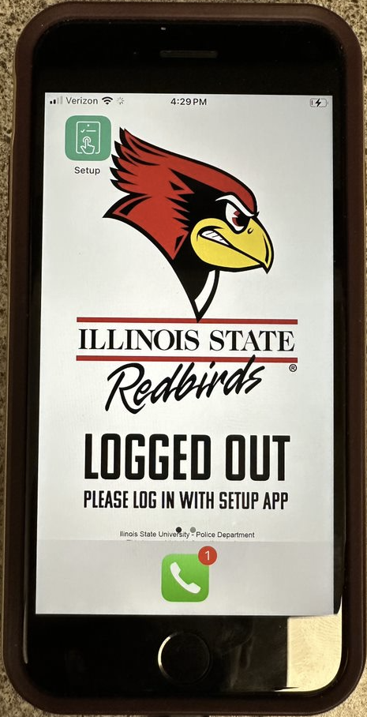
Brazos Mobile Enforcement
Full digital citation system for University Police on mobile
Leveraging JAMF for full mobile profile build (login, setup, and reset) using SSO for iOS devices

Slide 14
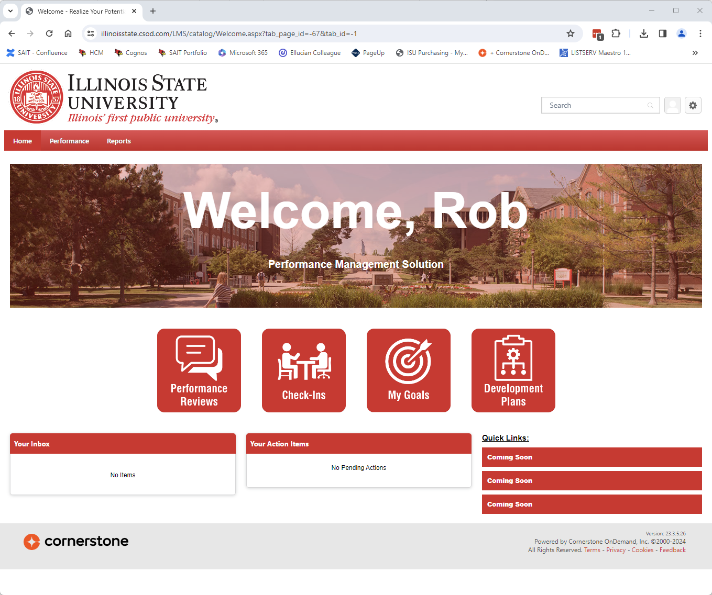
Employee Performance Management
Comprehensive system for managing employee evaluations and performance
Starting with Division of Student Affairs, HR, and Technology Solutions
Rob Bailey

Slide 15
M365 App Management
Default setting allowed users to add apps
650 apps in summer 2021
1200 apps by October 2023
Dan Taube

Slide 16
M365 App Management
User consent restricted in November 2023
Dan Taube

Slide 17
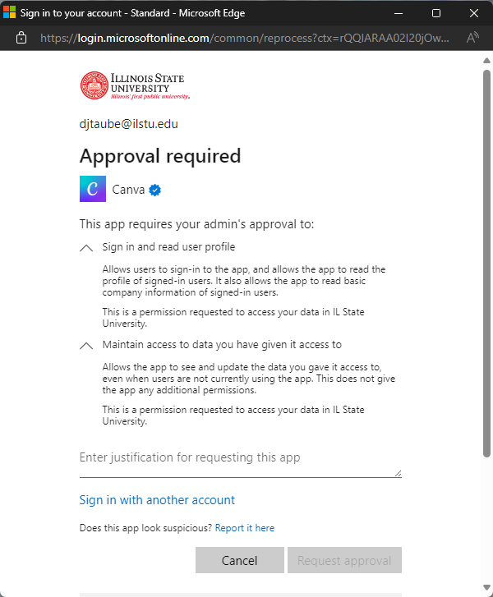
M365 App Management
Dan Taube

Slide 18
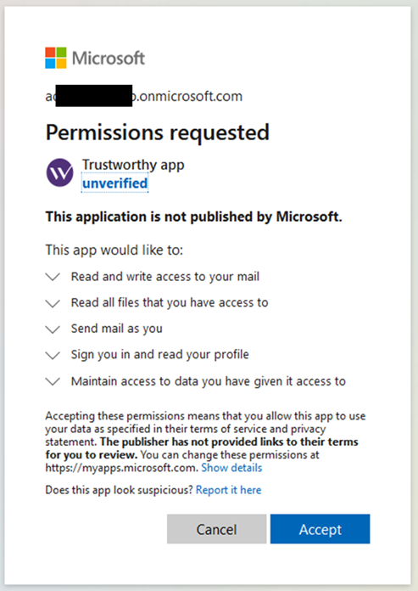
M365 App Management
App consent is like mobile apps.
What are you willing to share?
What are you permitted to share?
Teams, Exchange, OneDrive, SharePoint, and other apps.
Dan Taube

Slide 19
M365 App Management
Dan Taube

Slide 20
Software Requests
Software procurement feedback themes:
Transparency/Communication
Consistency of process
Time
Kev

Slide 21
Software Requests
New process for academic software tools coming next month!
The vision:
The new software procurement process works like a consulting/concierge service. Through coordination with the Academic Technology Review Board (ATRB), requests can be reviewed and processed. If a department has a software request, we first quickly scan existing products to determine if that product or similar is already on campus. If not, we guide the request through the procurement process and keep the customer up-to-date on status.
Kev

Slide 22
Academic Software
Request in Kuali Form
Tech Solutions Checks to See If Exists on Campus/Similar
Associate Dean takes info for review and discussion with requestor
Goes to ATRB for yes/no
IF yes, goes to Tech Solutions Business Office for Cherwell tracking and further purchase coordination (DUF, Accessibility, Export, etc.)
The process at a Redbird’s eye view:
Process similar for 365 apps – if contract exists, good to go. If not, becomes a software request if requestor so chooses.
Kev

Slide 23
Software Requests
Ultimate Goals
Enhance/Simplify the process
Reduce processing times
Single point of contact
Upfront communication of the process
Better documentation of software assets available to campus
Maximize existing portfolio/reduce duplicative purchases
Kev

Slide 24
CIT MVP Award
Announced at the CIT Annual Conference (August 2024)
Nominate a colleague at https://cit.illinoisstate.edu/awards/
Nominations due 6/30/24
Mike Regilio

Slide 25
CIT Student MVP Award
The Student MVP Award recognizes one student employee each year in the Illinois State University community for outstanding contribution(s) to the customers, staff, and/or operations of their technical team, as well as collaboration with others.
Mike Regilio

Slide 26
CIT Student MVP Award Nominees
Natalie Simova, Technology Support Center
Nichol Brown, Center for Integrated Professional Development
Stephen Pytel, ION Networking
Mike Regilio
Notes:
Only Drew Huniak will be present in person, please ask him to stand to be recognized

Slide 27
And the winner is… Nichol Brown
Provided front-line support for ReggieNet-to-Canvas Conversion
Developed and co-facilitated 18 training workshops
Consolidated 11 Canvas workshops into 5
Developed faculty resources for CIPD website
Improved CIPD processes
Ph.D. student & instructor in English Dept.
Instructional Technology Assistant
Center for Integrated Professional Development

Slide 28
Center for Integrated Professional Development
Dr. Anthony Piña – CIPD Co Director
Allison Hauser – Learning Systems Coordinator
Tony Piña

Slide 29
Center for Integrated Professional Development (CIPD)
Retirement of Charles Bristow
Establish Learning Systems Coordinator position (Allison Hauser)
2023 Canvas Implementation by the Numbers
3211 ReggieNet-to-Canvas course migrations
1972 Total attendance at Canvas training workshops
1500 Canvas consultations and troubleshooting contacts with faculty
557 Enrollments in Canvas Fundamentals for Faculty online course
170 Number of Canvas training workshops (in-person & online)
78 Number of spring Canvas pilot courses
60 Number of spring Canvas pilot faculty
Tony Piña

Slide 30
Williams Outstanding Technology Service Award (WOTSA)
Established in 2001 by David B. and Kay O. Williams
Recognizes an individual who has made extraordinary contributions to the University in the areas of technology and service
Criteria includes building a "technology-friendly campus" in support of learning, teaching, research, and creative activities at Illinois State University
Tony Piña

Slide 31
Williams Outstanding Technology Service Award (WOTSA)
And the 2024 winner is…
Todd Thomas
CAST IT
Tony Piña

Slide 32
From TS APPS
PeopleSoft PeopleTools upgrade to begin in May – expect look and feel changes
Want to do more with Splunk, put in a ticket and just ask!
Another App, TS is currently working on…
Todd Smoak

Slide 33
A Mobile Native App
Similar to My
Focused on Current Student (initially)
Front Door to ISU Mobile Experience
Present Desired Content
Make Information Easy to find and Use
Disclaimer: the Ideas/Features you are about to see may depict actual future screen shots but are not necessarily finalized, but I hope it gives you an idea…
Todd Smoak

Slide 34
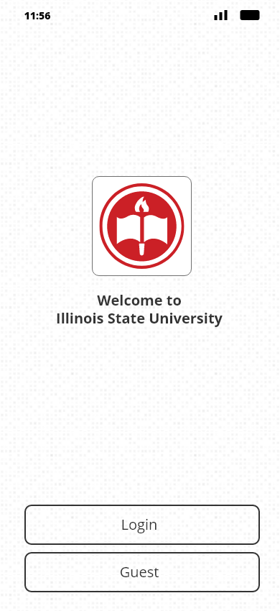
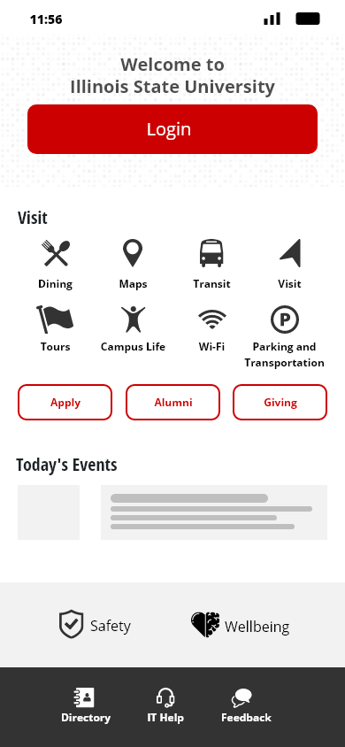
Screenshots? What happen to Live demos?

Slide 35
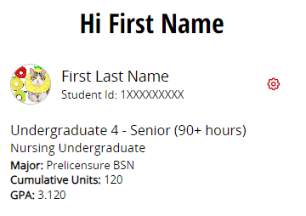
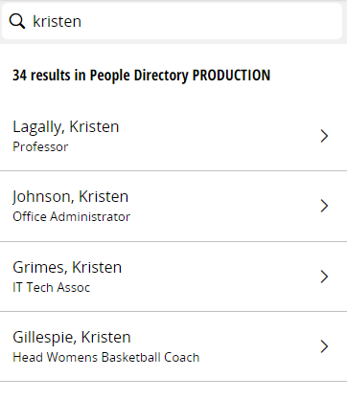
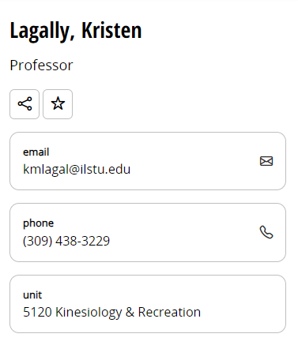
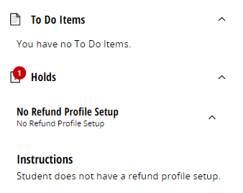
Profile
People Directory
Holds/To Do

Slide 36
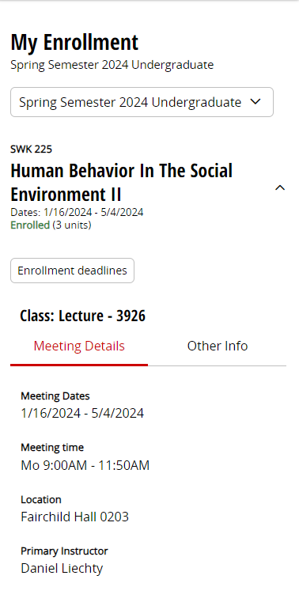
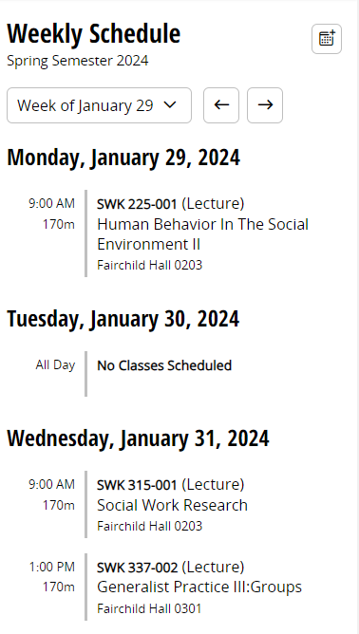
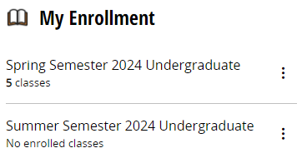
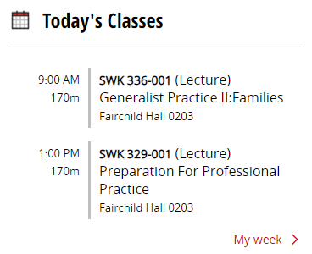
Classes

Slide 37
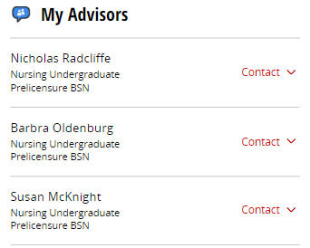
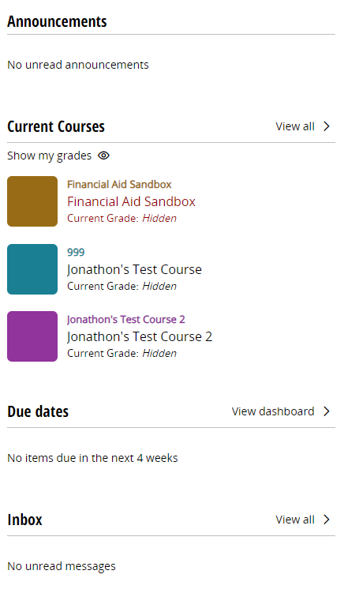
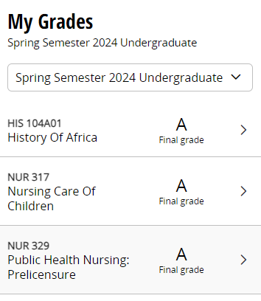
Grades
Advising
Canvas Summary
Todd Smoak

Slide 38
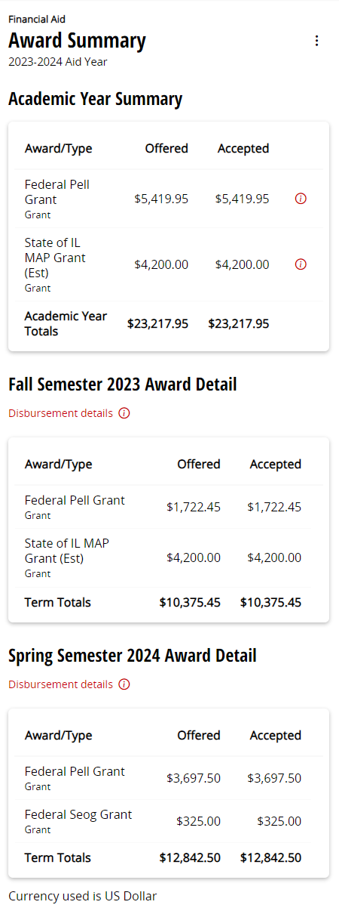
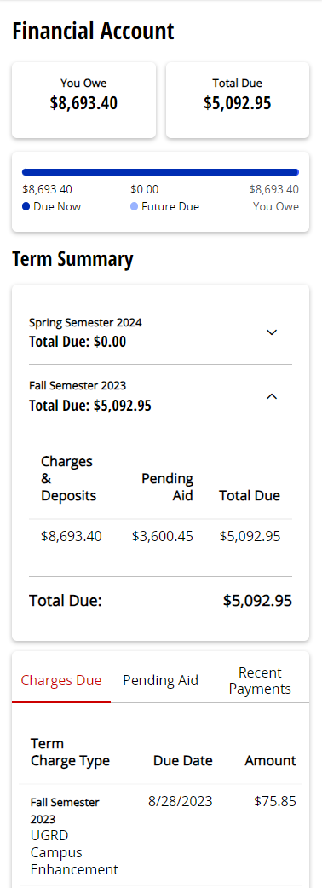
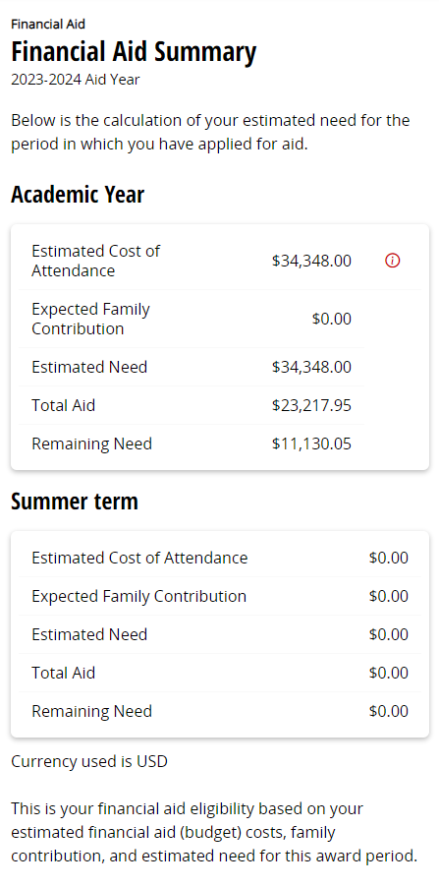
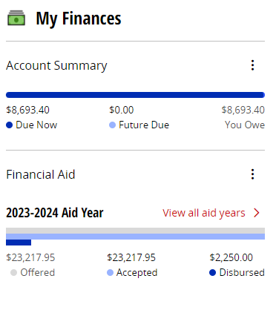
Finances

Slide 39
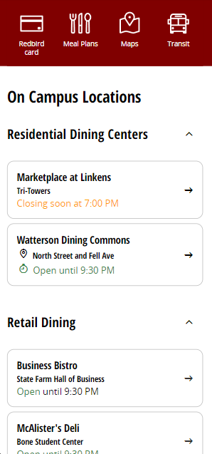
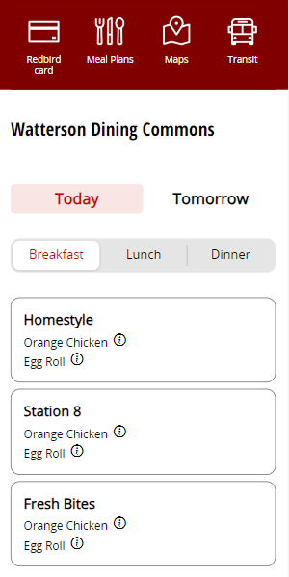
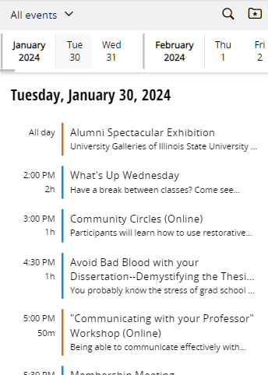
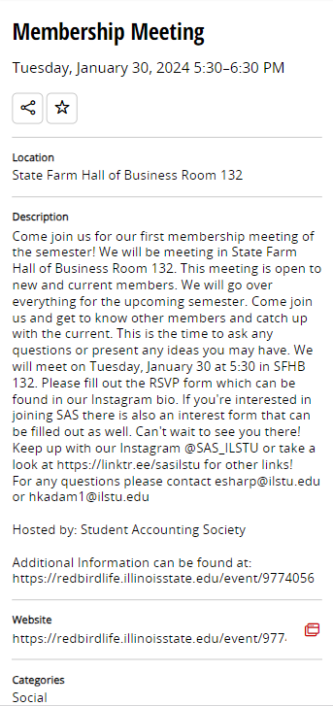
Dining
Events

Slide 40
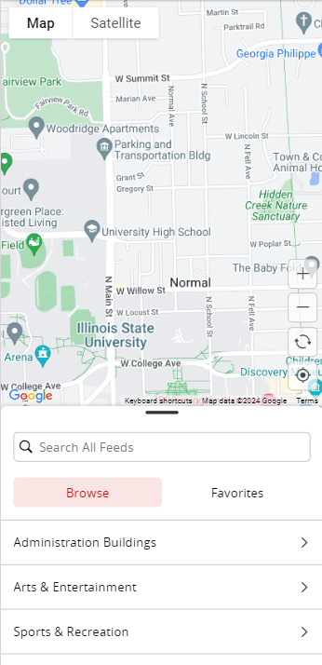
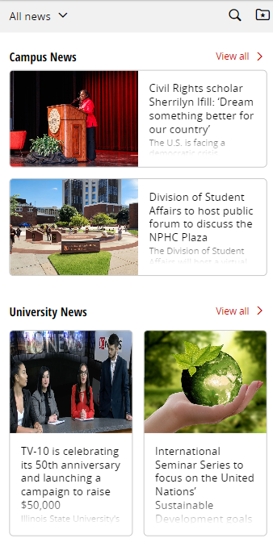
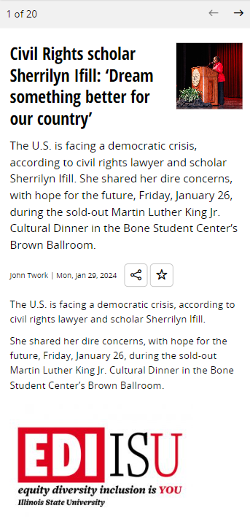
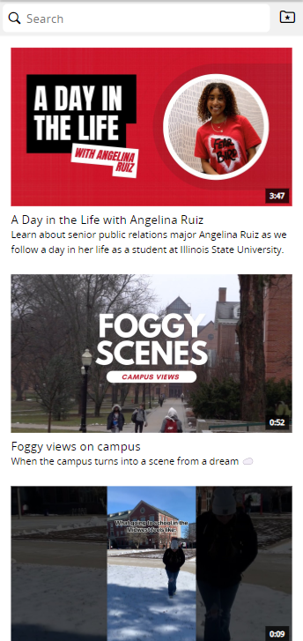
News Articles and Videos and Maps

Slide 41
ITSM Replacement Status
New Go Live – Spring 2025
Tyler Piper

Slide 42
Confluence
Addressing Stability Concerns
Disabled Incompatible/Out-of-date Addons
4 vCPUs to 16 vCPUs
8GB to 32GB RAM
Nightly Server Restarts
Additional Monitoring & Alerting
Tyler Piper

Slide 43
Confluence - Analytics
Help.IllinoisState.edu
Year | Article Views | Article Creations
2022 | 1.13 Million | 5423
2023 | 2.25 Million | 3636
Tyler Piper

Slide 44
Formstack
Project 10713: Formstack Analysis
User Email Sent on 1/2/2024
Capped on Accounts and Forms
Data Security Concerns
Reviewing & Documenting Use Cases
Identifying Alternative Systems
Form Upgrade Effort: New Form Version – Enhanced Features
Must Upgrade Existing Forms by July 2nd (Auto Upgrade)
Custom CSS (Themes) and Embedded Form Visual Issues
Tyler Piper

Slide 45
Tech Infra & Research Computing
Continuous Improvement
Wired Network Upgrade – Phase 1
CUBE Upgrade
SMTP Hardening
Craig Jackson

Slide 46
Service Enhancements
Ansible Automation Platform (SOE)
RHEL Configuration Management
https://help.illinoisstate.edu/technology/server/guides#accordion-auto-01
Auto-Patching Baseline not Manual Patching
Azure AVD
Campus Resiliency Test
Craig Jackson

Slide 47
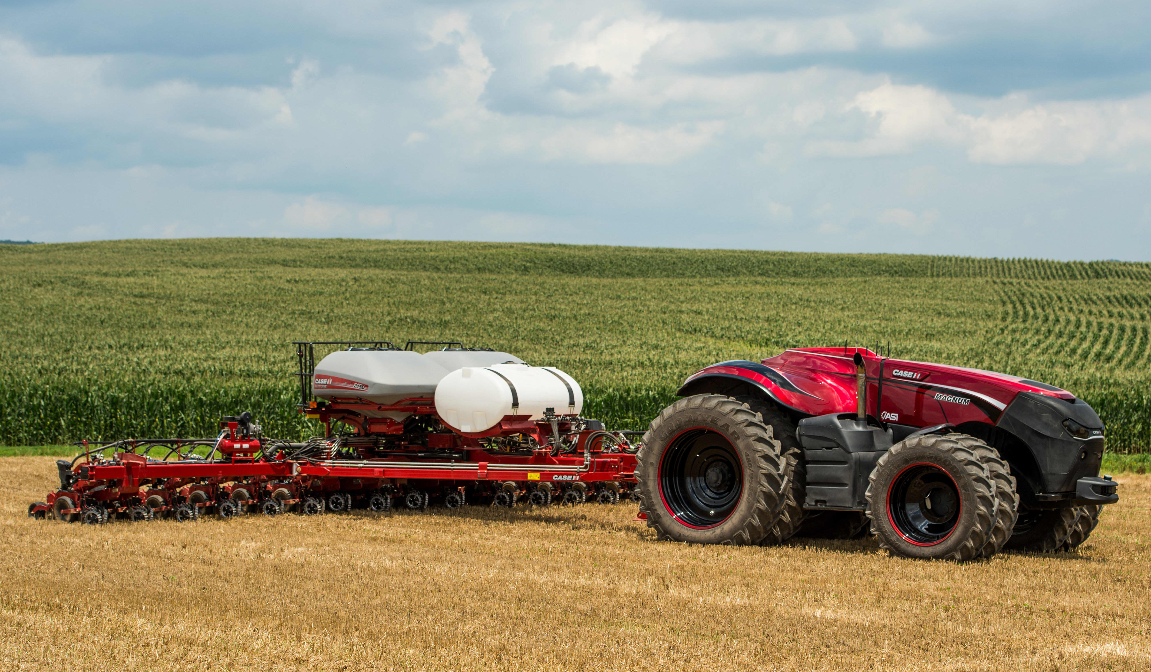
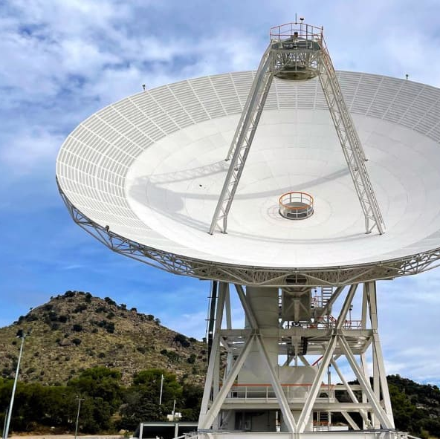
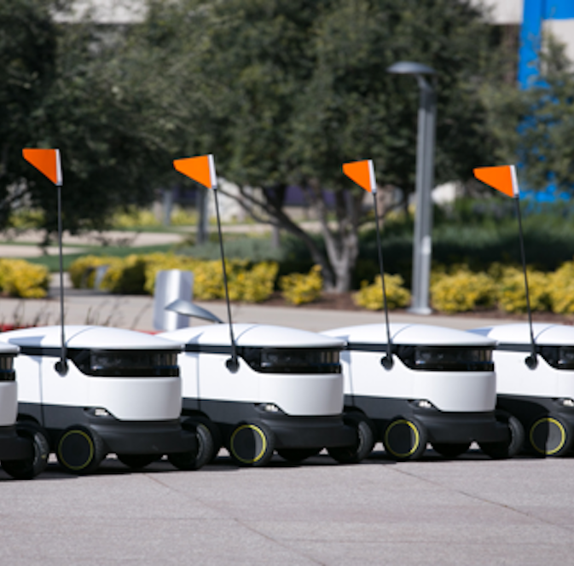
Research Computing
Notes:
Hyperconnected Quad
Robotics, autonomous vehicles, devices
CubeSats & Ground Stations
Satellite dishes to receive data
AI Operations Sub-Committee
Technical testing of apps and services

Slide 48
Redbirds of a Feather, 11 am – 12 pm
From Routine to Remarkable: Recognizing Purpose in Your Work
Ask the Engineer
Knowledge Management Roundtable: Best Practices, Tips & Tricks
AI@ISU: Navigating Artificial Intelligence at Illinois State University
ZOOM ONLY - links in your Outlook calendar invitation

Slide 49
Social Lunch – 12:15 pm
Join us for an informal, social lunch and take advantage of the discounted price of just $8.10! Cash not accepted, bring a credit card or Redbird Card with flex dollars.
ROOM CHANGE: Watterson Dining Commons Culinary Support Center Private Dining Room (walk past Homestyle and Salad bar and look for double glass doors in the North-East Corner)
Zoom links in your Outlook calendar invitation

