Slide 1
Notes:
https://www.redhat.com/en/interactive-labs/write-your-first-playbook
There are 2 ways of using Ansible Playbooks: from the command line interface (CLI) or using the Red Hat® Ansible Automation Platform’s push-button deployments.

Slide 2
Ansible 101: Introduction to Ansible Playbooks and the Ansible Automation Platform
Tech Solutions CCA
Jim Johnson

Slide 3
What is Ansible?
Open-source automation tool that can automate:
Configuration Management
Infrastructure as Code / Config as Code
Task Automation
And more!
Agentless
Declarative language
Idempotent
Can manage various systems:
Servers
Networking Devices
On-prem & Cloud Infrastructure
Notes:
Agentless - Ansible operates over SSH and WinRM, making it agentless and eliminating the need to install any software on remote systems Declarative Language - Ansible uses a simple and human-readable YAML syntax to describe the desired state of your systems.
IT professionals with specific domain expertise—like in network, security, or cloud—can create playbooks without having to learn a complicated coding language.
Idempotent – A task in Ansible could be ran multiple times only making changes if it needs to. You can run it once or 1000 times and it only makes change 1 time

Slide 4
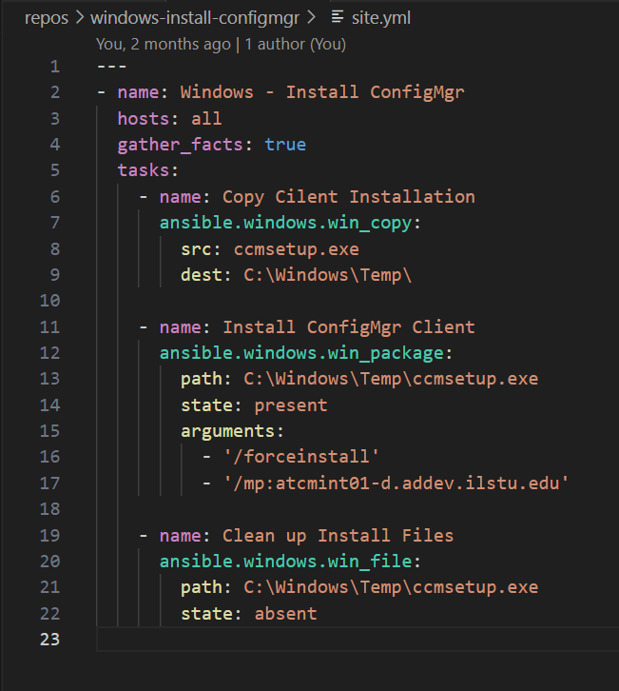
Ansible Playbook
YAML File
A Playbook is made up of plays.
Each play runs one or more tasks.
Notes:
Components: Control Node, Managed Nodes, and Inventory.
Communication with managed nodes using SSH or WinRM.
Ansible Playbooks: YAML-based syntax.

Slide 5
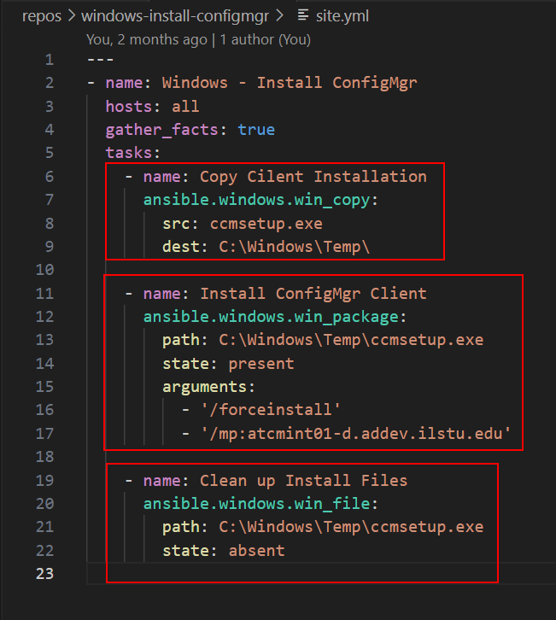
Tasks
Name your tasks
Pick an Ansible module
Define parameters for the module
Module Index
https://docs.ansible.com/ansible/latest/collections/index_module.html

Slide 6
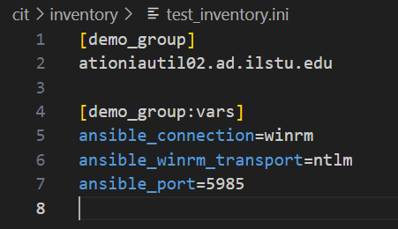
Inventory
Hosts to Target
Inventory File
List of Hosts
Grouping Hosts
Inventory Source Plugins

Slide 7
Running a Playbook
ansible-playbook [playbook filepath] --user [username] --ask-pass --inventory [filepath]

Slide 8
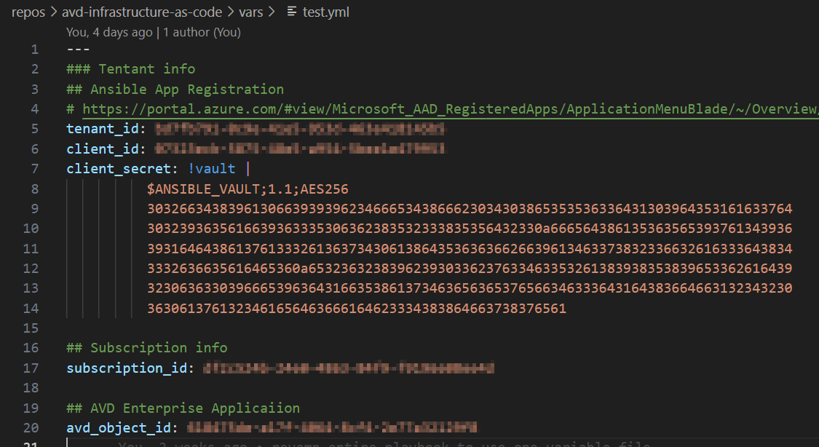
Managing Secrets
Ansible Vault
Ansible Lookup Plugins
AWS Secrets Manger
CyberArk Conjur
HashiCorp Vault
And more!

Slide 9
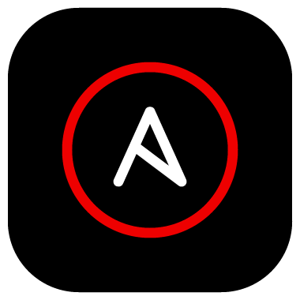
What If I told you…
That we can streamline the process with the Ansible Automation Platform
You write:
The playbook
It handles:
Your Inventory
Your Credentials
Your Runtime Environment
You get:
Push Button Automation

Slide 10
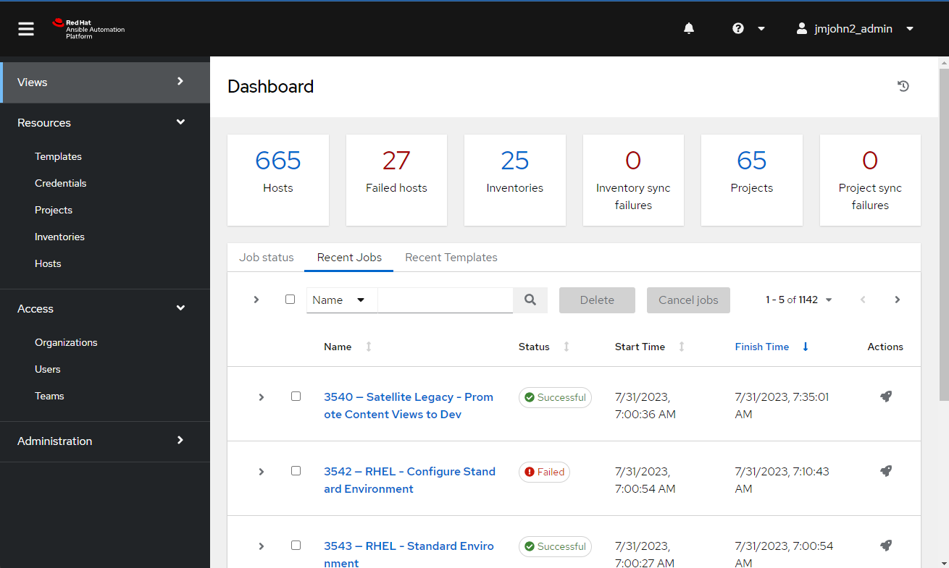
Ansible Automation Platform (AAP)
Automation Controller
Control Plane
Previously called Ansible Tower
Has an UI, API, and CLI
Role Based Access Control
Execution Environments
Control Nodes
Job Runners
Containers running in OpenShift
Private Automation Hub
Management of Ansible Content
Event Driven Ansible Controller
Notes:
Think of it sort of like Rundeck, but for Ansible content.
Touch on Job Sharing with other teams

Slide 11
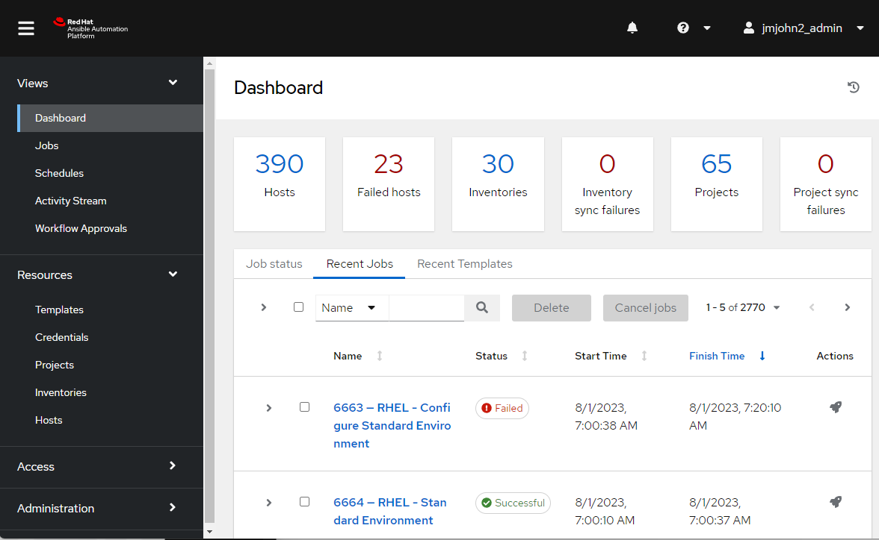
AAP Controller Overview
Views:
Dashboard
Recent Jobs
Scheduled Jobs
Resources:
Templates – Where jobs are saved
Push Button Job Runs
Scheduled Jobs
Credentials
Ansible Vault Passwords
Machine Login Accounts
And more
Projects
Playbooks Hosted in GitLab
Inventories
All Systems from VMware and AWS
Hosts

Slide 12
Get Started
Installing Ansible: Ansible Docs
On Windows:
Install Windows Subsystem for Linux (WSL)
Use Latest Version, v2
On macOS/Linux:
Natively supported
Write Playbooks using Visual Studio Code
Ansible & WSL Extensions
VS Code & Git Integration
Getting Started with AAP
Request Access Today!
Read our Getting Started guide: https://help.illinoisstate.edu/technology/server/guides/get-started-with-the-ansible-automation-platform
Notes:
It provides syntax highlighting, IntelliSense, and code snippets for Ansible YAML files, enhancing productivity.

Slide 13
Questions?

