Slide 1
Please Login into the Lab Computer!

Slide 2
Redefining VDI: Transitioning from Citrix
Tech Solutions CCA
Sam Dockery & Jim Johnson

Slide 3
Citrix VDI @ ISU
2014 - Citrix VDI environment stood up
2016 - Started deploying XenApps & XenDesktops
2017 - Re-platformed Xen
2020 - Re-platformed to ESXi
2021 - Pandemic VDI Surge
Today
Notes:
2020
- Moved from Xen to VMware ESXi
- Ran xen for awhile > issues arose > migrated to vmware since we had it > things got better
- Another hypervisor to support
Pandemic
Physical Labs as a Virtual Lab Offerings
Remote Desktop Broker for your ISU Workstation (1:1’s)
Return to Campus
Scaled back licensing
Overall Usage Drops

Slide 4
Citrix VDI Current Use Cases
Virtual Apps
SPSS
Microsoft 365 apps (Office)
Virtual Desktops
General Use Computer Lab
College of Arts and Sciences Lab
College of Business Labs
Physical Labs as a Virtual Lab Offerings
Remote Desktop Broker for your ISU Workstation (1:1’s)

Slide 5
Why Change?
Citrix licensing expires in December 2023
12-Year-Old VDI servers
They don’t support VMware ESXi 7 (and 6 is EOL)
Rough Citrix Sales & Support Experience
Current Citrix VDI usage is low overall
Notes:
Working on a 6mo extension but we are preparing for the worst
The servers' processors are too old, don’t support ESXI 7
Precautions are in place for the current VDI ESXI hosts, on a completely locked down subnet.
Pricing on a new VDI cluster as about 20k a node, and we probably would want 3-4 nodes.
Stats on Usage

Slide 6
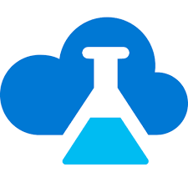
Microsoft VDI Solutions
Azure Virtual Desktop (AVD)
Azure Labs
Notes:
Looked at Vmware Horizon and spoke to Vmware reps about their on-prem and cloud offering
Looked at Citrix’s Desktops as a Service, cloud offering
Both use AVD, so they were basically a wrapper for it.
Both of these service runs in Cloud – No Hardware
Licensing already covered – quotes for VDI solutions are expensive
Our goal is to go live with AVD this Winter to replace Citrix, but also still look at Azure Labs as a supplementary / new option

Slide 7
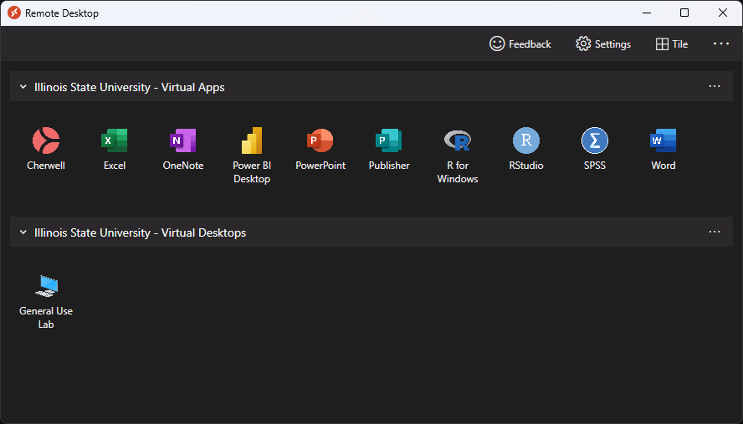
What is Azure Virtual Desktop (AVD)?
AVD is a desktop and app virtualization service that runs on the cloud.
Which Use Cases?
Virtual Apps
Virtual Desktops
Replace Physical Lab > Virtual Offerings with Virtual Desktops

Slide 8
AVD Capabilities
Host Pools
Application Groups
Windows Multi-Session
Unique to AVD
Scaling Plans
Connect to AVD from:
Windows Client
macOS Client
Android & iOS App
Web Browsers:
Edge
Chrome
Firefox
Safari
Thin Clients
Notes:
Host pools – Collection of VMs that run the same configuration
Pooled vs Personal
Application Groups – We control what Apps or Desktops get published to security groups
Reduce costs with pooled, multi-session, previously only Windows Servers supported with via RDS
While looking at Citrix and Vmware offerings, their Desktop as a Server

Slide 10
Try it out!
Open the “Remote Desktop” app from the Start Menu.
It is not “Remote Desktop Connection”
Or browse to: http://remotedemo.illinoisstate.edu/

Slide 11
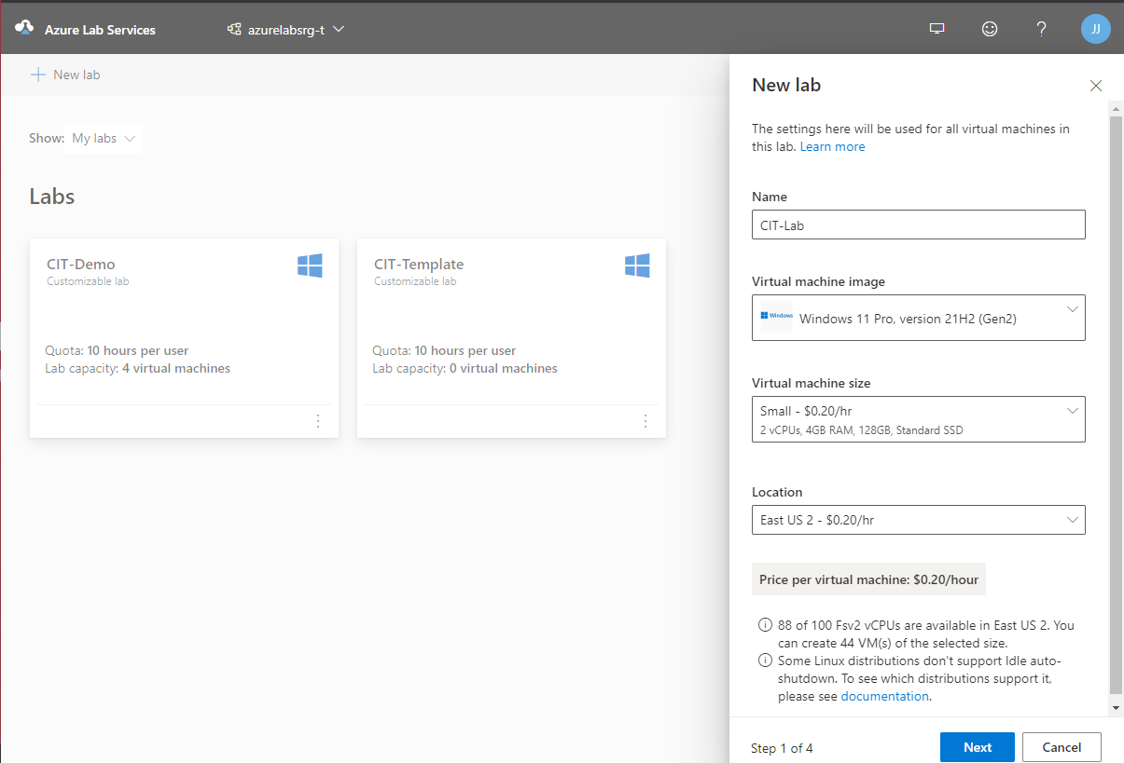
What is Azure Labs?
Which Use Cases?
Another Replacement for Physical Lab > Virtual Offering
New Use Cases! Used as a teaching tool.
Multiple OS Offerings
Windows / CentOS / Ubuntu / and more
RBAC designed for 3 personas:
IT Admins
Educators
Students
Notes:
If the Physical Lab to Virtual, can’t be roped into a AVD virtual app/desktop > then what about Azure Labs as an option
- Connect with RDP file or SSH

Slide 12
Azure Labs – At a glance
Notes:
Save Custom Templates, like when a Template per Class

Slide 13
Azure Labs Demo!
Notes:
Canvas
Educators can create and manage labs directly inside a course in Canvas.
Educators don't need to maintain lab participants in two different systems. The list of lab users is autopopulated based on the Canvas course roster. Azure Lab Services automatically performs a synchronization every 24 hours.
After the initial publish of the template virtual machine, the lab capacity (the number of virtual machines in the lab) is automatically adjusted based on the addition/deletion of students from the Canvas course roster.
Students access their labs directly inside a course in Canvas.
https://learn.microsoft.com/en-us/azure/lab-services/tutorial-access-lab-virtual-machine-teams-canvas?tabs=canvas

Slide 14
What’s Next for AVD?
Preparing AVD for production use.
December Cutover
Creating Supporting Documentation
Reaching out to IT teams that have current use cases in Citrix.

Slide 15
What’s Next for Azure Labs?
Continue Testing
Canvas Integration with Azure Labs
Do Enough Use Cases Exist?

Slide 16
Questions?

