Slide 1
You Bet Your Assets!
Asset Management is Boring – That means we should be able to Rock it Right?
Notes:
[keep it loose]
[Hard to follow some of the state of the art tech stuff that has been covered today with something as simple and “old news” as asset management – but I get riled up about this subject NOT because it is interesting, but rather embarrassing – we can and should do better as a campus but where does that change come from?

Slide 2
WIIFM?
Updated
Interested
involved (small i for now)
(What’s In It For Me)
Notes:
It is always a good idea to start with the Whats in it for me info, so here it is.
What I hope you can get out of this session is :
- Updated –know where we are at (and that we are still working on it!)
- Interested / maybe even fired up
- and optionally Involved in byte-sized chunks.

Slide 3
DDWWAD! (Don’t Do What We Are Doing)
Its Crazy (100K CI records soon, then non-IT assets, then…)
You are part of why we’re doing it
Not ready for everyone’s everything yet – but soon
Notes:
We are not guessing or expecting any other support group is going to track as much in the CMDB as Technology Solutions by number, or type – it is a lot. [click]
When the network assets and processes get converted from Pinnacle to Cherwell we will have somewhere around 100K active CI records and that is just the IT assets. [click]
Soon we expect to represent all of our state tracked Non-IT assets in Cherwell also (like furniture, vehicles, etc.)

Slide 4
“Why would you do that!?!
½ Digital
½ Manual
Annually
Spreadsheet
Human Eyes & Writing
Updates to Colleague?
Single Process
Real Time
Database
Barcode Scanners
Itemized Update Feed
Notes:
Some of you up hearing that may think “Why would you do that?”
[Watch the click through this text!}
Because someone has to inventory all of them and we do not want to keep doing an inventory once a year using a spreadsheet, human eyes and hands, followed by incomplete updates made in Colleague. Beyond that, these assets also have a lifecycle, and move and get retired and can be linked to service requests just like IT assets.
So – If I can walk around with a tablet and a Bluetooth finger scanner and record where assets are
… and the data I’m collecting goes directly into my asset management system that is a database instead of a spreadsheet
… that keeps a history and can aggregate data that needs to be updated in Colleague..
….and offers a more manageable means of tracking those updates being completed (Big breath)
---- why would I only do it with computers and go back to the spreadsheet for …. Anything else!?!

Slide 5
“That’s just a Pipe-dream!”
Come back to this later
Notes:
Now I’m guessing you may be thinking – “Ballard that is a pipedream that has been talked about for 2 decades, its never going to happen.”
BUT today you are going to see a few of the things Andrew has developed that indicate just how serious, and far along, and close to realizing it we are.
More about that later, but for now I want to talk a little bit more about WHY!

Slide 6
Just the Facts (1 of 4)
- Not Complaining
- Not Pointing Fingers
- Food for thought:
What we consider our asset management process on this campus is the result of hundreds of decisions over time – rather than a process designed to manage assets consistently.
Notes:
I am going to say a lot of things that sound like I am complaining – I am not. Nor am I trying to point the finger at any group or individual on this campus. I want to make it very clear that the summary of everything else I share in the next 5 minutes is just this:
What we consider our asset management process on this campus is the result of hundreds of decisions by a large group of people over time– rather than a process designed to manage assets consistently.
I propose that we actively pursue the later - a process designed to manage assets consistently.
I did not and will not say replace Colleague because I don’t want to – I want to augment what processes and data we have in Colleague.

Slide 7
Just the Facts (2 of 4)
1. Our Asset Management System (Colleague)
2. Process depends on factors like Division, Department, Team, Support Team, P.C. Specialist, ISU/Dept/System/DNI Tagged etc.
2a. What type of process do you have with many so many different methods?
3. Depend on hand entry, paper, spreadsheets, record level updates.
4. Limited access to Colleague, and no ability to track more (data or records)
1. Our Asset Purchase Management System (Colleague)
Notes:
I have spent way too much time identifying the phrases that work to get peoples attention and make it clear that we need to change how we (all of us) manage assets. I would like to share some of them with you and please let me know if I say something that is not true.
(Notice that I said not true – don’t let me know if I share a process that you disagree with, I don’t agree with many of them, and we will never get through the list)
We have a purchasing management system that we call an asset management system – I am talking about Colleague or what many still call Datatel. There is a reason that it seems like a stretch to ask that system to do what is needed for asset management – we (ISU) did not purchase the module built to do that.
2. Depending on the asset type or division, or department, or team or possibly P.C. Specialist we have 100 or more different asset management processes for the same lifecycle step (like initial deploy).
2-a. Can anyone tell me what type of process you have if there are more than 20 ways to do it?
Unfortunately the result is a lot like no process. But that is disheartening, lets move on to
3. All of the processes we have (for colleague related assets) depend on hand/eye manual creation on physical paper, traveling via campus mail, exported spreadsheets, and record level updates that are not fast enough to keep up. ( PAUSE OK truth check, anyone want to disagree with any of that?) I believe that we can make that better by putting better tools and processes in the hands of PC Staff and that is no small order, but it is the right thing to do.
4. Not that many people have access to Colleague, and even those who do have limited access to specific fields - and there is no way to request new fields for management or decision support – the data in these records is specifically designed to help the purchasing department and to some extent Property Control, it is not really meant to help us. And that’s ok because we have tons of operational management systems like MECM, and Orion, and Vsphere and you get the idea – but none of those tend to be designed to track or update assignment details and that is one of the neat little areas in the VENN diagram that our ITSM is uniquely positioned to take care of for us.

Slide 8
Just the Facts (3 of 4)
5. Induction process does not use commonplace technology?
6. How to break AM process (quick moves)
7. Collective AM process failing to provide
Asset Lifecycle Management
Organizational Unit Decision Support
Inventory
Notes:
5 - Our asset induction process happens without leveraging commonplace technology solutions and often results in incorrect/mismatched or delayed record entry that can cause confusion and costs time for multiple business units every year for the life of the asset. How many of you have an example of an incorrect serial number that you have tried to fix in colleague more than once?
6 - If you want to “break” our asset management process, all you have to do is move something twice in a short period (1 week or even 1 month) the current processes don’t complete fast enough to avoid confusion about which update is the most current. At least if every update reached the P.C. staff via the same method they could easily compare update requests for dates, but some are emails, or chats, or phone calls etc. and they want the information, so they accept it from many avenues, but that is too much to ask anyone to manage. Flexibility and workarounds can be a good thing, but when they result in no recognizable process they hinder accurate and timely updates.
7 - For these reasons and many more, all of our collective AM processes are failing to provide any of the following with any measurable success or consistency:
Asset Lifecycle Management { } BY THAT I MEAN(What we have, how we use it, replace, and retire it efficiently and consistently with tracking, communication, and history)
Organizational Unit decision support { } (That is your department or team saying “what are our options/opportunities based on the total set of assets/attributes that we have available right now)
Inventory { } ( Of course the annual inv. happens but it is painful, & technology/practices could make it easier to do, and report on AND much closer to real-time.
Let’s think about this for a minute – do any of us know of a company large or small still using these methods ISU does for inventory?

Slide 9
Just the Facts (4 of 4 When are we going to get to the good stuff?)
8. Items 1-7 about colleague tracked assets only
9. What would you track, manage and inventory if it was easy?
Visibility to all assets you want to track in one place
Easy updates from actions you are doing every day
Designed to ensure/track Colleague updates (for appropriate assets)
New inventory tools bring the process into the 1990’s! (at least)
Insight into the broader set of IT groups and assets on campus
Notes:
8. Now I talked about items 1-7 in terms that were just about the assets that we have recorded in Colleague - each one could be discussed in more length considering what departments could or should do for assets that are not recorded there. But the truth is that JUST dealing with the assets we have to and the annual inventory is so inconsistent and frustrating for most, that they would not even consider tracking more assets than what is required.
9. Every IT unit has something that they would like to track like an asset, but can’t because at some point the rules changed and the state/Property Control decided not to track it in our purchasing system anymore. So many of you have your own ghost/ghost asset databases or worse yet, you track them in a spreadsheet with versioning problems and no ability to link tickets, communications, history, etc.\
9a. Like I said, no one is expecting or even suggesting that you track everything that Technology Solutions will in Cherwell. But what if you had a place that let you look at all of your assets together in one place, and update them easily and consistently, and share updates with PC for the assets they care about, but still account for the full set once a year using something other than a spreadsheet? What if that system also gave you insight to the broader set of IT groups and assets on the campus for things like
-Network jack information
-Current high and low end equipment models others are supporting (Believe it or not, Andrew even has a method baked into Cherwell to track which models are “current” vs. end of deployable life) because that is the type of next level thinking /management you can do when you have the full set and current data.

Slide 10
Anyone thinking – That’s Impossible?
Or maybe just impossible on our campus?
Notes:
Anyone here think that what I am talking about is impossible given technology available today? (didn’t think so – we are doing much more advanced things with technology everywhere else, just not for asset management – why?)
But that isn’t the real question – Does anyone here think that it is impossible on this campus?
For many years, any such effort was designated a “shadow AM system” and it was frowned upon but that has been changing and we are actively talking with the comptrollers office about data feeds from Colleague to update records in Cherwell (with the data that it knows best –purchasing data).
That report of 36583 IT assets from the last 10 years just came from the Comptrollers office earlier this week! So not just talking, but starting to get data from them that is add-hoc now but we expect to be more automated in the future.
Comptroller’s report of last 10 yrs. of IT assets: 36,583 records
>>>As part of that discussion with they actually brought up what it might take to have a data feed back to Colleague from Cherwell which could effectively make Colleague the system of destination for asset assignment information

Slide 11
System of destination?
Purchase information
Assignment information
Who bought it (never changes)
When (never changes)
What account (never changes?)
How much (better not change)
Attributes like Tag/Serial# (better not change)
(Assignment Details-top section of CW record)
Location (changes, Colleague not designed to collect)
Pri User (changes, Colleague not designed to collect)
Dept (changes, Colleague not designed to collect)
Notes:
Lets look at some of the data in Colleague and see if we can identify a couple different categories:
Basic purchase information looks like Who purchased, When purchased, What account, How much, & key fields like Asset Tag & Serial numbers
This type of information goes in once and does not change – hopefully for the life of the asset
Other fields are meant to address how it is being used right now like Where is it? Who is the primary user? What Department do they work for?
Make no mistake, when we are talking about things like laptops – that is your data, you are in a position to know it and keep it updated better than anyone else.
By design, this assignment info has become the top portion of ci records in the current version of the forms
– these are key updates to collect when any incident or service request results in assignment changes AND
that needs to be captured and sent to PC in a way that helps them update records efficiently.
-If our system is built to get updates from the people doing the work and we make it easy for them to make updates
then we can still say that Colleague is the system of record - or more accurately the official system where we want to store accurate assignment information
– but since no utility exists within Colleague go gather the info, effectively it is the system of destination for this assignment info

Slide 12
Not a dream/out of reach
“next-level” Onestep design (Ballard)
Return to stock (from Incident or CI records)
Global (in terms of user availability) but detail oriented
Colleague update process (Andy)
(Datate) changes needed process
Database
Barcode Scanners
Itemized Update Feed
Reliable for thousands of complete/consistent updates
Updating invisible fields for smooth process /dashboards
Inventory Process (Andy)
In use! (and also still in development)
Many Onesteps integrated with a dashboard
Confirms
Updates (or creates as needed)
CI records/location/inventoried by date & user
Notes:
So there is a reason for IT to lead this charge, and to do this work and we are not as far off as you think.
I are going to show you the Return to Stock Global onestep that is designed for everyone to use and I think you will find it interesting, surprising, and useful in time.
Then Andy is going to show you the dashboard that he created to help identify and track changes that need to be updated in Colleague, and finally the inventory process that he is using right now.

Slide 13
Notes:
Many of you have used or even created onesteps to manipulate some data in Cherwell and often simple onesteps can be a powerful way to normalize data or populate fields based on information that we know.
The series of objects in your one steps may look similar to the one I created about a year ago depicted in this screenshot.
But we want to talk about a different kind of onesteps that look more like this.
These are what we have been referring to as Global onesteps and the term global was originally intended to reflect that they are designed for all to use – but in making them we have also learned how to make them CI type “agnostic” (work for all physical assets).
These are created to do more complex things thousands of times for any number of people or object types – let me offer a glimpse into the Return To Stock example shown in that bottom diagram.

Slide 14
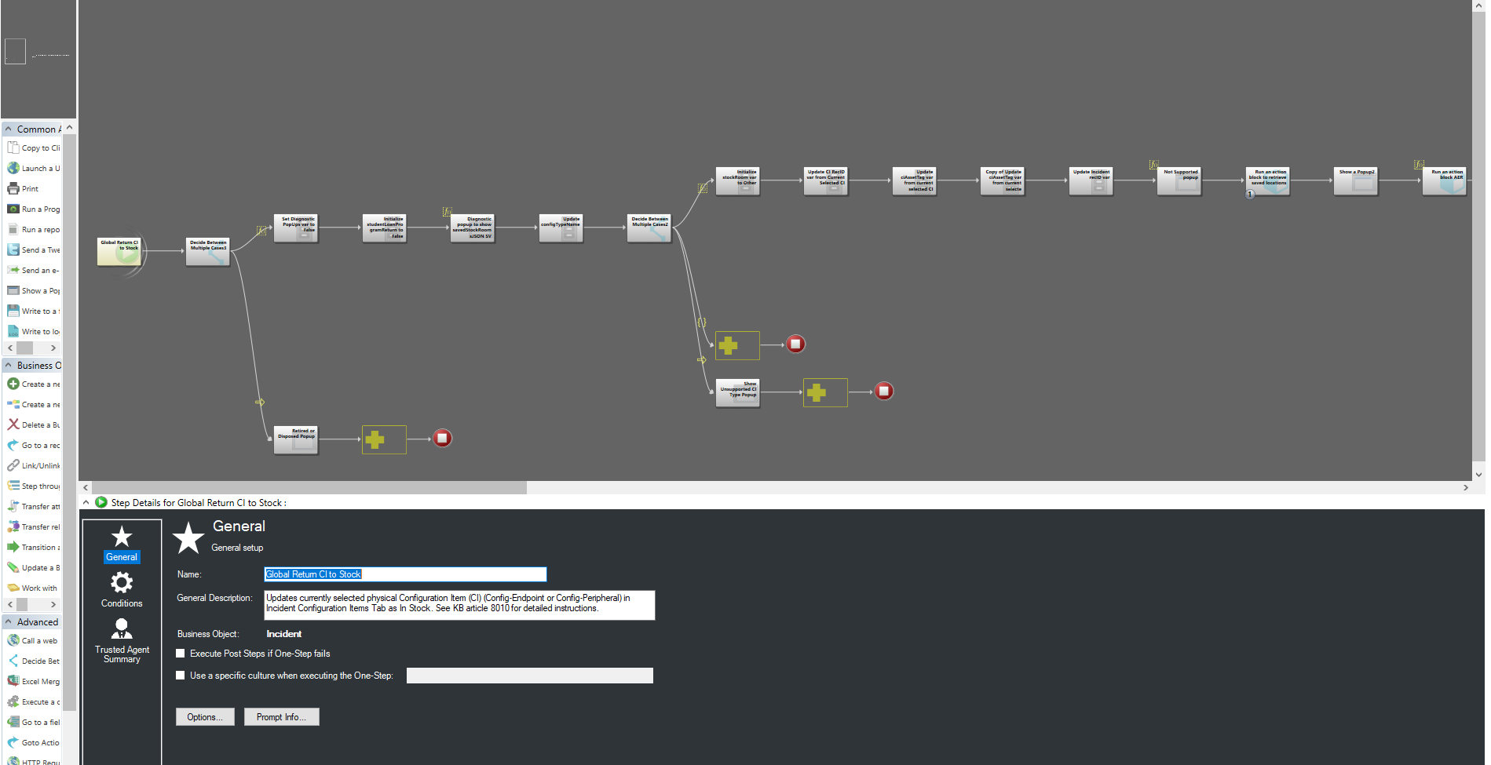
Overall OneStep Properties

Slide 15
Do not proceed if asset has status of Retired or Disposed

Slide 17
Run action block to retrieve specific user’s saved “stock room” locations
Notes:
So this is actually going to jump into another onestep and come back…

Slide 18
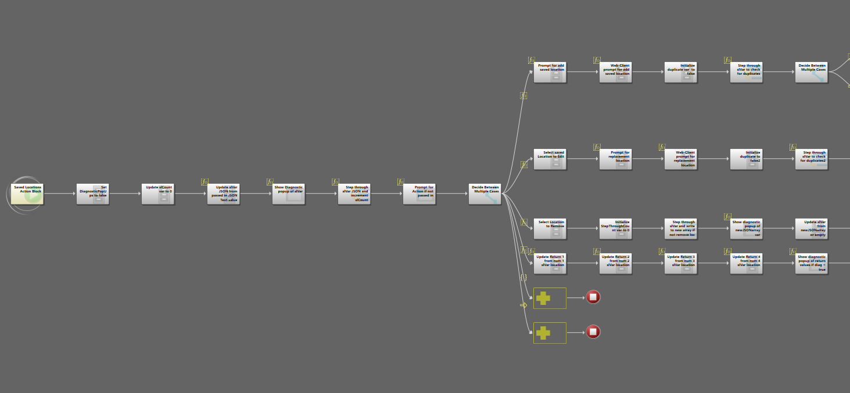
Allows users to store, edit or delete their own set of valid stock locations that are NOT session based!
Transition Video
Main action block properties
Notes:
This acton block allows all ysers to store, edit, and delete their own set of valid stock locations that are not session based – so build them once, and when you are logged in they will be available for selection during subsequent runs of the onestep.

Slide 20
The object type shows this is another action block, in an action block, in a 1 step (skip this level for the sake of time).
Transition Video
Step through slVar JSON and increment count (conditional)

Slide 21
Transition Video
Prompt for action if not passed in(conditional)

Slide 22
Add stock room steps
Transition Video
Edit stock room steps
Remove stock room steps
Prepare output for 1step return
Chose between Add, Edit, or Remove based on user input.

Slide 25
Back to the original 1Step -
Prompt user to select a saved stock or other location
JH 0205
SLB 0026
JH 0114 (TSC)
Notes:
So this step lets the user select from a list of user specific, validated, session agnostic stock rooms

Slide 26
Run action block to Add, Edit or Remove stored “stock room” locations

Slide 29
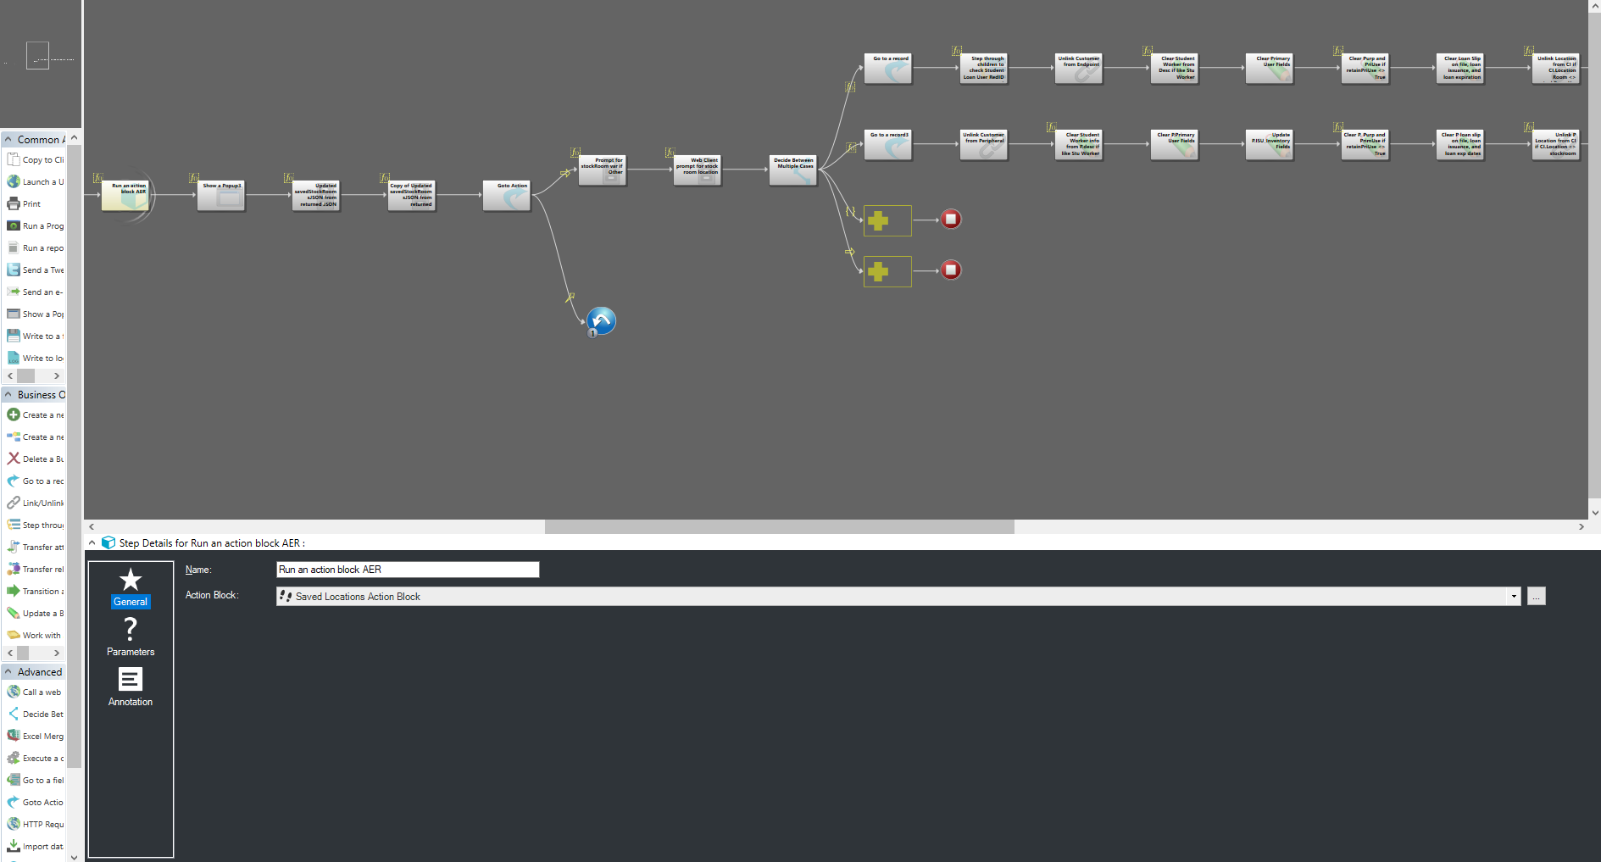
Go from Incident record to Endpoint record (using link!)

Slide 32
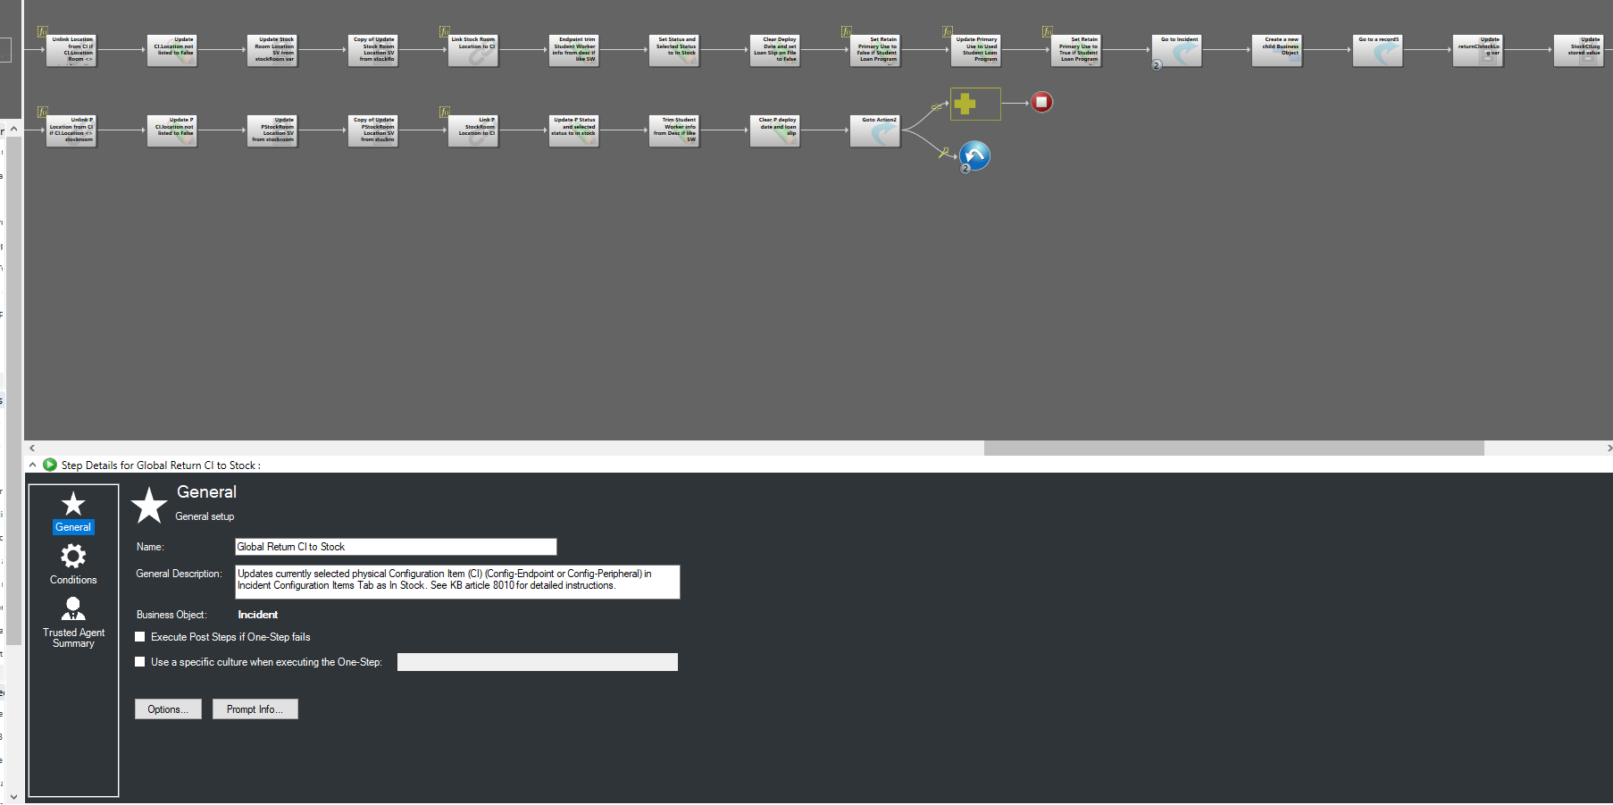
Unlink current location (if not already set to selected stock loc).

Slide 35
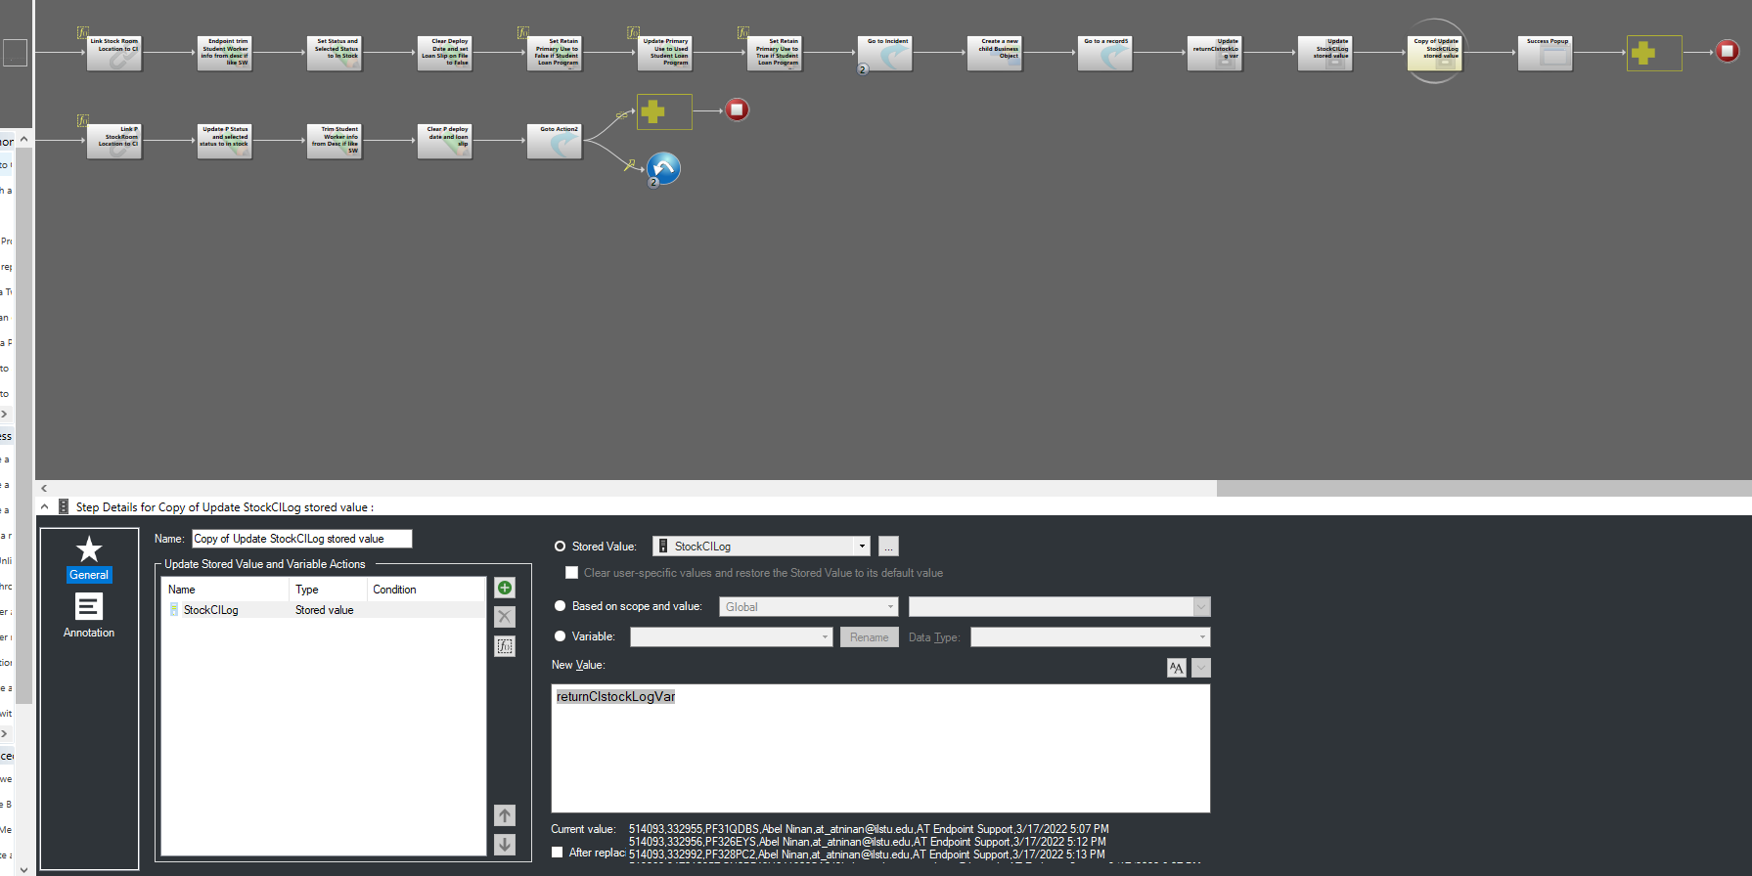
Copy of Update stored Value with returnCIstockLog variable

Slide 36
Successful run popup with tokenized data
Notes:
Ok so that is a quick walkthrough of one of these Global OneSteps that you hear us refer to, and 5 of that scale exist today, 3 of them have mirror versions that can be run from a CI record instead of an Incident (any physical CI type)
And we intend to make more, and keep making them more capable and modular.
For now we will expose them in the CI records, but at some point we would like to discuourage that use, because if you think about it returning an enpoint or multiple endpoints to stock without a Service Request is kind of like an illegitimate move – his
tory and documentation that we need are not attached or complete.
Andrew created a Teams chatroom for Onesteps a while back, and for the most part that has been used for people who are creating their own to reach out to others when they get stuck or find something cool. In the future we want to use that space more to collect feedback and requests about more global onesteps like this, and standardize on them as they are created so that we get consistent process, and output.

Slide 37
Asset Tracker Dashboards for on-site inventory checks
Notes:
All right, I am done rambling and I am going to turn things over to Andrew who is going to show you how he is doing his inventory this year
This is not a small inventory either 0 it includes just under 7000 assets in 841 rooms distributed among 76 buildings across the campus.
By they way, that is just when Andrew is wearing his Endpoint Asset Manager hat, when he dons his eRecycling hat it adds
Over 12441 assets processed through that program, recorded in Cherwell regardless of what unit they came from
(So we are getting your assets in Cherwell sooner or later – even if you don’t put them in)
STOP
Endpoint Support Stats
6,745 Supported Assets – 4,110 Endpoints 2,630 Peripherals 5 Servers
841 rooms in 76 Buildings across campus
eRecycling
12,441 IT assets processed - 10,250 Endpoints 1,972 Peripherals 154 Servers 65 Enclosures
1,013 IT assets issued back to the University

Slide 38
Asset Tracker - Campus

Slide 39
Asset Tracker - Building

Slide 40
Asset Tracker - Room

Slide 41
Asset Tracker - Popup

Slide 42
Asset Tracker - Popup

Slide 43
Asset Tracker - Popup

Slide 44
Asset Tracker – Group Scan

Slide 45
Colleague (DataTel) Updates

Slide 46
Asset Management One-Steps
One-steps available in the incident associated Global > Asset Management folder
Assign Physical Asset
Move Asset to Build/Repair
Return Asset to Stock
Mass Assign Assets
Link Multiple Assets
Property Control One-steps
Email Receiving Report
Print Asset Surplus Form
Print Asset Transfer Form

