Slide 1
Ruffling Feathers?
User experience advocacy in practice
Notes:
Good afternoon. My name is Ben Bricker. I am an IT communications specialist with the Office of Technology Solutions. We are going to explore user experience advocacy together in this session. Hopefully, you will leave feeling comfortable sharing user stories in a way that wont make admins bristle at the thought of yet another project!

Slide 2
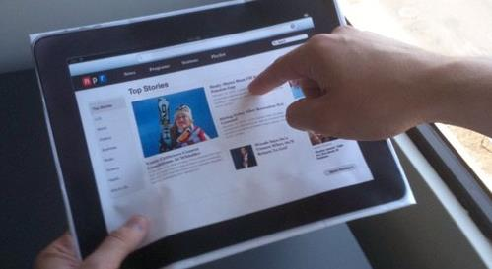
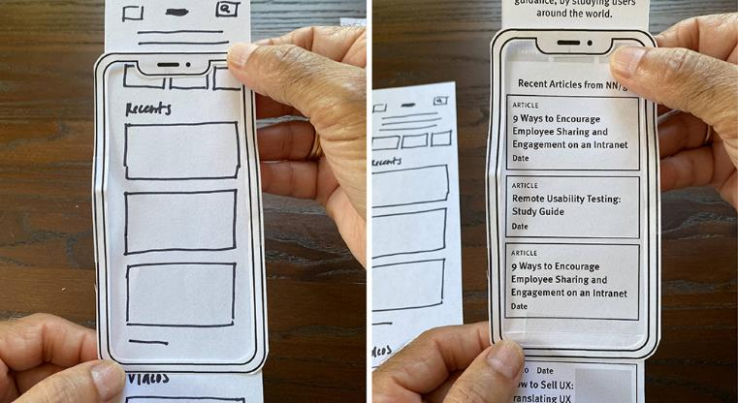
What is user experience testing?
Software development – from scratch.
Paper prototypes and in-person interviews.
3 goals: uncover problems in design, discover opportunities for improvement, learn about the user’s behavior and preferences.
Who does UX work?
“High-Tech” Anthropologists
Creative mindset
Researchers and designers
…and NOT you! Right?
Notes:
So first the background…. User experience design grew out of software development in the nineties and early 2000’s. The UX researcher may utilize paper prototypes or digital versions to interview users at early stages of development to get feedback. 3 Goals are… UX designers and researchers are ….

Slide 3
How does it apply to us?
NOT “from the ground up” software development
NOT the decision makers
NOT even someone that supports technology

Slide 4
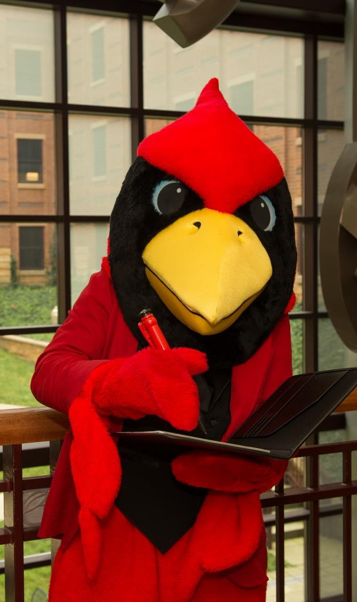
You know technology. How do I ….?
“That’s a common problem. You see it happens when the software can’t recognize the TCP/IP network address. What that causes is …”
“I’ve never used that software…Let’s google it.”
“I’m a networking engineer. I don’t think I can fix your spreadsheet problem.”
“It seems to be working…”
Notes:
Well let me ask you a have you ever had someone say to you “hey, you know about tech. How do I….” and in turn have you give one of these responses… You may respond with a long and way too detailed explanation. … or the least helpful response “It seems to be working”

Slide 5
It’s not working FOR ME!
Who
What
When
Where
Why
How
Notes:
So being the helpful and compassionate human being that you are you guide them to ..or INVENT a solution. The users pain point is resolved. Thank you for your help and everyone goes on with their day, right? What about tomorrow, will they have the same problem, are other people affected? … We need to capture this user’s experience and share with those whose job it is to address the problem. Which brings me to….

Slide 6
Learning objectives
Attendees will:
Be aware of user experience
Be empowered to capture user stories
Share them to improve processes
Notes:
Your handout has questions to get the conversation going and help you capture information that others can act on.

Slide 7
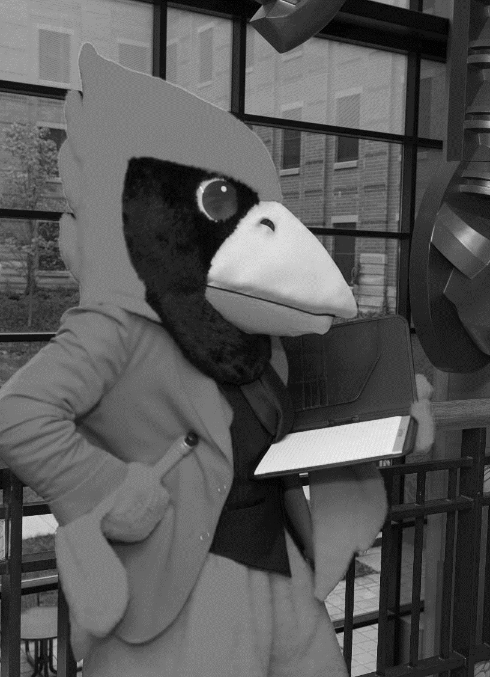
Exercise
Instructions
2 volunteers to role-play: user that needs to transform Grimlock and help desk associate that is providing phone support.
In-person attendees - Observe and document the exchange using your handout.
Notes:
And you can put that handout into practice right now. Participants on Zoom feel free to use a piece of paper for notes. We are going to do an exercise. I need 2 volunteers, does anyone know what this toy is and how to play with it? (choose 2 people) Everyone else observe, think about the process these two are going through and how things can be improved.

Slide 8
ANALYSIS DAY
BATTLE DAY
Notes:
So ___ is an exec assistant at RobotRex Gaming and part of their job on meeting days is to communicate whether this is to be an analysis meeting or practice session. Today is Battle Day and they have 10 minutes before the meeting to turn Grimlock here from robot to Dino mode. They will have 2 minutes to do it themselves, then they can call their friend ___for help.

Slide 9
Who is the user?
Why do they need to do the thing?
What are the pain points?
Where is the Issue? Bug / Training / Process
How do we make this better?
Notes:
Does our user need a cheat sheet? Can we change the instructions to help them? Highlight the parts most people get hung up on?

Slide 10
Beyond Troubleshooting
Notes:
User experience advocacy goes beyond troubleshooting, workarounds, When we are in think of solving a user's problem. We have switch from listening to advising often. The short term is to resolver their issue ASAP., But that is not a long-term solution. So we have go back and listen again to plan long term and bigger scale improvements.

Slide 11
Capturing the User’s Story
What did the user experience? (ask them)
Where are the problems? (ask user)
When are improvements needed? (ask them)
Who can help with improvements?
Why do we need something different?
How do we find out who else is affected?
Notes:
Interview Ballard and Tech Support and get their perspective. [discussion]
Where is the problem in the users day? You may not have 10 minutes to troubleshoot in the morning, but it could be done the night before. Why and how work together. For example does it affect just 10 user or will every student that comes to campus for the first-time encounter this.

Slide 12
Process Improvement
Sharing the user’s story with others to solve the problem behind the problem.
Notes:
Here’s where we start “ruffling feathers” …. Or encounter the fear of it anyway. Process improvement is BIG right. Month long projects with multiple teams. “I know this person could work on this problem but they are so busy.” Just tell the story. “What is if isn’t worth the trouble? “ Part of running project is to determine ‘if the juice is worth squeeze”. But they need all the information which is what you have.

Slide 13
Brainstorming! User (and other) Feedback
“Why can’t we use
My little Ponies, instead?”
“Why can’t we have two robots?”
“Can more than one person be responsible?”

Slide 14
Does this need to be a project?
First just have conversations…
Not everything needs project to resolve the issue.
You were still an advocate and that is much better than thinking “It’s not my problem”
If it does become a project, everyone involved will need the information you have. Expect to be interviewed and participate in brainstorming sessions.

Slide 15
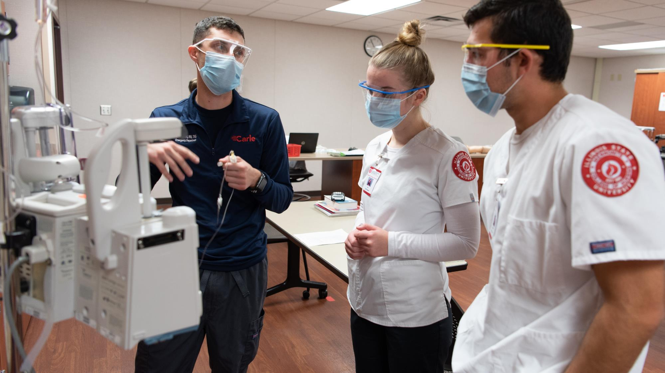
What does it look like in practice?
Notes:
Covid hotline example.

Slide 16
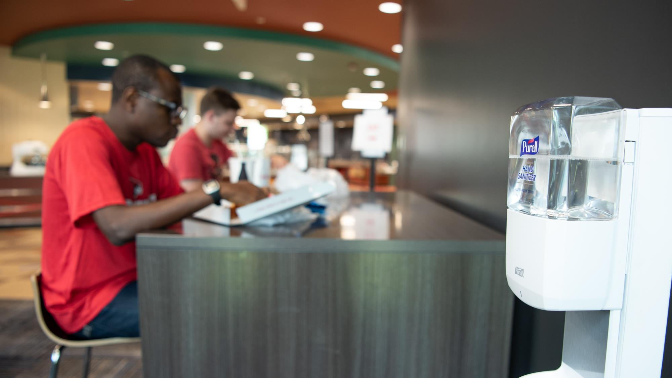
Covid Response helpline
User placed an order for Covid supplies (anti-bacterial gel stands) via the help form?
Short term fix – responded with a link to the facilities web form for department requests. She thanks me and placed the order.
Why did she do it this way?

Slide 17
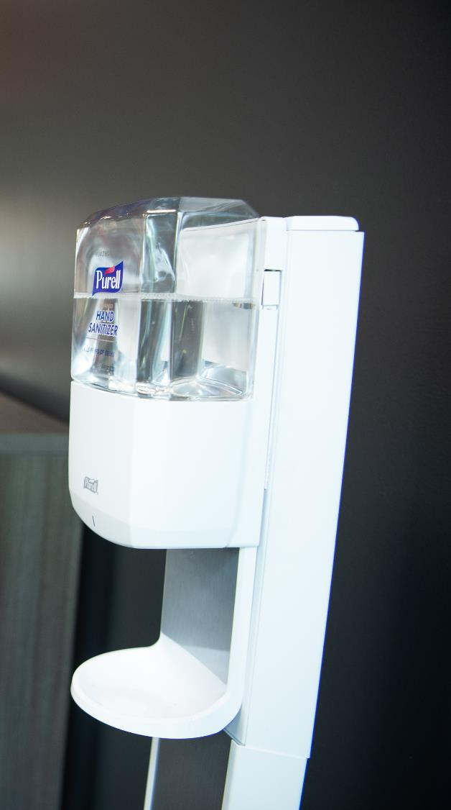
The Follow-up
So I made some phone calls …
Long term fix – The manager of the covid supplies store front got a dozen stands to keep on hand so that they can add it for user convenience.
We added a link to the facilities form at the top of the covid supplies store front.
No project or meetings. User experience improved.
Notes:
Why did they need to submit multiple requests? Was there something that wasn’t clear on the site?

Slide 18
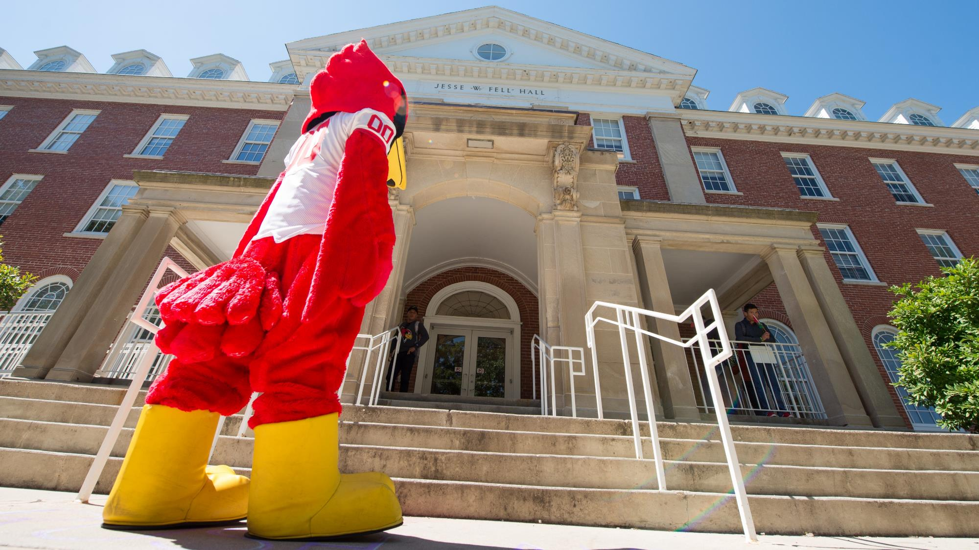
Now you go do it …
come back and tell us your story.
Notes:
Wouldn’t be great if by next CIT we had 5 other stories of simple requests for help that turned into projects, meeting or just 5 people from different department meeting over coffee and saying I can so something about that piece until the problem is solved. There are awards for things like this….

