Slide 1
Cyber Hygiene, Automation, and Defense
Dan Taube
Chief Information Security Officer

Slide 2
Cyber Trends
$3.86 million
Average cost of education sector data breaches
Cost of a Data Breach Report 2022 | IBM Security
Cyber Hygiene, Automation, and Defense
August 3, 2022 | Dan Taube

Slide 3
Cyber Trends
System Intrusion, Basic Web Application Attacks, and Miscellaneous Errors
Account for 80% of education sector data breaches
Data Breach Investigations Report 2022 | Verizon
Cyber Hygiene, Automation, and Defense
August 3, 2022 | Dan Taube

Slide 4
Cyber Trends
Use of Stolen Creds and Ransomware
Top two action types in education sector data breaches
Data Breach Investigations Report 2022 | Verizon
Cyber Hygiene, Automation, and Defense
August 3, 2022 | Dan Taube

Slide 6
Cyber Hygiene
Poor Hygiene Conditions
Failure to patch known vulnerabilities
Poor configuration management
Inefficient management of admin privileges
Cyber Hygiene, Automation, and Defense
August 3, 2022 | Dan Taube

Slide 7
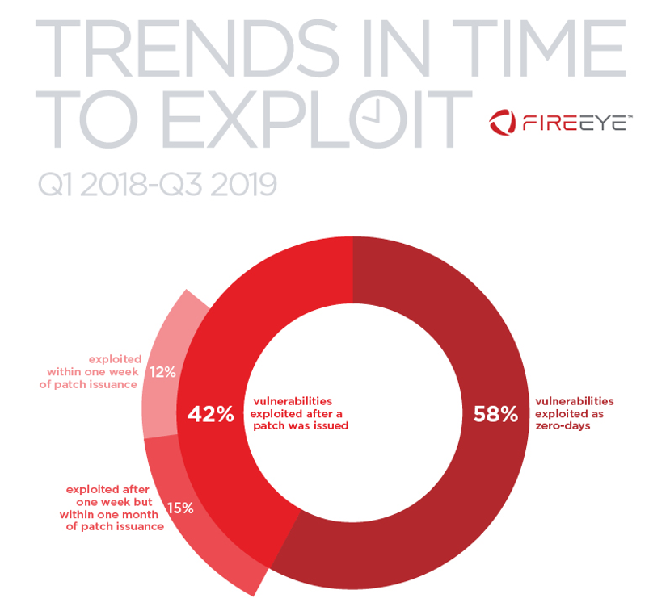
Read more in “Think Fast: Time Between Disclosure, Patch Release and Vulnerability Exploitation” by Mandiant

Slide 8
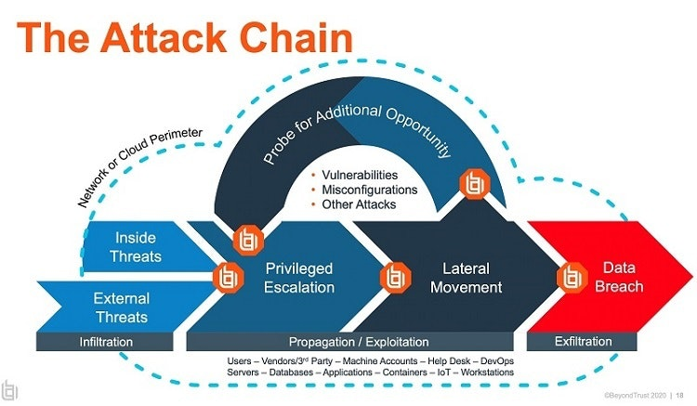

Slide 9
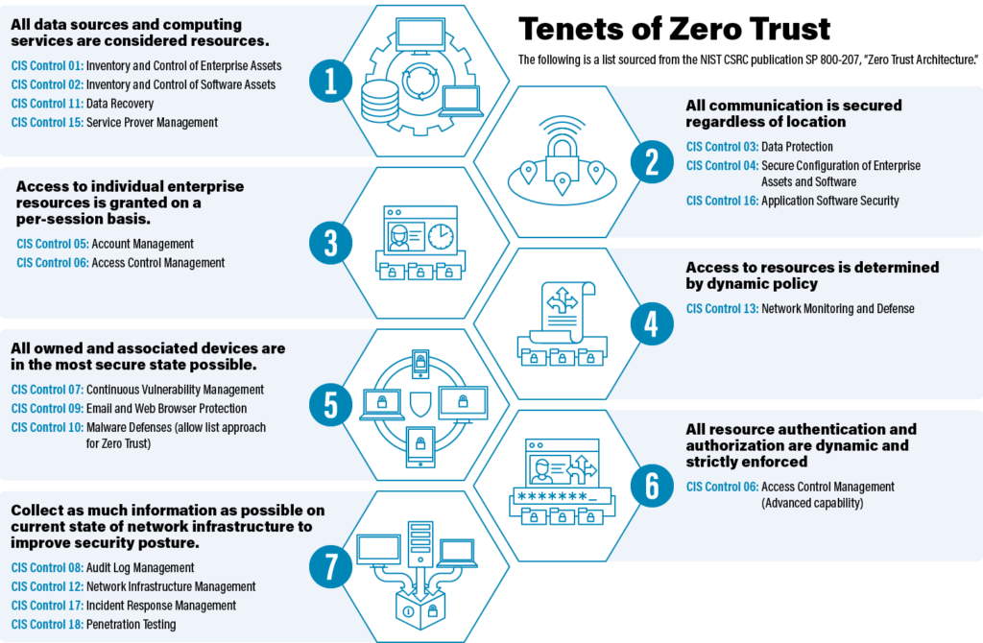

Slide 10
Cyber Automation
Continually do more with less, faster
Leverage shared responsibility and collaboration
Prepare for the unexpected and unpleasant
Champion the message of standardization
Cyber Hygiene, Automation, and Defense
August 3, 2022 | Dan Taube

Slide 11
Cyber Defense
Embed security into the process
Fulfill due diligence and due care responsibilities
Enable regulatory and contractual compliance
Be effective in reducing the likelihood of breach
Cyber Hygiene, Automation, and Defense
August 3, 2022 | Dan Taube

