Slide 1
Campus Network Update

Slide 2
Campus Network Updates
Campus LAN updates
WAN updates
ISU Farm

Slide 3
What do you call a retired Catalyst 6500 repurposed as furniture?
A routing table.

Slide 4
Network Architecture

Slide 5
Campus LAN
50 GB Port Channels
uPoe+ capabilities
MGIG Capability for future Wi-Fi upgrades
Automation

Slide 6
Campus WAN
Future Capacity
Thousand Eyes

Slide 7
ISU Farm Network
So the cows can stream moooooovies

Slide 8
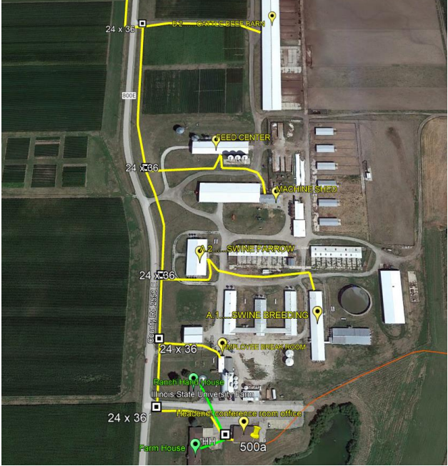
ISU Farm Network Expansion
Fiber
Wired and Wireless
Enhance Research

Slide 9
Thank You!

