Slide 1
Improving user experience through effective communication.
Present by Ben Bricker – CIT Fall 2021
Illinois State University

Slide 2
Utilizing the “StoryBrand” Framework
Key Ideas
Aspirational stories resonate with your audience.
Put your audience in role of the story’s “Hero” to get them engaged.
“Brands that help customers avoid some kind of negativity in life (and let their customers know what that negativity is) engage customers for the same reason good stories captivate an audience: they define what’s at stake.”
― Donald Miller, Building a StoryBrand
Created By Donald Miller

Slide 3
Hero | Guide | Villain
Characters in an aspirational story.

Slide 4
The user is the Hero | we are the Guide
”STORYBRAND PRINCIPLE ONE: THE CUSTOMER IS THE HERO, NOT YOUR BRAND.”
“Here is nearly every story you see or hear in a nutshell: A CHARACTER who wants something encounters a PROBLEM before they can get it. At the peak of their despair, a GUIDE steps into their lives, gives them a PLAN, and CALLS THEM TO ACTION. That action helps them avoid FAILURE and ends in a SUCCESS.”
― Donald Miller, Building a StoryBrand: Clarify Your Message So Customers Will
Characters in an aspirational story.

Slide 5
Wait… we aren’t the hero?
Client presents a problem.
We provide technology that addresses the problem.
When technology doesn’t work, we fix it.

Slide 6
IF the Guide takes the place of the hero… they become the Villain.
Characters in an aspirational story.

Slide 7
You may be the Villain if…
The villain impedes the hero’s journey or tries to lead the hero astray.
Do your users need to do the follow to reach their goals?

Slide 8
Users find Work Arounds
“it’s fine… I do this every day!”
to the systems that you have put in place.

Slide 9
I’ll call my guy!
Can you “work your magic” and fix this real quick?
Users call a technician they know for individualized support?
This “awkward situation” makes the technician choose between doing the work they have been assigned and helping the users.
Let’s talk about submitting a ticket…

Slide 10
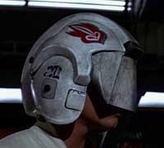
Villains dictate … Guides observe, advise, & equip the hero
“(1) identifying what their customers wanted (to be seen and heard),
(2) defining their customers’ challenge (that people didn’t recognize their hidden genius),
and (3) offering their customers a tool they could use to express themselves (computers and smartphones).
Each of these realizations are pillars in ancient storytelling and critical for connecting with customers.”
― Donald Miller, Building a StoryBrand

Slide 11
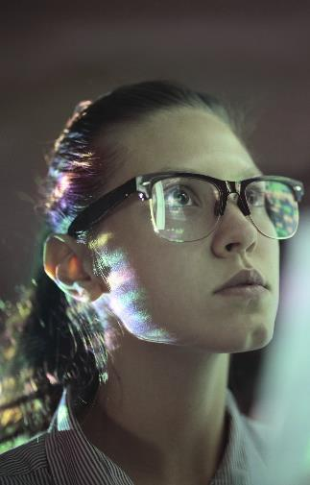
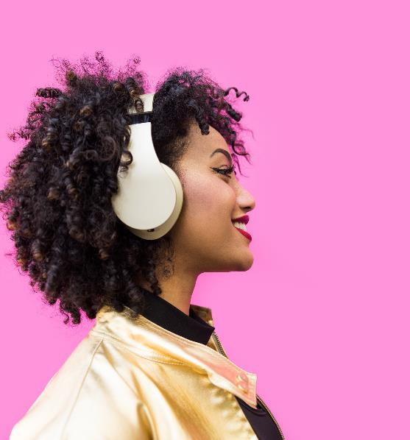
How we “think” our users experience virtual work?
We tend to focus on knowledge and information which is only part of the user’s experience.
Sight
Hearing / Speech
Touch
Smell
Taste

Slide 12
The User’s actual experience…
When communicating, we need to consider what our users feel as well.
Sight
Hearing / Speech
Touch
Smell
Taste

Slide 13
Conversations with our users can capture the Whole picture.
“I read the instructions and the help article.”
“I called tech support. They explained what I was wrong.”
“Working with this software is really tough.”
“Something doesn’t smell right.“
“I got the task done, but the whole project left a bad taste in my mouth.
The last 3 examples represent intuition. They are hard to describe, but vital to identifying a good or bad experience.

Slide 14
Usability Testing
We can learn a lot by watching the user interact with our systems on their terms. After observing, we need to ask them how they feel about the experience. This will help us get the whole picture.

Slide 15
Discussion
What have you run into?
Have you done user testing?
Workaround stories?

