Slide 2
Welcome to the 2021 CIT Annual Conference

Slide 3
Keynote Address
Vice President for Academic Affairs
and Provost
Dr. Aondover Tarhule

Slide 4
Break!

Slide 5
IT News

Slide 6
Next Learning Management System (NextLMS) Initiative
Collaborative project between Technology Solutions and the Office of the Provost
Cross-Functional Taskforce will be the advisory group
Composed of student, faculty, and admins across campus
Created by the end of this semester
Project stages:
Evaluation and Selection
Migration and Adoption
Current Update:
Initial meetings of the Executive Team (Tech Solns, Provost’s Office, CTLT)
Presentations given to the Provost and the Provost’s Office, Deans, Academic Senate, & Student Govt Association
Upcoming Presentations: Chairs/ Director’s Council and Cabinet
For more info: http://NextLMS.Illinoisstate.edu
Rosie Hauck

Slide 7
Adobe Creative Campus Updates
Current ISU Core Apps Build: Photoshop, Illustrator, Premiere Rush, XD, Acrobat
Addition of Adobe Substance 3D (Creation of 3D and XR content) into the Creative Cloud
Adobe Faculty Development Award
In partnership with College of Education, as well as CTLT and Milner
Bringing digital literacy and technical skills to students by providing a (decision-making) model for instructors to integrate Adobe tools into their curriculum
Phase I - Spring 2022 and Phase II - Summer 2022
Rosie Hauck

Slide 8
Adobe Creative Campus Updates (cont)
Initiative to create an ISU repository of Adobe artifacts and resources
To highlight various projects and student work
Provide resources for instructors or students to be able to utilize these tools
Eg: COE Devt Grant outcomes, Adobe self-service tutorials and activities curated by the Marketing Dept, and from various classes across campus
Adobe Marketing materials for students and faculty available by request (Contact TechZone)
Rosie Hauck

Slide 9
Learning Spaces and AV Technologies Updates
For FY2021, in coordination with Facilities Management, completed 18 AEF classroom upgrades
Installed 44 Wide-Angle cameras across campus for use in suddenly blended classes
Secured 1400 personal amplifiers for faculty use in classrooms for instruction while wearing masks
Currently working with Facilities Management on 11 AEF classroom upgrades for FY 22
Continues to design, quote and install a variety of classrooms and Zoom-enabled Conference Rooms across campus
Rosie Hauck

Slide 10
University Technology Advisory Committee (UTAC)
Faculty service committee started this semester
Goal is to serve as an advocate for Technology Solution initiatives and as resources for the Colleges/Units
Current semester’s focus is on educating the committee on the various areas, services, and resources available through Tech Solutions
Please let me know if your area has any need for faculty perspective from this team!
Rosie Hauck

Slide 11
Dave Greenfield

Slide 12
TechZone Notes
Windows 11 Info
Computer Purchasing: Dell, Lenovo, Apple
Ordering delays
Mass Purchase Plans
JAMf counts and plans
Dave Greenfield

Slide 13
Zach Parcell

Slide 14
Carla Birckelbaw

Slide 15
Carla Birckelbaw

Slide 16
Carla Birckelbaw

Slide 17
ION Update
Power Down
December 3

Slide 18
DataStore Sys Admins
Current Staff
Ben Wyman / Tim Walsh / Kevin Selinger Zach Parker / Craig Watts / Randy Hill / Devin Carlson Majeed Abu-Qulbain / S Hagberg / Josh Durst
Retired/Former Staff
Rudy Radosevich / Celia Liang / Matt Kollross Mark Alhstrom / Colby Butler / Matt Dukes RJ Bertsche, Mark O’Lear, Jim Rohack

Slide 19
Enterprise Backups
Upgrading Commvault and the overall environment for enhanced data protection
Please attend session today for more information
Testing with colleges and units will be scheduled as part of CIS framework
Please attend session today for more information

Slide 20
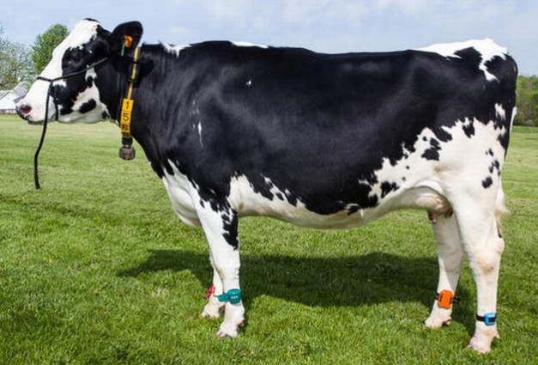
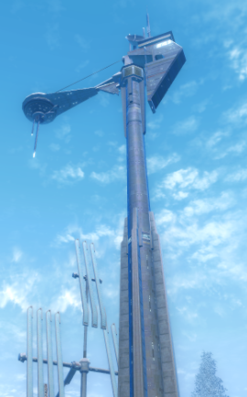
University Farm Connectivity

Slide 21
Sixty Six Games Expo - Thank you
TechZone
SA IT
Endpoint
Rosie Hauck, Tyler Hoobler, Dave Greenfield, Melinda Colle-Tripp, Rachal Roach, Dan Thames, Charley Edamala
Notes:
Thank you

Slide 22
CIT MVP Award
The MVP Award recognizes one full-time technical staff member each year in the Illinois State University community for outstanding contribution(s) to the support of faculty, staff, students, and/or operations, as well as collaboration with others.

Slide 23
CIT MVP Award
And the 2021 winner is…
Michaela Cooper
Tech Solutions Information Security Office

Slide 24
Next up for CIT
Spring 2022 CITx, date TBA
Nominate one of our great student employees for the CIT Student MVP Award – cit.illinoisstate.edu/awards. Due 1/31/22.

Slide 25
Break!

Slide 26
Retirement News
Rudy Radosevich
Dan Taube

Slide 27
Leveling Up Security Our Journey
Past – 2020
DIY and Best Effort Security
2020 – Present
Partnership and Organization
Our Future
Culture of Security
Dan Taube

Slide 28
2020 – Present Partnership and Organization
Improved Data Protection
Drive Encryption
Defender for Endpoint
Improved Access Protection
O365 Multi-Factor Authentication
Risky Users and Risky Sign Ins
VPN Multi-Factor Authentication
Reduced Legacy Authentication
Improved Web Protection
Cisco Umbrella (DNS)
Microsoft SafeLinks (Email)
Improved Infrastructure Protection
Removal of Legacy OS Versions
Security Hardened Backups
Improved Patch Management
Improved Awareness
Information Security Docs
Departmental Training Sessions
Information Security Program
Dan Taube

Slide 29
Our Future Culture of Security
Improve Security Strategy
Use CIS Controls and Safeguards
Share Configuration and Practices
Use Risk to Inform Priority
Report on Performance
Develop Risk-Aware Users
Improve Security Management
Establish a Security Council
Run Incident Response Exercises
Build a Security Operations Center
Develop Policies and Standards
Provide Transparency
Dan Taube

Slide 30
Cybersecurity Awareness Month “Do Your Part. Be Cyber Smart.”
Beware Crafty Social Engineering
Caller ID Spoofing Legitimate Numbers
Impersonation of Legitimate People
Inclusion of Unsuspecting Participants
Stop Bad Practices
Unsupported or Out-of-Life Software
Logged in User as Local Administrator
Champion Cybersecurity
Promote Best Practices
Echo “Secure the Bird” Messages
Dan Taube

Slide 31
ReggieNet support continues!
Moving ReggieNet handouts to web pages
Opscan Evaluation is back to full-time hours (M-F 8:30 a.m. to 4:30 p.m. – Williams 118)
Short Courses will continue to be offered online (using Zoom)
Jim Gee

Slide 32
Tentative features/improvements in Sakai version 22
New Discussions tool
New tables and forms UI
New Calendar tool UI
Meetings tool (including integration of Zoom/Teams)
Video feedback for Assignments tool
Workflow improvements for Assignments, Tests & Quizzes
Jim Gee

Slide 33
Enterprise Data & Analytics
Student Success Dashboard
Additions to the University Student Success Dashboard
Launched the Graduate Student Success Dashboard
Data Acquisition & Reporting
IT: Cherwell, Teams, O365,SCCM, Jamf
Student Affairs: Redbird Life, Career Center, Dining, Rec Center
Financial: Annual Fiscal Reports, Mobile Billing
Data Analysis
Improved the performance of our predictive model
Added features: Account Balance, Test and Transfer Credit, Dining Habits, Schedule of Difficulty, Engagement
Rachel Hart

Slide 34
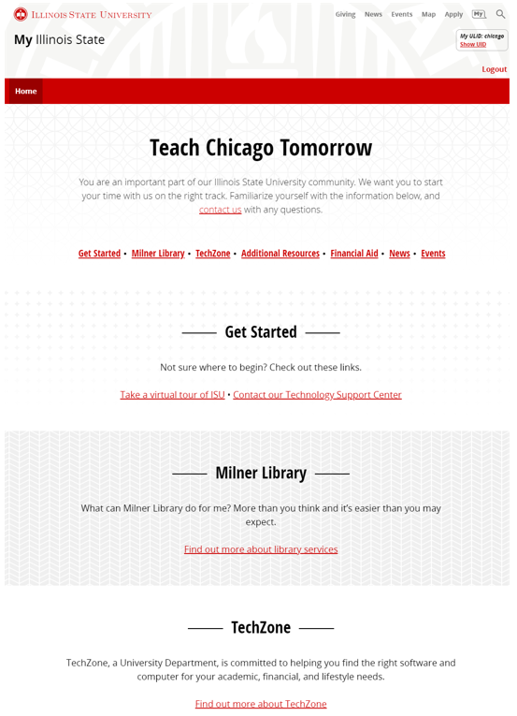
New in My
Teach Chicago Tomorrow
Tailoring content and resources for a new student cohort
Making them feel welcome even if they have never set foot in ISU
Arturo Ramirez

Slide 35
Website fun facts
Improvements to content
Career Center downsized
Old site:
300+ pages and 212 pdfs
New site:
33 pages and 5 pdfs
Arturo Ramirez

Slide 36
Milner Library Wi-Fi Grant
+ + =
Paul Unsbee

Slide 37
In a nutshell
$18,000 from Secretary of State for expansion of library study space and services responding to COVID-19
Expand and Strengthen outdoor coverage in areas between:
Bone Student Center
Bowling and Billiards Center
Milner Library
Paul Unsbee

Slide 38
That’s a Wrap!
Today’s sessions, lunch and afternoon break will be on the third floor
Don’t forget to pick up your t-shirt from the lab area in the basement, open until 4:15 pm. Online attendees can pick up from JH113 by 10/29.

