Slide 1
Modernization of Identity and Access Management
Jeremiah Haywood – IAM Administrator Majeed Abu-Qulbain – Enterprise Architect
10/22/2021

Slide 2
Agenda
InCommon Collaboration Success Program (CSP)
Identity Management and upcoming changes
Authentication and upcoming changes to Single Sign-on
Roadmaps and Release Strategies for both IDM & SSO

Slide 3
Collaboration Success Program
What is it?
Why did we join?
Notes:
Brief! What? - Put on and coordinated by Internet2/InCommon subject matter experts and staff - Brings Higher ed institutions together as both new participants and alumni to learn about and solve problems with the trusted access platform components
(Shibboleth, Grouper, Midpoint, CoManage)
- Offers formal training on the individual TAP components and how they can be integrated to work together
Why?
- We were already members of incommon and leverage their Certificate Services & eduRoam
- We really like the focus on higher ED so many benefits to participate
- IDM team POCs lead to the discovery of Trusted Access Platform (TAP) components and midpoint
- Auth Team POCs lead to a shib investigation
Link to learn more about the CSP: https://incommon.org/academy/csp/ Link to learn more about the Trust Access Platform: https://incommon.org/trusted-access/

Slide 4
Collaboration Success Program
Our Experience
Training Leveraged 10 seats across 3 IAM Products
Working Group Participation
Weekly Office Hours
Use case & design discussions
Architecture reviews with SMEs
CSP Alumni Prod case studies
1 on 1
Collaboration with other universities
Notes:
Training
Midpoint (IAM team + Majeed):
Training delivered by Evolveum Employee (Company that leads development of midpoint)
Ivan Norris – Midpoint Trainer/Implementor was very detailed in teaching and demonstrating foundational concepts and could address questions of any complexity
Grouper Training (IAM team + Majeed):
was delivered by primary developers which allowed the following
very in depth conversation on any topic
Were able to response to questions accurate while including demo of how they achieve certain functionality at there own institutions
They were very open to feedback about the product and even in training were looking for ways to enhance the product
Shibboleth Training (Auth team + Majeed)
Skilled up on the foundations of Shibboleth administration
New member on Auth team (Shawn) started position a month prior to training. Training and other CSP activity got him up to speed quickly
Final Note on Training: As CSP Alumni we get discount on future training for any ISU member (not just member from IAM related teams)
- We plan on leveraging this to re-take the training to continue to expand and keep up skillsets
- Excellent training path for new staff members in this space
- Economical way to ensure skillsets are maintained and enhanced
Weekly Office Hours
use case & design discussions
architecture reviews with SMEs
CSP Alumni Prod case studies
Working Groups Collaboration with other universities (go to next slide with all the CSP universities)
CUT Everything below (to much detail for the time) Jeremiah: examples for how working group and collaboration affected specific config
Slavek feedback on hybrid ldap group management
Internal repository lookup assistance, guiding examples
Use cases and configuration around multi-account per identity
Majeed:
- touches on identifying a logical future state Architecture and how we conducted reviews and obtained feedback
- Use case guidance: very specific implementation detail on how to integrate shib with Azure AD and to convert auth method references to standardized REFEDS Profile assertion

Slide 5
Collaboration Success Program
Notes:
1 on 1s with:
UNC Chapel Hill
University of Delaware
University of Illinois
University of Massachusetts Amherst
Colorado State
U of Western Ontario (connected with them through the community)

Slide 6
Identity Management
What is an Identity?
Many titles: User profile, persona, user record, user account, etc.
The IDM’s Role
Collect data from source systems and aggregate on the digital identity. Then provision to target systems.
IDM vs. Directory
Directories (AD/LDAP) excel at storing and releasing data.
IDM’s manage and provision the data to the directories.
IDM’s excel at making decisions based on data.
Notes:
What is an Identity?
The first thing to determine is what an identity is
An identity consists of various attributes that make up a user
These attributes can exist in sources across systems and applications
The IDM’s Role
The IDM’s job is to collect data from various source systems and aggregate them on a digital identity
Once the identity data has been collected target provisioning
Difference between a directory
Ultimately, directory servers are databases that store information
Directories excel at storing identity data and releasing it to application with appropriate permissions to access the data
They are not well equipped to evaluate entitlements/make decisions whether to allow or deny specific operations
IDM manages the data in the directories in addition to application specific provisioning

Slide 7
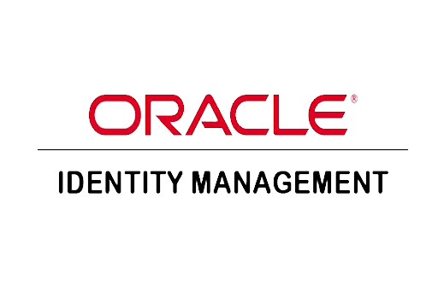
Identity Manager Comparison
Lacks core functionality requirements
Reconciliation
Group management
Rigid structure
Feature rich
High flexibility and customization
Comprehensive configuration
Functionality
Legacy deployment principals
Inability to automate current deployment (e.g. pets)
Modern deployment principals
Ability to automate deployment and containerization (e.g. cattle)
Deployment
Corporate community
Unsatisfactory support
Academic based community
Responsive support
Community
Notes:
*Comparison of current IDM environment (OIM 11g) to future state.*
Identity Manager Evaluation
The IAM team evaluated several identity managers prior to landing on midPoint, the following were evaluated:
WSO2
OpenIDM
ForgeRock
Keycloak
GLUU
OIM 12c
Functionality
Current pain points in OIM exist around the inability to;
Reconcile user data between the IDM and downstream targets
Effectively remove directory group membership
Midpoint allows for;
Full reconciliation to downstream targets
Comprehensive configuration options for resources
Deployment
Pets and Cattle DevOps Concept
Pets
Equate to what we think as traditional methods of deployment
Server or VM
Takes a lot of care to maintain, upgrades and config changes need to be done on each instance
Takes a lot of care, feeding and manual operations
When missing or there’s issues everyone notices
Cattle
Equate to methodologies related to containerization and orchestration
Containers, Kubernetes, OpenShift
They are all configured identically
Infrastructure as code
When issues arise, they’re easily torn down and replaced
Can get shot and the system can get re-provisioned by the orchestration
Community
Oracle
Diminishing community Support
Difficult to get responses
Hard to get custom features developed
Midpoint
Significant amount of higher ed institutions using midPoint
Support
Feature development and enhancements are foundational
Multiple methods to engage with the community
Active Slack community
Working groups
CSP directed collaboration

Slide 8
Group Management
Affiliation Automation
Centralized entitlement assignment
Access auditing
Policy based access
Notes:
What is Grouper?
At the most basic level Grouper is a tool to put entities into groups.
IAM Uses
Affiliation Automation
Current state affiliations are calculated in Campus Solutions and sent through an integration to OIM
Future state Grouper will be able to connect directly to CS to query for any populations desired and send to Midpoint
Ultimately simplifies the affiliation process
Centralized entitlement assignment
Current state group management is fragmented
Centralized group management brings the benefit of comprehensive access auditing
Policy Based Access
Grouper is used to manage these policies
Policies result in:
Group membership
Attribute entitlement
Enforcement occurs at:
Application layer
SSO layer

Slide 9
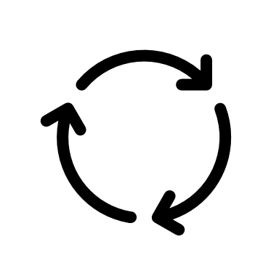
Problems Solved and New Capabilities
Reconciliation
Data accuracy
Compliance
Data confidence
Affiliation Automation
Performance Improvements
End to end control
Group Math
Fine grained control
Dynamic calculations
Modern Functionality
Flexibility
Immutable Infrastructure
Notes:
Reconciliation
Data accuracy
Absent manager, title, phone number and addresses on directory accounts (LDAP/AD) which lead to data issues in applications
Incorrect data will be fixed with the implementation of midPoint
Incorrect directory group membership
This can affect licensing requirements (365, Adobe, etc.)
Affiliation Automation:
Decreased process complexity
Flexibility
Capability to connect to any data source and develop a role
Group Math
Ability to easily develop curated populations based on basis groups that we already have
Adds reusability to the groups
Use cases
All student population + custom group
All faculty and staff including instructors only
All faculty in a specific department
All staff excluding IT staff
Modern Functionality
Flexibility
Containerized deployment on Openshift using infrastructure as code
Change control
Allows for rapid redeployment to different environments
Immutable infrastructure
No modifications to the server are done while it’s running, instead you build a new server with the updated configurations
Simplifies operations
Infrastructure is set through code minimizing the need to manage various production servers
Improved failure recovery
Images are kept in source control making changes easily trackable
Dynamic scaling
Base images can be used to add new nodes based on loads

Slide 10
What can people expect to see?
Primarily a behind the scenes technology replacement
Short Term
Removal of security questions
Automated provisioning of secondary accounts
Data accuracy
Long Term
Delegated access control via Grouper
Better licensing management
Application-level access provisioning beyond LDAP and AD
Notes:
What can people expect to see
The implementation of Midpoint and Grouper are primarily a behind the scenes technology replacement
ISU currently has strong IAM processes
Most limitations are due to technology limits
The goal is to set a foundation for future improvement
Short Term
Removal of security questions
In order to align with industry best practices IAM plan to move away from security questions in favor of a third-party email flow
Automated provisioning of secondary accounts
With the use of Grouper and Midpoint we will be able to automate the process of secondary account provisioning (e.g. admin accounts, student worker accounts etc.)
Where automation isn’t ideal, we will provide the tools to other IT teams to easily provision secondary accounts based on their needs
Data accuracy
Correct data elements in the directories, both user attributes and entitlements
Long Term
Delegated access control via Grouper
The ability to hand off access control to other IT teams to apply entitlements
Better licensing management
Potential for application licensing being driven by Grouper
Application-level access provisioning beyond LDAP and AD
Direct application provisioning (e.g. provisioning to Zoom directly)

Slide 11
Any Questions?
Notes:
What exactly does delegation look like in Grouper?
Tree structure
Access to specific folders and reference groups
Security features
Does grouper have self service capabilities?
Discuss templating abilities
Community focused on developing user facing portions
What are we excited about implementing?
Automation of offboarding for secondary accounts
Improved synchronization between directory groups
Infrastructure improvements
Orchestration benefits
Immutable infrastructure

Slide 12
Authentication & Single Sign-On
Overview of Authentication @ ISU
What is Shibboleth
What is Federation
Upcoming Authentication Changes

Slide 13
Overview of Authentication @ ISU
Seamless SSO Experience across SAML and CAS apps
Roughly 60 Apps Integrated with CAS (mix of on and off prem)
Roughly 80 Apps Integrated with OAM’s SAML (mix of on and off prem)
Notes:
This is how we are operating today. Problems with are current State: 1) While CAS and OAM are integrated for a seamless SSP experience, Office 365 is not currently part of that seamless experience 2) No MFA protection at the SSO layer
3) A lot of management overhead: Several components that need to be managed properly
4) Product complexity (webgate integration between OAM, CAS along with complicated logout flow) Note on terminology: CAS refers to 2 things: An SSO protocol and also the name of the product we are using that implements the CAS protocol. We plan on migrating Apps that use the CAS protocol to a different product that also supports the CAS protocol (Shibboleth) Oracle Access Manager (OAM): is the product we use to implement the SAML protocol. We plan on migrating apps that use the SAML protocol to Shibboleth’s implementation of SAML “Central Login” is the branding for the entire SSO experience that is made by all of these components.

Slide 14
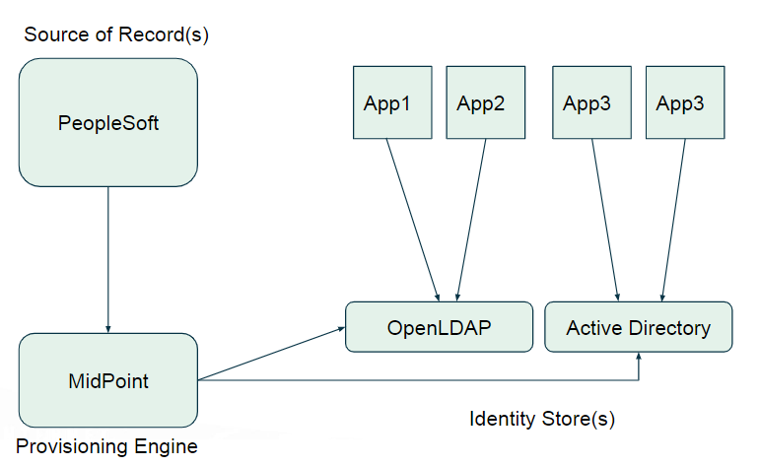
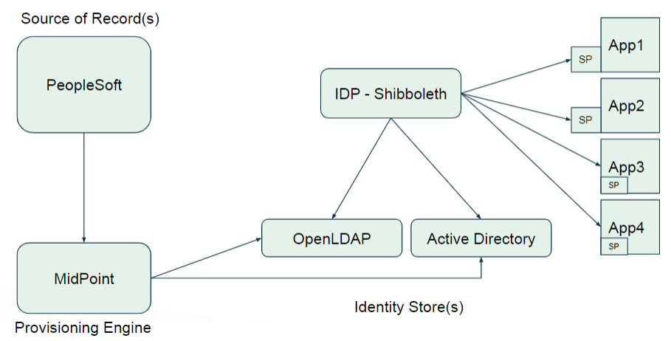
Authentication: What is Shibboleth?
Legacy – No Single Sign-On
With Single Sign-On
IDP = Identity Provider (Handles Auth)
SP = Service Provider (Application Trusts IDP)
Notes:
What is Shib: Shibboleth It is a single sign-on (SSO) solution that allows applications to make informed authorization decisions in a privacy-preserving manner.
Single Sign-on:
Single Sign-On allows the user to log in once and access services without re-entering authentication factors.
Enhances Security by reducing the number of applications that have access to a users sensitive credentials (passwords, etc)
SAML Terminology
Service Provider (SP): A resource (application) that requires federated access, such as your campus portal (my.ilstu). The SP is responsible for validating messages from IdP and providing information
Identity Provider (IdP): An organization, such as a university or Internet2, that provides identity accounts for its members or users. The IdP is responsible for authenticating user and gathering/release appropriate information
Single Sign-On (SSO): Another definition using SAML terms - A method of signing on to a SP using your IdP credentials.

Slide 16
Authentication: What is Changing
User Facing Changes
New Login Branding
Bringing Office 365 into SSO experience
New Logout Experience
Azure MFA Prompts after username/password

Slide 17
Authentication: What is Changing
Behind the scenes
Consolidated Architecture
Reducing # of components that need to be managed/secured
Modernized Deployment
DevOps Approach: Gitlab driven containerized deployment on OpenShift (Cattle)
Notes:
Consoliated Architecture: - As mentioned, Shib supports the 3 main SSO protocols (SAML, CAS, and OpenID Connect (OIDC). This allows to converge both CAS and OAM into a single product - this greatly reduces the managed overhead in keeping these systems Patched, Upgraded, Monitored, Highly Available and Secured! Modernized deployment: - in addition to shrinking down the # of components that need to be managed, the main Shibboleth component will be deployed in a containerized fashion on top of openshift that leverages DevOps concepts such as Infrastructure as Code (gitlab), automated deployments, rapid upgrades, rapid rollbacks (if needed) – As Jeremiah touch on before – The auth team is also making the move from Pet style deployments (OAM & CAS) to Cattle style deployments (Containerized Shib on openshift)

Slide 18
Any Questions?

Slide 19
Release Strategy: Identity Management
Midpoint & Grouper Production Environments are online, bootstrapped with Identity data but not managing any directories just yet
Continue Improvements based on Midpoint and Grouper features. Multiple Accounts mgt
New “Transition State” Account Self Service is launched to support both Midpoint and OIM simultaneously. Security Questions are gone!
Midpoint takes over AD provisioning duties from OIM
June 2022 ->
December
2021
February
2022
April
2022
May
2022
Performance Testing and Data Validation against production data (Midpoint and Grouper)
Grouper takes over AD/LDAP Automated role/affiliation sync duties from OIM.
Midpoint takes over LDAP provisioning duties from OIM
Decommission OIM!! Also deploy new version of Account self-service that no longer makes calls to OIM
Begin transitioning application policy mgt to Grouper
Fine Print
These dates are firm estimations but are subject to change with appropriate notice if issues are found during final functionality & Performance testing as well as data validation.
Notes:
Other things to mention: Lar

Slide 20
Release Strategy: Authentication
Shibboleth Production Environment is online and integrated with Azure AD. OAM & CAS are not yet integrated.
CAS app and OAM SAML app migrations to Shibboleth
December
2021
January
2022
February
2022
March
2022
April
2022
ADFS is converted to a Transparent Proxy to sit in between Azure AD Shibboleth
OAM is delegated to Shib. SSO session is unified and seamless across CAS, OAM, Azure AD & Shib and protected by MFA
Fine Print
These dates are firm estimations but are subject to change with appropriate notice if issues are found during final functionality & performance testing or user experience issues.
Notes:
Call Attention to the following: - As usual with large projects like this the communication and engagement is key. We can’t move forward without your help in validating functionality
- We will leverage the “Authentication” and “Identity and Account” sub channels of the “ISU IT Staff” Teams channel for outbound and inbound communications related to this e

Slide 21
Any Questions?

