Slide 1
Before We Begin
1000ms= 1 second
Reaction Time Test
https://humanbenchmark.com/tests/reactiontime
ISU Esports Athlete Scores: 160, 153, 192, & 163ms on Gaming Systems
Aim Test
https://humanbenchmark.com/tests/aim
ISU Esports Athlete Scores: 352, 349, 360, & 338ms on Gaming Systems
Post your scores in the chat!
Notes:
Compare this score to your personal setup. You with a ‘feel’ a difference compared to your personal peripherals.

Slide 2
Esports: A Technical Look at ‘Gamer’ Equipment and what it takes to be an Esports Athlete
Tyler Piper & Jack Blahnik
Facilitated By: Ben Bricker
Notes:
Introductions
Agenda – Gaming vs Office Specced Peripherals. How much does it matter gameplay performance? That is the focus of the peripheral portion of this presentation.
Following the peripheral discussion Jack will take over to dive into the player side of competitive gaming and Esports.

Slide 3
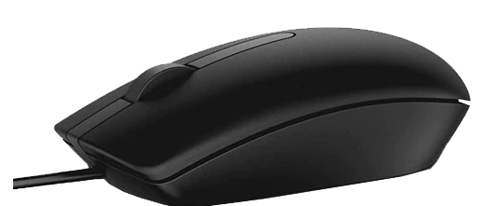
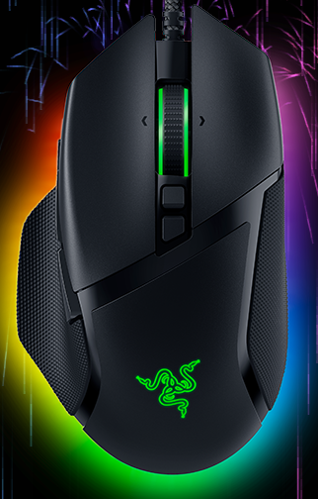
Mice
Vs.

Slide 4
Logitech attempts to use every gaming peripheral buzzword…

Slide 5
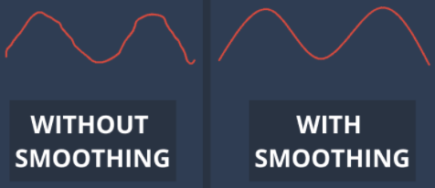
Mouse Specs: What does it all mean?
Term
Simple Definition
Why It Matters
Sensor
Optical (LED) or Laser – Images are taken of the surface and processed to determine movement.
Resolution and Frame Rate determine how accurate movements are picked up. Fast movements with a low-quality sensor can be inconsistently processed or missed completely. Sensors with higher DPI capability = Better.
Acceleration
A setting to increase cursor move distance when a fast mouse movement is performed. In gaming this will make your ‘flick’ movements move the cursor/reticle further than normal. Windows setting and may be a mouse or in-game setting.
Turn IT OFF
Smoothing
Your device/system attempts to predict your desired next movement to ‘smooth’ it. May also be an in-game setting.
Considered a QoL feature on some mice or in games, but lower quality sensors also use this compensate by attempting to predict where you intend the cursor to go. This results in inconsistency and inaccuracy.

Slide 6
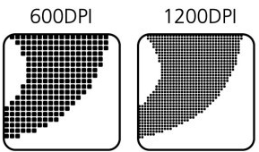
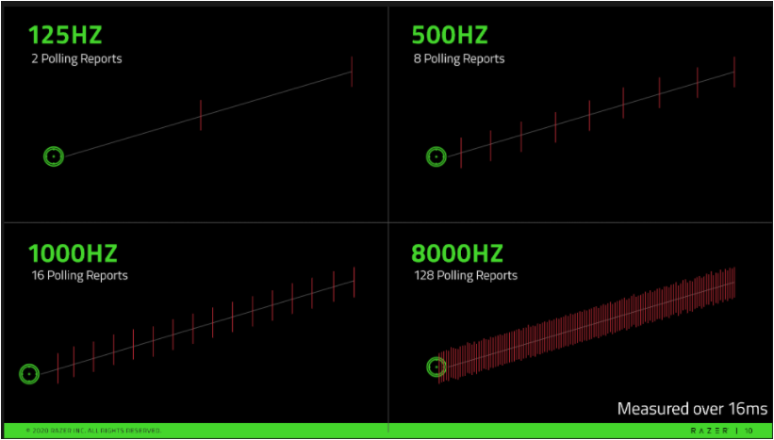
Mouse Specs: What does it all mean?
The rest was mostly ‘nice to have’ or marketing garbage.
Term
Simple Definition
Why It Matters
DPI
The number of Dots Per Inch of movement that a device can detect.
The greater the DPIs, the higher the mouse responsiveness, movement accuracy, and cursor/reticle movement speed capability. Office Mice 300-1,600 DPI capability. Logitech Example: 200 – 20,000 DPI Higher DPI = Slightly Less Input Latency. ~10-20ms
Polling Rate (Hz)
The tick rate at which your mouse communicates input to your computer.
A higher polling rate will decrease the lag that occurs between when you move your mouse and when the movement shows up on your screen. Office Mice are mostly 125Hz. Gaming – 500Hz+ Higher polling rate increases the responsiveness of the cursor/reticle to fine mouse movements. While this does increase the accuracy of cursor movements in relation to how you moved the mouse it may decrease aim accuracy due to a more notable reticle ‘jitter’.

Slide 7
What Mouse Settings Do The Pro’s Use?
Sensitivity (Sens)
Effective Dots Per Inch (eDPI)
Windows = 6 (Default) Enhance pointer precision = Off (Not Default) Mouse DPI = 400 – 1000DPI - 800 Most Common, personal preference for system use. In-Game = 1 to 4, Game Dependent Polling Rate = 500Hz or 1000+Hz
Your actual sensitivity being used in the game. Mouse DPI x In-Game Sensitivity Examples: 800 DPI x 2 In-Game = 1600 eDPI 1000 DPI x 1.6 In-Game = 1600 eDPI The sensitivity is the same feel for both players. Pro Tip! Set your mouse DPI sensitivity to be comfortable for system use and adjust in-game sensitivities.

Slide 8
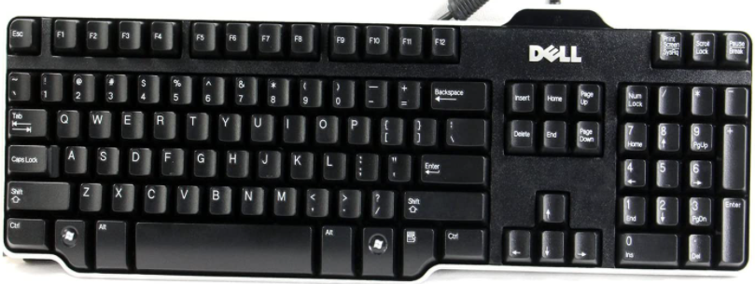
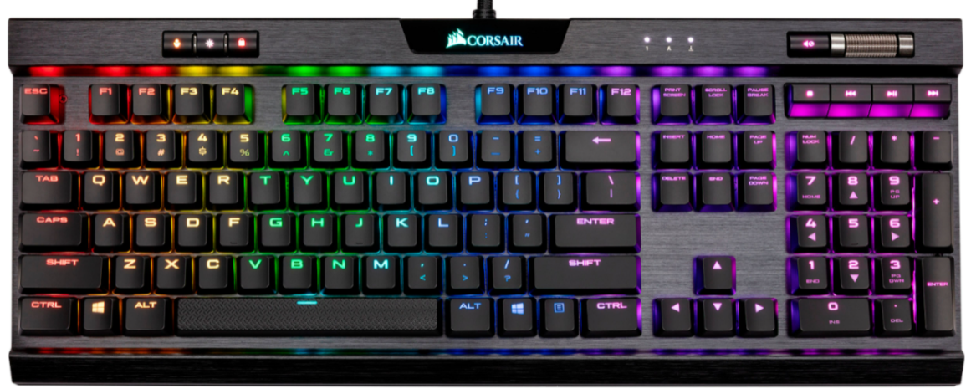
Keyboards
Vs.

Slide 9
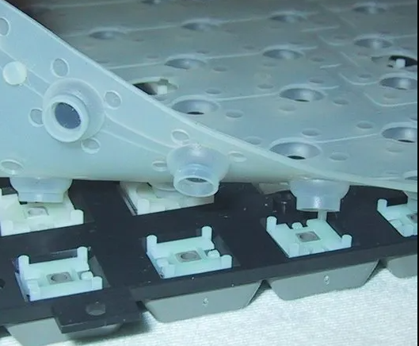
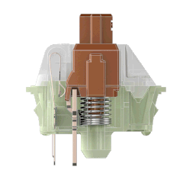
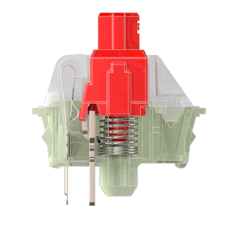
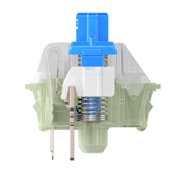
Membrane & Mechanical Key Switches
Membrane
Tactile (Press Feedback)
Linear (Smooth Press)
Small Notch
Smooth
Clicky (Sound) + Tactile (Feedback)
Polling Rate
Same as a mouse.
Higher = Better!
If you use this type, apologize.
Notes:
Membrane – wear out and less consistent keypresses. Little key travel time and almost no feedback. Can feel ‘spongy’.
Mechanical – Tactile have a notch that catches to provide key press feedback and a little click sound.
Linear – smooth all the way down, sound comes from the ‘bottom out’ of the key. Not needed to actuate the key.
Click + Tactile – The type that shall not be spoken of. Provides feedback like tactile but also a secondary ‘click’ sound to really annoy your coworkers.
These work by closing a switch circuit on actuation with the PCB. Optical Mechanical – Same concept but with a laser that is interrupted on keypress.

Slide 10
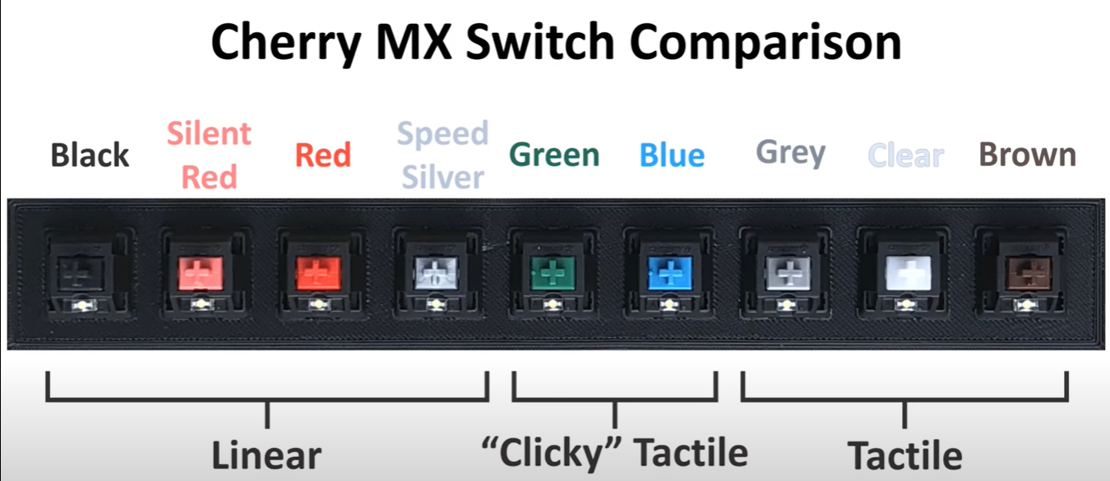
Actuating Force
Greatest
Least
60cN 45cN 45cN 45cN
2.0mm 1.9mm 2.0mm 2.0mm
4.0mm 3.7mm 4.0mm 3.4mm
80cN 60cN
2.2mm 2.2mm
4.0mm 4.0mm
80cN 65cN 55cN
2.0mm 2.0mm 2.0mm
4.0mm 4.0mm 4.0mm
cN = centinewtons
Notes:
Actuation Force
Actuation Depth
Bottom Out

Slide 11
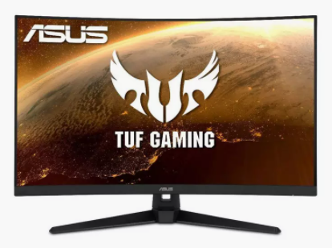
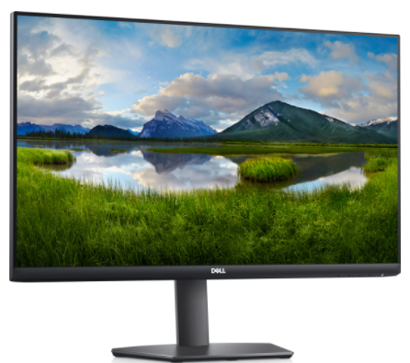
Monitors
Vs.
Vs….

Slide 12
This….

Slide 13
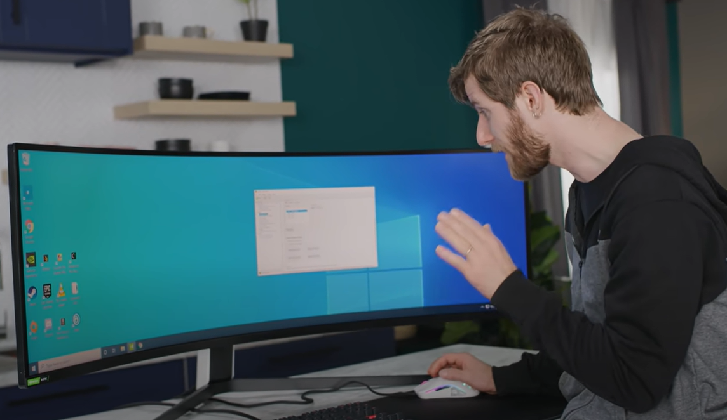
Linus for Scale

Slide 14
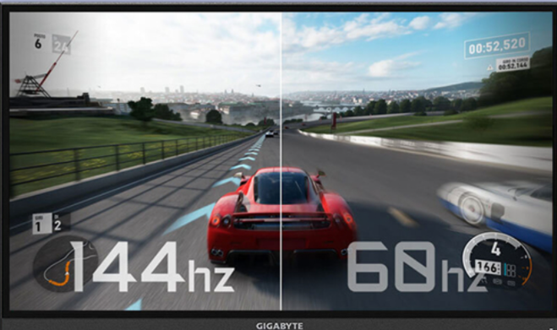
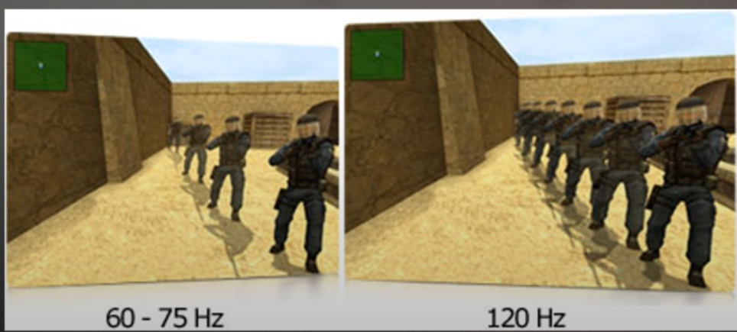
Monitor Specs Matter
Size: 22+ Inches, larger sizes need to be curved.
Ideally, no head movement.
Bigger is not always better.
Head movement & higher resolution = performance impact.
Response Time: Time to switch a pixel from one color to another. Sub 5ms is considered good for gaming. 1-2ms is common now.
Refresh Rate: 60, 120, 144, & 240Hz
How often the image is updated per second.
Frames per Second (FPS) is visually limited by the display refresh rate.
Types: OLED vs. LCD vs. LED vs. TN vs. IPS vs. VA

Slide 15
Peripheral Conclusion
Reaction Time and Aim Test Scores – Office vs Gaming Equipment
Gamer Mouse > Office Mouse: Consistency, Latency Reduction, & Comfort
Keyboard: Personal Preference. High Polling Rate (Maybe)
Monitor: High refresh rate, low response time.
Latency Performance Improvement vs Office Quality
A 100ms latency reduction is 1/10th of a second
In terms of % improvement, 25% faster
Paying for brand name, features, and quality (in that order)
Blue and Green Switch Users are the worst.
After Video, Biggest Improvement = Surround Sound Headphones

Slide 16
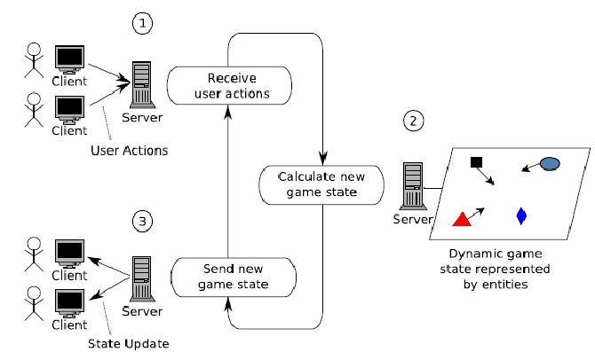
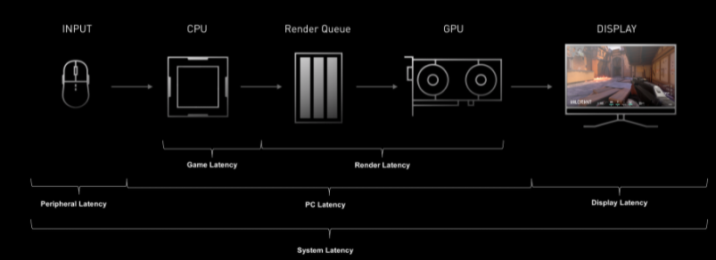
Network & Tying It All Together
Network Output
Packet Send Rate
Packet Size
Packet Loss
The delay between what you see compared to when it happened vs. when someone else sees it is the biggest challenges in online gaming. This is one reason tournaments are in-person.
Notes:
Transition to Jack for discussion about competitive gaming and Esports Athletes.

Slide 17
Esports Players
Preparation
Adaptation
Communication
Mindset
~Dr. Alok Kanojia “Healthy Gamer”
Notes:
4 pillars
Preparation
Adaptation (label yourself something that is unchangeable)
Communication
Mindset (if you have mindset that you can’t go in and communicate, then this actually destroys your ability to communicate).
Diagnostic problem, look for solutions, not problems. If practice was all that is took to be good at a game, we should see a clear correlation with the amount of games played and your skill at a game.

Slide 18
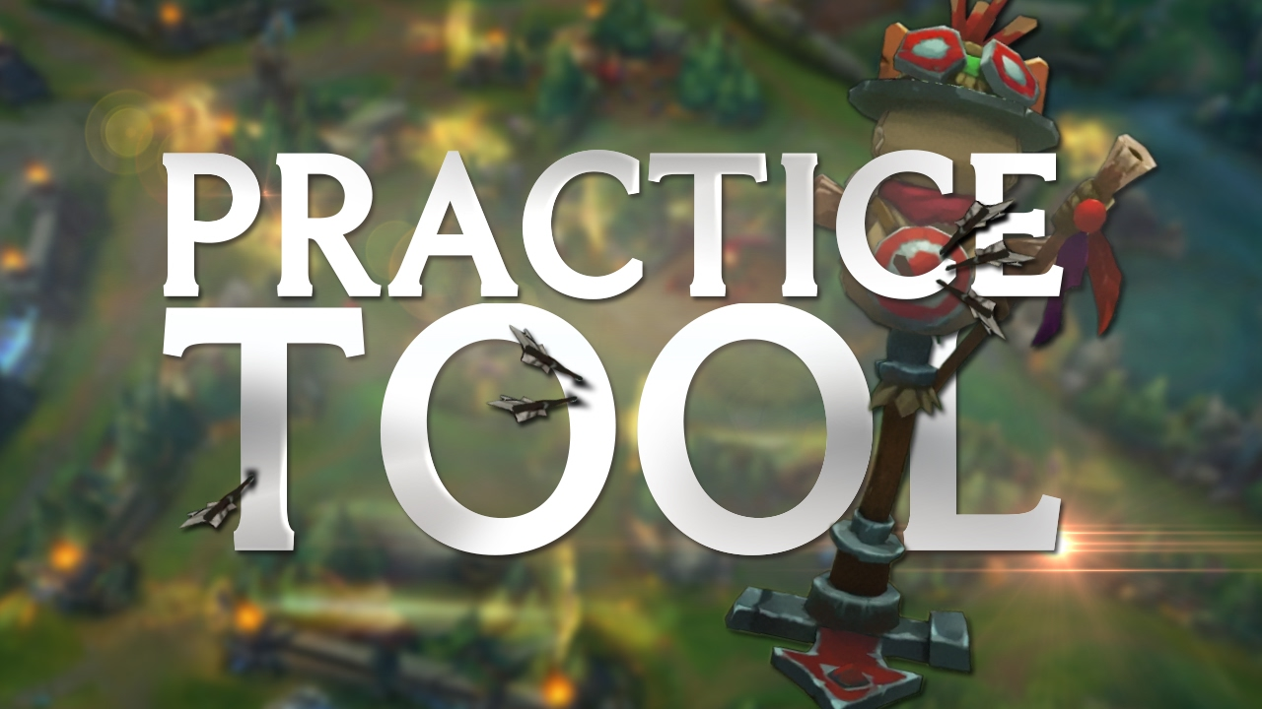
Preparation
Intentional Practice
Drills
1v1s
Watching VODs
More time/reps ≠ better skill
“Auto-piloting”

Slide 19
Adaptation
Success = Ability to adapt
Going all in on one strategy…
Labeling ourselves something that is unchangeable
“I’m just bad at…”

Slide 20
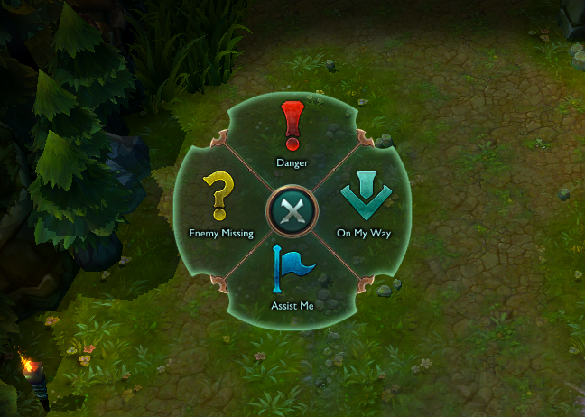
Communication
Clearly articulate with your teammates and support staff
Many players choose to “Mute All”
If you go in thinking your teammates are bad and can’t communicate, that will likely be the result

Slide 21
Mindset
Mindset is everything
What can I do to be better?
Control what you can control

Slide 22
Questions?

Slide 23
Additional Material
How Your Table and Chair Impacts Your Aiming When Gaming
Which Mouse Pad is Better for Aiming? (Hard pad vs. Cloth pad)

