Slide 2
Enterprise Backups
Notes:
Tim intro.

Slide 3
The Backup Service
Keep 60 Days worth of backup data
Systems are backed up every day
Incremental backup occur every Sat, Sun, Mon, Tues, Wed, Thurs at 10pm
Synthetic Full occur every Friday
A Synthetic Full is a combination of all Incremental backups taken after the last full/Synthetic Full
A copy of all Commvault data is shipped to DR daily starting at 6am
There are many other types of backups (SQL, Oracle, AD, S3).
Notes:
Ben
Talk a little more about Agent based backups vs standard VM backups.
Touch on DB backups, S3 backups, File Servers.
Transactional backups are done every 4 hours for databases.
Note: 60 Day retentions is due to almost all restores requested wanting the latest.

Slide 4
The bad old days Or Why not tape?
Notes:
Tim
Tapes are cheap, manpower is not (~5/Tb). Tapes are hard to verify when sitting in a locker. Had an incident in the past that archived copies were corrupt.
Sure we get “infinite storage”, but managing and maintaining that specialized equipment is not.

Slide 5
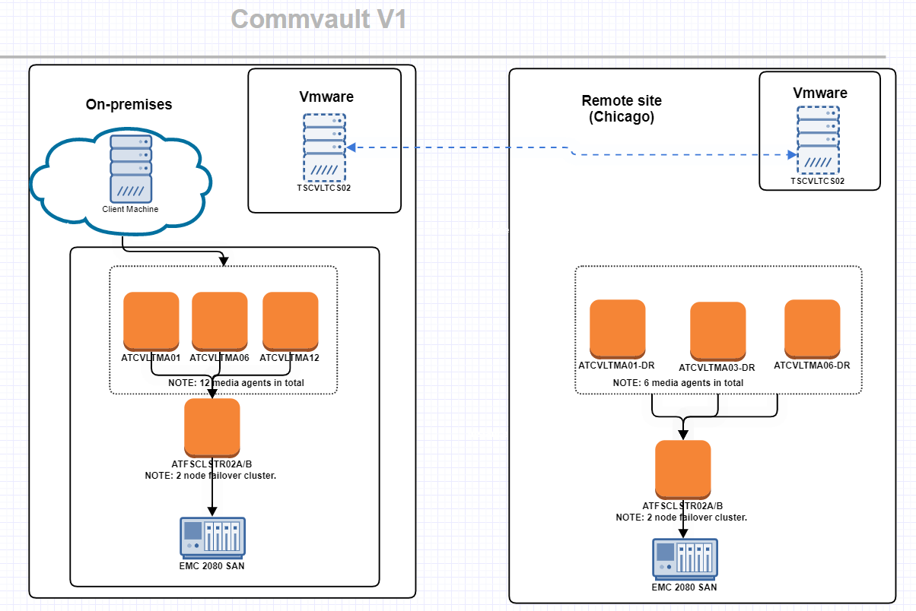
Old and busted Arch
Notes:
Ben:
Explain how things work today.
Touch on RBA vs Chicago
Data Flow:
server > MA > storage > DR > storage
MA move the data
Storage holds that data
DR holds copy of the data.
Data Storage:
Deduplication comes into play
Currently we have ~500TB stored but that is ~1600TB.
“Instant” Access to all backups since it’s all disk. Data need to be rehydrated.

Slide 6
Current Challenges
Limited space
Limited flexibility
EOL hardware
Limited bandwidth
Notes:
Ben: Whole new SAN need to be bought to expand our space. All hardware is currently EOL.
Ben: Another Driver is the amount of data we are now backing up (Transition to Tim)
Tim: Backing up about twice the amount of data per day as 2017. (seeing 45Tb/day up from 22-25Tb/day
Tim: Single 10Gb interlinks limit bandwidth and no redundancy

Slide 7
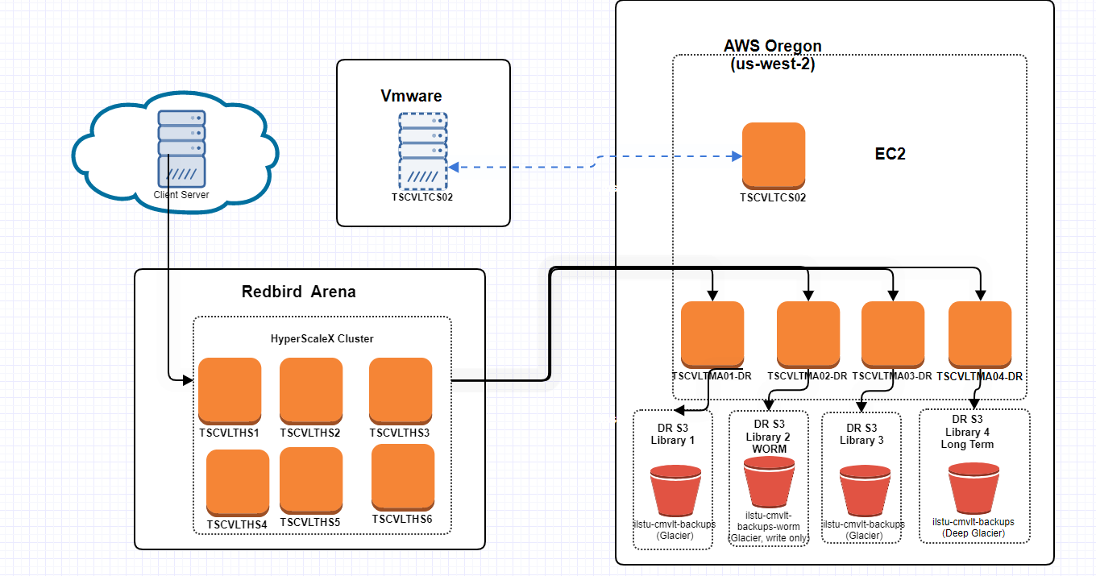
New Architecture
Notes:
Tim
Things to note:
New architecture was slated to be in production by now. Covid/Supply Chain pushed us back.
On-prem:
Raw data flow is the same. Client to onprem to DR. Now with redundant network links.
(fully loaded 2U machines 24 16T drives supplementary drives)
DR:
DR is now in AWS, using ec2 instances for data movers(media agents)
Move from dedicated links to public internet links S3 is more of a hybrid tape/disk approach to storage. (has lag time, but unlimited space and can verify backups)
Glacier /deep on next slide.
Onprem:
HCI:No more external storage. Data movers and storage integrated into 1.
Data is redundantly distributed across nodes

Slide 8
Hyperscale Advantages
1. Increased flexibility and expansion
2. MUCH more space (1.4Pb!)
3. Better bandwidth
4. Slightly lower costs
Notes:
Tim
Add a node at a time, vs replacing the whole SAN. 1 Node buys about 40% of our existing storage, or 200T usable.
DR decoupled from on-prem for sizeing
DR has different storage classes for different usages. Deep Glacier($1/Tb-month vs Glacier($4/Tb-month). Can expand AWS footprint quickly if we need faster rehydration.
2. Currently have about 600T of usable space. 1.4Pb should net us about 4 years
3. Double the bandwidth to campus, while being resilient to hardware failures.
4. No need to buy, and maintain a whole separate DR system(and the distance problems that it can entail)
NOTE: Deep Glacier is about $6/TB held for 6 months(minimum). U
DR Restores no longer “free”, nor “instant”, but almost never done outside of backup testing. ($2.5/Tb to $20/Tb depending on time requirements)

Slide 9
Basic Navigation of CV
URL: https:\\commserv.ilstu.edu
Login: Use adilstu\<admin username>
Notes:
Ben
Pull up https://commserv.ilstu.edu
Sign in with adilstu\svc_cmvlt_demo
Pass is in pmp
Log into web client
Note: future state is coming will have a similar look and feel but more functionality.

Slide 10
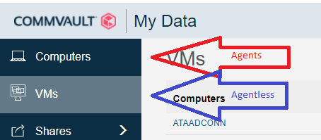
Viewing files
Notes:
Ben:
Show off file on ationiautil02 agentless.
Show off files on atguac01 has agent. Restore file to my home dir
VMs: backed up VMDK, Computers via files system. Takes awhile to view files in VMs, instant for computers. VMs are easier to restore whole, Computers are more flexible.
Files level restore are supported with and with out agent. Restore process in the background is different.

Slide 11
Current Restore Process
Restore with web client
Put in a ticket with the CCA team
We work with you to get the file or VM restored.
Notes:
Ben
Right now, self service works well with and agent and is hit and miss without agent.

Slide 12
Improved Restore Process
All File level and basic VM restores can be done by the IT Admin who owns the Data without a ticket to CCA
Notes:
Tim
More complex restores would still go through CCA.
Highly encouraging self service via commvault
Ex
Very large VM’s.
P to V restore. (step through process)
Bare Metal Restore
Complex out of place restores
Restore to cloud

Slide 13
Report reading
Green is good (no action needed)
Red is bad (contact CCA)
Orange is both (Read the details)
Notes:
Tim
Location: \\vpfpfiles01\Folders\AT Infrastructure Apps\Backups
Good: COE
Bad: VPUA
Mixed: COB
Expecting just a daily glance at the report from our clients.

Slide 14
Best Practices
At least glance at the backup reports daily
Delete unneeded data. We have a limited licenses and hardware for backed up data.
Keep important data either on OneDrive, or a network share
Use full agents for database servers
Don’t get 0wned.
Notes:
Tim
We try to make it as seamless as possible but we only have 4 eyeballs between us.
1. Audit your servers to make sure they’re all on the report occasionally. (6 months and/or whenever a new server is added).
2. We’re using 90+% of our licensed capacity, Keeping data trimmed helps the university keep costs low. Commvault is not an inexpensive product. Legal reasons as well.
3. I can’t restore what I can’t see.
4. Many DB servers aren’t very happy with the 1 second blip in vmware(and hyperV I expect has the same)
5. While we do have ransomware protection, We still need to be hyper vigilant. Commvault does have protections to make sure that Commvault itself isn’t owned, but will gladly back up encrypted files.

Slide 15
A note on Ransomware
Commvault does have some ransomware protections built in.
In the event data is encrypted due to ransomware we would move to restore date from Commvault back to the last good backup
If on premise Commvault itself is encrypted along with our data, we would restore from AWS off site copies.
If active data, onsite back, and off-site backup are encrypted we are exploring the use of immutable (also called WORM write once read many) copies of our data in a separate S3 bucket in AWS that we can restore from.
Notes:
Tim
Commvault locks it’s backup files to the Commvault processes and users and if this protection is bypassed by a higher elevated account, alarms are thrown. This isn’t foolproof.
Ben:
Full DR scenario: Move to AWS, bypass onprem until university is stable. Directly restore Vmware VMs into AWS ec2. Most essential services are already in AWS, so no restoration is needed. (LDAP, AD, CAS,DNS etc) Never, yet had to restore production data from off-site. (only test restores)

Slide 16
Questions?

Slide 17
Notes:
Questions?

