Slide 1
Defense in Depth: CIS Controls and Safeguards
Information Security Office
October 22, 2021

Slide 2
Presented by the Information Security Office
Dan Taube
Seth Pheasant
Jim Johnson
Interim Chief Information Security Officer (CISO)
Information Security Manager
Windows System Admin

Slide 3
Discussion Overview
Our Security Journey
CIS and the CIS Controls Framework
Closing the Gaps
CIS Controls in Practice
Next Steps

Slide 4
Our Security Journey
Past – 2020
DIY and Best Effort Security
Inconsistent Practices
Decentralized Controls
2020 – Present
Partnership and Organization
Improved Communication
Program Established
Our Future
Culture of Security
Maturity of the Program
Risk-based Prioritization

Slide 5
Center for Internet Security (CIS)
Community-driven nonprofit
Over 20 years of promoting cybersecurity
Provide guidance and tools for CIS Controls
Over 12,000 member organizations
Partnered with Amazon, Microsoft, & Google

Slide 6
Controls & Safeguards
Timely best practice solutions
Focused on pervasive cyber threats
Version 8 has 18 controls with 153 safeguards

Slide 7
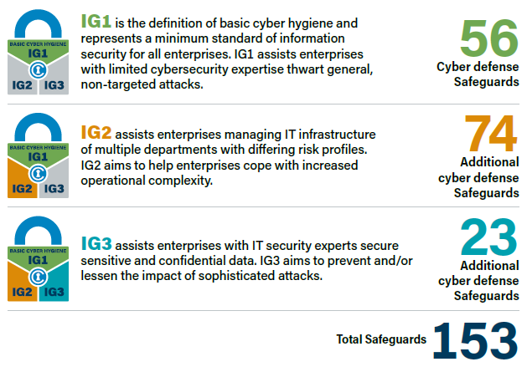
Implementation Groups
Simple and accessible approach to Controls
Recommended & prioritized implementation
IG1 is recognized as “Basic Cyber Hygiene”

Slide 8
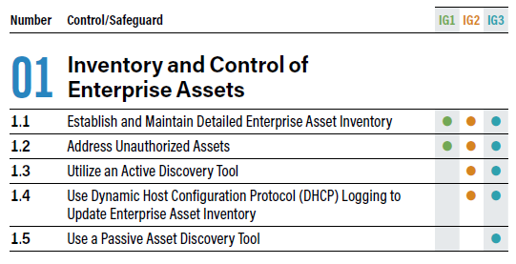
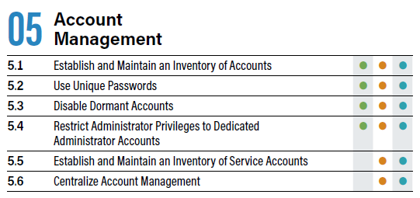
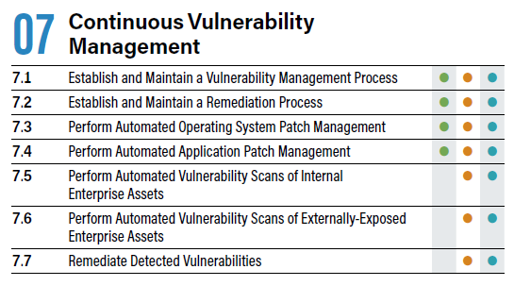
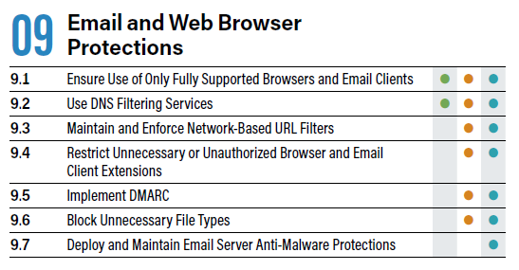
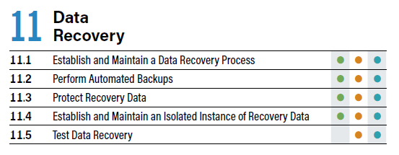
Why the CIS Controls?

Slide 9
Closing the Gaps
CIS Control | 2020 – 2021 Security Change | “Best” Practice | Compliance Obligation | Insurance Expectation
03. Data Protection | Encrypt end-user devices | ✔️ | ✔️ | ✔️
05. Account Management | Use separate accounts for admin privileges | ✔️ | ✔️ | ✔️
06. Access Control Management | Require multi-factor authentication | ✔️ | ✔️ | ✔️
07. Continuous Vulnerability Management | Automate patch management | ✔️ | ✔️ | ✔️
09. Email and Web Browser Protections | Use DNS filtering services | ✔️ | ✔️ | ✔️
10. Malware Defenses | Use anti-malware software | ✔️ | ✔️ | ✔️
Compliance obligation considered for this slide include NIST 800-171, PCI DSS, FERPA, HIPAA, and Illinois PIPA. This does not fully encompass all obligations the University faces.
Insurance expectation reflects what cyber insurance carriers are expecting as a minimum with relation to providing coverage for cyber incidents.

Slide 10
Framework Comparison
CIS Controls v8 | 89 pages | 18 controls | 153 safeguards
Prioritized set of Safeguards to mitigate the most prevalent cyber-attacks against systems and networks. | Initial release in 2008 and latest release in 2021. Purpose built by a community focused on meaningful, prioritized, and timely security.
NIST Cybersecurity Framework 1.1 | 55 pages | 23 controls | 108 safeguards
Framework for Improving Critical Infrastructure Cybersecurity | Initial release in 2014 and latest release in 2018. Focused on cybersecurity program functions.
NIST SP 800-53 Rev. 5 | 492 pages | 18 controls | 322 safeguards
Security and Privacy Controls for Information Systems and Organizations | Initial release in 2005 and latest release in 2019. Audited against by Illinois Auditor General.
NIST SP 800-171 Rev. 2 | 113 pages | 14 controls | 110 safeguards
Protecting Controlled Unclassified Information in Nonfederal Systems and Organizations | Initial release 2017 and latest release in 2021. Derived from the “moderate security control baseline” in SP 800-53. Recommended by Department of Education for Title IV entities for GLBA compliance. Audited against by the Illinois Auditor General and FSA Cyber Compliance.

Slide 11
Framework Language
CIS Controls v8 | 7 Continuous Vulnerability Management
Establish and Maintain a Vulnerability Management Process
NIST Cybersecurity Framework 1.1 | Identify Risk Assessment 1
Asset vulnerabilities are identified and documented
NIST SP 800-53 Rev. 5 | Risk Assessment 5 Vulnerability Monitoring
a. Monitor and scan for vulnerabilities in the system and hosted applications [Assignment: organization-defined frequency and/or randomly in accordance with organization-defined process] and when new vulnerabilities potentially affecting the system are identified and reported; b. Employ vulnerability monitoring tools and techniques that facilitate interoperability among tools and automate parts of the vulnerability management process by … (continues on like this)
NIST SP 800-171 Rev. 2 | 3 Requirements 3.12.2
Develop and implement plans of action designed to correct deficiencies and reduce or eliminate vulnerabilities in organizational systems.

Slide 12
Audit Perspective
FY20 – “2020-003 Information Security Weaknesses”
Lack of adequate IT policies and procedures
Lack of user access reviews
Lack of segregation of duties
Local admin on endpoints under regular account
Access for terminated employees not removed in timely fashion
Poor patch management performance for endpoints and servers
NIST SP 800-53 testing
Repeated under 2018-002 and 2019-001
FY20 – “2020-007 Weaknesses in Cybersecurity Programs and Practices”
Lack of a formalized cybersecurity plan
Lack of IT policies and procedures
Repeated under 2019-005
Illinois Audit Advisory 2021 – “Cybersecurity Reviews”
“We identified significant weaknesses at 29 agencies.”
“We will continue to emphasize the review of cybersecurity programs and practices in future compliance examinations.“
“… agencies’ responsibility to ensure that confidential information is protected from accidental or unauthorized disclosure…”
8 agencies listed are the public universities with varying marks of deficiencies

Slide 13
In Good Company
Illinois Partnership to Advance Technology in Higher Education (IPATHE)
IT leaders from each of the Illinois public universities
Cybersecurity subgroup of security leaders collaborating on challenges
CIS Controls framework being adopted across to improve consistency/uniformity
Verizon Data Breach Investigations Report (DBIR)
Industry leader in cyber forensics that publishes data and findings annually
In 2020, and continued in 2021, the CIS Controls were promoted as the best practices to mitigate threats leading to incidents and confirmed data breaches

Slide 14
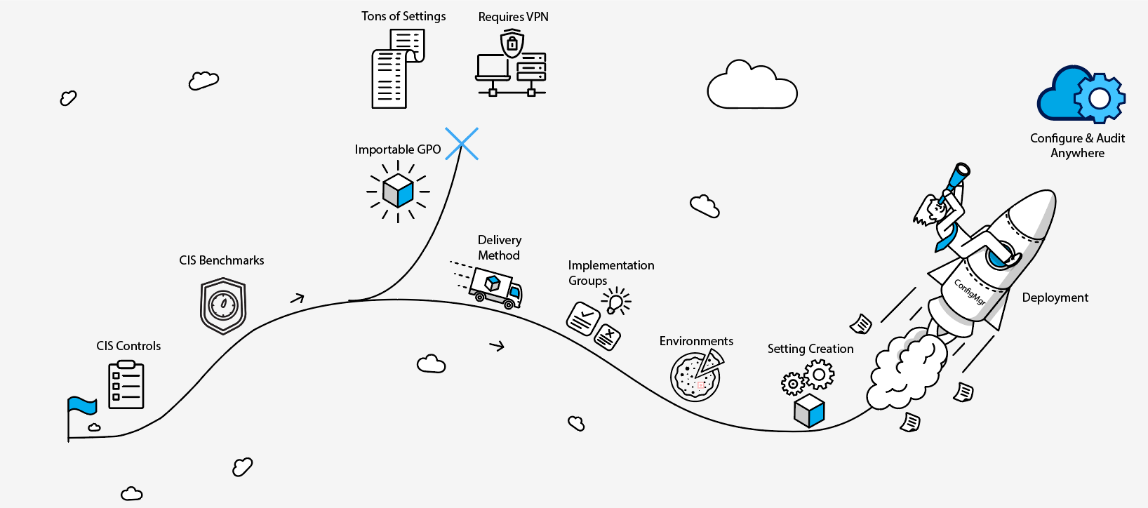
Adoption to Adaption

Slide 15
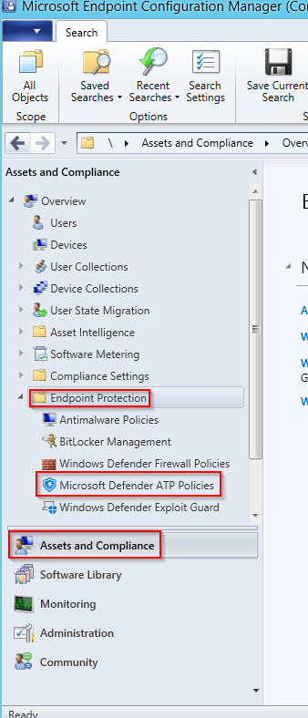
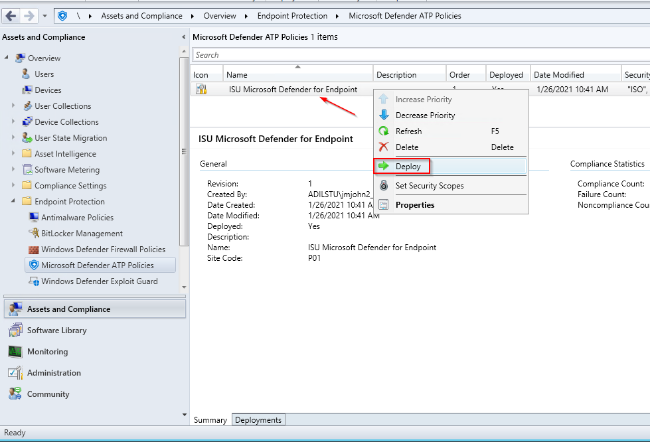
ConfigMgr Resources
Addresses technical controls and safeguards
Work in progress represented on Docs site

Slide 16
The Road Ahead
2020 Q4 – Get IT Started
Establish CIS Controls user group and meet
Develop and publish supporting documents
Deliver executive report
2021 Q1 and Q2 – Formalize the Program
Establish the Security Council
Develop and publish strategy and policy
Conduct self-assessments against controls
Identify and implement priority controls
2021 Q3 and Q4 – Set the Cycle
Continuous improvement

Slide 17
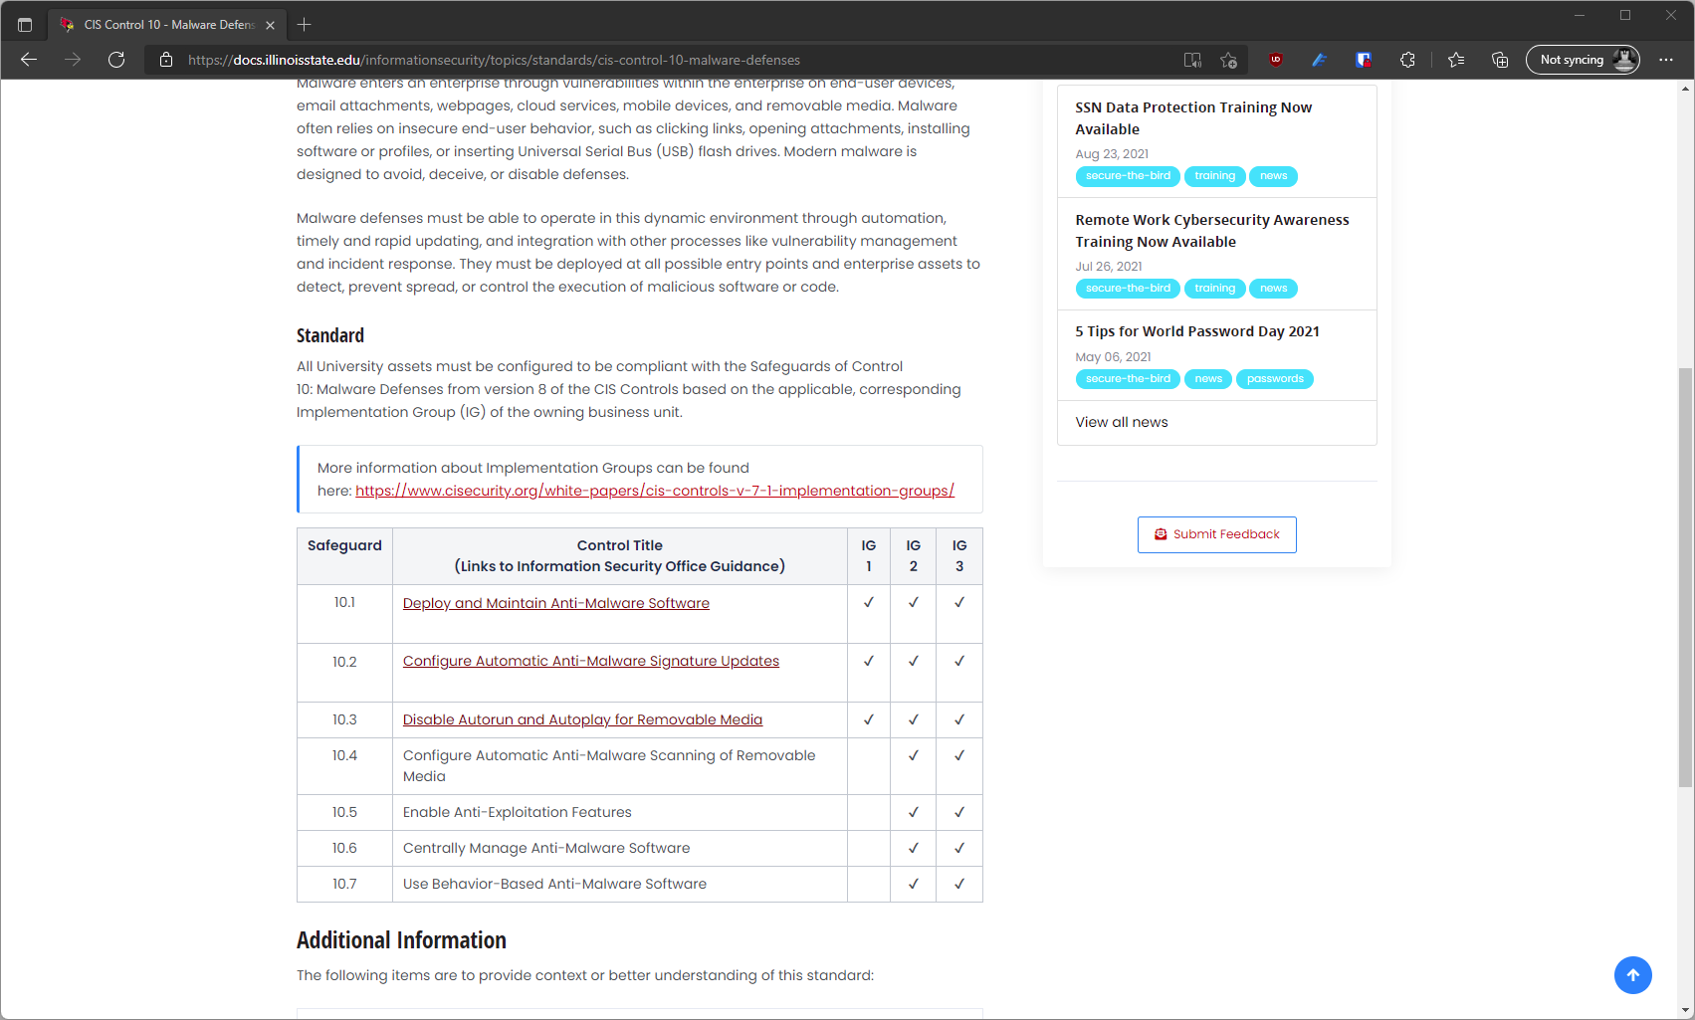
Resources Docs Website
docs.illinoisstate.edu

Slide 18
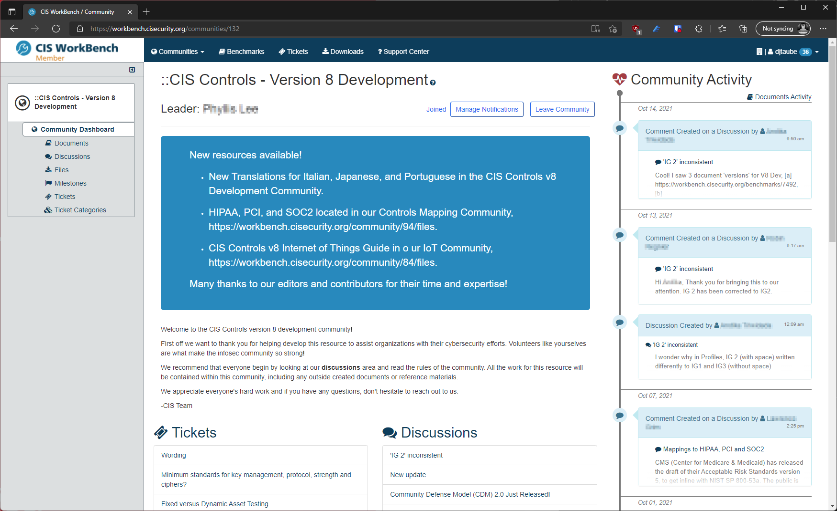
Resources CIS WorkBench
workbench.cisecurity.org

Slide 19
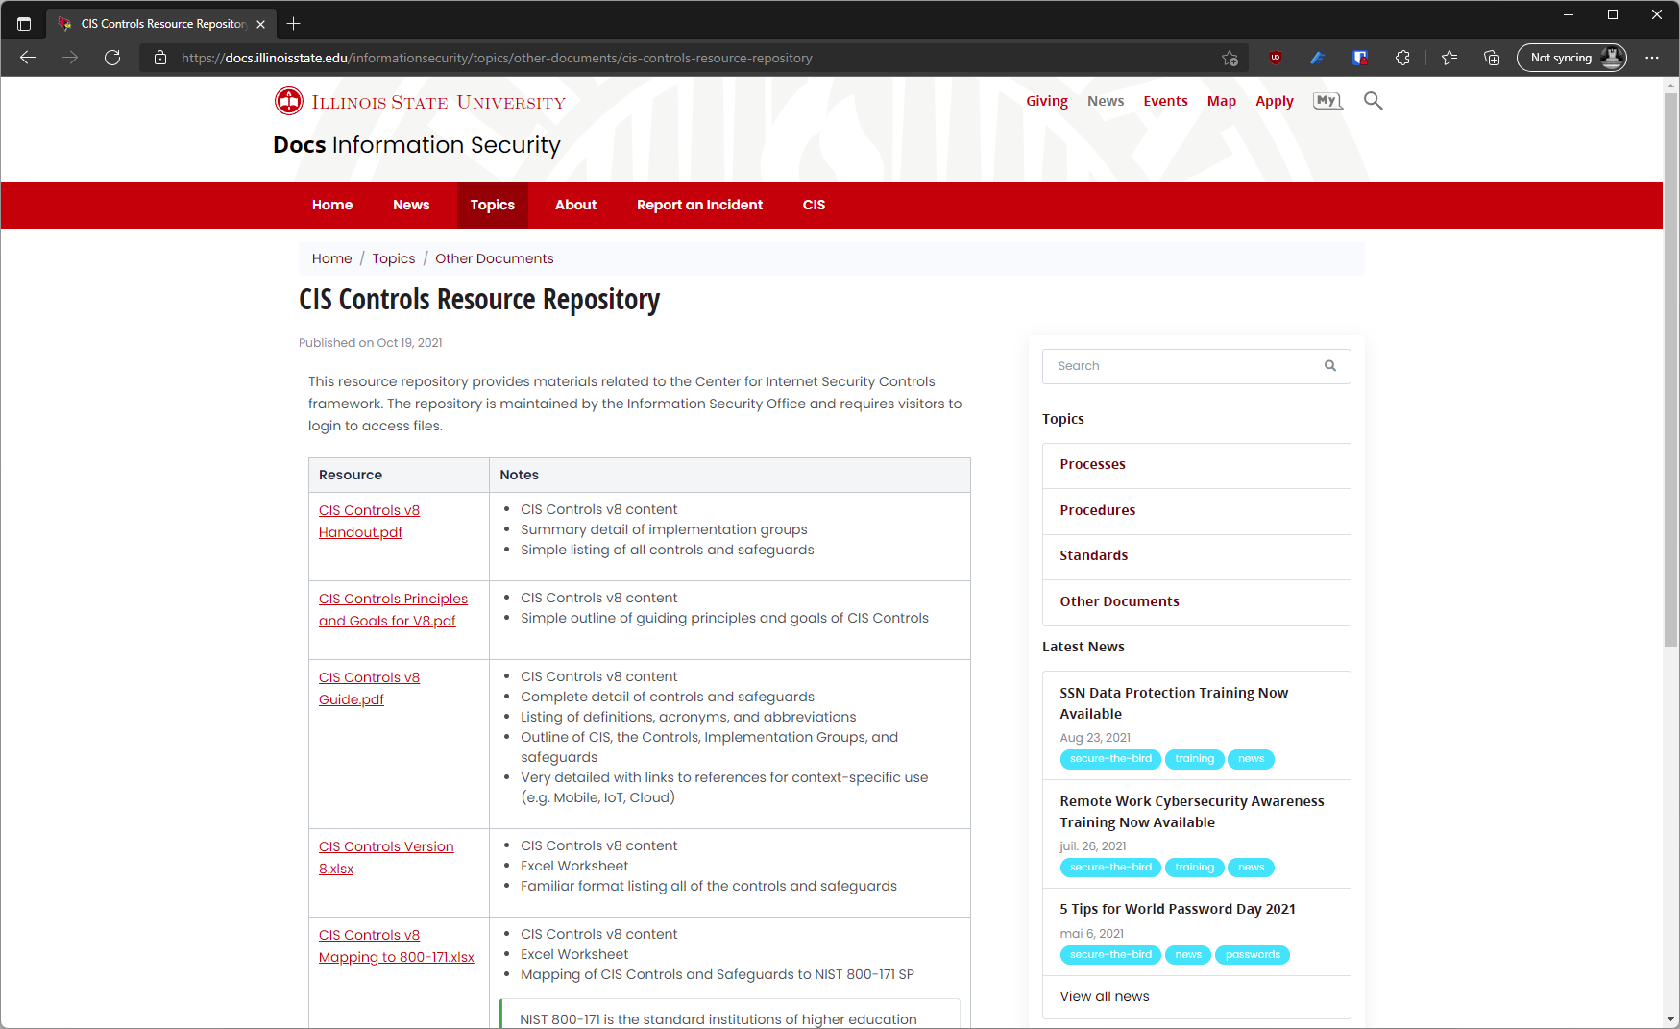
Resources Docs Repository
docs.illinoisstate.edu/informationsecurity/cis

Slide 20
Defense in Depth: CIS Controls and Safeguards
Information Security Office
October 22, 2021

