Slide 2
Don't Go Mad with NoMAD
Macs without binding to Active Directory

Slide 3
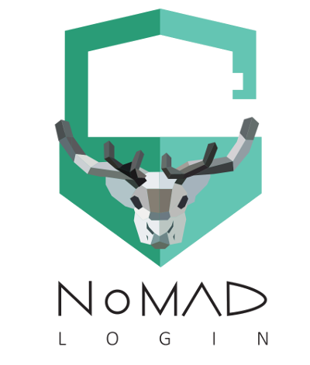

Slide 4
NoMAD
Free!
Open-source
Keep users on local accounts
Gets Kerberos tickets without having a mobile account
Can sync AD password with local user account
Has a change password shortcut that is configurable

Slide 5
NoMAD
Path to PLIST files –
/Library/Preferences/com.trusourcelabs.NoMAD.plist
~/Library/Preferences/com.trusourcelabs.NoMAD.plist
Most Changed Preferences –
https://nomad.menu/help/standard-preferences/
List of All Preferences –
https://nomad.menu/help/preferences-and-what-they-do/

Slide 6
NoMAD Login
Also Free!
Open-source
Replaces the macOS Login Screen
Just-in-time local user creation
Demobilization of cached AD mobile accounts
Customizable login UI
https://gitlab.com/orchardandgrove-oss/NoMADLogin-AD/wikis/Login-Gallery

Slide 7
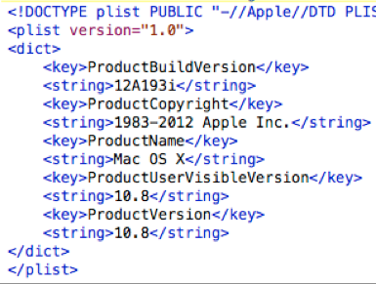
What is a PLIST file?
It is a preference file that is used with applications.
Think .ini files on Windows
Where are they locationed:
~/Library/Preferences
The tilde (~) is shorthand and means “your home folder”
/Library/Preferences
The system’s preferences folder. These settings apply to all users, not just yours.

Slide 8
How do you edit PLISTs?
Terminal
Using the Defaults command
defaults read [plist]
defaults write [plist] [setting] [-string/-bool/-int/more…] [value]
You will need use sudo for plists in /Library/Preferences
sudo defaults write /Library/Preferences/com.trusourcelabs.NoMAD.plist ADDomain -string ad.ilstu.edu
Create your own file in a text editor and copy it over
There is free GUI software available, too.

Slide 9
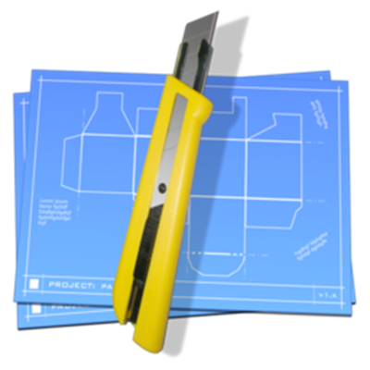
Packages
Packaging/repackaging tool
http://s.sudre.free.fr/Software/Packages/about.html
Add your own post install scripts to existing installs
Install multiple packages at once

Slide 10
Demo

