Slide 2
Managing Macs on a Shoestring Budget

Slide 3
Who is this guy?
Matt Gromer
CFA-IT
Mac Admin

Slide 4
Outline
MacAdmin Core Concepts
Munki, MunkiReport, & Munki Rebrand
Autopkg & Autopkgr
Hello IT
Reposado & Margarita
Miscellaneous Tools & Utilities

Slide 5
How a Mac Admin is Made
1. “A Wild Mac Appears”
2. “The Sacrifice”
3. “The Wilderness”
Notes:
Something running macOS has somehow become a part of your support structure. If you’re lucky, it’s just one. But it’s never just one.
Someone is called on to support the damn thing. It’s you. It’s not a choice. It just happens.
Suddenly nothing makes sense anymore. What’s a pkg? There’s no registry? How does any of this work? Does apple hate me? Personally, like, me, specifically me?

Slide 6
Now What?
Books
Classes
Certifications
Community
Tinkering
Notes:
There’s tons of information in various forms:
Books
Classes
Official certifications
The best options are:
Using the community
Tinkering

Slide 7
Core Concepts
Apple School Manager
ASM/ABM/DEP
MDM (Profiles)
Unix-Based OS
Bash/ZSH Shell Scripting
Plists/Profiles
Mobile Device Management
Local Management
Notes:
ASM/ABM – Apple School Manager / Apple Business Manager
DEP – Device Enrollment Program
MDM – Mobile Device Management
MacOS is Unix-Based, meaning that a lot of the core concepts of Unix translate over, from general file structure and permissions to command-line functions.
MacOS comes with Bash baked in, soon Zed Shell, which allows for some pretty robust shell scripting.

Slide 8
Apple & Enterprise
Changes are made with consumers in mind.
Consumer -> Educators -> Enterprise
The market & community are expected to pick up the slack.
Notes:
Apple prioritizes its consumer feature first and foremost, followed by Educators (classroom tech, teaching products), and finally followed by enterprise.
Apple’s stance is “hey, Jamf exists, and they do a good job.”

Slide 9
Thankfully, they have.
Notes:
Thankfully, the community and market took up the challenge.
There’s a broad array of tools available for any budget.
Normally, you’d get what you pay for, but not in this case.

Slide 10
Munki
Managed software solution
Open-source
Widely-adopted

Slide 11
Munki’s Components
Client
Manifest
Repository
Catalog

Slide 12
Munki’s Components
Client
Manifest – What the Munki client checks against.
Repository – Where Munki looks for stuff to download.

Slide 13
Munki’s Components
Notes:
Catalogs
Catalogs are a Boolean attribute given to a specific package and manifest by which everything is grouped.
The most common catalogs are ”production” and “testing”.
Most like a metadata “tag”.
A manifest flagged as “testing” will be able to see any munki packages also flagged as testing.
If a package is flagged as ”production” and not “testing”, a machine with a “testing” manifest won’t be able to see it.

Slide 14
A Brief Demo of Munki
(not in PowerPoint)

Slide 15
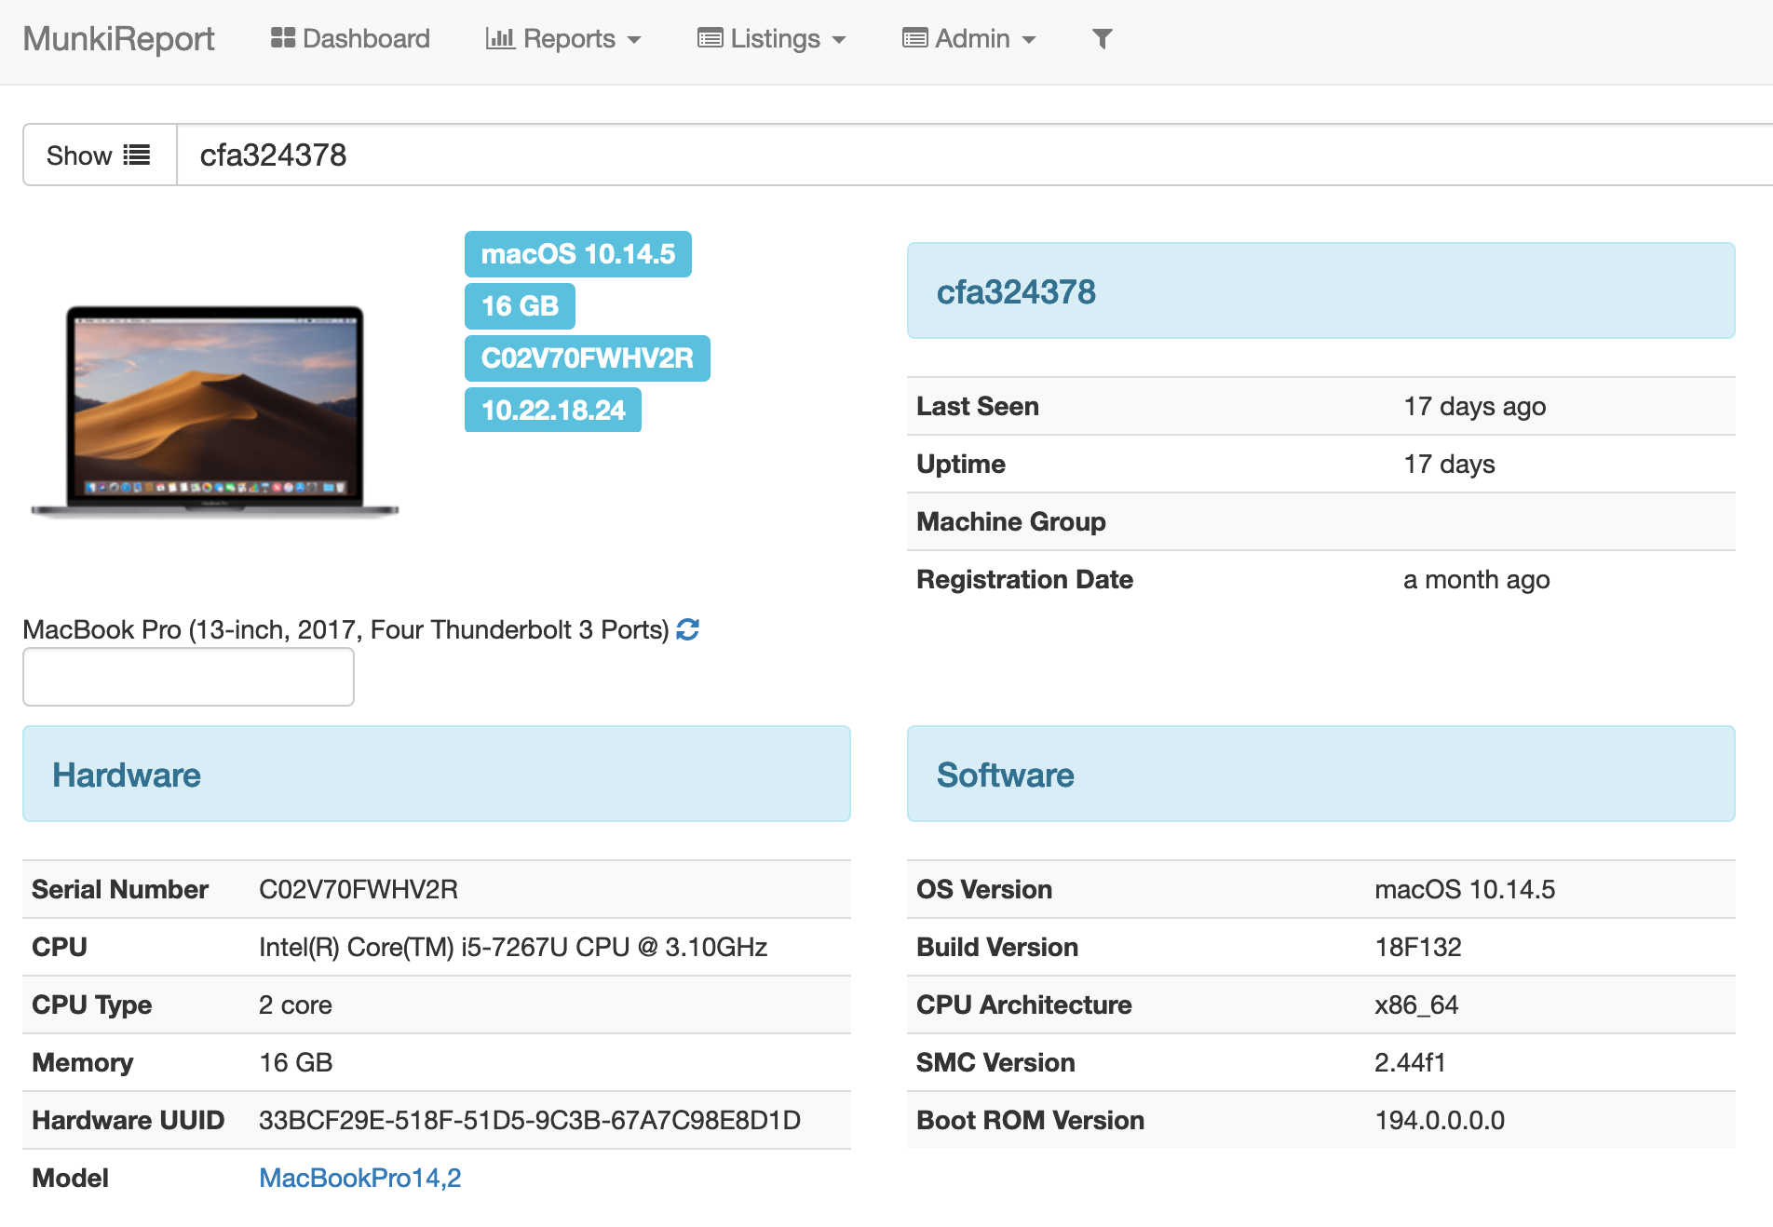
MunkiReport
Notes:
Munkireport is an add-on to Munki, one that piggybacks through the client program.
Uses plug-ins to mine for specific data from the client machine and sends it back to its central DB.
Extremely broad array of plugins, written in Python.
Potentially overwhelming amounts of data, if desired.

Slide 16
munki_rebrand
Notes:
Munki rebrand is a useful python utility that allows for the munki Managed Software Center to
be renamed, its icon changed, and will even allow for embedding a post-install script.
Useful for making sure people recognize the software center as genuine, and allows
Munki to self-configure.

Slide 17
What about Jamf?
Munki
Jamf
Mobile Device
Management
Software Management
Notes:
Jamf does both MDM and software management
Monkey does just software management, but it has more full-fledged functionality there

Slide 18
Autopkg & Autopkgr
Automated software acquisition and packaging
Integrates with Munki repositories.
Community-curated recipe repos.
macOS-Only

Slide 19
Autopkg(r) Demo

Slide 20
The Munki Ecosystem
Adobe
Microsoft
Manifest
Munki Repository
Other
Sources

Slide 21
Hello IT
Customizable menu bar
Designed to enable self-service
Extremely customizable, powerful

Slide 22
Hello IT & Sudoers.d
Sudoers & Sudoers.d
”Wrapper” scripts
Execute-only script folder
AD Group Definitions
User
Hello IT Wrapper
Script
Locked Folder
Root
Script
Root
Script

Slide 23
Hello IT Demo

Slide 24
Reposado
Margarita
Open-Sourced Apple Update Server
Can host or relay
Does not touch major OS updates
Web GUI Frontend for Reposado

Slide 25
Reposado Demo

Slide 26
Google Santa
Binary-based white- and blacklisting
Open-source
Controlled either locally or from sync server

Slide 27
Other Tools
Suspicious Package
Packages
Lets you dig into packages
Extract specific items from packages
Friendly, somewhat-intuitive package builder
Much easier than CLI

Slide 28
Other Tools
Jamf Composer
Outset/Offset
System-state snapshot
Invaluable for deploying some “tricky” software
Not free
Outset:
Boot/Login
Once/Every Time
Offset:
Logoff

Slide 29
Questions?

Slide 30
Links, All the Links
Munki
MunkiAdmin
MunkiReport
munki_rebrand
AutoPkg
AutoPkgr
Hello IT
Reposado
Margarita
Google Santa
Packages
Suspicious Package
Composer
Outset/Offset

Slide 31
Munki Environment Workshop
(Pending audience interest)

