Slide 1
Illinois State’s Design System
The journey into creating a unified language for Illinois State’s digital products

Slide 2
What's in it for you?
Notes:
- A repository of digital best practices that encompass design, content, and code topics for Illinois State University.
- Make your life easier

Slide 3
TL;DR of how we got here

Slide 4
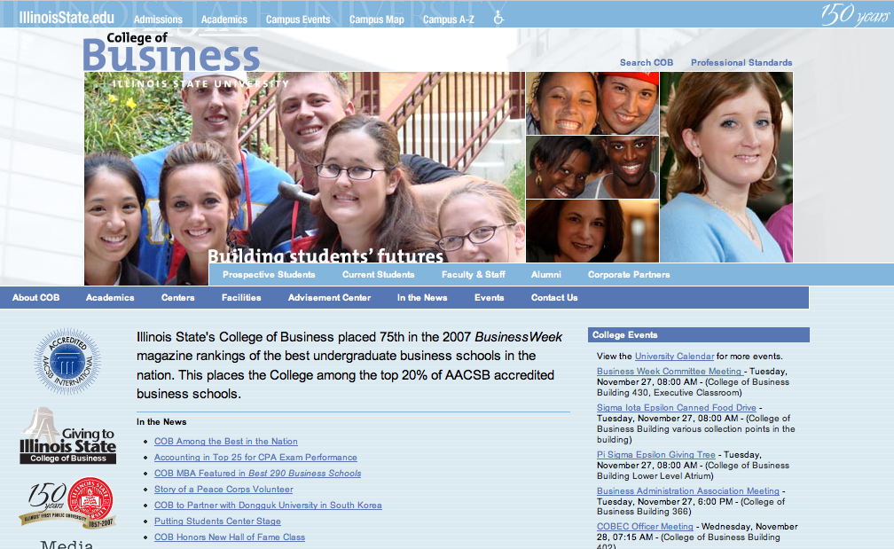
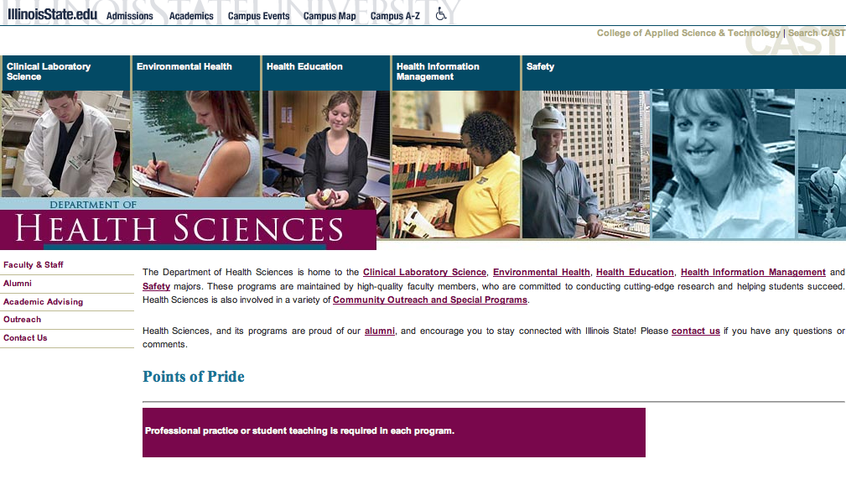
~2000 - 2007
Notes:
IWSS was created in ~2000 to help create websites for all the academic units
Wild west of design and development
Basic HTML, CSS, and Javascript
Every site was unique, all options were available
Only slight consistency with visuals and markup (really it was based on who in the office built the site)

Slide 5
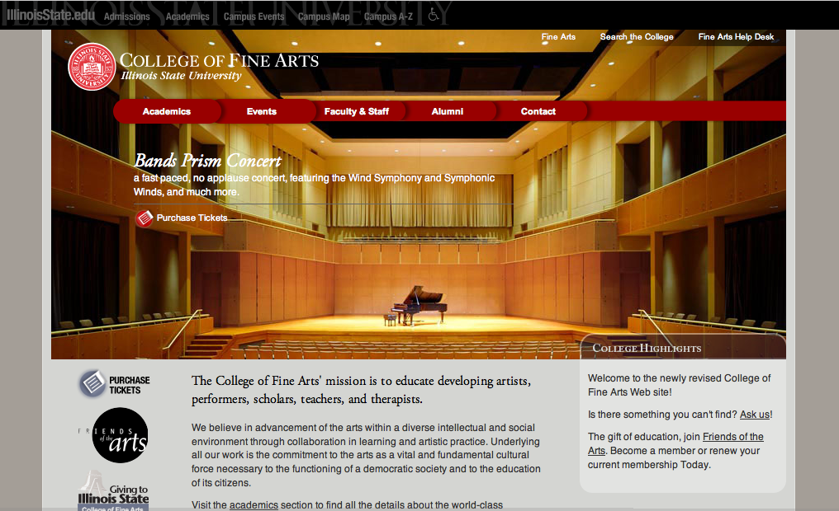
~2007 - 2013
Notes:
Around 2007 we transitioned to using the official print logo from UMC for branding consistency of all websites
Attempted to use a storyboard template for a consistent starting point
Attempted to limit color options to provide a more consistent Illinois State web presence (not received well)

Slide 6
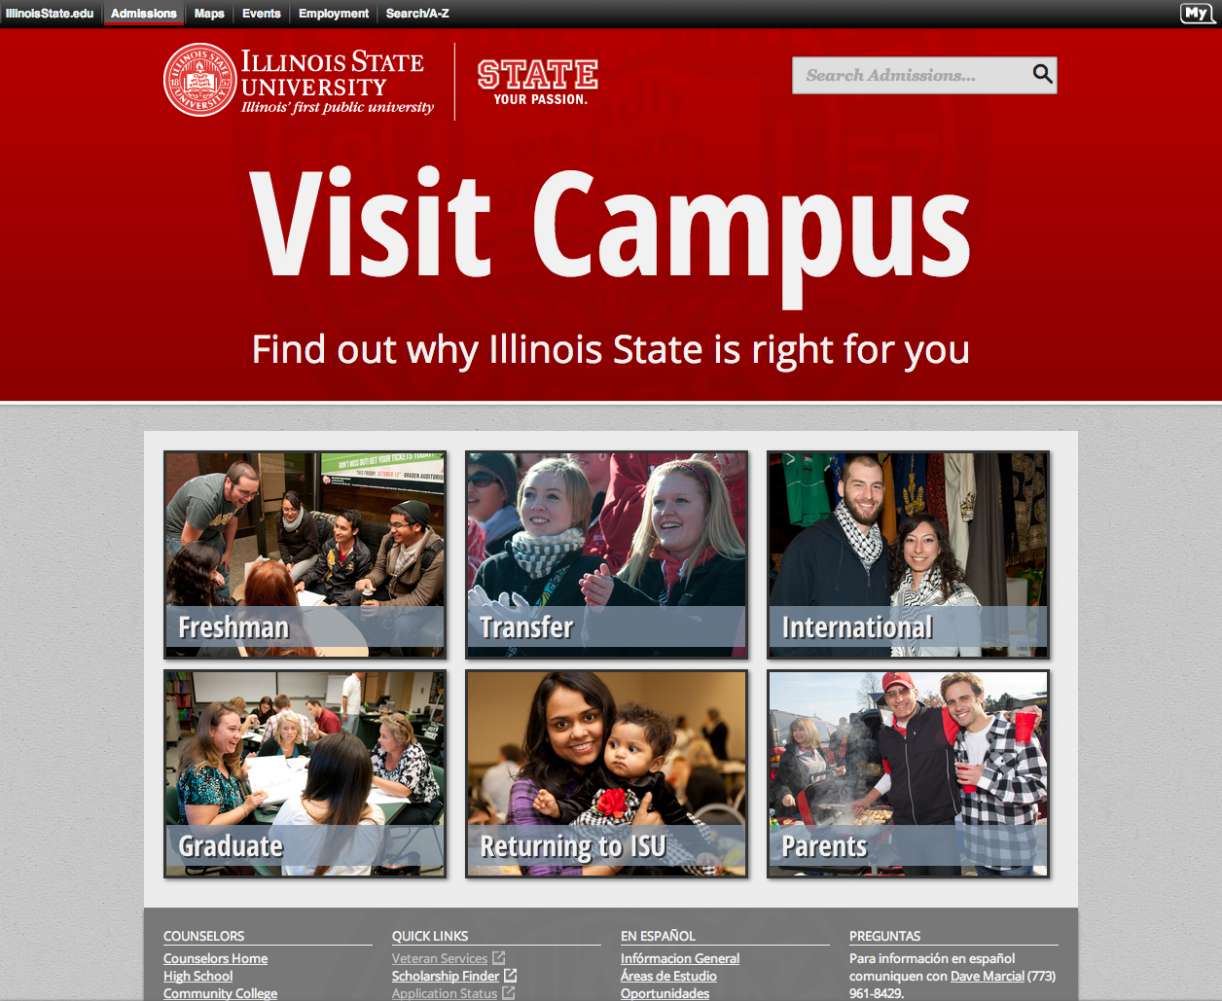
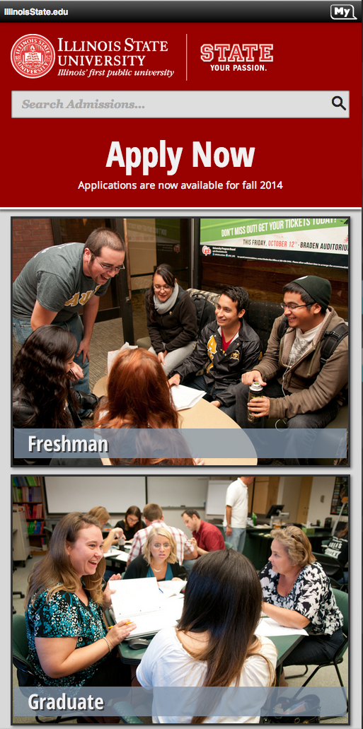
~2013 - 2018
Notes:
Enforced more university branding standards on web
Consistent use of logos
Only one version of the iGuide
Limited color palette to a primary of red, white, and black with options for a secondary and maybe a tertiary color
Heavier photo use from University photographer
Started using Content Management System
Locked users/editors out of HTML and CSS
Started using more consistent class naming conventions and layout templates
Mobile first web template
Consistent header and footer
Limited page layout options based on what we had been building
More robust storyboard for a starting point on the build
Still hard to apply universal changes to websites
The markup and CSS were still individual based on who built the site
Developers still making a lot of one-off scripts

Slide 7
2015 - 2017
Style Guide
Brad Frost’s Atomic Design
Bootstrap
Started holistic evaluation of Illinois State’s web presence
Determined we needed a style guide, but never really had time to develop it
IllinoisState.edu redesign
Notes:
Style guide need
Problems with ownership and purpose - designers vs. developers vs. content
Never officially a project - too much client work, no backing from managers
Never really died, but was only thought about in silos
Designers started atomic design approach
Developers started more consistent coding practices and building less one-off modules
Content started more consistent use of properties
Illinois State redesign
Started with what designers had set rules for already, pared that down even more
Created completely new layouts based on flexible width design
Completely changed how we wrote markup and CSS
Grand ideas of converting to PostCSS, creating new v4 template in OU Campus, creating a performance budget, etc.
Web is not the only office that maintains the content, we are dependent on campus partners for content (words and visuals)
Same markup and CSS for My Illinois State, but realized gaps in UI needs for task oriented websites

Slide 8
Design System
Notes:
Officially a project within our office, with dedicated time and resources
Benefit the campus at large, not just the WEB office

Slide 9
What is a design system?
A set of interconnected patterns and shared practices coherently organized to achieve the purpose of digital products.
Notes:
Shared practices is the important part because it’s how we choose to create, capture, share, and use the patterns.
Distinct products are created by how those patterns are executed and applied. And how those patterns interconnect to achieve a design purpose.

Slide 10
“A design system should have guidelines for: perspective, point of view, extending creative direction to everyone that decides to build something with the design system. That stuff should be baked in. Otherwise, we all might as well use Material Design and call it a day.”
– Dan Mall

Slide 11
Build vs Borrow vs Bootstrap

Slide 12
Learn, Borrow, then Build
Simple. Standard. Stable.
Frameworks come with a lot of great stuff…but also stuff you’ll never need
Structured, modular, and data driven
Prioritize ownership and accountability for all aspects of the system
Accessible
Trackable and transparent (activity)

Slide 13
Purpose Statement
We anticipate what’s next, create foundations, and build intuitive experiences for Illinois State University.
Notes:
This is “the why”
Informs all design and development decisions

Slide 14
Principles
Listen. Ask. Understand. Deliver. Repeat.
Notes:
These are “the how”
Shared guidelines that capture the essence of what good design means for the team and advice on how to achieve it

Slide 15
Illinois State University's Digital Design System
Notes:
Illinois State's Digital Design System is

Slide 16
“A design system is not a place to push new frontiers but to gather settled solutions.”
– Josh Clark
The Most Exciting Design Systems are Boring

Slide 17
This is a website.
There's not much on it right now and that's on purpose.
designsystem.illinoisstate.edu
Notes:
We're bringing you in "early" in this process.

Slide 18
How can you contribute?
Talk to us
Help us, help you

Slide 19
The End!

