Slide 1
Cherwell Asset and Configuration Item (CI) Management
By Andrew Nelson

Slide 2
Disclaimer
Over the past year AT Endpoint Support has been using the following methods and processes. These are not absolute and are constantly being updated and improved.

Slide 3
IT Asset Management Key Success Factors
Link Configuration Items (CI) to Incidents and Service Requests. A CI’s lifecycle is meaningless if there are no linked Incidents or Service Requests representing why changes to a CI record were performed.
Ensure all linked CIs have been updated before closing an Incident or Service Request
Ensure CI assignment fields are updated accurately and consistently by using Incident Asset Management One-Steps

Slide 4
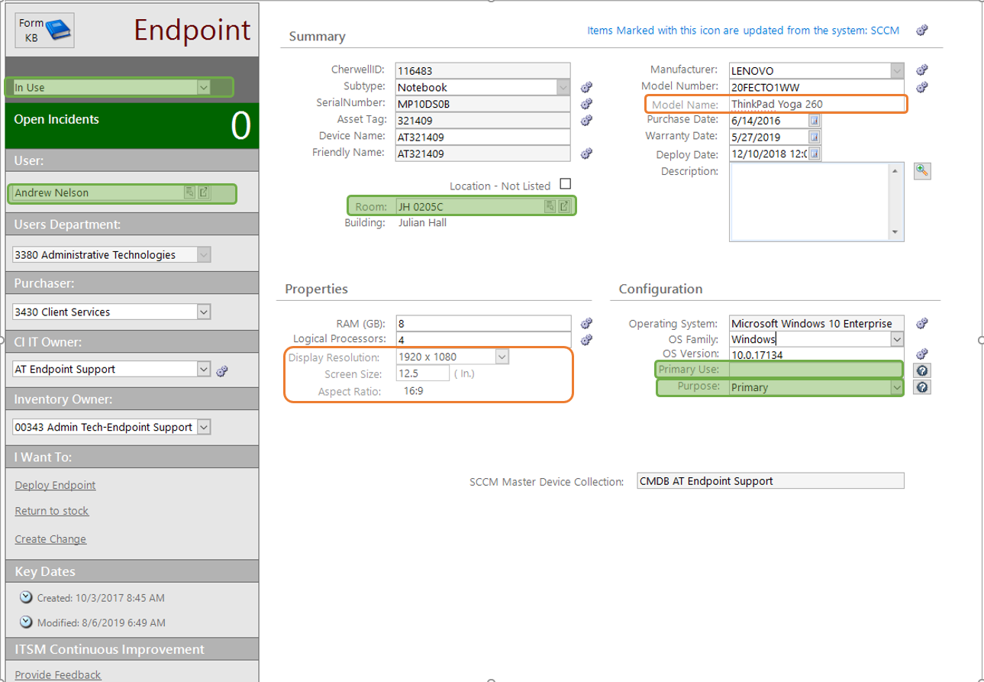
CI Endpoint Form

Slide 5
New Configuration Item fields
Endpoints and Peripherals with a display screen
All Physical CIs (Endpoints, Peripherals, and Servers)
Display Resolution
Screen Size
Aspect Ratio (Auto-filled based off Display Resolution)
Model Name: Manually set, but provides easier identification of CIs with non-descriptive Model Numbers.
Audit Fields:
Location Change Date and Location Change User
Last Inventory Date and Last Inventoried By

Slide 6
New CI Audit Fields
Location Change
Last Inventoried
Stores current date and current user. Set automatically by any of the incident related asset management one-steps or by a One-Step after physical verification of CI.
Intended to be set only when a CI Lifecycle Event occurs (aka CI change has a linked Incident/Request) or when CI has been located during the Annual Inventory Process. These fields cannot be edited from the CI form, but can only be changed via a One-Step.
Stores current date and current user of when the CI Location-Room field is changed.

Slide 7
Significance of new audit fields
Gives Inventory Stewards any easy way to see CIs that have recently changed locations. Previously, the Last Modified fields were the only way to tell when a CI changed location and this was often negated by nightly SCCM overwrites to a CI.
Provides better CI Management Oversight. By comparing Change Location fields and Last Inventory fields, validated changes to a CI are more easily seen. Validated changes represent an CI lifecycle event.

Slide 8
CI Management One-Steps
Incident Associated – CI management from an Incident
Assign a CI
Move a CI to the build room/work bench
Return a CI to a Stock Room
Mass Assign all linked CIs
Link Multiple CIs/List of CIs to an Incident
Print Property Control Equipment Surplus Form
Print Property Control Equipment Transfer Form
Transfer all linked CIs
Print “In Repair” Device Label

Slide 9
CI Management One-Steps
Configuration Item Associated – CI management from a CI or from CMDB grid view
Verify CI for 2019 Annual Inventory: Updates Inventory Verified fields with current user and current date.
Update Annual Inventory Found CIs: Updates CI Assignment Fields and sets Inventory Verified Fields from a XML file of physically found/scanned Assets.
Verify New CI: Sends a CI Verification email to Inventory Steward and Property Control Inventory Specialist notifying them of newly received IT equipment. This used in place of the hard-copy Property Control Receiving Report
Create CIs from Mass Purchase: Prompts once for CI Type, Asset Type, Purchase Date of Mass Purchase then repeatedly prompts for Asset Tag and Serial Number, creating a CI for each pair scanned.

Slide 10
Incident Management One-Steps
Onboarding
Offboarding
Create child “Computer Deploy” request
Create child “OS Install” request
Create child “Software Install” request
All the above copy info (Customer, Location, and/or CIs) from the parent request to populate the child request and auto-links pre-specified Knowledge Articles pertaining to each request.
Create child “Offboard Equipment” request
Creates child request from Offboarding Specifics Fields of parent request and auto-links pre-specified Knowledge Articles pertaining to request.
Auto-links all CIs, assigned to offboarding employee, to the request to ensure all CIs are reclaimed or reassigned.

Slide 11
What’s Next?
Within the next month
Within the next 6 months
Submit Global Incident Associated CI Management One-Steps for approval
Implementation of Inventory Steward/Specialist table for current Property Control and eRecycling One-Steps
Global Incident Associated One-Steps:
Child Offboarding request
Verify New CI/Property Control Receiving Report
Link multiple CIs/list of CIs
Cherwell Asset Management (CAM) evaluation

