Slide 2
Welcome!

Slide 3
This is the CIT Conference
For 2019…

Slide 4
…Our 7th Annual Conference…

Slide 5
Made Possible in Partnership With..
Administrative Technologies
The Office of Academic Technologies
And
Student Affairs IT

Slide 6
Keynote Address
Improving the Student Experience with
a Smart Campus

Slide 7
Leroy Jenkins &
Roger Murff
Amazon Web Services
Education

Slide 8
Stretch!!!

Slide 9
IT News

Slide 10
Academic Enhancement Fund
New per credit hour fee
Revenue to be used for
Academic technologies and new academic facilities that support student success
Software, hardware, spaces, services
Replaces the “TechTuition” Fund…
Mark Walbert

Slide 11
Academic Enhancement Fund
Still allocates funds for Deans to use
Picks up the software bills formerly paid by TT and Office of the Provost
New this year:
“Free” printing for students
ArcGIS software
Adobe CC for students…?
Mark Walbert

Slide 12
Academic Enhancement Fund
uLabs support for STV 250 and SCH 230 now managed by CAS-IT
uLabs support for MLB 213B now managed by MLB-IT
Mark Walbert

Slide 13
Multi-factor Authentication (MFA)
Pilot Project Underway
Microsoft Azure MFA Solution
Protects O365 Services
Conditional Access
Enabled through Account Management
Dan Taube

Slide 14
Multi-factor Authentication (MFA)
Phased Pilot Project
Pilot Phase 2
Approval
Pilot Phase 3
Pilot Phase 1
Approval
Selected Units (e.g. DSC, UIT, VPs, Faculty Senate, etc.)
Finalize Config/Int, Comms, and Support
AT Department
Project Team, Steering Team, and TSC
Phase 2 Approval by ATLT
Phase 3 Approval by ATLT and Selected Units
General Release Approval by University Leadership
Finalized Config and Integrations
Identify Phase 3 Units
Develop General Release Plan
April 2019
September 2019
October 2019 (Planned)
Develop Comms and Support
Revise Comms and Support
Dan Taube

Slide 15
Multi-factor Authentication (MFA)
Conditional Access
ISUNET traffic is exempt
Devices can be remembered
Enabled by security group
Dan Taube

Slide 16
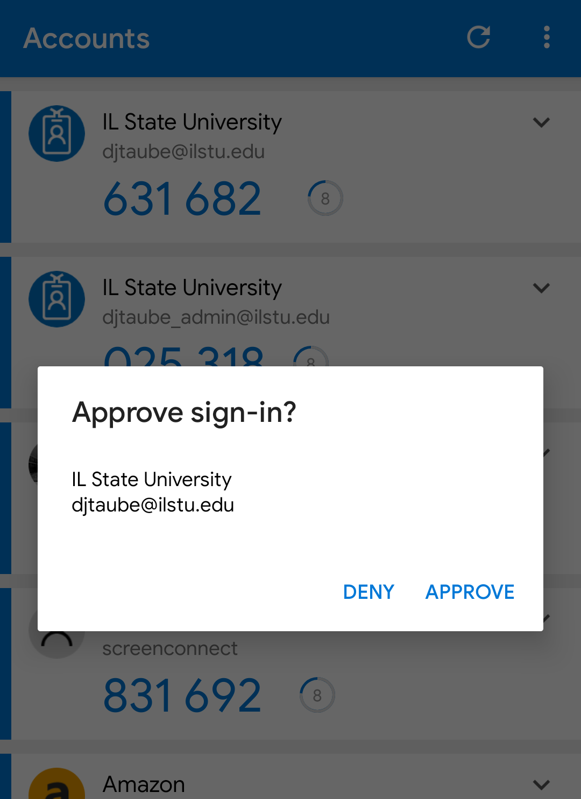
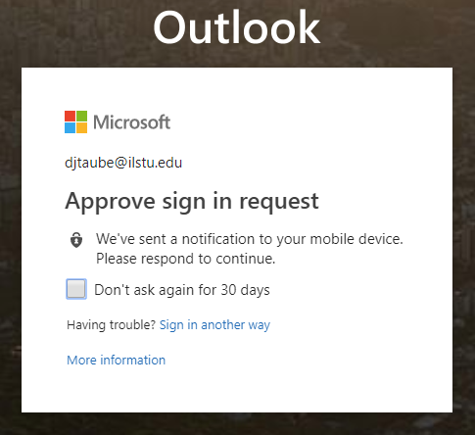
Multi-factor Authentication (MFA)
Contact methods (Use one or many)
Microsoft Authenticator for Push or OTP
Google Authenticator for OTP
Hardware token for OTP
Phone call to any number
Dan Taube

Slide 17
uPrint MobilePrint
Pharos Uniprint Feature
Web and Mobile App
Email-to-Queue (uprint@ilstu.edu)
Upload from Anywhere
Pay and Print at a Release Station
Dan Taube

Slide 18
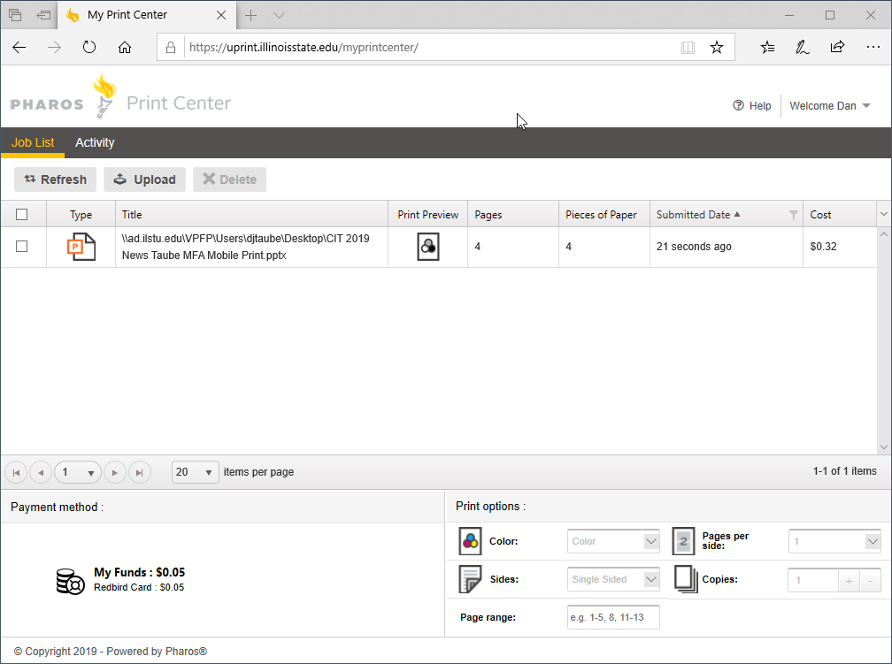
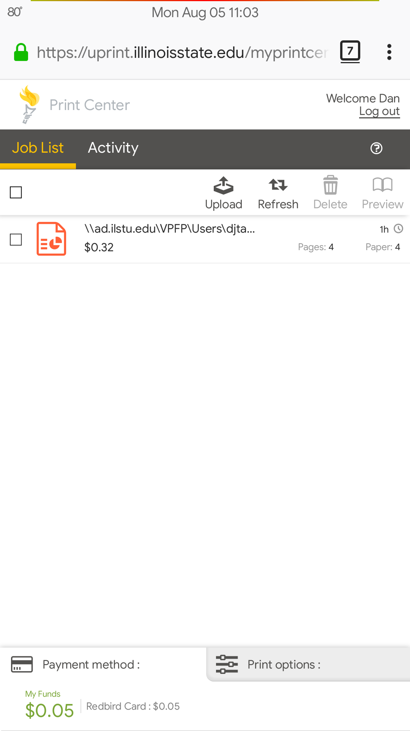
uPrint MobilePrint
Uses CentralLogin
Branding underway
Articles in progress
Will be linked in My
Marketing by AT
Dan Taube

Slide 19
Updates from APPS
Reggienet just got an upgrade, what changed?
Added Grading Rubrics!
Check out these great CIT sessions:
Illinois State's Digital Design System
AT Book Club - the First 1 1/2 Years
Prepping for Career Advancement
Amanda Smith

Slide 20
Long Distance Authorization Codes
Yep, getting rid of them.
Some cost analysis showed we spend as much in the management and cost recovery as we spend in a year.
Domestic long distance for all, international long distance controlled on a phone-by-phone basis.
Hope to be live very, very soon.
Kevin Hand

Slide 21
Redbird Life
https://redbirdlife.illinoisstate.edu
Student Engagement Portal
Over 300 Student Organizations
Registered Student Organizations (RSOs)
Fraternities/Sororities
Sport Clubs
University Organizations
Dean of Students Office
Career Center
Health Promotion & Wellness
Justin Smith

Slide 22
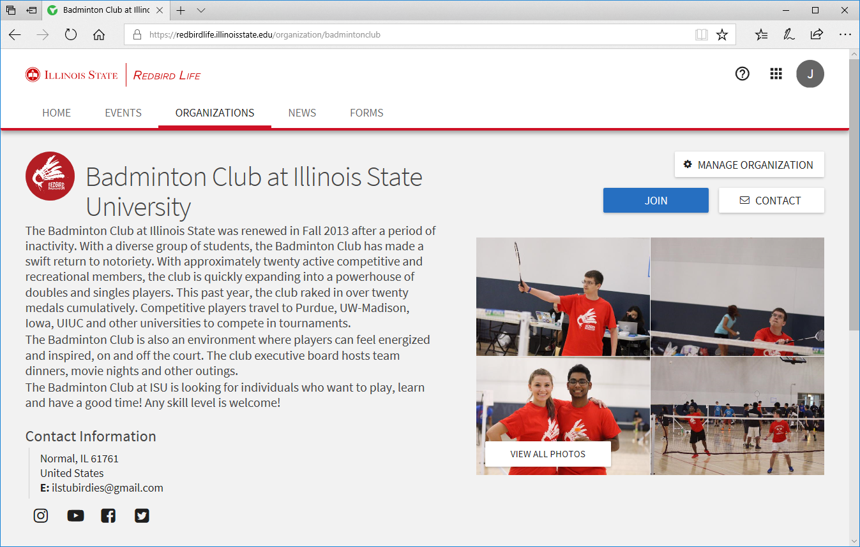
Organization Page
Join / Contact
Member Roster
Photos
Events
Forms
Constitution and other documents
Justin Smith

Slide 23
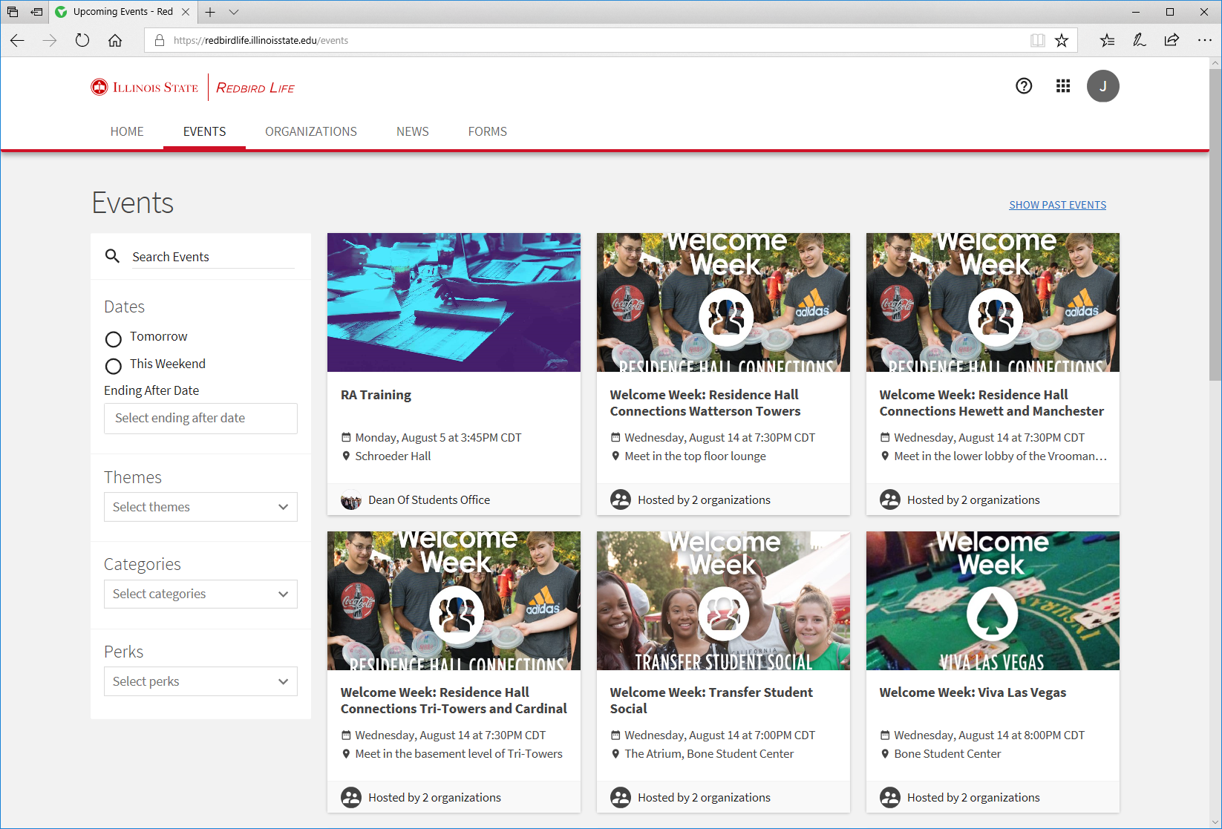
Over 100 Events…
Filter by Theme, Category, or Perks
Perks = Free Stuff or Free Food
Limit Available Seats
Control Visibility
Track Attendance
Justin Smith

Slide 24
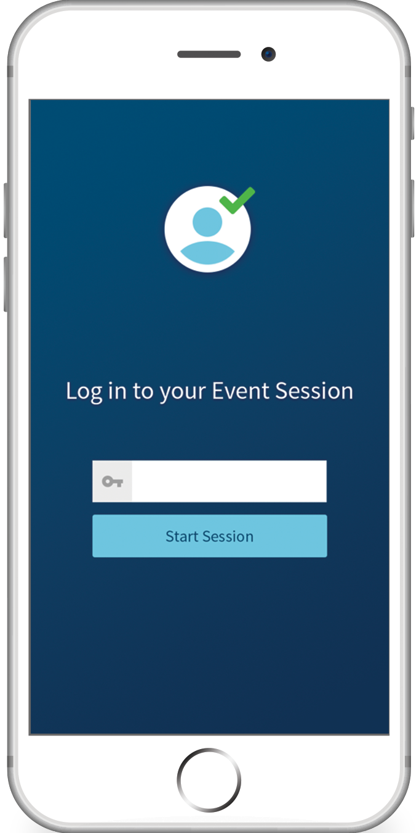
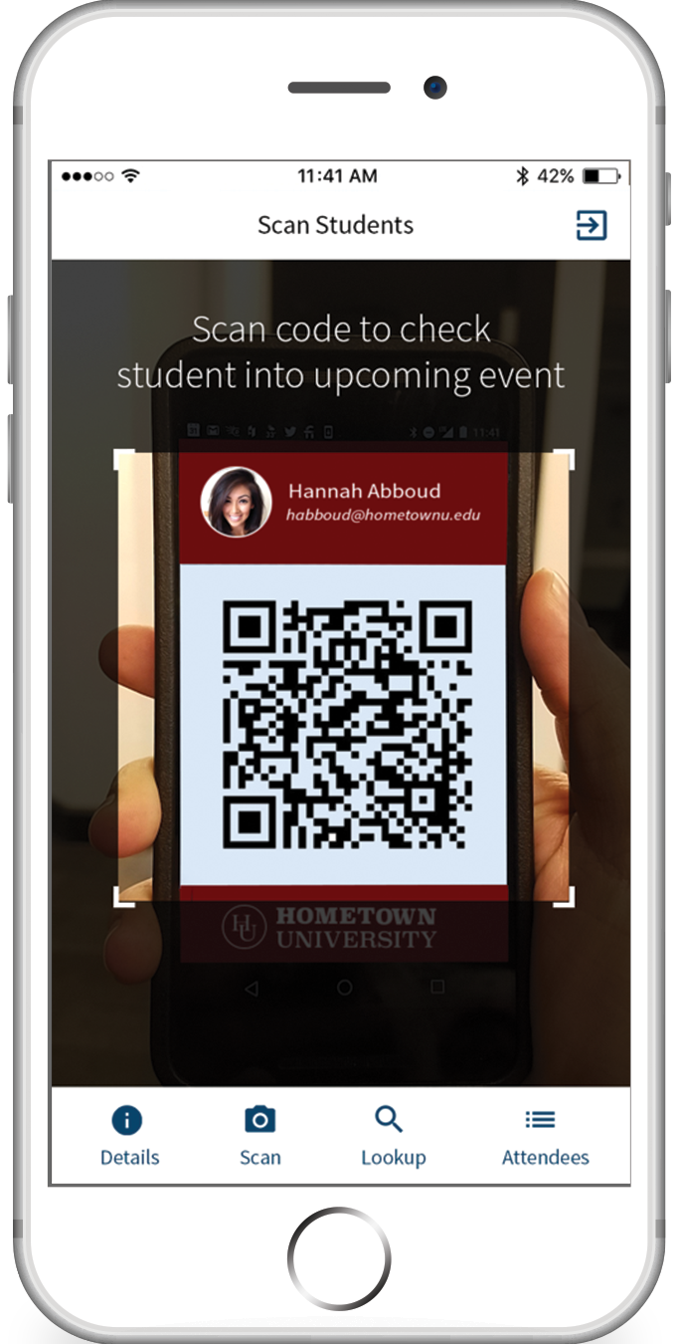
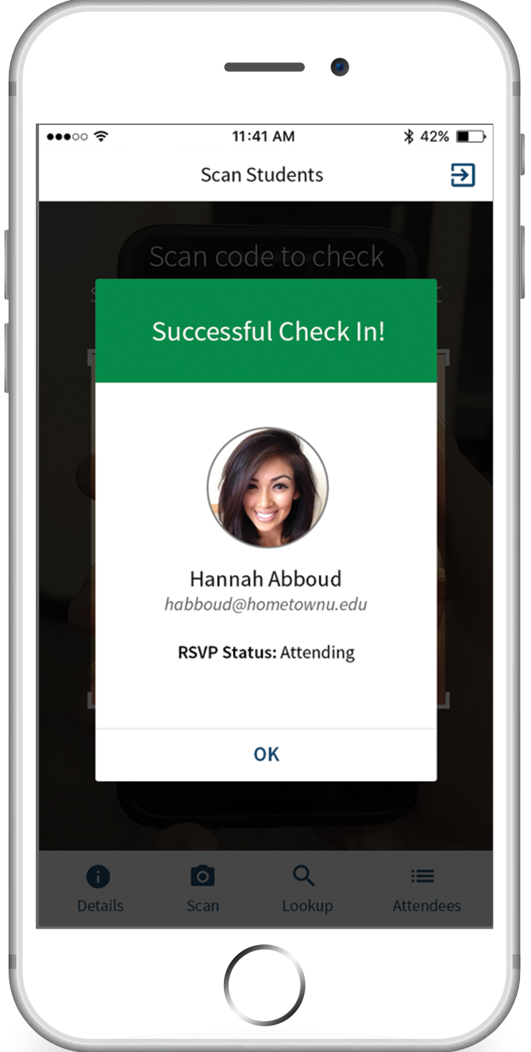
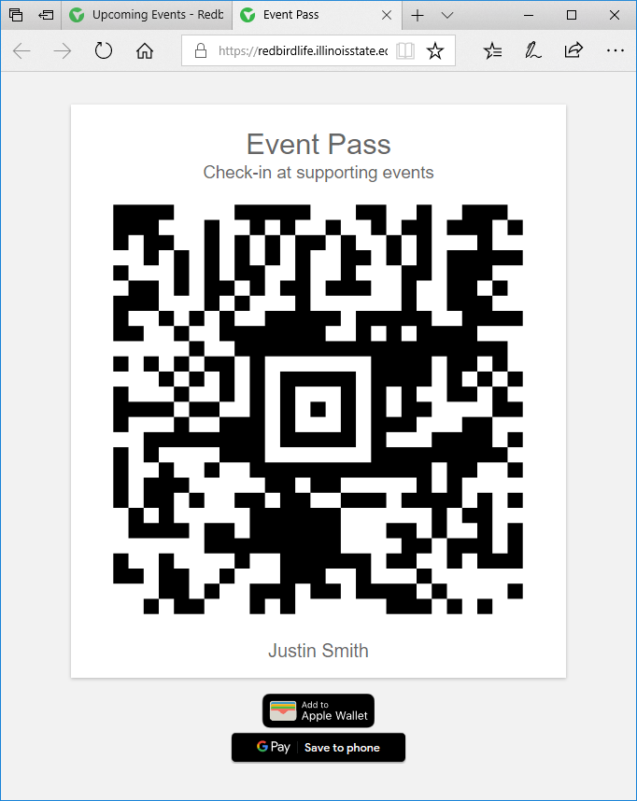
Event Pass
Use for ALL events
Save to Wallet
Check-In Mobile App
Free App – iOS and Android – Anyone Can Use It
Justin Smith

Slide 25
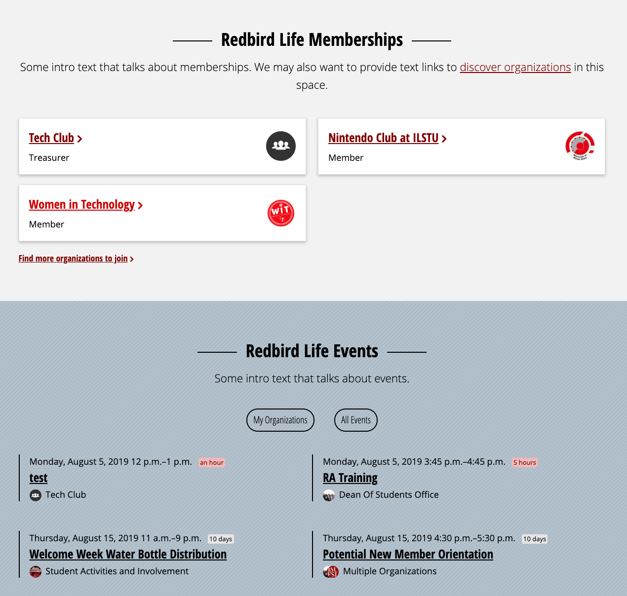
My.IllinoisState.edu
Redbird Life Memberships
Events List
My Event Pass
THANK YOU, AT WEB!!
Arturo
Jordan
Ryan
Amanda
Mary
Trey
Justin Smith

Slide 26
Campus Solutions
Daily Automated Import
All Students, Faculty, and Staff
THANK YOU, AT PROJECT TEAM!!
Dave
Kaiser
Jamie
Jake
Justin Smith

Slide 27
Contact Us
Student Affairs IT
StudentAffairsIT@IllinoisState.edu
Justin Smith
jjsmit1@ilstu.edu
Justin Smith

Slide 28
2nd Annual
CIT MVP Award

Slide 29
Nominations:
Jen Bethmann, WEB
Ryan Northrup, ION

Slide 30
Nominations:
Jen Bethmann, WEB
Ryan Northrup, ION

Slide 31
2nd Annual
CIT Student MVP Award
Is Coming Up…

Slide 32
Cherwell Classification System
Production
10 Services
71 Categories
43 Unique Subcategories
Proposed
5 Services
16 Categories
41 Unique Subcategories
Notes:
At CITx back in May I presented a status update on the progress made by the Cherwell Classification System Revision Working Group. At that time, we were close to finalizing our revision proposal and were seeking feedback before presenting to the ITSM Advisory Group.
Based on feedback, we made additional tweaks and the end result we feel is a greatly simplified, more intuitive structure.

Slide 33
Cherwell Classification System
ITSM Advisory Group Approved!
Now What?
IT Staff Review
Implementation
Tyler Piper
Notes:
I’m happy to announce that we have received ITSM Advisory approval.
IT Staff Review – A copy of the proposed classification system will be emailed out to ISU IT Staff, along with definitions for its components. To help ensure its success, we are asking everyone to take some time to look it over and try it out with examples from your day to day ticket work. If you are finding it difficult to classify something, please provide feedback so we can address it.
Implementation – The classification system is one of the largest components to an ITSM, making this the most drastic and impactful change we will have made to Cherwell since its launch. With this in mind, the Advisor Group is expecting implementation to be sometime in November, possibly over the Thanksgiving break to minimize work disruption.

Slide 34
Working Group Members
Tyler Piper – AT TSC
Seth Engeman – CFA
Sam Dockery – COE
George Wiman – COB
Eric Schuller – CAS IT
Tim Tribble – SAIT
Ben Hendrix – CAST
Matt Helton – Milner
Thank You!
Tyler Piper
Notes:
On behalf of the ITSM Advisory Group, thank you to the working group members for their participation and to their respective teams for allowing them to dedicate time to this effort.

Slide 35
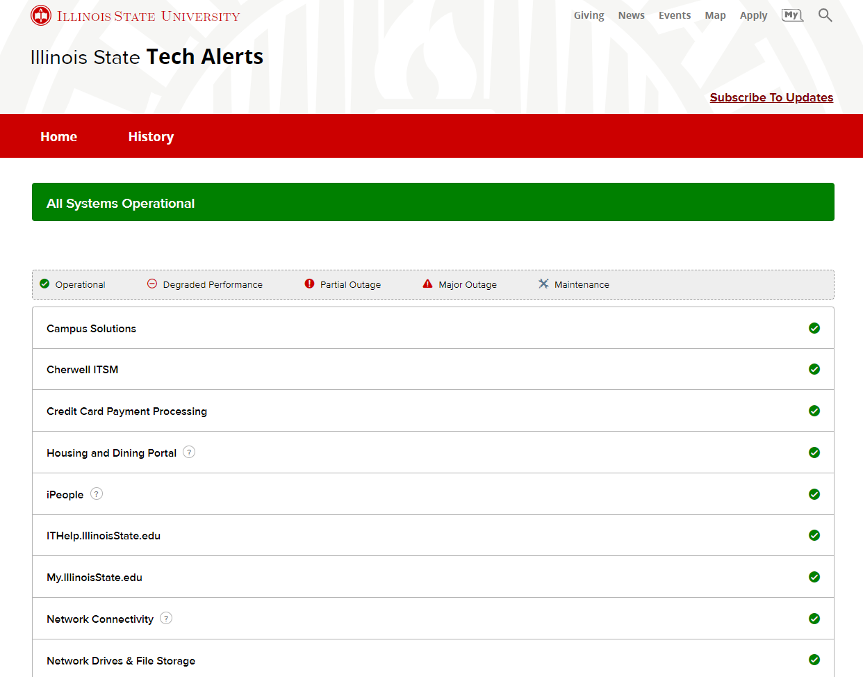
Tech Alerts 2.0
Tyler Piper
Notes:
New Tech Alerts, powered by Statuspage.IO. Widely used by Higher Education with customers like Harvard, Georgia Tech, and the University of Chicago.

Slide 36
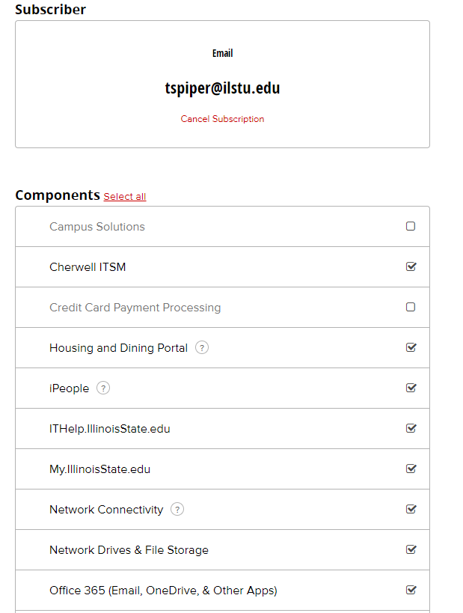
Tech Alerts 2.0
Service Based Subscriptions
Separate Email and SMS Notifications
Alerts.IllinoisState.edu
Go Live = August 12th
Notes:
Service Based Subscriptions – Previously Impact Type
*IT Staff will continue to receive all notifications.

Slide 37
Student Technology Education
Student Technology QuickStart Guide
Available on the IT Help Portal.
Introduction to Technology ReggieNet course
Course completion not required
Available to all incoming students this fall.
Trevor Neuber
Notes:
The Student Technology QuickStart Guide is a knowledge article series aimed at new students.
The articles provide students information about IT services here on campus and where to obtain help if needed.
A ReggieNet course titled “Introduction to Technology at Illinois State University” was developed as a supplement to the QuickStart guide.
This course provides students information about technology products they will interact with while on campus including Office 365, My Illinois State, and ReggieNet.
This course is not required, but will be available to all incoming students beginning this fall.
The course is setup in a way that students can interact with ReggieNet and begin familiarizing themselves with the system before classes begin.
Both resources were developed to aid in student’s success with technology while they are on campus and address some of the most common questions.

Slide 38
TSC Live Chat
New point of contact for the TSC!
Available from the IT Help Portal!
Go Live = September 3rd!
Trevor Neuber
Notes:
The TSC will be introducing Live Chat on September 3rd.
Live chat will be found in the IT Help portal.
Chat will be available through both desktop and mobile browsers.

Slide 39
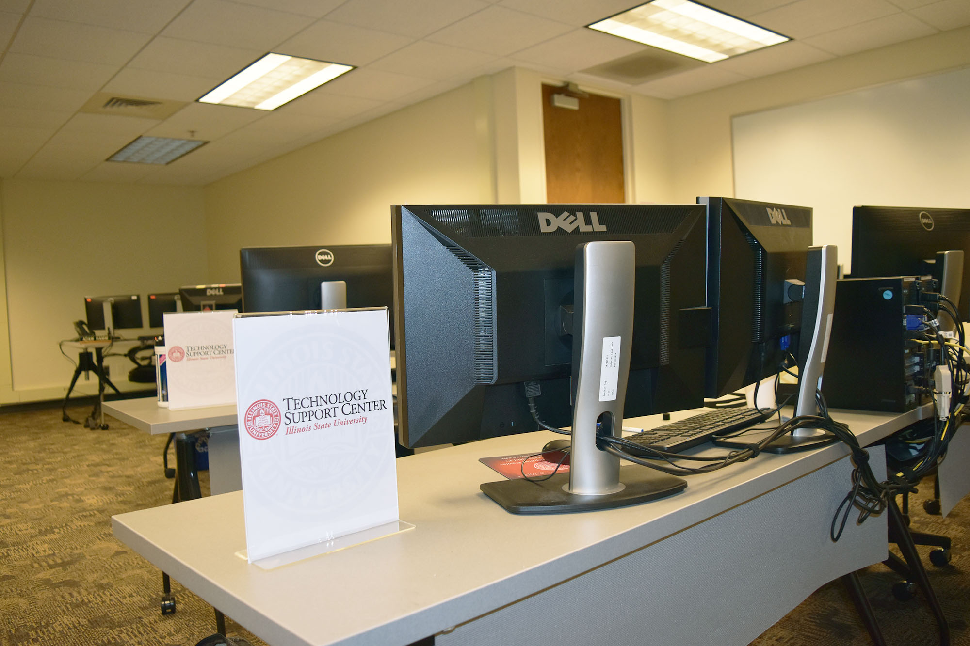
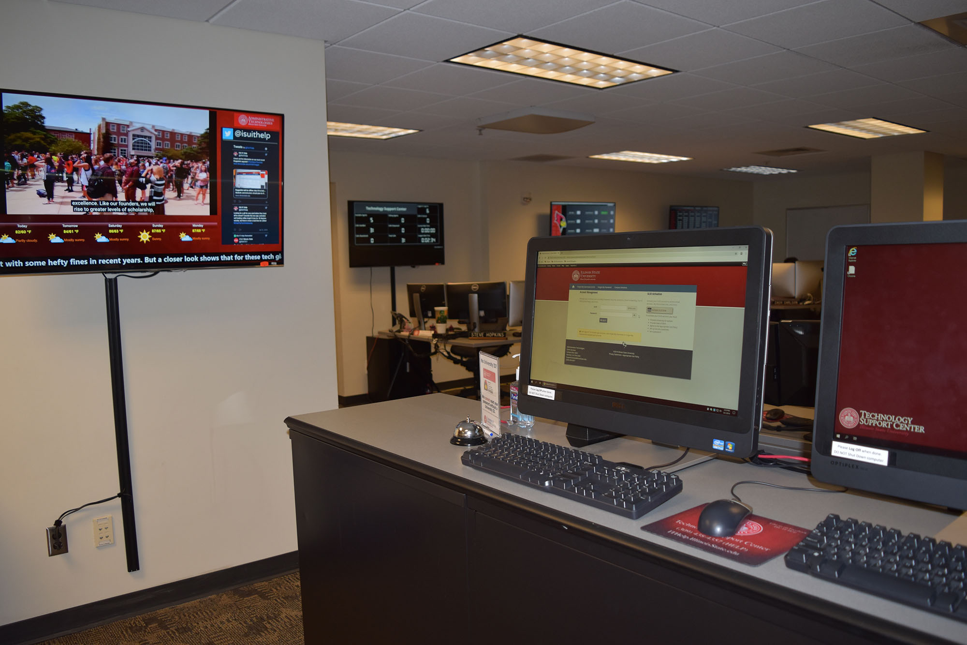
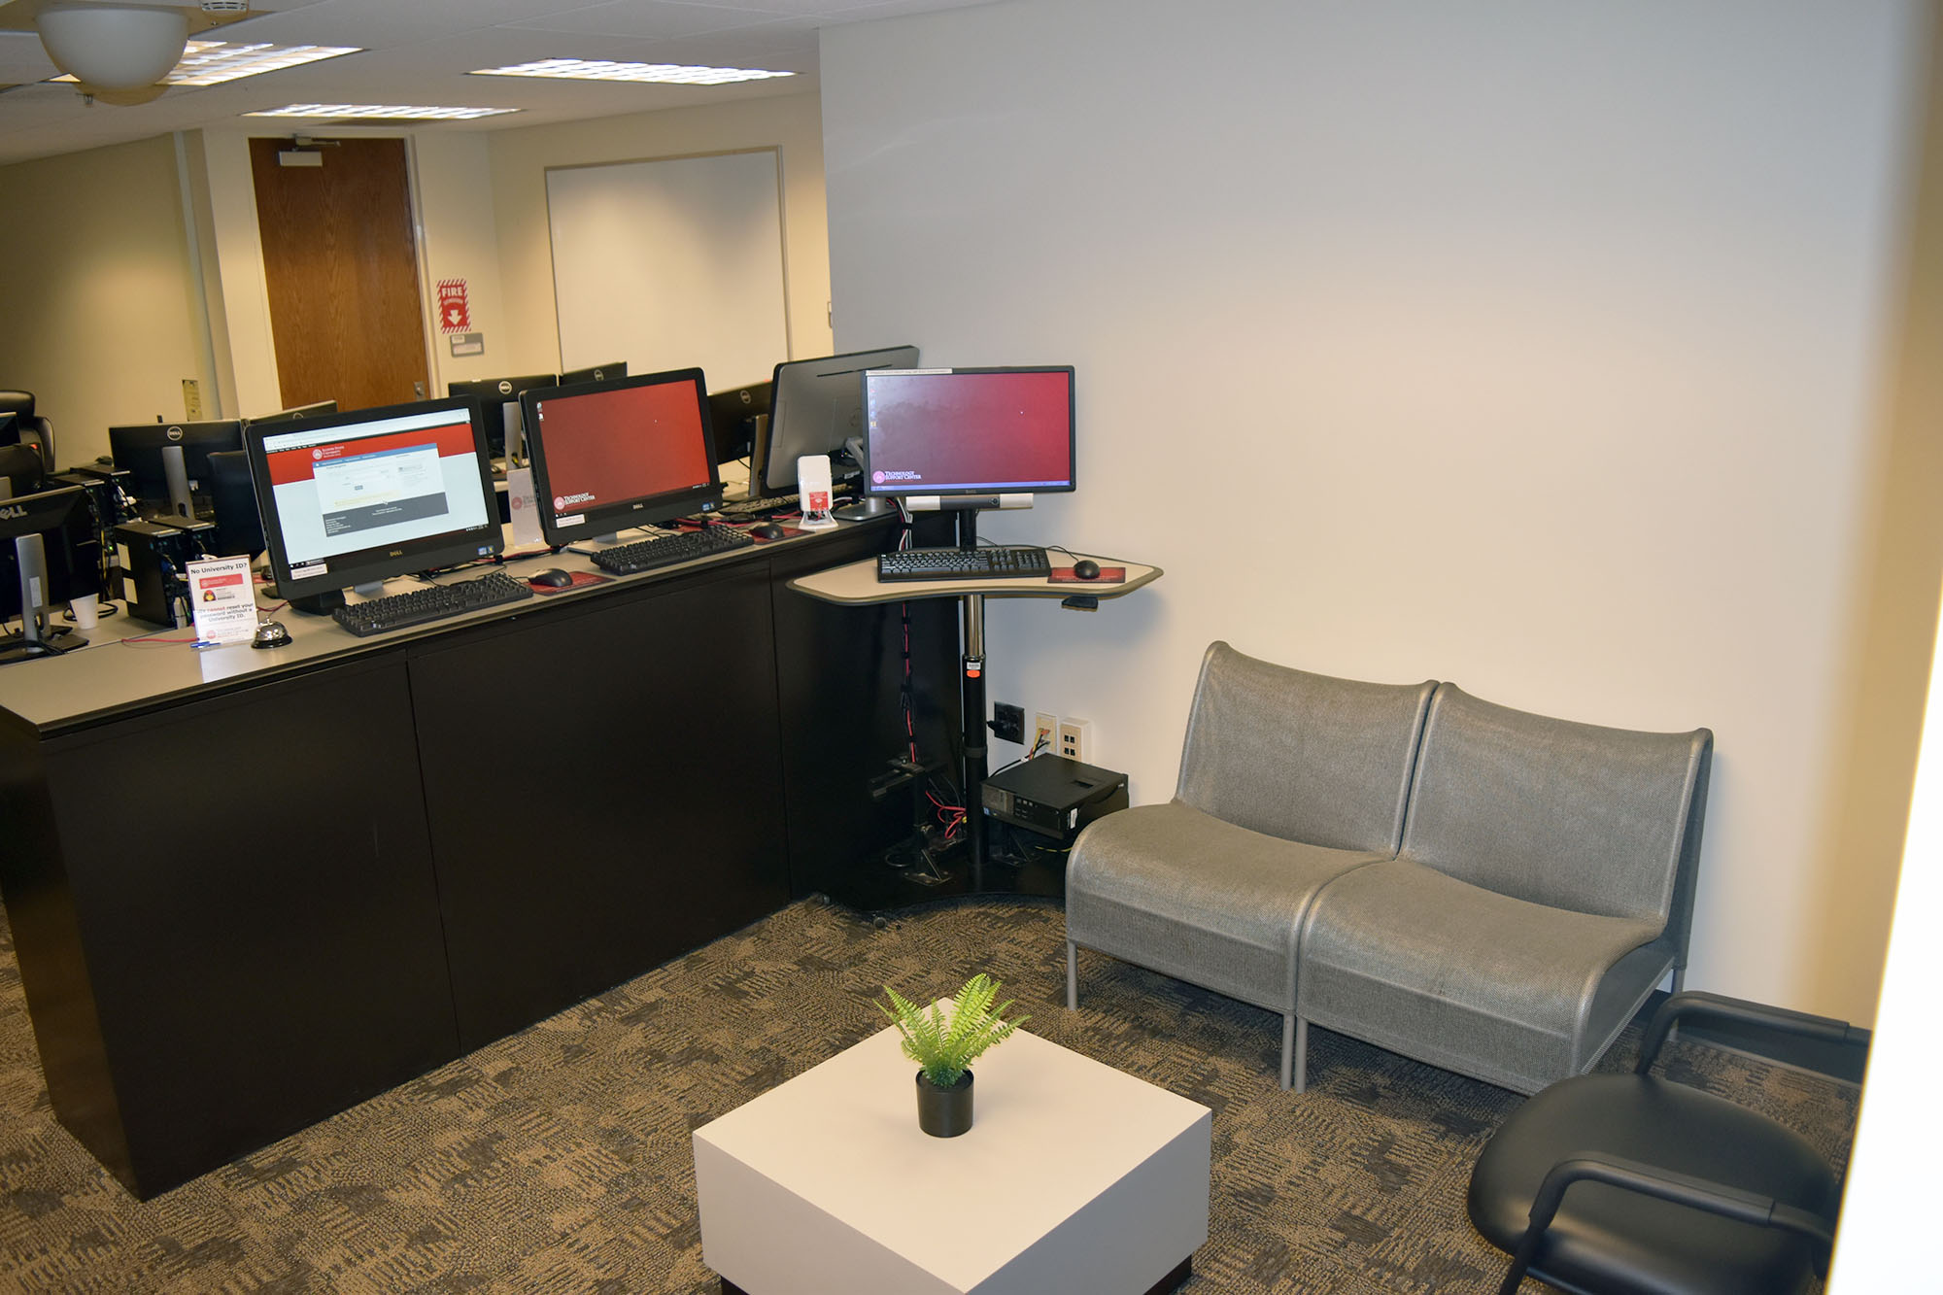
Technology Support Center New Location
The TSC has moved!
Now located in Julian Hall 115
Trevor Neuber
Notes:
Come visit the TSC in our new location (Julian Hall room 115).
We are now conveniently located off the quad and our expanded waiting area allows us to accommodate more people.

Slide 40
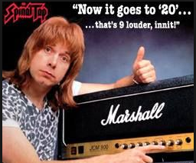
Data Center Network Upgrade
Increased backbone speeds up to 400GB/s
Increased redundancy at the switch and router level
Connect servers/appliances
1G, 10G, 25G, 40G, 100G
Please consult with Networking
Notes:
Please consult with the Networking team when purchasing or upgrading to get the proper NIC’s

Slide 41
Server Updating
Craig Jackson
Notes:
Service Based Subscriptions – Previously Impact Type
*IT Staff will continue to receive all notifications.

Slide 42
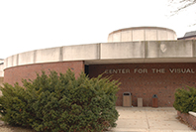
Upgrades

Slide 43
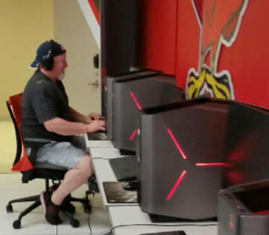
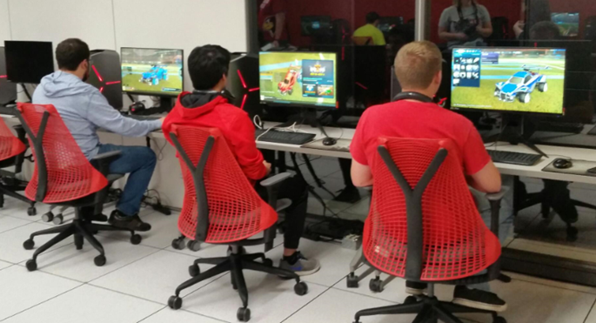
Supporting Innovation Esports
Craig Jackson
Notes:
Service Based Subscriptions – Previously Impact Type
*IT Staff will continue to receive all notifications.

Slide 44
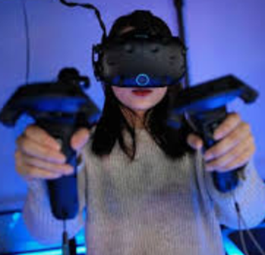
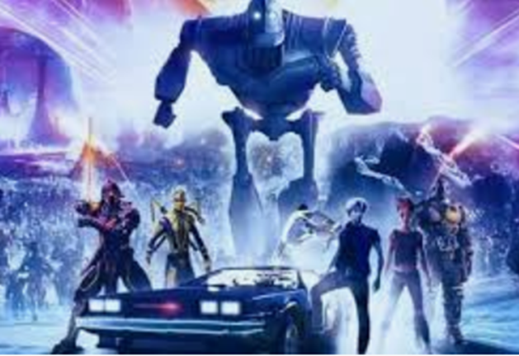
Supporting Innovation AR/VR
Notes:
Service Based Subscriptions – Previously Impact Type
*IT Staff will continue to receive all notifications.

Slide 45
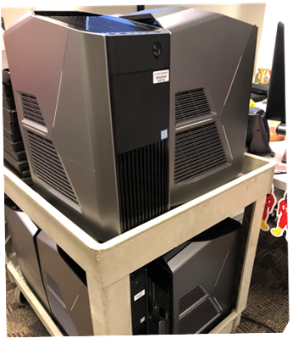
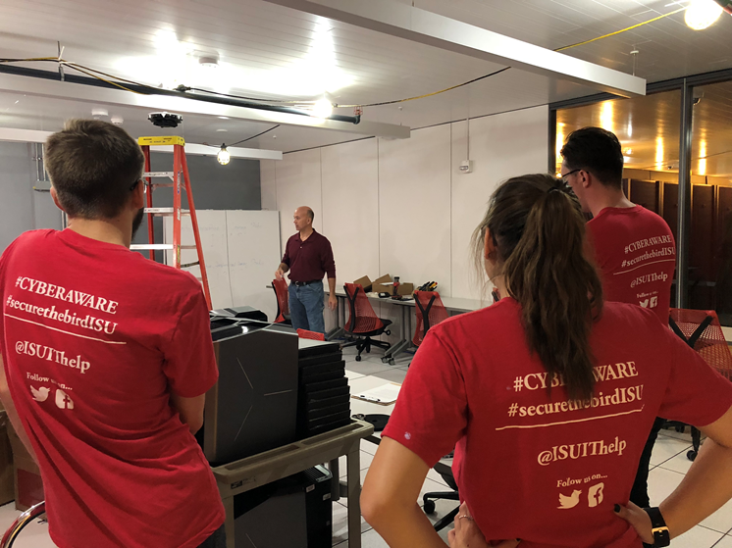
Supporting Innovation SEE Program Enhancement
Notes:
Service Based Subscriptions – Previously Impact Type
*IT Staff will continue to receive all notifications.

Slide 46
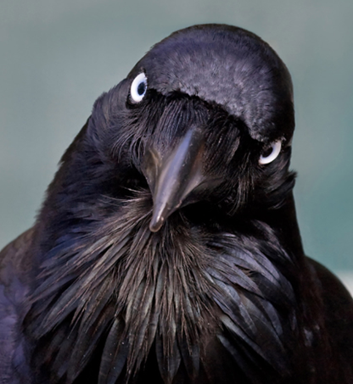
Craig Jackson
Notes:
Service Based Subscriptions – Previously Impact Type
*IT Staff will continue to receive all notifications.

Slide 47
Data Stewardship Council Portfolio Fiscal Year 2019 Year in Review
The Data Stewardship Council (DSC) manages the demand process for enterprise IT efforts to enable the University to integrate and coordinate its business and academic processes.
Amy Tuttle

Slide 48
Types of Projects Completed
Projects with measurable impact
Enhance diversity, global learning, and a global campus environment
Support, facilitate, and enhance student recruitment through enrollment
Enhance campus emergency responsiveness
Transformative projects
Improve the student experience – study abroad, signing up for Preview Day, activating their account, managing their financial aid disbursements, etc.
Improve the staff experience – providing data in an easy to use manner
Improve faculty experience through reducing the complexity of steps
Security and compliance projects
Comply with yearly mandatory training requirements
Support the security posture of Illinois State
Projects to increase efficiency and effectiveness
Eliminate manual data entry and improve data integrity
Improve ability for staff to find files in a secure environment through electronic storage
Provide recommendations for improving transparency, eliminating waste, and improving awareness of process
Amy Tuttle

Slide 49
By the Numbers
Completed 42 DSC projects
AT staff spent >26,100 hours towards these projects (that does not include the time of our business partners)
Categorized by type and size of project:
PeopleSoft | 18
Line of Business | 10
Integrations / Homegrown | 12
Process Improvement | 2
<30 hours | 9
30-100 hours | 15
100-300 hours | 11
300-500 hours | 1
500-850 hours | 3
5500-8000 hours | 3
Amy Tuttle

Slide 50
Amy Tuttle

Slide 52
A Word from Mark Walbert
Co-chair of the Data Stewardship Council
Paul Unsbee
Amy Tuttle

Slide 53
3D Printing Update

Slide 54
251% Fall to Spring Growth!
Paul Unsbee

Slide 55
New 3D Printer LulzBot TAZ 6
Doubles capacity
Dual color printing
Better print quality
Higher success rates
Cheaper filament
Greater filament choice
Paul Unsbee

Slide 56
College Computer Lab Update

Slide 57
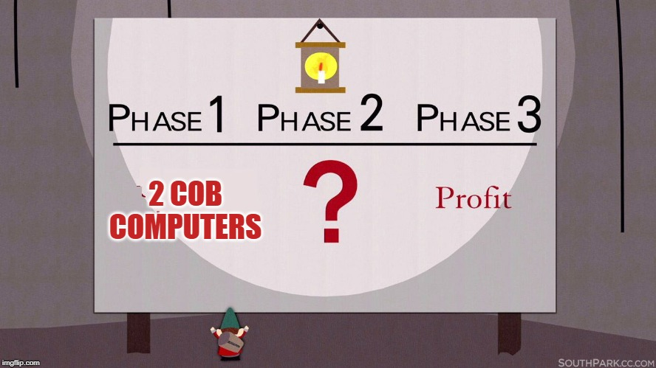
Where we started
Paul Unsbee

Slide 58
Where We Are Now
2 COB Lab Workstations
2 CAST Lab Workstations
2 CAS Chemistry Workstations
Interest from two additional schools
Paul Unsbee

Slide 59
Impact Last Academic Year
1,741 total logins
715 unique users
1.5 hours average session time
Paul Unsbee

Slide 60
Collaboration Station Update

Slide 61
Collaboration.Next
Larger 43” 1080p TVs
LSAVT supplied BYOD-HUB
Matches classroom experience
Simple, on-screen instructions
Plug-n-Play
No software, No Dongles

Slide 62
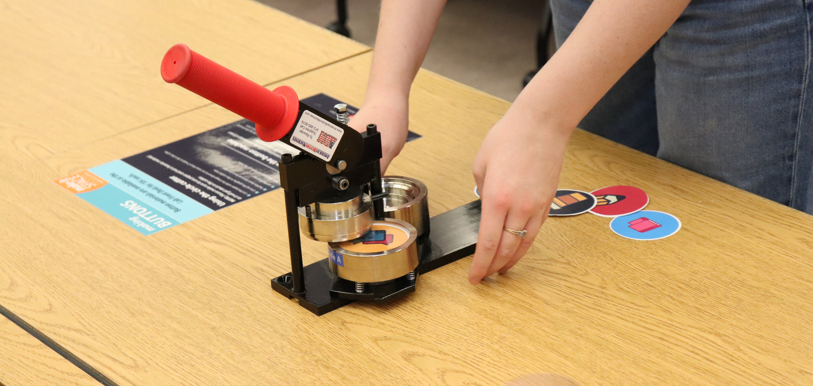
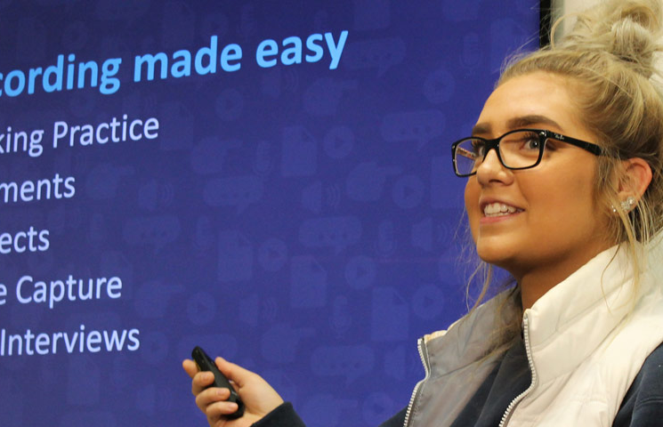
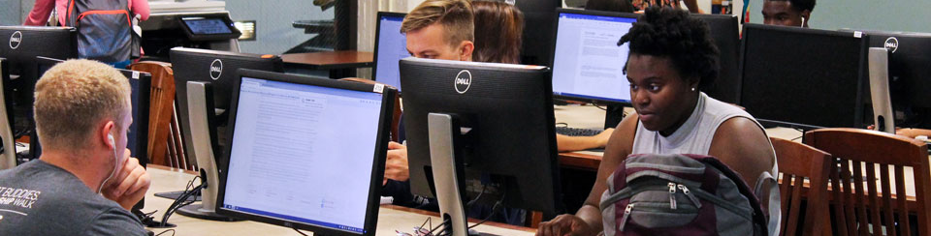
IT services @ Milner
Spoilers, there’s a lot

Slide 63
LAAB – Library as a Lab
Printing/Copying/Scanning
Duplex & Color Printing!
Workstations on every floor
High-end Multimedia Editing Workstations
College Lab Computers
Equipment Checkouts
DSLR Cameras, Camcorders, Projectors, Microphones, and more!
Make It Space
3D Printing now with 100% more color
Self-service Laminator
Ellison Die Cutter w/ Die Cuts
Paper cutter
Button Maker
Laptop Checkouts
In building only
Collaboration Stations
Meeting Rooms
…and more!
Paul Unsbee

Slide 64
University-Funded Software for 2019-20
Microsoft Office 365 A3 “Suite” including…
Office ProPlus
Windows OS computers (managed; shared access; assigned; personally owned)
Note: OneNote 2016 can be added as separate app but now not needed
Office 2019
Mac shared computers
Mac assigned computers if not using user license
Note: Win/Mac user Office365 licenses available via ULID logon at office365.ilstu.edu
Dave Greenfield

Slide 65
University-Funded Software for 2019-20
Adobe - Year2
ISU User License: All Fac/Staff/GAs - NO CHANGE
Via app or package - upgrade any time
ISU Serial License: Labs/Classrooms/Open Areas
Now Shared Device License
Students federated
Dave Greenfield

Slide 66
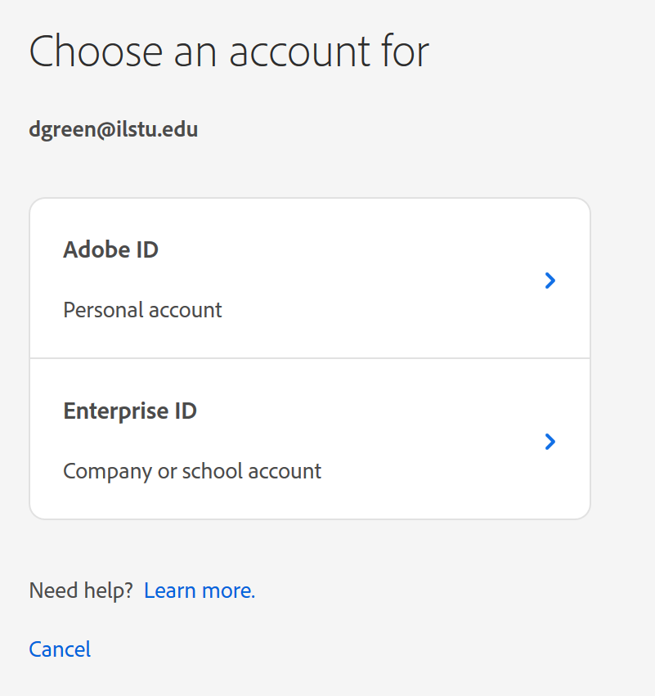
Adobe Software Updates
Dave Greenfield

Slide 67
University-Funded Software for 2018-19
Statistical Programs
SPSS Premium (and Modeler)
Includes Tables & Forecasting, NOT Amos
SAS
Mathmatica
MiniTab
Other
ESRI ArcGIS (Coming)
Dave Greenfield

Slide 68
Ongoing University coordinated/
Unit-Funded Software
AirWatch
Jamf (coming)
Dave Greenfield

Slide 70
10/31/19
Dave Greenfield

Slide 71
The CIT “After Event”
@ Pub II
Come And Socialize!!!

Slide 72
And now… Lunch!

