Slide 2
System Dependency Maps
Coming to an ITSM near you
September 3rd!

Slide 3
Who has….?
Everyone does

Slide 4
What is a CMDB?
Notes:
A repository that acts as a data warehouse storing information about the IT environment and the components that are used to deliver IT services. The data consists of configuration items and relationships that allows the representation of systems and services incorporating components from the sections across our department, (and beyond).
We have all been linking system CIs to incidents, problems, and changes for over a year – but until now that was only helping with reporting and statistics because the records did not include attributes or associations to the components. So we have all been investing int The systems that we are mapping now are those same records so soon when you link them in other records you have the option to take a look and see more details about what makes it tick.
When complete our CMDB will link our CIs into systems and services with a related history of events and changes, and help link the technical side of A.T. with things like costs, contracts and vendors.

Slide 5
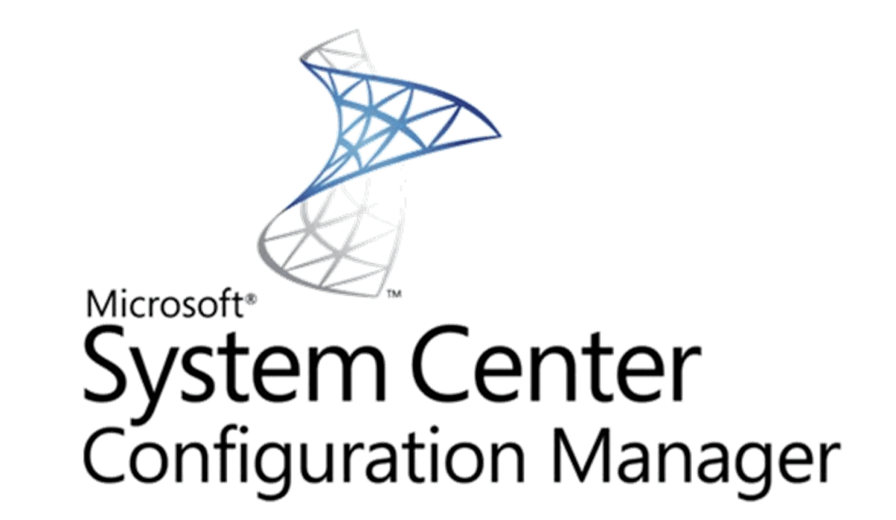
Where do we store our documentation about systems?
Notes:
A repository that acts as a data warehouse storing information about the IT environment and the components that are used to deliver IT services. The data consists of configuration items and relationships that allows the representation of systems and services incorporating components from the sections across our department, (and beyond).
We have all been linking system CIs to incidents, problems, and changes for over a year – but until now that was only helping with reporting and statistics because the records did not include attributes or associations to the components. So we have all been investing int The systems that we are mapping now are those same records so soon when you link them in other records you have the option to take a look and see more details about what makes it tick.
When complete our CMDB will link our CIs into systems and services with a related history of events and changes, and help link the technical side of A.T. with things like costs, contracts and vendors.

Slide 6
The CMDB will map entire systems quickly & easily

Slide 7
Services delivered with multiple systems can seem like…

Slide 8
The CMDB can make spaghetti into this…

Slide 9
Dependency & Impact Diagrams
•How to read a Cherwell visualization
•Two main visualizations
•When would we use these?
Notes:
Over the last couple months we have been meeting with the system administrators on Dudley Roach’s team to make system dependency maps.
There are two main visualizations that result from these sessions,
Dependency, and Impact
I am going to go over a little bit about how to navigate to, and read them along with details about each, and when they will be useful.

Slide 10
How to read Cherwell Visualizations
Subject CI
All others related
Relationship type in right panel
Filters show other relationships
(with alternate colored lines)
5. CI type colors remain consistent
Notes:
Regardless of which type you are looking at, Cherwell visualizations all have some key features that stay the same :
Each one has a subject CI, and it will be displayed in a slightly larger box at the top of the diagram
The other objects shown link to the subject via a relationship that is spelled out in the filters available under Links in the right panel.
You can turn on multiple “layers” using these filters, but keep in mind that the different line colors indicate different relationships.
Originally the CI colors would assign randomly each time you opened a visualization – at this point they have been assigned, and every light green object is an app instance of some type.

Slide 11
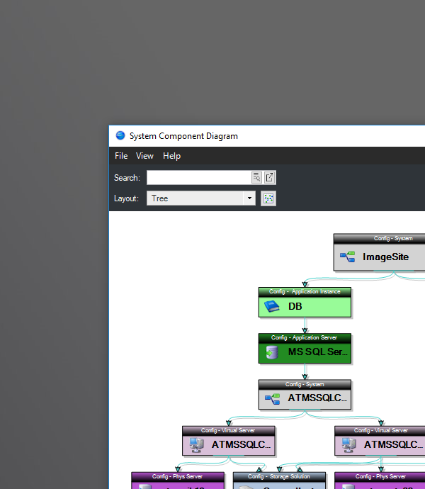
Dependency (System Components) Diagram
Notes:
I have labeled these System Components Diagrams to call attention to the fact that this type of diagram is only useful for system CIs.
System Definition
For ISU’s purposes, a system is defined as any logical grouping of CIs that are designed to work together to provide a unique identifiable function, or service.
These grouping mechanisms are a little bit new to us and have caused some confusion as some see system and automatically think server …
but the longer we use them the more it becomes clear that they help us to track relationships and attributes that have been missing or documented inconsistently in the past.
-If you display a visualization from a System CI, you will automatically get the system components diagram.
-It is a dependency diagram as the subject system is dependent on all displayed components to be operational.
-You may notice that each one of these could be written out something like:
Image site consists of these two application instances each running on an application server, on these virtual servers, on these physical servers
Where each layer is dependent on the next until you get to the physical blades that it all runs on.

Slide 12
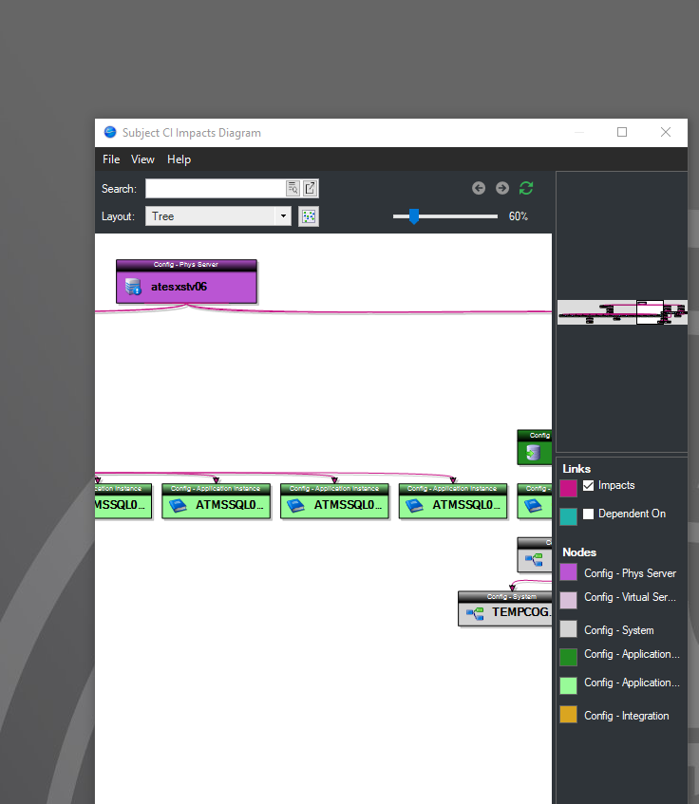
Impact Diagram
Notes:
Navigating to the visualization from any other CI type will bring up an impact diagram.
They can be written out something like: all of the CIs shown here would be impacted if the subject CI were to produce blue smoke…
These diagrams can get rather large, and in order for them to be accurate (and useful) we need to build some discipline about sticking to dependency relationships.
Often during mapping sessions the admins bring up a relationship that reflects a connection or process or an order of operation– because that is what they are accustomed to documenting in their environment diagrams.
To some degree, the way that these CIs link to eachother helps because you can’t just relate any CI type to any other CI type – it turns out that dependency relationships are pretty predictable.
For example, an app instance pretty much has to be hosted somewhere, and that CI has to be an app server, a cluster, a VM, or a physical server.

Slide 13
How do I find these diagrams?
Within Cherwell, select tools/CMDB
Select Config – System as a filter
Search for your system & open it
Click on the Visualize link in the left pane
Notes:
Demo in Test - Fourwinds

Slide 14
Let’s look at an incident for Velocity
Notes:
- Al Tolliver calls in, maybe he calls the TSC, maybe he calls Rob Oakley. Says Velocity isn’t updating.
- Rob checks Velocity and it looks like they system is up and running.
- But, Rob knows that when the SQL database is updated, Velocity needs to be rebooted.
- But it’s July, and Rob likes to take a vacation.
- Now, the call goes to Jarrod, who started on the team last week.
- Jarrod doesn’t know about the SQL database situation.
- If Rob didn’t get a chance to tell him before he went to Europe for 2 weeks, Jarrod is left scrambling.
- But what if, Jarrod could log in to Cherwell, click on Velocity and see this:

Slide 15
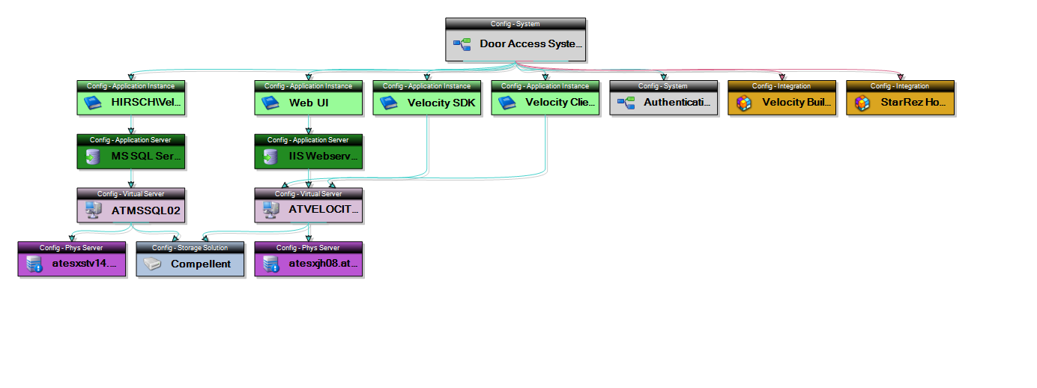
Velocity
Notes:
Here he gets an idea bout the components, scale, technology involved,
even some of the other systems that have integrations with Velocity,
And if he has a question or hunch about any of the components, he can navigate to them and find out who the CI IT owners are for that item

Slide 16
So how do you make an SDM?
•Many have been working with the system CIs for over 2 years, associating
-Incidents
-Problems
-Changes

Slide 17
(Meanwhile – behind the scenes…)
•Working with the DBAs, App Admins, and CCA we have populated thousands of records
Physical Servers
Virtual Servers
Clusters
Application Servers
Databases

Slide 18
How to make an SDM (cont.)
Most mapping sessions consists of linking 1 or more application instances up, & down.
Here’s what that looks like – “real-time”.
Notes:
Demo what making Archibus looked like and the ease of setting those links

Slide 19
Significant value to assist troubleshooting during outages and service degradation.
Putting the CMDB to use
1. Assist in troubleshooting during outages and service degradation.
Notes:
When there is some kind of an outage or service degradation, we never know who will start seeing symptoms, or get the call first -all technical staff have read access to these records and can see the visualizations.
In short order they can get an idea about system or service having trouble, its scope, and interactions with other systems, and who ALL of the teams and or people who keep its components running.

Slide 20
Significant value to assist troubleshooting during outages and service degradation.
Putting the CMDB to use (cont.)
2. Associate Incident, Problem, Change, and Release records to CIs (more specific than system level)
[We upgraded the database server to SQL 2016…]
[We upgraded the web app to eliminate the use of Silverlight…]
Notes:
We have been associating everything at the System level, but that was never the goal, just kind of a workaround for reporting and building the habbit.
What if we could assign these things to the actual CI that is broken, or being upgraded or changed?

Slide 21
Significant value to assist troubleshooting during outages and service degradation.
Putting the CMDB to use (cont.)
3. Assess changes for possible impact during the planning and Change/Release process.
Notes:
AT has Change/Release coordination meetings every week on Monday afternoons, and we have seen a scenario play out many times in those meetings.
Someone proposes a change and Nathan Stien starts thinking and asking questions about how that change may affect one of the important integrations running in jBoss Fuse (ESB)
His initial set of integrations are all in the CMDB and linked to the systems involved, so if there is a question and we need all attendees to see/understand which integration(s) could be affected- we will be able to bring them up quickly
Beyond that, if there is no Nathan or other SME available that day and we are not sure – we can check!

Slide 22
Significant value to assist troubleshooting during outages and service degradation.
Putting the CMDB to use
4. Identify system purpose and more easily illustrate duplication of systems.
Notes:
During these mapping sessions we have heard a lot of the app admins frustrations, and many of them are difficult to illustrate or report on reliably.
The system record, and the ability to add attributes to system CIs and app instance CIs will help with that in time.
We all know that we have many duplicate systems that have uncalculated costs in licensing and administration
– lets stop talking about it and find ways to document and illustrate it so these problems get the attention they deserve

Slide 23
Significant value to assist troubleshooting during outages and service degradation.
Putting the CMDB to use
5. Illustrate the volume of CI we are responsible for, and…
How components from many teams (tech silos) work together to provide functions, systems, services
Notes:
We all know most systems depend on several teams, but no other system or method supports showing them and linking them all to reflect purpose

Slide 24
Significant value to assist troubleshooting during outages and service degradation.
Putting the CMDB to use
6. Help inform budget and planning processes by allowing vendors and contracts to be linked.
Notes:
As we go through the system mapping process, it has been surprising how often the answers we need are in the contract and may not be in other diagrams or documentation. Surprising to everyone but Lew Steinbach and Kevin Hand who know the contracts.
For instance we rarely choose to call an application what it actually is, we say Archibus (the companies name) and pretend they only offer one solution, or a full suite of them and we have licensing to use the entire suite – but the contract says that we have X licenses to use products A, and B (in a lineup that goes to J).
We are all greatfull to Lew for coordinating and taking care of those contracts, and I don’t think many are envious of that undertaking – but if all those contracts with important facts end up in a file drawer or Teams Folder only accessible to Lew –we can’t utilize them the way that we should.

Slide 25
Significant value to assist troubleshooting during outages and service degradation.
Putting the CMDB to use
7. Coordination between IT teams, both within AT and eventually across all IT units on campus.
Notes:
As you all know, most services are delivered with multiple systems and these diagrams just offer a more dynamic and accessible illustration of that.
They allow anyone with access a more complete understanding of those systems and the various ways they interact than we have had in the past.
Having this utility available will be transformational and improve the way that we design, troubleshoot, support and communicate about our services for the campus.

Slide 26
Notes:
Questions?

