Slide 2
Pros and Cons of Identity Automation
Panel Discussion
Devin Carlson | Ryan Grahs | Ben Rappleyea
Nathan Stien | Derek Story | Dan Taube
Post questions in CIT channel of Teams
Visit docs.illinoisstate.edu/identity

Slide 3
Pros and Cons of Identity Automation
Before We Begin, Identity Defined…
Historically referred to as the ULID at ISU, a digital identity is an amalgamation of information and attributes about an online persona that can be bound to a physical person.
Post questions in CIT channel of Teams
Visit docs.illinoisstate.edu/identity

Slide 4
Pros and Cons of Identity Automation
Planned Agenda
Systems Driving Identity
Dynamic Roles (“Affiliations”)
Identity Lifecycle
New Employee Identity Creation
Known Issues
Crowd Questions
Improvement Initiatives
Post questions in CIT channel of Teams
Visit docs.illinoisstate.edu/identity

Slide 5
Pros and Cons of Identity Automation
Systems Driving Identity
Post questions in CIT channel of Teams
Visit docs.illinoisstate.edu/identity

Slide 6
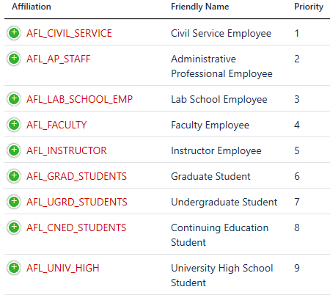
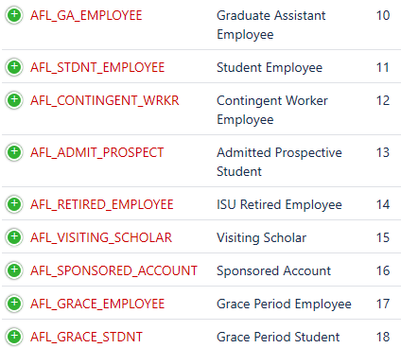
Pros and Cons of Identity Automation
Dynamic Roles (“Affiliations”)
Post questions in CIT channel of Teams
Visit docs.illinoisstate.edu/identity

Slide 7
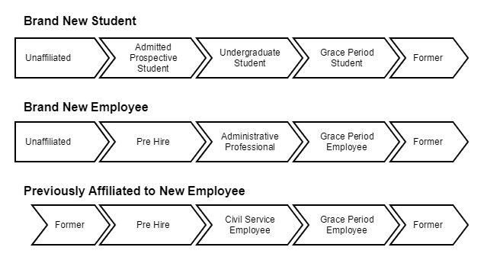
Pros and Cons of Identity Automation
Identity Lifecycle
Post questions in CIT channel of Teams
Visit docs.illinoisstate.edu/identity

Slide 8
Pros and Cons of Identity Automation
New Employee Identity Creation
Post questions in CIT channel of Teams
Visit docs.illinoisstate.edu/identity

Slide 9
Pros and Cons of Identity Automation
Known Issues
Timing
Data Entry
Lack of Reconciliation
Performance Load
Post questions in CIT channel of Teams
Visit docs.illinoisstate.edu/identity

Slide 10
Pros and Cons of Identity Automation
Crowd Questions
Post questions in CIT channel of Teams
Visit docs.illinoisstate.edu/identity

Slide 11
Pros and Cons of Identity Automation
Improvement Initiatives
Upgrade of Systems
Redesign of Automations
Stability and Resilience Efforts
Incident and Problem Management
Post questions in CIT channel of Teams
Visit docs.illinoisstate.edu/identity

