Slide 2
Major Incident Coordination & Communication
Tyler Piper & Elizabeth Giller
August 2019
Notes:
*** INTRO SLIDE***
Elizabeth
Welcome to the final session of the 2019 CIT Annual Conference. I am Elizabeth Giller, one of the 3 Incident Coordinators on the Incident Coordinator team within the Technology Support Center. [Insert some background on yourself here if you wish].
Tyler
I am Tyler Piper, Assistant Director of the Technology Support Center. Today we will be discussing Major Incident Coordination and Communication. We will start by defining what we mean when we say something is a Major Incident, and then walk through a scenario to show you what is happens behind the scenes to identify and scope an impact, communicate it, restore service, and hopefully reduce the frequency or severity of future impacts.

Slide 3
INTRODUCTION
Definitions
Severity
Examples
PROCESS
FINDINGS
Common Root Causes
Process Value

Slide 4
Incident: A current unplanned interruption to an IT service or reduction in the quality of an IT service
Account & Access Management
Campus Data Network
Campus Phones
Campus Solutions
Cherwell ITSM
Ellucian Colleague
HCM/iPeople
My.IllinoisState.edu
Office 365
Payment Processing
ReggieNet
Security Events
Server and Storage Infrastructure
Major Incident: A current or potential unplanned impact from a customer perspective to a technology service critical to academic or business processes.
Impact: A reduction in IT Service functionality, performance, or outage.

Slide 5
Major Incident Severity
Severity 3
1 Service
Severity 2
2+ Services
Severity 1: A catastrophic event typically involving more than IT services and may have environmental or health and safety implications.
Notes:
All Major Incidents start as a severity 3 with additional tasks, procedures, and roles being invoked as severity is escalated.
Severity level escalation is at the discretion of Incident Coordinators in collaboration with Administrative Technologies leadership.
But what about that one thing that one time?
Financial, legal, or academic calendar considerations may raise the profile of an incident involving a non-critical service resulting in the initiation of the Major Incident process at the discretion of Administrative Technologies leadership.

Slide 6
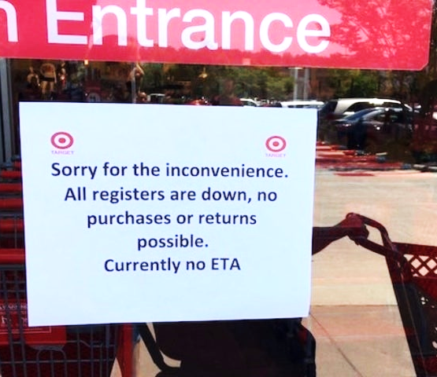
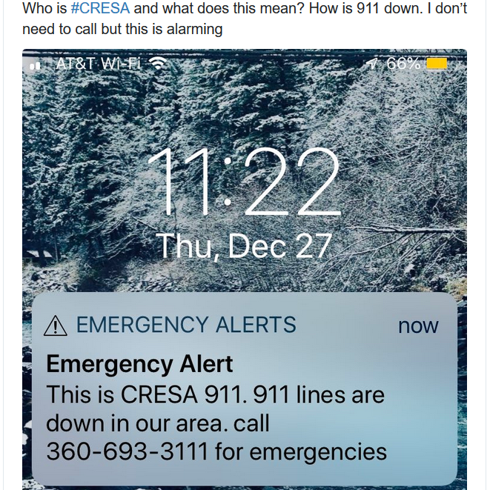
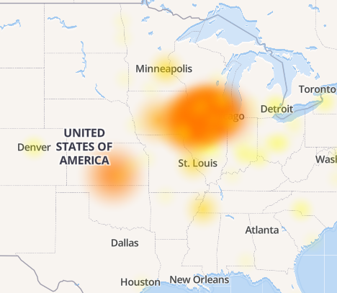
Major Incident Examples
Public
Target Stores
Massachusetts Emergency Services
ISU
Multi-system outage
Office 365 Email degradation
Notes:
Public
Target registers down in ALL Target stores. – June 15th, 2019 – 2 Hours
Massachusetts 911 outage, December 2018 –This is not the first time a CenturyLink outage has disrupted 911 services. In 2015, the carrier agreed to a $16 million settlement with the FCC stemming from an April 2014 outage that impacted seven states.
ISU
Multi-system outage – May 2019, affected Central Login, MY, VOIP, Pharos, Virtual Servers and several databases. Stay tuned later to hear root cause on this one.
Email degradation – 9 hour degradation in July due to components on Microsoft’s end.

Slide 7
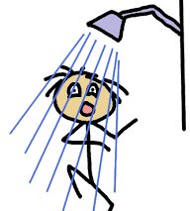
Hot showers,
Release
Change
Incident
and the relatives…
Notes:
Let's see it in action!
For those of you that read the presentation description and were really hoping to dive into some real ISU IT Impact scenarios, I'm sorry. In going through some of the big impacts over the past couple of years, we had a tough time picking out examples that we could explain without a ton of background information and also be discussed for 45 minutes without putting half of you to sleep. With that said, we felt a more hypothetical and relatable non-IT example would help us better present our material.
We titled this scenario: Hot Showers, and the Relatives….
Some of your relatives, let’s say your In-Laws, are taking a vacation to see your family and experience all that Bloomington-Normal has to offer. They don't want to deal with the hassle of hotels and ask to stay at your home for the week. Sounds simple enough, you have an extra room and your kids will enjoy seeing them. You do things like clean the house, buy food, and let everyone known the plan. This would be a Change.
The day of their arrival comes and goes smoothly. Everyone is having a good time, catching up, your mother in law even manages to get through dinner without channeling her inner Gordon Ramsay. This would be considered a Release.
Fast forward to a few days later. You have one of those days at work where all you want to do is go home, watch your favorite show, have an ice cold …soda, take a hot shower, and go to bed. When you arrive home you set out to do exactly that. Your show was everything you hoped it would be, the soda, and the subsequent second soda were great, and now it's time for that shower. You turn on the water, high five your reflection in the mirror, and step in. Then, to your shock, the water is…ice cold. This would be an Incident.

Slide 8
What would you do?
Retry?
Phone a friend?
Call the Technology Support Center!?!
Notes:
If you happen to not be an Incident Coordinator, what would you do?
I’d yell out the bathroom door at the kids for using all the hot water.

Slide 9
Major Incident Coordination Process
Identify
Act
Resolve
Review
Notes:
Lucky for you, you just so happen to be an Incident Coordinator and know exactly how to get this resolved as quickly as possible.
Single point of contact for management, functional, and technical support
First level customer contact management

Slide 10
Identify Scope/Verify Impact
Identify
What | Who | How | Identify, Verify & Document
Who is affected | Residents? Guests? Only You?
Scope of impact | Just this shower? Sinks too?
Details/Confirmation of impact | Reproducible? Is handle/faucet broken? Who was last to use it? When? How long has hot water been out? Has anyone else reported an issue? Does anyone else need hot water now or soon? Who, when & what for?
Additional Considerations | Any recent changes? Workarounds?
Notes:
***IDENTIFY STEP***
Identify Scope & Verify Impact
Impact & Urgency Matrix - Is this a major incident? How many people are impacted and how soon until it causes a disruption?
This may or may not be identified at the time of impact, and may or may not be easy to identify relation.
Workarounds?
Take a cold shower. Depending on your customer base, this may or may not be an acceptable workaround.

Slide 11
Cold Water Analysis
Identify
What | In Action | Scenario
Impact | All of “Campus” no hot water in house | HIGH
Urgency | Debatable (“business” critical?) Sink full of dirty dishes, teenager just home from wrestling practice, and other stinky kiddos | HIGH
Major Incident? | Impact and Urgency considered | YES
Notes:
***IDENTIFY STEP***

Slide 12
Major Incident Coordination Process
Identify
Act
Resolve
Review
Notes:
***ACT STEP***

Slide 13
Contact Support Staff
Act
What | In Action | Scenario
Relay relevant information | The hot water doesn't work in the shower. It was verified to also not work in the kitchen. Appears to be all hot water. | No hot water
Basic troubleshooting was completed | Tried all sinks and showers. Didn’t confirm washing machine.
Establish communications paths | Veoci Conference Call
Notes:
***ACT STEP***
Veoci (Side Rooms) -
• Communications: A side room used to discuss the development of communication plans, review wording, and document social media responses.
• Contingency Planning: “What if” action plan discussions for impacts.

Slide 14
Action Plan
Act
What | Who | How | In Action | IT Equivalent
Water Heater Check | Go to the basement and check for issues. | Infrastructure Monitoring Manual Tests
What happened earlier? | Interrogate Ask people what they know. | Check System Logs
Notes:
***ACT STEP***
Based on known information and recovery options, you start to map out an action plan.
*Keep in mind we don't know the root cause, and may never know.
All members of the recovery team check their particular areas of expertise and report their findings.

Slide 15
Action Plan
Act
Options | Considerations
Wait for hot water heater to catch up. | What if it never does? Should we assume it will?
Order and install new water heater | Is this a recurring problem?
Rent hotel rooms for family & guests | May not be ideal, but provides hot water service as a temporary workaround
Heat water on stove and take a bath | May not be ideal, but provides hot water service as a temporary workaround
Do nothing | Could be permanent solution due to time/money. Results in Problem Record with “known error” KB article
Goal: Restore service as quickly as possible.
Notes:
Goal - Restore service as quickly as possible. This does not necessarily mean in the most efficient way.
*Keep in mind we don't know the root cause, and may never know.
Other considerations – place hand sanitizer in restrooms.
Do nothing - Your customers may find an alternative if you don't provide service adequately.
Deciding not having hot water and using the workaround for extended time - problem + known error article.

Slide 16
Communications
Act
What | In Action
Tech Alert | Inform hot water users that hot water is not available. Root cause is not known at this time. No ETA. Workaround = use cold water.
Leadership/Other IT Staff Areas | Teams ISU IT Staff Email distribution group
University | Social Media News Article
Goal: Communicate within 15 minutes.
Notes:
***ACT STEP***
So at this point we should be less than 15 minutes into the impact. That may seem reasonable for this scenario, but think about some of the complex systems we have on campus. Imagine trying to get scope an impact, contact the right IT Staff, start up a Veoci room and conference call, and write a Tech Alert that accurately captures the impact in a way end users will understand.
If impact lasts ~15 minutes, may post after acknowledging something wasn't working right and that the system is now stable.
Other Communication paths included:
Tech Alert
TSC Phone Upfront message

Slide 17
Major Incident Coordination Process
Identify
Act
Resolve
Review
Notes:
***RESOLVE STEP***

Slide 18
Resolve
What | In Action
Work until recovery | Administrators makes decisions on what recovery actions to try. Sometimes, trial and error is needed, other times the issue resolves without outside intervention.
Validate Recovery | Direct testing of system performance or availability. Confirmation with impacted users when possible.
Tech Alert | Communicate the issue has been resolved. Include recovery time and any required actions.
Scenario Resolution: You went downstairs, had another soda. You tried again 30 minutes later.
Notes:
***RESOLVE STEP***

Slide 19
Roles & Responsibilities
Incident Coordinator | IT Staff | Communications | IT Leadership
Verify Impact or Outage Contact IT Support Staff Create the Infrastructure Incident Create Veoci Room Invite Technical Teams Start a Conference Call Create TSC Phone Upfront Message Post Tech Alert Establish Next Update Expectations Coordinate TSC Response Create OneNote Documentation Entry Document Resolution Progress | Verify Impact or Outage Provide Impact Details Join Veoci Room Join Conference Call Provide Troubleshooting Details Provide Recovery Action Details Engage Vendor as Required Engage Functional Staff as Required Provide Tech Alert Update Information | Update Social Media Monitor Social Media Mentions Draft Mass Communications Initiate MY Announcements/Banners | Join Veoci Room Ensure Team Engagement Communicate Team Progress to Veoci Update Campus IT Teams
Notes:
*** INTRO SLIDE***
Tasks can be split to multiple IC’s, but not after hours.
Severity 3 – shown here
Severity 2 – Physical Response Room & Additional Communications (CTLT, CS-L, AP-L, ect)
Severity 1 – Coordinate with EOC
Severity 1 Roles
As incident severity escalates, the necessity for responsibility specific, assigned roles may be required. These roles will be assigned by Administrative Technologies leadership as deemed necessary.
Incident Manager: Overall Point of Contact.
Communications Lead: Oversees all communications.
Technical Lead: Acts as approver and prioritization of analysis and recovery tasks.
Planning Lead: Contingency planning and resource allocation.
Campus IT Liaison: Communications on status and coordination of IT resources campus wide.

Slide 20
Roles & Responsibilities
Incident Coordinator | IT Staff | Communications | IT Leadership
Post Resolution Tech Alert Close Child Incidents Close Infrastructure Incident Request Root Cause & Other Answers Create Problem Record Attach Veoci Log to Infra Incident Finalize OneNote Document Create Event Review Entry Schedule Post Impact Review Meeting | Update and Close Infrastructure Incident | Update Social Media | No Additional Tasks
Post Impact Resolution
Notes:
***RESOLVE STEP***

Slide 21
Major Incident Coordination Process
Identify
Act
Resolve
Review
Notes:
***REVIEW STEP***
Elizabeth

Slide 22
Review
Info
Who | AT Leadership
What | Review Meeting of Prior Major Incidents
When | Bi-weekly
Why | Review root cause, determine follow up action items, discuss prevention, evaluate need for process/communication changes or improvement
How | Agenda created from prior 2 weeks coordinated events. Details include impact, resolution, root cause, length of outage, response times and actions as well as questions and notes.
Notes:
***REVIEW STEP***
Elizabeth

Slide 23
Review
Event Details
Impact
Resolution
Root Cause
Length of outage
Response times & actions
Questions & Notes
Resulting Actions
Determine follow-up action items
Discuss prevention
Evaluate need for process/comm changes or improvement (and next steps if necessary)
Notes:
***REVIEW STEP***
Elizabeth
Review root cause, determine follow up action items, discuss prevention, evaluate need for process/communication changes or improvement
Agenda compiled from prior 2 weeks coordinated events. Details include impact, resolution, root cause, length of outage, response times and actions as well as questions and notes.

Slide 24
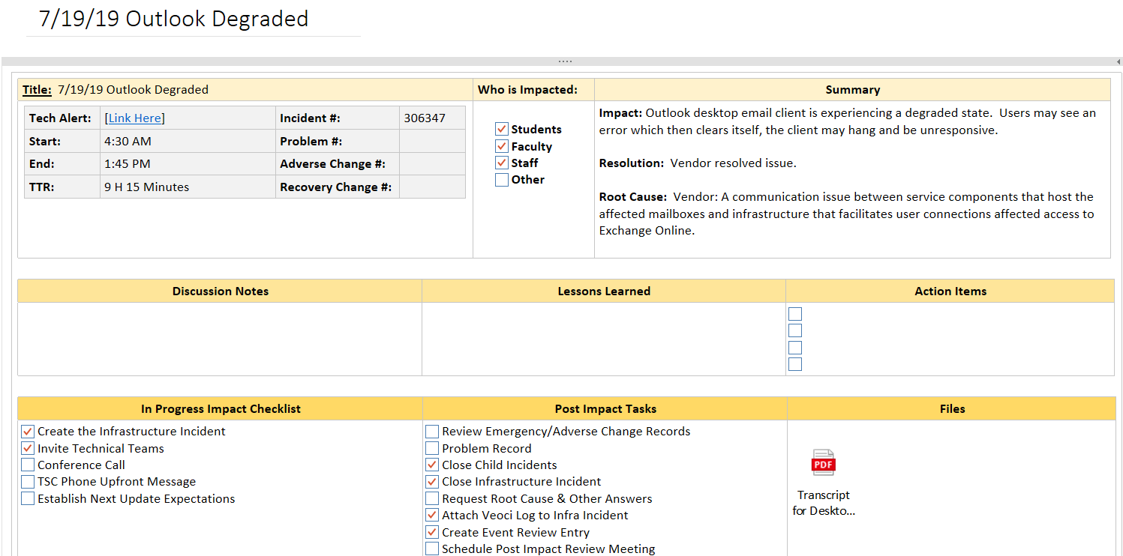
Review
Notes:
***REVIEW STEP***
Elizabeth
All relevant information is recorded in this template. As we discuss the event in the Executive Event Review Meeting with leadership we review the Impact, Resolution, Root cause and length of outage (total time to resolution).
Additional key information is also included for reference including link to tech alert, start and end time, incident/problem/related change.
Discussion notes, Lessons learned and Action items are added during the meeting. Occasionally some of this information is determined prior and then reviewed.
Checklist, tasks and files

Slide 25
Review
Notes:
***REVIEW STEP***
Elizabeth
Response times and actions
Questions and notes

Slide 26
Review
Review & cleanup notes
Send Post Event Review Summary
Compiled list of follow up action items
Link to updated event notes
Action items reviewed at next Event Review meeting
Notes:
***REVIEW STEP***
Elizabeth

Slide 27
Findings
Major Incident Coordination Process
Identify
Act
Resolve
Review
Notes:
***REVIEW STEP***
Reiterate steps and transition into Findings.
32min at this point

Slide 28
What Causes Major Incidents?
Common Causes
Additional Info
Hardware
Change
Human Error
Queries
Jobs
80% result of Change
Prior industry average
hosted solutions factor
2018
83 Impacts
33% Vendor
Notes:
Common causes – review each
Back to our Multi-system outage from this past May. It affected Central Login, MY, VOIP, Pharos, Virtual Servers and several databases. Guesses on Root Cause? Hardware!
Change is the cause?: Not necessarily the case anymore with the reliance on vendors, integrations, points of failure.
Cloud, Integrations (Connections and System Dependencies)

Slide 29
Value
Year (5 Month Span) | # of Impacts | Avg. Recovery Time¹
*2017 | 73 | 7 Hours, 25 Minutes
2018 | 126² | 5 Hours
2019 | 70 | 5 Hours, 10 Minutes³
1. Average time is calculated with impacts resolved within 36 hours.
2. The increase in impact volume is heavily attributed to improved documentation.
3. We are reliant on vendors to resolve their impacts.
Notes:
2017 was prior to the Incident Coordinator team and the Major Incident Process
*The value in giving our users 2 ½ hours back on average for every impact.
Increased communication among IT Staff
Better Processes

Slide 30
Thank You!
A big Thank You to the IT Staff that work after hours and weekends to get our Services back up and running.
Notes:
***WRAPUP***

Slide 31
What are your questions?
Notes:
***QUESTIONS***

Slide 32
Notes:
***CONCLUDE***

