Slide 2
Building Cherwell Searches
Tyler Piper
August 2019
Notes:
Isutest.cherwellondemand.com/cherwellclient

Slide 3
Field Identification
Clause Types
Important Tips
Search Examples
Exporting & Sharing
Agenda
Notes:
Searches (Queries) are the backbone of dashboard widgets, reports, and in general allow you to utilize Cherwell data to make better decisions in support of your customers.

Slide 4
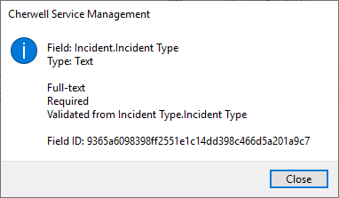
Field Name Identification
*Desktop Client Only*
Notes:
The first thing you need to do when building a search is identify the data fields you will want to use to narrow your results.
You will also need to know field names in order to include those data elements in the data export of the results.
Some field names don’t match the field label. In addition, some fields do not have the ability to find the field name. Contact the TSC for assistance.

Slide 5
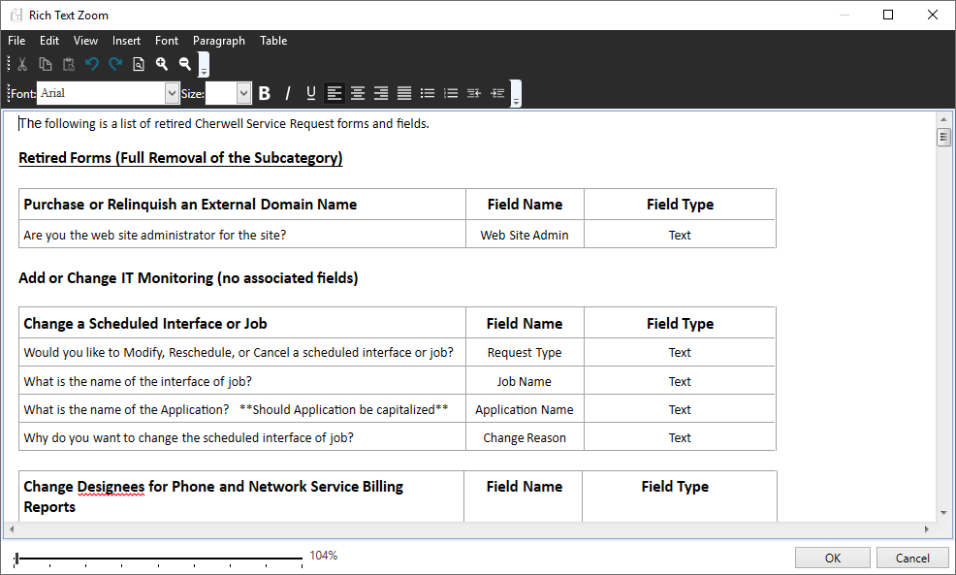
Field Name Identification
Retired Fields: KB5807
Coming Soon:
- Data Dictionary
Notes:
The first thing you need to do when building a search is identify the data fields you will want to use to narrow your results.
You will also need to know field names in order to include those data elements in the data export of the results.

Slide 6
Clause Types
Group Clause: Groups together several Clauses.
Must be true (AND logic), or if only one Clause must be true (OR logic)
Comparison Clause: Finds all records containing a field with a particular value.
Ownership Clause: Finds records associated with a particular owner (person or Team).
Related Clause: Finds Business Objects whose related Business Object satisfy some of the criteria.
Queue Clause: A Queue Clause is a clause that finds all records that exist or do not exist on Queues.

Slide 7
Search Examples
Primary CI
Open Past Due

Slide 8
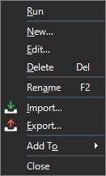
Exporting & Sharing
*Desktop Client Only
Notes:
.CED File
Can’t find it on the list? Check File Association at the top.

Slide 9
Tips for Success
Keep It Small
Narrow Date Range
Single Owner/Owning Team
Keep It Simple
Limit Relationship Searches, or Ask for Help
TEST IT FIRST

Slide 10
Questions?
AT Incident Coordinators
tspiper@ilstu.edu
Notes:
Isutest.cherwellondemand.com/cherwellclient

