Slide 2
Business Value of IT in Higher Education

Slide 3
In 1998…
2.4 million websites
Google was launched

Slide 4
Today…
Over 1.5 billion
Google still around and added a couple more services

Slide 5
In 1998…

Slide 6
Today…
Students can apply through a common online application to hundreds of schools….
AND can can interact with admissions officers, current students and alumni through college blogs, Twitter handles, and Facebook pages.

Slide 7
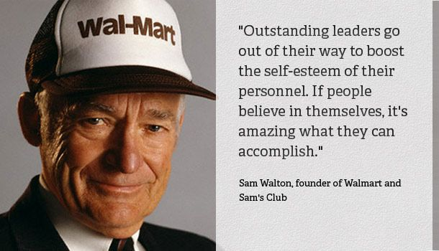
In 1998…
Business Intelligence=

Slide 8
Today…

Slide 9
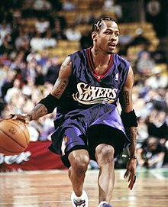
In 1998…
AI=

Slide 10
Today…
AI=

Slide 11
Look where we’ve been in 20 Short Years.

Slide 12
The Landscape has and continues to Change

Slide 13
We’re in a Constant State of Change!
Technology and “business” is coming together in ways we have never seen before.
According to Gartner, CIOs and IT leaders must have ambitions to match the widespread opportunities for IT to play a leading role in the digital business era. We are in a state of change with technology and its management!

Slide 14
State of the State

Slide 15
Higher Education
Competition: Students demand services, facilities, quality, but also value.
According to Gartner, the cloud has exacerbated overlap in staff objectives and technology solutions by making it very easy for campus departments to procure technology solutions without the awareness of either the CIO or other IT leaders on campus.

Slide 16
What is Business Value of IT?
We all know ISU’s “business” is education. But we’re not in business.
Should we use the term business in higher education???
What does business value mean to IT people?
What does it mean to faculty and administrators?

Slide 17
The concept has its place in Higher Ed
REPLACE:
Increased revenue
Increased sales
Increased market share
WITH:
Increased enrollment
Increased retention
Lower student debt

Slide 18
IT plays a significant role… So do our “business partners” or campus community

Slide 19
Winds of Change
Shift from technology provider to services provider
Constant State of Change
Complex Integrated Systems
Digital Transformation
We need to tell the value story for buy-in

Slide 20
How Do We Deliver Value?
Partner with the people we serve. Strategic Goal I.D.2 Increase collaboration across departments and divisions.
Tell the story. What we can do, how we can do it to transform our university.
Get to know their “business”. Come along side them to offer solutions that can transform their work which transforms our institution, supporting Strategic Initiatives.

Slide 21
Ways to Look At BVIT

Slide 22
How Do We Deliver Value?
Operational Excellence
Growth
Transformation

Slide 23
How Do We Deliver Value?

Slide 24
Business Value of IT
General themes from the literature:
Actual value can be challenging to calculate.
Can be hard to articulate to non-IT people.
CIOs and leaders that can articulate the value story are more successful and able to lead digital transformations at their organization.
According to Gartner, IT is still perceived as a black hole to its business stakeholders.
Gartner also says we need to create a “strategic business conversation”.

Slide 25
WE Can Do IT!
IT can help transform the University…BUT
We need buy-in from our campus community.
To get buy-in, we need understanding.
According to Gartner, IT is still perceived as a black hole to its business stakeholders.
Gartner also says we need to create a “strategic business conversation”.

Slide 26
We need to tell the story..
IT can help transform the University…BUT
We need buy-in from our campus community.
To get buy-in, we need understanding.
And lastly, we need to align with campus strategic goals and the community we serve.

Slide 27
Survey Results Help Inform Us
TechQual
ReggieNet
Per Mark Walbert:
Faculty negative
Students positive
Staff right down the middle

Slide 28
Recent Examples
Predictive Analytics (Ensure Student Success)
Advisor Dashboard
INTO (Diversity)
Very strategic initiative pulled together quickly. Planning and process by ESP helped speed that up.
WEB (Marketing and Recruiting, telling ISU’s story)
Completely revamping ilstu.edu
ReggieNet (Student Success)
Continue to upgrade and stabilize the platform. Students actually like the tool.

