Slide 2
2018 TechQual+ Survey Results
Mark Walbert and Carla Birckelbaw
Notes:
Higher Education TechQual+ Project @ University of Georgia [ https://www.techqual.org ]
Started in 2006, based on SERVQual and, later, LibQual+ methodology

Slide 3
Survey Format
2018 TechQual+ Survey Results

Slide 4
Survey Format
Four Sections of 4-5 questions each on:
Connectivity and Access
Technology and Collaboration Services
Support and Training
Quality of IT Services (new this year)

Slide 5
The Survey Instrument
§1. Connectivity and Access Tell us about your ability to access technology services through the Internet
Having an Internet service that operates reliably.
Having an Internet service that provides adequate capacity or speed.
Having an Internet service that provides adequate Wi-Fi coverage.
Having adequate cellular (or mobile) coverage throughout campus.
Notes:
Out on 4/xx to all F/S/S in survey pool for three weeks. Reminder sent on 4/xx…

Slide 6
The Survey Instrument
§2. Technology and Collaboration Services Tell us about the quality of Web sites, online services, and technologies for collaboration
Having Web sites and online services that are easy to use.
Having online services that enhance the teaching and learning experience.
Having technology services that allow me to collaborate effectively with others.
Having systems that provide timely access to data that informs decision-making.
The availability of classrooms or meeting spaces with technology that enhances the teaching and learning experience.

Slide 7
The Survey Instrument
§ 3. Support and Training Tell us about your experiences with those supporting your use of technology services
Getting timely resolution of technology problems that I am experiencing.
Technology support staff who have the knowledge to answer my questions.
Receiving communications regarding technology services that I can understand.
Getting access to training or other self-help information that increases my effectiveness with technology.

Slide 8
The Survey Instrument
§4. Quality of IT Services
Tell us about the quality of ReggieNet, our learning management system.
Tell us about the quality of ITHelp.illinoisstate.edu, our IT support website.
Tell us about the quality of Campus Solutions, our student information website.
Tell us about the quality of My.illinoisstate.edu, our student, faculty, and staff portal.
Tell us about the quality of Microsoft Office 365, our online productivity and collaboration software.

Slide 9
The Survey Instrument
Finally, we also asked a more general question on:
What aspects of information technology services such as ReggieNet and Campus Solutions are most important to you? (Multiple responses allowed)

Slide 10
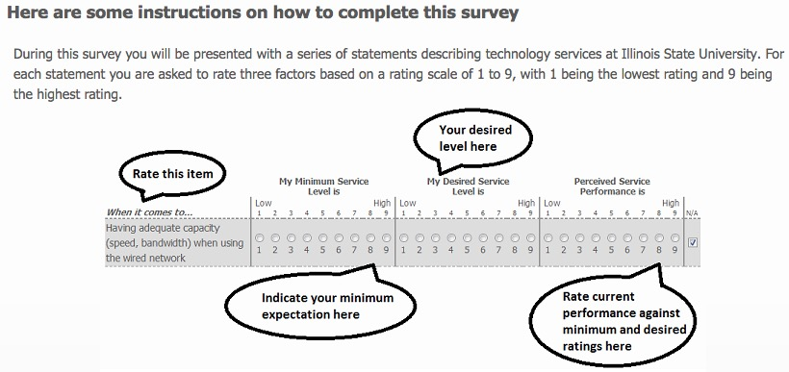
Question Response Format
Notes:
How easy was it for you to complete this survey? (1 = very difficult, 9 = very easy)
2017 7.4065
2018 7.4
How confident are you that the answers you provided are meaningful? (1 = not at all confident, 9 = very confident)
2017 6.8423
2018 7.1

Slide 11
Service Level Adequacy
When perceived service performance exceeds minimum expectations, the resulting service level adequacy gap score, Adeq > 0
When perceived service performance is below minimum expectations, the resulting service level adequacy gap score, Adeq < 0
Notes:
H₀: Adequacy Gap Score = 0

Slide 12
Key Findings
2018 TechQual+ Survey Results

Slide 13
Key Findings from this Survey
Statistically Significant Positive Perceptions
1. Having an Internet service that operates reliably. Adequacy Gap Score = 0.44
2. Having an Internet service that provides adequate capacity or speed. Adeq = 0.58
3. Having an Internet service that provides adequate Wi-Fi coverage. Adeq = 0.48
4. Having adequate cellular (or mobile) coverage throughout campus. Adeq = 0.38
7. Having technology services that allow me to collaborate effectively with others. Adeq = 0.22
18. Tell us about the quality of Microsoft Office 365, our online productivity and collaboration software. Adeq = 0.28
Statistically Significant Negative Perceptions
8. Having systems that provide timely access to data that informs decision-making. Adequacy Gap Score = -0.35
16. Tell us about the quality of Campus Solutions, our student information website. Adeq = -0.91
Notes:
All respondents; Outliers removed
Significant at the 0.05 confidence level

Slide 14
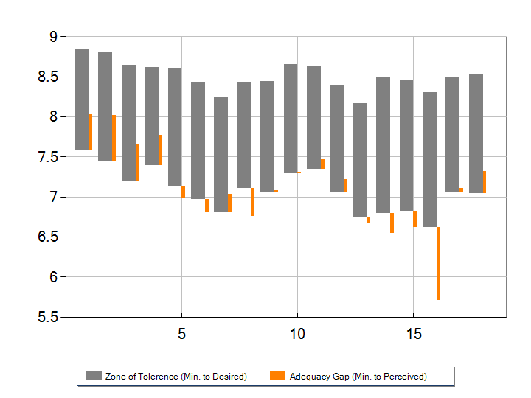
Response Zones
Notes:
Gray bar Orange bar
Top = Desired service level Rises if Perceived > Minimum
Bottom = Minimum service level Falls if Perceived < Minimum

Slide 15
Response Zone Analysis
Six service levels exceed the minimum expected:
Having an internet service that:
…operates reliably (Adeq = +0.44)
…provides adequate capacity or speed (+0.58)
…provides adequate WiFi coverage (+0.48)
Having adequate cellular … coverage throughout campus (+0.38)
Having technology services that allow me to collaborate effectively with others. (+0.22)
…quality of Microsoft Office 365, our online productivity and collaboration software. (+0.28)
Notes:
In the 2017 Survey, the Adequacy Gap Scores (Adeq) were:
1. +0.15 — Nearly 3 times higher this year! (+0.44)
2. +0.28 — Nearly doubled this year!
3. +0.01 — Huge improvement this year!
4. +0.15 — More than doubled this year!
7. -0.14 — Switched from below min. to above min.! (though not statistically significant last year)
18. New question for 2018

Slide 16
Response Zone Analysis
Two service levels are below the minimum expected:
Having systems the provide timely access to data that informs decision making (Adeq = -0.35)
…quality of Campus Solutions, our student information website (-0.91)
Notes:
In the 2017 Survey, the Adequacy Gaps were:
5. -0.68 — Only about half as bad this year!
16. New question for 2018. Adequacy Gap is about as bad as possible…

Slide 17
Data Summary Tables
2018 TechQual+ Survey Results

Slide 18
Respondent Demographics
530 attempted the survey
223 completed the survey (42% of attempts)
Faculty and staff had higher completion rate (67%-69%) than students (36%)
Males had a slightly higher completion rate (56%) than females (55%)
The older the respondent the higher the completion rate…
Notes:
2018 Survey had the lowest response rate yet…
2013 — 329 completed the survey (56% of attempts)
2017 — 625 completed the survey (58% of attempts)

Slide 19
Respondent Demographics
University Role/Sex
49 faculty (69%)
118 staff (67%)
53 students (36%)
134 female (55%)
78 male (56%)
Age group
0-24 35 (29%)
25-34 33 (60%)
35-44 35 (68%)
45-54 45 (72%)
≥ 55 46 (76%)
Notes:
2017 Demographics
177 faculty 0-24 114
264 staff 25-34 85
176 students 35-44 116
355 female 45-54 127
240 male ≥ 55 117
2013 Demographics
83 faculty 0-24 26
211 staff 25-34 62
24 students 35-44 56
141 female 45-54 74
171 male > 54 55

Slide 20
Legend for Tables
Minimum Level of Service
Desired Level of Service
Perceived Service Quality
Adequacy Gap Score = perceived - minimum
Superiority Gap Score = perceived - desired
p-value for H₀: Adequacy Gap Score = 0
Red Color = Perceived < Minimum
Green Color = Perceived > Desired

Slide 21
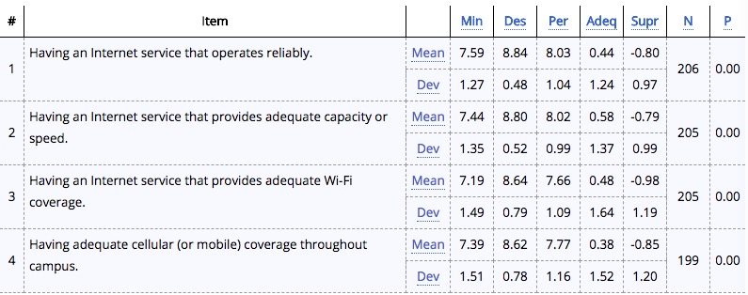
Connectivity and Access Tell us about your ability to access technology services through the Internet
Notes:
All respondents; outliers removed
Minimum Level of Service
Desired Level of Service
Perceived Service Quality
Adequacy Gap Score = perceived - minimum
p-value for H₀: Adequacy Gap Score = 0
Reject H₀ for questions 1-4…

Slide 22
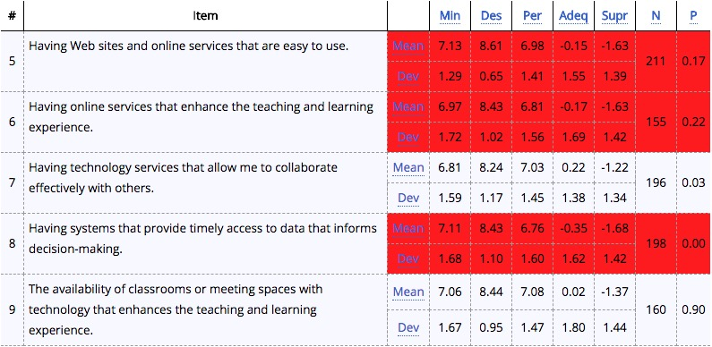
Technology and Collaboration Services Tell us about the quality of Web sites, online services, and technologies for collaboration
Notes:
All respondents; outliers removed
Minimum Level of Service
Desired Level of Service
Perceived Service Quality
Adequacy Gap Score = perceived - minimum
p-value for H₀: Adequacy Gap Score = 0
Fail to Reject H₀ for questions
5. Gap = -0.15 p = 0.17
6. Gap = -0.17 p = 0.22
9. Gap = +0.02 p = 0.90

Slide 23
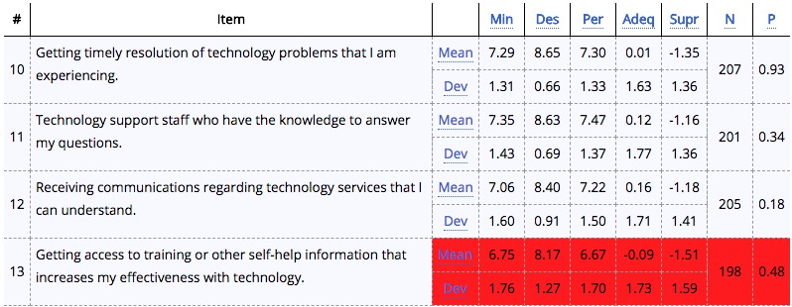
Support and Training Tell us about your experiences with those supporting your use of technology services
Notes:
All respondents; outliers removed
Minimum Level of Service
Desired Level of Service
Perceived Service Quality
Adequacy Gap Score = perceived - minimum
p-value for H₀: Adequacy Gap Score = 0
Fail to Reject H₀ for questions
10. Gap = +0.01 p = 0.93
11. Gap = +0.12 p = 0.34
12. Gap = +0.16 p = 0.18
13. Gap = - 0.09 p = 0.48

Slide 24
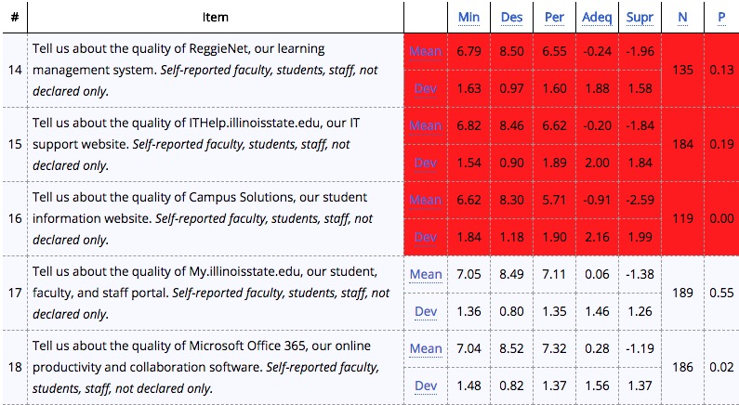
Quality of IT Services
Notes:
All respondents; outliers removed
Minimum Level of Service
Desired Level of Service
Perceived Service Quality
Adequacy Gap Score = perceived - minimum
p-value for H₀: Adequacy Gap Score = 0
Fail to Reject H₀ for questions
14. Gap = - 0.24 p = 0.13
15. Gap = - 0.20 p = 0.19
17. Gap = +0.06 p = 0.55

Slide 25
Final Question
What aspects of information technology services such as ReggieNet and Campus Solutions are most important to you? (Multiple Answer)
Ease of use | 79%
Stability | 77%
Feature set | 28%
Help available | 35%
None of the above | 6%

Slide 26
Sub-Group Analysis
2018 TechQual+ Survey Results

Slide 27
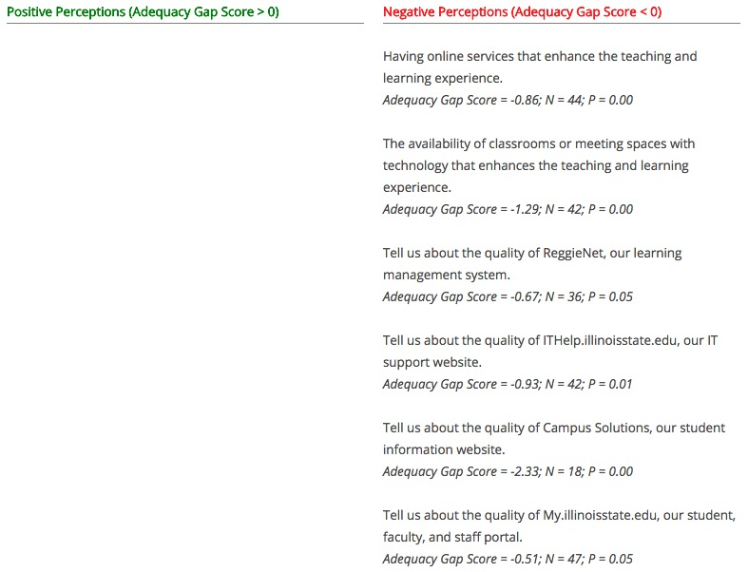
Faculty only
Notes:
Outliers removed
Significant at the 0.05 confidence level

Slide 28
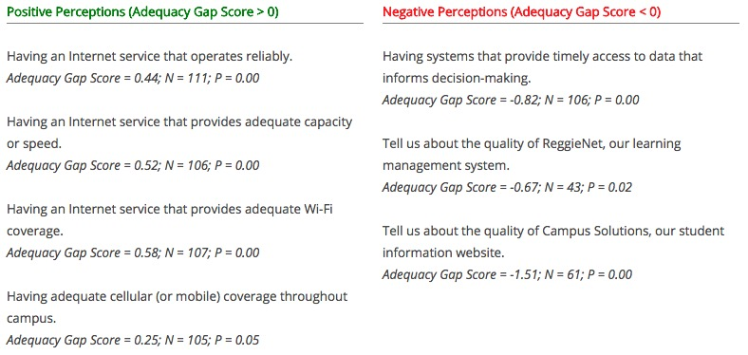
Staff only
Notes:
Outliers removed
Significant at the 0.05 confidence level

Slide 29
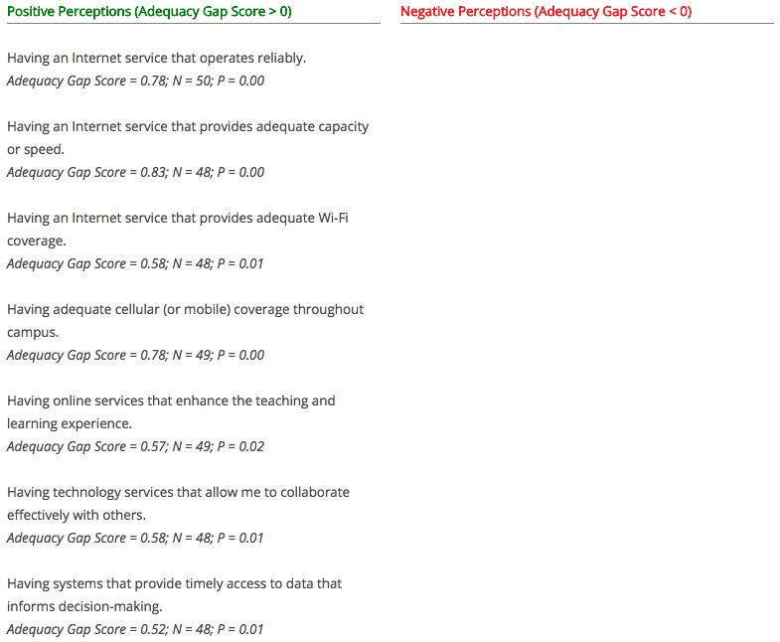
Students only
Notes:
Outliers removed
Significant at the 0.05 confidence level

Slide 30
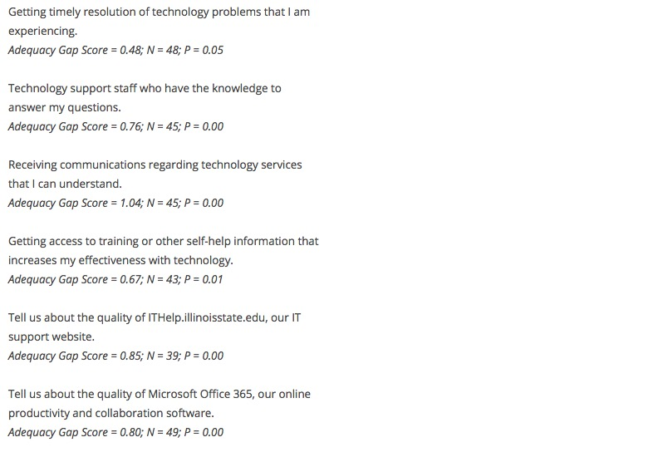
Students only (cont.)
Notes:
Outliers removed
Significant at the 0.05 confidence level

Slide 31
Peer Group Comparison Research Universities (low)
2018 TechQual+ Survey Results
Notes:
Outliers are NOT excluded from these responses…

Slide 32
Connectivity and Access Tell us about your ability to access technology services through the Internet
Notes:
Minimum Level of Service
Desired Level of Service
Perceived Service Quality
Adequacy Gap Score = perceived - minimum
p-value for H₀: Adequacy Gap Score = 0

Slide 33
Technology and Collaboration Services Tell us about the quality of Web sites, online services, and technologies for collaboration
Notes:
Minimum Level of Service
Desired Level of Service
Perceived Service Quality
Adequacy Gap Score = perceived - minimum
p-value for H₀: Adequacy Gap Score = 0

Slide 34
Support and Training Tell us about your experiences with those supporting your use of technology services
Notes:
Minimum Level of Service
Desired Level of Service
Perceived Service Quality
Adequacy Gap Score = perceived - minimum
p-value for H₀: Adequacy Gap Score = 0

Slide 35
2018 TechQual+ Survey Results
Suggestions
Notes:
Each of the standard questions includes option to make Suggestions.
Optional questions on the quality of Campus Solutions, ReggieNet, ITHelp.IllinoisState.edu, My.IllinoisState.edu and Office 365
A few reminders about these qualitative Suggestions…

Slide 36
Comments on the Suggestions
Some respondents clearly have cherished grudges on specific topics
Not all customer expectations are realistic
Some of the things respondents asked for already exist
As with any survey, feedback tends to be far more negative than positive – much more motivation there to respond
This year's theme appears to be navigation
Notes:
Each of the standard questions includes option to make Suggestions.
Optional questions on the quality of Campus Solutions, ReggieNet, ITHelp.IllinoisState.edu, My.IllinoisState.edu and Office 365
A few reminders about these qualitative Suggestions…

Slide 37
Suggestion Themes
Positive Comments
Campus Solutions
Cherwell/IT Help
Cognos
iPeople
ReggieNet
WiFi
Network Performance
Cellular Service
O365/Collaboration Tools
Learning Spaces
My.IllinoisState.edu
Web sites
Technology Training
Knowledgeable staff
Timely response
Access to Data
Site Navigation
UX/UI
Tech Alerts
Not current/modern
Nostalgia for Old Systems
Notes:
In reviewing the comments this year, many of the same themes from last year surfaced
A few new themes:
Access to data – There is a generalized concern about getting access to data – it is unavailable, too hard to get to, or not the way it used to be
Site navigation – the word “navigate” appeared so many times it begged its own theme. People seem to see this as a separate thing from their assessment of the same site’s interface… can I find the thing I need to do?
UX/UI – people really care about a system or site’s interface – this was a major theme last year and remains so this year. There were many comments about things that don’t work intuitively or take too many steps, or generally work in the way that seemed logical to the commenter.
Tech Alerts – Tech Alerts was namechecked a bit this year, mostly in the context of getting too many of them
Not current/modern – There seems to be a general perception that we are behind the market in some areas. There were also a number of comments that referred to systems or sites as “stuck in the 90s” or some version of that with different years.
Nostalgia for Old Systems – There were enough references to liking the way things worked in the “old system” that they warranted their own theme.

Slide 38
Notes:
Hard to read, but the number of comments assigned to each theme … these comments are not unique comments, as respondents didn’t always confine themselves to a single theme in a single response, so some comments counted in more than one theme. Top 3 – More technology training available, UX/UI, and Site Navigation

Slide 39
Notes:
For the themes that were tracked in both 2017 and 2018… a comparison between years of the comments on a single theme as a percentage of the total number of comments. As you can see, the percentage of comments attributed to Campus Solutions, Cherwell/IT Help, O365/Collaboration Tools, and More technology Training Available had a pretty good jump this year compared to 2017.

Slide 40
Reporting on Progress
itgovernance.IllinoisState.edu/survey
Notes:
When we released the 2018 TechQual survey, we put some effort into showing our work – what we had done so far to respond to the comments from the 2017 survey. The progress reports were organized by the same themes we tracked last year, and posted to a nice web site WEB put together off the IT governance site: itgovernance.illlinoisstate.edu/survey. Respondents to the 2018 survey were notified of the progress report in the email invitation to the 2018 survey.

Slide 41
Accentuate the Positive - Samples
I work in a lower level where students and faculty on some carriers have poor reception. That has definitely improved over the last couple of years.
Most websites, including the new ISU website are very easy to use and look modern. Most websites for the Colleges look good. Sites like My.Illinoisstate.edu work great and are easy to use.
Tech team responds to my questions/problems in a very timely manner. They are very, very polite, understanding, not condescending, and solve my problems.
I really like the Microsoft 365 platform and especially onedrive which my fellow students and I use all the time to collaborate on documents.

Slide 42
Accentuate the Positive - Takeaways
Several comments praising specific IT staff and/or IT teams – “my team is awesome!”
Some backhanded compliments – “some of the new tools are nice”
Recognition of improvement over time is important here, people are paying attention

Slide 43
Campus Solutions - Samples
It's clunky and requires users to go through a lot of screens, which takes longer - data is scattered and not particularly intuitive.
Can't get the information we need, which used to be available on the Mainframe.
It can be pretty slow and is not very intuitive for students ( or advisors). The process of registration is particularly poor.
Outages form CS/Oracle are still much too frequent, despite our complaints to Oracle.
The conversion from a mainframe SIS to Campus Solutions/data warehouse has caused our work to be substantially more difficult and has slowed our response time.
Notes:
For each of the themes that generated 20 or more suggestions, we will view a few sample responses, read through key takeaways from the suggestions as a whole on this theme, and take a look at the items listed in the progress report for this theme. There are, of course, many new things happening in all of these areas and we will have much more progress to report prior to the 2019 TechQual survey – you will hear about some of those at IT News and throughout the day today.

Slide 44
Campus Solutions - Takeaways
LEAP casts a long shadow – still some deep resentments about choices made in the process
General feeling of slow performance
Concerns/confusion over data access, particularly compared to past access
Interface frequently described as “clunky” or “not intuitive”
Navigation issues mentioned frequently as a separate issue from interface

Slide 45
Campus Solutions - Progress
Improved Class Roster functionality in My.IllinoisState.edu, including showing enrollment counts
Established focus groups including students, faculty and advisors to give input on new functionality – this group helped define the new home pages for Campus Solutions and quicker access to frequently used features
Completed an upgrade to Campus Solutions that included several mobile-friendly features and options
Completing a pilot of automated waitlist functionality for course registration for a select number of courses
Increased security for sensitive employee data
Integrated Appointment Manager into Campus Solutions and My.IllinoisState.edu
Added Health and Safety Tracking to iPeople

Slide 46
Cherwell/IT Help - Samples
The online knowledge base is not great. When searching for simple things, it seems to bring up irrelevant articles.
The ticket system is an unnecessarily complicated labyrinth that is very frustrating to use. Why can't I just make a call when I have a problem?
Just too hard to navigate and find quick keywords to help with problems.
UI is not good. Not easily searchable for topics I am looking for.
the ITHelp site has lots of information, but finding what you need is often complicated and time consuming.

Slide 47
Cherwell/IT Help - Takeaways
Search does not deliver expected Google-like results, and logging in to see knowledge are top frustrations
Knowledge base has good information, but they can't find what they need
Clunky interface, and difficult to find the right form to address a specific need
Some suggestions referred to frustrations with process, a feeling that the system does not allow them to get to the person/team they want to reach, or in the preferred manner (email, phone, etc.)

Slide 48
Cherwell/IT Help - Progress
Conducted a survey specific to ITHelp.IllinoisState.edu, which provided additional points of feedback to act upon
Completed interim design changes to ITHelp.IllinoisState.edu, making it easier to submit issues and find the technology information you need
Completed an upgrade to the software behind ITHelp.IllinoisState.edu, which makes possible a redesign and interface improvements coming in 2018

Slide 49
ReggieNet - Samples
It works so much better since you outsourced it. But it falls way short of the other LMSs out there like Canvas and Blackboard. All the "open " systems are problematic when it comes to being creative and flexible.
not nearly as easy to use as Black Board
ReggieNet has a failure rate that is too high for a university of this size. It is always interesting when you give an online exam. You never know if the system will be able to handle all the questions.
Much better than in the past but we still have issues. It's difficult to trouble shoot student issues as we can't see what they see.
More guides or more accessible guides on how to do things on Reggienet as both a teacher and student would be helpful.

Slide 50
ReggieNet - Takeaways
Lot of suggestions with some variation of "it's improved, but..."
Perception that there are better LMS platforms we should be using persists, as do reports of "random crashes"
Many suggestions about the ReggieNet gradebook – both pro and con
Several suggestions around more training/help available
Some confusion with My Illinois State

Slide 51
ReggieNet - Progress
Major updates to ReggieNet will now happen only between semesters
The Gradebook tool was updated, with more features and a more modern layout
Improved Turning point clicker functionality
ReggieNet home page now displays outage information and can automatically enable alternate login options
Increased the session timeout to allow more time before session end
Completed enhancements to increase accessibility for the visually impaired
Updated ReggieNet documentation and video to help faculty navigate the interface
Links to ReggieNet course sites are now available in My.IllinoisState.edu
Improved the grade import process to Campus Solutions
Support staff are taking an active role in the nationwide community of software developers behind ReggieNet, advocating for changes requested by ISU faculty
Working with faculty to test the upgrades to understand the usability of the system
Improving communication to faculty and students by adding more lead time to produce documentations and engage in outreach
Improved testing process for updates to ReggieNet, to increase stability and reliability of the system

Slide 52
WiFi - Samples
My WiFi is constantly giving out when I’m around campus. It’s best when I am in my dorm. But walking around the quad it is constantly going in and out. Very poor connection and quality
More access to wifi outdoors
Having to log on is a nuisance, so I turn it off and use cellular instead, especially a nuisance in Redbird Arena, where I believe it should be open access.
The campus WiFi network works very well most of the time, but there are days where my laptop cannot get a signal abruptly, which lasts up to a few hours. I suggest that the campus WiFi be as well maintained as the wired connections to the campus computers, which are always on.
Certain buildings have some dead spots and I get kicked off sometimes.

Slide 53
WiFi - Takeaways
Reports of WiFi being "spotty" or "inconsistent"
Device connection issues mentioned but WiFi considered the problem
Expectation of WiFi everywhere, and frustration when it is not available outdoors or between buildings
Confusion with cellular connections
General feeling that more capacity is needed

Slide 54
Network, WiFi & Cellular - Progress
Implemented an easier way for students in the residence halls to register all of their devices to campus wireless (e.g., Roku)
Added outdoor wireless access on the Quad, Tri-Towers, and Redbird Activity Center
Increased wireless access for CFA
Currently working with several carriers to improve cellular coverage for the campus community

Slide 55
O365/Collaboration Tools - Samples
I generally like OneDrive and it has made some things very much easier. The online versions of Word and Excel are also excellent additions. it is hard for students to get to OneDrive sometimes. They seem to have trouble finding how to get in and see the shared folders.
A lot of clicks to get to where you want. Slow response time. Some of the new tools are nice.
Would be helpful to supply trainings prior to upgrading windows and office suites. Still do not know how to effectively use Office 365.
Microsoft Teams and Zoom are examples that we are heading in the right direction here. I appreciate those that promote the proper use of the tools and how productive staff can be if they are used right.
Office 365 is available but the staff and faculty all use google docs.

Slide 56
O365/Collaboration Tools - Takeaways
A lot of comparison to the Google suite, and assertion that faculty, staff and students prefer to use it
Suggestions that there was no communication or training provided with the Office 365 rollout persist
Many suggestions centered around Teams, both a feeling that it has gotten out of control and that more should be encouraged to use it
Concerns about interface, reports of slowness, and difficulties sharing within Office 365

Slide 57
O365/Collaboration Tools - Progress
Office 365 is a dynamic site and new applications are added regularly – since last year, new applications include Video, To-Do, Groups and Teams
Launched a new media hosting service for faculty, easily linking video from the Office 365 Video app to their ReggieNet courses
Piloted Groups and Teams in Office 365, two new and powerful communication/collaboration tools
Certified OneDrive web-based document storage for all University data except Highly Restricted data – OneDrive storage may be accessed from anywhere
Zoom web conferencing software was made more widely available

Slide 58
Learning Spaces - Samples
The problem with the "tech" in a lot of these rooms is that the low-tech items like furniture are major barriers to instruction. There needs to be a way for instructors who facilitate technology-rich learning environments to request certain learning spaces
More private study spaces would be helpful, or more of the "lounge" or "restaurant" style seating found on the 3rd floor of the library would be beneficial
We still have some classrooms with old technology that doesn't work consistently
Most meeting spaces are unreliable when it comes to technology. I need more reliable systems in all parts of the university, not just classrooms.
Skype and Zoom accounts should be provided every faculty member and should be available in every classroom so that students and guest speakers can be brought into the class from remote locations

Slide 59
Learning Spaces - Takeaways
Everything, everywhere – a feeling that all rooms should be outfitted with hardware and software for collaboration and all should have access
Many suggestions around the need for flexible spaces, and the limitations physical elements of a learning space can place on the experience
Conference rooms frequently included in this category
Feeling that some classrooms are outdated, in need of upgrade
Need for more spaces for student study and collaboration

Slide 60
Learning Spaces - Progress
Conducting a pilot test of wireless screen sharing in classrooms – if the pilot goes well faculty will be able to request this feature just as they request software installations or clickers
All managed classroom interfaces were upgraded in FY18 and are now the same everywhere, including a marked mute button
Three collaborative classrooms were created, in a pod arrangement that allows teams of up to 5 students each work together as a group, using technology to collaborate with each other and the instructor

Slide 61
My Illinois State - Samples
Probably the only major application on campus that actually works.
Making improvements, but it was much better before CS
Overall good. Sometimes it's hard to find things.
My ilstu is VERY confusing when it comes to registering for classes, and again not very intuitive in terms of user experience. I would also get confused between My ilstu and Go ilstu, and then ReggieNet... it would be nice if there were just one website for everything as a student.
PUT EVERYTHING HERE! THEY GET IT. IT WORKS. YES, I'M THIS PASSIONATE ABOUT IT. MY IS THE SOLUTION.

Slide 62
My Illinois State - Takeaways
It's a portal – people get confused about what is My and what is something that links through My
Several comments about how My used to be better, in the mainframe days
Many suggestions around difficulty finding things and confusing organization
Some suggestions around focusing on faculty/staff resources in My

Slide 63
My Illinois State - Progress
Launched a new version of My.IllinoisState.edu, including many new features:
Quick Links section for easy access to high profile resources like Office 365 and ReggieNet
Dropdown navigation menus for easy access to frequently used features by category
A more personal view and layout for resources based on who you are
Student Class Schedules prominently displayed for easy access
Courses I Teach for faculty and instructors, including the much requested feature of student photos
Calendar View to Class Schedule and Courses I Teach
A new version of the popular GPA Calculator module
Academic Program information (Majors, Minors, etc.) added to Class Rosters for faculty
Detailed Textbook information for students
Personalized notifications about Holds, Tasks and To Do Lists for students
Registration Date and time notification to prepare students for semester registration periods
Easy links to change personal information like Address and Preferred name in the My Profile section
Added personalized password expiration notifications to help campus complete the Account Refresh password reset process
Implemented banner announcements for Account Refresh and other major notifications
Implemented Midterm Grades improvements with 40,000 grades submitted and 20,00 student progress reports per semester
Provided final grades with more than 12,000 pageviews in [time frame], including more than half of the views from mobile devices

Slide 64
Web Sites - Samples
Most of our prospective student facing websites (IllinoisState.edu, departmental websites, etc) are excellent and far exceed my minimum level of service.
Since the recent change I find it more confusing to navigate. I liked having the A-Z selection at the top. Easy that way. Overall, I think it takes longer to find what you're looking for.
Some ISU Web sites are easy to navigate whereas others are not.
Standardize and provide support to making all departments look and feel the same. Currently you can see differences going from one department to the next.

Slide 65
Web Sites - Takeaways
Many suggestions centered around concerns with navigation after the redesign of the homepage, and particularly the A-Z search
General suggestions about departmental web sites – a feeling that they should be standardized and have a similar look and feel across the University as well as concern over resources to make that happen
Several suggestions about commonly used things moving or being difficult to find from faculty/staff, suggesting a disconnect between how they want to use a web site and what is available on some sites

Slide 66
Web Sites - Progress
Launched a user-centric and prospective audience focused University Homepage
New homepage serves as a platform to strengthen recruitment and enrollment initiatives
Incorporated old Admissions website into the new modern design of the homepage to tailor content for prospective students and families
An intelligent search was added to highlight and promote ISU’s unique Academic Programs
Completed a major effort to revamp Milner Library’s website with major redesigns for Collections and Exhibits
Launched recruitment focused websites for Agriculture and Technology Departments
Transitioned 200+ websites to a modern and secure server infrastructure

Slide 67
Technology Training - Samples
I feel that services may exist that aren't communicated to the ISU community as effectively as they could be. I think that department leadership should help to supply some of that content to their staff.
The challenge here is finding out what we have available to us and what services are free to us as faculty and what services we need to find funding for
It would be nice to have a whole semester schedule for training up front and reminders along the way. It is hard to know what classes are only being offered once.
365 has been implemented without adequate training or preparation.
Having workshops or training videos on software programs available to students would be helpful. It is hard to use the programs effectively and efficiently when you are not familiar with how to use it or the features it has.
It's really hard to find articles to try to learn to fix things myself. I realize it's helpful to submit a ticket with the exact issue, but the options don't always match the problem.
Access to on demand training in a more organized context sensitive way.

Slide 68
Technology Training - Takeaways
Many suggestions about not knowing what training is available
Several different forms of training were mentioned – self-help articles, on-demand training, video and classroom training
Some applications were mentioned specifically as needing more training available
Frequent mention of difficulty in finding self-service articles through IT Help
Some feeling that there should be training for more advanced users

Slide 69
Technology Training - Progress
Published over 60 new knowledge base articles to help you use campus technology, in addition to new videos and classroom training
Installed additional digital signs in campus computer lab spaces, promoting technology information resources available to help you
Launched a new mobile app for #ISUITHelp, including handy links to computer labs, mobile printing, phishing alerts, and more
IT Marketing team created several campus awareness campaigns targeted at important IT issues such as security.
In the planning stages for a campus IT communications group that will be used to facilitate communications regarding IT services as well as solicit feedback to improve existing or needed services.
Notes:
Some of the progress items were listed as communication & outreach, which seemed to blend with training as a topic this year

Slide 70
Access to Data - Samples
I wish I had a bit more flexibility with getting reports from the student information system using Cognos without having to rely on someone else to build the reports for me.
Accessing financial information is cumbersome. It takes a blend of Datatel, Budget Wizard, and departmental level spreadsheets to know where yous stand. And that's if you know how to use all those tools. Current balance information is not readily available.
Need access to data and reports to do my work well. Takes a long time to receive data and everything requires a ticket. Why??
Most data is so secure that people who need the data to make decisions cannot access it and have to rely on other people who do not have the same priorities to gain that data. Consider opening up data that has been collected to all that could use it or need it to make informed decisions.

Slide 71
Access to Data - Takeaways
General feeling that getting access to data is a slow and cumbersome process
Concerns about who owns data and the process to use data owned by more than one role
Financial systems data in particular considered difficult to consolidate from multiple systems
Frustration that data needed for decisions is not available

Slide 72
Access to Data - Progress
Created 25 new reports that contain the most highly requested data, such as Graduation Applicants, Degrees Awarded by Term and Advisor Case Load
Additional data has been made available, including Advisor Assignment, GPA, Term Statistics, Degrees, Graduation Application, Real Time Registration activities
The business intelligence software, Cognos, was upgraded to Cognos Analytics - provides an easier user interface and additional features such as Dashboards and subscribing and scheduling reports
Reduced requirements for training prior to access - to one training class focused on data security, Cognos Analytics fundamentals and available data and reports
Implemented a Data Dictionary to store and distribute definitions and examples for each element in a report
Updated the Data.IllinoisState.Edu website to include descriptions of all of the reports that are available along with the definitions for each of the elements in those reports
Produced monthly communications aimed at addressing known issues and sharing the new report offerings that are available
Increased training offerings and provided focused training for departments and user groups, such as Advisor Day
An Information Governance program which will ensure standards are applied to data access requests and delivery methods is being developed
The EDA team has been realigned with Administrative Technologies, allowing for more consistent handling of enterprise data requests
Notes:
Note: these were reported as Business Intelligence progress items, although "access to data" is a broader category of suggestions not only about Cognos

Slide 73
Knowledgeable IT Staff - Samples
Usually if I'm relying on tech support staff to help me with a technology question, it's because I wasn't able to find the answer or fix the problem myself. So, for me personally, it's important that the tech support staff are highly knowledgeable and resourceful when I come to them for answers.
Most tech support staff are very helpful and friendly. They genuinely try to diagnose the problem and get it fixed.
Sometimes staff can't answer the questions or claim the issue is resolved when it really isn't
I often get bumped to another person (phone and email)
Usually all staff are very knowledgeable.

Slide 74
Knowledgeable IT Staff - Takeaways
Customers can easily feel not listened to, particularly when they believe they know what is causing their issue
Resolution can mean different things to IT and to the customer
Wide range of knowledge reported among IT staff
Student staff in general not as trusted as full-time staff

Slide 75
Timely Response - Samples
It is frustrating to have to call into the Technology Support Center to ask my question when I know level-1 support is not going to have the ability to do so. It would be handy to have the ability to call some It departments directly.
Most of the time, the fulltime staff members are VERY helpful and are quick to answer questions, but there are some areas that only a few individuals are well-trained, so answers do not come quickly. And, some of the staff members are NOT people friendly.
Seems like first line staff keep up with tickets very well. Other units haven't seemed to kept the same vigor which causes us to go back to emailing and calling people directly. [#2767411]
It is not always clear who at ISU is responsible for helping with a particular technological issue. Some issues go to our local IT, some go to ISU's AT.
The IT employee who helps us is wonderful...clone him! He can't keep up with demand.

Slide 76
Timely Response - Takeaways
Many suggestions centered around a concern with getting their issue to the right person or team
Frustration with different levels of IT and not knowing where to go for which issues
Many suggestions praising specific IT teams or individuals for great service
Customers have noted the variability in the time it takes to get certain issues resolved

Slide 77
Knowledgeable IT Staff/ Timely Response - Progress
Completed many additions and improvements to the software behind ITHelp.IllinoisState.edu, which enable ISU IT staff able to respond faster to your technology issues
Resolved over 60,000 technology issues and requests - 49% of them were resolved within one day and 90% were resolved by their due date

Slide 78
Nostalgia for Old Systems - Samples
I think the updated system for registration and having links take you to a bunch of different webpages is awful. The way it was before, probably in 2013/14 when I first started here was far better and easy to navigate. All of the information was in one place and easy to find.
The conversion from a mainframe SIS to Campus Solutions/data warehouse has caused our work to be substantially more difficult and has slowed our response time.
The old IT help site was more friendly
Campus Solutions is cumbersome to use and what used to take 3 steps in the past now takes 10. It is not an efficient use of time or resources.
The new website has advisors take much longer to access information we need such as minor/major plans of study and the university catalog.

Slide 79
Nostalgia for Old Systems - Takeaways
Feeling that the "old way" was better, and they knew how that worked
Some association with vendor products here, and a feeling that the University has made some bad choices
These comments came up generally in suggestions about Campus Solutions, Cherwell/IT Help, ReggieNet, My Illinois State, and the ISU home page

Slide 80
Site Navigation - Samples
I only use it occasionally. It seems like when I do, I'm re-teaching myself every time. And if I need to find some information slightly different than what I need, it's not easy to find my way around to do that.
Slow and clunky. Hard to navigate. Often buttons that lead to cul-de-sacs.
Help desk website is not intuitive navigation.
The ISU website experience seems quite disjointed. The only way I can find everything is by Googling what I am looking for with the term "ilstu" afterward. Navigating from within our system is not a smooth process
Reggienet is not easy to use. Many of the university websites have a variety of links that are similar in name and content and are confusing. It is hard to find a specific page with a specific piece of information on a topic when there are four or five pages about that topic

Slide 81
Site Navigation - Takeaways
"Navigate", "navigation", "can't find", some variation on this theme appeared over and over in suggestions
It doesn't appear to be completely about resistance to change
Appears to be particularly frustrating when looking for "internal" information
Most frequent appearances came in combination with CS, ReggieNet, Cherwell/IT Help, My Illinois State, web sites in general and the ISU home page.

Slide 82
UX/UI - Samples
I am consistently amazed at how hard this site is to use, find information, and complete course registration.
I hate it beyond imagination. Things are twice as hard/cumbersome.
UI is not good. Not easily searchable for topics I am looking for.
Campus Solutions is very slow and not user friendly. The UX/UI is not reflective of the user.
Though this system has improved over the years, some faculty still find it clunky and hard to use. As we integrate more and more technology into our classes, it is going to be critical that we have a platform that is easier to use (fewer steps for simple functions, integration with publisher content, a more attractive "face."

Slide 83
UX/UI - Takeaways
Navigation clearly an aspect of UX/UI, but customers mentioned them separately often
Suggestions included words like "clunky", "bulky", "not user-friendly", or even directly citing user interface or user experience
Some pretty strong feelings are present in some suggestions regarding specific applications

Slide 84
Not current/modern - Samples
Reggienet is ok, the staff that support that do what they can but it is clear that we did not make the right choice there. Faculty know all too well that Sakai as a platform has been losing ground to other solutions and IT leaders don't seem to be concerned about that. Clearly we are providing a tool for teaching and learning that checks the box but it is mediocre compared to what other Universities offer.
Students have more experience with collaborating with Google Docs and Google Classroom in this area. Learning a new platform (outlook and microsoft) seems to be difficult for some students.
ReggieNet feels like it is straight out of 1992. It is not user-friendly. I've figured it out, but it could be so much easier. Also, when it crashes on the first day of class... Bad things happen! (outlook and microsoft) seems to be difficult for some students.
Need renovated and updated flexible spaces!
Unfortunately, it's built on a 1980s Oracle framework. I would like better, more understandable user interfaces with much better organization and navigation.

Slide 85
Not current/modern - Takeaways
Perception that ISU systems are in need of updating, are not modern, or that we are not using the best product
Frequent citing of "interface from 1994" (years vary) as a way of describing an unattractive or dated user interface
Suggestions stated with assurance, as if it is something "everyone knows"

Slide 86
Questions or Feedback?

