Slide 2
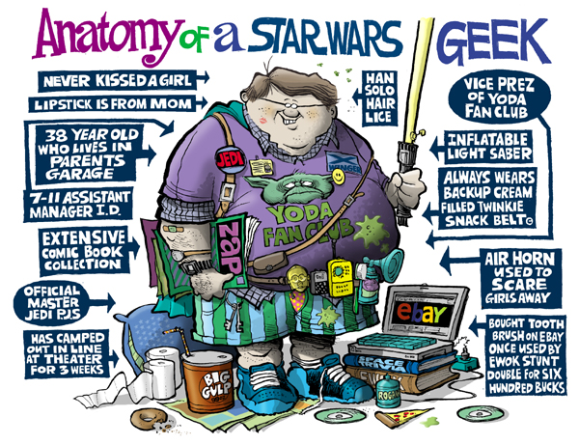
What is Our SW Geek Baseline?

Slide 3
A Little Bit About Me
I am not “The Star Wars Kid”.

Slide 4
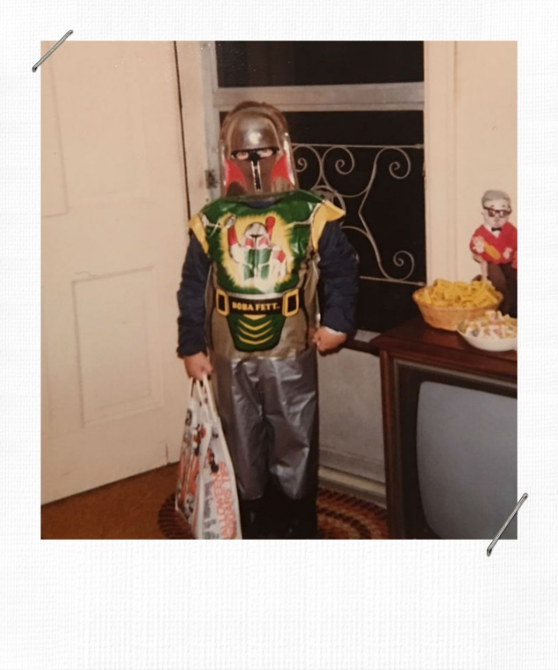
A Little Bit About Me
I was a Star Wars kid in the 70s.

Slide 5
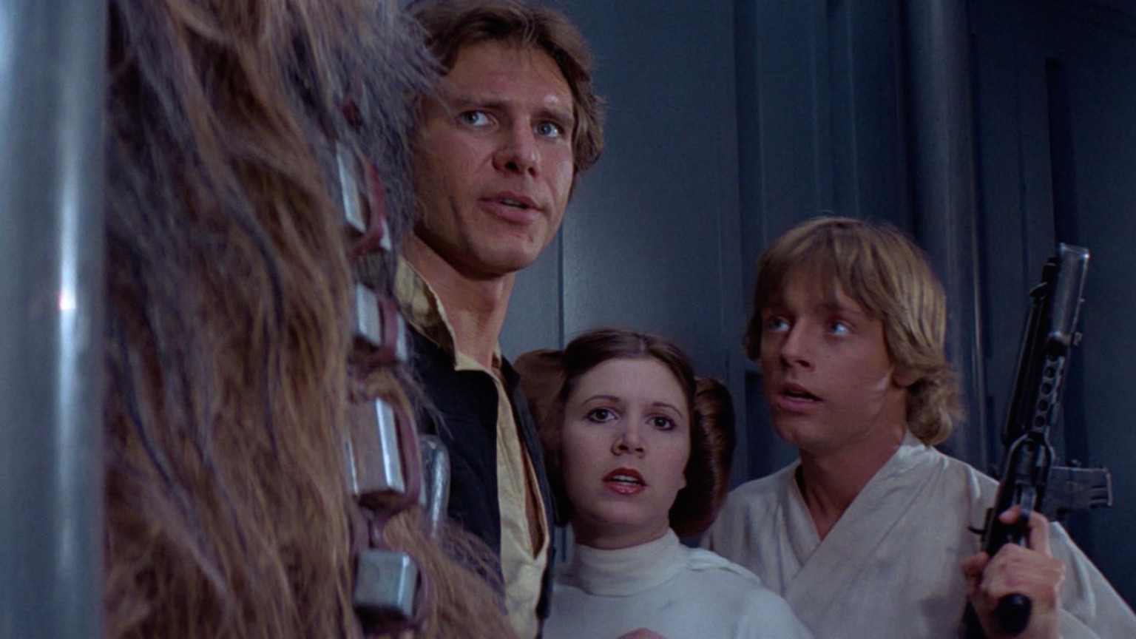
Not These Guys. Yet.
These are not the Rebels we are looking for.

Slide 6
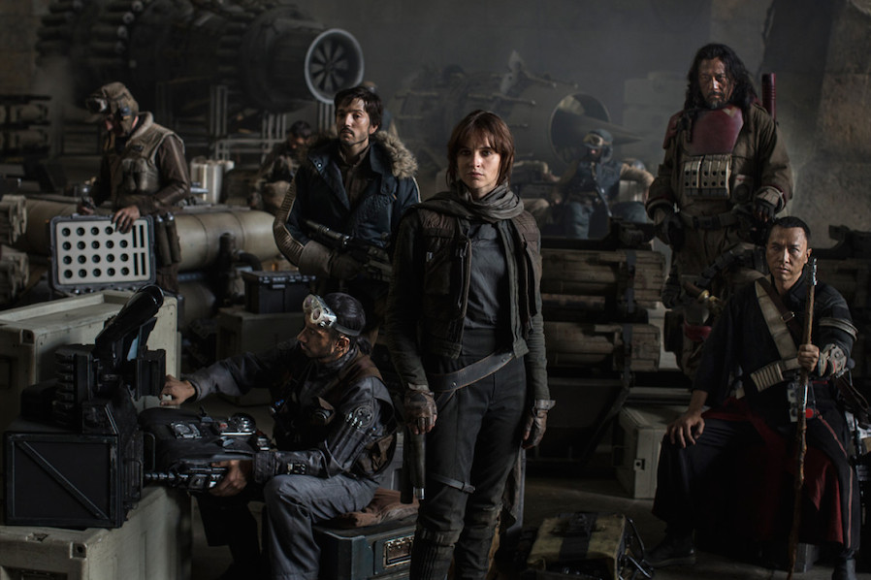
These Guys
The daughter of an Imperial scientist joins the Rebel Alliance in a risky move to steal the Death Star plans.

Slide 7
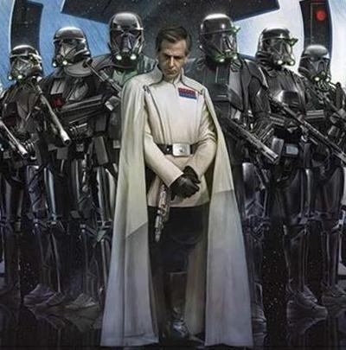
And This Guy
The Death Star Project is behind schedule and some project choices have introduced risks that go unrecognized.

Slide 8
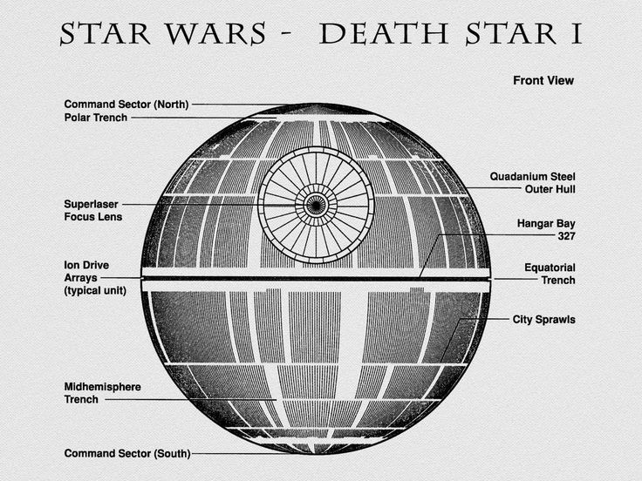
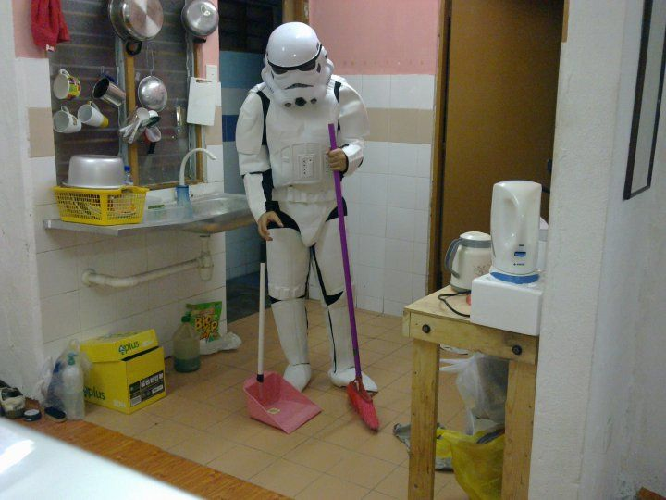
And the Biggest Project Ever
Construction Timeframe: 20 years
Cost: $852,000,000,000,000,000
Crew: Up to 1 Million

Slide 9
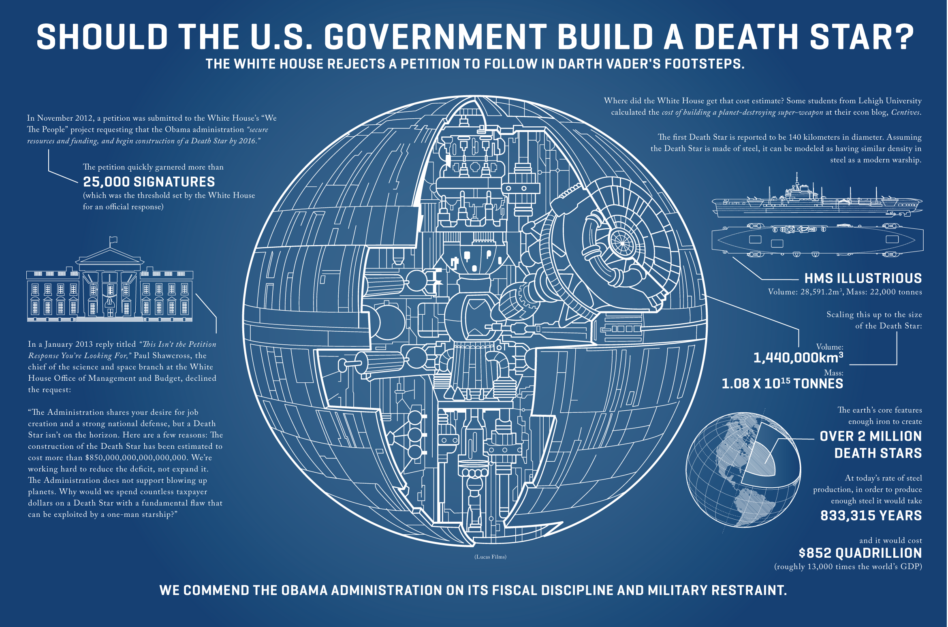
So Big It Needs Two Slides

Slide 10
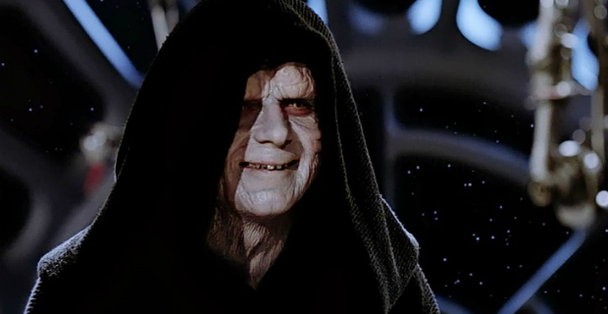
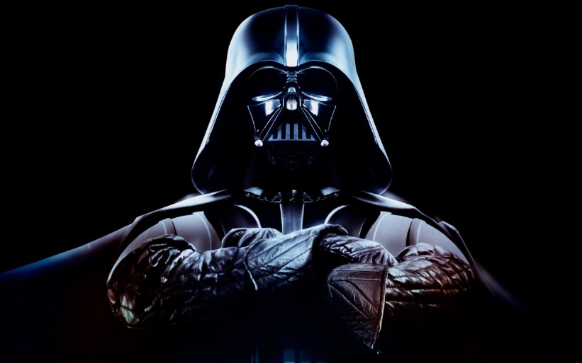
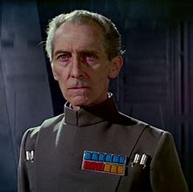
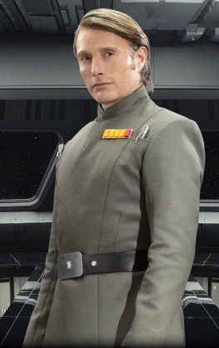
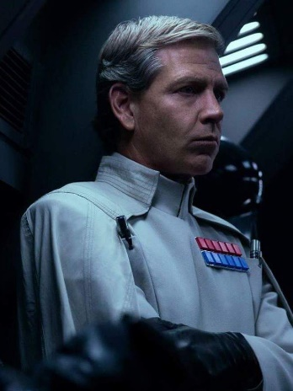
The Baddest Project Team Ever
Executive Sponsor: Emperor Palpatine
Project Leads: Grand Moff Tarkin, Darth Vader
Project Manager: Director Orson Krennic
Lead Scientist/Engineer: Galen Erso

Slide 11
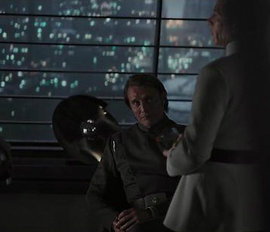
Remember Those After Hours?
Galen Erso and Orson Krennic in friendlier times.

Slide 12
A Challenged Working Relationship
The project is behind due to Galen’s absence.
Krennic resorts to the wrong kind of force.

Slide 13
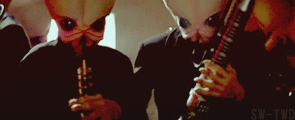
A Productive Working Relationship
Build Trust and Mutual Respect
Practice “Responsible Mindfulness”
Communicate Openly and Honestly

Slide 14
The Danger of the “Ego Risk”
The Death Star passes QA and Krennic is
ready to celebrate himself.

Slide 15
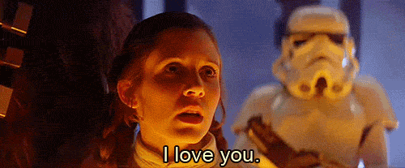
Checking Your Galactic Ego
Replace Talk and Hype with Action
Eliminate Pride to Enhance Relationships
Replace Passion with Purpose and Direction

Slide 16
Holy Sith! This Project Needs Help.
Desperate for validation, Krennic seeks affirmation from Project Lead Darth Vader.

Slide 17
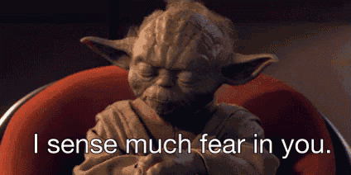
Getting the Help the Project Needs
Keep Requests Focused on the Project
Cover all Options Before Seeking Assistance
Specify the Assistance the Project Needs

Slide 18
How the Empire Celebrates?
Alerted to the security risk he created in Galen, Krennic decides to “congratulate” the team.

Slide 19
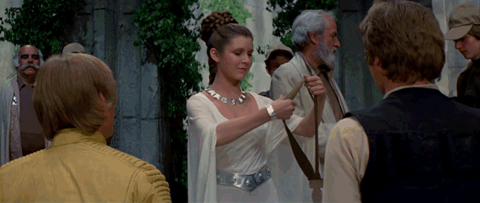
Better Ways to Reward the Team
Connect the Effort to the Project Objectives
Try to Combine Formal and Informal Rewards
Share Accomplishments with Supervisors

Slide 20
What We Learned
Krennic’s desperation to complete the Death Star Project, poor relationship with crucial team members, and misplaced aspirations created security risks that ultimately doomed the project.

Slide 21
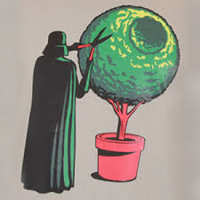
Discussion
Share Your Near Death Star Experience

