Slide 1
Email: isucit@illinoisstate.edu
#ISUCIT

Slide 2
Welcome to CIT 2018
6th Annual
Sponsors: AT, OAT, SAIT, TechZone, and COB
Suggestion Box
After Event at the Pub II
CITnow series has 2 sessions in the works
CITx in the Fall……session ideas?
#ISUCIT

Slide 3
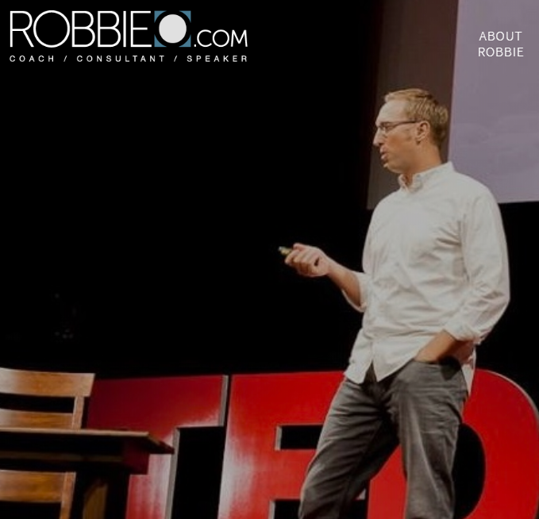
CIT 2018 - Keynote
Robbie Osenga
www.robbieo.com
#ISUCIT

Slide 4
CIT 2018 – MVP Award
Nominees
Tony Brook
Chris Johnson
Bart Lytel
#ISUCIT

Slide 5
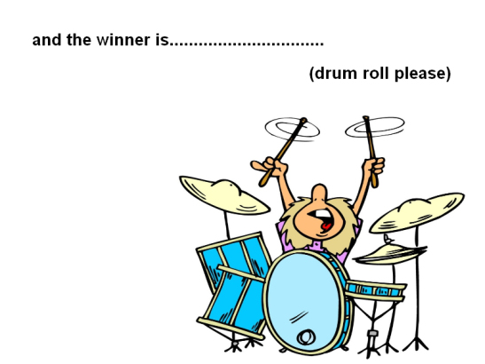
CIT 2018 – MVP Award
#ISUCIT

Slide 6
CIT 2018 – MVP Award

Slide 7
Center for Teaching Learning and Technology
Claire Lamonica
Director
#ISUCIT

Slide 8
STUDIO GLASS

Slide 9
STUDIO GLASS
Available at CTLT by appointment (contact Greg Maier)
Length of time using the system is roughly the time of the lecture (renders as it records)
Basic video editing available
Final result will be on a flash drive as an MP4 video file
Wear solid neutral colors if possible. Any writing on clothing will appear reversed in video.

Slide 10
AT - ION
Craig Jackson
Director
#ISUCIT

Slide 11
ION Update
Operational Excellence
Data Center Upgrades
Authentication Upgrade
Wireless Upgrade
AD Domain Upgrade
DNS/DHCP Upgrade

Slide 12
ION Update
Enhancing User Experience
Outdoor Wireless
Zoom
SSO’s
Students in the Global Address List

Slide 13
AT – Client Services
Carla Birckelbaw
Director
#ISUCIT

Slide 14
ITSM Project Complete
Change Management
Incident Management
Knowledge Management
Service Level Management
Problem Management
Release & Deployment Management
Request Fulfillment
Service Asset & Configuration Management
Notes:
With the release of the Change and Release record in July, the ITSM project has completed its final deliverable!
This has been quite a journey as we worked to change our IT culture – we moved from a place where we had two different ticket tracking tools that couldn’t talk to each other and not all teams were tracking their incidents… to a place where we now track activity in 8 ITIL processes and all teams use the same tool, in a common configuration that we continuously improve
By far the biggest success of this project was the way we worked together as a campus to develop common processes and use the same tool to track all of our service management activity on behalf of our customers and the University – a collaboration that continues now and into the future

Slide 15
ITSM Stats
184,584 incidents
2,945 changes
95 problems
3,272 knowledge articles
271 loaner items
1,196 loan reservations
76 contracts
10,708 CIs
27,662 tasks
67 vendors
138 projects
Notes:
If anyone wants to do know what IT does all day, they can take a look here… here’s all of the work you have recorded so far in the various Cherwell record types
This is an impressive body of work, and on behalf of the ITSM Advisory Group and the Campus-Wide ITSM Implementation Group, I’d like to…

Slide 16
ITSM Project Complete
Thank You
Notes:
Thank you for being willing to collaborate and change processes for the greater good
Thank you for being flexible and learning new things along with all of the other things you do every day
Thank you for seeing the value in recording our work in an ITSM tool, and
Thank you in advance for the continuing maturity we will enjoy as we improve our ITSM processes and the use of the information in our ITSM tool into the future

Slide 17
But wait, there’s more…
Service Request simplification
New version of the IT Help portal
Review of classifications
Single Sign On
New dashboards and metrics
Notes:
Next steps for ITSM…
All of our service request forms have been reviewed by a working group and the ITSM Advisory Group this summer - we know that customers find it difficult to find the right form in the IT Help portal and sometimes IT staff do too. So, using data on usage over the past year we will be reducing the number of request forms visible to customers from around 50 to 20 regular forms with input required and 8 that require only the description box. Many forms/subcategories are being cut altogether in both the portal and the clients. There will be a lot of specific communication around that when the changes are made live.
A working group has been evaluating feedback and options for improvement in the next version of the IT Help portal. They will be issuing a set of recommendations soon for a project starting this Fall – I can tell you at this point that the recommendations will include unauthenticated access to knowledge articles, a single, simple form for reporting incidents, and incorporation of other web sites.
This Fall, we will be reviewing the classification system in Cherwell – service, category, subcategory - and determining what changes need to be made there – where are people confused, which ones aren’t we using, what do we need to add
Single Sign On will be available for the IT Help portal and Cherwell web client soon, hopefully before Fall startup.
A new Extended My Work dashboard will be available soon for staff that work in several areas each day and need to see them all together – tracking incidents, changes, problems, and tasks on a single screen
And we will continue to work with all the data we have in Cherwell to tell IT’s story – for example, we released this with the TechQual survey this year in the progress report: IT resolved 60,000 issues and requests in the past year. That is an impressive number, but what does it really mean? Add to it that 49% of those were resolved within 1 day of request, and 90% resolved by their due date and you are telling a story about how quickly we respond to customers on a regular basis.

Slide 18
CIT 2018
CIT MVP Awards
Full-Time Award - $1,000, August CIT
Student Award - $500, April CITx
Put towards professional development
Thanks to Charley, Mark, and Rob for the support
#ISUCIT

Slide 19
CIT 2018
Student CIT MVP Award
Anyone can nominate a Student Tech
Been a Student Tech
Eligible to win once every 4 years
https://cit.illinoisstate.edu/awards/
#ISUCIT

Slide 20
Student Tech Support
David Greenfield
Director
#ISUCIT

Slide 21
University-Funded Software for 2018-19
Adobe!!!
about.illinoisState.edu/Adobe
User Licenses: Faculty, Staff, Graduate Assistants
Campus Labs/Classrooms (Univ computers):
Photoshop, Illustrator, InDesign, Acrobat &
Premier (as space allows)

Slide 22
University-Funded Software for 2018-19
Microsoft Campus Agreement
Current negotiation for next term
Sept 1, 2018
“A3” suite

Slide 23
University-Funded Software for 2018-19
Statistical Programs
SPSS (Base and Modeler)
No Tables or Forecasting
SAS
Mathmatica
MiniTab

Slide 24
Ongoing University coordinated/
Unit-Funded Software
Guidebook/ISU app (per event)
AirWatch (semi-yearly to June 1 & Jan 1)

Slide 26
10/15/18

Slide 27
Academic Technology
Mark Walbert
Associate Vice President
#ISUCIT

Slide 28
2018 TechQual+ Survey Results
Mark Walbert
Notes:
Higher Education TechQual+ Project @ University of Georgia [ https://www.techqual.org ]
Started in 2006, based on SERVQual and, later, LibQual+ methodology
Survey out on 4/16 to all F/S/S in survey pool for three weeks. Reminder sent on 4/23…
2018 Survey had the lowest response rate yet…
2013 — 329 completed the survey (56% of attempts)
2017 — 625 completed the survey (58% of attempts)
2018 — 223 completed the survey (43% of attempts)

Slide 29
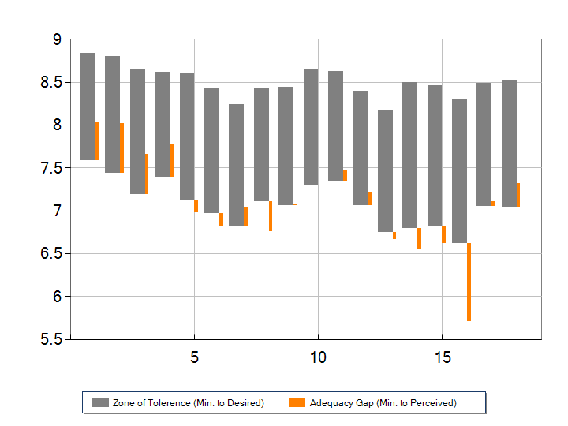
Response Zones
Notes:
Gray bar Orange bar
Top = Desired service level Rises if Perceived > Minimum
Bottom = Minimum service level Falls if Perceived < Minimum

Slide 30
Response Zone Analysis
Six service levels exceed the minimum expected:
Having an internet service that:
…operates reliably (Adequacy gap score = +0.44)
…provides adequate capacity or speed (+0.58)
…provides adequate WiFi coverage (+0.48)
Having adequate cellular … coverage throughout campus (+0.38)
Having technology services that allow me to collaborate effectively with others. (+0.22)
…quality of Microsoft Office 365, our online productivity and collaboration software. (+0.28)
Notes:
In the 2017 Survey, the Adequacy Gap Scores were:
1. +0.15 — Nearly 3 times higher this year!
2. +0.28 — Just over double this year!
3. +0.01 — Enormous improvement this year!
4. +0.15 — More than doubled this year!
7. -0.14 — Switched from below min. to above min.! (though not statistically significant last year)
18. New question for 2018

Slide 31
Response Zone Analysis
Two service levels are below the minimum expected:
Having systems the provide timely access to data that informs decision making (-0.35)
…quality of Campus Solutions, our student information website (-0.91)
Notes:
In the 2017 Survey, the Adequacy Gaps were:
5. -0.68 — Only about half as bad this year!
16. New question for 2018. Adequacy Gap is about as bad as possible…

Slide 32
Milner Library
Paul Unsbee
Director, Milner Library IT Services
#ISUCIT

Slide 33
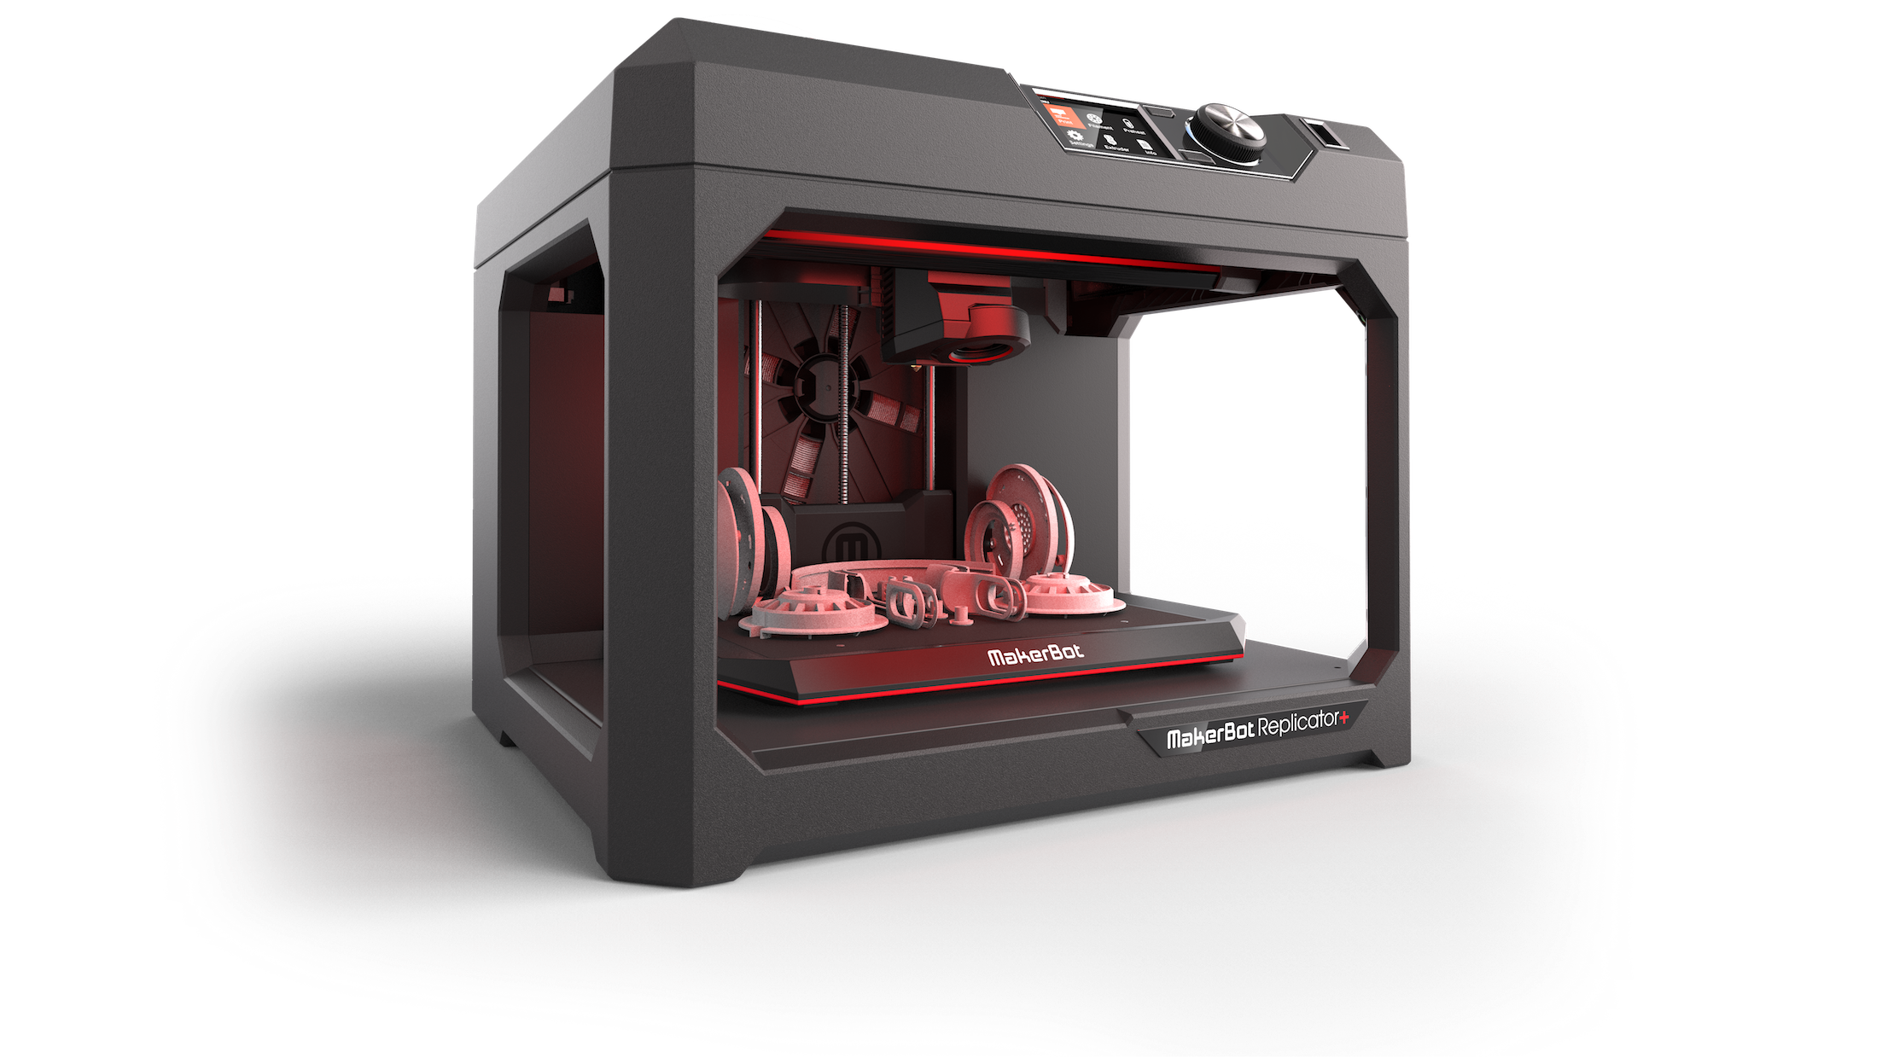
3D Printing Pilot Update

Slide 34
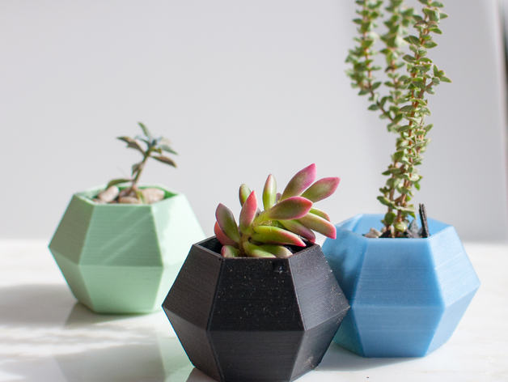
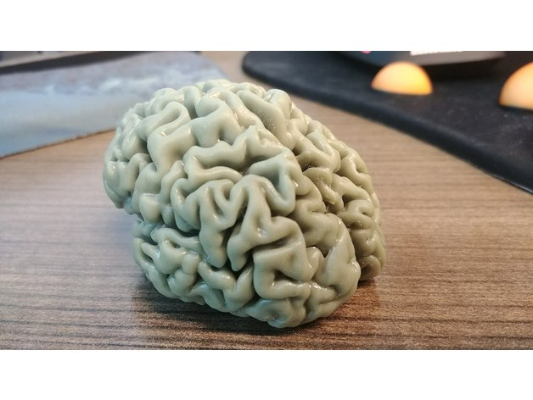
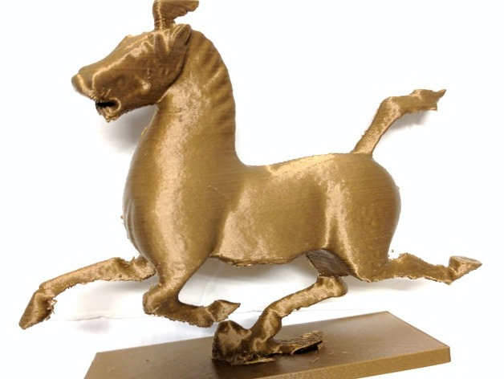
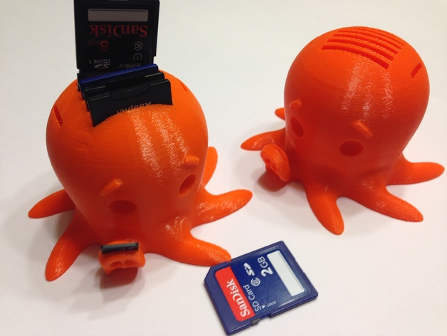
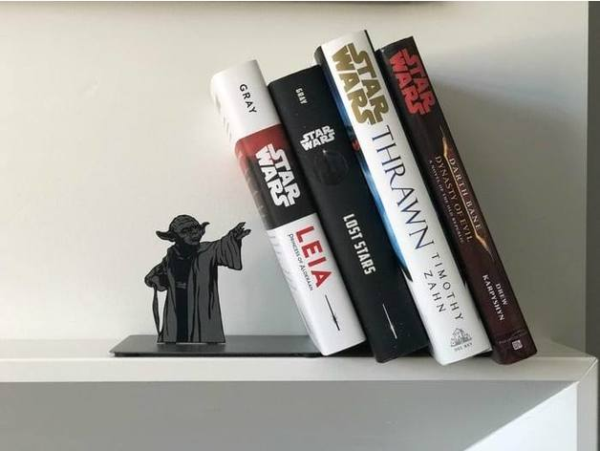
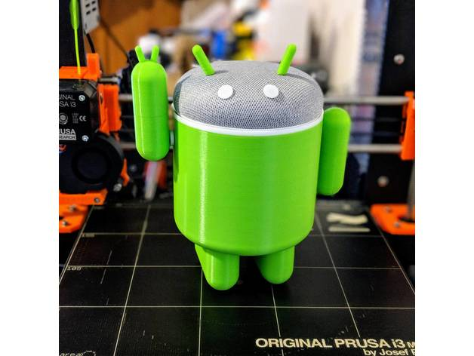
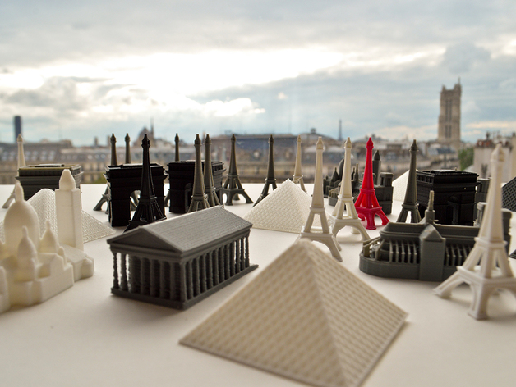
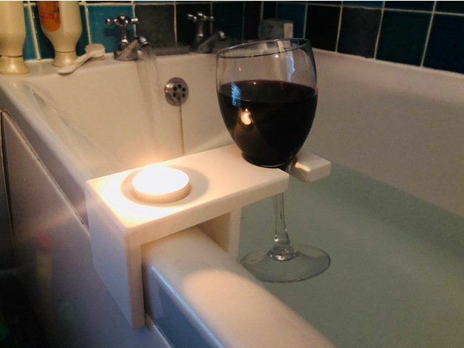
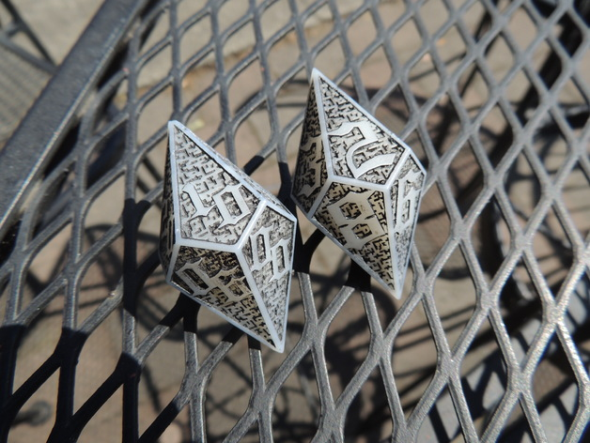
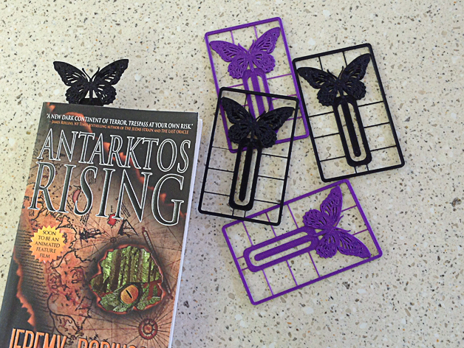
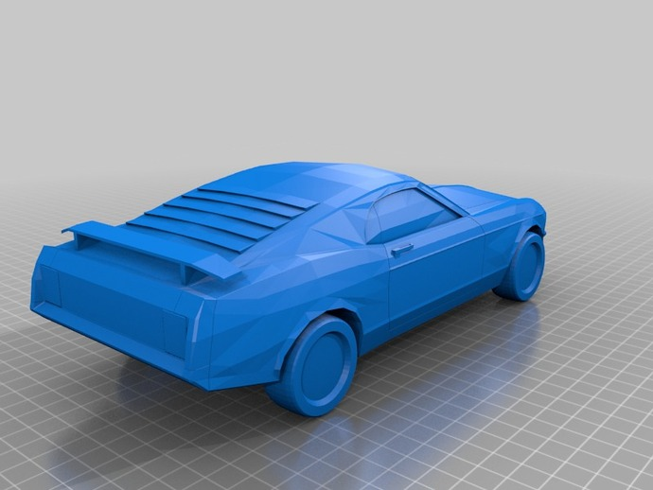
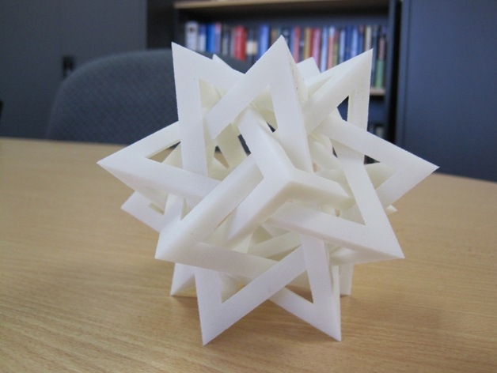
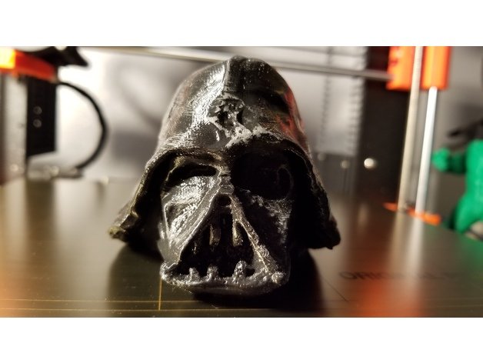
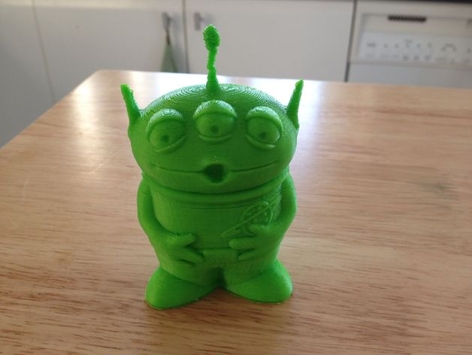
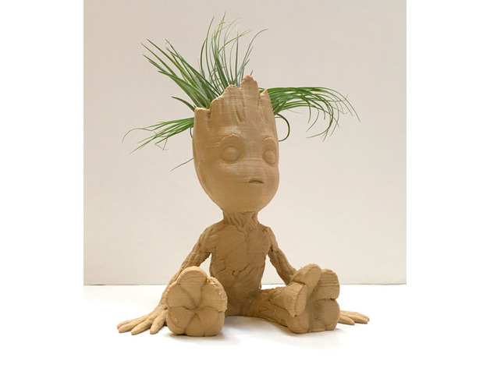
Over 62 Served!

Slide 35
Thank You!
Improved our submission form
Better understanding of expected print error/jams
Lower than expected!
Averaged 2 prints per working day

Slide 36
August 20th Launch
Dedicated service page on Milner Library site
Highlighted on Milner homepage and Facebook
3D Printer and Display Case Patron Facing!

Slide 37
New & Improved at Milner

Slide 38
Milner uLab.Next
One Location for Win & Mac Multimedia Editing Computers
iMacs & Dell Precisions with Ultrawide Monitors!
College of Business Lab Computers
Other colleges encouraged to participate
Makerspace/Pre-service Teaching Equipment
Self-service Laminator
Ellison Die Cutter w/ Die Cuts
Paper cutter
Button Maker

Slide 39
Duplex and Color uPrint
First color public uPrint queues on campus!
Color and B&W Duplex printing available at all 2nd floor printing locations.
Goal is to standardize on Color and Duplex printing at all Milner printing locations after FY19.
New uPrint student installer to include a new Color uPrint Queue.

Slide 40
AT - ISO
Kevin Crouse
Director
#ISUCIT

Slide 41
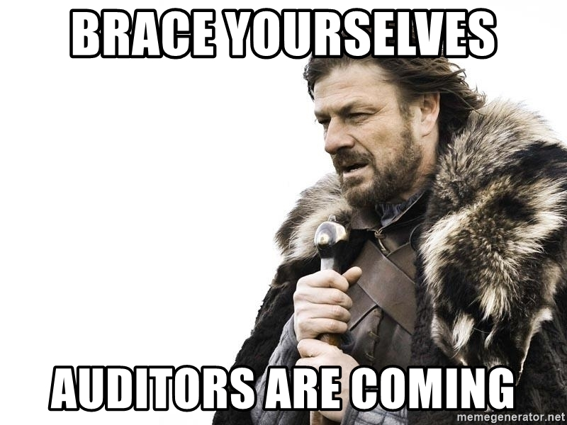
Audits and External Auditors
August….sometime…

Slide 42
Apps/WEB
Ryan Christie
#ISUCIT

Slide 43
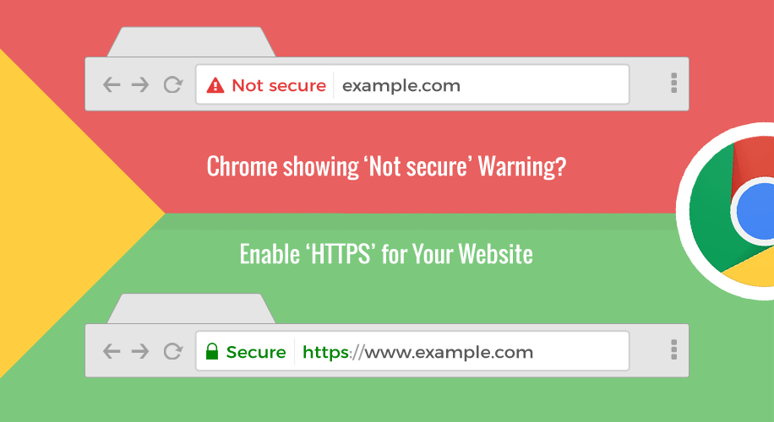
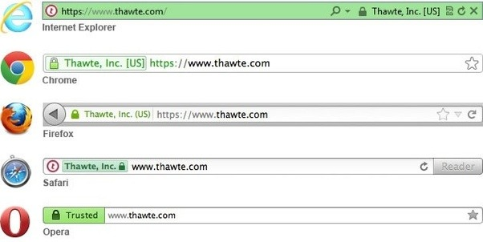
New Web Infrastructure
HTTPS
All (~100) OU Managed sites
Handful Remain

Slide 44
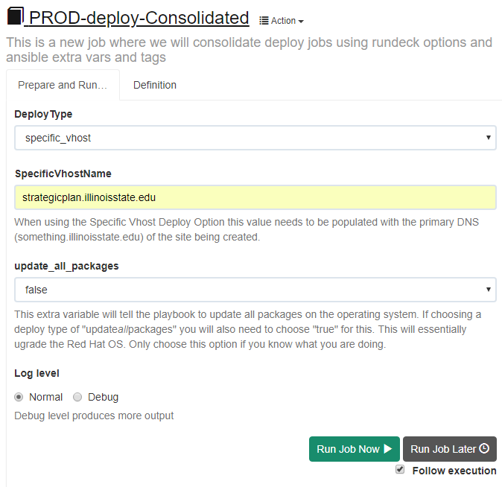
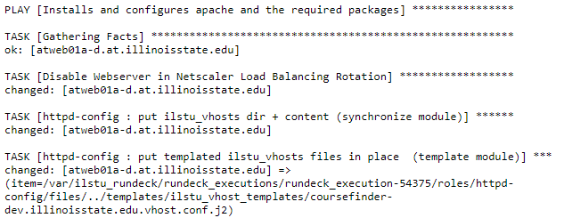
New Web Infrastructure

Slide 45
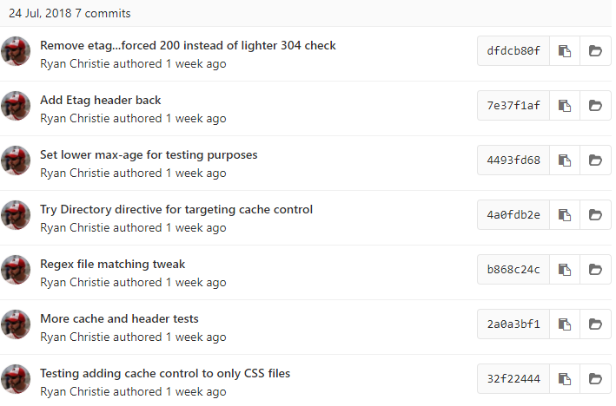
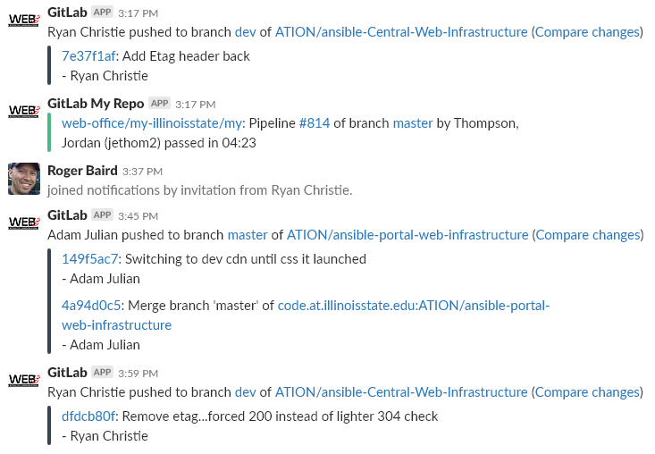

Slide 46
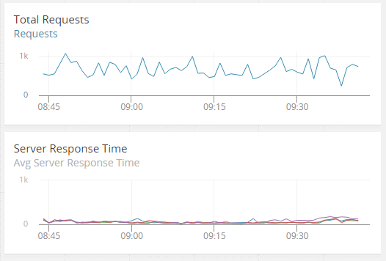
New Web Infrastructure

Slide 47
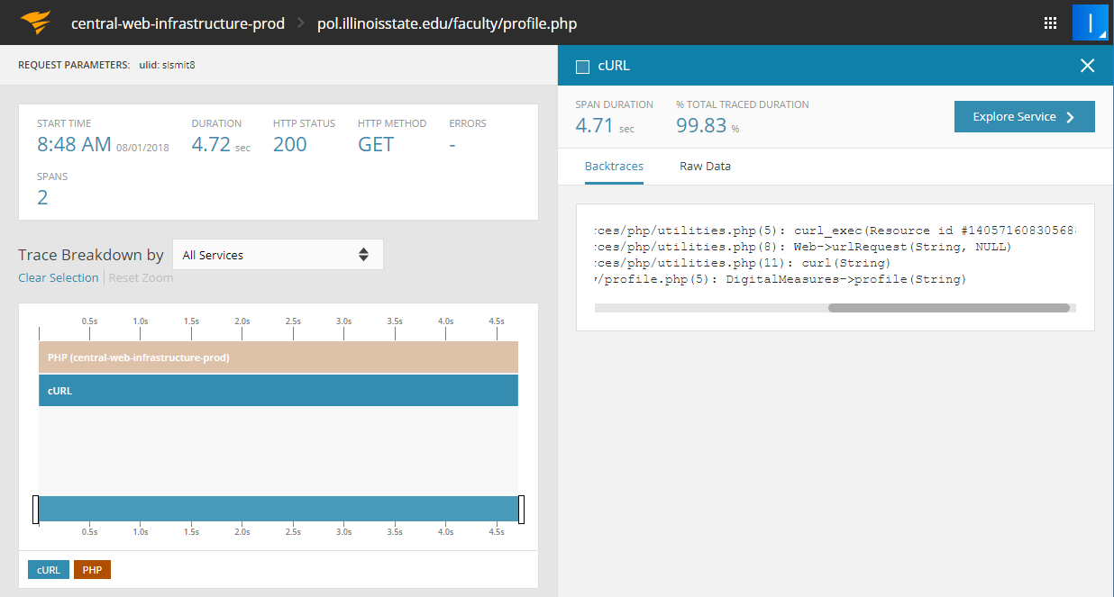
Application Performance Monitoring

Slide 48
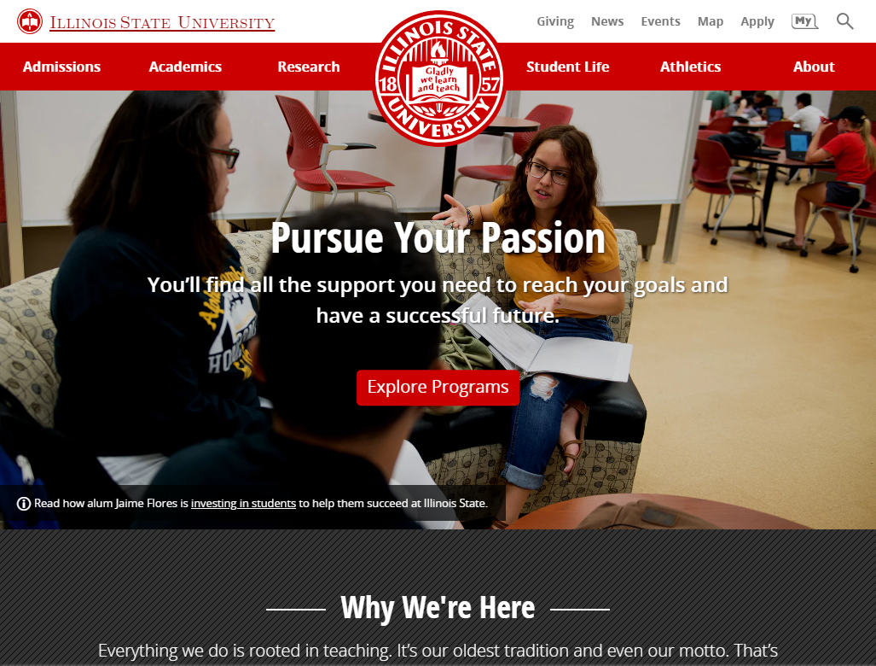
Homepage and next template
Increased prospective student focus
More visual and fast loading
Admissions NOW part of the homepage
Evaluating adding additional prospective focused sites
New v4 template coming soon
Borrowing from homepage and MY
Full width / highly visual
New content architecture strategy

Slide 49
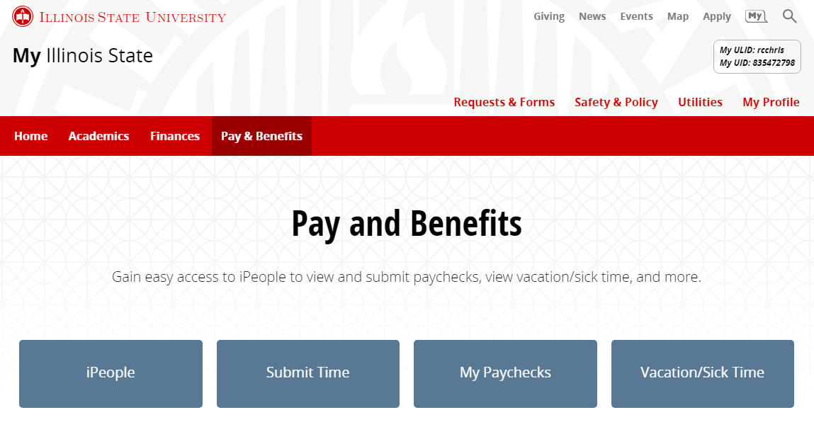
New MY

Slide 50
MY Stack

Slide 51
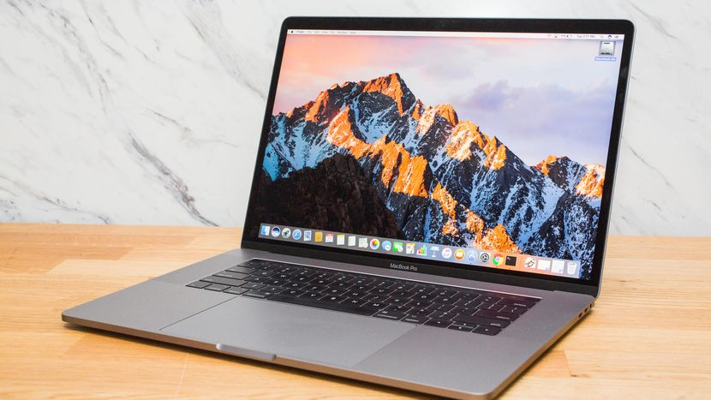
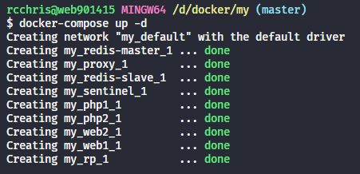
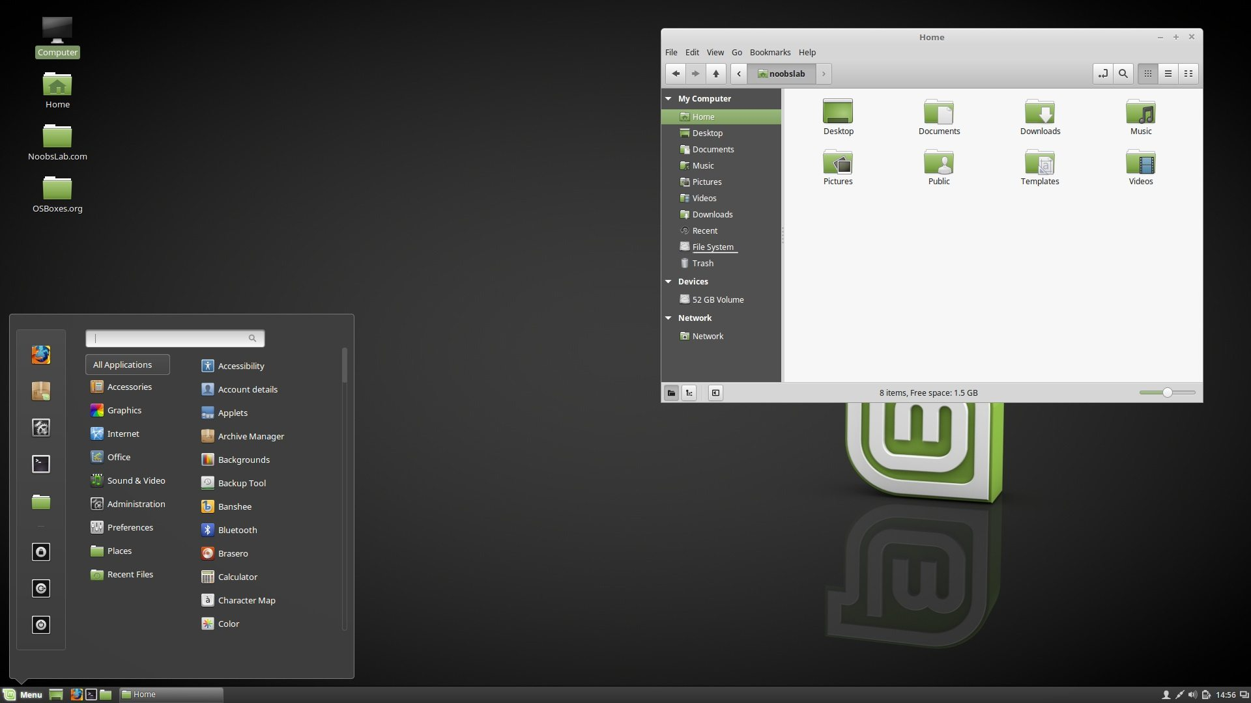
New Tech and Collaboration

Slide 52
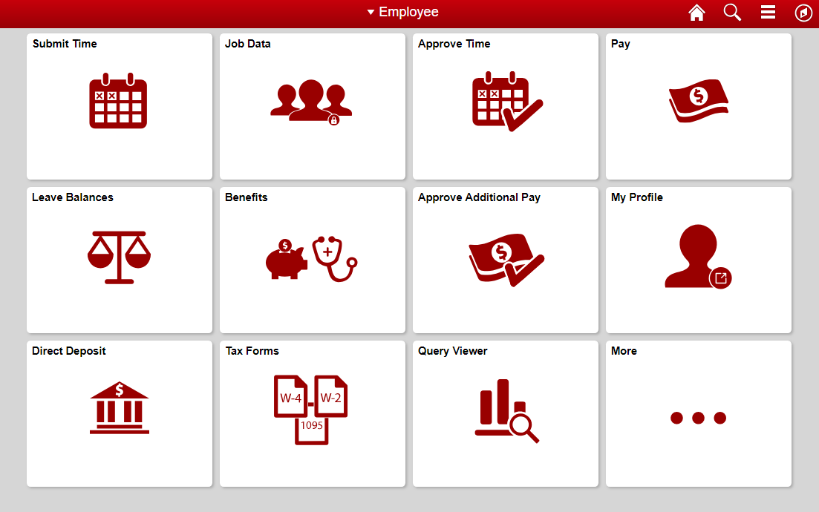
iPeople & Campus Solutions
Fluid tiles
Better My integration
New customizations
Academic Advisor experience in CS changed

Slide 53
Reggienet
Recently upgraded
Now with more
May have some anomalies…put in tickets
Looking for feedback

Slide 54
Campus OneCard Solution
Fun fact: Today there are several ID variants in use
Working with Facilities and the Card Office and Office of Identify and Access Management to plan a future One Card (1 ID) Solution
Further standardizing all ID cards issued on campus and how they can and should be used
Today there are a bunch of ID variants

Slide 55
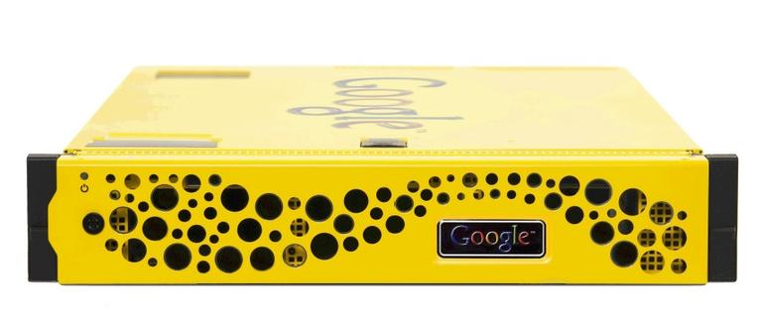
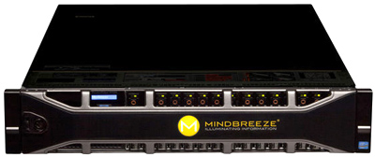
Coming Soon

Slide 56
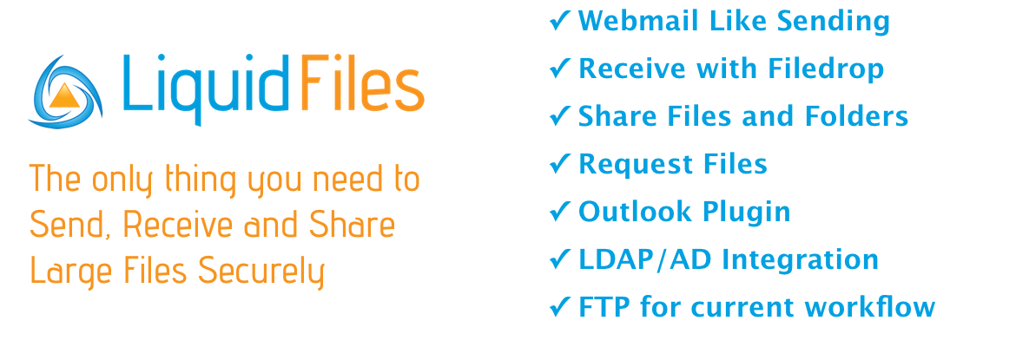
Coming Soon

Slide 57
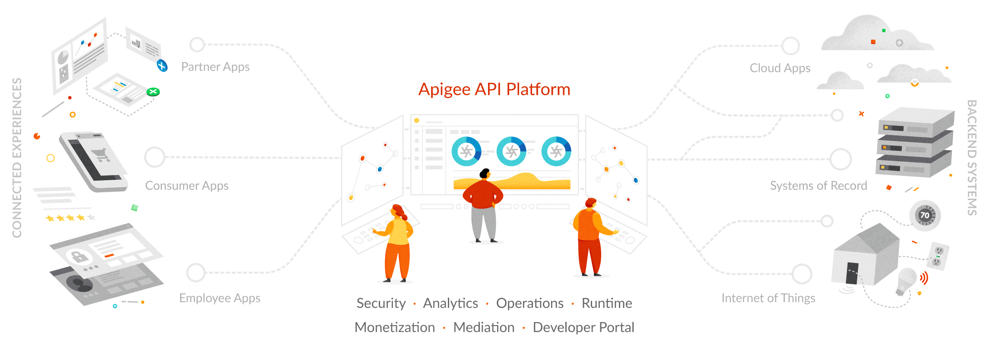
Coming Soon

Slide 58
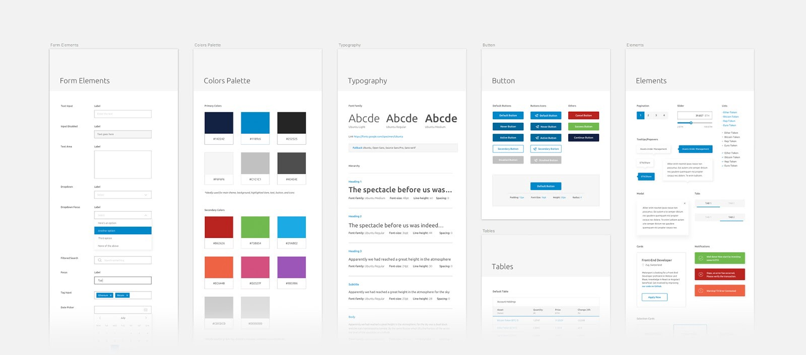
Pattern Library and Styleguide

Slide 59
CIT 2018
Thank you to the
CIT Planning Group
Carla, Paul, Jeff, Liam, Tyler, Bill, and I
#ISUCIT

Slide 60
CIT 2018
Thank you for coming
Would you like to join the CIT Planning Group?
Now, go have lunch…….
Email: isucit@illinoisstate.edu
#ISUCIT

Slide 61
Email: isucit@illinoisstate.edu
#ISUCIT

