Slide 2
Hardware Security: Keeping Drivers and Firmware Updated Jason Ross

Slide 3
Agenda
Why Do You Want to Manage Drivers and Firmware?
Utilities & Process
Driver Deployment Scenarios with SCCM
Reporting
Demo

Slide 4
Why do you Want to Manage Drivers?
Vulnerabilities (Ex: Spectre & Meltdown)
Applications that require latest drivers (Ex: Adobe Creative Cloud)
Security Compliance
Driver Packs don’t cut it!!

Slide 5
Process Overview
1. Create a Driver Repository(s)
2. Configure Installation Utility(s) to Install Drivers From Repository
3. Integrate Installation Utility(s) Into SCCM Task Sequence(s)

Slide 6
Driver Management Utilities
Creating a Repository
Installing Drivers from Repository
Lenovo Thin Installer
Lenovo System Update
ThinkVantage Update Retriever
Dell Repository Manager
Dell Command | Update

Slide 7
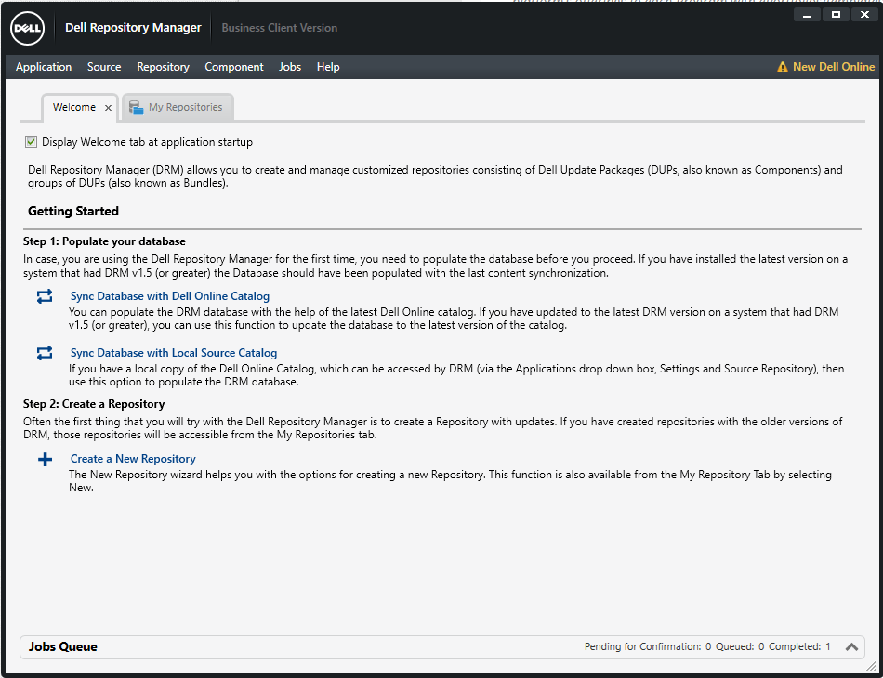
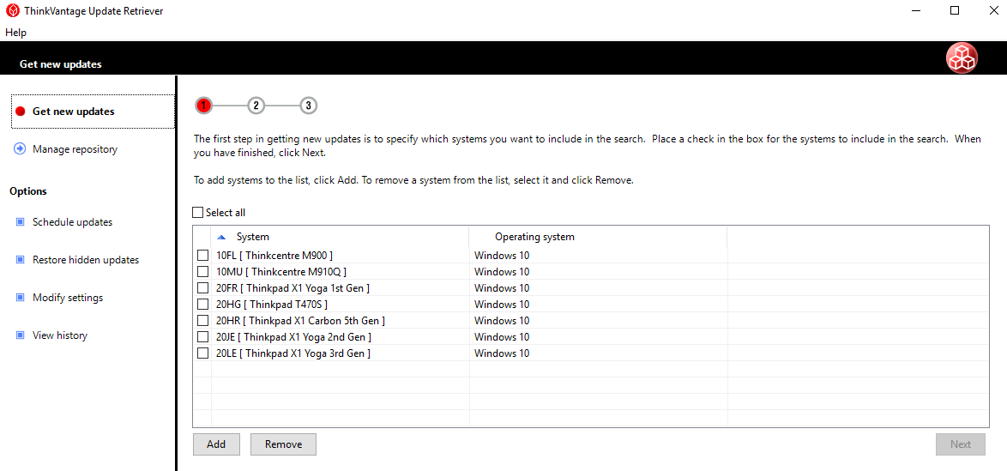
Driver Repository
Dell Repository Manager
ThinkVantage Update Retriever

Slide 8
Driver Deployment Scenarios with SCCM
1. Task Sequence to update drivers during OS build
2. Task Sequence to update drivers during upgrade of OS
3. Task Sequence to update drivers on a machine already built (has an OS and is in SCCM)

Slide 9
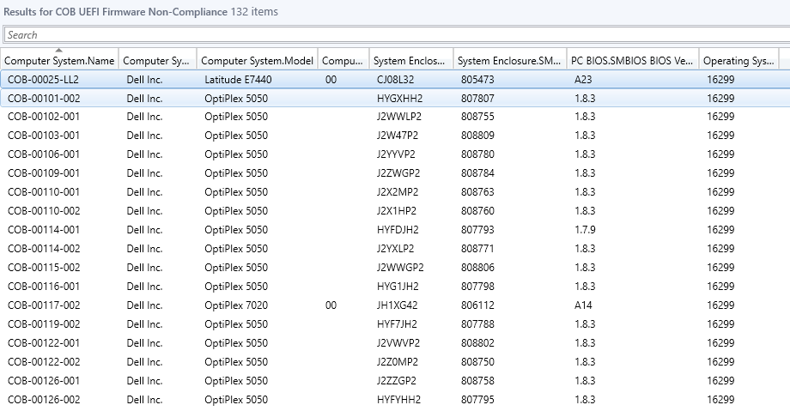
Reporting: SCCM Queries

Slide 10
Where Do I Find Documentation?
COB SCCM Documentation: Microsoft Teams->SCCM->COB SCCM Documentation
Dell: COB - Dell Drivers ,BIOS and Firmware Management
Lenovo: COB - Lenovo Drivers ,BIOS and Firmware Management

Slide 11
DEMO TIME!!!!!!!!!!

