Slide 2
Preventing SkyNet (and other threats) with ConfigMgr's Configuration Items
Shawn Esterman
Jim Johnson
Administrative Technologies

Slide 3
TABLE OF CONTENTS
About the presenters
Definitions
Why are configuration items great for security?
Configuration Items
Configuration Settings
Configuration Baselines
Deploying
Reporting
Additional Resources

Slide 4
ABOUT THE PRESENTERS
Work at AT Endpoint Support
Windows System Administrators
Administrators of
Configuration Manager
AirWatch
MBAM
Pharos
LabStats
ScreenConnect

Slide 5
Definitions
Let’s go over the terms you need to know

Slide 6
DEFINITIONS
Configuration Item (CI) | Used to determine compliance for settings for a configuration you define.
Configuration Setting | Part of a Configuration Item that verifies information on the device. Types of settings include Active Directory, Assembly, File System, IIS metabase, Registry Key, Registry Value, script, SQL Query, WQL Query, and XPath query.
Compliance Rules | Part of a Configuration Item that determines if the result of a configuration setting is compliant.
Configuration Baseline (CB) | Contains one or more Configuration Items, Configuration Baselines, or Software Updates that can be deployed to device collections.

Slide 7
Why are Configuration Items Great For Security?

Slide 8
CONFIGURATION ITEMS AND SECURITY
Configuration Items can be used to monitor your environment
Configuration Items can be used to remediate you’re your issues
CBs and CIs have versioning built in
Configuration Baselines can contain 1 or more CI to define configurations
Deploying CBs allows for easier testing than that of Group Policy
Reporting features in Configuration Manager are arguably better than that of Group Policy

Slide 9
Configuration Items
ABOUT

Slide 10
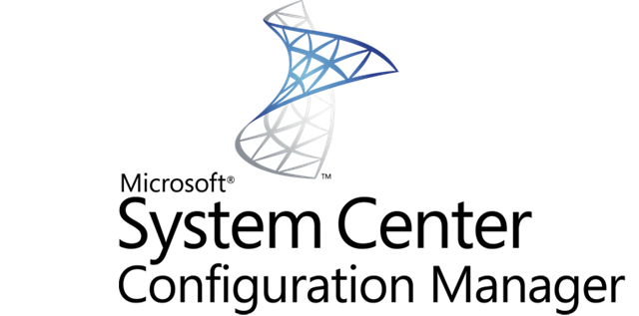
CONFIGURATION ITEM STARTER PACK

Slide 11
CONFIGURATION ITEM (CI)
Contains Configuration Settings to get information
Contains Compliance Rules to determine if those settings are correct
Allows you to configure remediation
Assets and Compliance / Compliance Settings / Configuration Items

Slide 12
CONFIGURATION ITEMS
CREATING

Slide 13
DESCRIBING THE CI
CONFIGURATION ITEM WIZARD
STEPS
Click the Create Configuration Item button
Specify a name and description
Specify the type of CI
Add any categories
Click Next
TIPS
Be descriptive, it helps in the reports
Tag your CIs if you plan on having various CIs for various configurations
Assets and Compliance / Compliance Settings / Configuration Items / Create Configuration Item Wizard

Slide 14
SETTING YOUR SCOPE
Specify versions of Windows you want to run against.
This allows you to have different configurations for Windows 10, Windows 7, and Windows Server.
Assets and Compliance / Compliance Settings / Configuration Items / Create Configuration Item Wizard

Slide 15
ADDING CONFIGURATION SETTINGS
In settings, click New…
Click Next when done adding settings
Assets and Compliance / Compliance Settings / Configuration Items / Create Configuration Item Wizard

Slide 16
REGISTRY VALUE COMPLIANCE Settings
CREATING CONFIGURATION ITEMS

Slide 17
CREATE SETTING SCREEN
Recommended that you create the registry value on the local machine or a remote machine.
Select Setting Type as “Registry Value”
Click Browse…
Assets and Compliance / Compliance Settings / Configuration Items / Create Configuration Item Wizard / Create Setting

Slide 18
FINDING YOUR REGISTRY VALUE
If registry key on remote machine:
Type the computer name and click Connect
Navigate to and select the registry value
Choose if the value should or should not exist
If you want to remediate by creating the value:
Check the box “This registry value must satisfy…”
Enter the correct value
This will create the rule we will use for remediation
Click OK when finished
Assets and Compliance / Compliance Settings / Configuration Items / Create Configuration Item Wizard / Create Setting / Browse Registry

Slide 19
AUTO-FILL FOR THE WIN
Most of the information should automatically fill in if you browsed to the registry value.
Add a description if necessary
Check the box to “Create the registry value as a REG_DWORD data type” if remediating
Click the Compliance Rules tab
Assets and Compliance / Compliance Settings / Configuration Items / Create Configuration Item Wizard / Create Setting

Slide 20
REVIEWING COMPLIANCE RULES
When adding a registry value, Configuration Manager generates the necessary compliance rules based on the information specified.
As you can see, it will confirm that the registry value exists and that the registry value equals 2.
The only issue we have now, is that remediation is still not enabled. As you can see in the Remediate column.
Select the first rule and click Edit…
Assets and Compliance / Compliance Settings / Configuration Items / Create Configuration Item Wizard / Create Setting

Slide 21
SETTING COMPLIANCE RULE TO REMEDIATE
Check the box for “Remediate noncompliant rules when supported” if you want to ensure the value is set properly
Click OK
Continue through the rest of the wizard
Assets and Compliance / Compliance Settings / Configuration Items / Create Configuration Item Wizard / Create Setting / Edit Rule

Slide 22
SCRIPT COMPLIANCE SETTING
CREATING CONFIGURATION ITEMS

Slide 23
CREATE SETTING SCREEN
Add a Name and Description
Select Setting Type as “Script”
Choose a data type
Click Add Script… under Discovery Script
Assets and Compliance / Compliance Settings / Configuration Items / Create Configuration Item Wizard / Create Setting

Slide 24
THE REQUIRED DISCOVERY SCRIPT
Enter the script you want to run. Be sure to do the following first:
Select the right script language
Ensure that it returns the correct data type
Ensure you understand what the code is doing or trust the source
Click OK when finished
Assets and Compliance / Compliance Settings / Configuration Items / Create Configuration Item Wizard / Create Setting / Edit Discovery Script

Slide 25
OPTIONAL REMEDIATION SCRIPT
Enter the script you want to run. Be sure to do the following first:
Ensure that it corrects the setting found in the Discovery Script
Ensure you understand what the code is doing or trust the source
Click OK when finished
Assets and Compliance / Compliance Settings / Configuration Items / Create Configuration Item Wizard / Create Setting / Edit Remediation Script

Slide 26
OTHER OPTIONS
Run scripts by using the logged on user credentials
This will run the script as the current user instead of SYSTEM. Similar to a User based GPO.
Run scripts by using the 32-bit scripting host on 64-bit devices If your scripts required you to run a 32-bit executable, check this box.
Assets and Compliance / Compliance Settings / Configuration Items / Create Configuration Item Wizard / Create Setting

Slide 27
SCRIPT COMPLIANCE RULES
Add a name and description
Select the condition for compliance
Run the specified remediation script when this setting is noncompliant
If you want to run your remediation script, you need to check this box. Report noncompliance if this setting instance is not found
If the Discovery Script does not return any values, it will mark this computer as non-compliant.
Assets and Compliance / Compliance Settings / Configuration Items / Create Configuration Item Wizard / Create Setting / Edit Rule

Slide 28
CONFIGURATION BASELINES
ABOUT

Slide 29
CONFIGURATION BASELINE (CB)
Wraps Configuration Items for deployment
Can contain:
Configuration Item(s)
Configuration Baseline(s)
Software Updates
Assets and Compliance / Compliance Settings / Configuration Baselines
Notes:
- baselines are the containers for your configuration Items, you can only deploy baselines and not config items directly
They can

Slide 30
CB PREREQUISITES
Enable compliance evaluation on clients needs to be enabled in Client Settings
This is enabled in Default Client Settings
Administration / Client Settings

Slide 31
CREATING A NEW CB
Click the Create Configuration Baseline button
Specify a name and description
Add Configuration Data
Select the configuration items you created previously
Recommended that you specify the revision
Add any categories
Click OK
Assets and Compliance / Compliance Settings / Configuration Baselines / Create Configuration Baseline

Slide 32
DEPLOYING
CONFIGURATION BASELINE

Slide 33
DEPLOY CONFIGURATION BASELINES
Select your baseline
Determine Remediation
Setup Alerts
Select Collection
Set a Schedule
Notes:
-Select your baseline, you can deploy out multiple at a time if you really want to
-Deploying your baseline, with a configuration item that has a remediation script doesn’t always mean your are going to remediate on your deployment. The checkbox allows you to chose.
-Alerts will appear in the section of the console

Slide 34
DEPLOYMENT GUIDELINES
Start Small
Deploy CI by Revision Number
Not Latest
Monitor First, Remediate Later
Notes:
-Like with everything in ConfigMgr, start with a collection with a small amount of computers.
-Going back to adding your config items to the bases, try to use revision numbers, so if you make a change to your configuration item, they are not auto deployed.

Slide 35
REPORTING
CONFIGURATION BASELINE

Slide 36
WHERE TO FIND REPORTS
On the Client Device
Control Panel > Configation Manager > Configurations Tab
In the ConfigMgr Console
Monitoring > Deployments
Collections Based on Configuration Baselines
Notes:
3 ways,
1 on the client themselves in control panel
2 in the configmgr console
monitoring deployments just like where you would find apps
Or you can make a collection that is based on the results of a baseline

Slide 37
REPORTING ON CLIENT
You can review reports from each individual device right from the Control Panel.
Notes:
Talk about columns
Revision number
Complaint status

Slide 38
REPORT EXAMPLE
Here you can see that this device is compliant for the baseline we deployed.
Notes:
The summary contains all the everything you included in your baseline

Slide 39
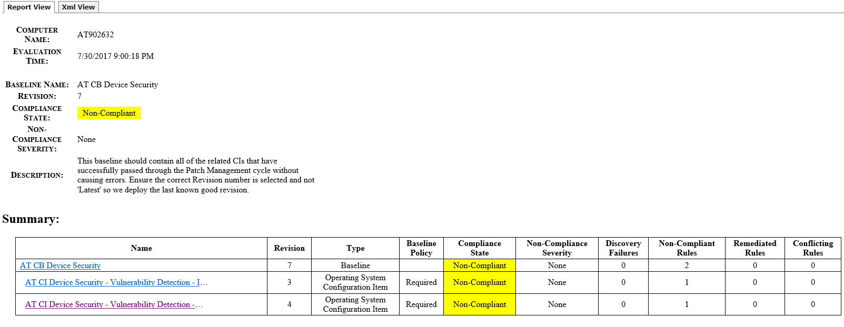
NON-COMPLIANT REPORT
This will tell you which Configuration Items failed and how many rules in in the CI failed.

Slide 40
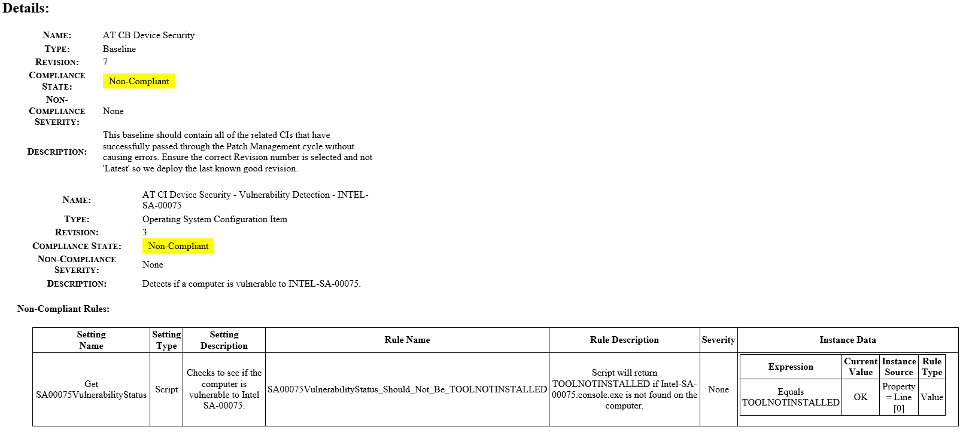
DETAILS ABOUT THE NON-COMPLIANT RULES
This is where the names and descriptions become useful.

Slide 41
VIEWING DEPLOYMENT STATUS IN THE CONSOLE

Slide 42
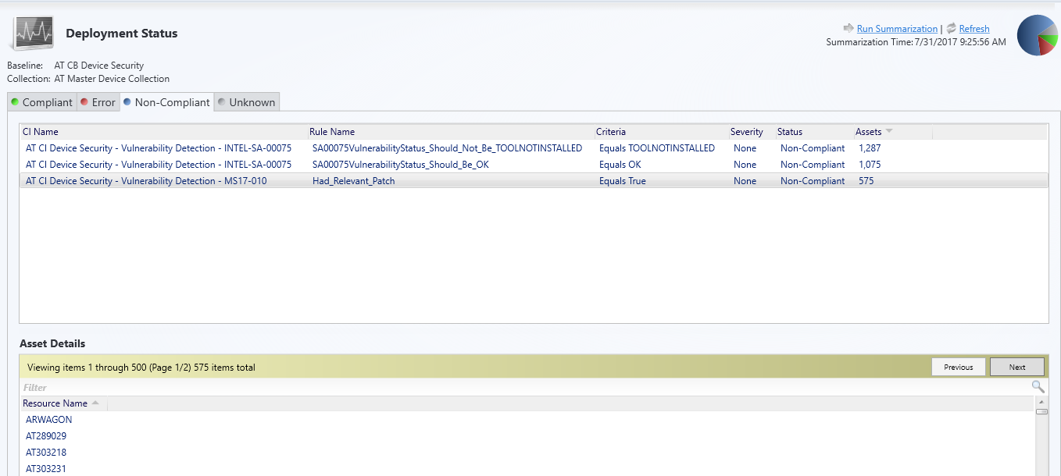
DEPLOYMENT STATUS
Shows which non-compliant rules exist on which device.

Slide 43
CREATING A COLLECTION FROM CB
Right-click the deployment, Create New Collection, and choose the criteria.

Slide 44
RESOURCES
CIT CB Demo - Device Security Settings.cab
CIT CI Demo - Disable SMBv1.cab
CIT CI Demo - Enable SmartScreen Filter.cab
CIT CI Demo - UAC Enabled.cab
CIT CI Demo - Verify MS17-010 Patch Installed.cab
CIT Script Demo - Disable SMBv1.ps1
CIT Script Demo - Verify MS17-010 Patched.ps1
Free resources for attending our session are listed in right pane.
The demos come with no warranty. Please review the contents and test before running in production.
Note: Disabling SMBv1 Client prevents you from connecting to older file shares like \\datastore

Slide 45
EXTRA RESOURCES
Security Compliance Manager
Disabling Automatic Updates on a lot of applications
Covert .POL & .REG Files to CI’s
How to Create Windows Configuration Items for Compliance Settings in Configuration Manager
How to Create Configuration Baselines for Compliance Settings in Configuration Manager

