Slide 2
IT News
Many thanks to our sponsors for all things CIT:
AT, OAT, TechZone, and the College of Business!

Slide 3
Opening Remarks
Shari Zeck, Interim Dean of Milner Library

Slide 4
Enterprise Data and Analytics (EDA)
Data Warehouse
Use ETL Tools to transform relational database information into dimensional data marts focusing on business processes.
Existing Data Marts: Census Records and Enrollment
Emergency Management Admissions Registration HR Contract Information Financial Aid
Secondary source of information for Campus Solutions data in outage situations for critical systems.
Emergency Management
Admissions Application
Rachel Hart, AT EDA

Slide 5
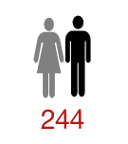
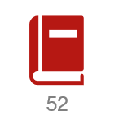
Cognos
Top 5 Cognos Reports
Report Name | Number of Times Executed
SDAR | 11,644
LIST OF APPLIED STUDENTS BY COLLEGE | 2,481
SRSS | 1,918
LIST OF ADMITTED STUDENTS BY COLLEGE | 1,656
CENSUS PLAN ROSTER | 1,452
Usage Growth
Calendar Year | Number of Reports Run
2014 | 63
2015 | 3,468
2016 | 19,714
2017 | 38,877
Supported on all browsers
Access requests via Cherwell or TSC.
Job Aids are available on data.illinoisstate.edu/training/resources
User support tickets assigned to EDA
Rachel Hart, AT EDA

Slide 6
Analytics
Creating Predictive Models for identification of FTIC students at risk for not returning the second year
Units involved
Two Models are currently active
1st Term model, provide information based solely on information available prior to 1st term
HS GPA
ACT/SAT Scores
FAFSA Information/Unmet Need
2nd Term model, strongest predictor 1st term GPA
Involvement
Unmet need
EDA | Student Affairs
EMAS | University Assessment
PRPA | University College
Rachel Hart, AT EDA

Slide 7
Select Survey – It’s been real…
Instance managed by WEB went offline 10/15/2017
CAS-IT managed instance will be offline 12/19/2017
Arturo Ramirez, WEB

Slide 8
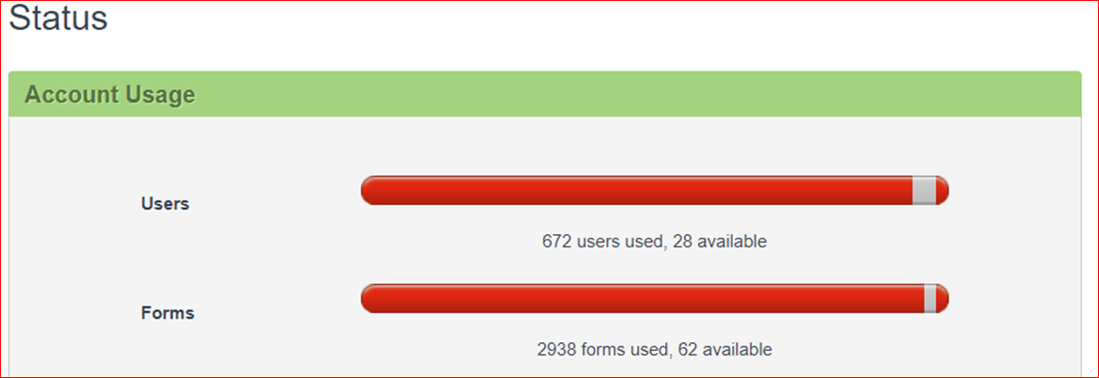
Qualtrics - About.IllinoisState.edu/Qualtrics
Use for surveys that are research
Use for surveys related to program review, course and faculty evals, etc.
Adhere to data security standards
Intending to publish? Go through IRB
Qualtrics surveys and data stay with their assigned accounts
Think before having a GA set them all up for you in their profiles
Formstack is a valuable but limited resource!
700 User Accounts
3000 Active Forms
Arturo Ramirez, WEB

Slide 9
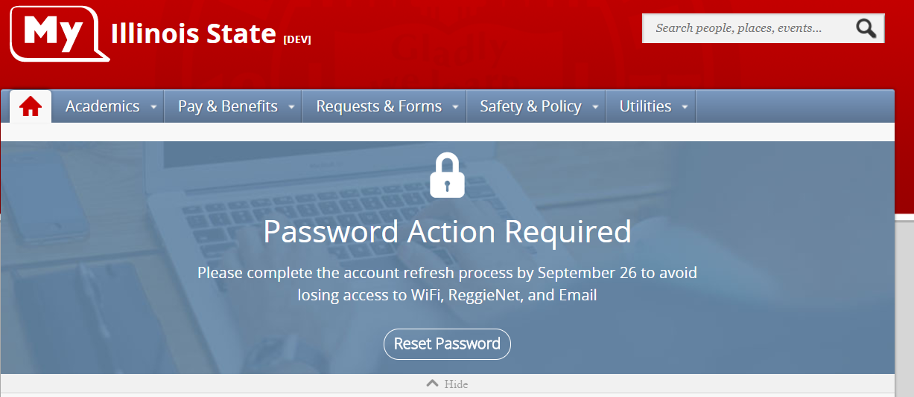
My.IllinoisState – Timely reminders and alerts
Arturo Ramirez, WEB

Slide 10
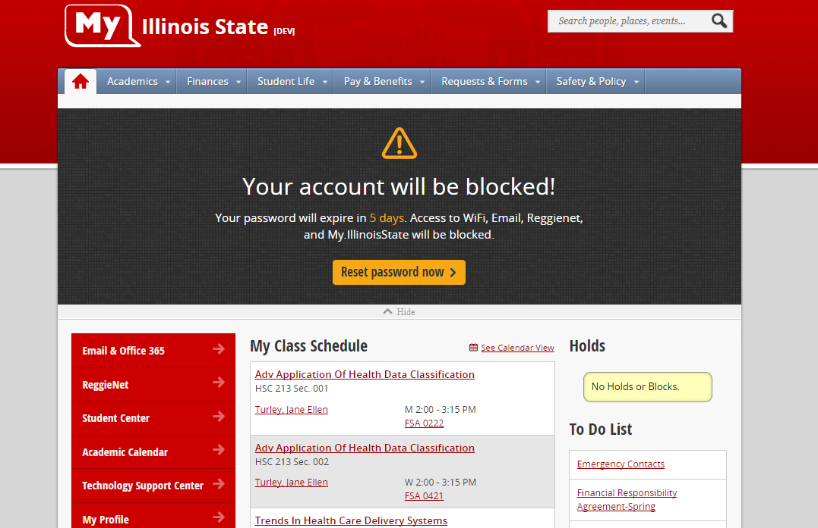
My.IllinoisState
Account refresh process banner
Arturo Ramirez, WEB

Slide 11
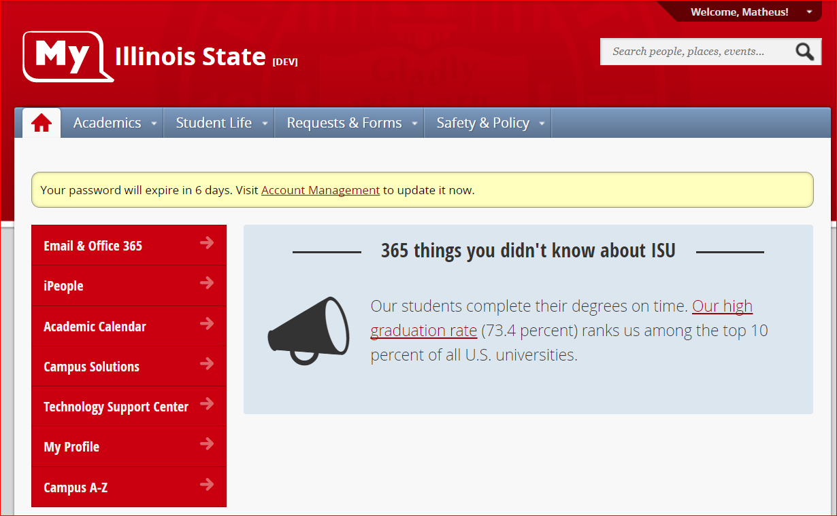
My.IllinoisState
Password expiration alerts
Arturo Ramirez, WEB

Slide 12
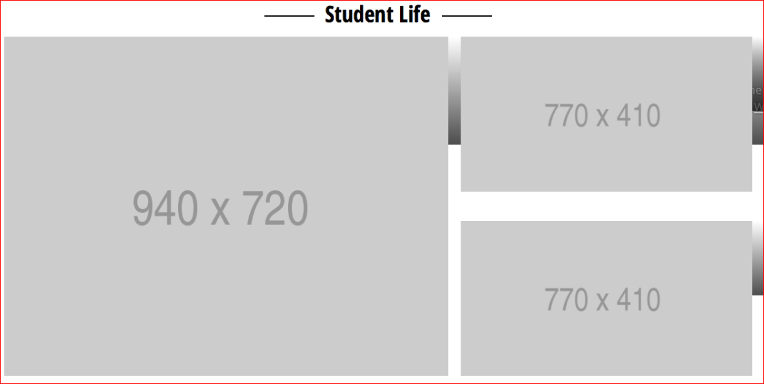
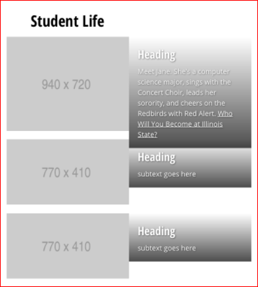
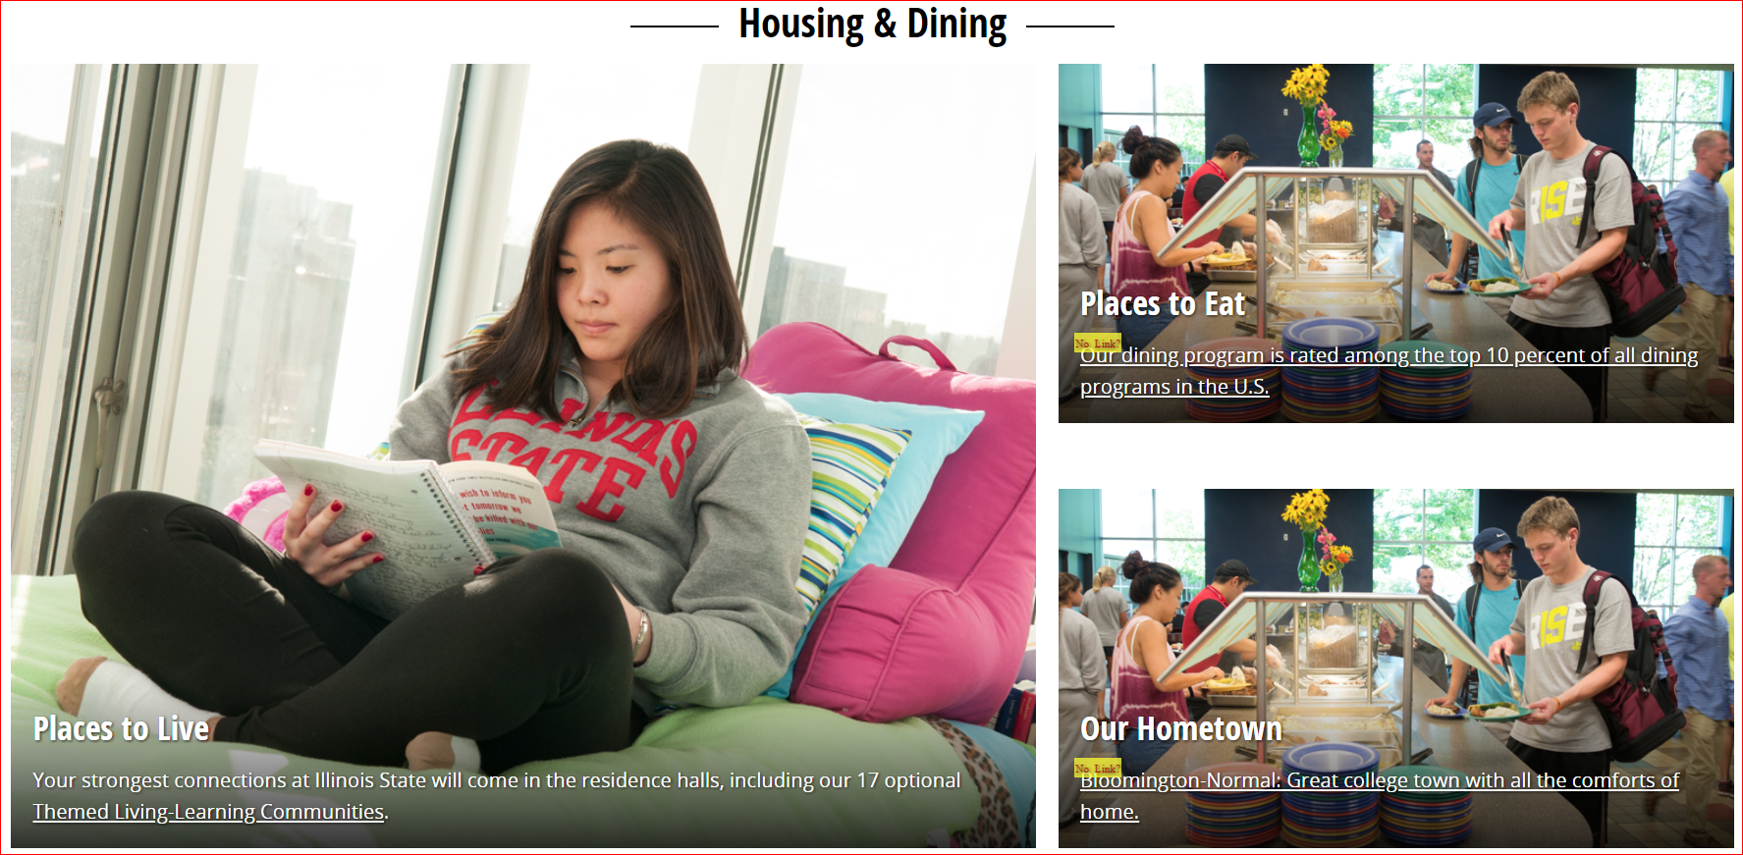
ISU Homepage
Incremental iterations
Arturo Ramirez, WEB

Slide 13
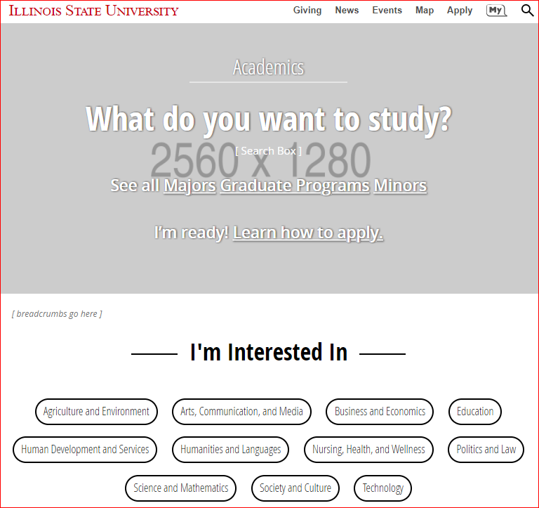
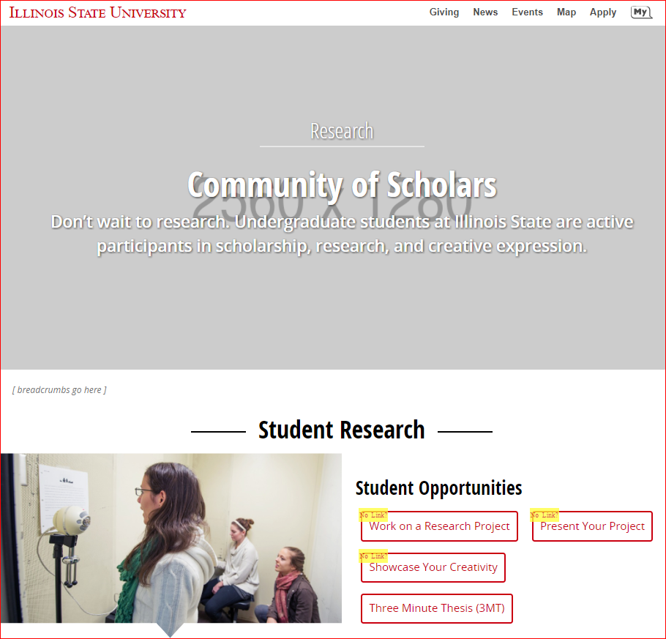
ISU Homepage
Landing pages – visual elements
Arturo Ramirez, WEB

Slide 14
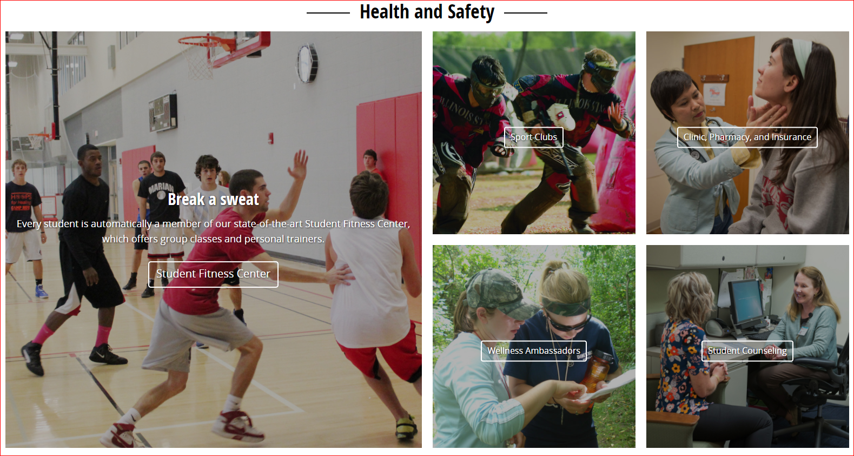
ISU Homepage
Student Life Section
Arturo Ramirez, WEB

Slide 15
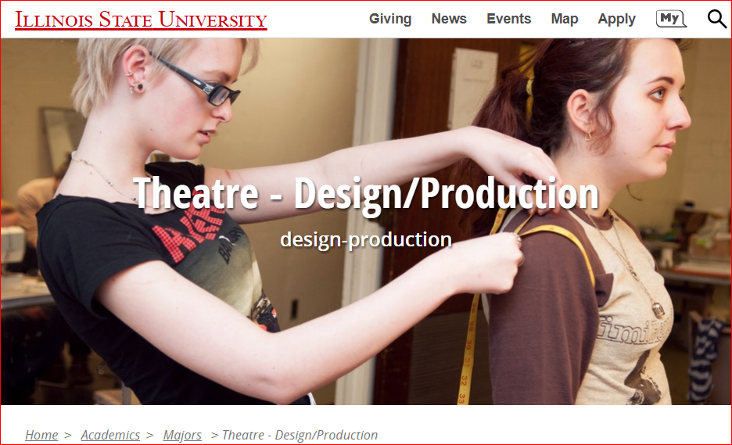
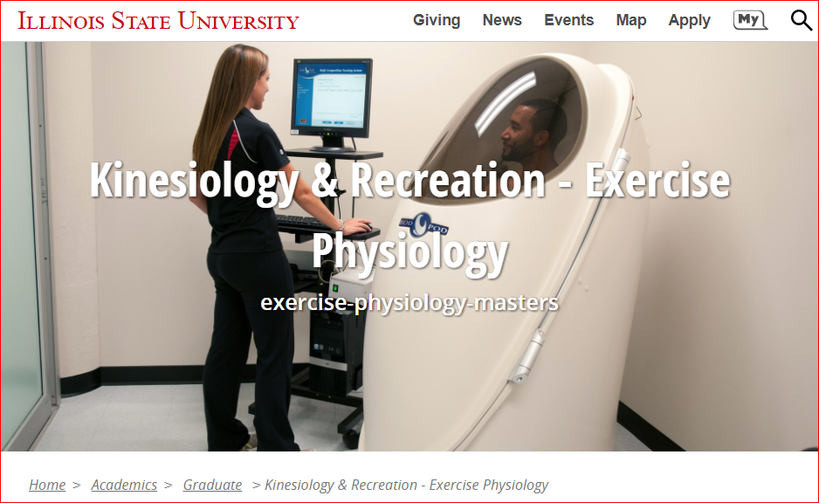
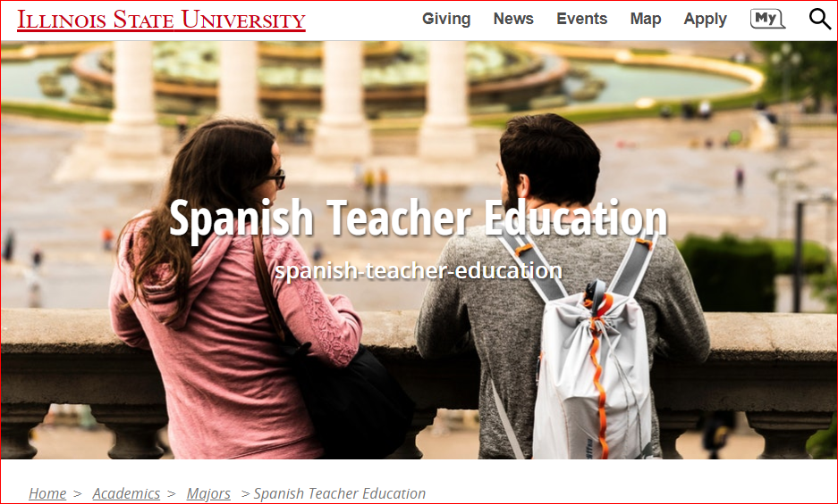
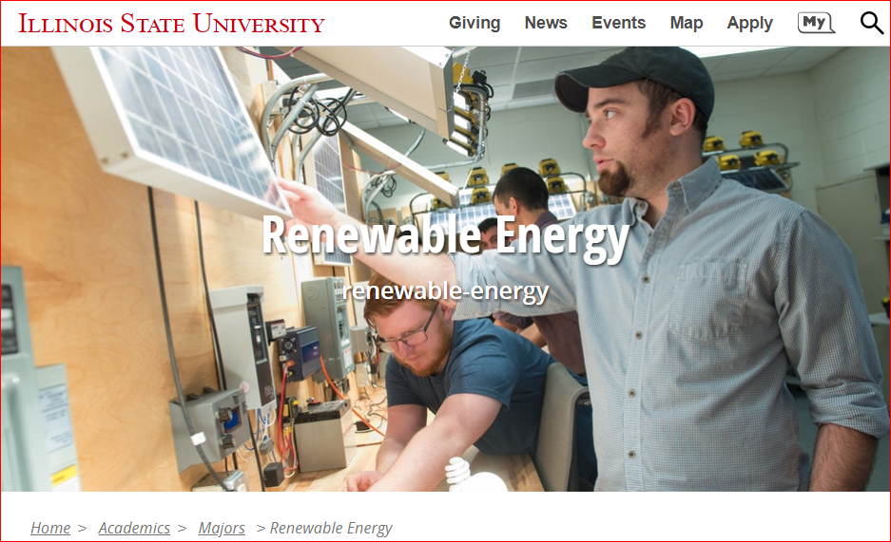

Slide 16
AT Update
Charley Edamala, AVP, AT

Slide 17
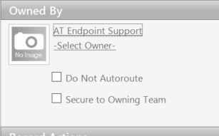
ITSM – Recent Accomplishments
Endpoint Configuration Items live in production
Problem Management and Project Management live
Continuous Improvement
Carla Birckelbaw, AT Client Services
Notes:
- Over 6000 Endpoint CIs in production and linkable to incidents, requests, and customers (and more). These items have been brought into Cherwell automatically and are being updated daily through SCCM. So we’re managing the endpoints in the preferred management system but tracking them for support purposes in the ITSM.
- About half of the support teams using this part of the system so far.
- Linking your endpoints to other records allows you to spot trends with a single piece of equipment as well as assisting with inventory. Imagine being able to record the entire lifecycle of a laptop, from purchase to retirement, with every incident, customer association, transfer and location along the way. We’re working currently on a way to work the official transfer of equipment to Property Control right from the Cherwell CI form.
Also new categories for easy recording of standard changes
We were seeing mismatches between the Request Type (Incident or Service Request) and the Subcategory. Incidents should only be Submit Incident, but the tool allowed you to choose other subcategories previously. That has now been changed so you can’t select something else by mistake. Conversely, a Service Request cannot have Submit Incident at its subcategory.

Slide 18
Campus-Wide Dashboard (My Work)
Carla Birckelbaw, AT Client Services
Notes:
- A LOT of people involved in putting together this dashboard, meant to be a global dashboard for any team’s use in managing their active queue – please raise your hands
Available through Dashboard Manager – Global – My Work Campus-Wide Default
All of your team and individual tasks and incidents on one screen, easy links to other default dashboards

Slide 19
ITSM - Looking Ahead
Upgrading backend system to 9.2 before break
Simplify request forms, simplify portal design
Explore 3rd party options that can integrate and improve knowledge and search options
Integrations with other systems, including single sign on and My
Evaluate and streamline classification schema
Carla Birckelbaw, AT Client Services
Notes:
ITSM Advisory Group has developed a set of goals for near-term ITSM improvements, based on feedback received from customers and IT staff
Many goals, highlights include… make it easier to find things
Also more training for IT staff, focus on metrics, and regular opportunities for feedback

Slide 20
Also of note…
Winter Session Dec. 16 – Jan. 14, 13 courses
Computer Lab Planning
After Lab Stats upgrade 12/18, install client in all labs
Planning Group in the Spring
CIT Planning Committee seeking a few new volunteers - contact us at isucit@ilstu.edu
Carla Birckelbaw, AT Client Services
Notes:
Winter Session support provided to faculty by CTLT, and students by the TSC – during Administrative Closure, students should email the TSC at SupportCenter@ilstu.edu and put “Winter Session” in the subject
Only roughly half of our labs have Lab Stats running currently, but all are eligible and should be included – if you can’t remember your account or unsure if you have one, contact Endpoint to get set up

Slide 21
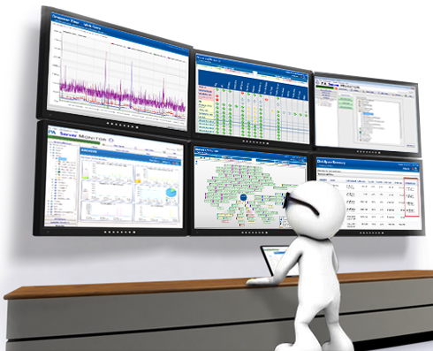
Up and Coming from AT APPS
Direct Database Access to Require VPN even on Campus
Future Server/Application/Service Monitoring Strategy and Tools?
Todd Smoak, AT APPS

Slide 22
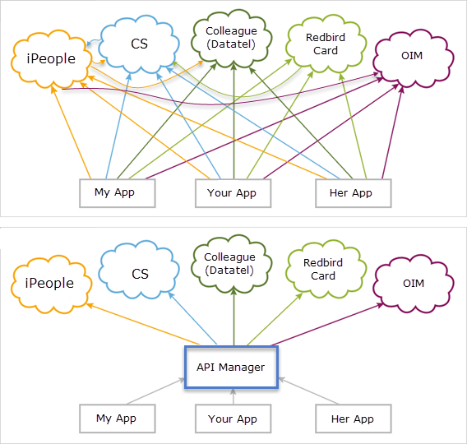
Working w/Web on API Management Layer
Todd Smoak, AT APPS

Slide 23
Information Security: Risk Management Program
Coordinated with Internal Audit & Risk Management
Enterprise & Unit-Based Risk Assessment
Threat Assessment
Individual Project/Proposal Risk Assessment
Risk & Threat Mitigation Strategies
Kevin Crouse, AT ISO

Slide 24
Program benefits:
Demonstrates due care and due diligence
Provides a roadmap for improvement
Assists in meeting compliance requirements
Proactively builds a Cyber-Resilient University
Kevin Crouse, AT ISO

Slide 25
Microsoft Teams Showcase
Paul Unsbee, Milner Library
Dan Taube, AT Endpoint Support

Slide 26
ION Update
Infrastructure Upgrades
New Data Center Firewalls
New NTP Server
LANsweeper
AD (Fire, Water)
Successful Partnerships
Account Refresh & Password Resets
Classroom Renovations
CFA Wireless Enhancements
Virtual Applications
Craig Jackson, AT ION

Slide 27
Office365 – Active Portal Users
Craig Jackson, AT ION

Slide 28
Office365 – SharePoint Users
Craig Jackson, AT ION

Slide 29
Office365 - Email
Craig Jackson, AT ION

Slide 30
Redbirds of a Feather 10:30-11:30
Powershell on Parade (SFHB 132)
IT Security (SFHB 148)
Growing Your IT Career (SFHB 149)
Intro to Regular Expressions… Just Enough to Make You Dangerous (SFHB 131)
CITx Informal Lunch at the Normal Meatheads
after the event – continue the conversation!

