Slide 2
Illinois State University Outdoor Wireless Project
Chris Johnson
Lawson Cassels
Christopher Delk

Slide 3
CURRENT WIRELESS STATUS
5GHz Coverage design focused on classroom, offices, and locations where students, faculty, staff physically reside.
Access Point Increase
Campus – (49% Increase – 1,048 to 1564)
Residence Halls – (344% Increase – 426 to 1892)
Interesting Facts
13,200 clients (unique devices) on campus daily - 1.96Gbps
7,000 clients (unique devices) in residence halls - 3.58Gbps
Implementation of Text Self-Registration Guest-Wifi

Slide 4
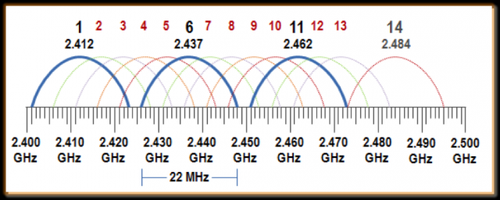
2.4GHz and 5GHz Spectrum

Slide 5
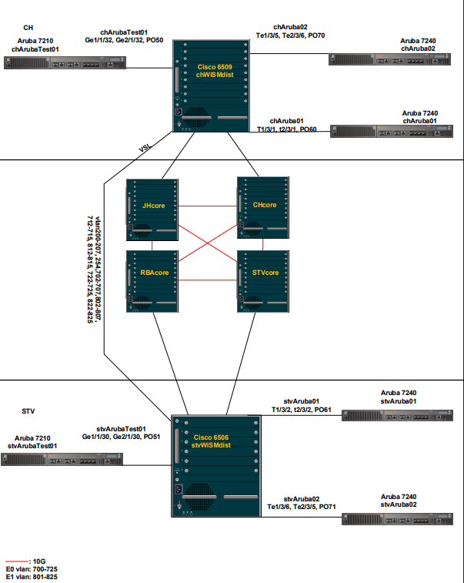
WIRELESS TOPOLOGY

Slide 6
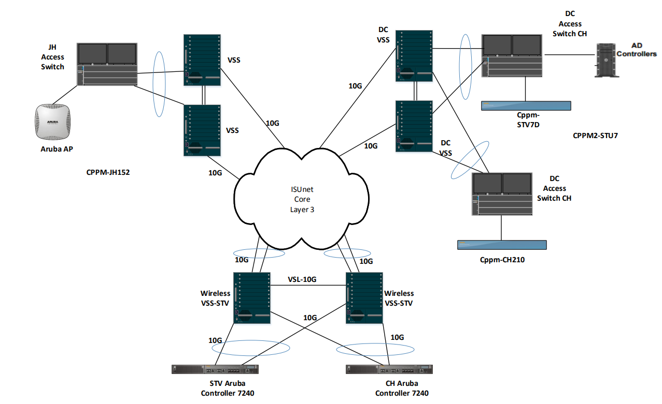
TRAFFIC FLOW

Slide 7
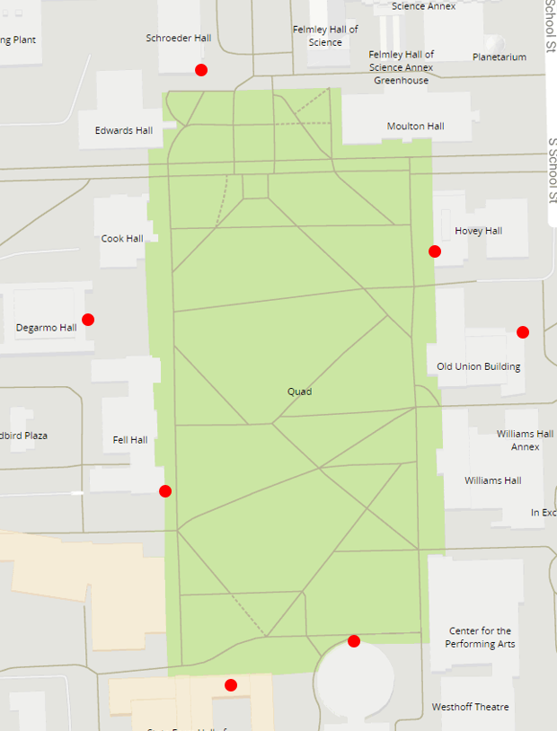
CURRENT QUAD WIRELESS LOCATIONS

Slide 8
WIRELESS SURVEY
An essential step in planning
Hardware and software that assists in the measure of network capability, health and capacity.
Assists in planning and wireless design.
Can confirm or deny wireless coverage.

Slide 9
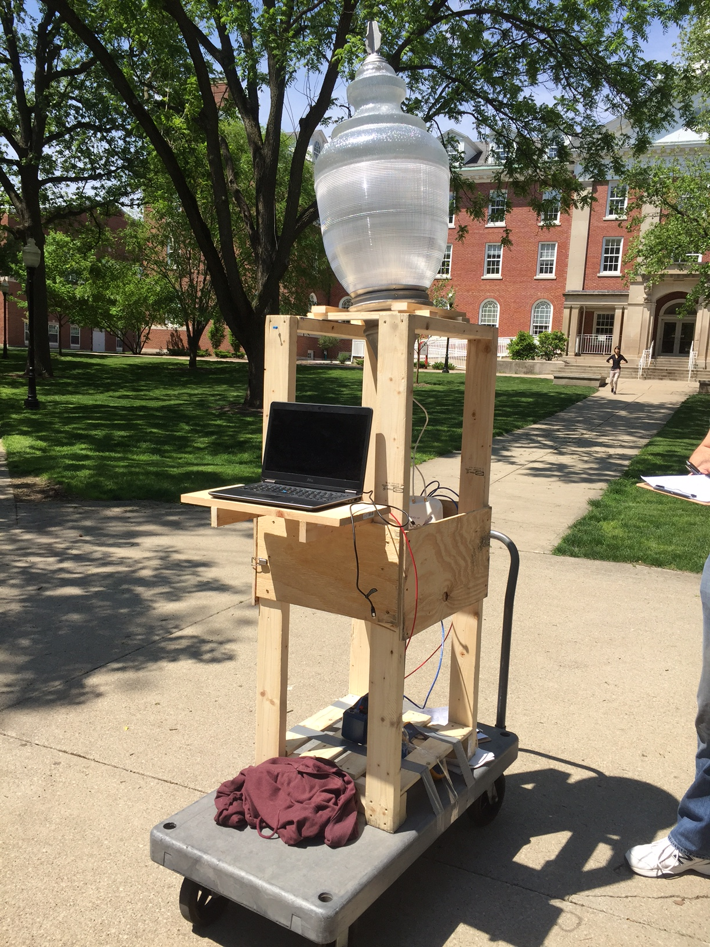
OUTDOOR SURVEY RIG

Slide 10
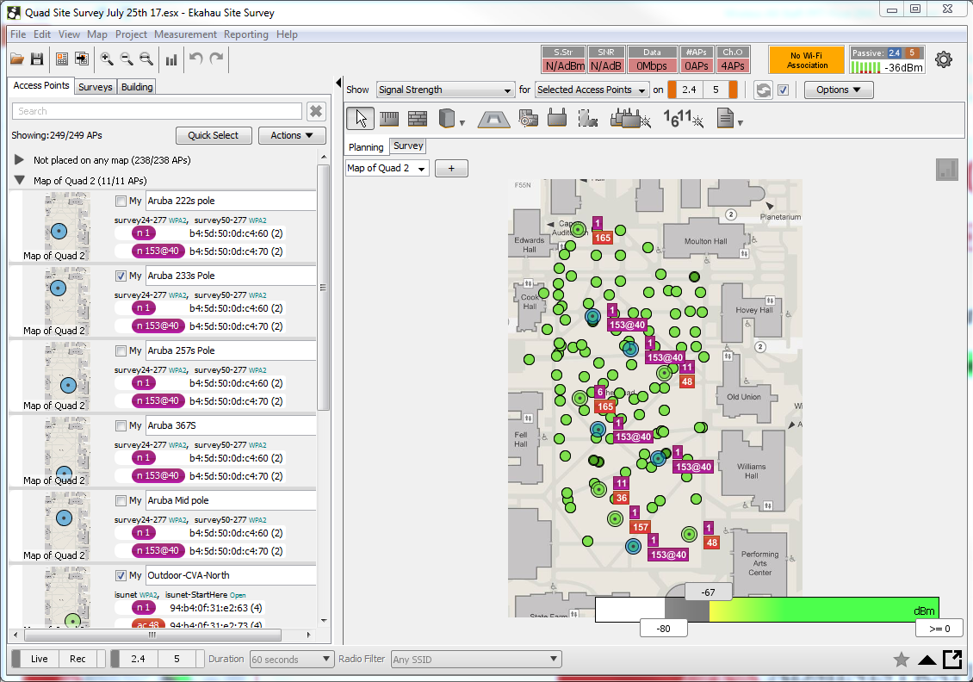

Slide 11
CURRENT QUAD WIRELESS COVERAGE
5GHz Wireless Signal Strength

Slide 12
NEW QUAD WIRELESS LOCATIONS
5 New Outdoor AP Locations cover area that was not adequately covered before.
= New AP Location

Slide 13
PROJECTED WIRELESS SURVEY
5GHz Wireless Signal Strength

Slide 14
PROJECTED CLIENT CAPACITY
Maximum number of clients depends on;
Number of associations to an AP Radio
Content that Clients are sending and receiving
Noise floor( background RF noise) and other traffic on channel

Slide 15
ASSOCIATIONS BY RADIO
Radio | Default # Associations | Maximum # Associations
5GHz | 69 | 255
2.4GHz | 69 | 255
Total | 138 | 500

Slide 16
ASSOCIATIONS BY SSID
SSID Name | Max Allowed Associations | Total
Isunet | 150
Isunet-StartHere | 150
 |  | 300
5 new AP locations = 1500 additional associations
1500 Associations ≠ 1500 additional clients

Slide 17
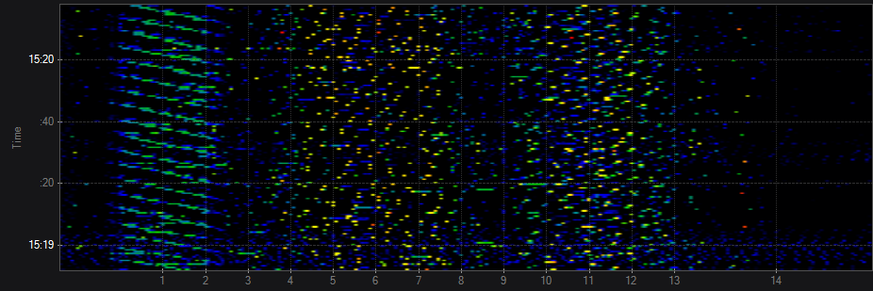
NEUTRAL ENVIORMENT (INDOORS)

Slide 18
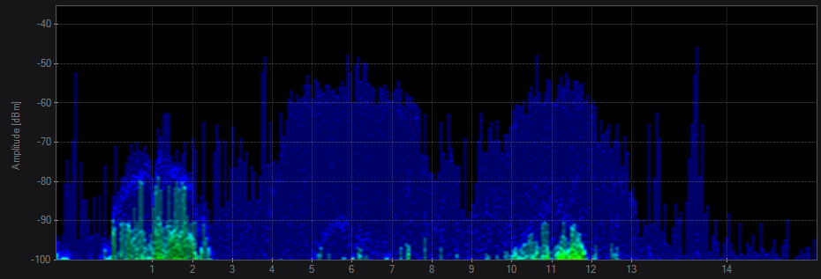
NEUTRAL ENVIORMENT (INDOORS)

Slide 19
NOISE FLOOR

Slide 20
INTERFERENCE

Slide 21
CHALLENGES OF OUTDOOR WIRLESS
Need for additional AP locations
Coverage
Capacity
Distances of AP location to nearest uplink
Ethernet Vs Fiber
Aesthetics of the Antenna and AP location

Slide 22
CHALLENGES OF OUTDOOR WIRLESS
POE – Power Over Ethernet 802.3af & at
Cat6 Cable
Uses: Phones, AP’s, Camera’s
Hybrid Fiber / Powered Fiber
Custom Cable
Uses: Camera’s, AP’s and more

Slide 23
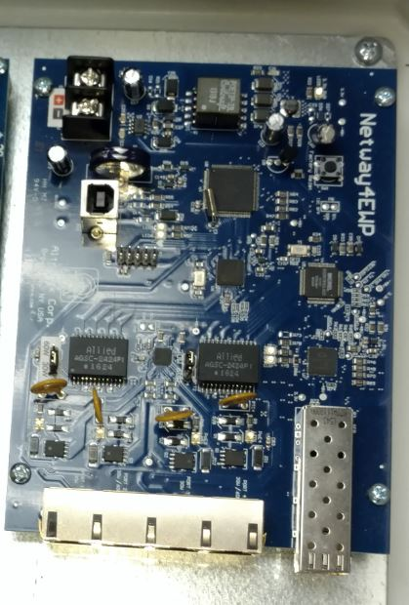
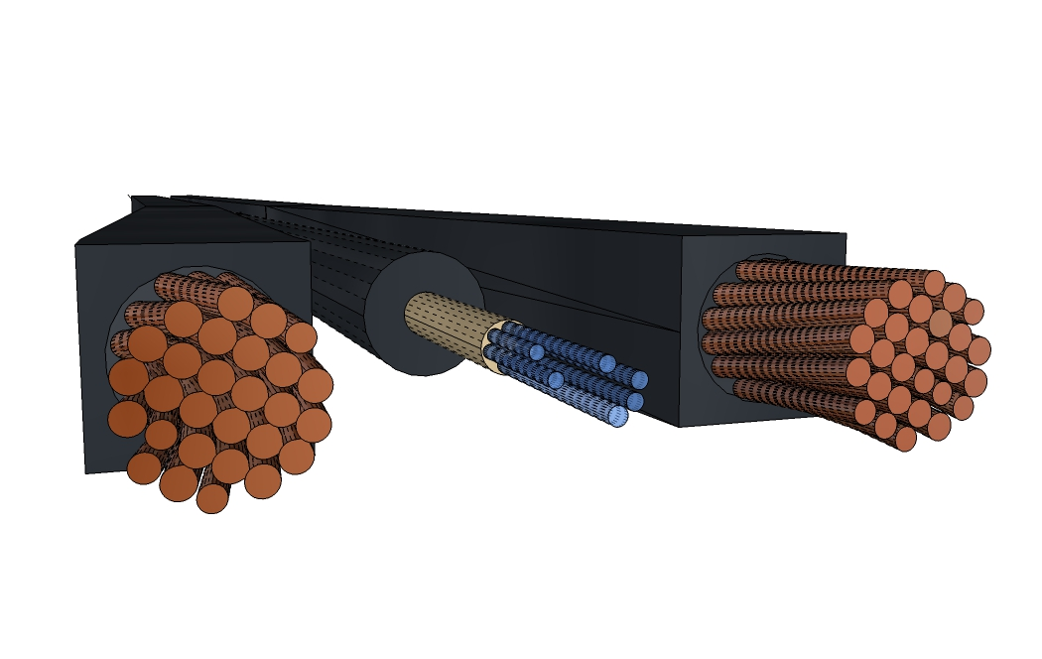
Solution: Powered Fiber

Slide 24
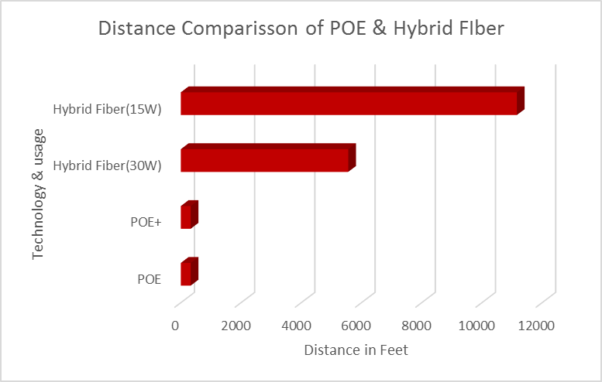
POE VS HYBRID FIBER

Slide 25
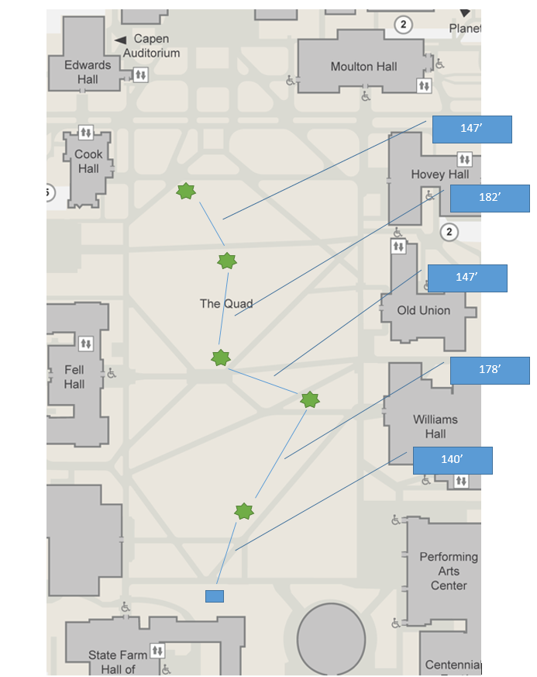
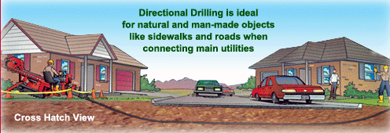
Solution: Drilling

Slide 26
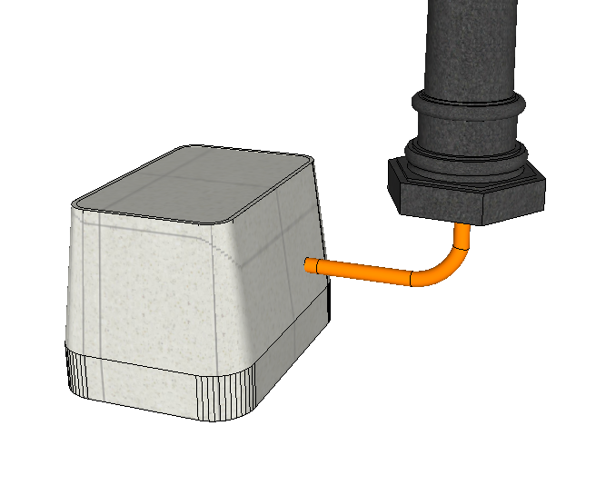
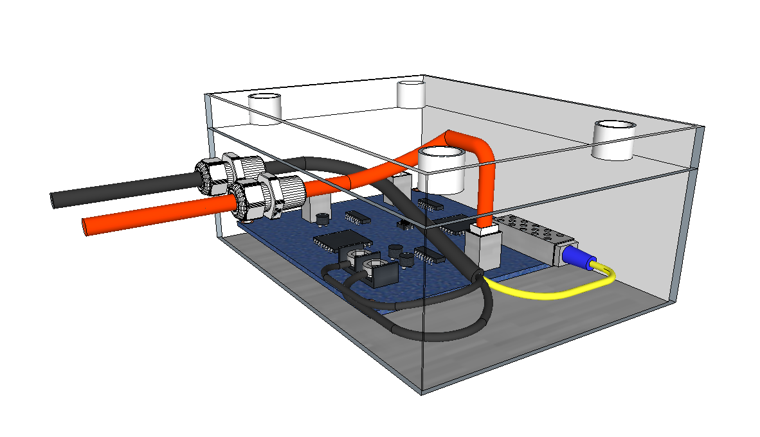
SOLUTION: PROTECTING THE EQUIPMENT

Slide 27
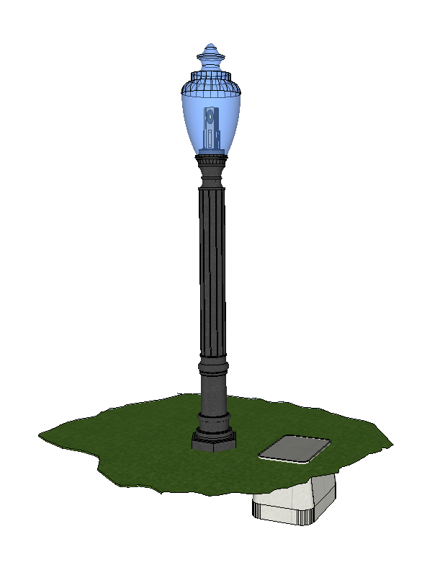
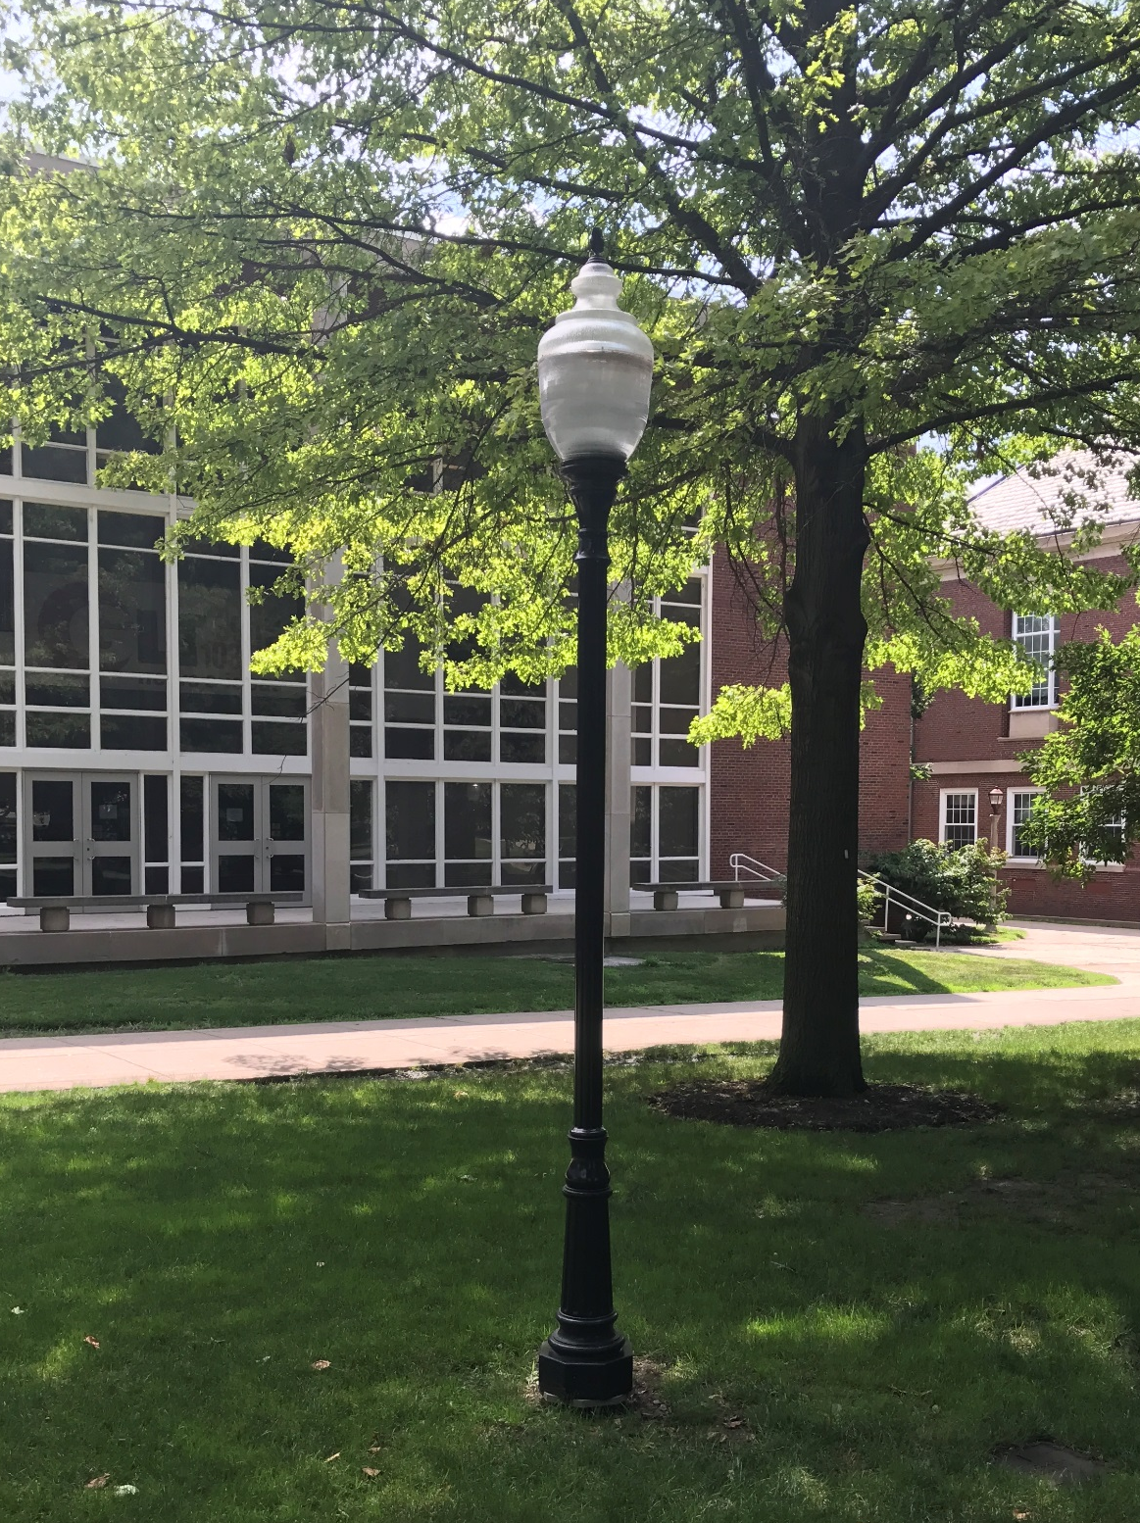
SOLUTION: CUSTOM ANTENNA DESIGN

Slide 28
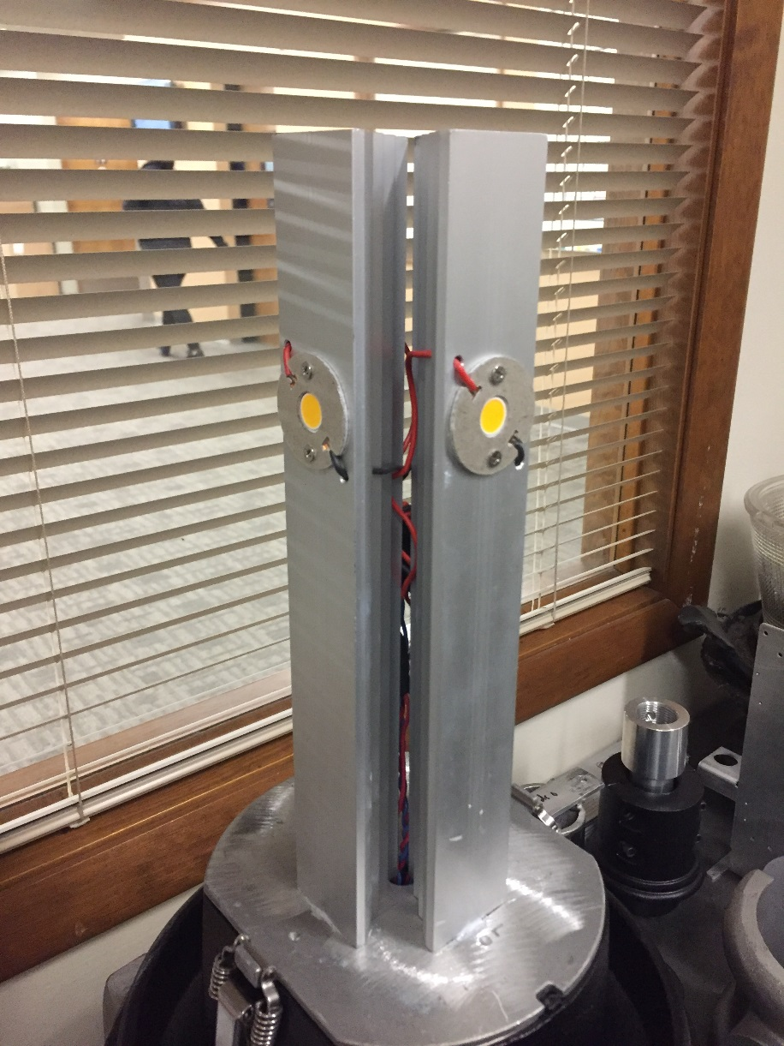
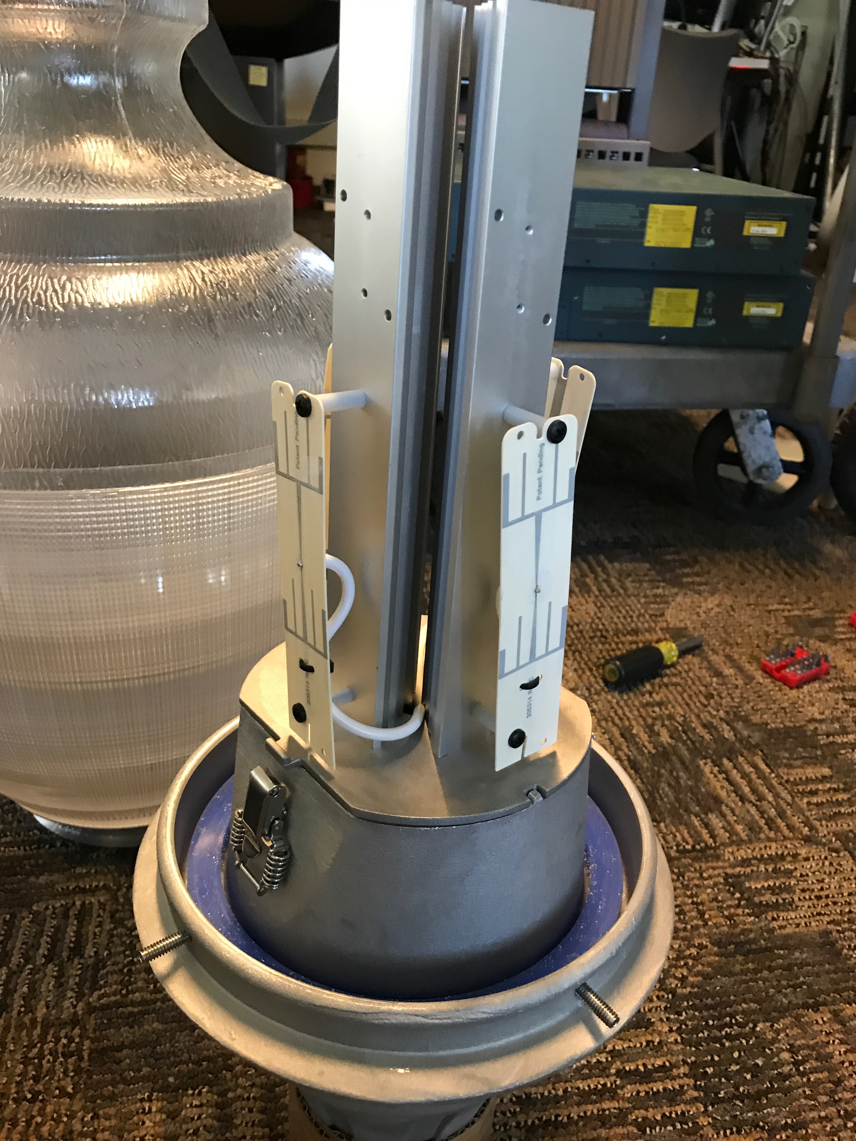
SOLUTION: CUSTOM ANTENNA DESIGN

