Slide 2
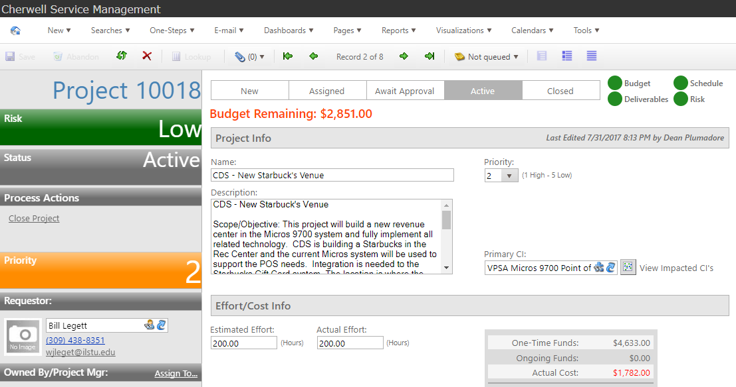
Walk thru the Cherwell Project Module
Agenda:
Hi, I’m Dean
Once thru creating a project
What will this be good for?
Reporting
Dashboards
Needs care and feeding to remain relevant.
Questions?

Slide 3
2) Once thru creating a Project
New – ITPT Project
#10058 – Name and Description
What makes sense to include at this time?
Name, General description, Priority, Primary CI
Requestor
Owned by/Project Mgr
Planned End Date (planned start date, maybe)

Slide 4
2) Once thru creating a Project
Arrangement Tabs to be used as appropriate
Deliverables as a simple timeline
Cost Items to build budget
Project members
Change Request to track the change

Slide 5
3) What will this be good for?
Consolidating project related efforts.
Organizing small projects.
Linking bigger change requests to a “project”.
Creating and organizing KBs related to project.
Creating a portfolio of work to be done.

Slide 6
3) What will this be good for?
Managing large projects…..NO.
Managing non-IT projects……NO.
Replacing MS Project……NO.
Replacing Daptive or Baseline or ???.....NO.

Slide 7
4) Reporting
Nothing currently pre-built in Test.
What report would we want?
By priority
By due date
By team
By requestor
By project deliverable?

Slide 8
5) Dashboard/s
Only 1 currently pre-built in Test.
What dashboard/s would we want?
By priority
By due date
By team
By requestor
By project deliverable?
Widget on another dashboard?

Slide 9
6) Care and Feeding
How can we do this?
“Automatically” using Tasks…..not quite, may only get labor spent. Doesn’t feed to cost.
Manually updating
Any ideas?
Notify Task Owners to Update Tasks

Slide 10
Questions?

Slide 11
Walk thru the Cherwell Project Module
Thank you………dP
depluma@ilstu.edu

