Slide 1
2017 TechQual+ Survey Results
Illinois State University
Notes:
Higher Education TechQual+ Project @ University of Georgia [ https://www.techqual.org ]
Started in 2006, based on SERVQual and, later, LibQual+ methodology

Slide 2
The Survey Instrument (§1)
Connectivity and Access Tell us about your ability to access technology services through the Internet
Having an Internet service that operates reliably.
Having an Internet service that provides adequate capacity or speed.
Having an Internet service that provides adequate Wi-Fi coverage.
Having adequate cellular (or mobile) coverage throughout campus.
Notes:
Out on 4/17 to all F/S/S in survey pool for two weeks. Reminder sent on 4/24…

Slide 3
The Survey Instrument (§2)
Technology and Collaboration Services Tell us about the quality of Web sites, online services, and technologies for collaboration
Having Web sites and online services that are easy to use.
Having online services that enhance the teaching and learning experience.
Having technology services that allow me to collaborate effectively with others.
Having systems that provide timely access to data that informs decision-making.
The availability of classrooms or meeting spaces with technology that enhances the teaching and learning experience.

Slide 4
The Survey Instrument (§3)
Support and Training Tell us about your experiences with those supporting your use of technology services
Getting timely resolution of technology problems that I am experiencing.
Technology support staff who have the knowledge to answer my questions.
Receiving communications regarding technology services that I can understand.
Getting access to training or other self-help information that increases my effectiveness with technology.

Slide 5
The Survey Instrument (§4)
Additional Questions
If ISU can do one thing to improve your experience with technology on campus, what would it be?
What technology services are NOT offered at ISU that you would like to have available?

Slide 6
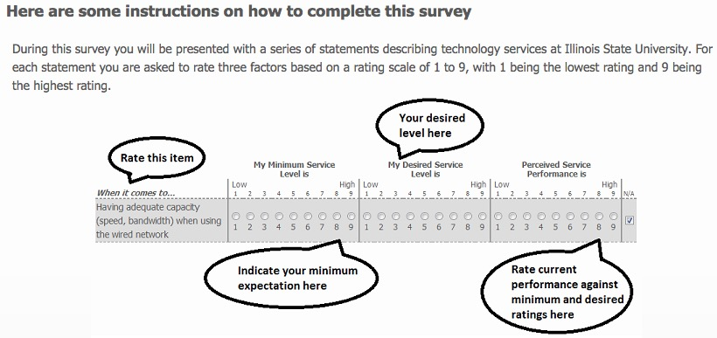
Question Response Format
Notes:
How easy was it for you to complete this survey? (1 = very difficult, 9 = very easy)
7.4065 (n=615) [82% easy]
How confident are you that the answers you provided are meaningful? (1 = not at all confident, 9 = very confident)
6.8423 (n=615) [76% confidence]

Slide 7
Service Level Adequacy
When perceived service performance exceeds minimum expectations, the resulting service level adequacy gap score > 0
When perceived service performance is below minimum expectations, the resulting service level adequacy gap score < 0

Slide 8
Key Findings from this Survey
Positive Perceptions (Adequacy Gap Score > 0)
Having an Internet service that operates reliably. Adequacy Gap Score = 0.15
Having an Internet service that provides adequate capacity or speed. Adequacy Gap Score = 0.28
Negative Perceptions (Adequacy Gap Score < 0)
Having online services that enhance the teaching and learning experience. Adequacy Gap Score = -0.39
Having Web sites and online services that are easy to use. Adequacy Gap Score = -0.51
Having systems that provide timely access to data that informs decision-making. Adequacy Gap Score = -0.68

Slide 9
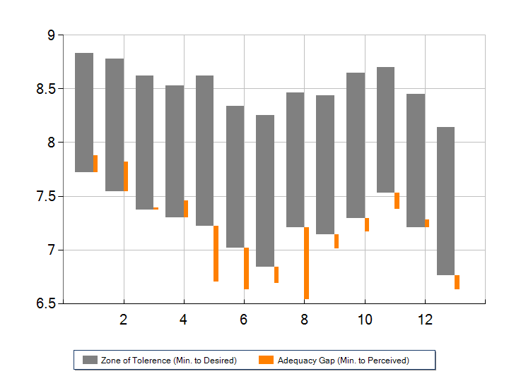
Response Zones
Notes:
Gray bar Orange bar
Top = Desired service level Rises if Perceived > Minimum
Bottom = Minimum service level Falls if Perceived < Minimum

Slide 10
Response Zone Analysis
Five service levels exceed the minimum service level expected
Having an internet service that operates reliably (+0.15)
Having an internet service that provides adequate capacity or speed (+0.28)
Having an internet service that provides adequate WiFi coverage (+0.01)
Having adequate cellular … coverage throughout campus (+0.15)
Receiving communications regarding technology services that I can understand (+0.07)
Notes:
In the 2013 Survey, the Adequacy Gaps were:
1. +0.09 — So we’ve improved!
2. +0.22 — Improved
3. -0.46 — Improved a lot!
4. N/A (Internet access via tablet or mobile device)
12. -0.04 — Improved

Slide 11
Response Zone Analysis
In three areas, perceived service levels are much lower than expected service levels:
Having websites and online services that are easy to use (-0.51)
Having online services that enhance the teaching and learning experience (-0.39)
Having systems the provide timely access to data that informs decision making (-0.68)
Notes:
5. Suggestions indicate that users view website as monolithic, esp. MY
6.
In the 2013 Survey, the Adequacy Gaps were:
5. -0.53 — About the same
6. N/A (access campus websites and online services via tablet or mobile device)
8. N/A (2013 Survey did not ask about access to data…)

Slide 12
Response Zone Analysis
Five service levels are less than the minimum service level expected:
Having technology services that allow me collaborate effectively with others (-0.14)
The availability of classrooms or meeting spaces with technology that enhances the teaching and learning experience (-0.13)
Getting timely resolution to technology problems that I am experiencing (-0.12)
Technology support staff who have the knowledge to answer my questions (-0.14)
Getting access to training or other self-help information that increases my effectiveness with technology (-0.13)
Notes:
In the 2013 Survey, the Adequacy Gaps were:
7. -0.06 —> Got worse…
9. (2013 #8) -0.20 — Improved
10. (2013 #11) -0.30— Improved
11. (2013 #10) -0.22 — Improved
13. -0.16 — Improved a little

Slide 13
Data Summary Tables

Slide 14
Legend for Tables
Minimum Level of Service
Desired Level of Service
Perceived Service Quality
Adequacy Gap Score = perceived - minimum
Superiority Gap Score = perceived - desired
p-value for H0: Adequacy Gap Score = 0
Red Color = Perceived < Minimum
Green Color = Perceived > Desired

Slide 15
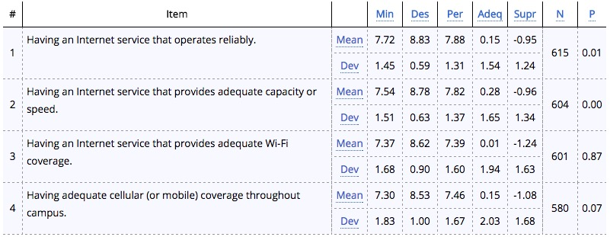
Connectivity and Access Tell us about your ability to access technology services through the Internet

Slide 16
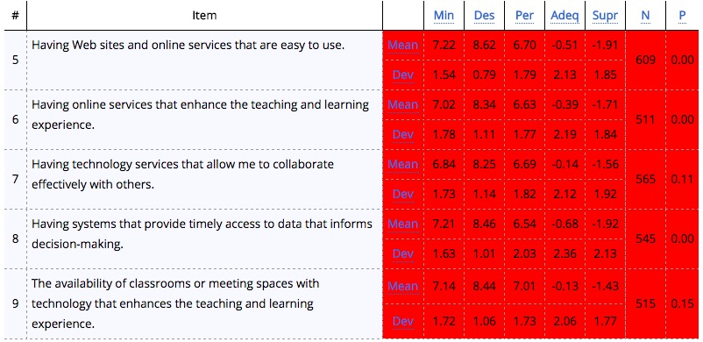
Technology and Collaboration Services Tell us about the quality of Web sites, online services, and technologies for collaboration

Slide 17
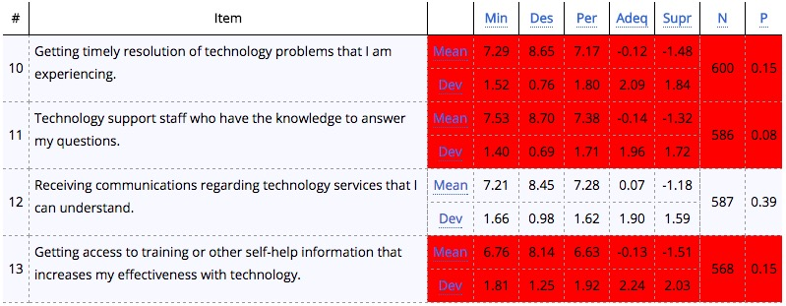
Support and Training Tell us about your experiences with those supporting your use of technology services

Slide 18
Population Analysis
1,075 attempted the survey
625 completed the survey (58% of attempts)
Faculty and staff had higher completion rate (74%) than students (48%)
Males had a slightly higher completion rate (69%) than females (60%)
The older the respondent the higher the completion rate…
Notes:
329 completed the survey in November 2013 (56% of attempts)

Slide 19
Population Analysis
625 surveys completed
177 faculty (29%)
264 staff (43%)
176 students (28%)
355 female (60%)
240 male (40%)
Age group
0-24 114 (20%)
25-34 85 (15%)
35-44 116 (21%)
45-54 127 (23%)
> 55 117 (21%)
Notes:
2013 Demographics
83 faculty 0-24 26
211 staff 25-34 62
24 students 35-44 56
141 female 45-54 74
171 male > 54 55

Slide 20
The Results

Slide 21
General Comments on the Comments
Confusion around who provides what part of a technical service
Confusion around what a web site is as opposed to a web-based application
Some people clearly have closely held and cherished grudges
Pretty easy to pick out the IT staff responses
Not all customer expectations are realistic
Some of the things respondents asked for already exist
As with any survey, feedback tends to be far more negative than positive – much more motivation there to respond

Slide 22
Let’s Start with the Positive
What’s Included: all comments with any positive component
Sample Responses:
Generally very impressed by the reliability of both wired and wireless Internet access on campus. Kudos!
Some of the services are difficult to navigate, but the site is massive and overall, VERY good!
The best thing about the technology at ISU is the support staff. They work incredibly hard and short staffed, to say the least, and underappreciated.
Cognos is getting there. It's been a long road, but I know people are working hard.
The staff is great, just not enough of them

Slide 23
Let’s Start with the Positive
Takeaways:
Many customers do appreciate the service we provide and are happy to tell us about it
There was name-checking here in a positive way – “my support team is awesome!”
Some customer comments displayed a more balanced understanding of the challenges of providing IT services

Slide 24
Campus Solutions
What’s Included: all comments regarding Campus Solutions, Go.IllinoisState, the mainframe, LEAP Forward, Student Center, Faculty Center, etc.
Sample Responses:
Our websites and online services are stuck in 1990s.
Campus Solutions is non-intuitive and requires way too many menus and clicks to find information.
The systems that were purchased to replace the mainframe are cumbersome, not easy to use and have created more problems than solutions.
AP staff in our department consistently complain about work they used to do on the mainframe takes much more time and coordination with the new systems.
Outages with Campus Solutions seem almost weekly.

Slide 25
Campus Solutions
Takeaways:
People really care about interface
This change was really hard for staff and there is lingering bitterness
There are expectations about how systems should integrate that are not being met – ReggieNet and CS in particular
A feeling that some tasks take longer or are not possible in the system persists
Student Center and Faculty Center in particular were frequently named as issues
The need for support specific to CS and training was commonly mentioned
Interesting that iPeople shares the same base technology but generated only a handful of comments

Slide 26
Campus Solutions
We’re working on it:
Campus Solutions 9.2 upgrade recently completed, with new navigation and better mobile experience
Enterprise Portal Working Group working to streamline the user experience by bringing CS functionality into My
The need for support specific to CS and training was commonly mentioned
Feedback assigned to: Enterprise Portal Working Group

Slide 27
Cherwell/ IT Help
What’s Included: comments are primarily concerned with the IT Help portal, but some Cherwell rich and web client comments as well
Sample Responses:
The current IT Help page with the Knowledge Base Articles needs improvement. In the previous version, I had good success when searching for a knowledge base article. In the current version that's not so much the case.
The information in the return "tech tickets" is sometimes vague and unclear as to if or how the issue was resolved.
Searching for KB articles is painful and not user-friendly. And most of the time I cannot find what I am looking for.
I wish the IT support ticket system was more open ended. i find the ticket system confusing in that the choices offered never reflect the issue I am concerned with.
A better self-help experience. I should be able to find instructions and fill out forms easily, but Cherwell is like 90's technology.

Slide 28
Cherwell/ IT Help
Takeaways:
People really care about interface.
Specific to IT Help, some customers are: having difficulty in finding the right knowledge article, confused by site navigation, can’t find what they want, frustrated by search results being too broad, unhappy about having to login to see knowledge articles, sissing the old TSC web site, not happy about having to fill out details in forms to make a request
There is confusion over routing of tickets to the right IT team – both customers and IT staff reported delays caused by tickets being routed to the wrong team
There is frustration over the variable amount of time it takes to resolve tickets and often the first level team is held responsible
There is a desire for more and easier reporting from Cherwell

Slide 29
Cherwell/ IT Help
We’re working on it:
ITSM Advisory Group began work on this a few months ago, developing a survey that will be released soon to customers who have interacted with the Cherwell system
A CIT session will be held this afternoon to gather IT staff feedback on their experience as Cherwell users
TechQual survey results will also play into a larger set of feedback, and used to inform changes made with the upgrade this Fall to Cherwell 9.x as well as development work with the Cherwell API
Feedback assigned to: ITSM Advisory Group

Slide 30
Cognos/Business Intelligence
What’s Included: comments regarding Cognos and Cognos reporting, business intelligence data needs
Sample Responses:
Access to data about students and about foundation accounts only got worse over time, new systems are complicated and require repeated inputs of the same data, and always provide too much information.
ISU is way far behind when it comes to this technology
Cognos is a bear to extract data from Campus Solutions. Every time I run a query, I feel like I need to vet it for accuracy.
Right now we are in a data vacuum, which means a lot of people are making, at best, educated guesses.
Getting access to data has been an issue since the new SIS implementation.

Slide 31
Cognos/Business Intelligence
Takeaways:
There is a fair amount of impatience for access to data/reporting for various areas of campus
The data provided from the system does not appear to be fully trusted
Expectations for access to data remain high

Slide 32
Cognos/Business Intelligence
We’re working on it:
The Enterprise Data and Analytics (EDA) team continues to work through a backlog of requests, creating new reports for different areas of campus, as well as providing training
Feedback assigned to: Enterprise Data and Analytics

Slide 33
ReggieNet
What’s Included: comments regarding ReggieNet and online learning
Sample Responses:
Reggienet has gotten more issue ridden as I've progressed through my undergrad.
ReggieNet's gradebook is quite limited - especially regarding assigning extra credit on graded assignments
ReggieNet needs to be more stable and user friendly.
There are features that should be improved in the platform. For example: Tests and Quizzes--After grading one quiz and updated all grades, you are pushed back to the creation page, not the published page. Many of the features require multiple clicks to work through the submission process.
Reggienet should not randomly go down. This has gotten much better, but it is still a frequent issue.

Slide 34
ReggieNet
Takeaways:
People really care about interface
There is a widespread and persistent belief that ReggieNet is “down all the time”
The timing of the most recent ReggieNet upgrade (over Spring Break) caused a number of comments
Many comments expressed the expectation that ReggieNet and Faculty/Student Center in Campus Solutions should be tightly integrated
Switching to Blackboard was frequently mentioned, along with general disdain for an open source tool and a belief that ReggieNet is unsupported
There is a very low threshold of acceptance among users for changes in ReggieNet

Slide 35
ReggieNet
We’re working on it:
Feedback assigned to: Teaching & Learning group (not yet formed)

Slide 36
Network, Wifi and Cellular
What’s Included: all network connectivity, including wired and wireless, cellular is also included here as it is conflated with Wifi
Sample Responses:
Obviously NO internet service is 100% reliable every day, but it does seem as if there are times when ISU's service is down more than I experience at home or around town.
I don't know very much about how networking works but I know that there should be absolutely no issues what so ever with internet speeds and wifi coverage when it is so vital to the success of students.
Lots of gaps within buildings and across campus.
Needs to be improved, sometimes it will say I am on the WIFI and then not work or switch to my cellular data which I do not like and wish did not happen.
I am shocked to find spots with no/few bars on campus. I could understand if this was 2000--but not in 2017.

Slide 37
Network, Wifi and Cellular
Takeaways:
People really care about Wifi
Wifi is of ultimate importance when it comes to network connectivity
Expectations for network connectivity have risen to the point where any area that lacks coverage or good speed is unacceptable
There are very few network outages, and yet many reports of wireless being unavailable persist
Although ISU can’t control cellular service, this is not well understood and IT is held responsible for lack of cellular coverage

Slide 38
Network, Wifi and Cellular
We’re working on it:
Many improvements have been made to the residence hall networks, and the lack of frequent comments in this survey is a testament to that
Wireless access on the quad will soon be enhanced greatly through an innovative solution developed by the Networking team
Feedback assigned to: AT Infrastructure, Operations & Networking (ION)

Slide 39
Office 365/Collaboration Tools
What’s Included: Office 365 (incuding email and calendar, plus the other tools available), Sharepoint, other collaboration tools
Sample Responses:
As far as I know we nothing that ISU offers to allow collaboration effectively. Individual departments pay for services such as Webex, GoToMyMeeting etc to get that service.
There are no university wide services that allow simple and effective collaboration either through file/document sharing or web conferencing. This is especially problematic for inter-institutional collaborations.
It seems many different departments across the campus utilize different tools in different ways. It would be nice if everyone shared a common tool to communicate (besides email).
I honestly don't know what all is out there for collaboration and anything I do know about, I've found out through happenstance.
Sometimes there are too many ways of communicating electronically and it get confusing which method to use

Slide 40
Office 365/Collaboration Tools
Takeaways:
There is interest in web conferencing tools; Zoom was mentioned with some frequency
Collaboration tools still have work to do in being intuitively easy to use
Faculty and staff are using a variety of tools not provided by the University for collaboration purposes
There is a general lack of awareness of tools available for collaboration and which might be best for which purpose

Slide 41
Office 365/Collaboration Tools
We’re working on it:
We completed the move to Office 365 for email and calendaring for all faculty, staff and students
The Office 365 Governance group is working to provide information resources and a little structure around the Office 365 experience
Microsoft recently visited campus and had discussions with several campus groups about Office 365
Feedback assigned to: Office 365 Portal Apps Governance group

Slide 42
Classroom Tech/Computer Labs
What’s Included: comments about physical classroom, conference room and computer lab spaces, printing
Sample Responses:
When the tech doesn't work in the classroom when I am about to present, I begin to freak out. This is imperative above all else.
The technology in some classrooms is woefully inadequate. Most classrooms are also equipped with outdated furniture which makes collaboration difficult.
All class rooms with 20+ students need to be higher end classrooms
In my experience, the classrooms have very good technology although sometimes the teachers don't know how to use it.
Not consistent. I have taken several classes here at ISU, some classrooms are hi tech and designed very nice. Others are going back in times like the 1950s. Would like to see more upgrades across campus.

Slide 43
Classroom Tech/Computer Labs
Takeaways:
Physical space configuration matters
As always, a challenge to make a single physical space meet many and varied needs
Expectations for equipment and support in classrooms are very high
Need for standard configuration of equipment in physical spaces and training – frequent comments about differences between spaces and confusion
The need for a space where proctored exams may be taken continues to be on the faculty wish list
The need for more smart boards was raised frequently
Power and wifi can be an issue in a classroom where all students are expected to be working on their devices
There is a desire for “more printing” (unspecified)

Slide 44
Classroom Tech/Computer Labs
We’re working on it:
A working group will examine computer lab usage this Fall
Milner Library is considering a maker space
Feedback assigned to: Teaching & Learning Group (not yet formed)

Slide 45
My.IllinoisState.edu
What’s Included: comments about My.IllinoisState.edu specifically
Sample Responses:
The myilstu page is helpful for navigating between many different pages but it's difficult to know what info can be found on which page and the occasional lack of functionality using the "back" button makes this navigation difficult.
Too many websites and access points for all of the things that we use. How about a portal that can take me to the things I use and have access to?
MyIllinoisState really needs to be revisited and improved.
Improve the portal so things are easily found and accessible
I don't like having to log in a bunch of times and open up a bunch of different windows every time I want to do multiple things in MyIllinoisState during the same time frame.

Slide 46
My.IllinoisState.edu
Takeaways:
Because the purpose of My is to be a portal to many other services, it is often confused with the services it links to – so a comment referencing My can really be about email, or ReggieNet, or Campus Solutions
Navigation on frequently used sites/applications matters – small changes to where a needed link can be found are noticed (and not appreciated) by customers
Authentication, and particularly having to login multiple times is a problem for many customers – the expectation, particularly in My, is that they login once and get to everything they need

Slide 47
My.IllinoisState.edu
We’re working on it:
Interim changes to My went live on July 31
More extensive improvements to My are planned for the coming year
Feedback assigned to: Enterprise Portal Working Group

Slide 48
Web Sites
What’s Included: the ISU institutional web presence, college and departmental web sites, individual faculty/staff web site options
Sample Responses:
I find our web sites to overly text dense and challenging to find needed information.
I would like easier access to web server space that I can manage on my own.
The ISU search function rarely comes up with the most useful links initially, which makes it a hard page to navigate. [#2518718]
Websites are not consistent across the University. Some are easy to find what you want (or how to contact someone) while others seem to "hide" contact and/or needed information. You may have to go down several levels to find out what you need.
There is no uniform model across campus for websites. There are too many broken links; it's too difficult to edit or change information on a website and people give up. It is often very difficult to find anything useful, even the simplest information, on the ISU website or department websites.

Slide 49
Web Sites
Takeaways:
People really care about interface
Very little tolerance among customers for downtime on web sites
Faculty will seek outside sources for web hosting when they don’t know about or like the services IT offers them
Some strong feelings among faculty/staff about how they prefer to handle their individual sites
The decentralized nature of web content management can lead to an uneven quality of information provided on ISU’s web sites
There were a surprising number of negative comments about searching on ISU sites – can’t find what they are looking for
There is a general feeling that it is hard to find information on web sites
Inconsistent results from People Search were frequently mentioned
Frequent comments about too much text on web sites

Slide 50
Web Sites
We’re working on it:
The AD/LDAP project is addressing the inconsistent people data that leads to frustrations with People Search
Feedback assigned to: Web Content Management Group

Slide 51
Communication/Outreach
What’s Included: comments regarding communication on IT services (from any team), marketing and awareness of IT services, Tech Alerts
Sample Responses:
This is a mixed bag, some are perfectly clear and others are incomprehensible. Maybe try to work on standardizing vocabulary, etc.
Short and sweet are good, and a common area for receiving would also be appreciated. These days email boxes are flooded with so many communications about technologies, events, announcements, and almost spam emails that things get lost
I mostly understand the verbiage, I don't always understand the reasons behind why we are doing something - Like teaching, the tech change should have learning objectives/outcomes that explain why.
The recent ULID update email looked like spam. It is hard to separate important news from random announcements.
You need to send out an email to professor explaining WHAT THE CHANGES TO WEBSITES WILL BE!!!

Slide 52
Communication/Outreach
Takeaways:
There are varying opinions, but generally customers want more plain English communication on IT issues
There is a desire for more communication to faculty/staff about Campus Solutions and ReggieNet particularly
Very difficult to communicate, particularly about account-related issues, in current world of phishing schemes
The “why” of how a change came to be made is important to people – this can extend down to the resolutions in incidents/service requests
Technology alerts need to be written in basic terms and go out only to those it effects.
We can’t communicate enough about changes – there are always still people that do not receive the message

Slide 53
Communication/Outreach
We’re working on it:
AT is developing a communications team with a renewed focus on external communications and collaboration with other campus communicators
Collaboration among IT teams and functional teams is strong with the initiatives underway currently and communications concerns frequently bubble up that way
An RFP is nearing completion for a new tool to standardize and streamline mass emails, as well as replace the backend of the TechAlerts system – the system will allow for many of the granular audience messaging people want
Feedback assigned to: SITCAG

Slide 54
More Technology Training
What’s Included: comments about lack of knowledge, training, lack of awareness of training options, need to better understand technology being used
Sample Responses:
On the academic side, it seems that there are formal training programs in place via CTLT. On the staff side, I think we'd benefit from a similarly formal training program (with sessions on a calendar, in advance) to introduce new people to various systems needed for everyday work. OUCampus, Formstack, News, Events, etc. This training is currently handled ad hoc.
I am not aware of any documentation that is available for the particular systems I use on a daily basis. If such documents are available, where are they stored? How are these resources distributed and communicated to staff?
Training here is less than desirable and the marketing of said training is even less impressive.
I dont think the university does a good job in this area. Other organization in the area have training sites, intranet sites for the faculty staff that list on going courses and self help, webinars and opportunities to grow.
Maybe have some more options for people to learn about their technology. I feel as if I was kind of thrown into a huge pool of technology and I don't always completely understand it.

Slide 55
More Technology Training
Takeaways:
Highest count of comments of all topics
Difficulty in finding knowledge in the IT Help knowledge base inhibits people finding resources that are available
Many comments referenced a lack of awareness of knowledge/training currently available
Frequent mentions of Lynda.com as a resource for self-help on common technology tools
Big focus on self-help here, anytime, on-demand training
There seems to be a feeling that more training would automatically solve user frustrations
Campus Solutions was frequently singled out as something on which more training is needed
Microsoft’s rapid development of Office 365 tools doesn’t help us here; difficult to keep up with their releases and provide support and training

Slide 56
More Technology Training
We’re working on it:
The AT Knowledge Team is continually updating knowledge available through the knowledge base, as well as training
Video and the use of ReggieNet for training purposes are current focuses in developing new resources
Feedback assigned to: AT Client Services

Slide 57
More Technology Training
What’s Included: comments around centralizing or standardizing services, consolidation of similar services, faster response, more knowledgeable IT staff
Sample Responses:
Unify tools and techniques to a point where the majority of systems are shared across colleges and thus become easier for any knowledgeable tech support staff member to support
Reduce the number of programs that are out there. It is very difficult to explain where things are to students and it is difficult to get multiple systems to talk to one another.
When we changed over to the new system/server, no one I contacted could answer all of my questions. Some of them are still unanswered
Training technology staff in a way that allows them to get me to a live person to solve my issue, or have the knowledge to solve my issue. Often I feel that I am put in a queue
Support appear to be searching for answers. At times, assume user error in all cases.
Frequently you can't talk to the person who has the knowledge so you deal with front line people, that put you on hold for long periods of time while they ask around and then ultimately put in a ticket that never allows you to talk to the person who can actually fix the problem and frequently requires that you provide proof there is a problem
It varies a lot. Sometimes resolution is so fast my head spins, sometimes it seems infinite.
Never have the voicemail message, and always have someone who can at least say they will open a ticket.
Make it easier to understand which technology people to go to.

Slide 58
More Technology Training
Takeaways:
Opinions vary, but there is desire to consolidate similar tool offerings to a single choice for consistency
There is a fair amount of frustration around Central Login, and having to login multiple times
Some feeling among customers that IT support staff (with students sometimes being singled out) don’t always have the knowledge to solve their issue
Many customers have the feeling that they can’t get to that one person who has the answer to their issue and are needlessly delayed because of process
Many comments indicated that customers don’t feel IT support has their perspective or needs in mind
Variability in the amount of time required for different issues frustrates customers
Expectations among customers for quick resolution to issues are high
Some customers seem to be associating their frustrations with response time with Cherwell/ IT Help
Some faculty/staff have strong opinions about their local support team, on both ends of the spectrum
Routing of tickets is an source of confusion for IT staff, and also for customers in which team they need to contact

Slide 59
More Technology Training
We’re working on it:
Many of the concerns related here are process issues in the IT Service Management area, and are being addressed as we mature as a campus
The ITSM project developed some standard processes that are not yet used consistently across campus, next steps include marketing those processes and working with teams to make incremental improvements over time
Feedback assigned to: ITSM Advisory Group

Slide 60
Questions for You
What are your thoughts on the TechQual+ results?
We plan to issue this survey annually. How can we improve our numbers and the tone of comments before next year’s survey?

