Slide 2
Experiential Learning Module
Overview and Benefits
Debbie Ungson-Walbert
Tal Parmenter

Slide 3
Who are these people?
Tal Parmenter – Internship Coordinator for the School of Information Technology, supervising internships for approximately 100 IT students annually.
Debbie Ungson-Walbert – Internship Manager at the ISU Career Center. She serves as the liaison between employers and academic departments on campus, and manages the experiential learning module in an effort to develop a campus-wide internship database.

Slide 4
What is this presentation?
This presentation is
An overview of the Experiential Learning Module
A suggestion how you can leverage it as a resource to make your life easier and provide better service
A discussion of the module’s benefits
This presentation is not
Technical training on implementation of the system
A mandate for how we think you should do your job

Slide 5
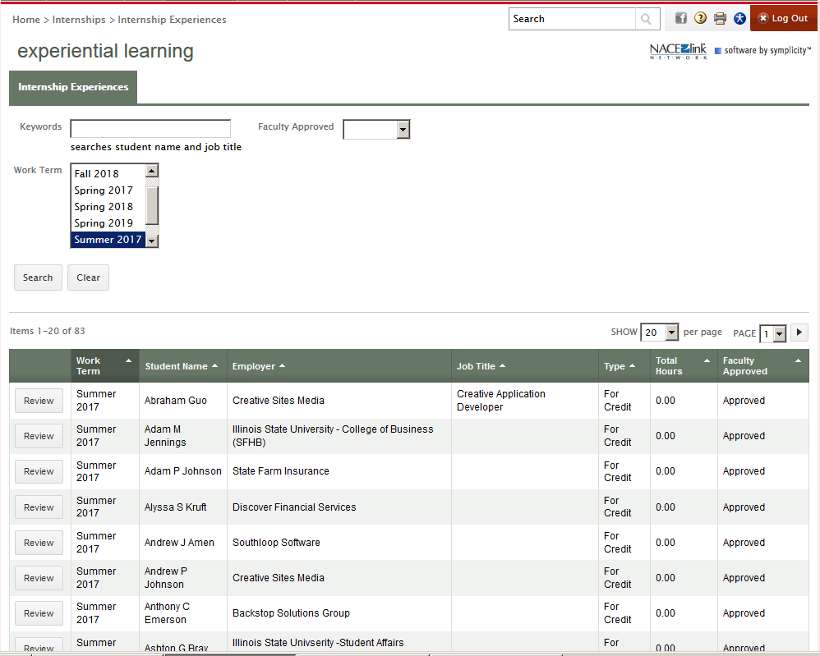
What is the Experiential Learning Module of Hire-A-Redbird?
A tool that facilitates the capture of a common store of internship information
Easily accessible and manageable with a few clicks of the mouse

Slide 6
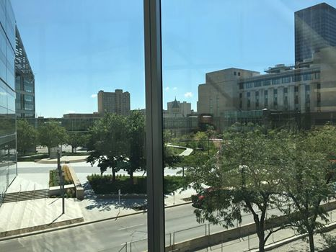
Why do we need it?
Initiative of the Provost Office to address need for:
Verifiable data for a variety of purposes
Quick access to information in case of emergency
Meet our obligation to maintain information on activities we require of students
Accurate count for the University’s professional practice liability insurance

Slide 7
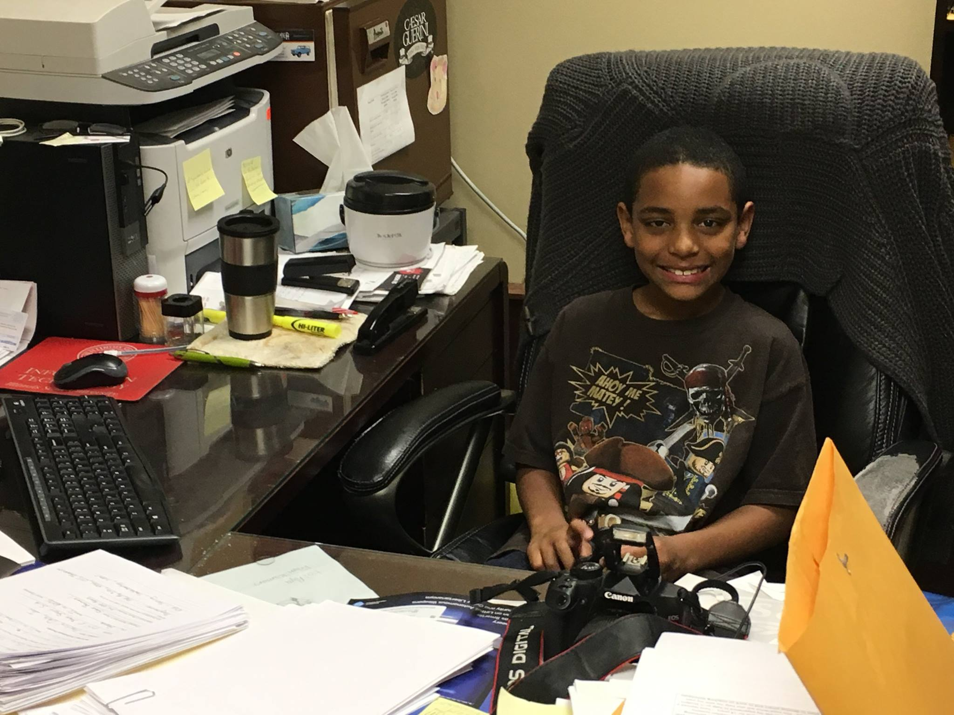
How can it make my life easier?
Replace the paper forms we are handling now
Internship application
Job description & Employment confirmation
Insurance verification
Acknowledgement of risk
All information submitted online by student
Complete online form and submit required supporting documents
Just review and approve

Slide 8
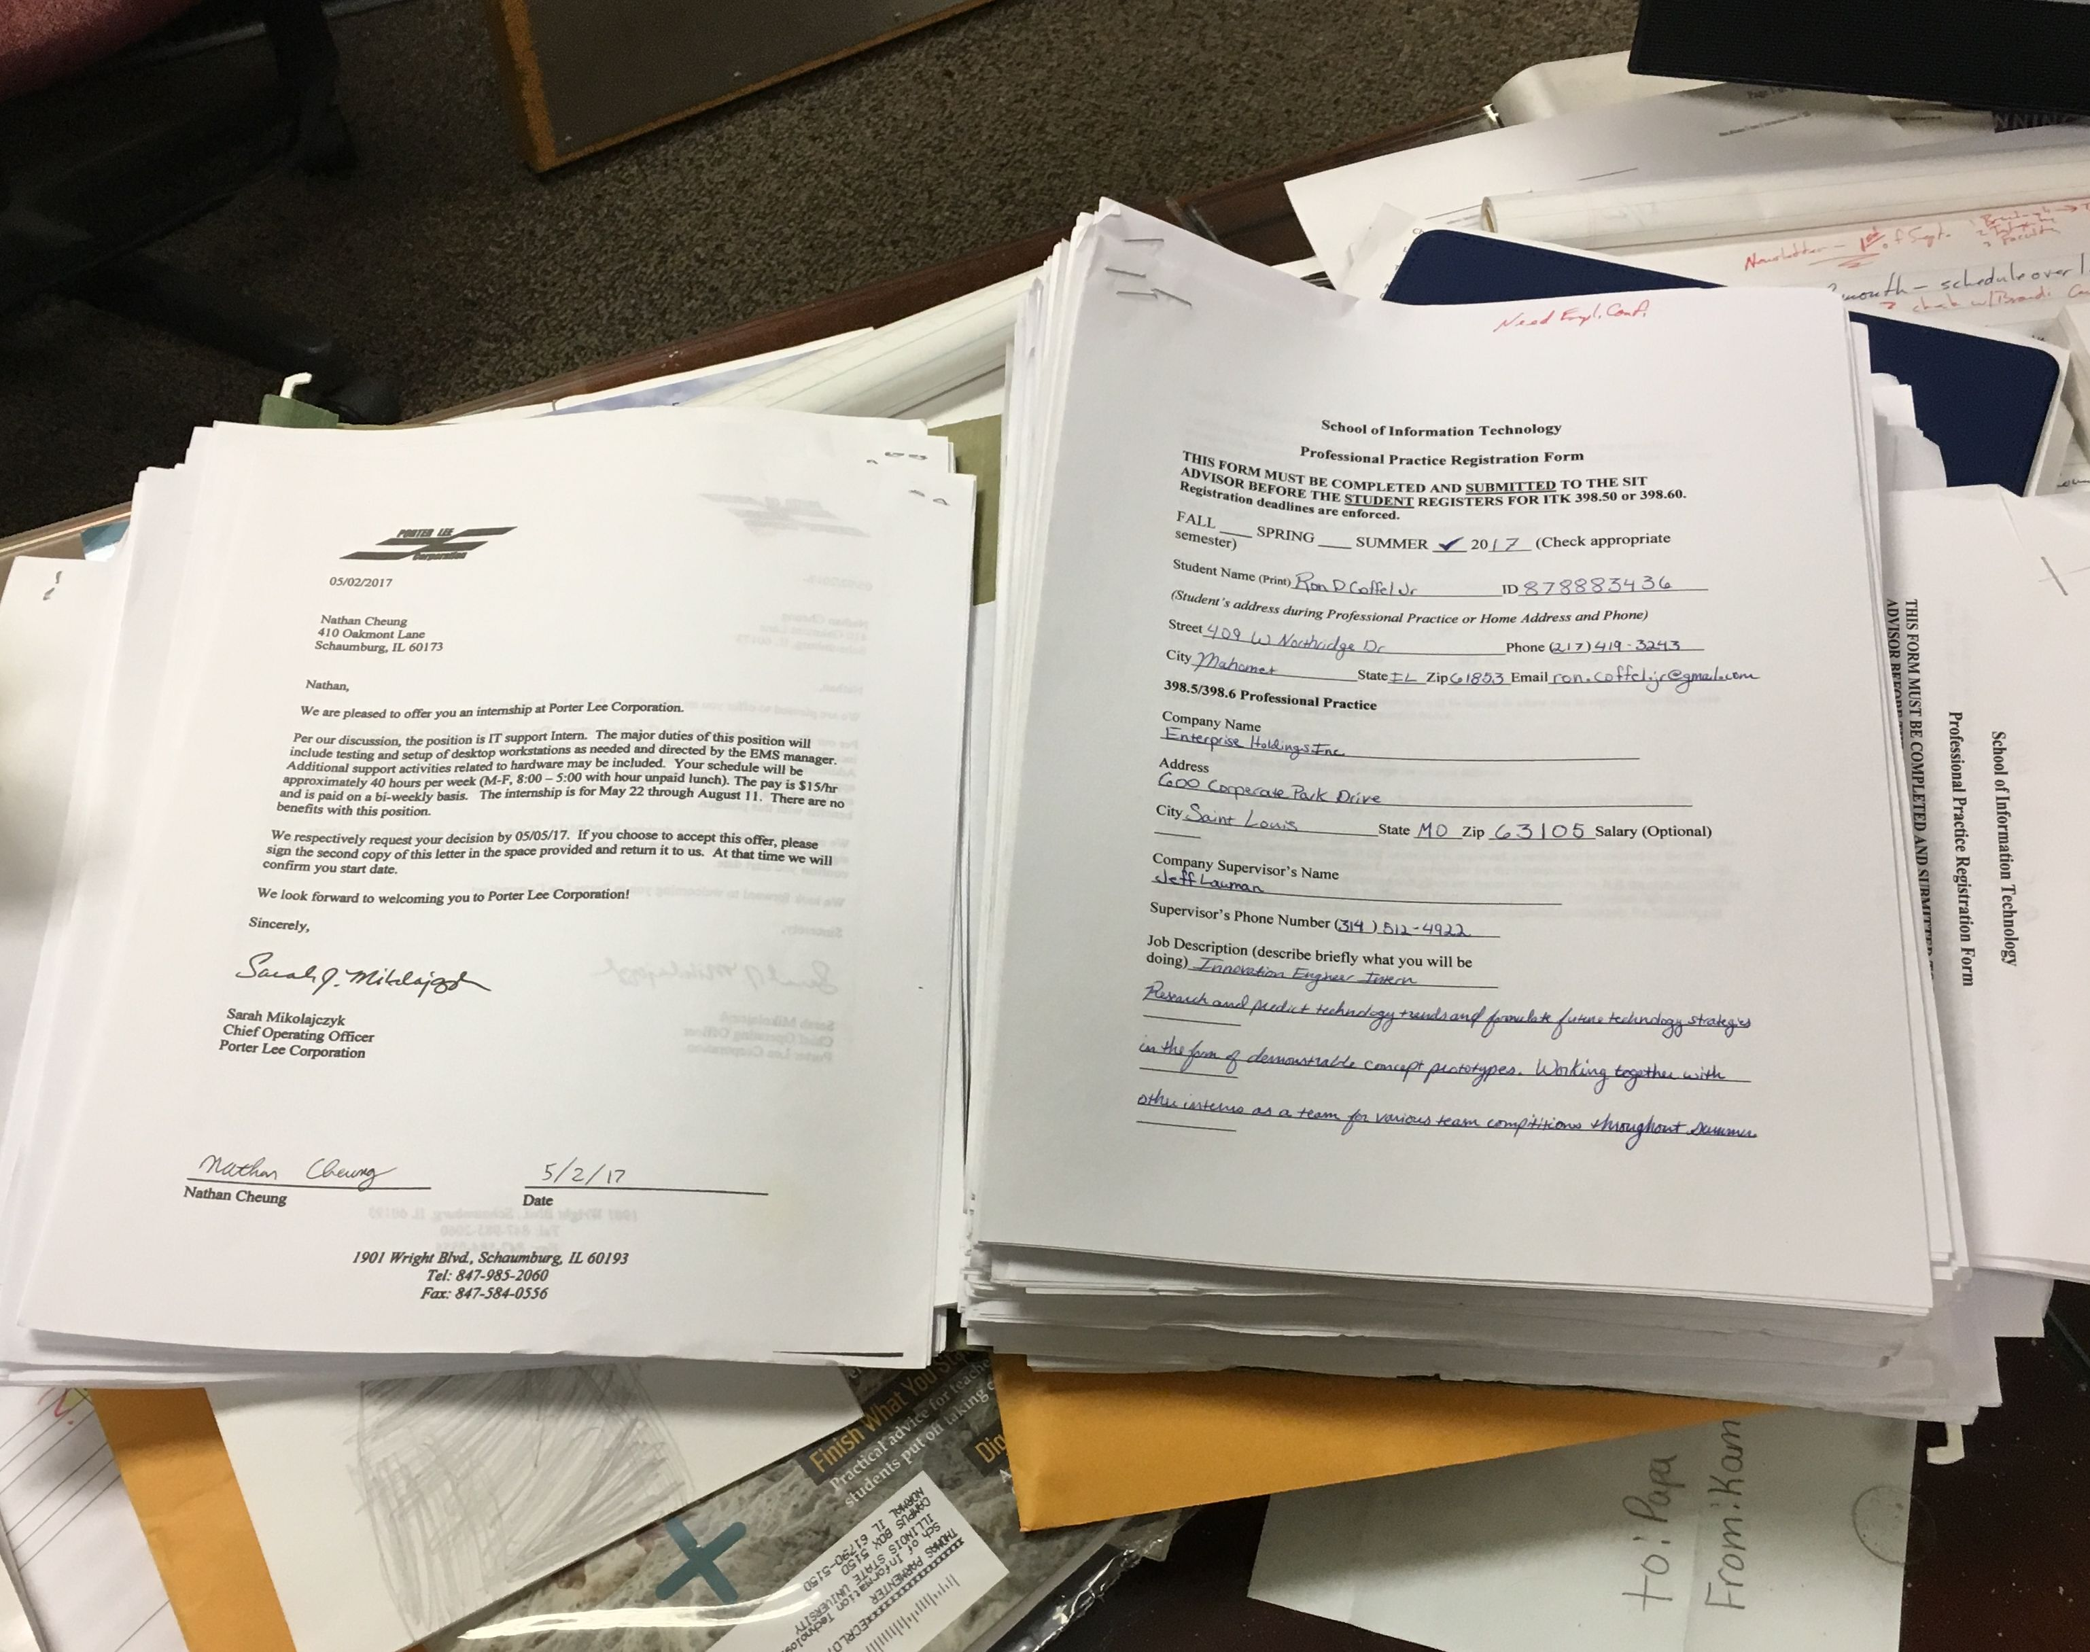
What are the benefits?
Info is immediately accessible
U.S. Foods inquiry – view specific internship
Student, supervisor, team info to quickly set up visit and connect
Development – quickly provide info to assist in cultivating relationships
Current and past history as internship partner
FBI recruiting policies

Slide 9
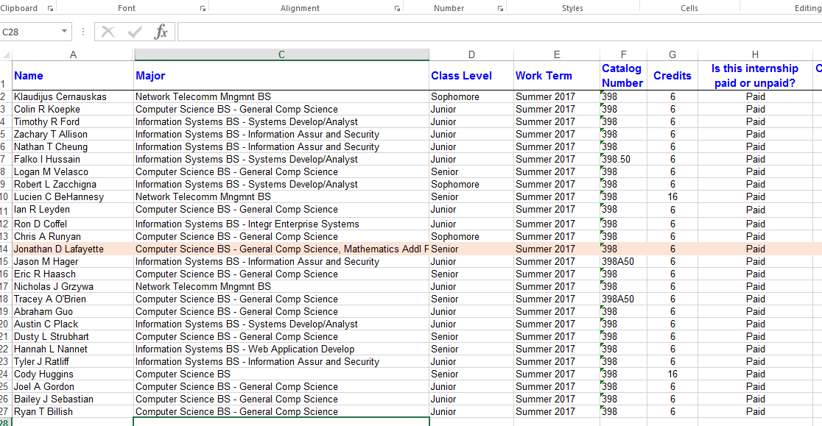
What are the benefits?
Generate reports for analysis and program assessment
What companies provide internships?
How many internships?
Total or specific partner
Single or multiple terms
Where are internships – local, in-state, out of state?
Salaries
Or paid/unpaid

Slide 10
What are the benefits?
What info would you like to capture/analyze?
Outcomes?
Repeat internships?
Credit/no credit?
??????
Work with Debbie to see what options for customization are available

Slide 11
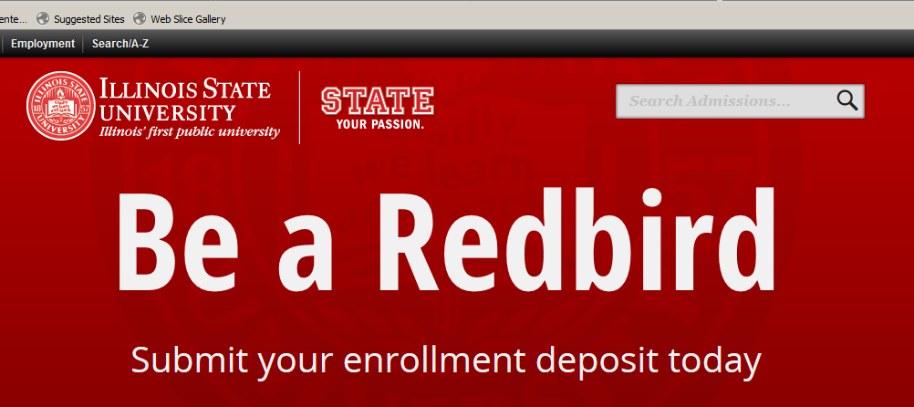
What are the benefits?
Recruitment / admissions
Verifiable information
[A] common DB allows us to track stats for trends and report out successes of our students/ graduates. Increasingly, parents ask about internships and employment in the college admissions process, so this is important for recruitment.
Jonathan Rosenthal

Slide 12
What are your questions?

